Slide 1
Water flow meters
Ian
20 Feb 2024

Slide 2
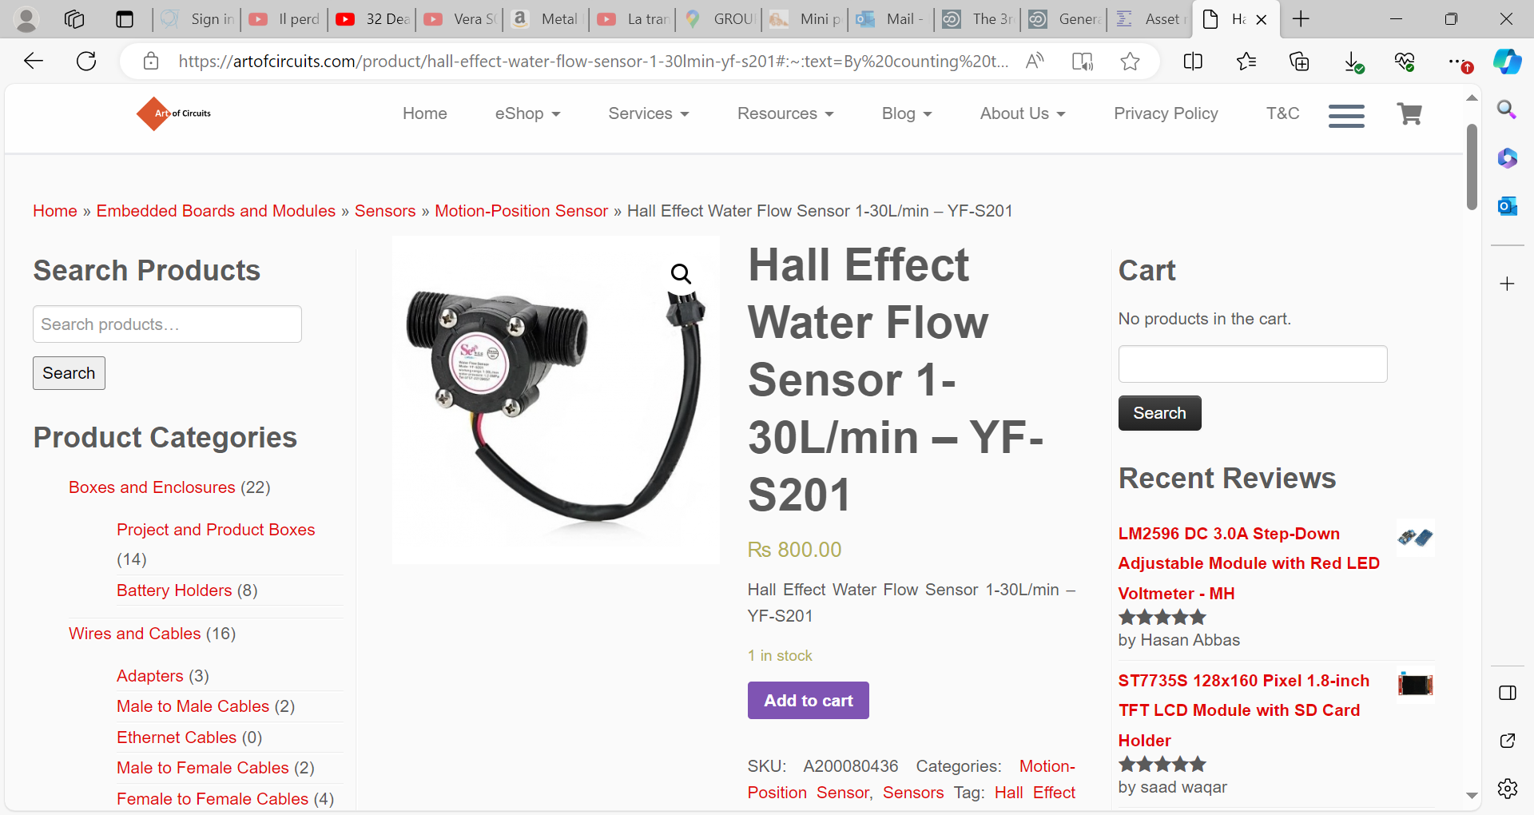
https://artofcircuits.com/product/hall-effect-water-flow-sensor-1-30lmin-yf-s201#:~:text=By%20counting%20the%20pulses%20from,fluid%20pressure%20and%20sensor%20orientation.
YF-S201 Flow Sensor

Slide 3
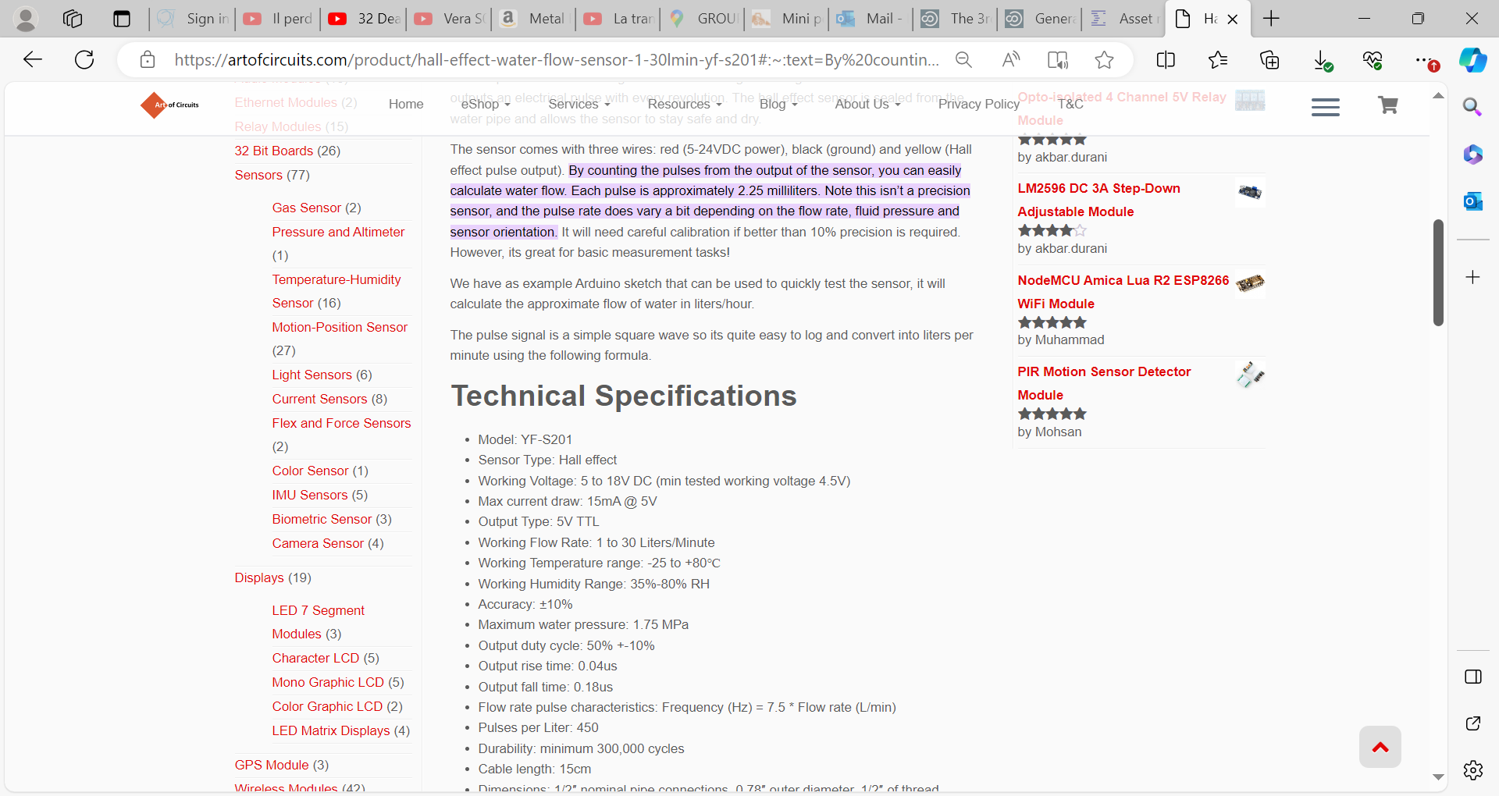

Slide 4
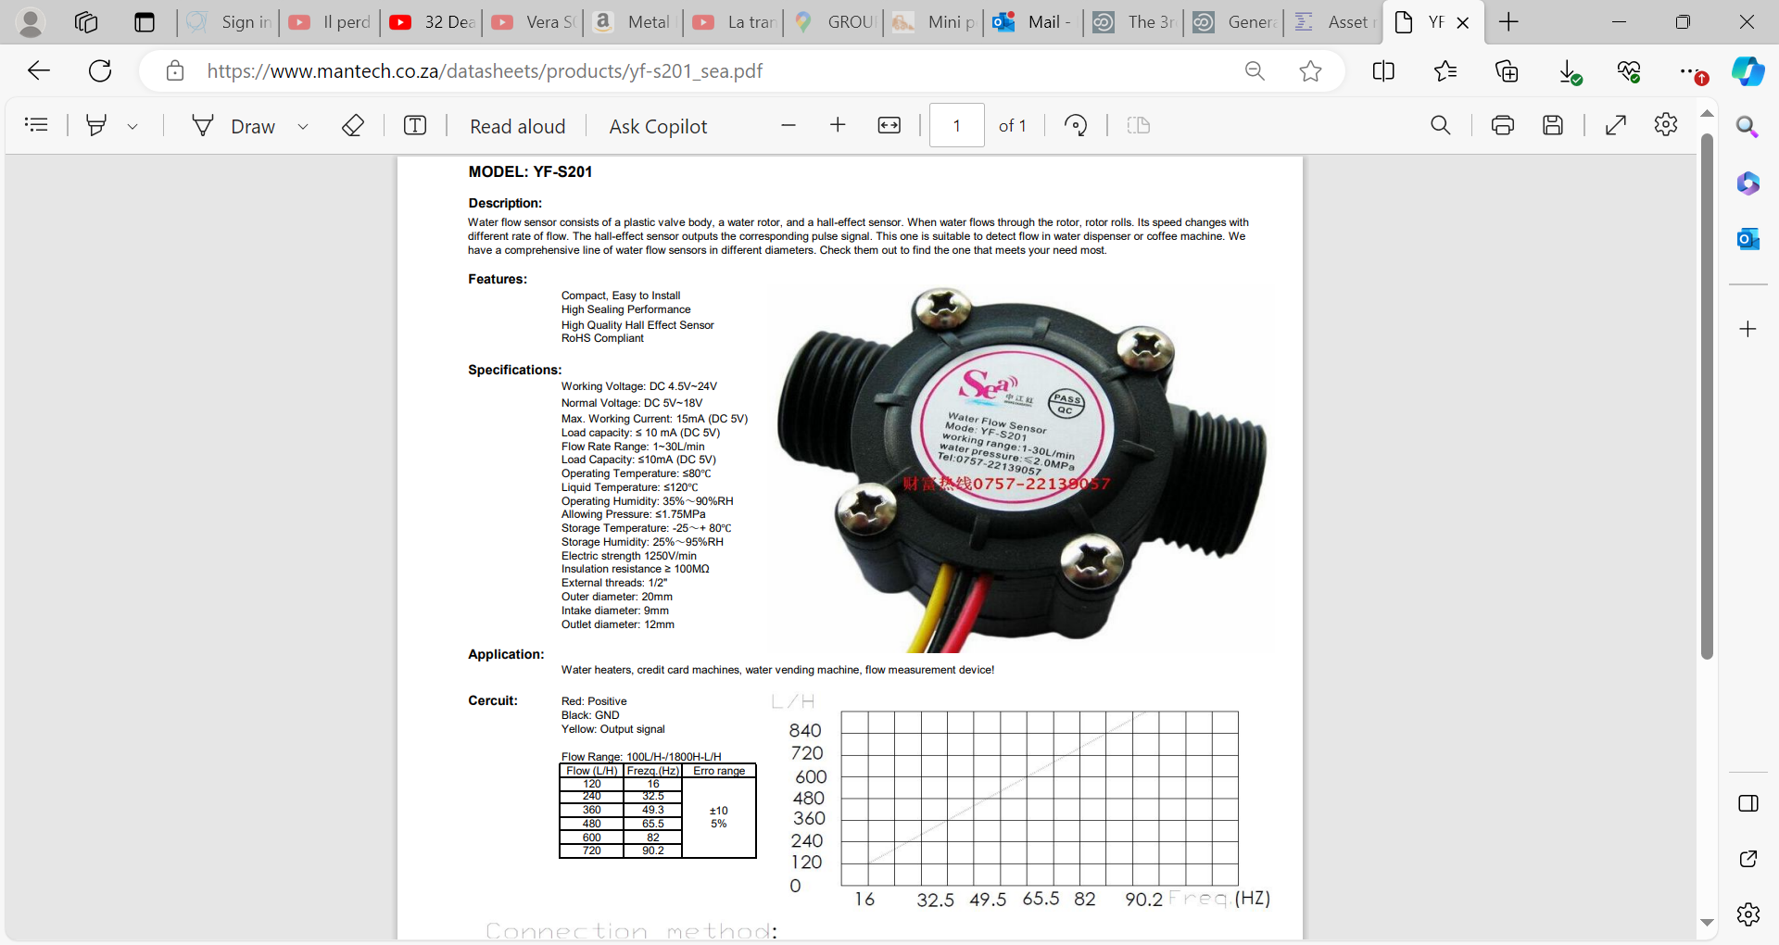
https://www.mantech.co.za/datasheets/products/yf-s201_sea.pdf

Slide 5
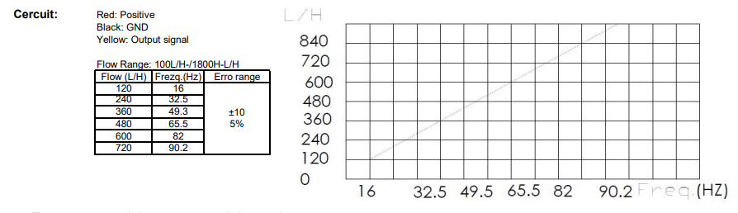

Slide 6
Arduino readout

Slide 7
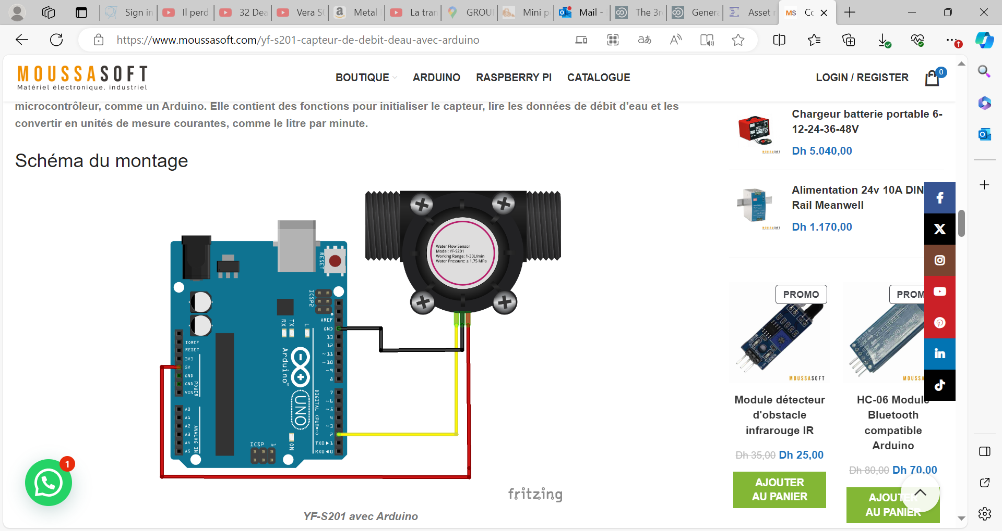
https://www.moussasoft.com/yf-s201-capteur-de-debit-deau-avec-arduino

Slide 8
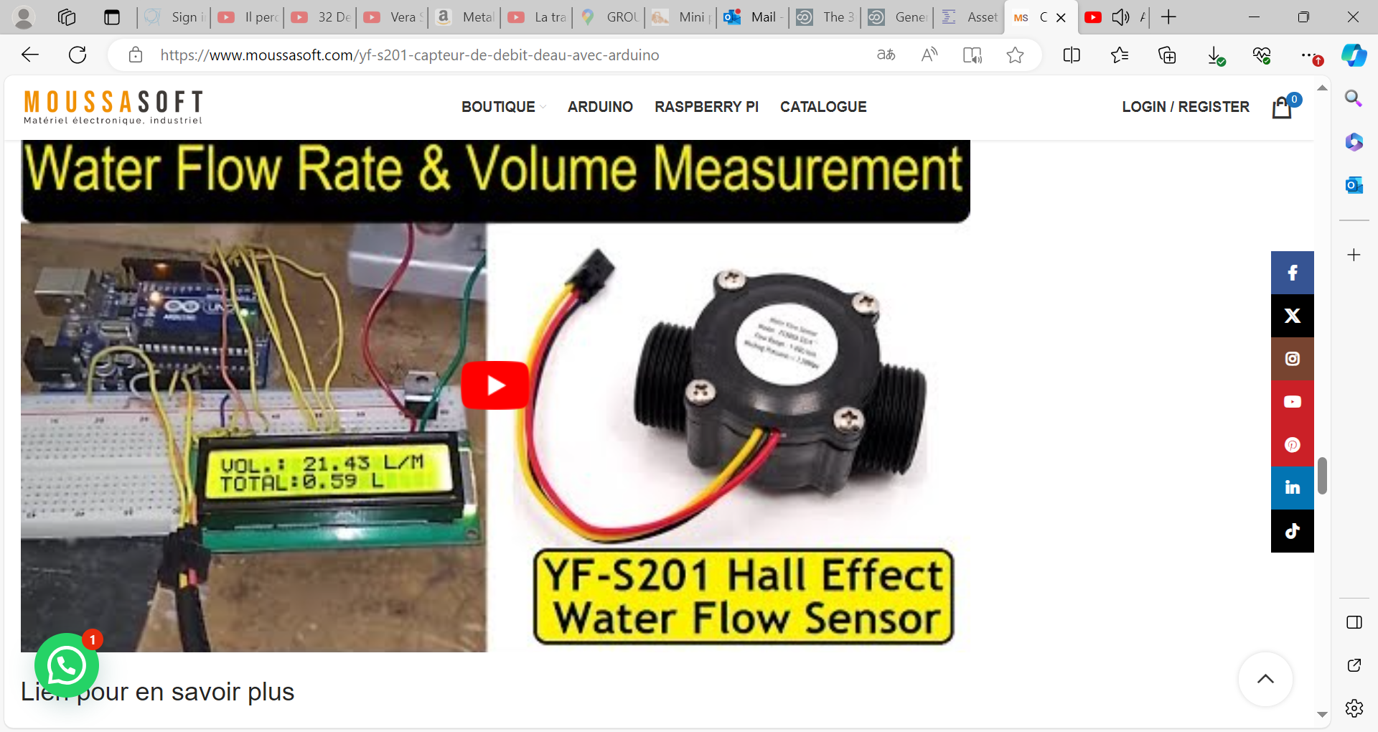

Slide 9
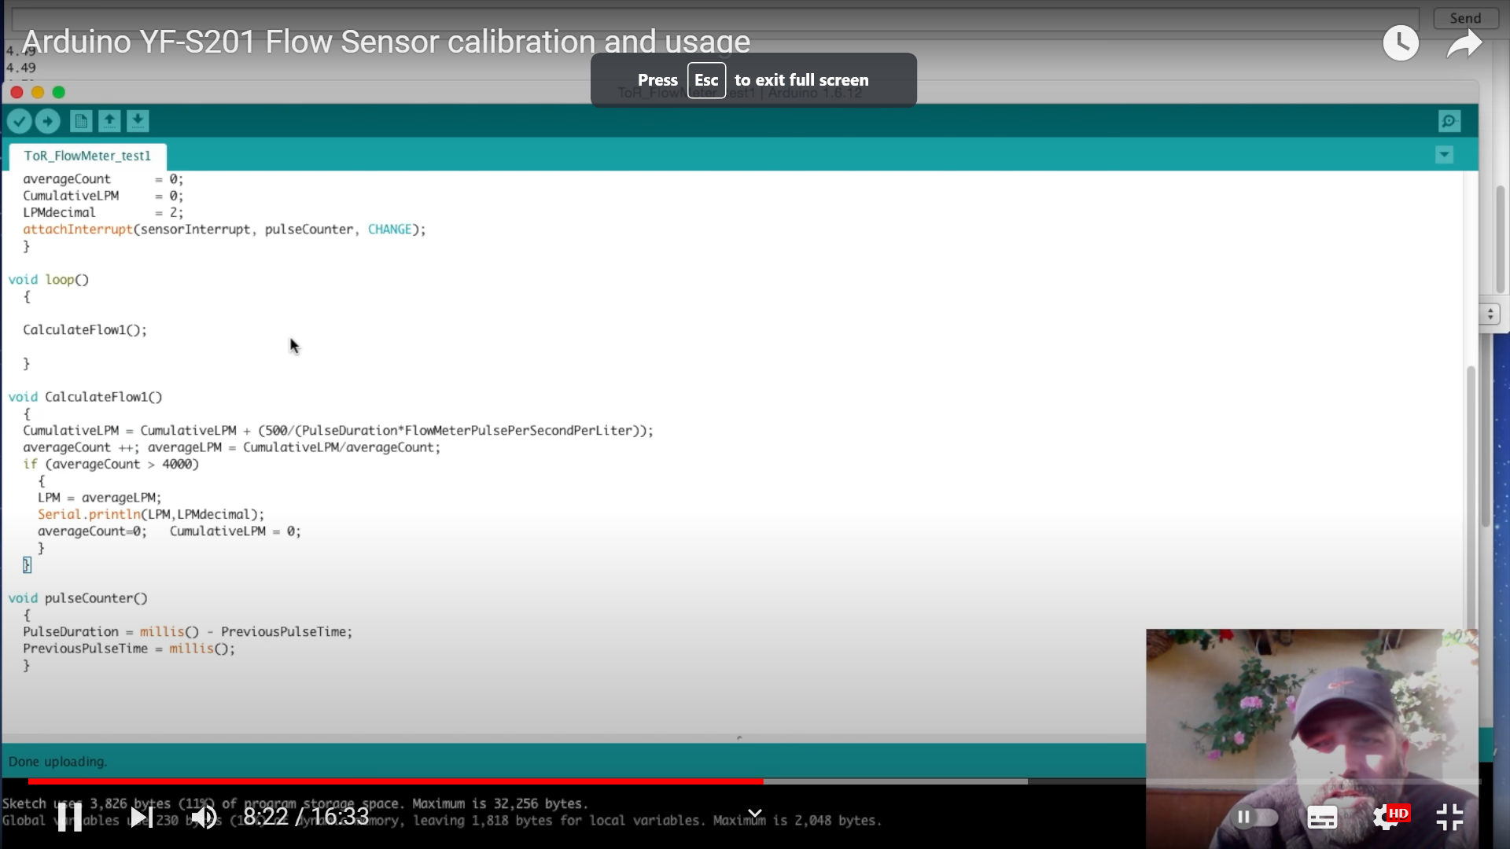
https://www.youtube.com/watch?v=gHQzjZk2LjA&t=602s

Slide 10
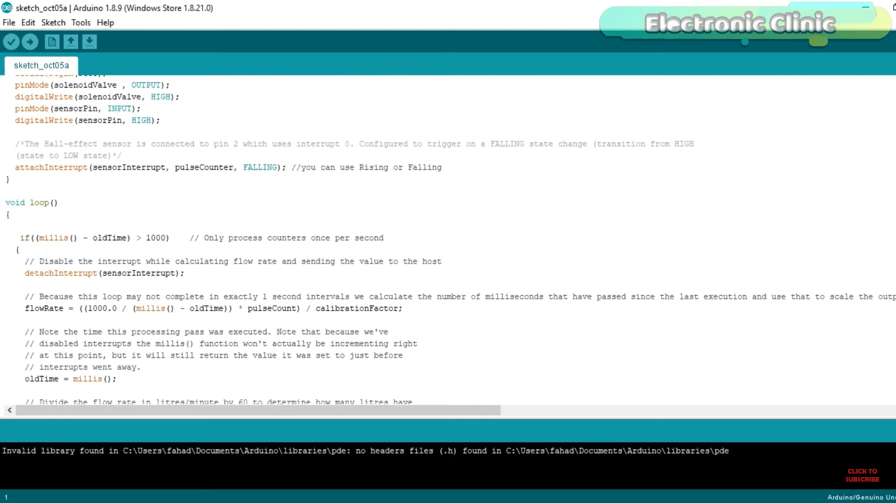
https://www.youtube.com/watch?v=uOJ31aYV_TM

Slide 11
https://www.youtube.com/watch?v=OEDG2ZaAdgk

Slide 13
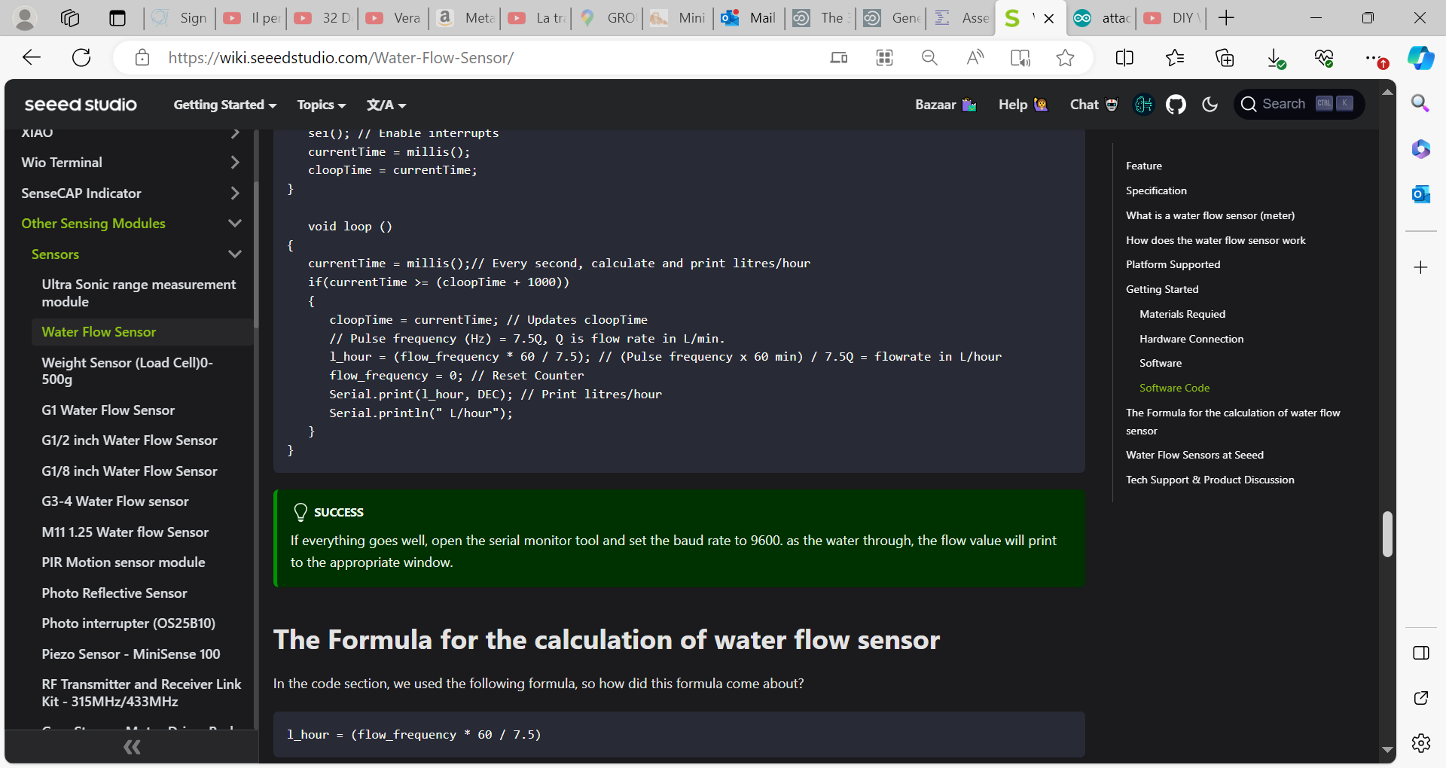
https://wiki.seeedstudio.com/Water-Flow-Sensor/ VERY complete

Slide 14
https://www.instructables.com/How-to-Use-Water-Flow-Sensor-Arduino-Tutorial/

Slide 15
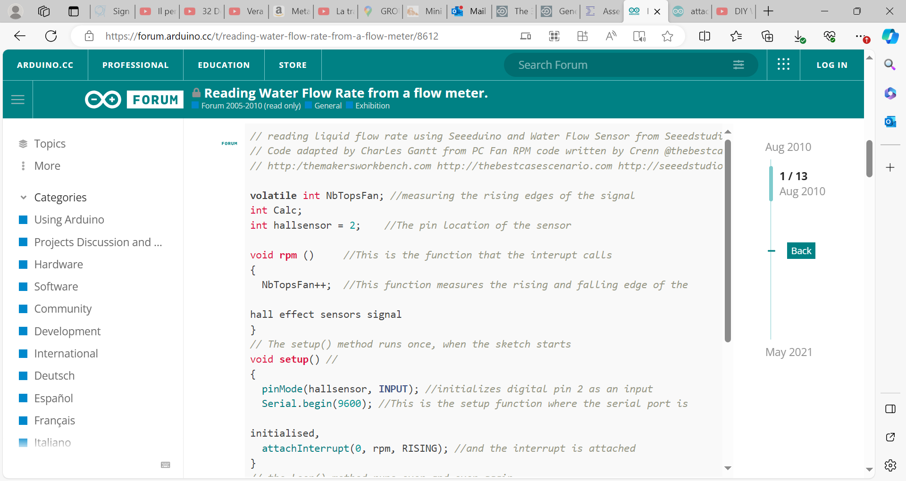
https://forum.arduino.cc/t/reading-water-flow-rate-from-a-flow-meter/8612

Slide 16
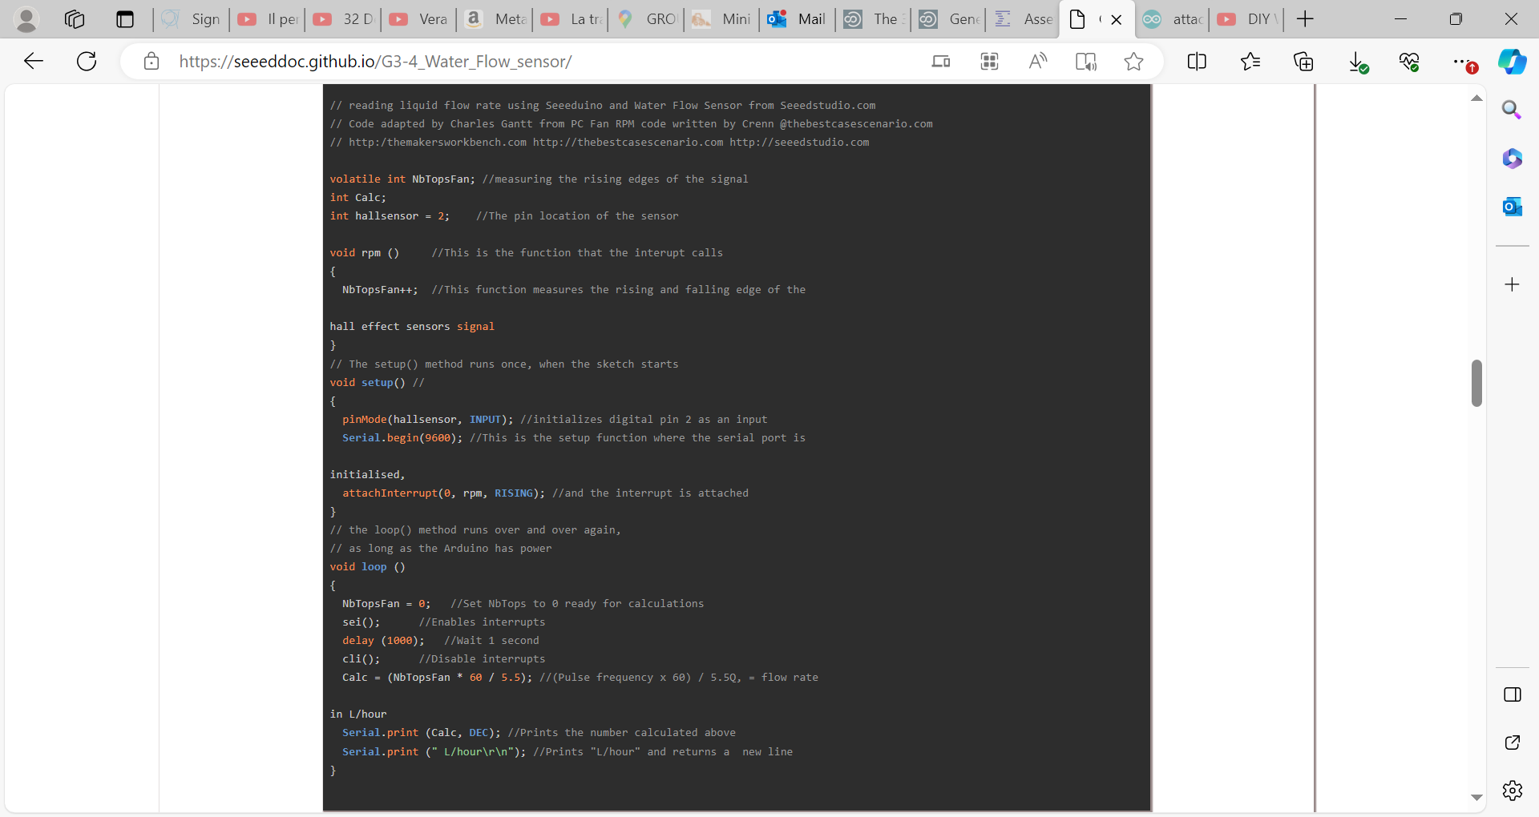
https://seeeddoc.github.io/G3-4_Water_Flow_sensor/

Slide 19
ESP-8266

Slide 20
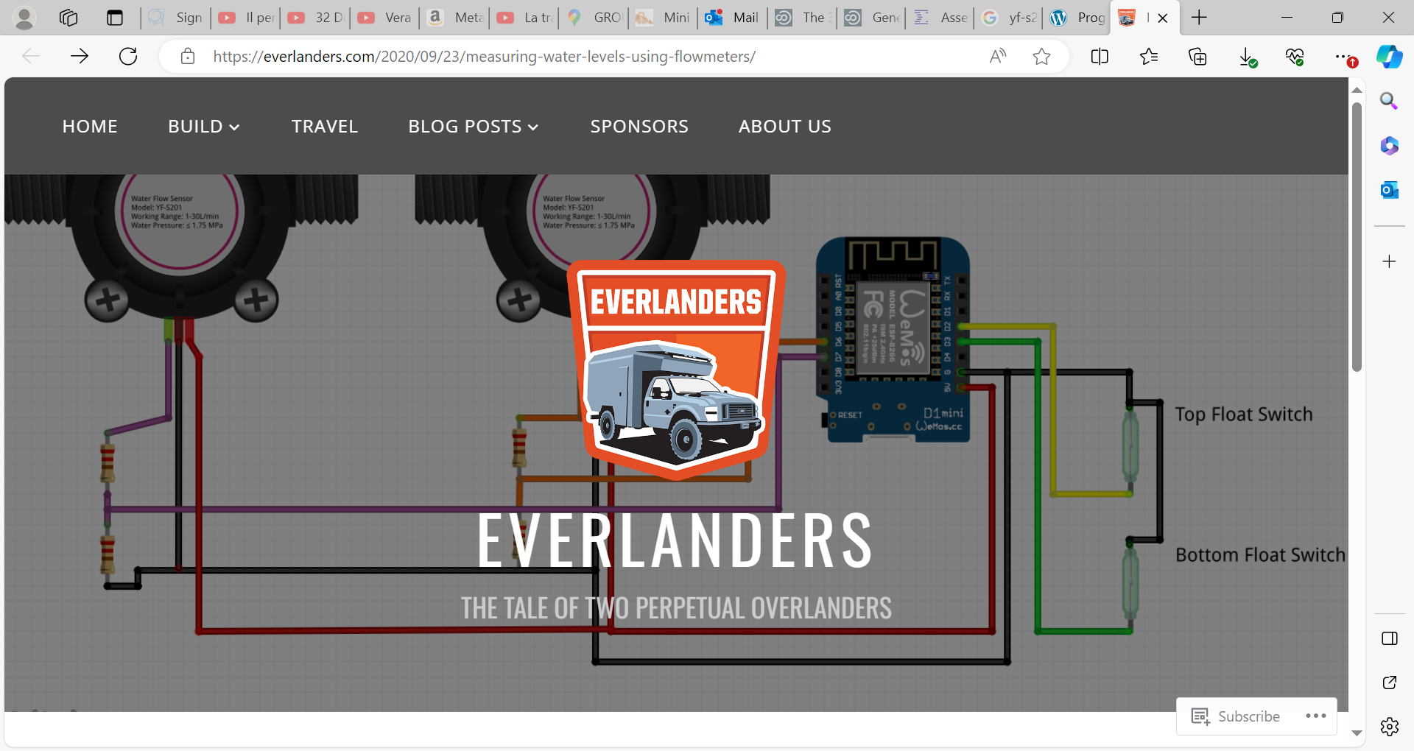

Slide 21
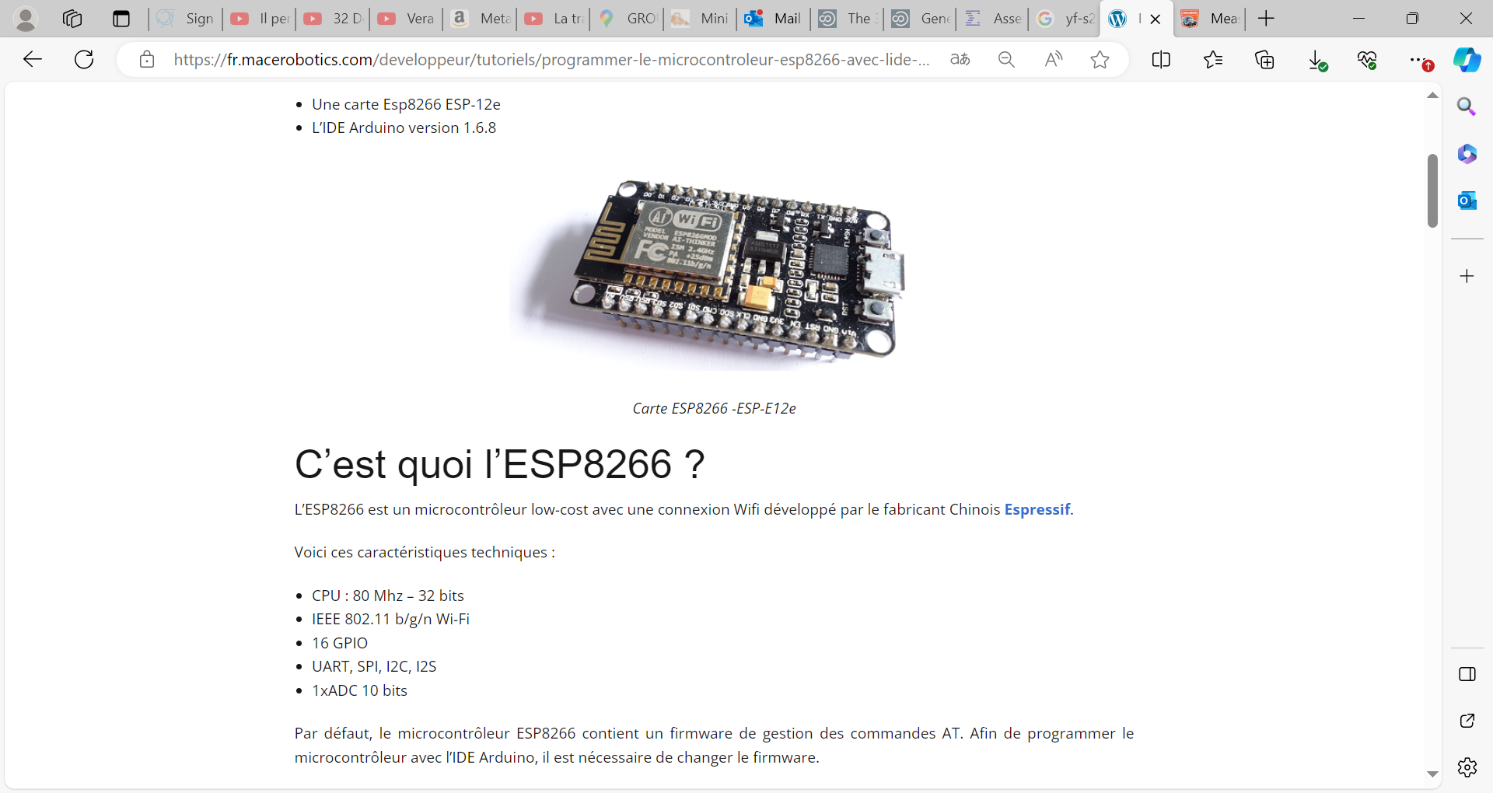
https://fr.macerobotics.com/developpeur/tutoriels/programmer-le-microcontroleur-esp8266-avec-lide-arduino/
https://github.com/esp8266/Arduino

Slide 22
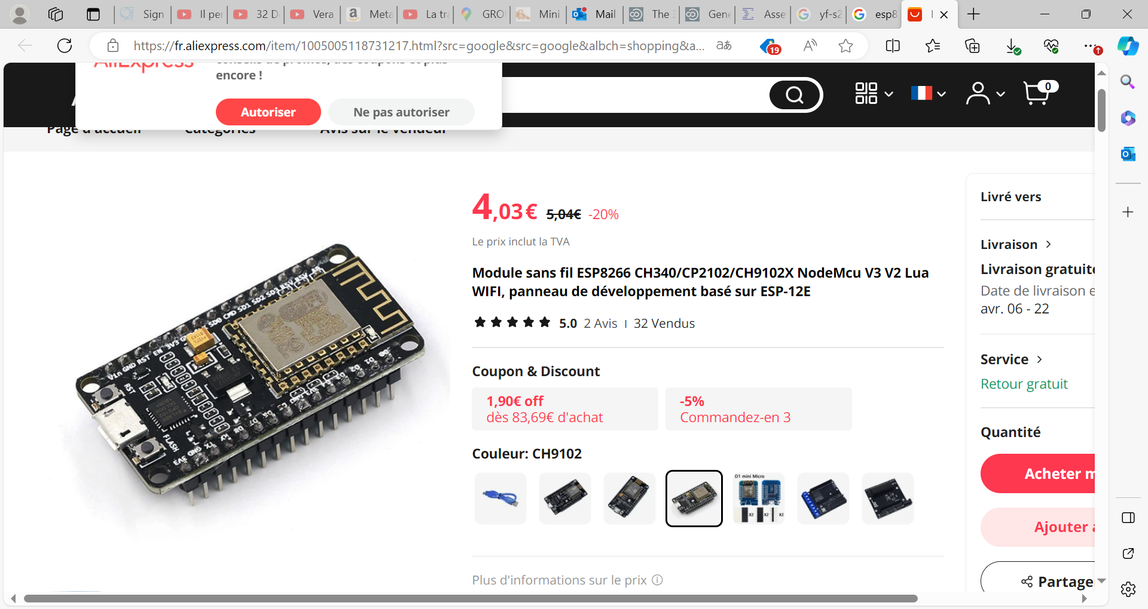

Slide 23
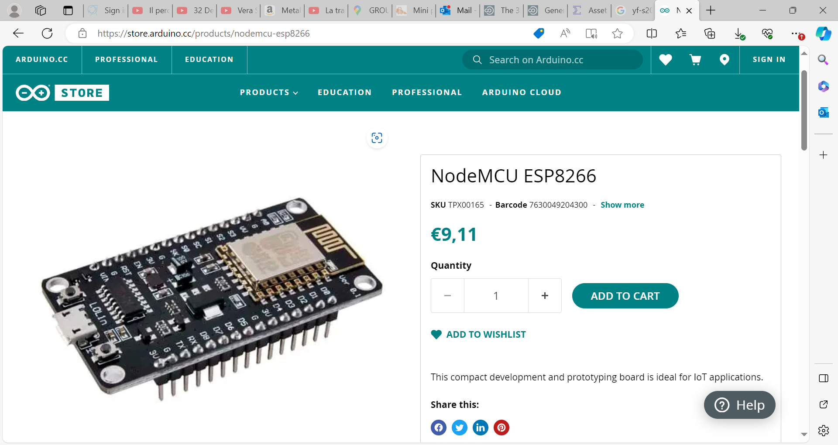
https://store.arduino.cc/products/nodemcu-esp8266

Slide 26
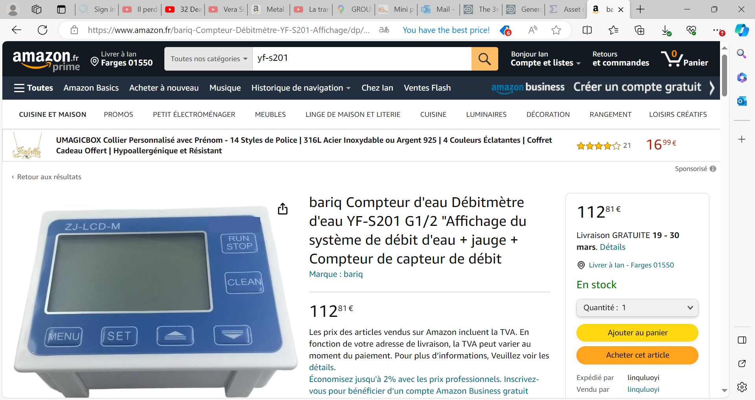
bariq Compteur d'eau Débitmètre d'eau YF-S201 G1/2 "Affichage du système de débit d'eau + jauge + Compteur de capteur de débit : Amazon.fr: Commerce, Industrie et Science

