Slide 1
Pumps in EN-CV room

Slide 2
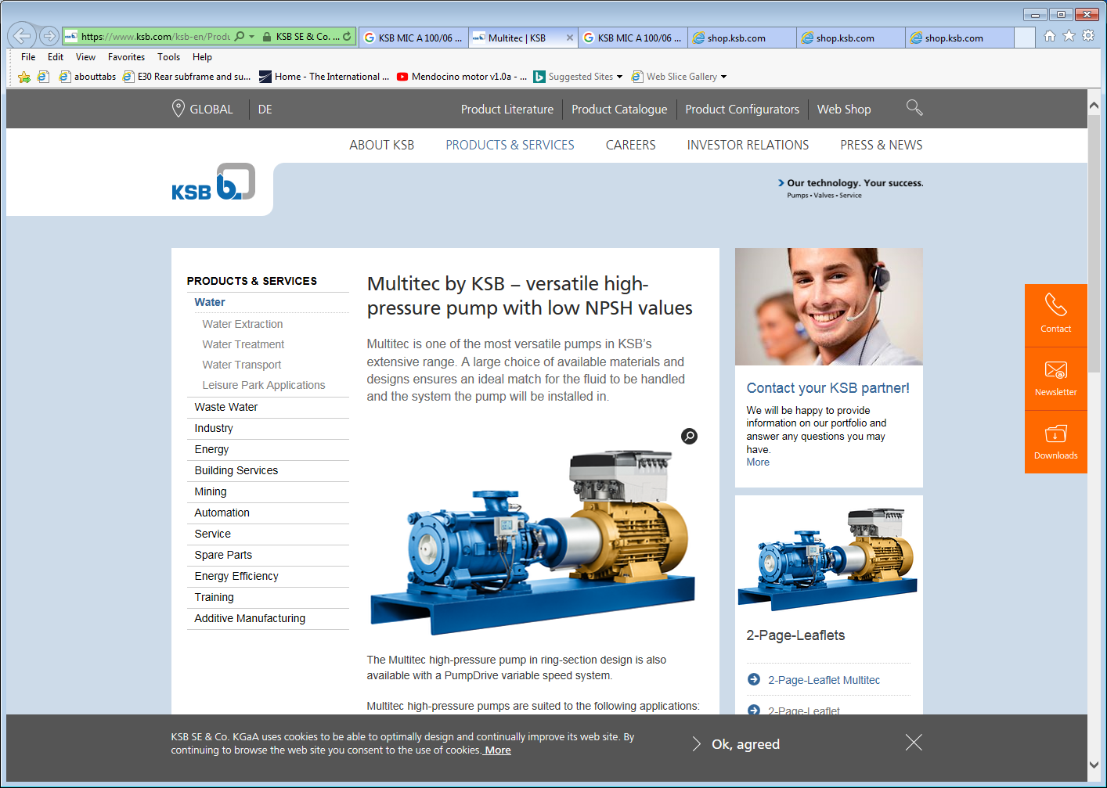

Slide 3
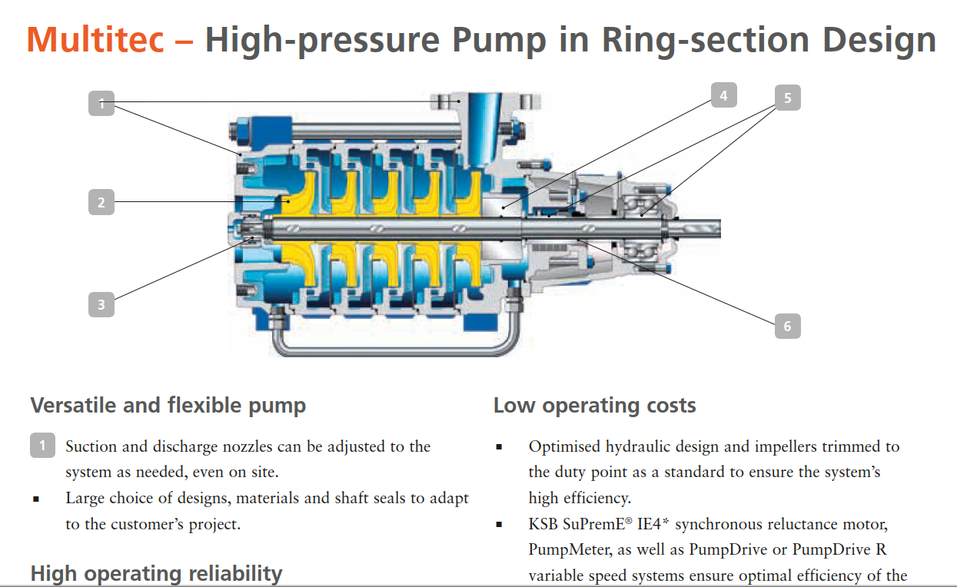
https://shop.ksb.com/ims_docs/00/00215A9B05B41ED6B1F817442993F45F.pdf

Slide 4
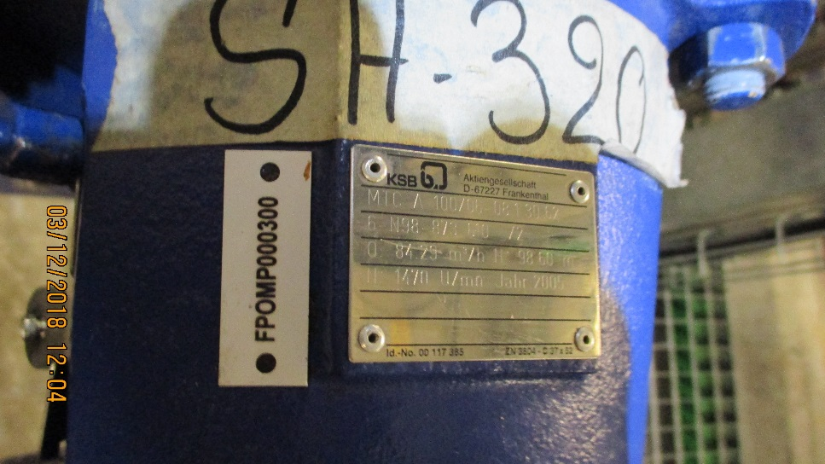

KSB
Aktiengesellschaft
D-67227
Frankenthal
MIC A 100/06 08 1 30 62 ??
6 N98-873 610 /2
Q: 84.29m3/h H: 98.60
? : 1470 U/min Jahr 2005

Slide 5
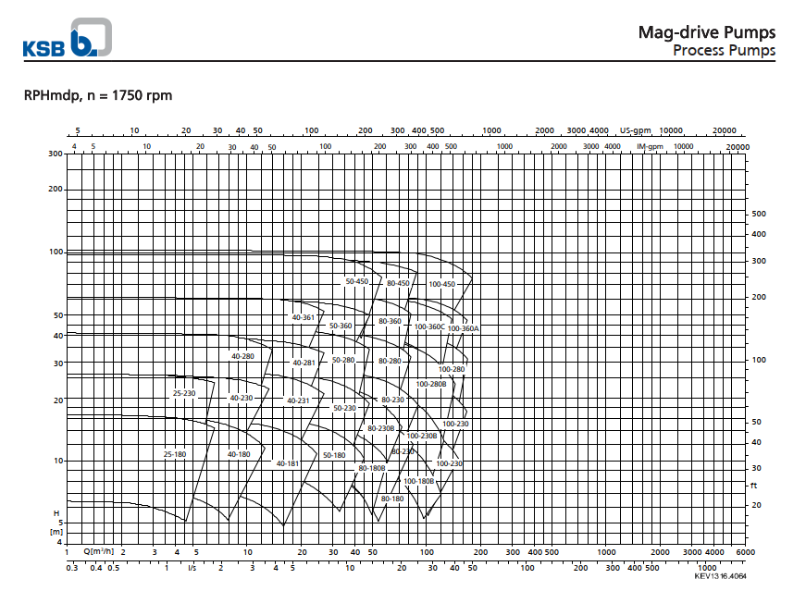
https://shop.ksb.com/ims_docs/37/37F958527659425AE10000000AD5062A.pdf

Slide 6
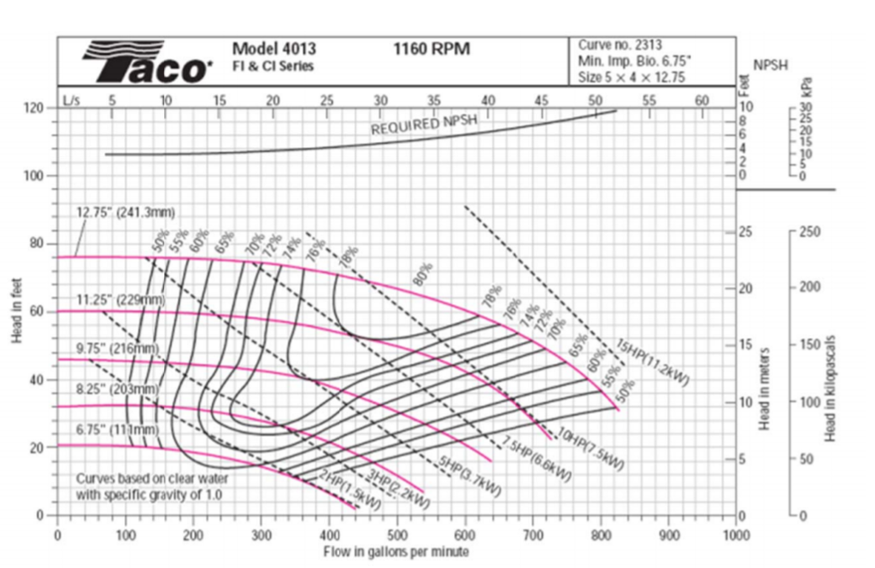
Typical impeller pump characteristics

