Slide 1
Sealing compound for Cooling Unions
Ian
12 April 2019

Slide 2
The CSC colleagues supplied Loctite 577

Slide 3
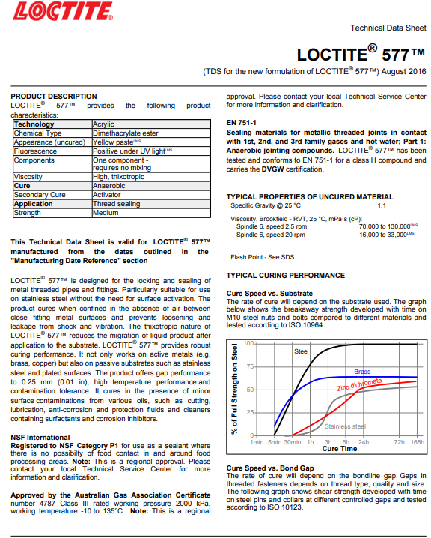
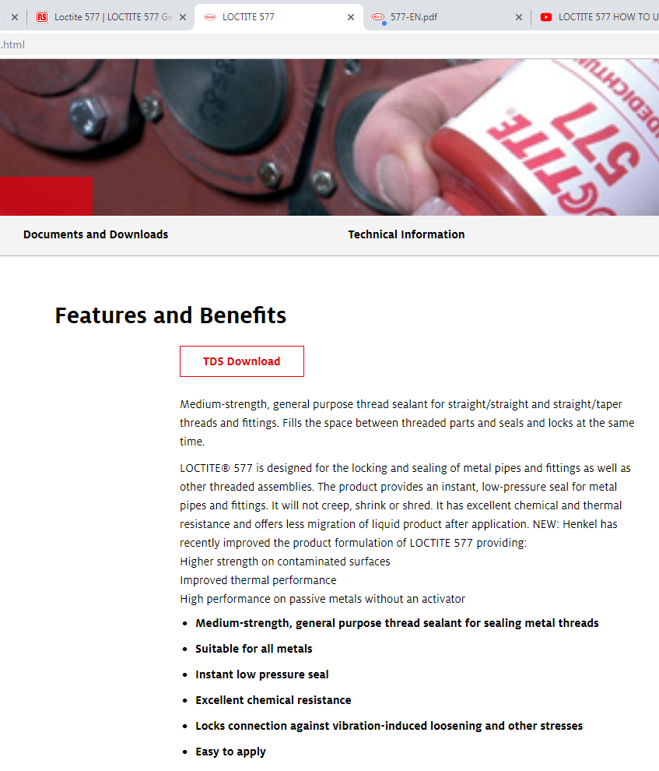
https://tdsna.henkel.com/NA/UT/HNAUTTDS.nsf/web/4E84399CD436E451882571870000D826/$File/577-EN.pdf

Slide 4
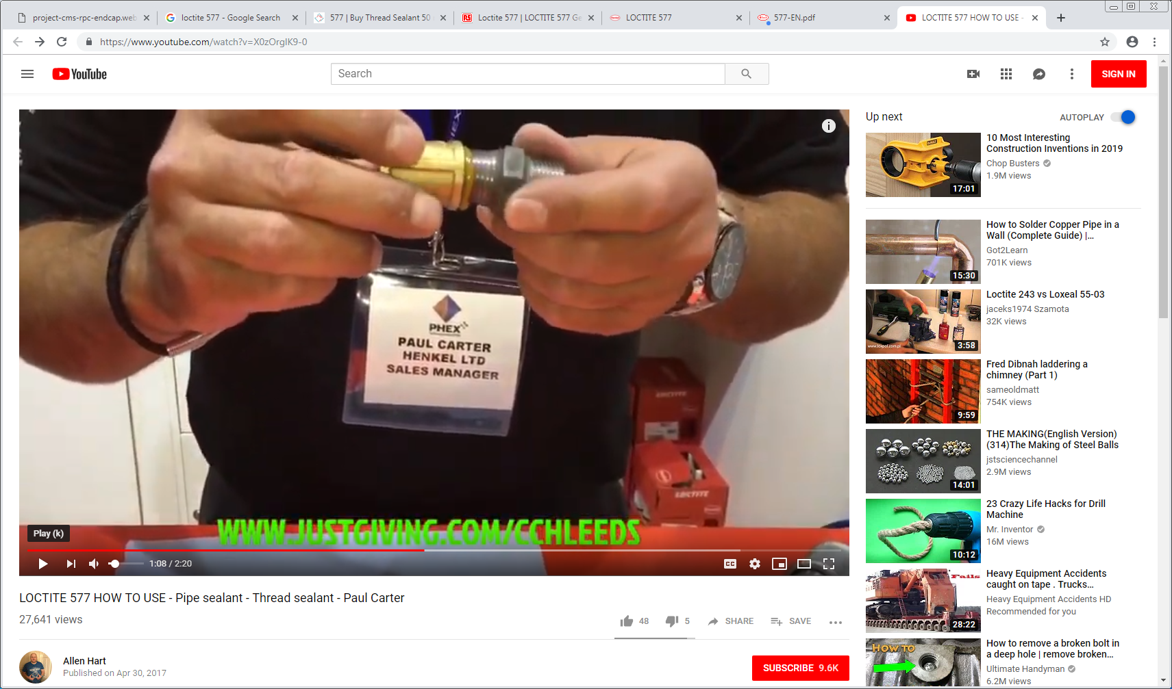
https://www.youtube.com/watch?v=X0zOrglK9-0
https://www.youtube.com/watch?v=vA-o868v8gg
https://www.youtube.com/watch?v=3SfJaHbhSes

Slide 5
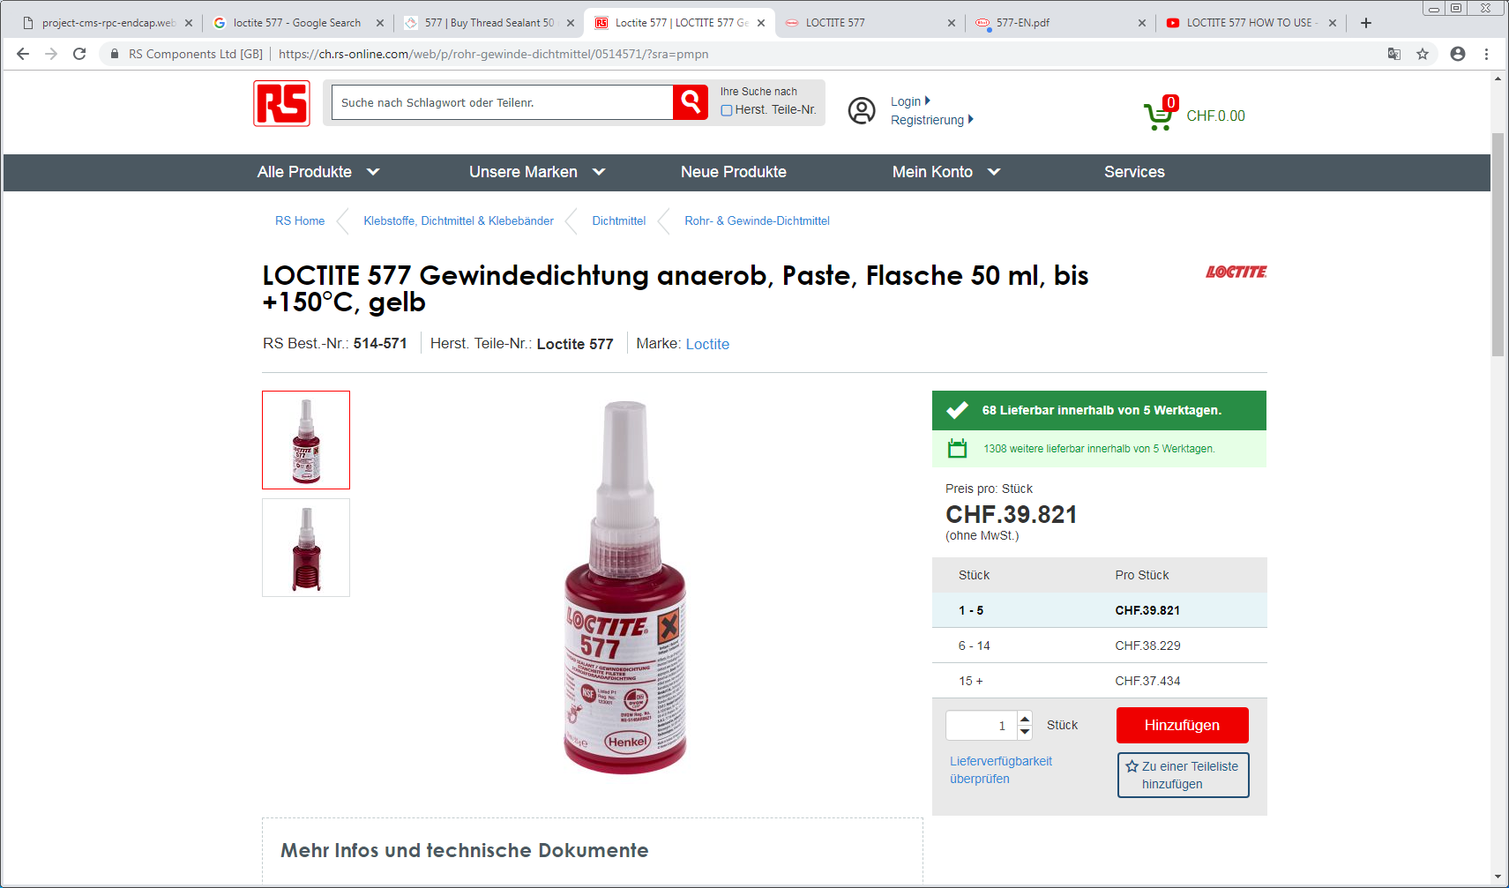

Slide 6
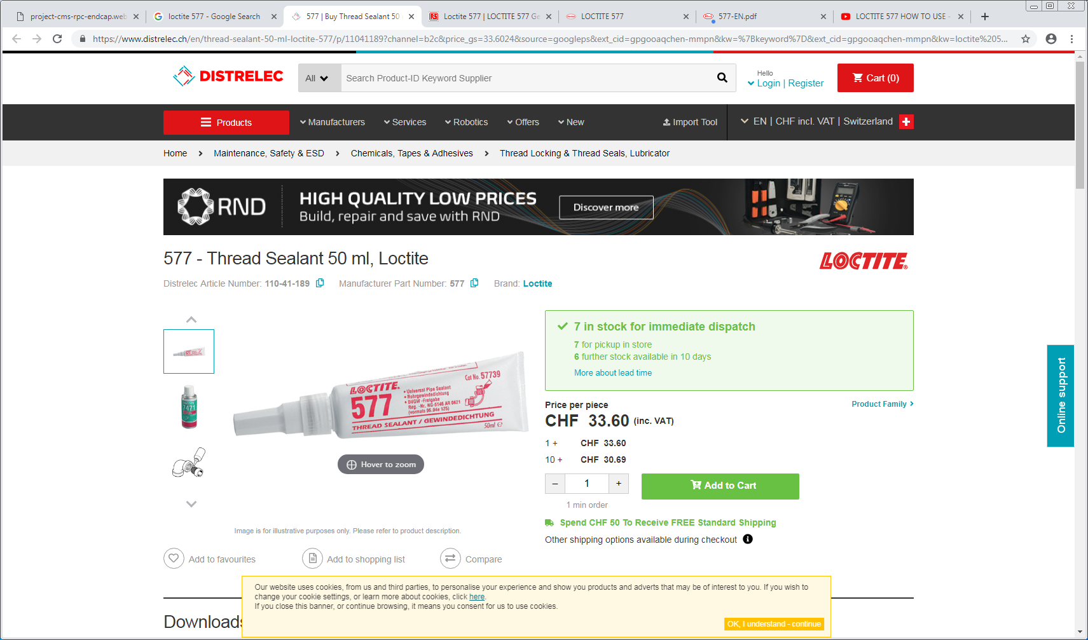

Slide 7
