Slide 1
RS feed back form
Ian
4 June 2024

Slide 2
RS France, distributeur de composants électroniques & fournitures industrielles (rs-online.com)
https://fr.rs-online.com/web/feedback.html

Slide 3
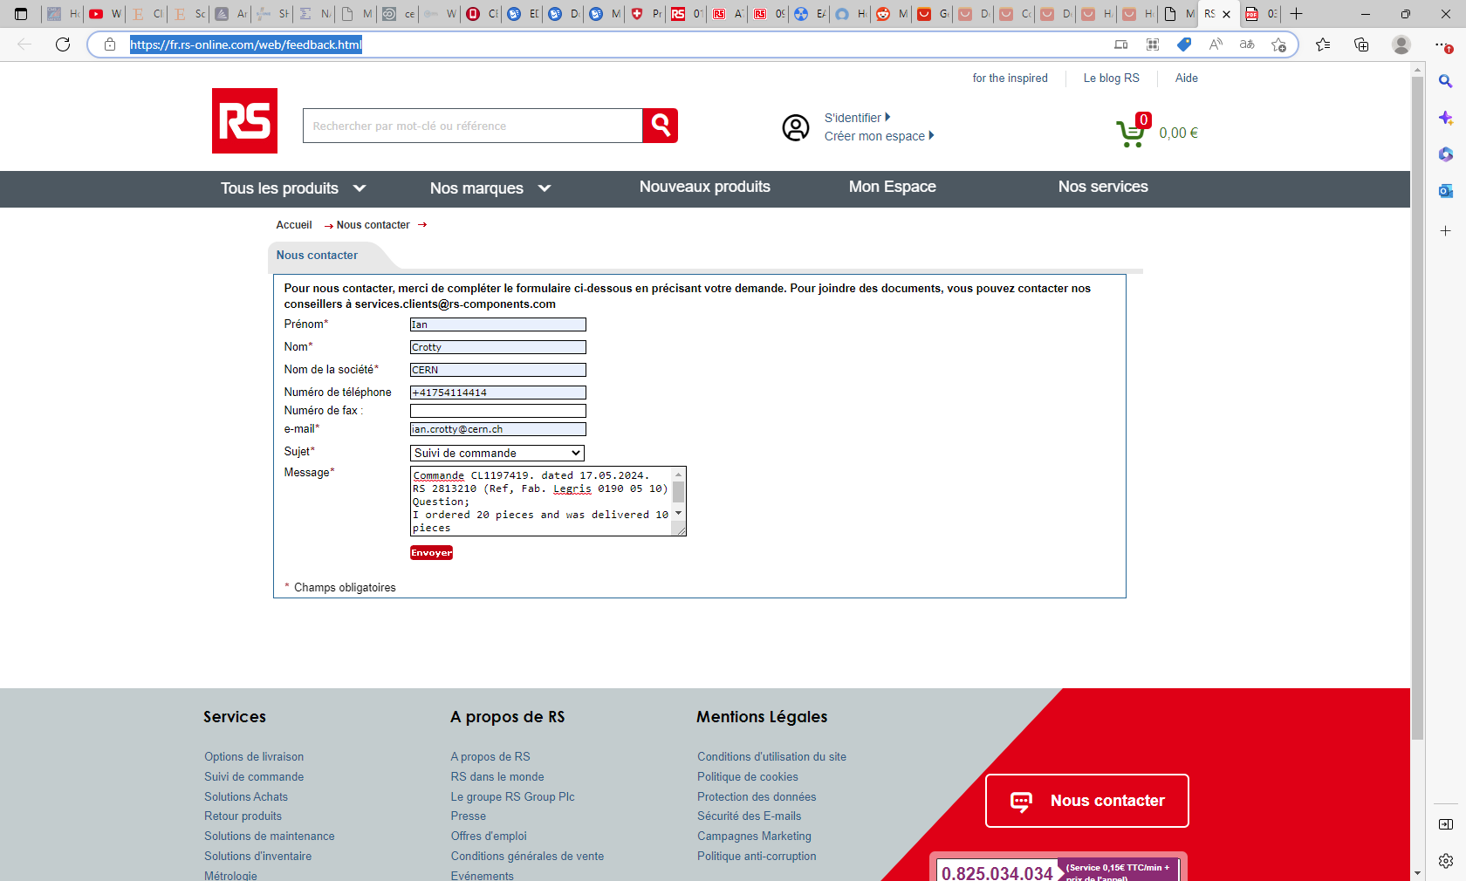

Slide 4
https://fr.rs-online.com/web/content/accueil/aide/reclamation
réclamation | RS (rs-online.com)

Slide 5
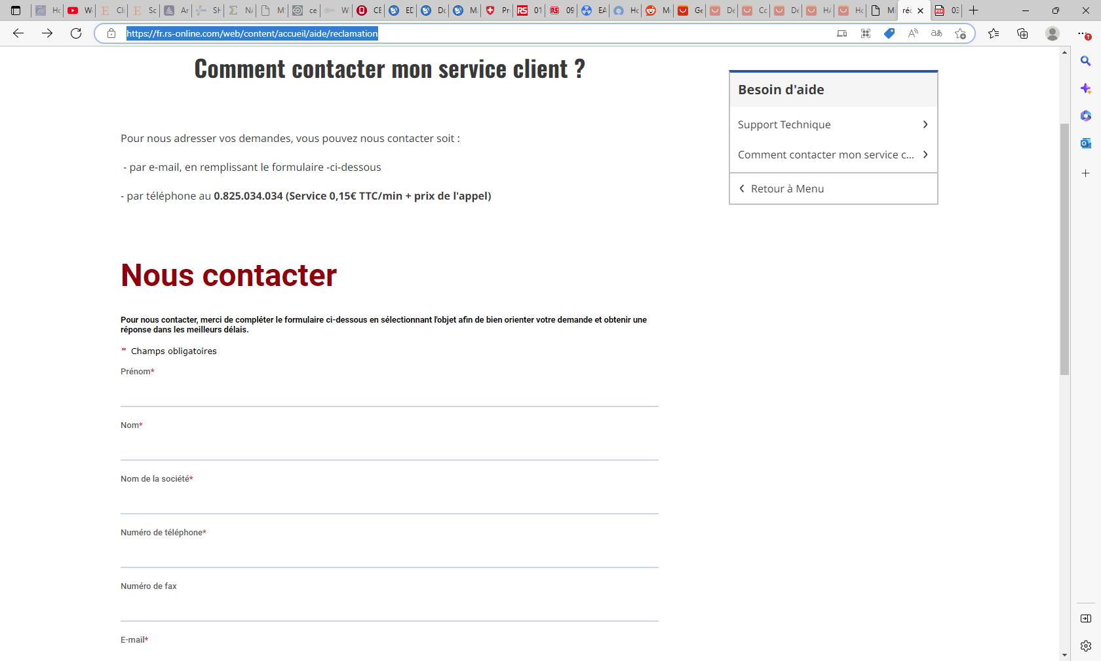

Slide 6
Message sent 4 June 2024 @ 1745hr for
CL 1197419 10 May 2024
RS 2813210
Still waiting for the 20 pieces , only 10 delivered
Email received around 5-6 June 2024
Saying that on the web page it is indicated 11 June bu it said 18 June (check dates)

