Slide 1
Other tools for inserting barb unions into Hose
Ian
18 April 2023

Slide 2
CMS special “
“Koul Tool” version

Slide 3
CMS CSC Special

Slide 8
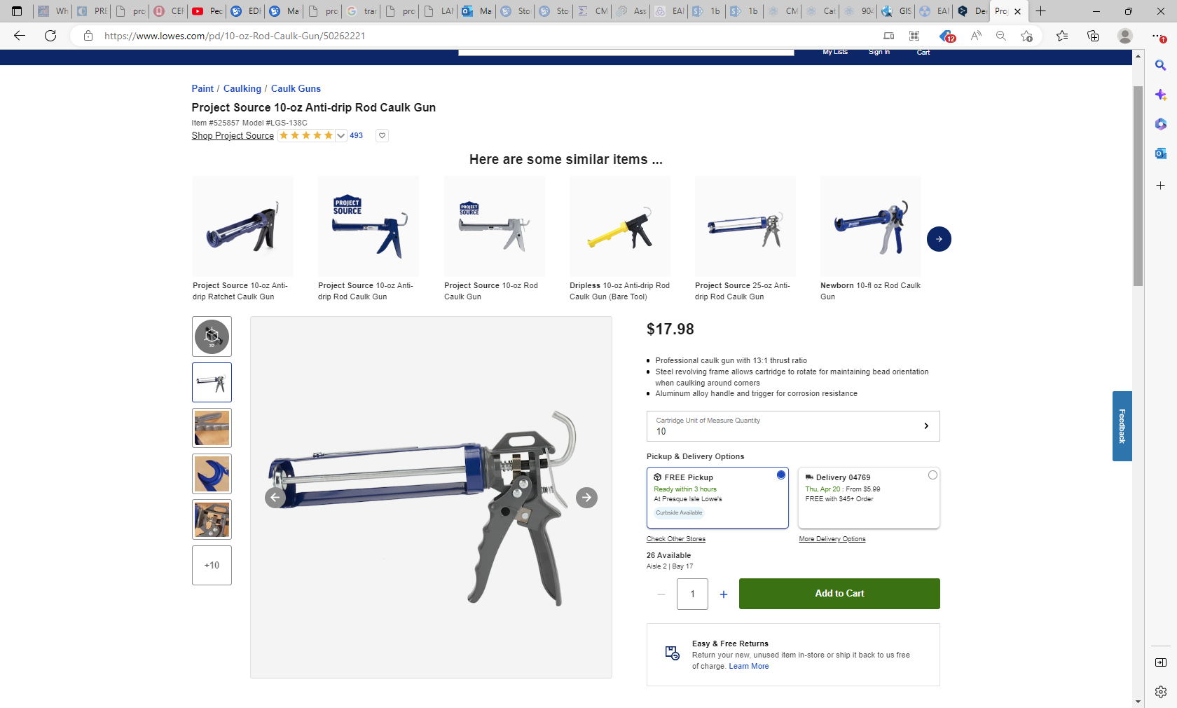
https://www.lowes.com/pd/10-oz-Rod-Caulk-Gun/50262221

Slide 9
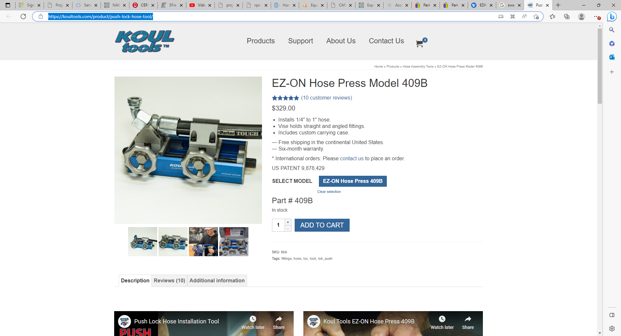
Push Lock Hose Tool | Barbed Fittings | Koul Tools

Slide 10
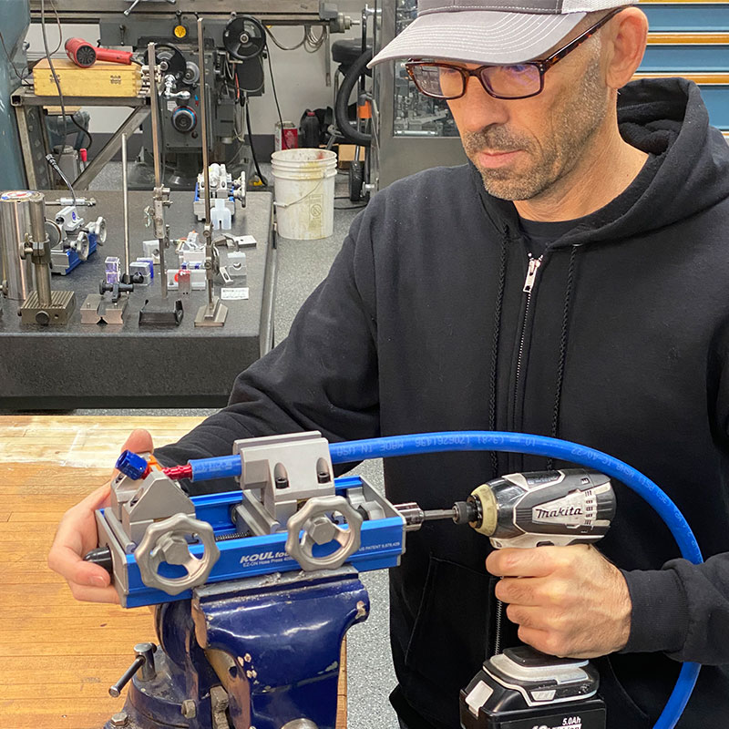
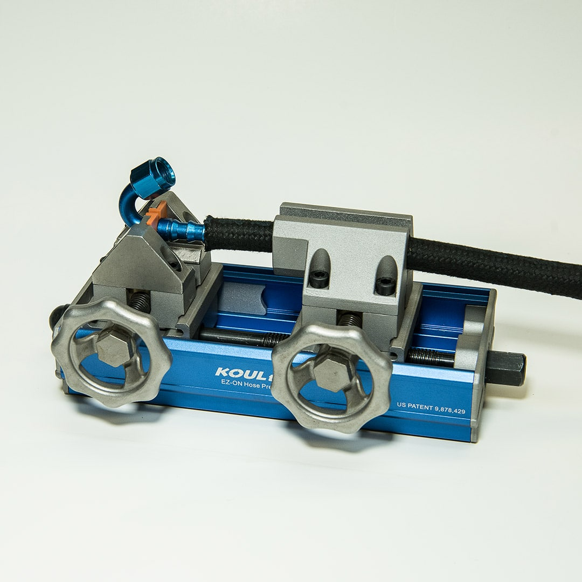
https://www.youtube.com/watch?v=a-zwXwePKrs

Slide 11
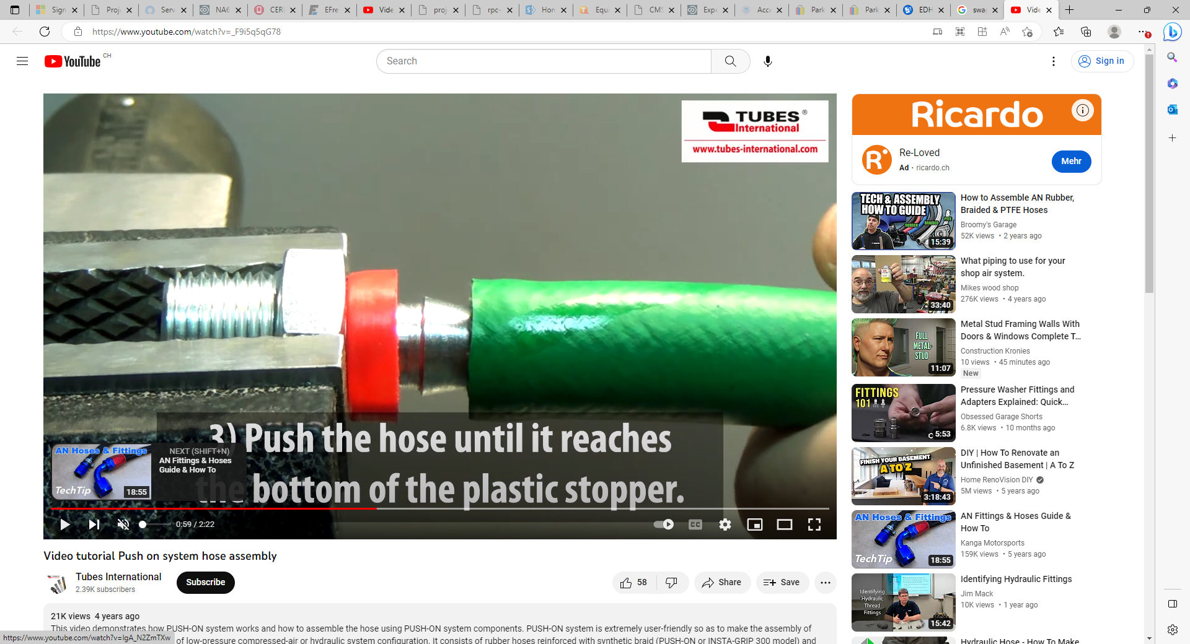
Tubes International
https://www.youtube.com/watch?v=_F9i5q5qG78

Slide 12
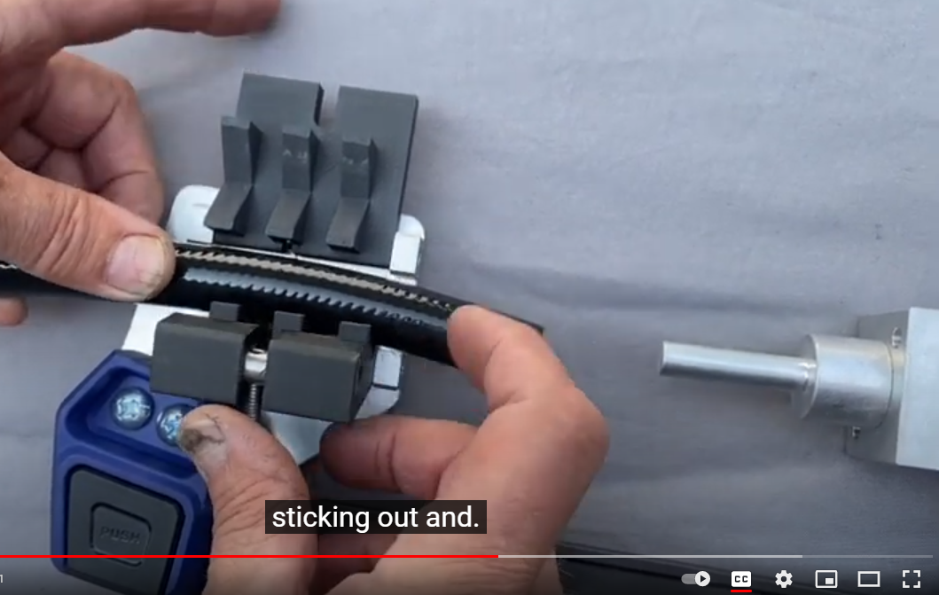
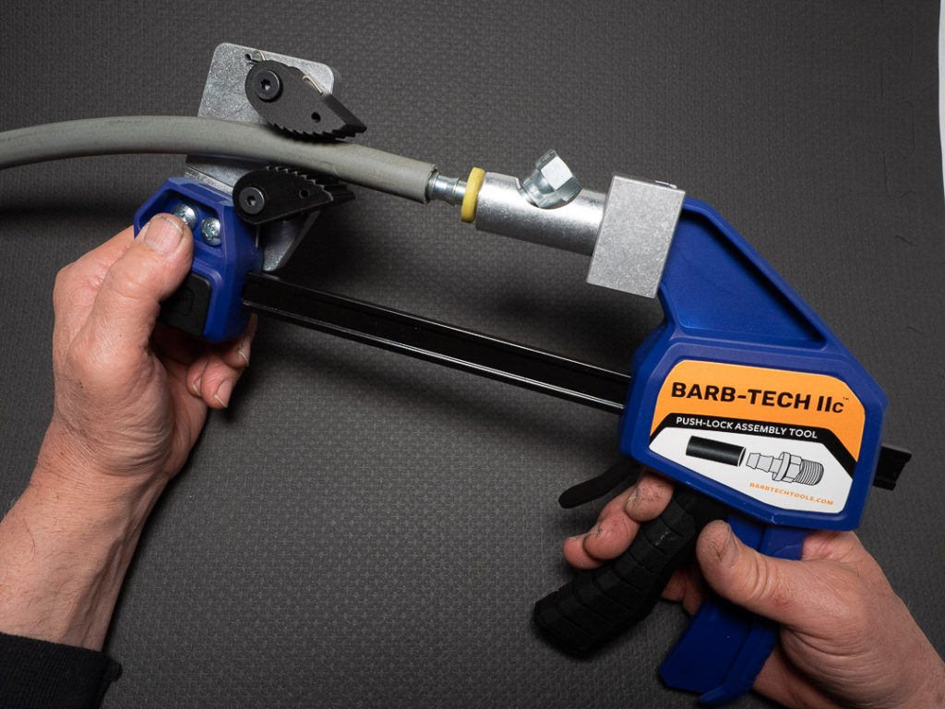
https://www.barbtechtools.com/benefits-of-hose-assembly-tool/
https://www.youtube.com/watch?v=Txqgcg3bKqY

Slide 13
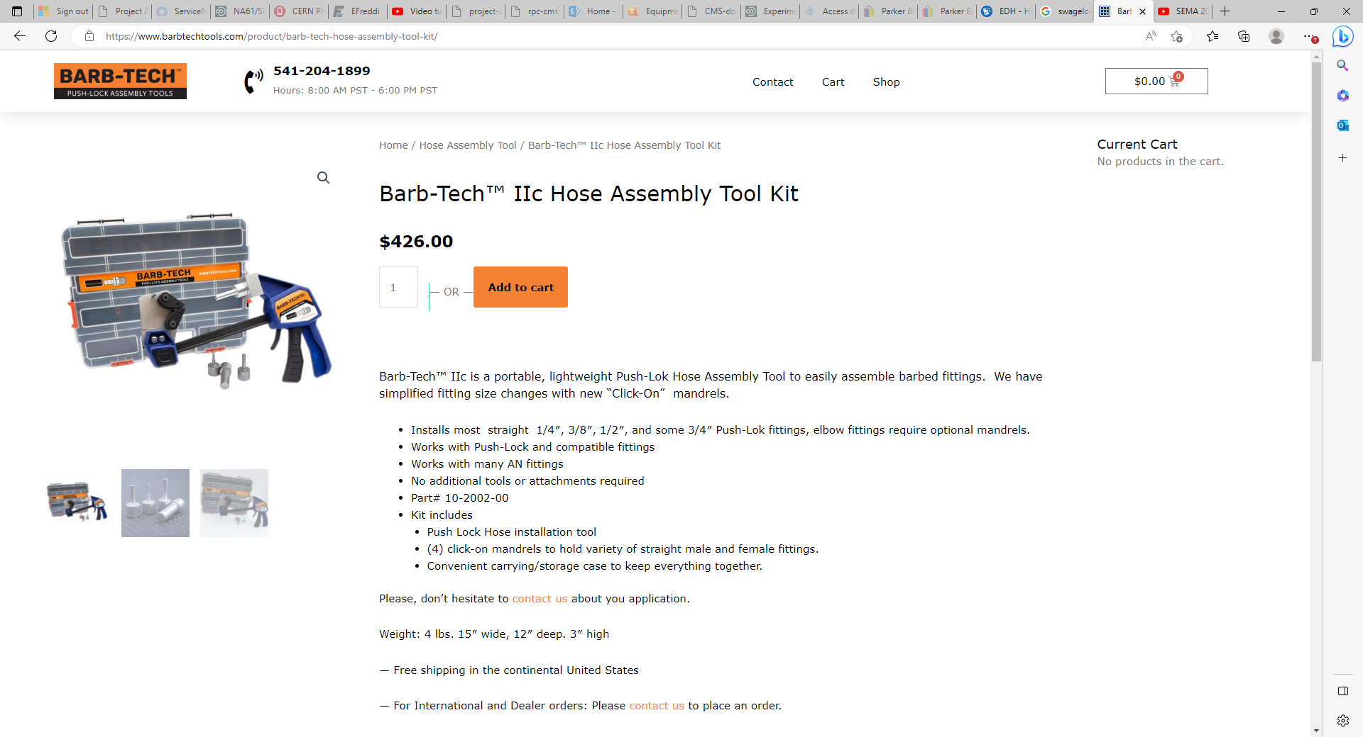

Slide 14
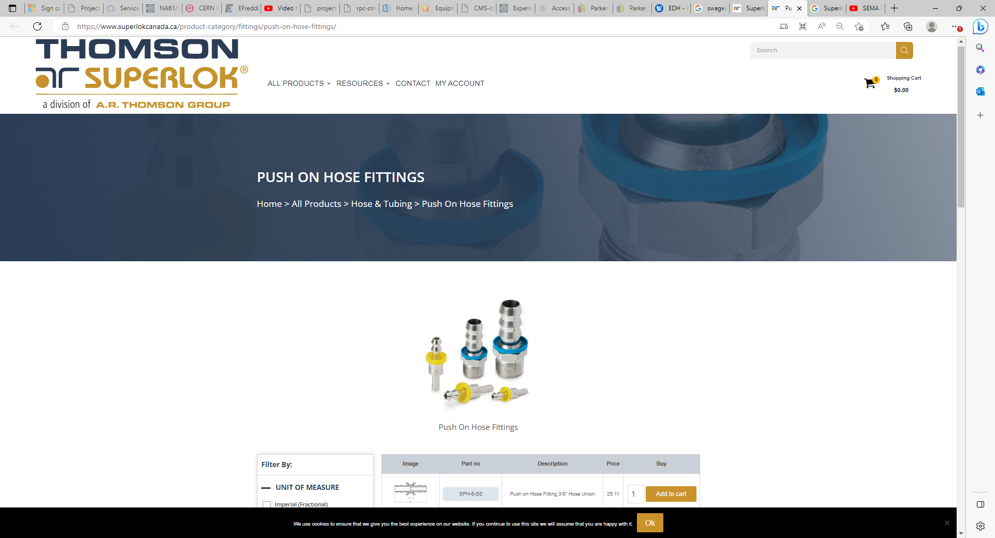
Superlok Push-On Hose Fittings

Slide 15
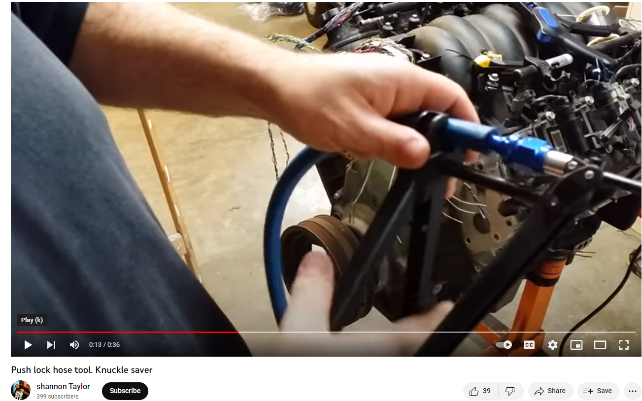
Aeroquip part#6173632.
https://www.youtube.com/watch?v=MQMpcZNpOjQ

Slide 16
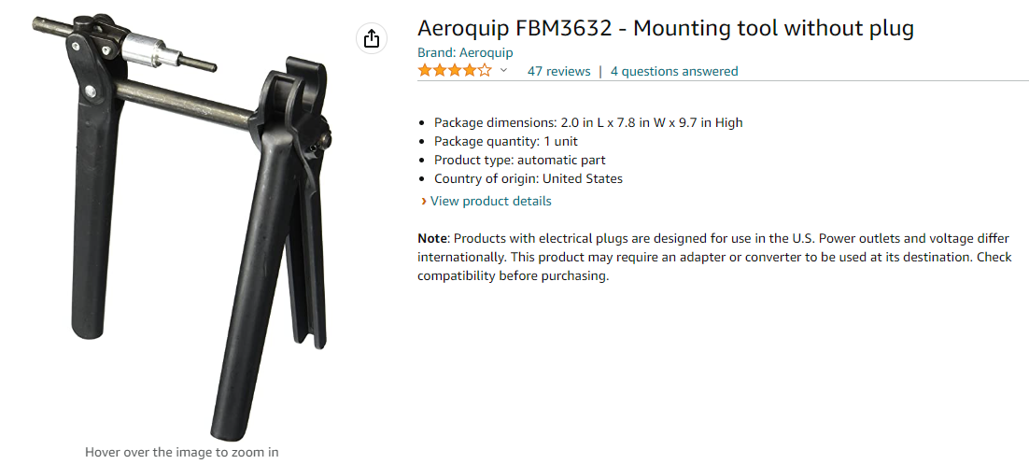
https://www.amazon.com/Aeroquip-FBM3632-Socketless-Fitting-Assembly/dp/B001U73F3Q

Slide 17
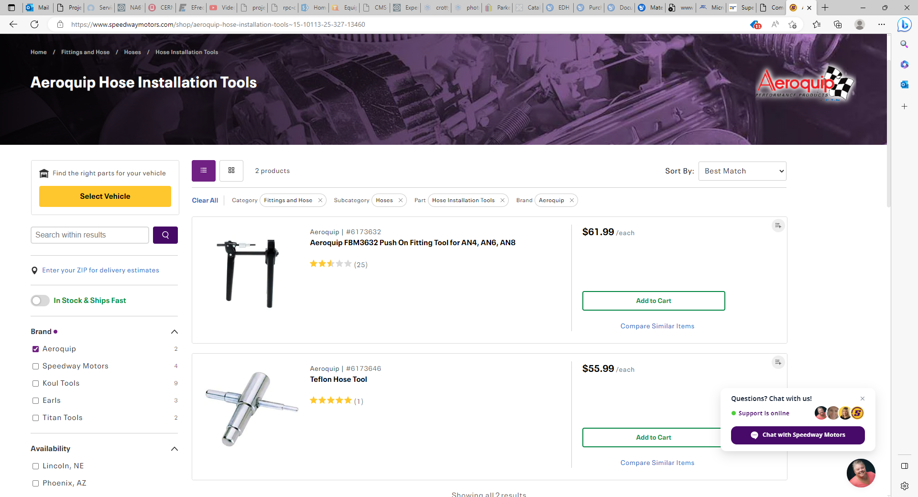
https://www.speedwaymotors.com/shop/aeroquip-hose-installation-tools~15-10113-25-327-13460

Slide 18
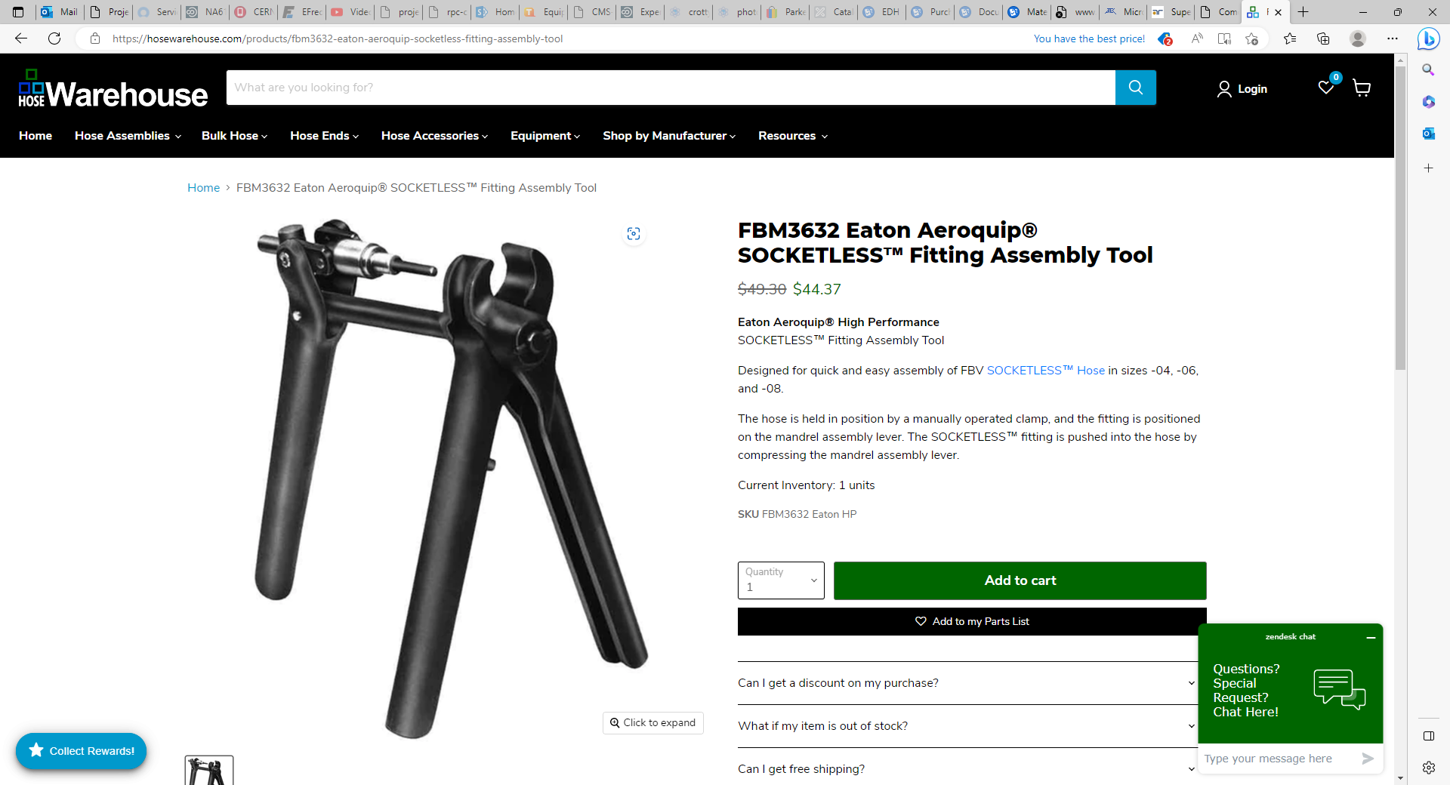
https://hosewarehouse.com/products/fbm3632-eaton-aeroquip-socketless-fitting-assembly-tool

Slide 20
With lubrication

Slide 21
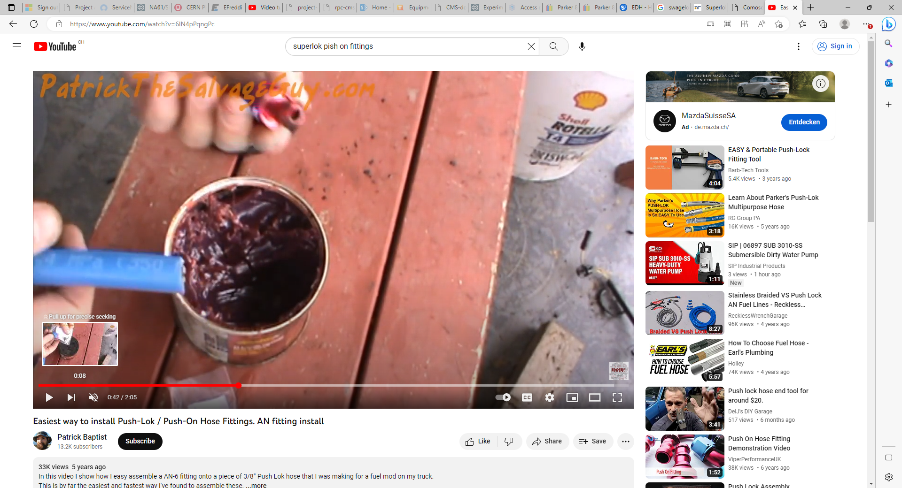
https://www.youtube.com/watch?v=6IN4pPqngPc

