Slide 1
Caulking Gun base for tool to push fit hoses, small
Ian
12 Feb 2025

Slide 2
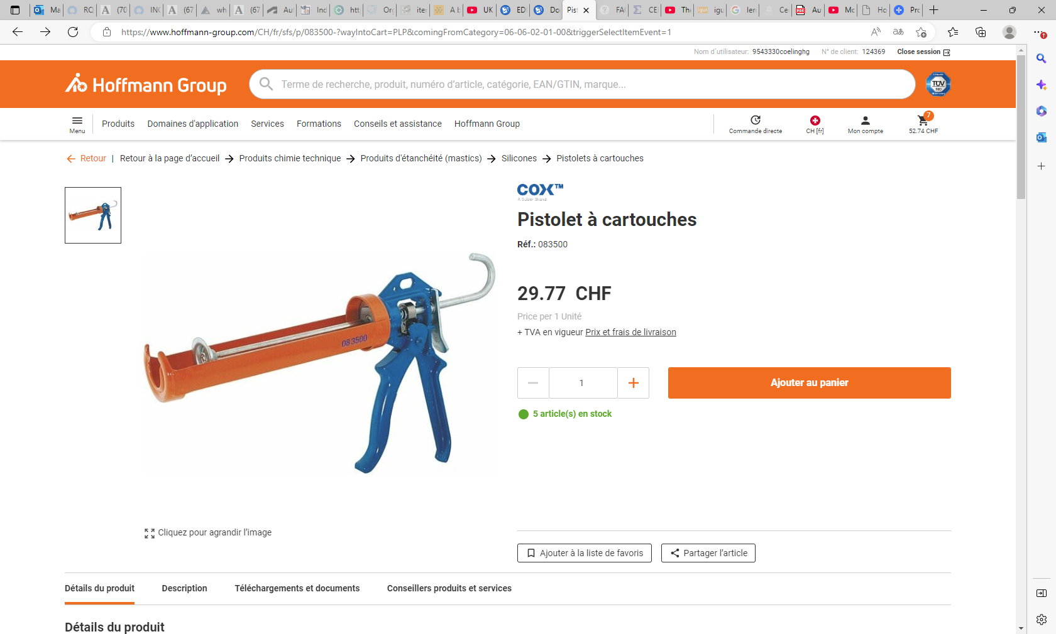
https://www.hoffmann-group.com/CH/fr/sfs/p/083500-?wayIntoCart=PLP&comingFromCategory=06-06-02-01-00&triggerSelectItemEvent=1

Slide 3
Use this pistol version as the arms on the sides are almost flat AND the mechanism is robust

Slide 4
