Slide 1
Tool to insert unions into Flexible hose such as Swagelok
“Push-on”
Ian
14 April 2023

Slide 2
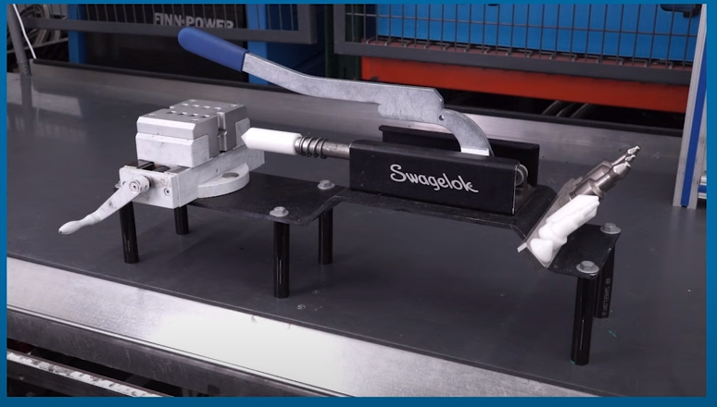

Slide 3
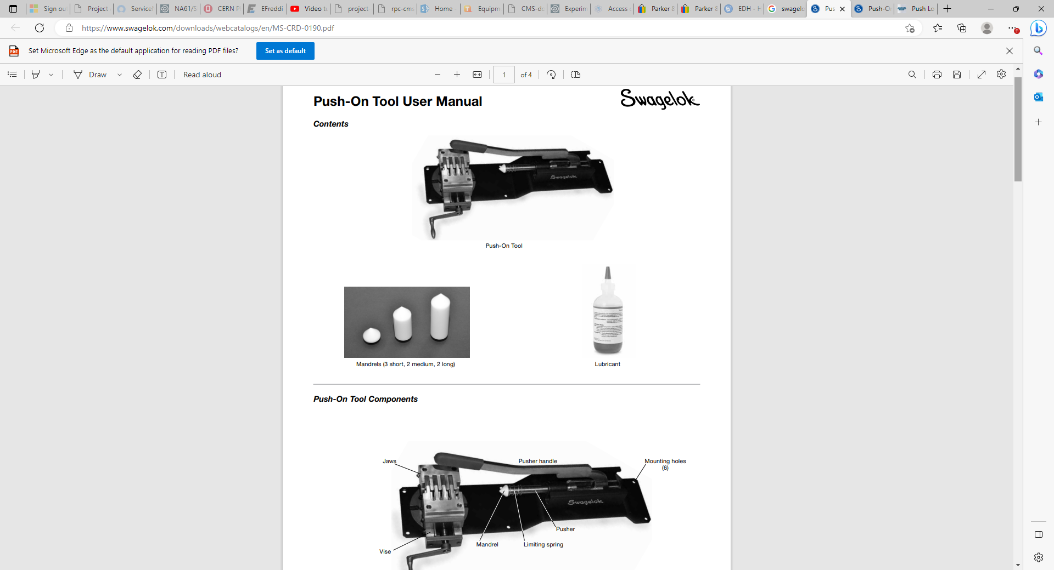
https://www.google.ch/url?sa=i&url=https%3A%2F%2Fwww.swagelok.com%2Fdownloads%2Fwebcatalogs%2Fen%2FMS-CRD-0190.pdf&psig=AOvVaw3pN9vSenVAODMUTlohwR4-&ust=1681557403111000&source=images&cd=vfe&ved=0CA4QjRxqFwoTCLi00NOfqf4CFQAAAAAdAAAAABAN

Slide 4
Can one use a lubricant , soap, to aide the insertion by hand ?

