Slide 1
Push lock type NBR hose fitting from Legris brass
Ian
16 May 2024

Slide 2
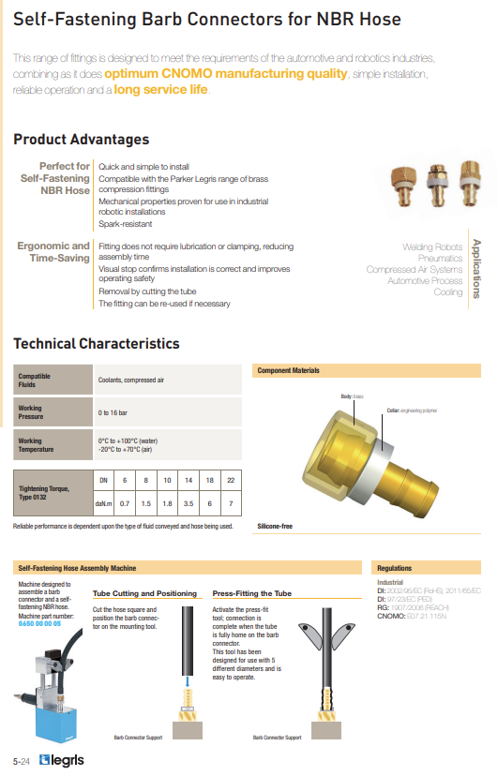
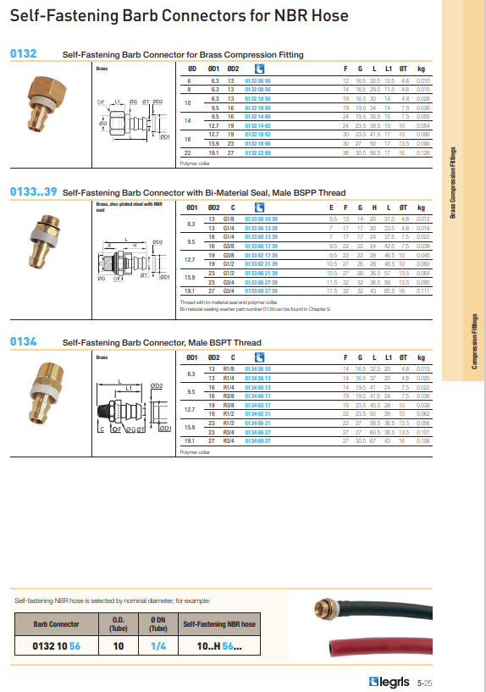
https://docs.rs-online.com/d51f/A700000009518927.pdf

Slide 3
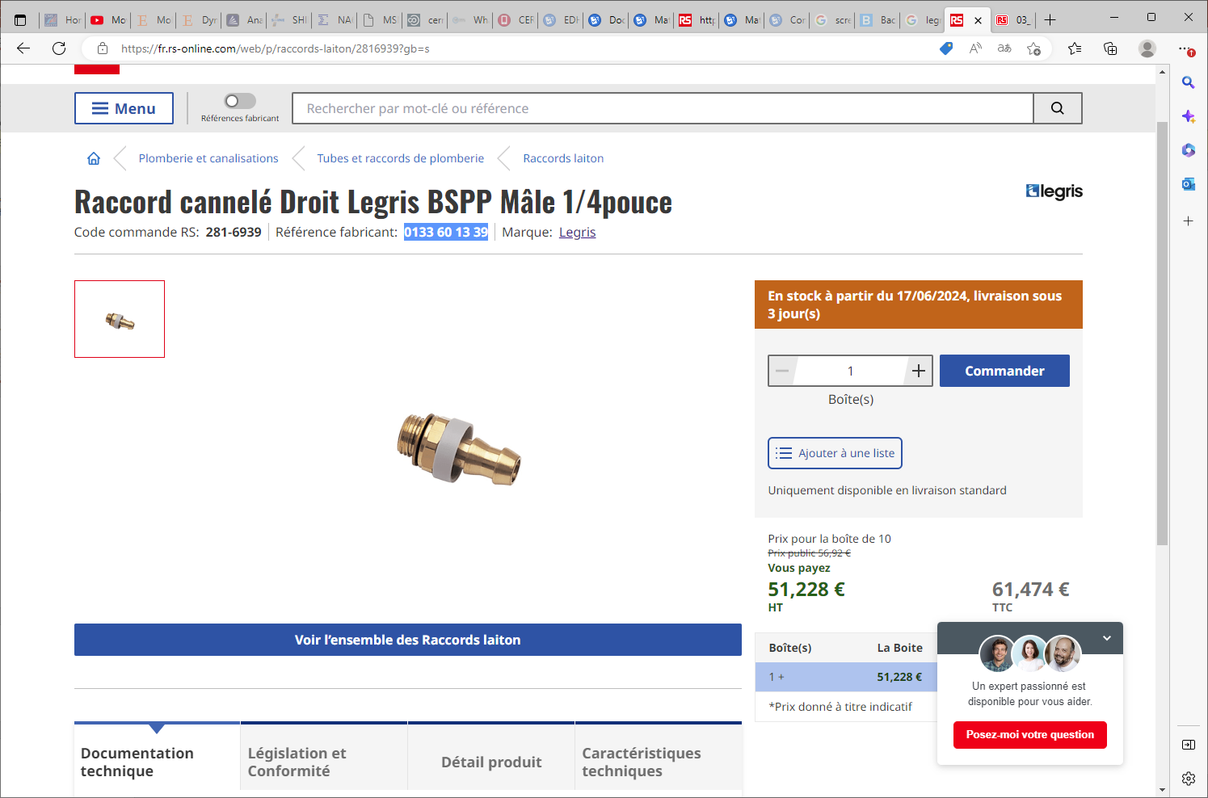

Slide 4
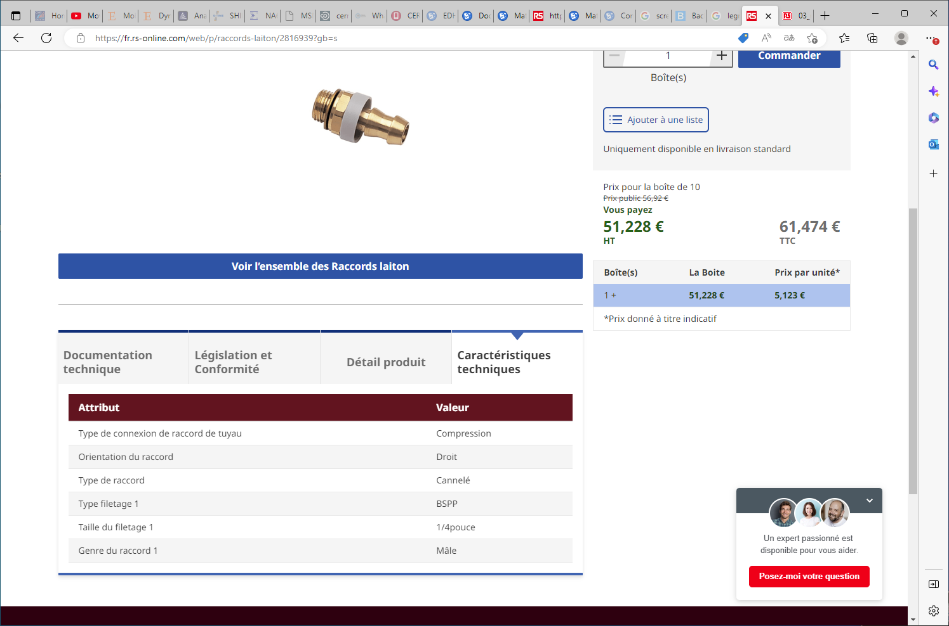
This information is not helpful as the “compression” means ?

Slide 5
But where is the hose ?

Slide 6
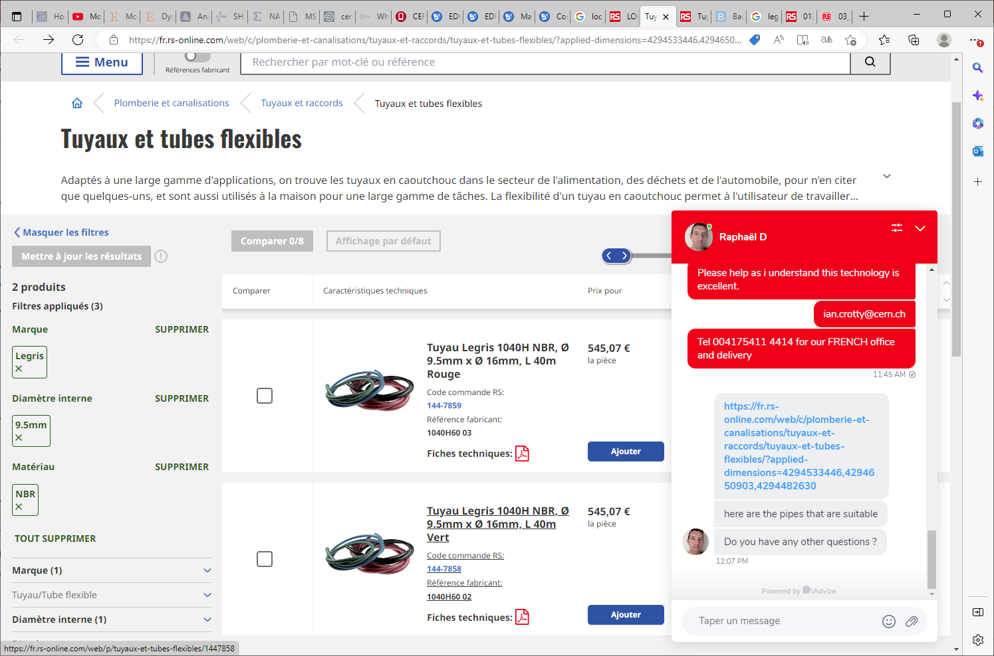
https://fr.rs-online.com/web/c/plomberie-et-canalisations/tuyaux-et-raccords/tuyaux-et-tubes-flexibles/?applied-dimensions=4294533446,4294650903,4294482630
1040H60 03
1040H60 02

Slide 7
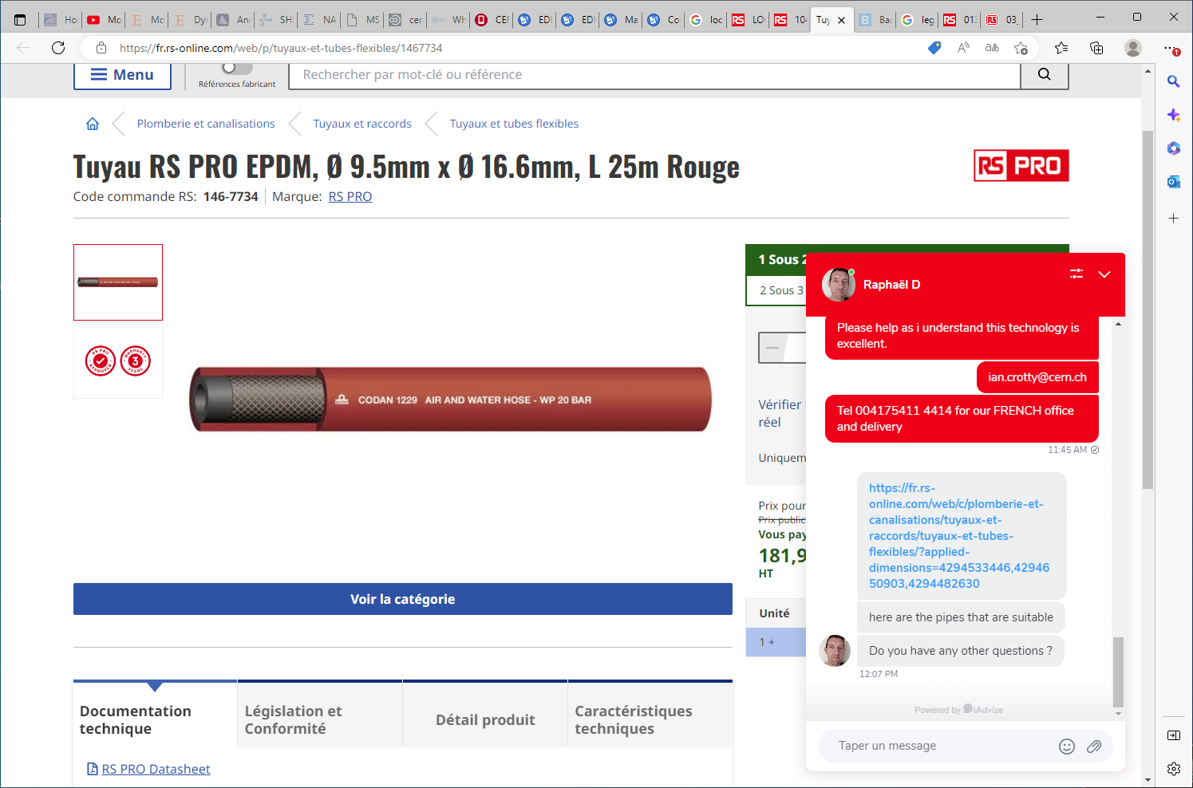
https://fr.rs-online.com/web/p/tuyaux-et-tubes-flexibles/1467734

Slide 8
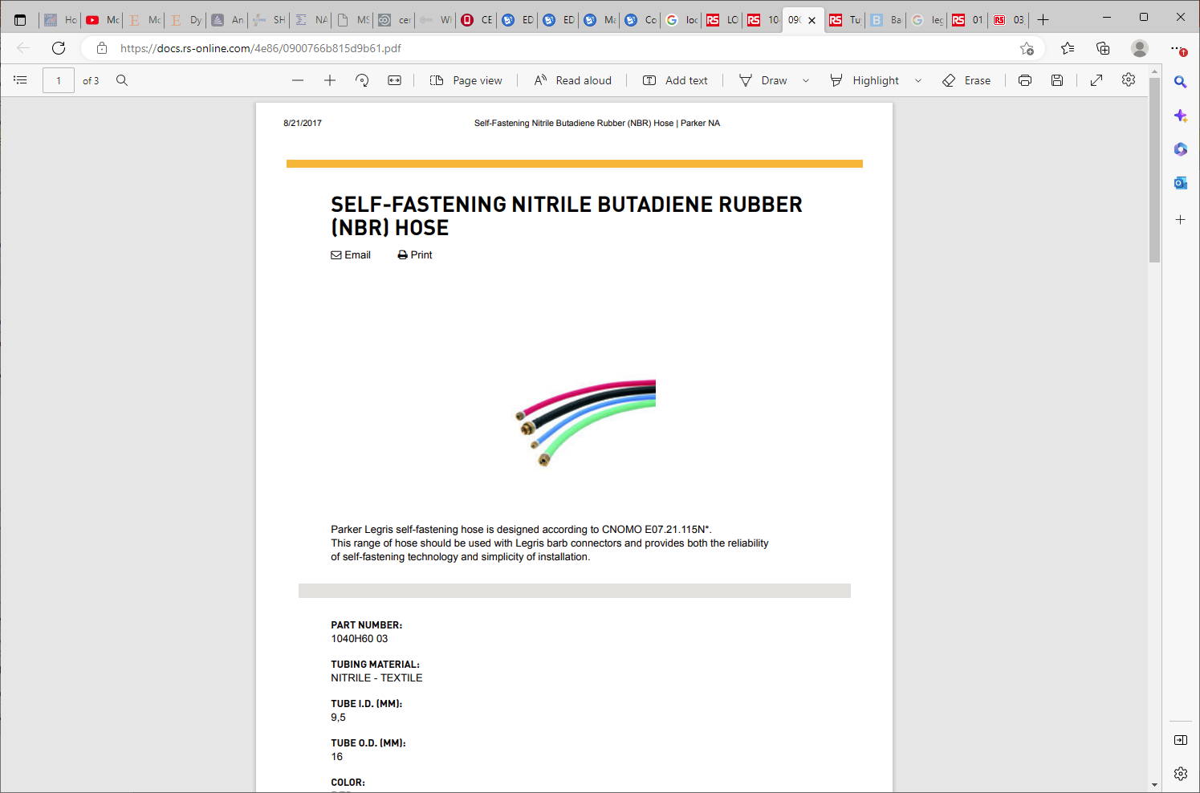
https://docs.rs-online.com/4e86/0900766b815d9b61.pdf
NITRILE BUTADIENE RUBBER (NBR) HOSE
Parker Legris self-fastening hose is designed according to CNOMO E07.21.115N*

Slide 9
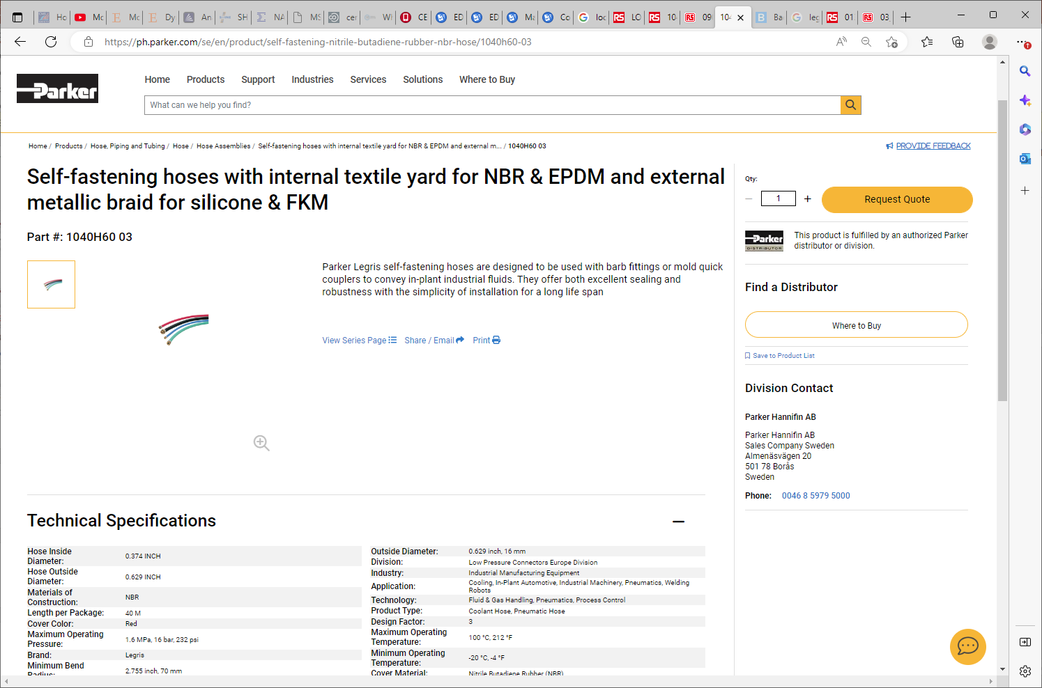

Slide 10
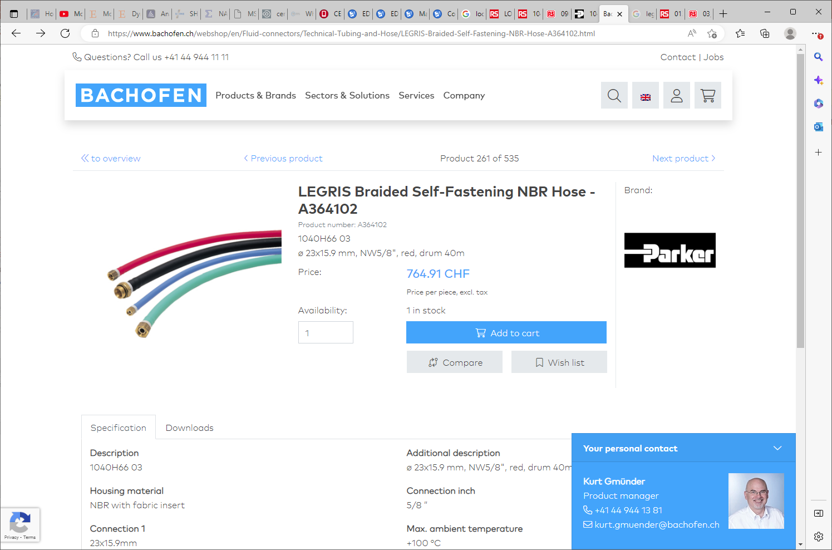
https://www.bachofen.ch/webshop/en/Fluid-connectors/Technical-Tubing-and-Hose/LEGRIS-Braided-Self-Fastening-NBR-Hose-A364102.html

