Slide 1
Leakless Bosteels
Ian
10 Aug 2023

Slide 2
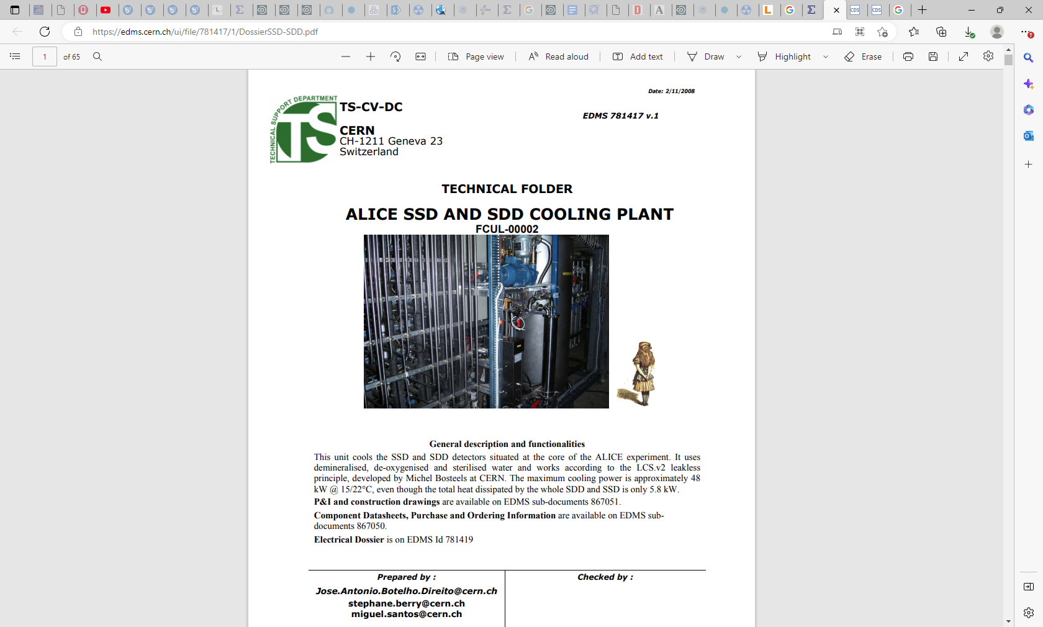
https://edms.cern.ch/ui/file/781417/1/DossierSSD-SDD.pdf

Slide 3
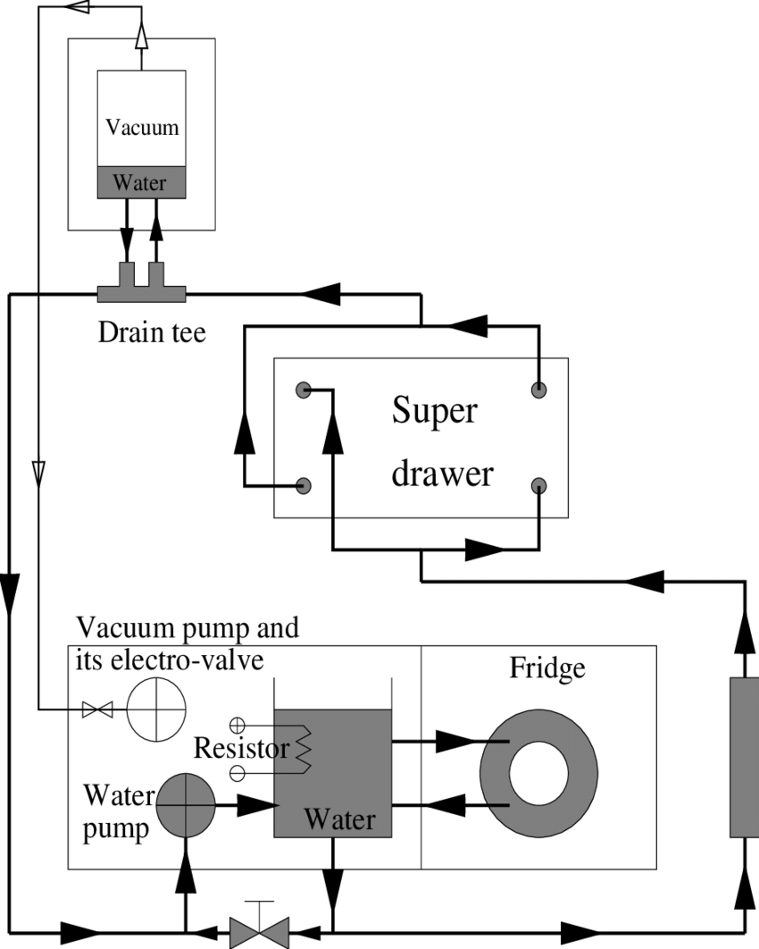

Slide 4
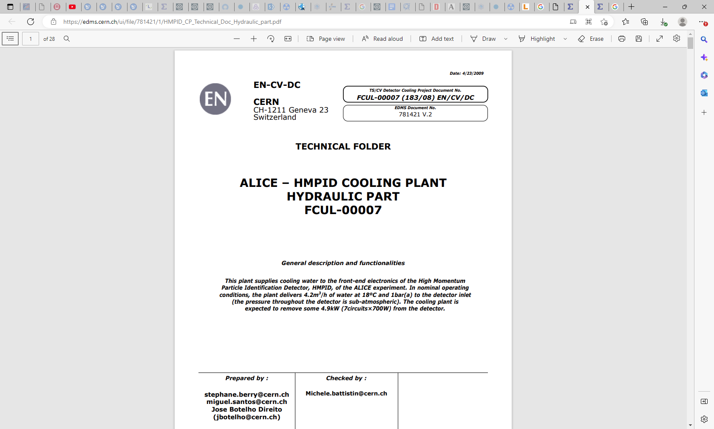
https://edms.cern.ch/ui/file/781421/1/HMPID_CP_Technical_Doc_Hydraulic_part.pdf

Slide 5
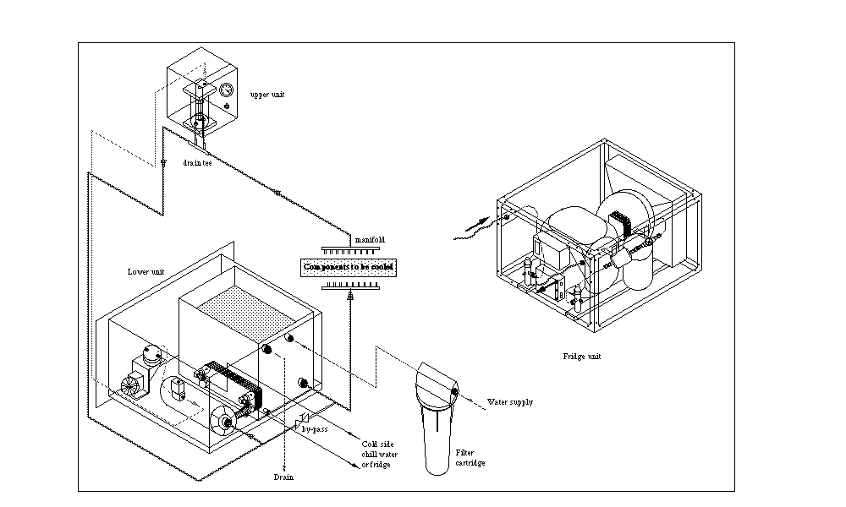
https://detector-cooling.web.cern.ch/coolingsystems/CoolingSystemWeb/Leakless1LabSystem1.htm
Liquid cooling systems: Leakless v.1 - LabSystem unit - Fluid Connections

Slide 6
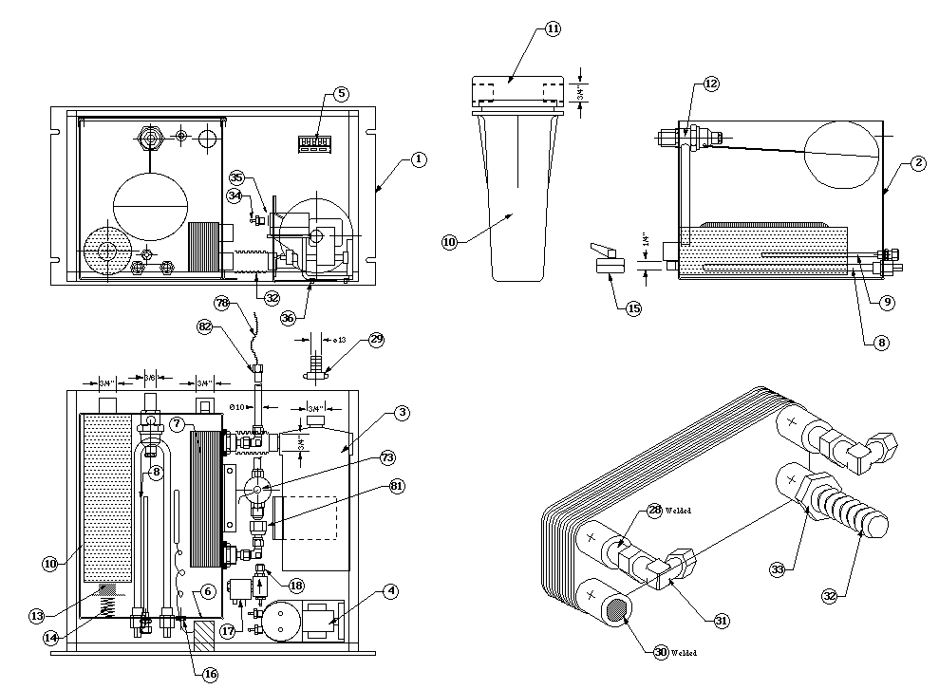
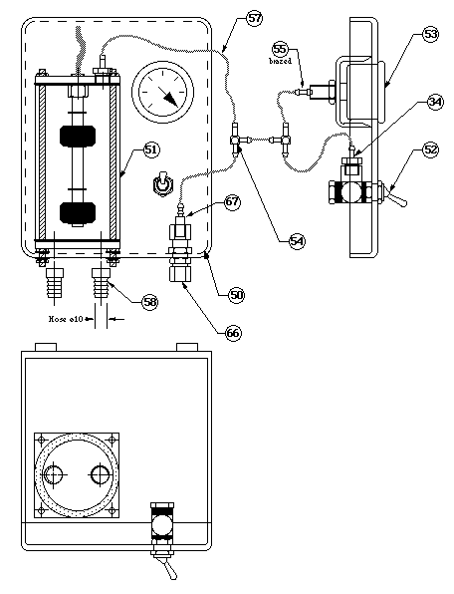
https://detector-cooling.web.cern.ch/coolingsystems/CoolingSystemWeb/Leakless1LabSystem4.htm

Slide 7
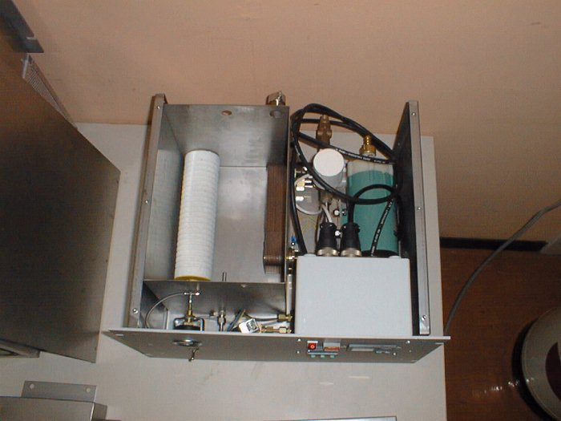

Slide 8
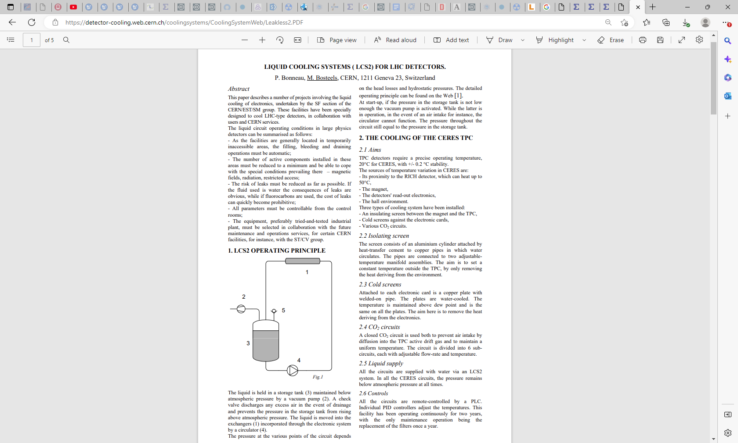
https://detector-cooling.web.cern.ch/coolingsystems/CoolingSystemWeb/Leakless2.PDF

Slide 9
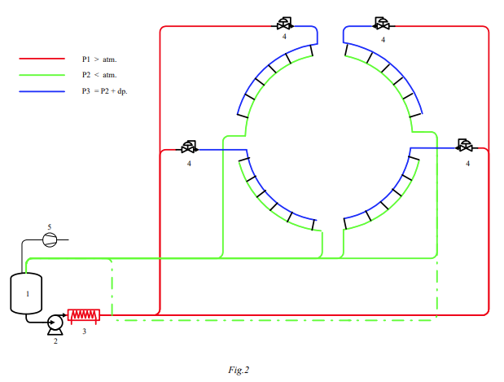
https://detector-cooling.web.cern.ch/coolingsystems/CoolingSystemWeb/Leakless2.PDF

Slide 10
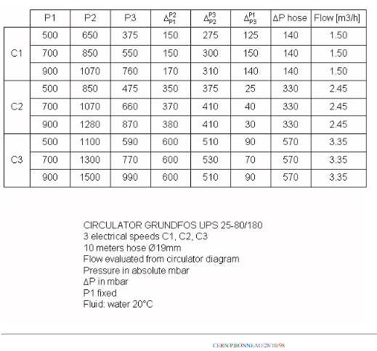
Liquid cooling systems: Leakless v.2 - Test Results
https://detector-cooling.web.cern.ch/coolingsystems/CoolingSystemWeb/Leakless2TestResult.htm

Slide 11
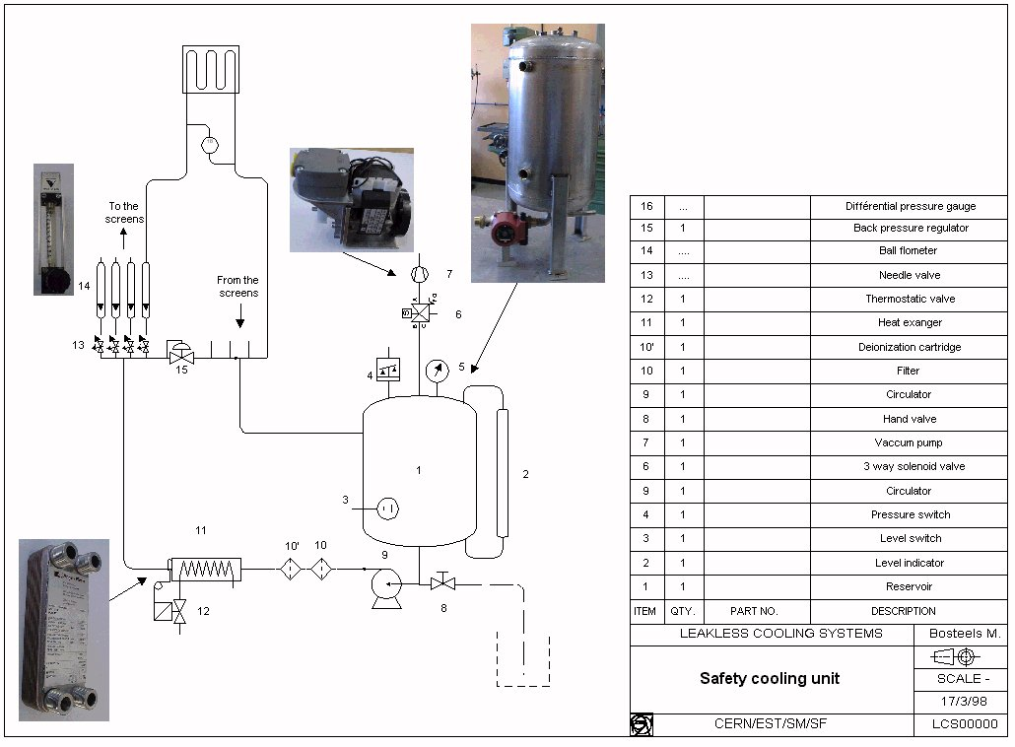

Slide 12
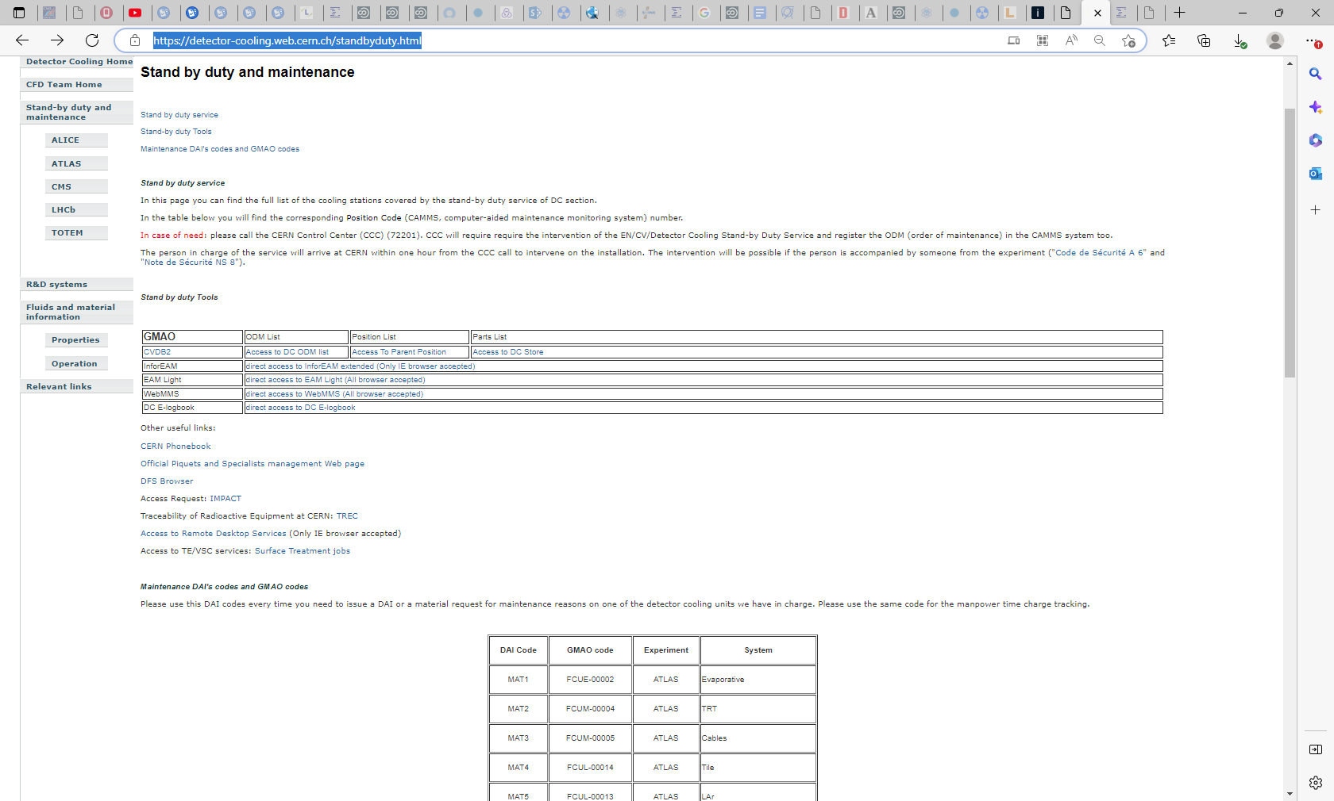
https://detector-cooling.web.cern.ch/standbyduty.html
All the codes are here except for the NA61 ! Which is FCUL-00038

Slide 13
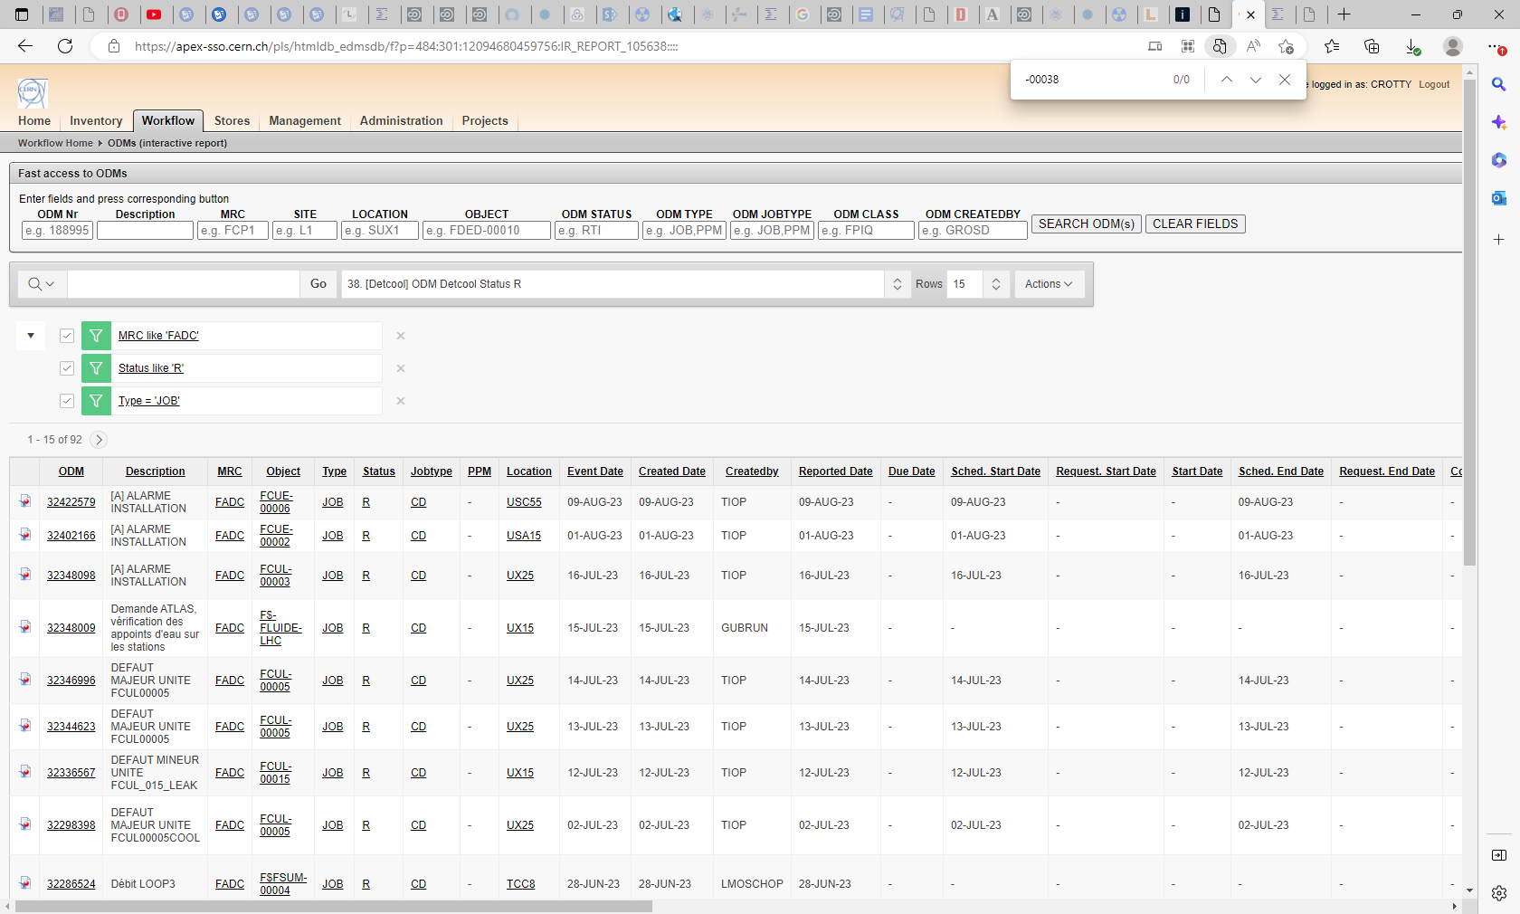
https://apex-sso.cern.ch/pls/htmldb_edmsdb/f?p=484:301:12094680459756:IR_REPORT_105638::::
There is CMs indicated for an ODM (maintenance order) for the 9 Aug 2023 but never one for NA61 !!

Slide 15
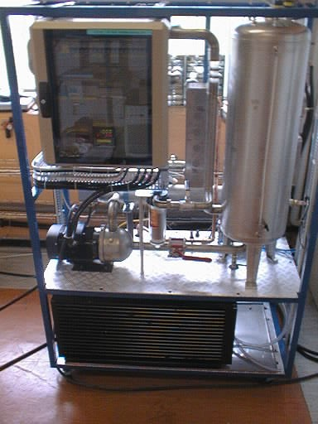
Is this the one that GEM uses ?
Under pressure that clears the lines when you disconnect the load

Slide 18
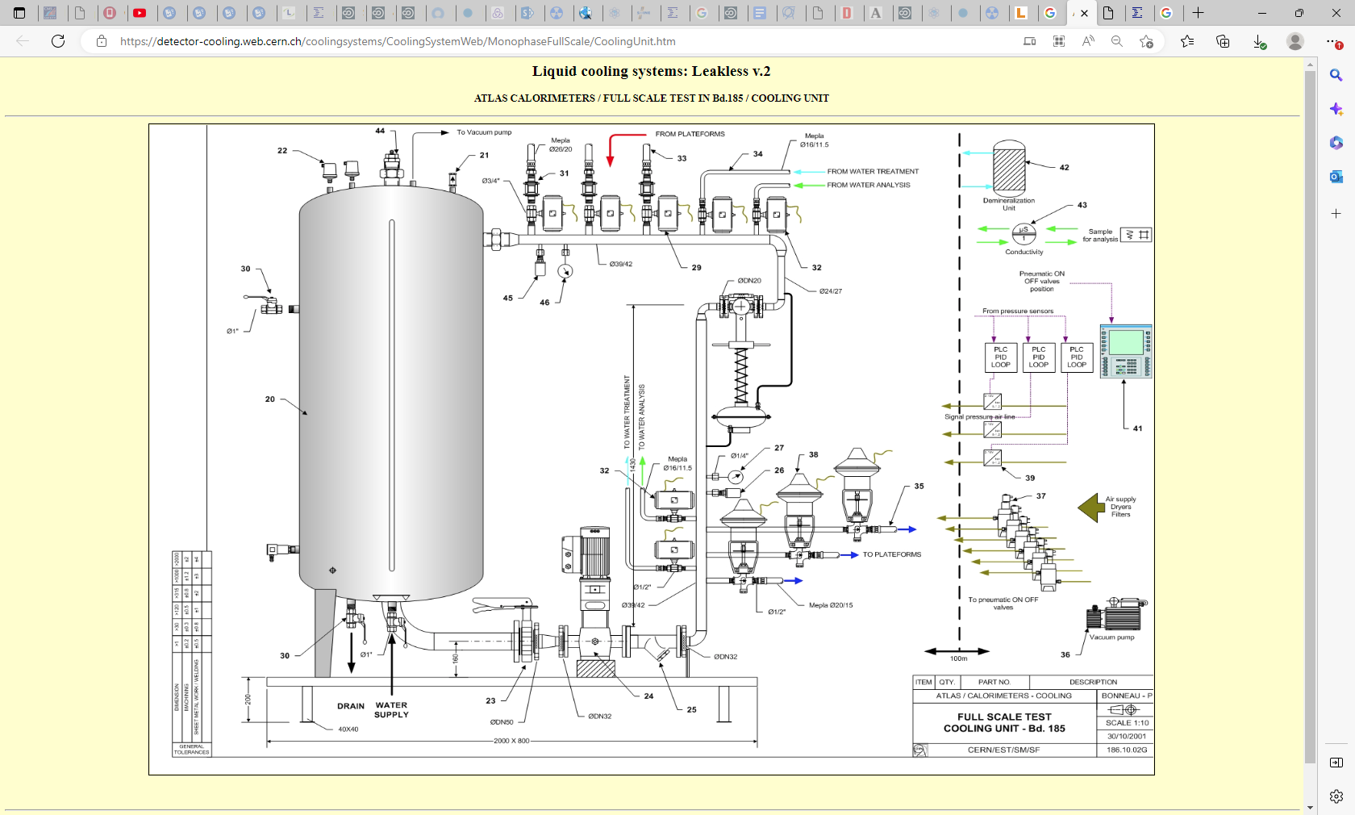
https://detector-cooling.web.cern.ch/coolingsystems/CoolingSystemWeb/MonophaseFullScale/CoolingUnit.htm

Slide 19
NA61
MTPC SR
MTPC HR
VTPC1
VTPC2 problem sensor top reservoir (9-10 Aug 2023)
Contacts EN-CV-LHC Alex Marion 161390 bald
Daniel Lefils 162915 I know him from early 2000s bat298/1-011
Stephan berry gone top Greece as planned
Reference FCUL 00038 ( this is the ENCV code for their systems)

Slide 20
Corrsion inhibition
Aquaris K-20, dosage 300 ml/ m3
. See DAI/2098833

Slide 21
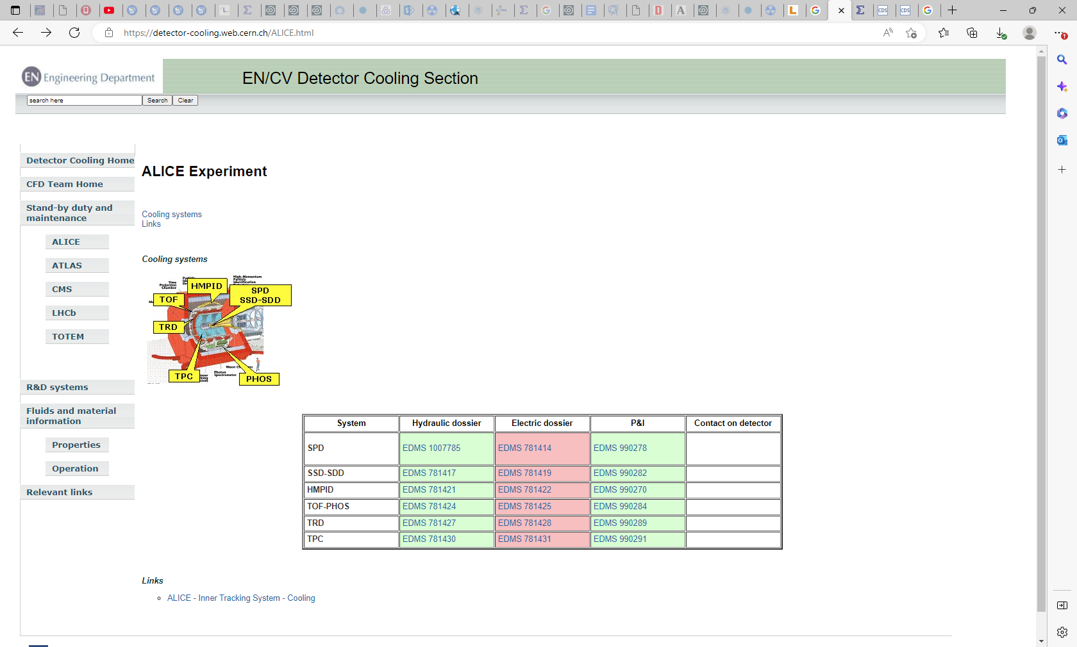
https://detector-cooling.web.cern.ch/ALICE.html

Slide 22
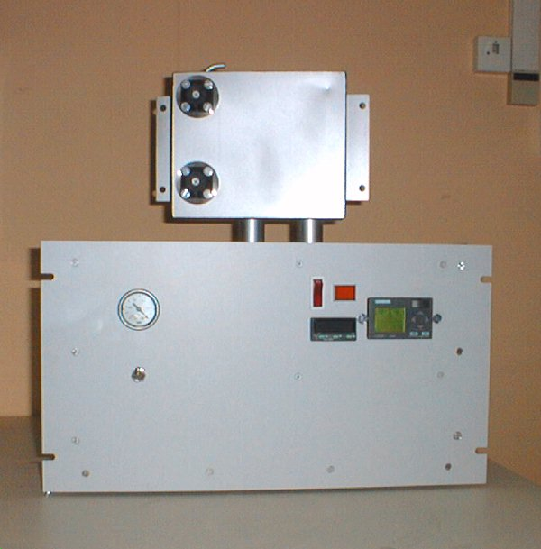

Slide 23
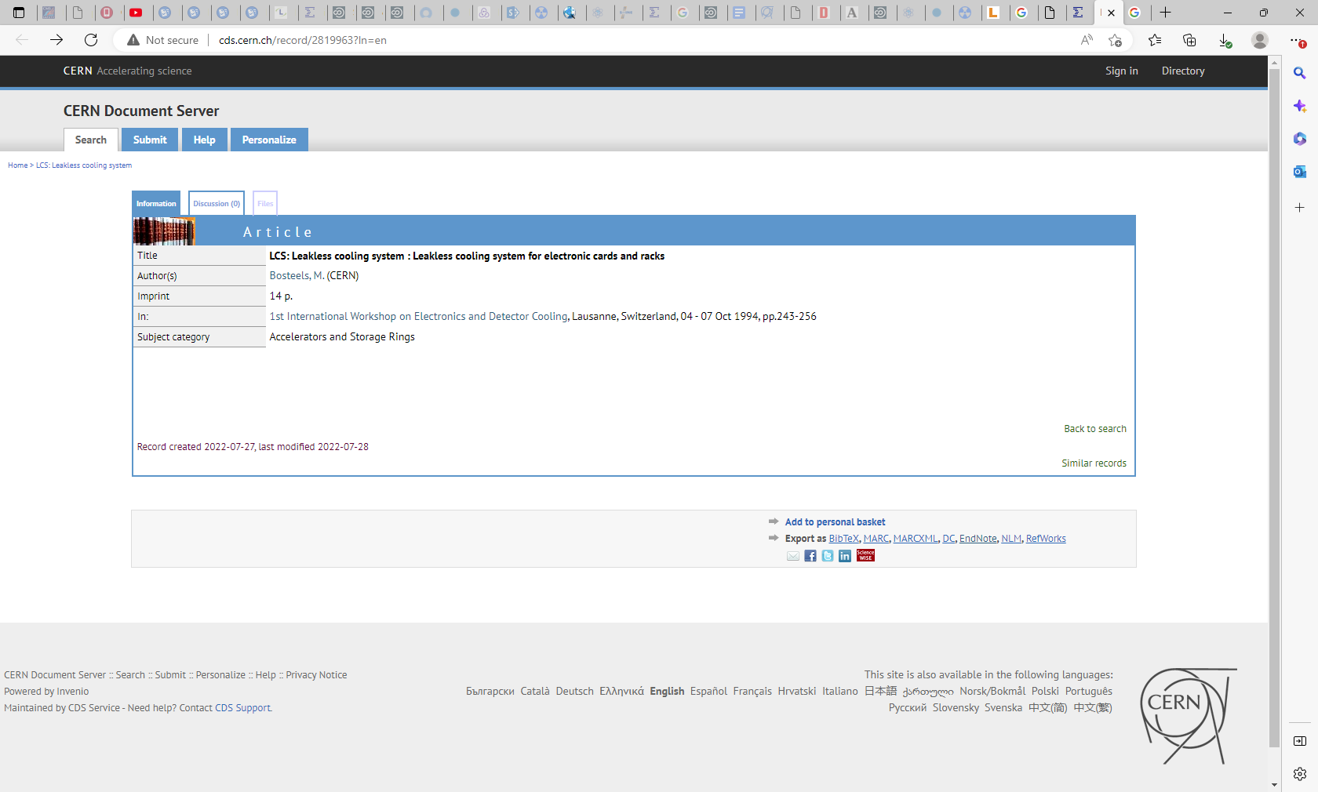
http://cds.cern.ch/record/2819963?ln=en

