Slide 1
Cable length measurement
Ian
7 Oct 2019

Slide 2
Principle of measurement
Measure resistance
Measure reflection time

Slide 3
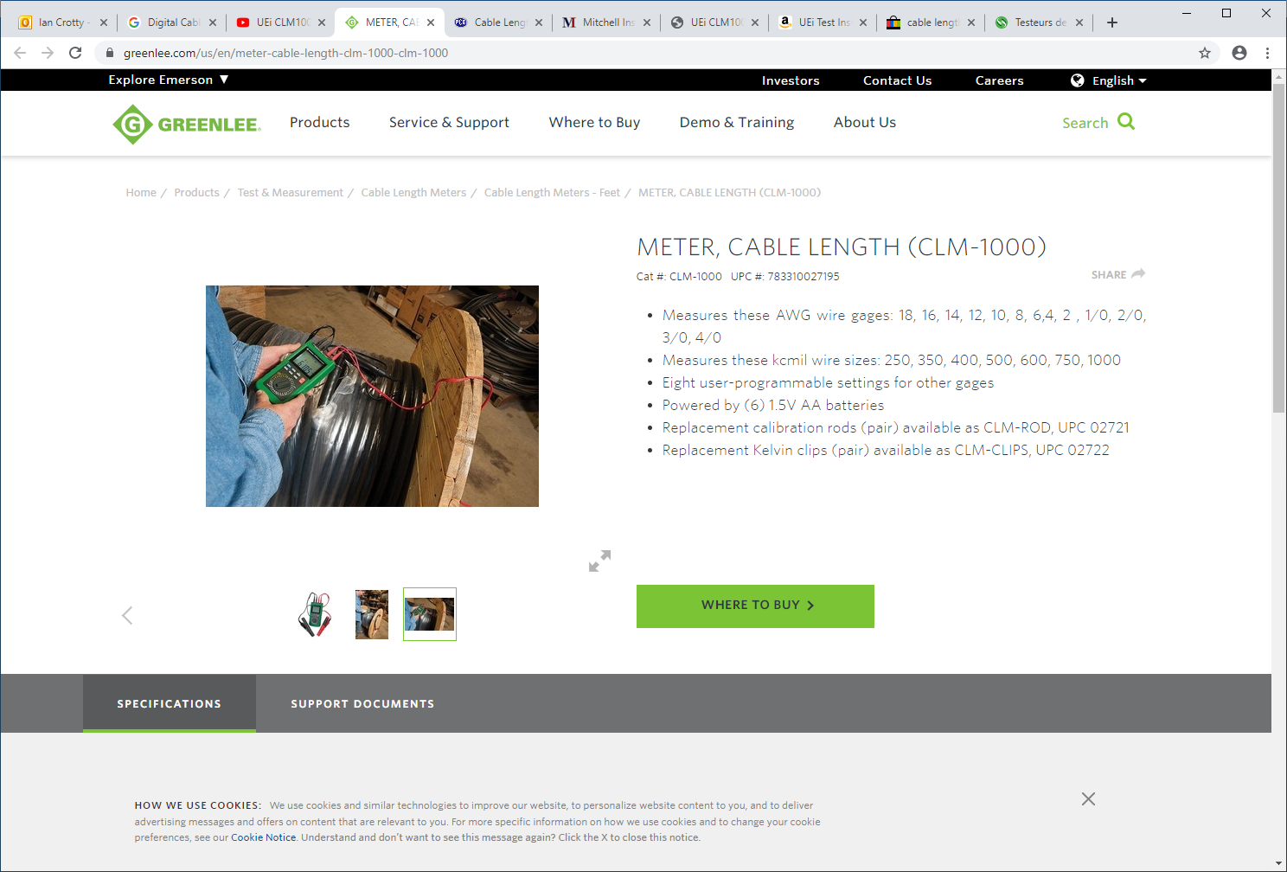
https://www.greenlee.com/us/en/meter-cable-length-clm-1000-clm-1000

Slide 4
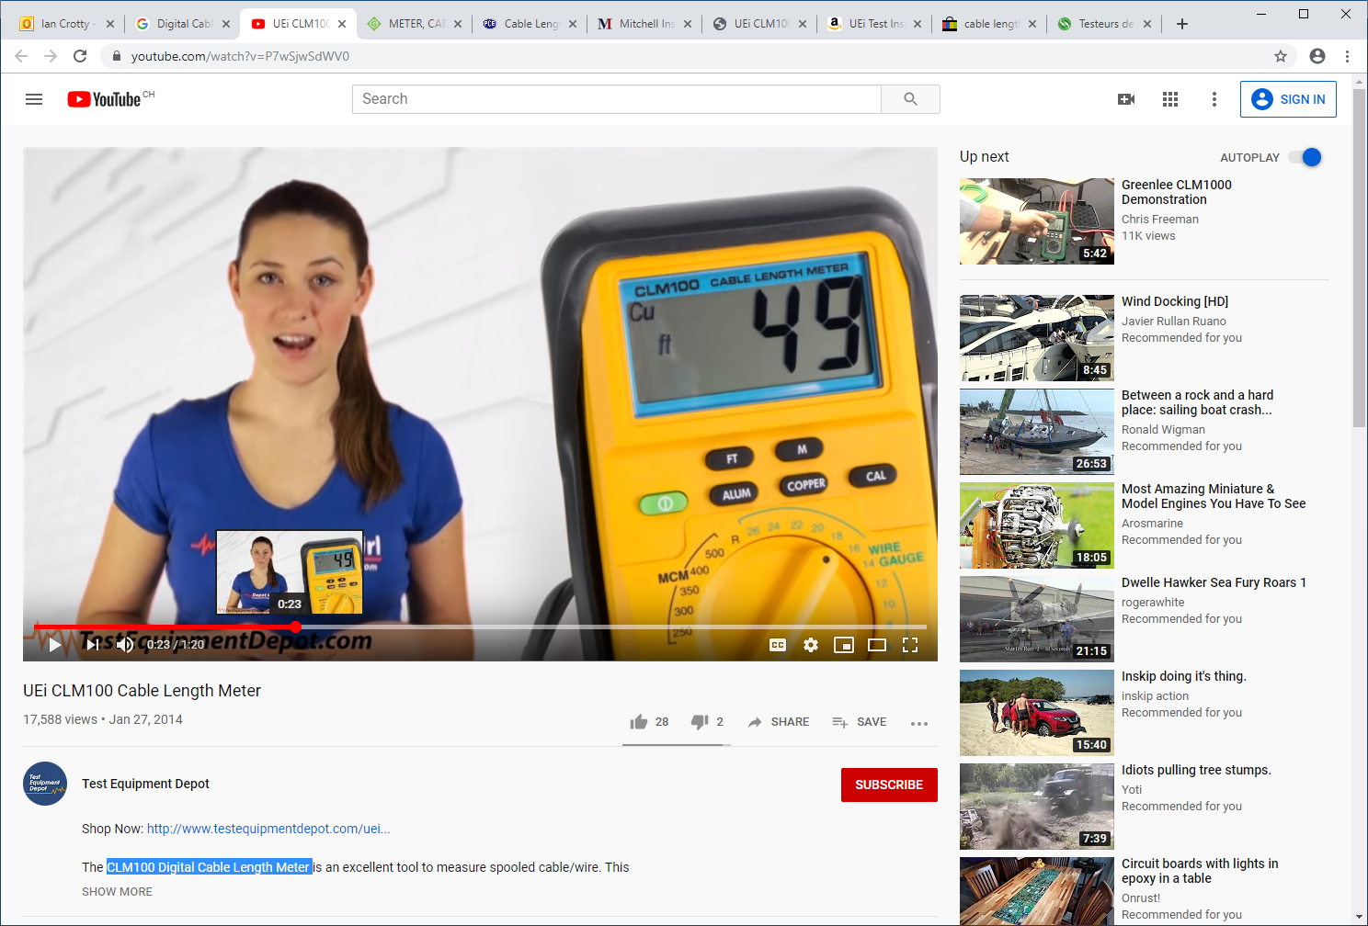
https://www.youtube.com/watch?v=P7wSjwSdWV0

Slide 5
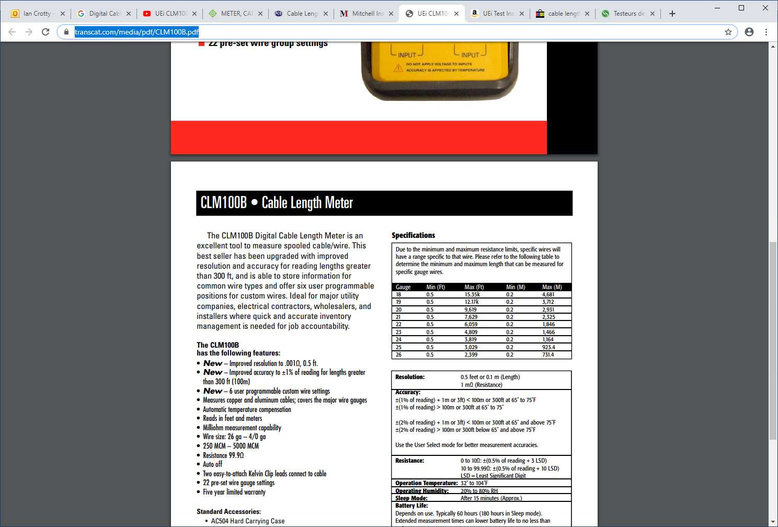
https://www.transcat.com/media/pdf/CLM100B.pdf

Slide 6
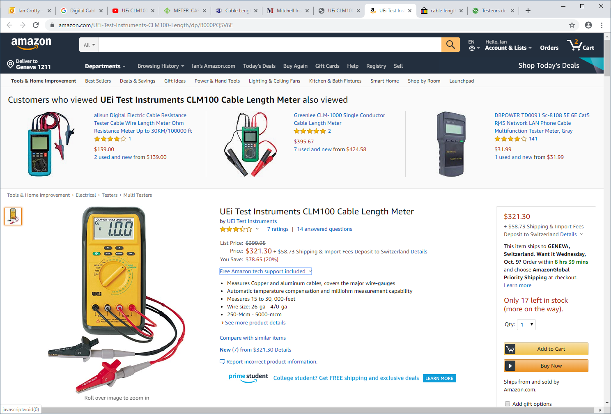

Slide 7
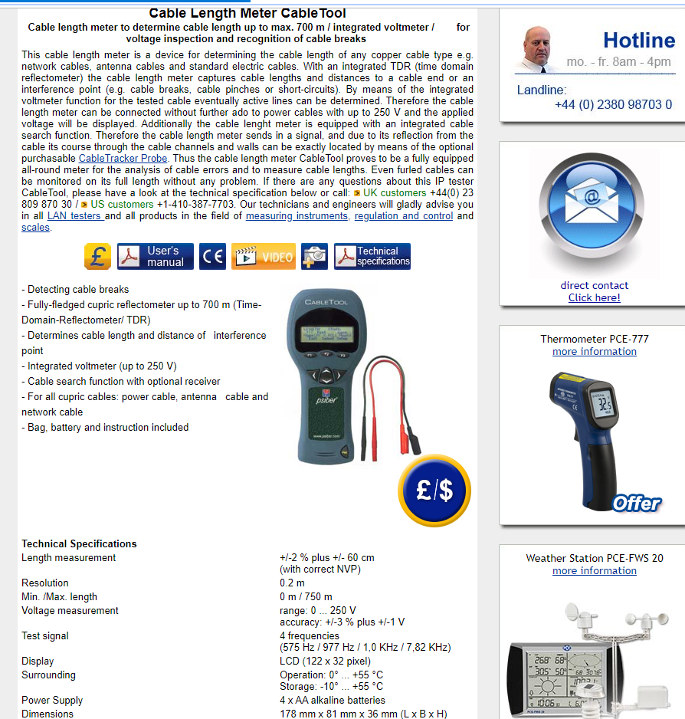
https://www.industrial-needs.com/technical-data/cable-lenght-meter-cable-tool.htm

Slide 8
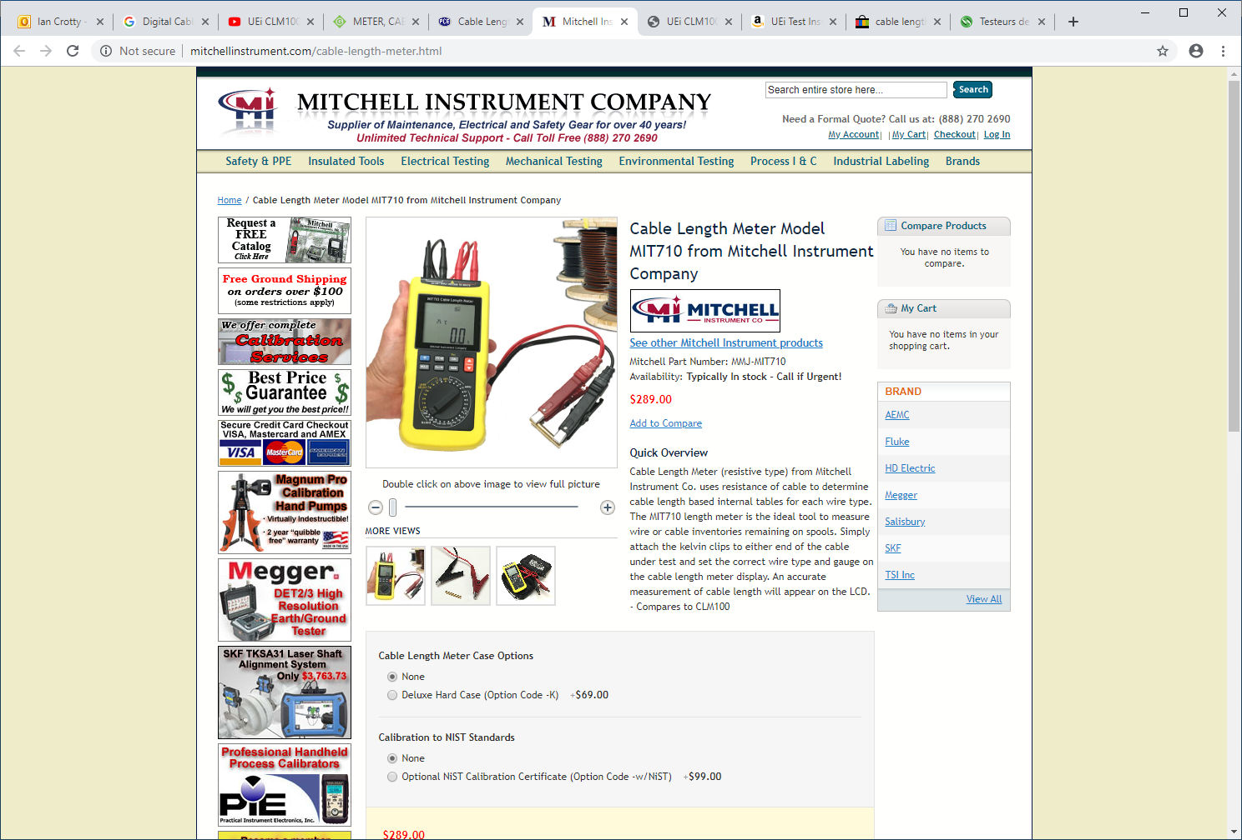
http://www.mitchellinstrument.com/cable-length-meter.html

Slide 9
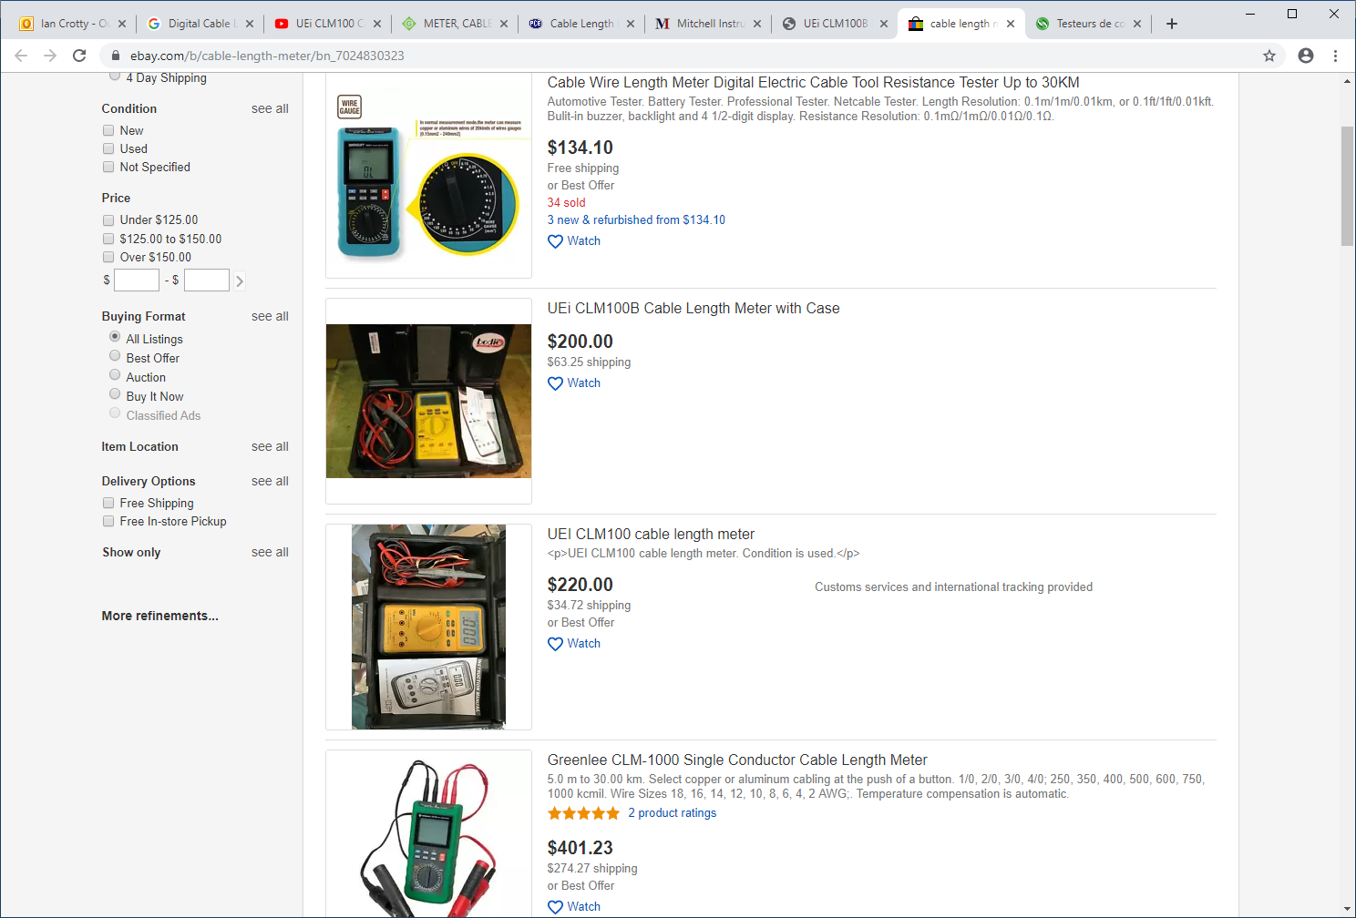
https://www.ebay.com/b/cable-length-meter/bn_7024830323

