Slide 1
LV Trigger Cable
Polish
Ian
April 2019

Slide 2
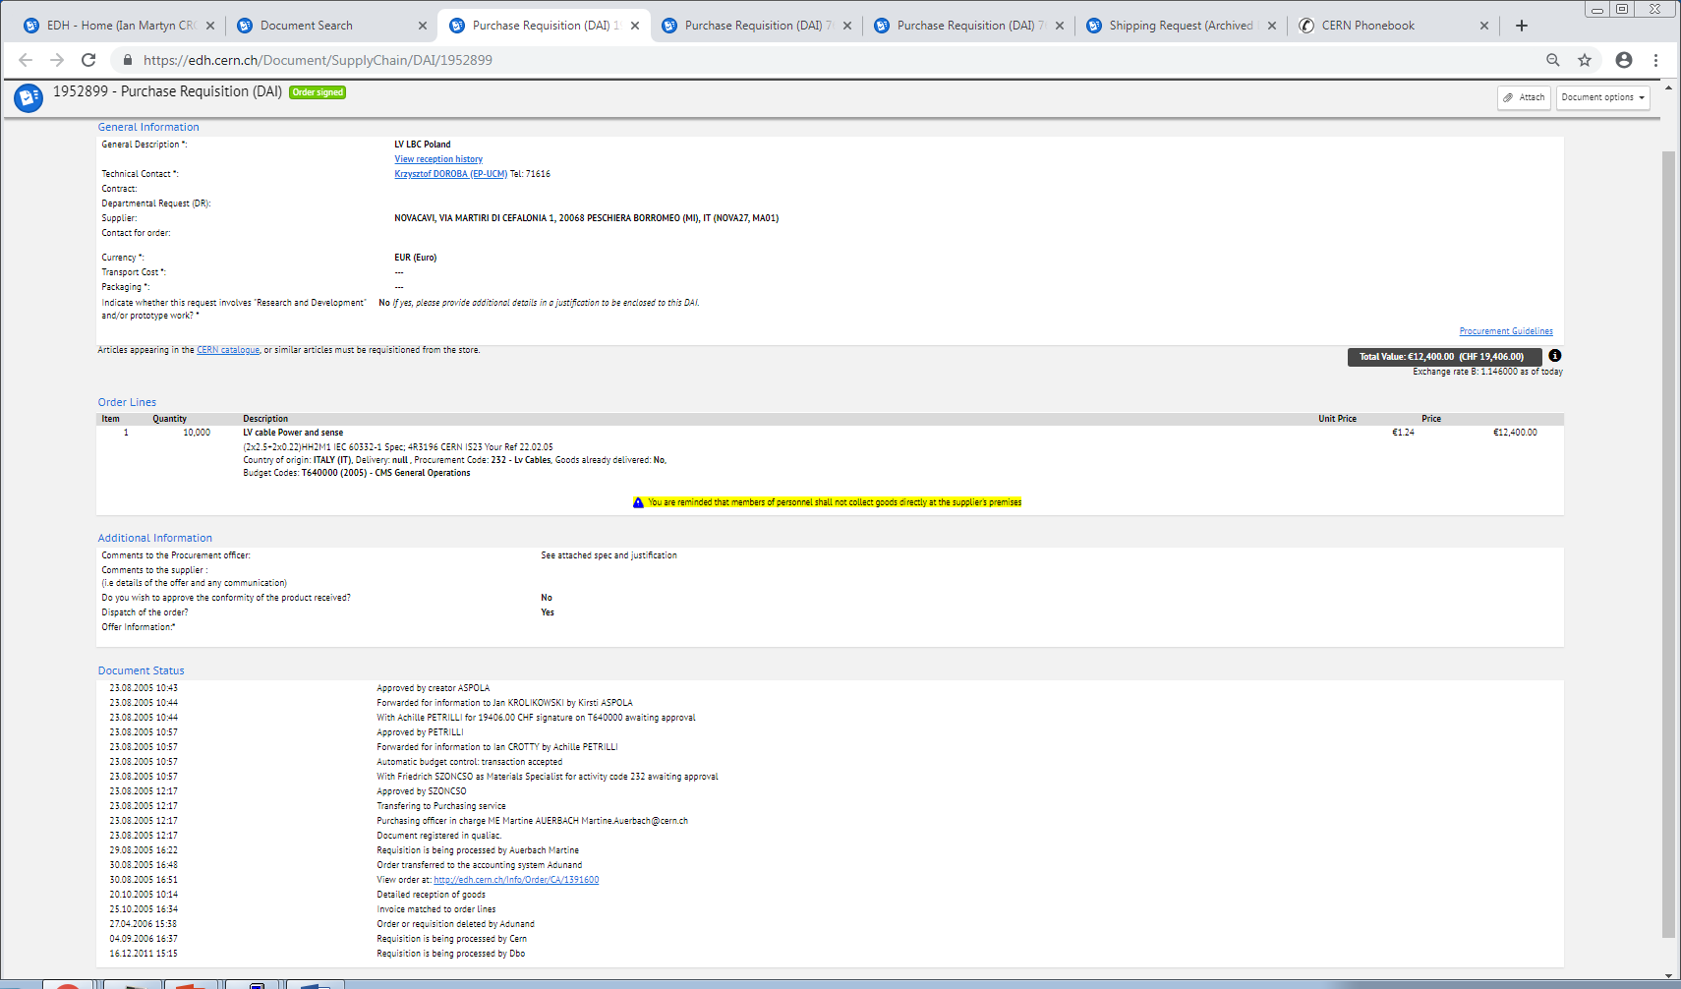

Slide 3
EDH 1952899
IEC 60332-1
Spec 4R3196 CERN IS23

Slide 5
LV cable Power and sense 10000m €1.24 €12,400.00
(2x2.5+2x0.22)HH2M1 IEC 60332-1 Spec; 4R3196 CERN IS23 Your Ref 22.02.05
Order CA 1391600 (1)
Technical contact K. DOROBA (EP-UCM) Tel: 71616
Commercial contact L. ABEL (IPT-PI-AT) Tel: 79561
Supplier contact NOVACAVI SPA
View profile
Document in EDH 1952899
Purchase order CA 1391600
Requ.: 1952899
Code T640000
Supplier NOVA27
Geneva the 29-08-2005
Technical contact NOVACAVI SPA
Dr. K. DOROBA Tel: 767 1616 Via Martiri di Cefalonia, 1
PH-UCM I-20068 PESCHIERA BORROMEO
Commercial contact
M. L. ABEL Tel: 767 9561
FI-PI-EXP Fax: 767 7530

Slide 6
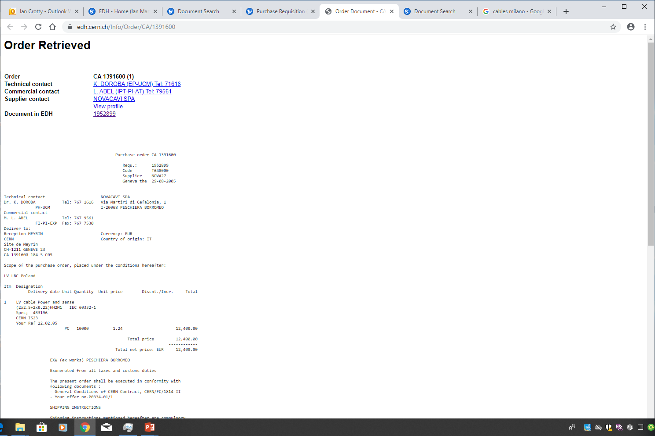

Slide 7
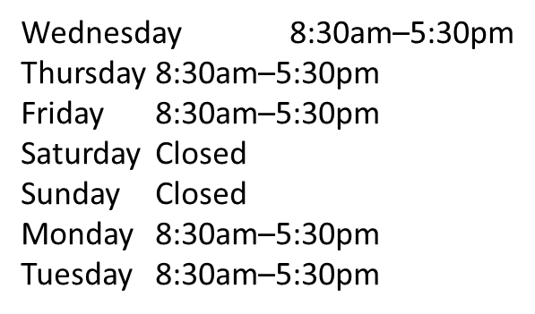
Novacavi
Address: Via Martiri di Cefalonia, 1, 20068 Peschiera Borromeo MI, Milan, Italy
Hours:
info@novacavi.it
Phone: +39 02 553 8321
Fax (+39) 02.5472354
5 Km South East from Milan
Tangenziale Est Linate exit – Km. 2
2 Km from Linate Airport
70 Km from Malpensa Airport
G.P.S.
N 45° 25’ 57,8’’
E 9° 17’ 17,7’’

Slide 8
Average length = 20m
18 cables per station
4 stations
72 cables x 20 m = 1440m
Stock in 904 = 540m
Need to order = 1km

Slide 9
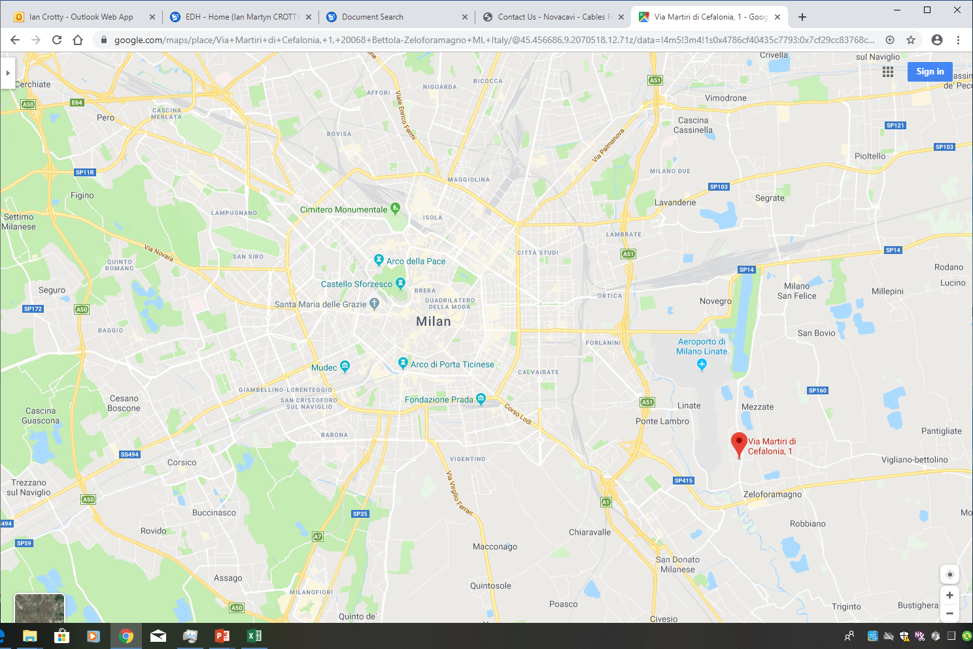

Slide 10
