Slide 1
HV(8kV) ECL “1” Generation
Ian
13 Aug 2025

Slide 2
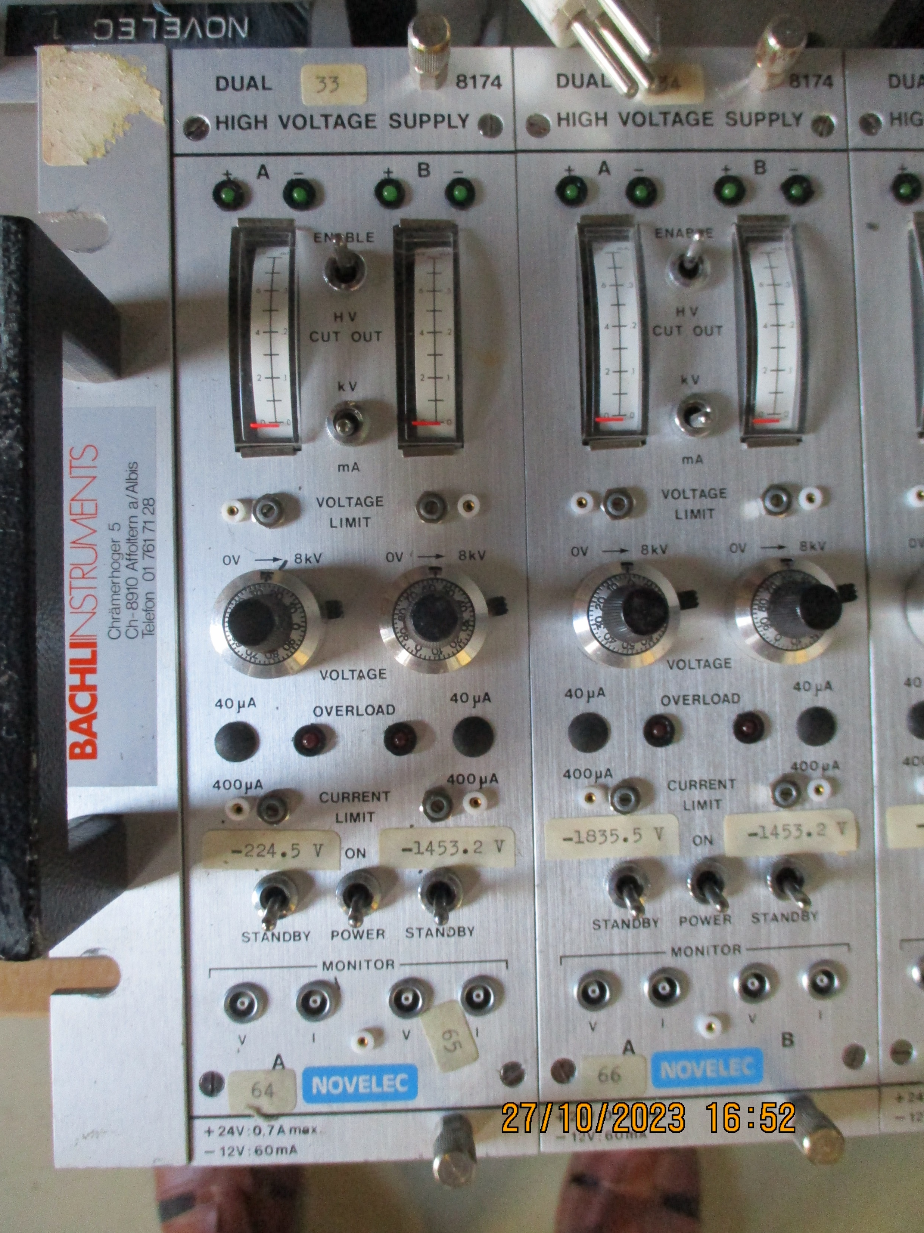
HV module photos

Slide 3
Sali Dapi
His V. divider version in a NIM bin

Slide 4
Sali ‘s version of the instructions for these intriguing modules

Slide 5
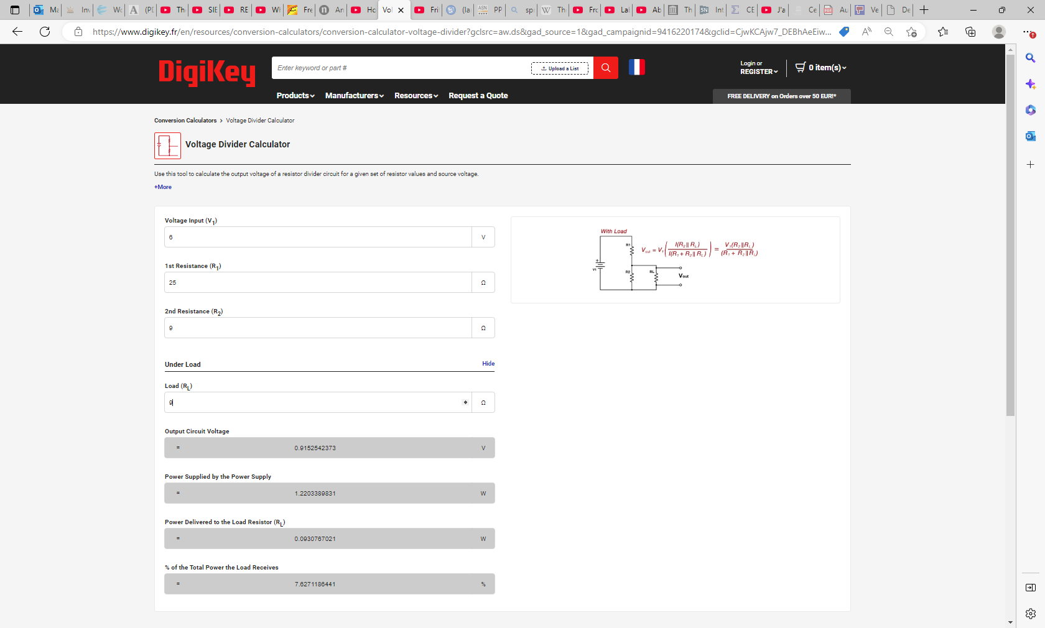
Voltage Regulator Calculator
Voltage Divider Conversion Calculator | DigiKey

Slide 6
Voltage regulator

Slide 7
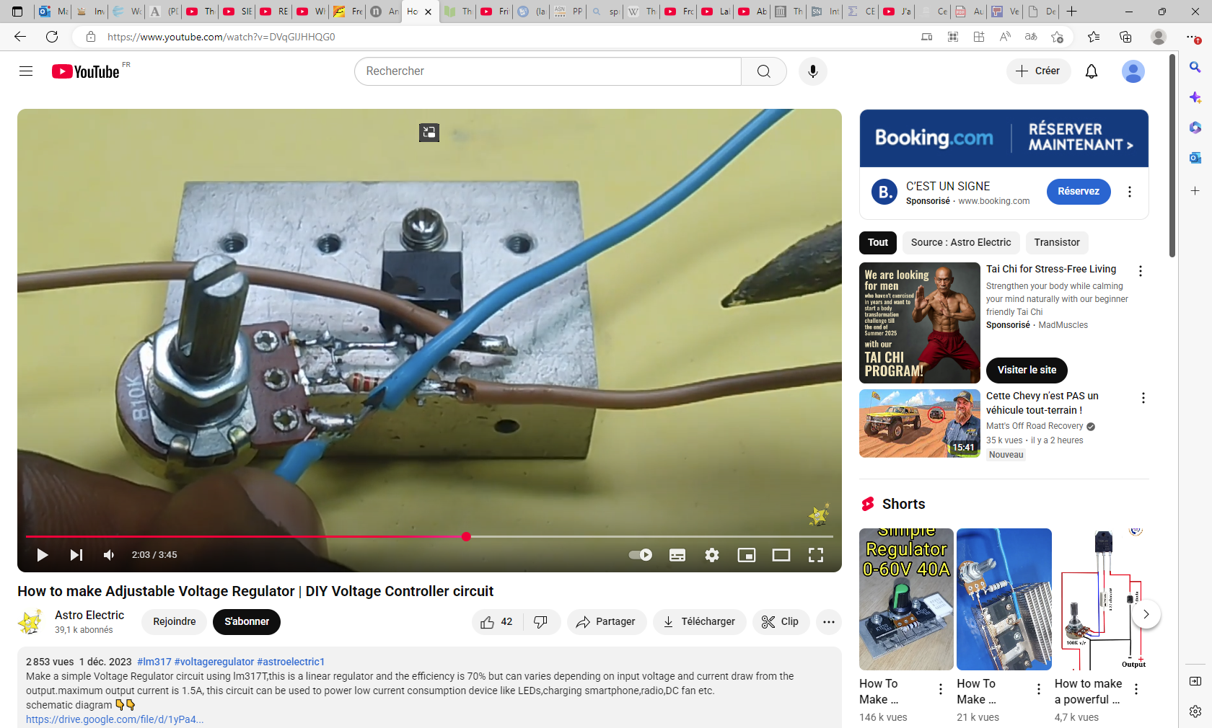
https://www.youtube.com/watch?v=DVqGlJHHQG0

Slide 8
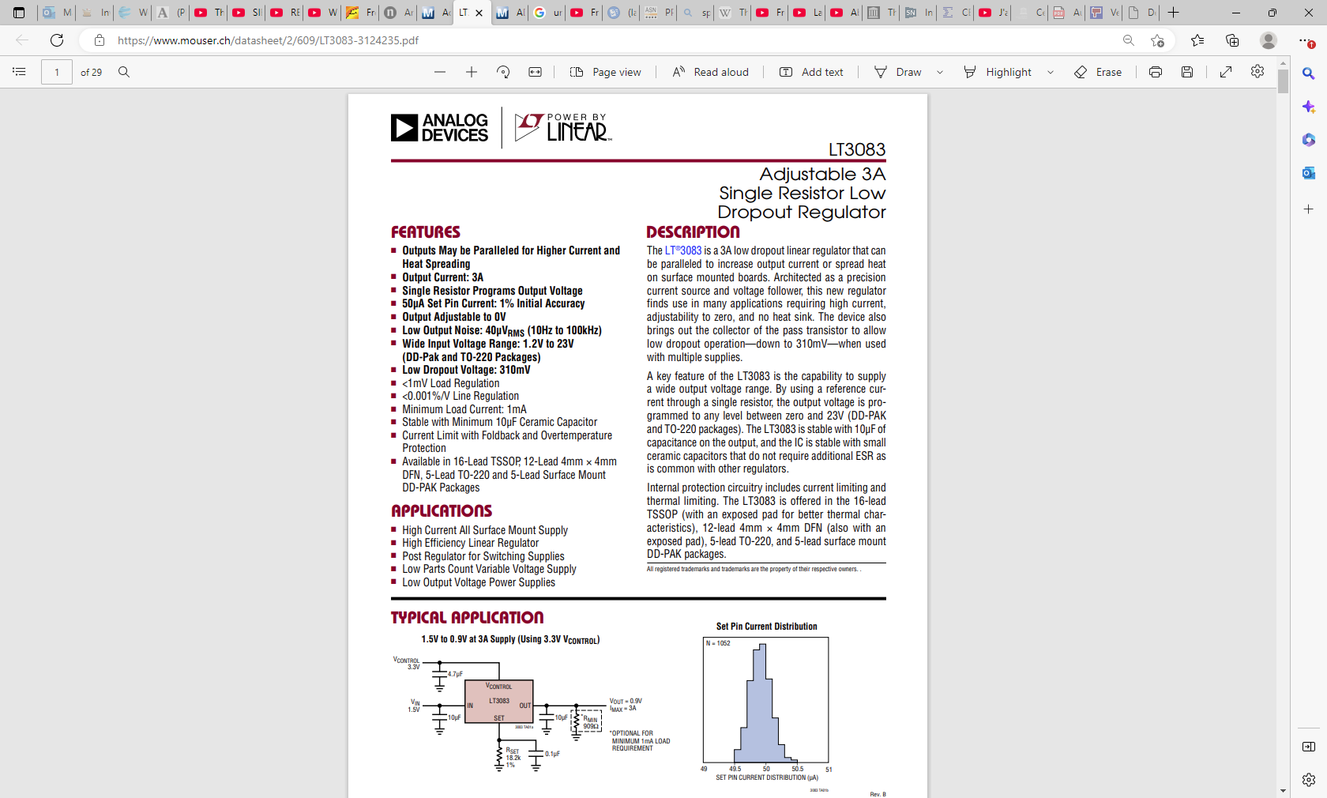
https://www.mouser.ch/datasheet/2/609/LT3083-3124235.pdf

Slide 9
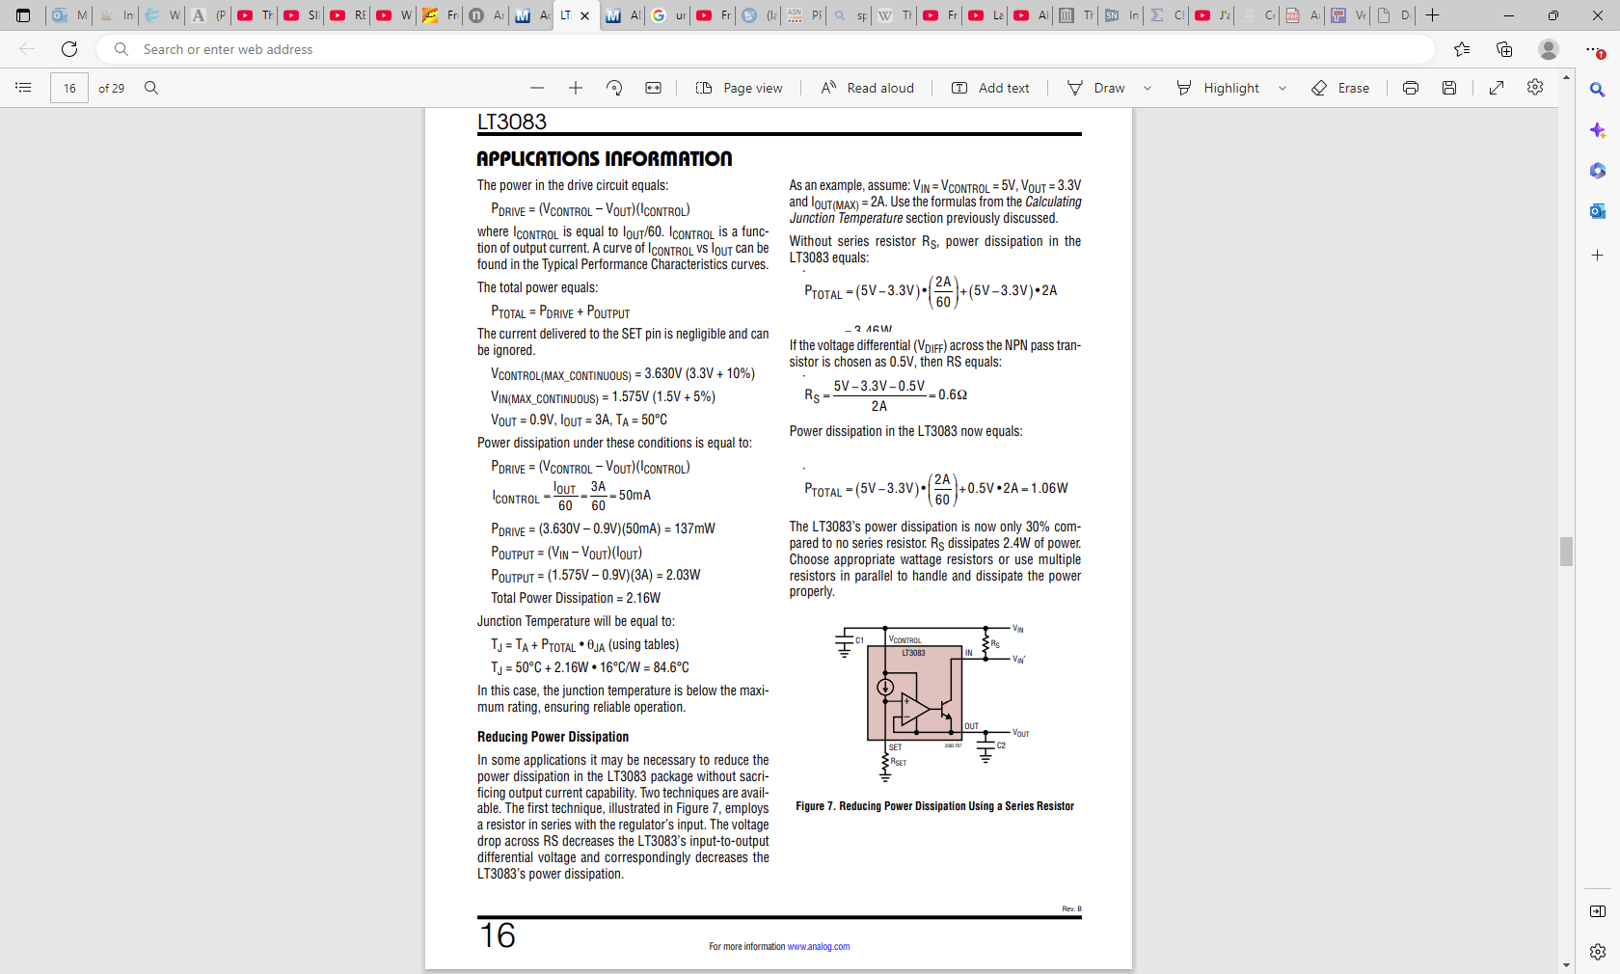

Slide 10
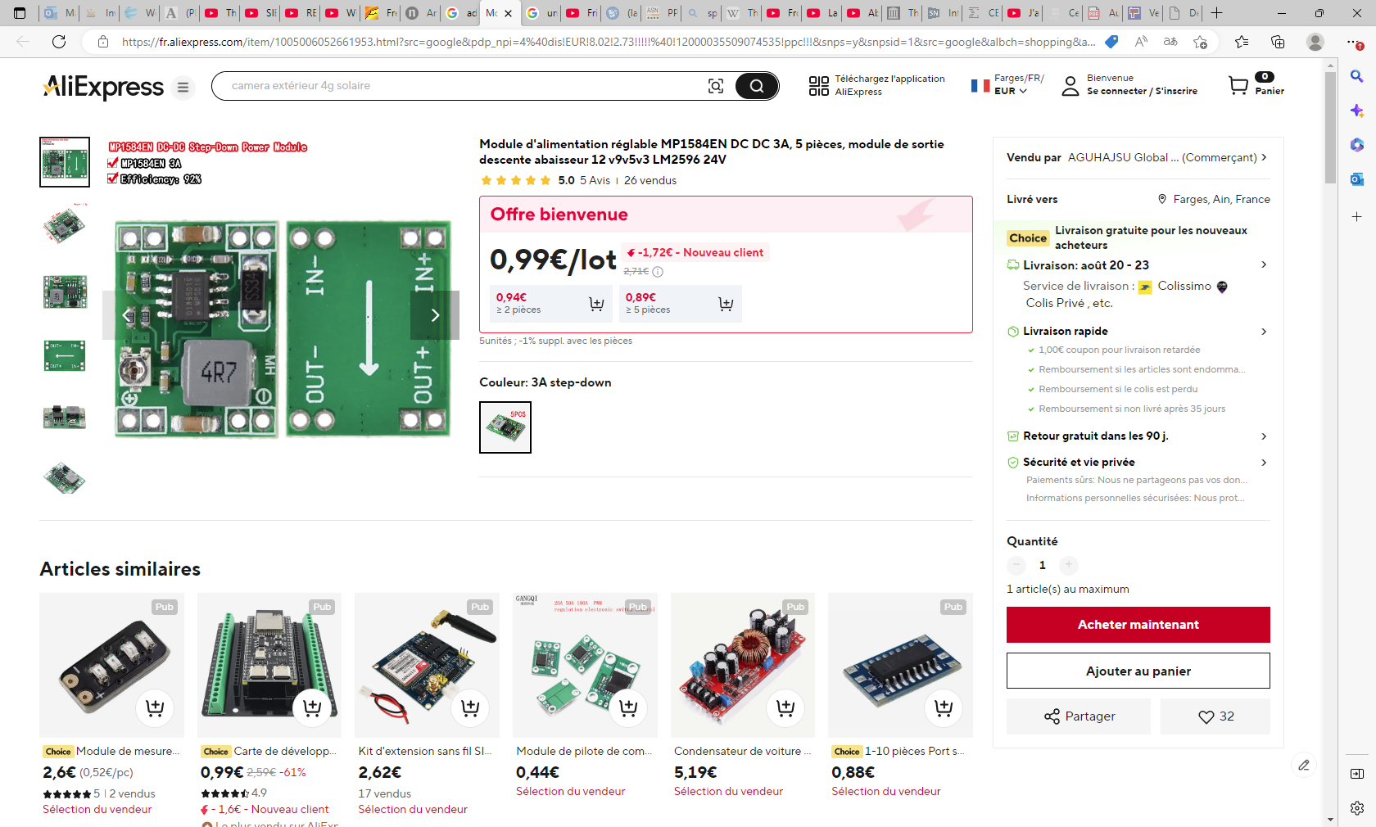
Module d'alimentation réglable MP1584EN DC DC 3A, 5 pièces, module de sortie descente abaisseur 12 v9v5v3 LM2596 24V - AliExpress 502

Slide 11
