Slide 1
RPC Fiber Lab Ethernet Cable Connection and installation
6/8/2019

Slide 2
Objective:
Connecting Ethernet Cable cat5 with fiche modular using crimping tool and connected from the passage behind the RPC fiber lab to the fiber lab.

Slide 3
Preparing steps:
1- making a plan of connecting the Ethernet cable by measuring the length of the cable need, the place of passing to the fiber lab and material request.
2- connecting two Ethernet cable cat5 by fiche modular cat6.
3- making a hole in the fiber lab wall and in the cable protection cover.
4- making cable suspension.
5-connect the cable to the computer and contact to the CERN service dick.

Slide 4
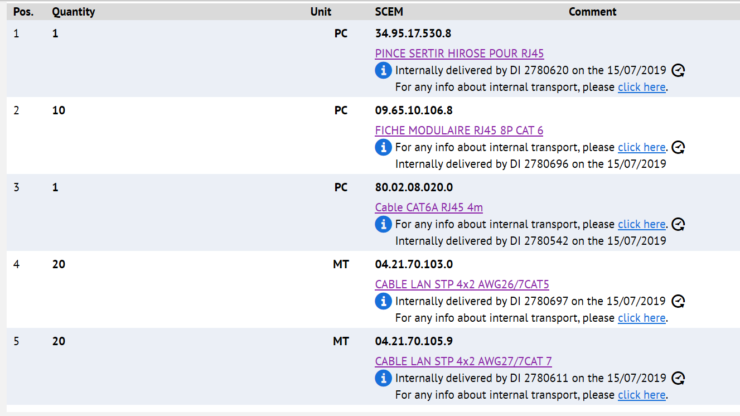
Material request

Slide 5
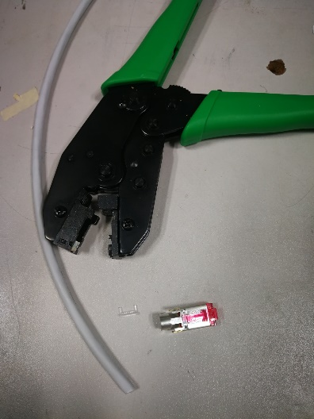
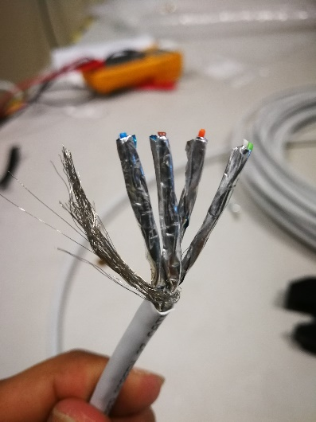
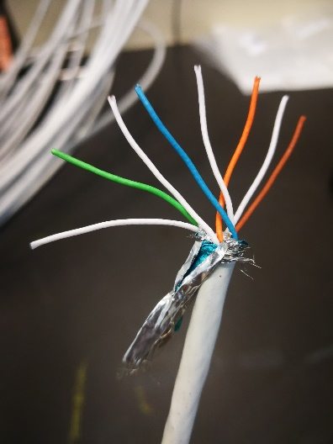
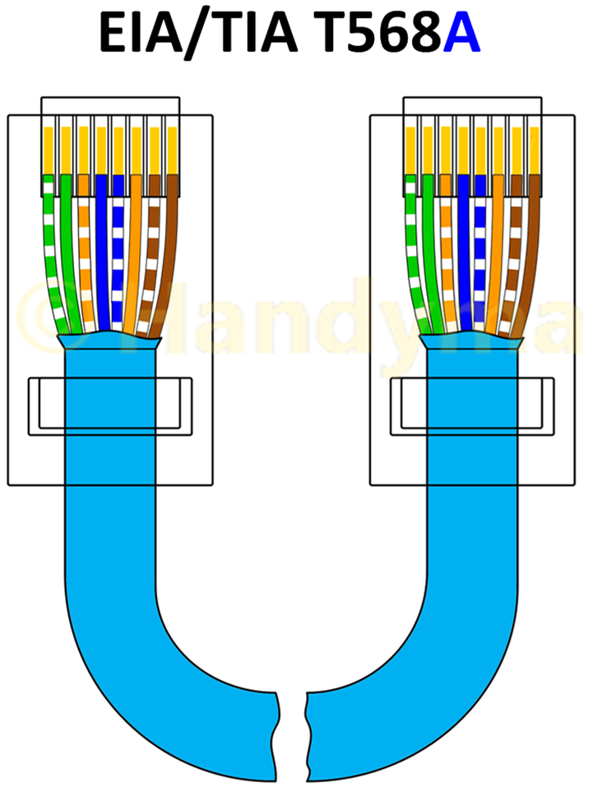
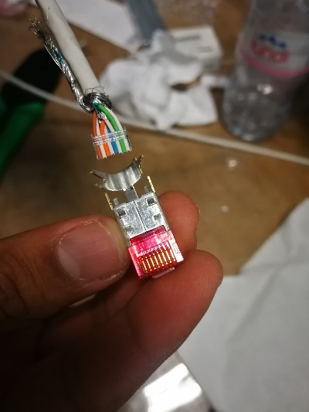
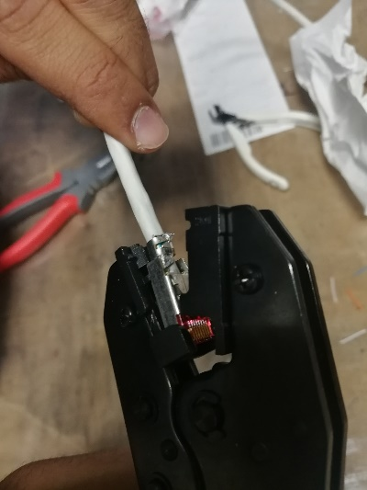
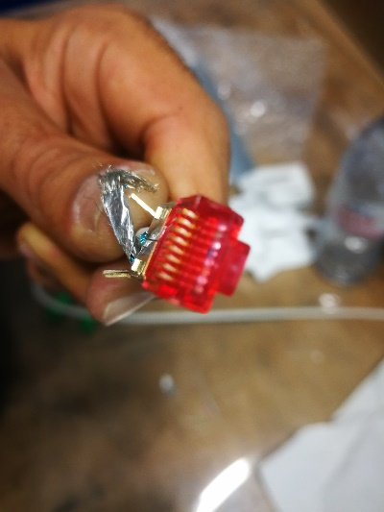
Ethernet cable connection by fiche modular crimp
1
2
3
4
1- 20m Ethernet cable cat5, RJ45 crimping tool and MODULAR 8P CAT 6 PLUG
2- Cutting and removing the cable sheet. There are 6 cables inside with different colures protected by aluminum foil sheet.
3-Put the 6 cables in order by colure. There are tow ways of colure’s order depending on the application, and we used A connection in both side of the cable
4- Enters the colure’s cables into the linear piece and fit it to be at the end of the modular plug and cut the rest of the cables. Enters the colors cables inside the modular plug with strong push.
5- Check the cable’s conductor appear at the end of the modular plug.
6- Using RJ45 crimping tool to crimp the modular plug.
6
5

Slide 6
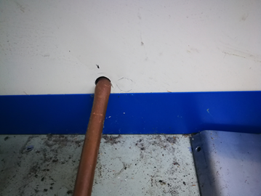
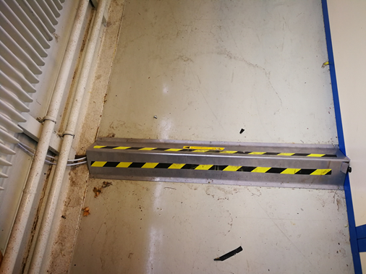
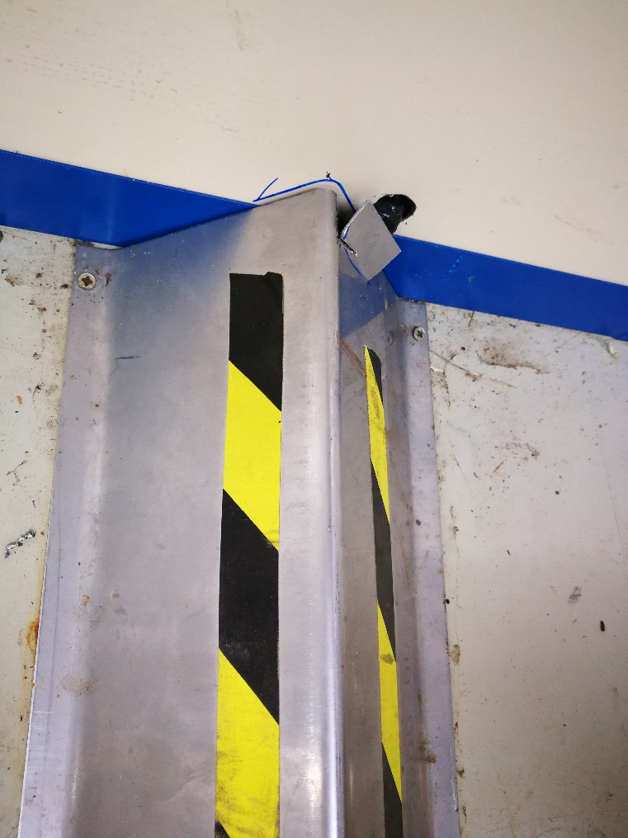
Making a hole in the fiber lab wall near the cases pipe which is protected by steel cover to pass Ethernet cable under this cover. Cut the steel cover and paned it to passing the cable through it.

Slide 7
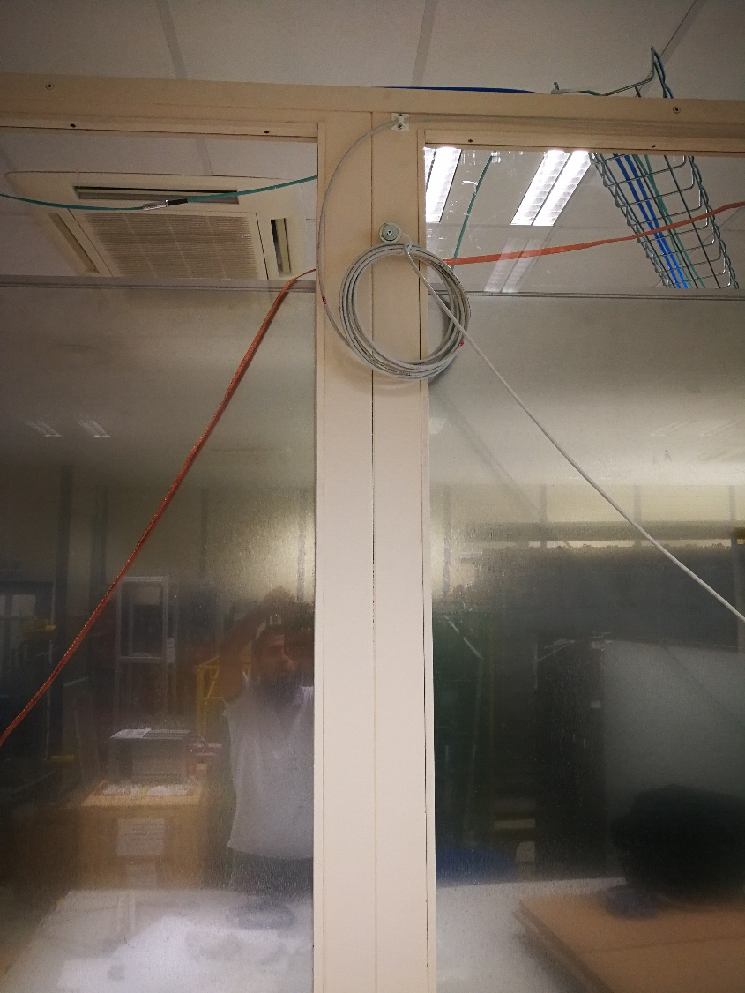
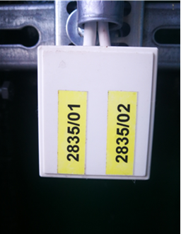
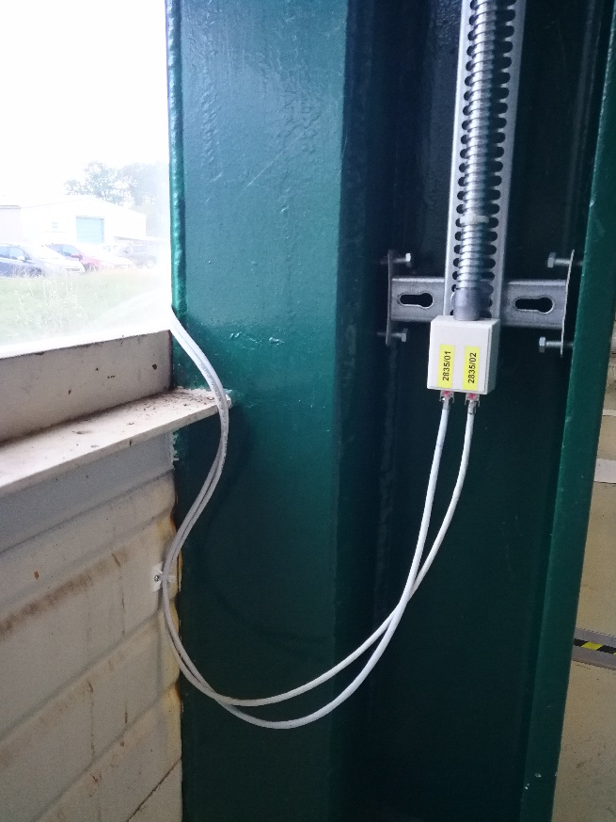
Making cable suspension
Connect the cable to the computer and contact to the CERN service dick.

