Slide 1
Auxiliary Service Chains for YE1.
Existing YE1 chains have an available cross section for services of 3,400cm² per chain, with an occupancy of more than 85%.
An additional service chain is proposed for YE1 detector services (post LS3), essentially for CO₂ cooling. A free cross section of 1000cm² is retained (4x110mm CO₂ vacuum insulated lines, 120cm² for dry-air pipes plus about 400cm² for YN detectors).
The chain is located on the near-side of the UXC5 balconies, at level X3, both (-) & (+) ends. It spans over 10m, to let a full opening of the YE1 disk. A second chain on the far side can be installed if necessary (check interference with survey line).
A patch-panel on the detector towers is foreseen, same X3 level. It would reduce the available space in height for the two electronics racks.

Slide 2
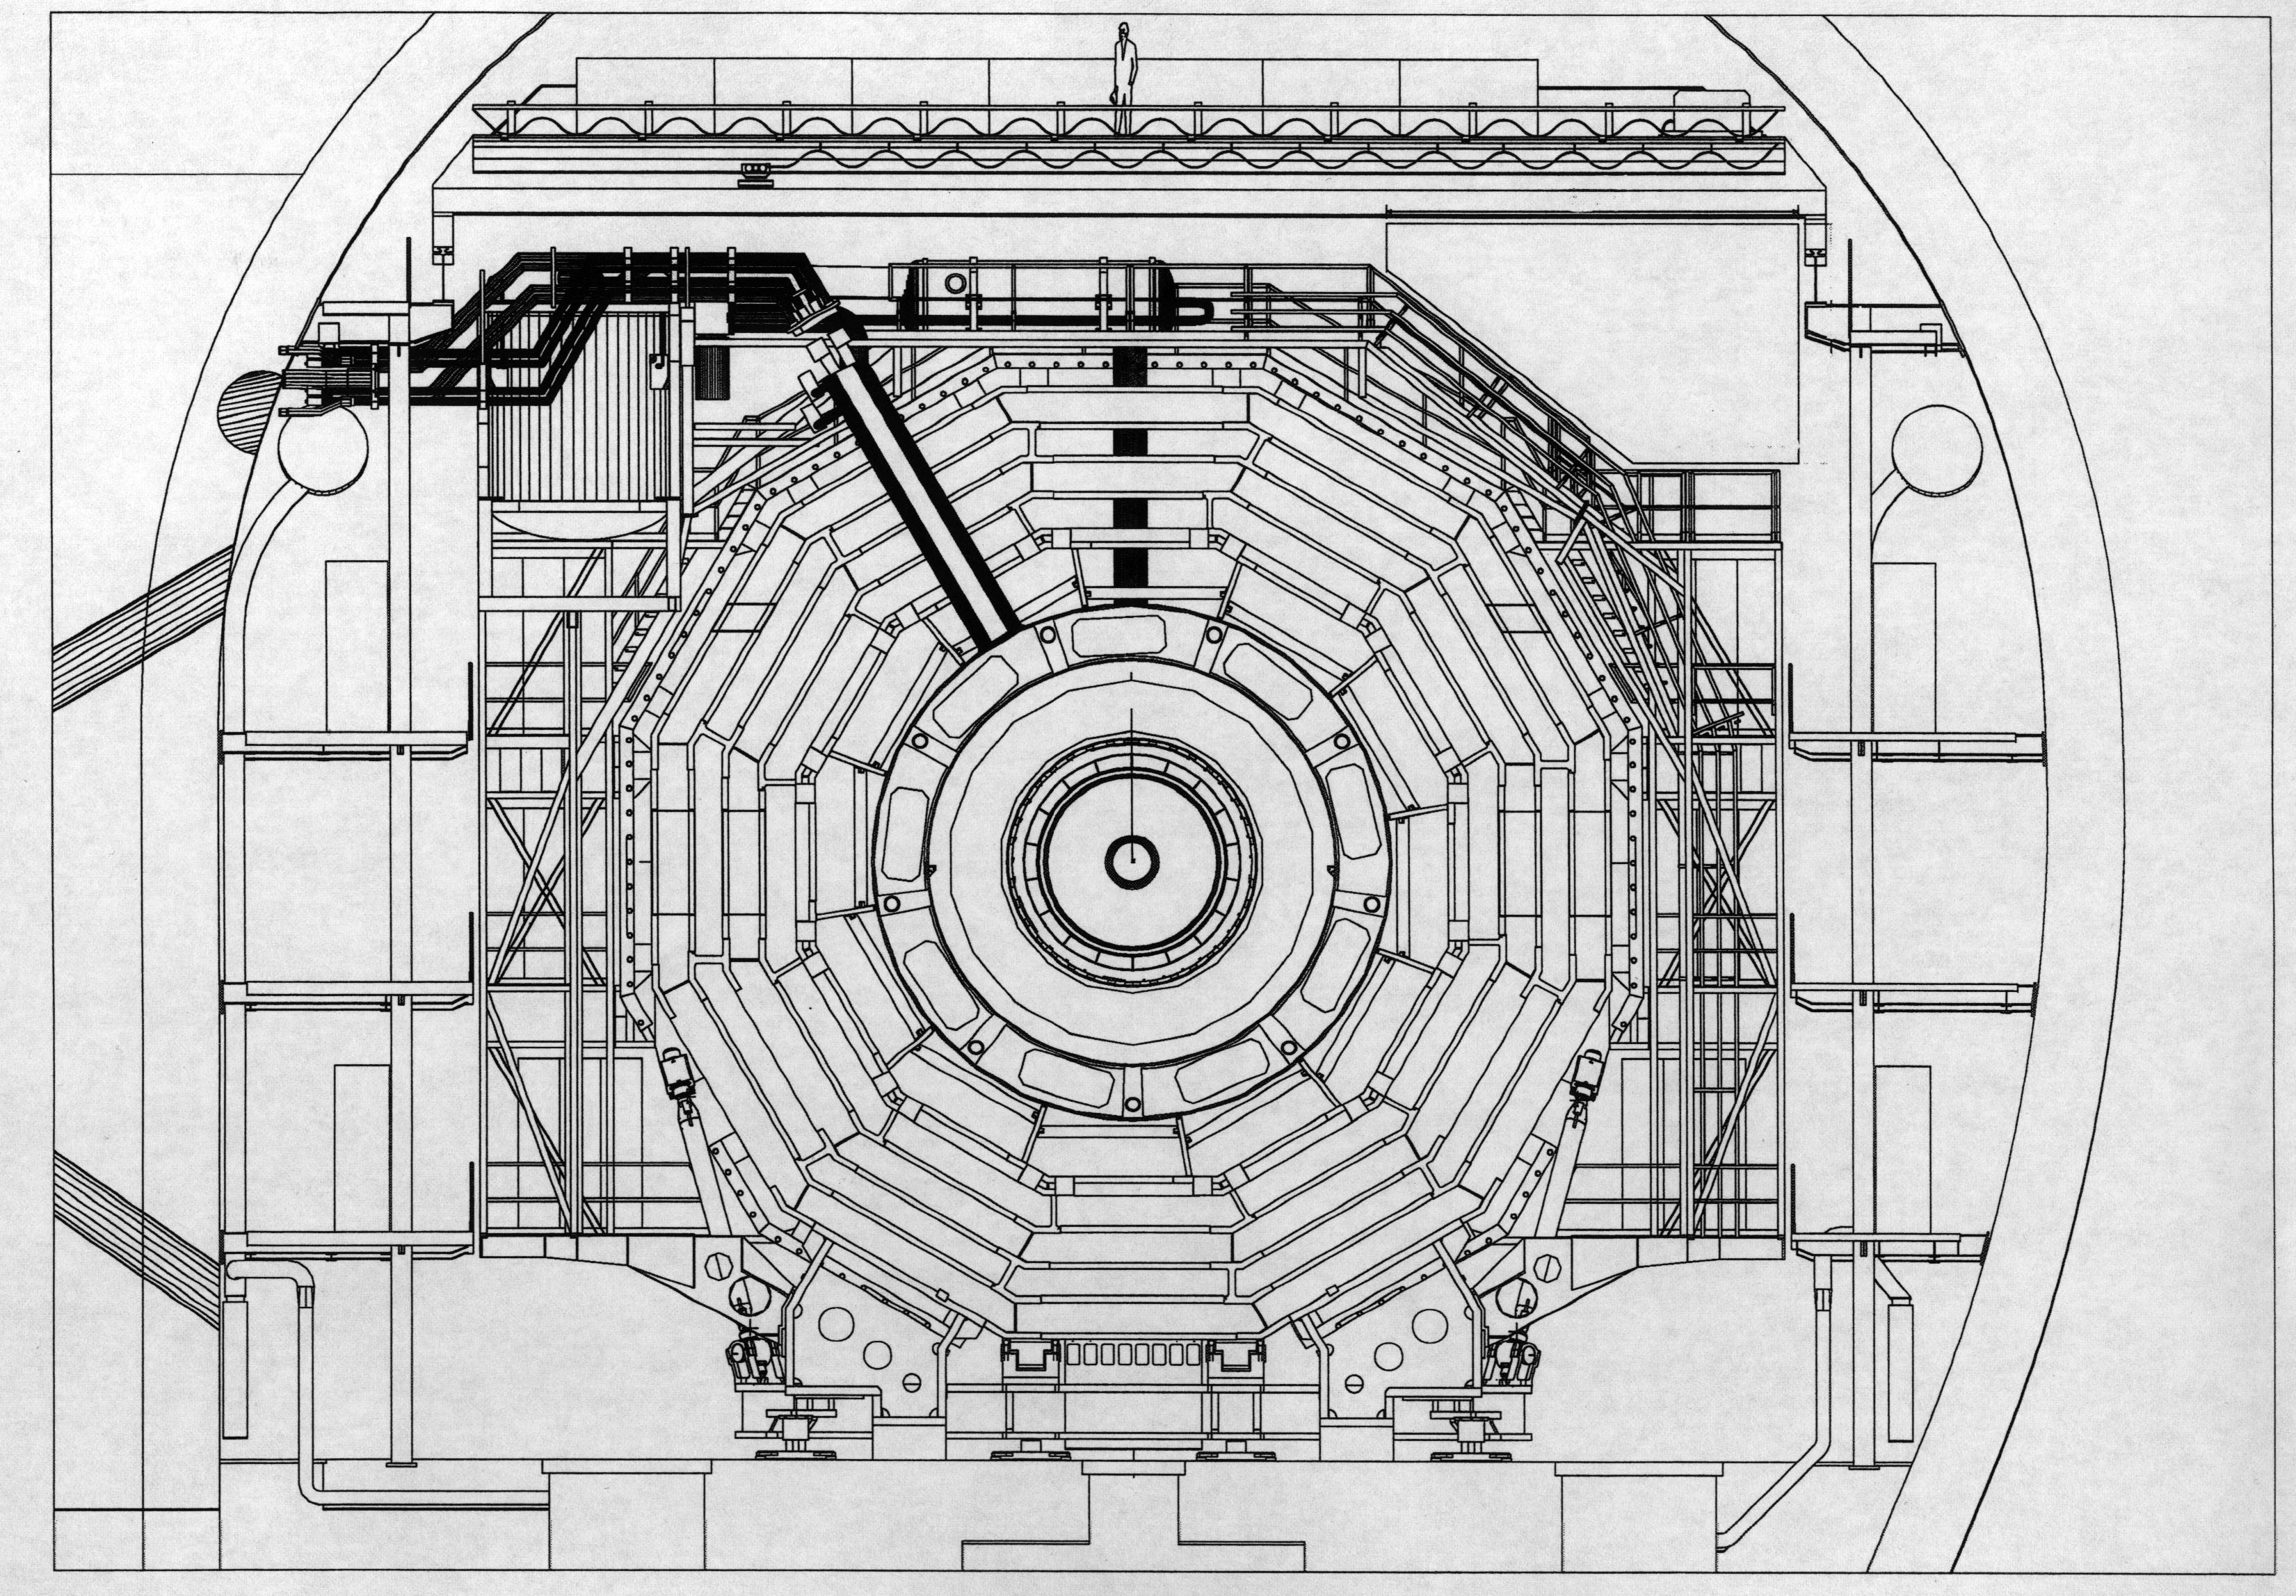
YE1
X4
Patch panel
CO2 piping
NEAR SIDE
X3
X2
Space left
for racks

Slide 3
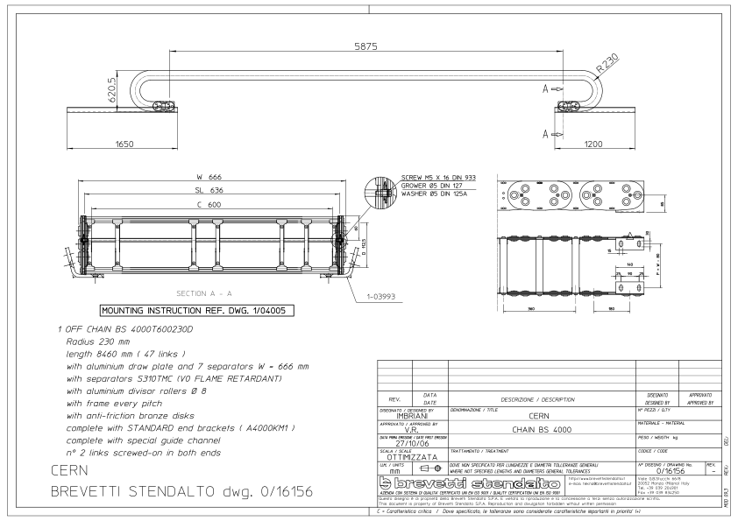
Typical medium size cable chain (YE3 type)

Slide 4
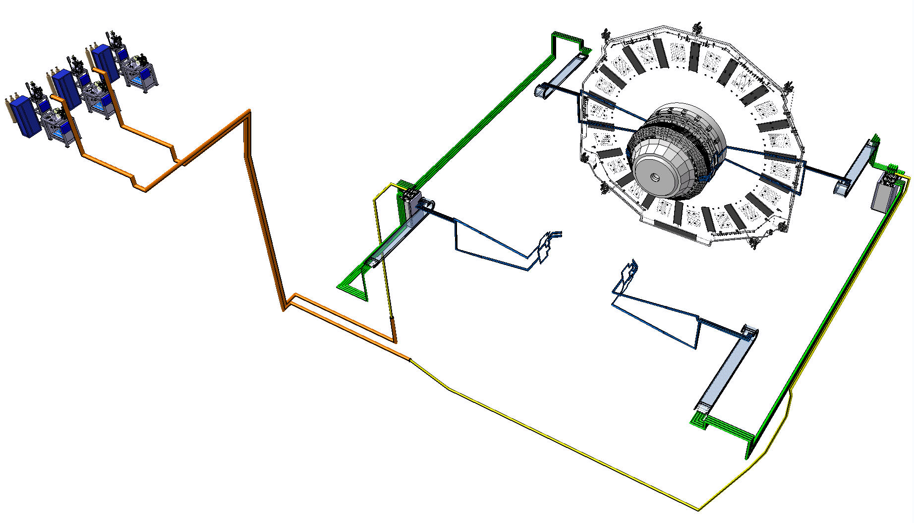
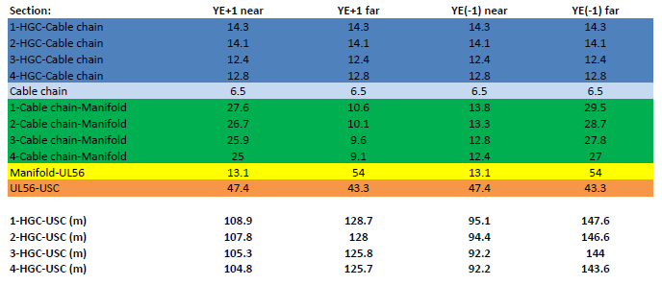
HGC Cooling System
concept
USC
Ex control room
UXC
OD 110 mm
Transfer lines
USC-UXC
Near side
CO2 pipes-balcony
YE+1
Manifold
Cable chains
Manifold
OD 250 mm
HGC
Cable chains
OD 65 mm
YE(-)1
CO2 pipes-balcony
UL 56
Far side
OD 150 mm
X0 level

Slide 5
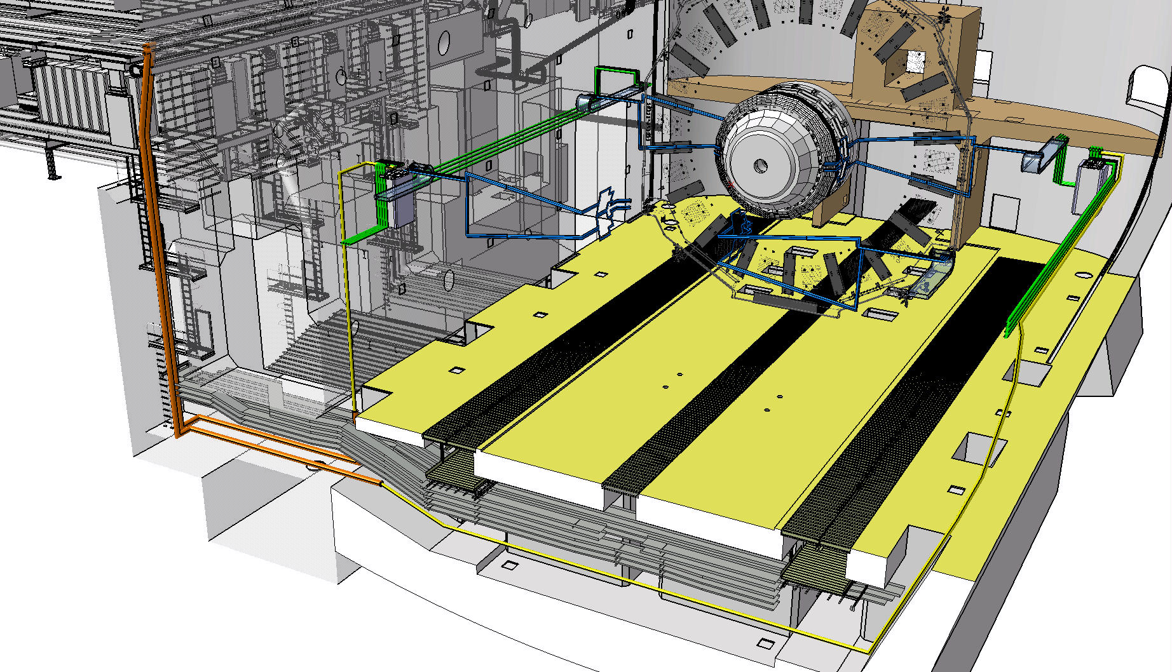
UXC
YE+1
USC
Ex control room
Near side
Far side
UL 56
X0 level

Slide 6
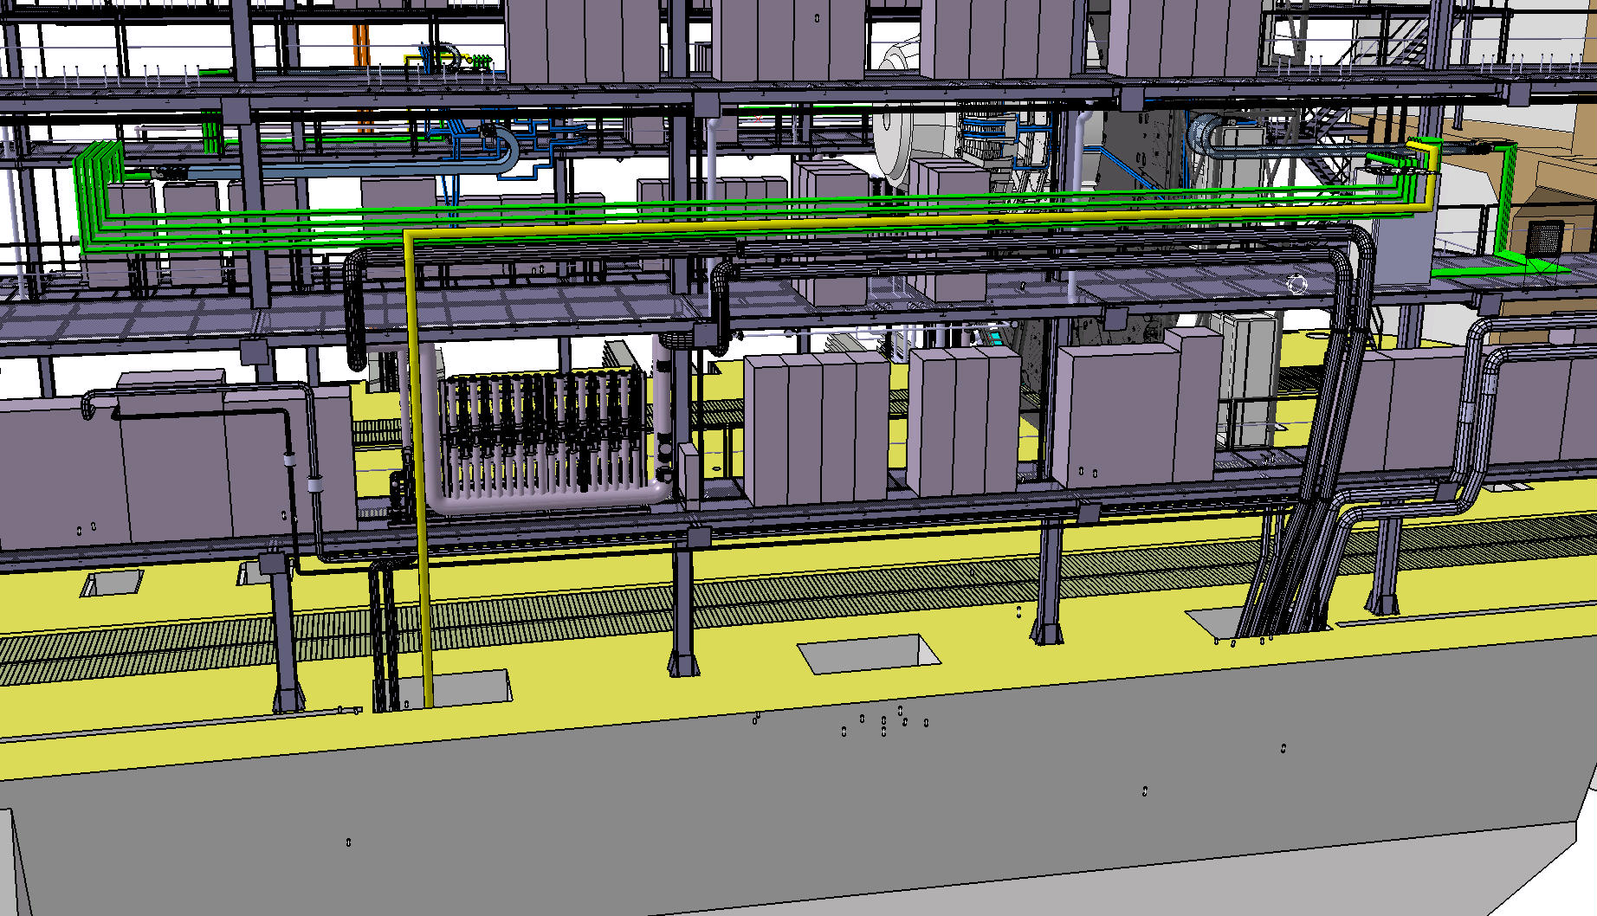
YE(-)1
YE+1
CO2 pipes-balcony
Manifold
UL 56
Far side

Slide 7
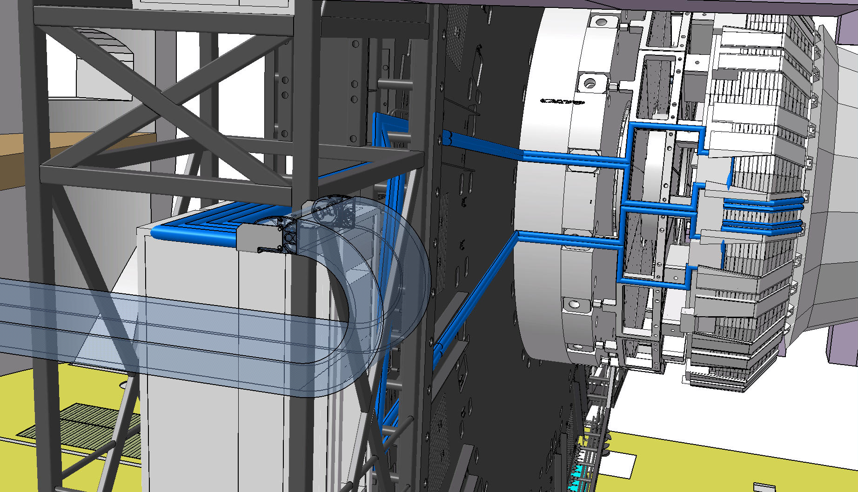
4
3
2
1
HGC
Cable chain
YE+1

