Slide 1
Transmission and Wave length sources
Ian
14 Jan 2020

Slide 3
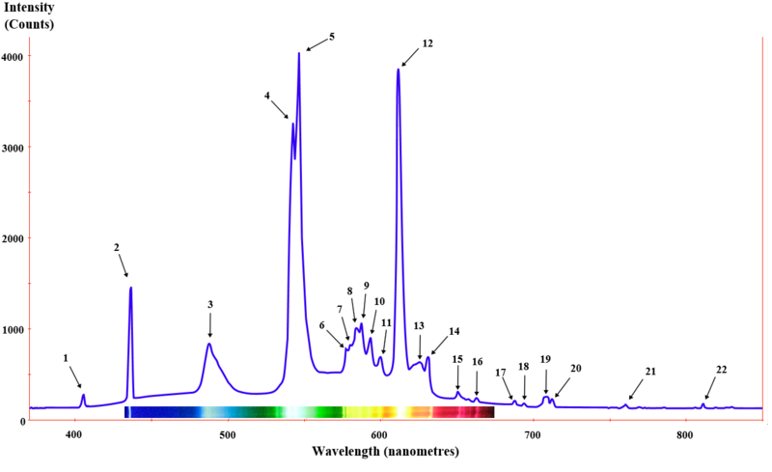
https://en.wikipedia.org/wiki/Fluorescent_lamp
https://en.wikipedia.org/wiki/File:Fluorescent_lighting_spectrum_peaks_labeled_with_colored_peaks_added.png

Slide 4
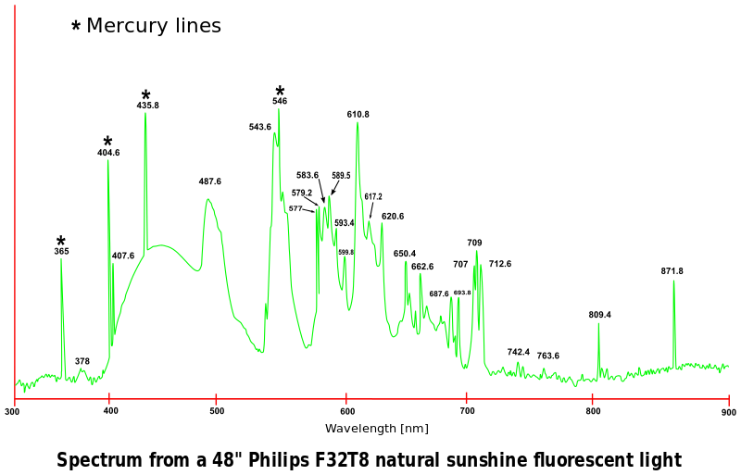
https://en.wikipedia.org/wiki/File:Spectra-Philips_32T8_natural_sunshine_fluorescent_light.svg

Slide 5
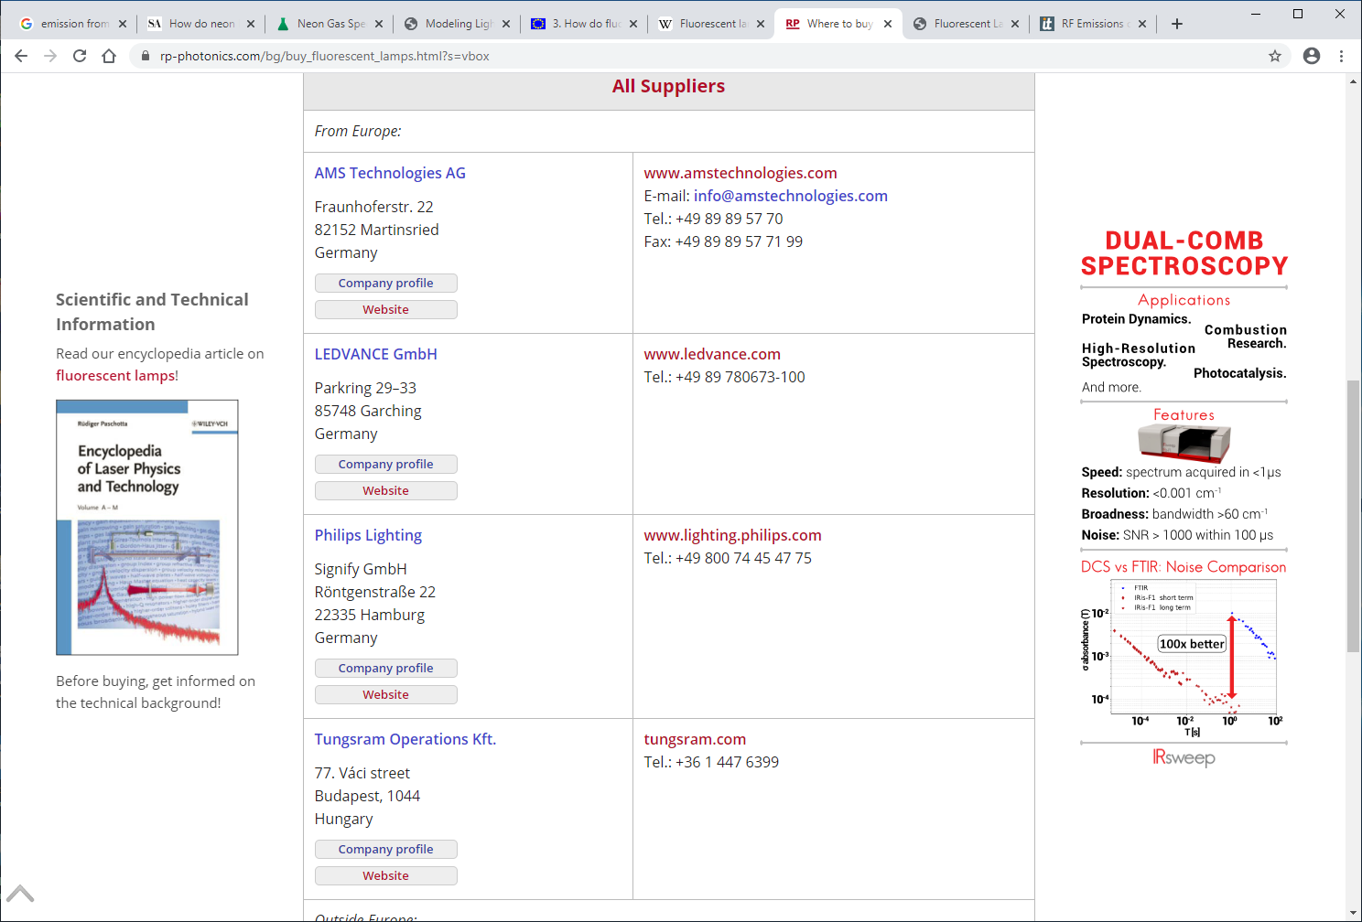
https://www.rp-photonics.com/bg/buy_fluorescent_lamps.html?s=vbox

