Slide 1
Transparency and homogeneity of HPL
A quick qualitative look
Ian with notes and transmission spectrum from Paolo Vitulo
6 Jan 2019

Slide 2
How did it come about to look at the transparency of HPL panels ?
The sun is low in the winter and in this area with the Jura mountains in the West it is rare to have the sun rays so low.
By chance it was observed that a piece of HPL left outside was not completely opaque to the sun light even in the evening an hour or so before sun set.
What follows are some different views of the same panel, 1656mm x 902mm. That appear to be a type 2 of perhaps RE4 SM production
The photos are all time stamped to help understand any changing light conditions.

Slide 3
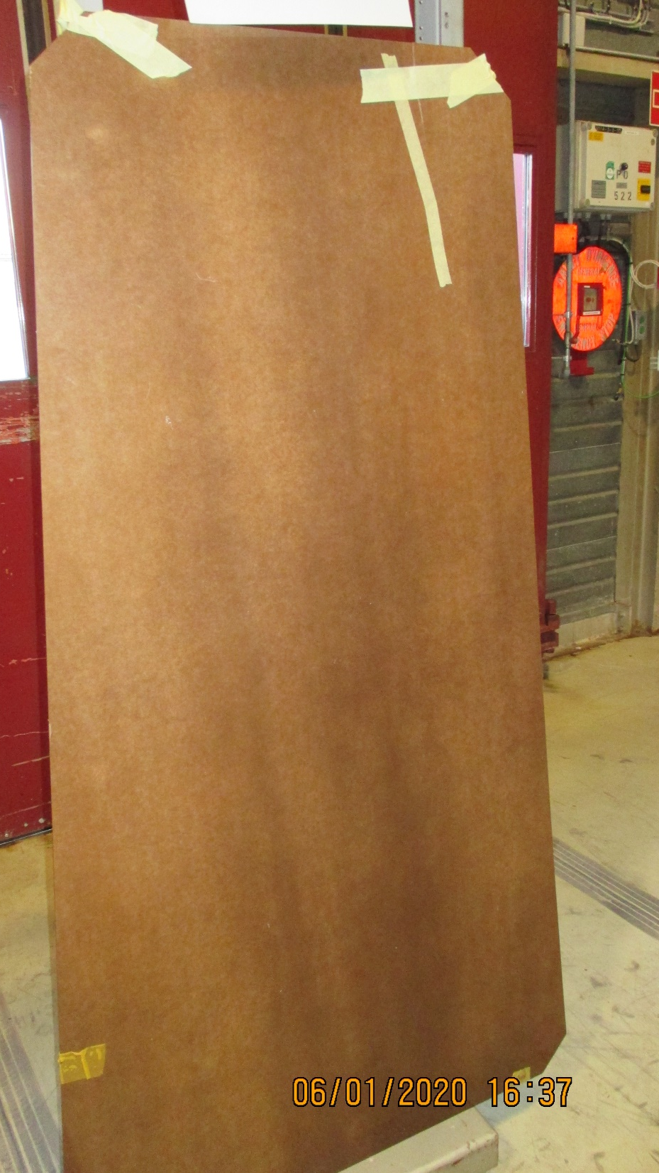
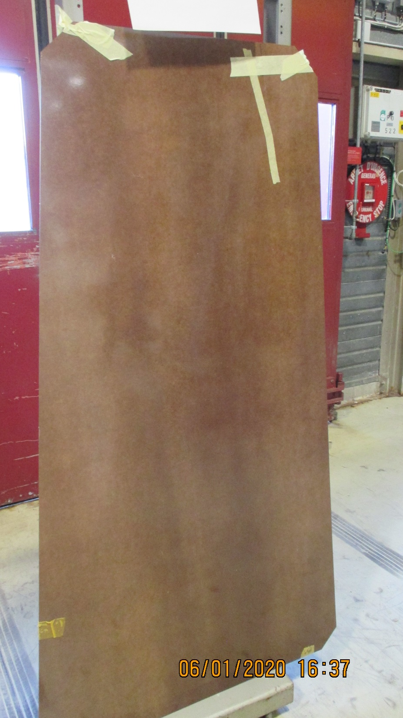
Inside
Lighting is important.
On the left is a photo of the HPL panel taken with flash
On the right is the same panel with no flash
There are 2 vertical (or longitudinal) streaks on the surface that are darker than the rest
Notice the yellow tape in the bottom LH corner.

Slide 4
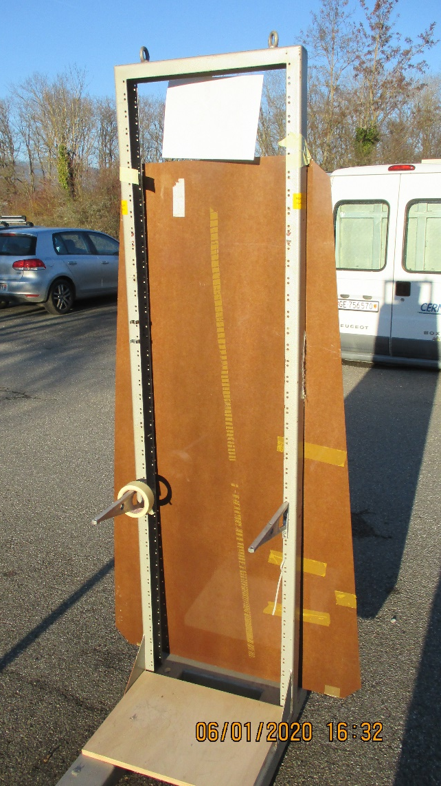
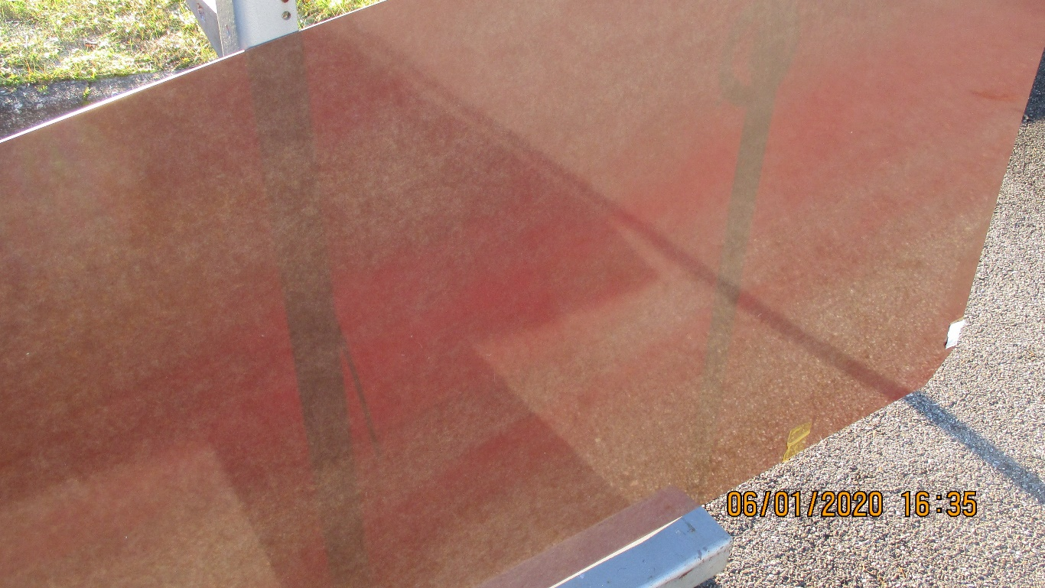
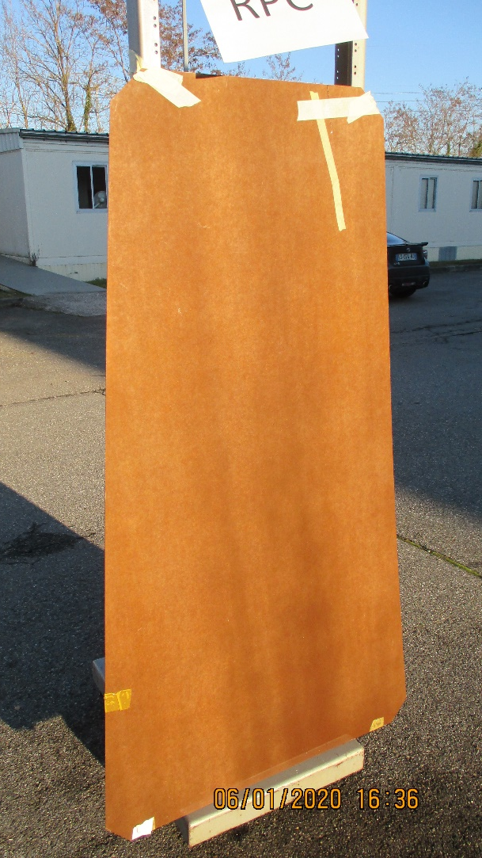
Outside.
The panel is exposed to the sun.
Again the two vertical streaks but perhaps less visible.
Rack uprights
The panel has been turned about its horizontal transverse axis and is seen from “behind” looking towards the sun.
Here the two vertical members of the rack are quite visible through the HPL.

Slide 5
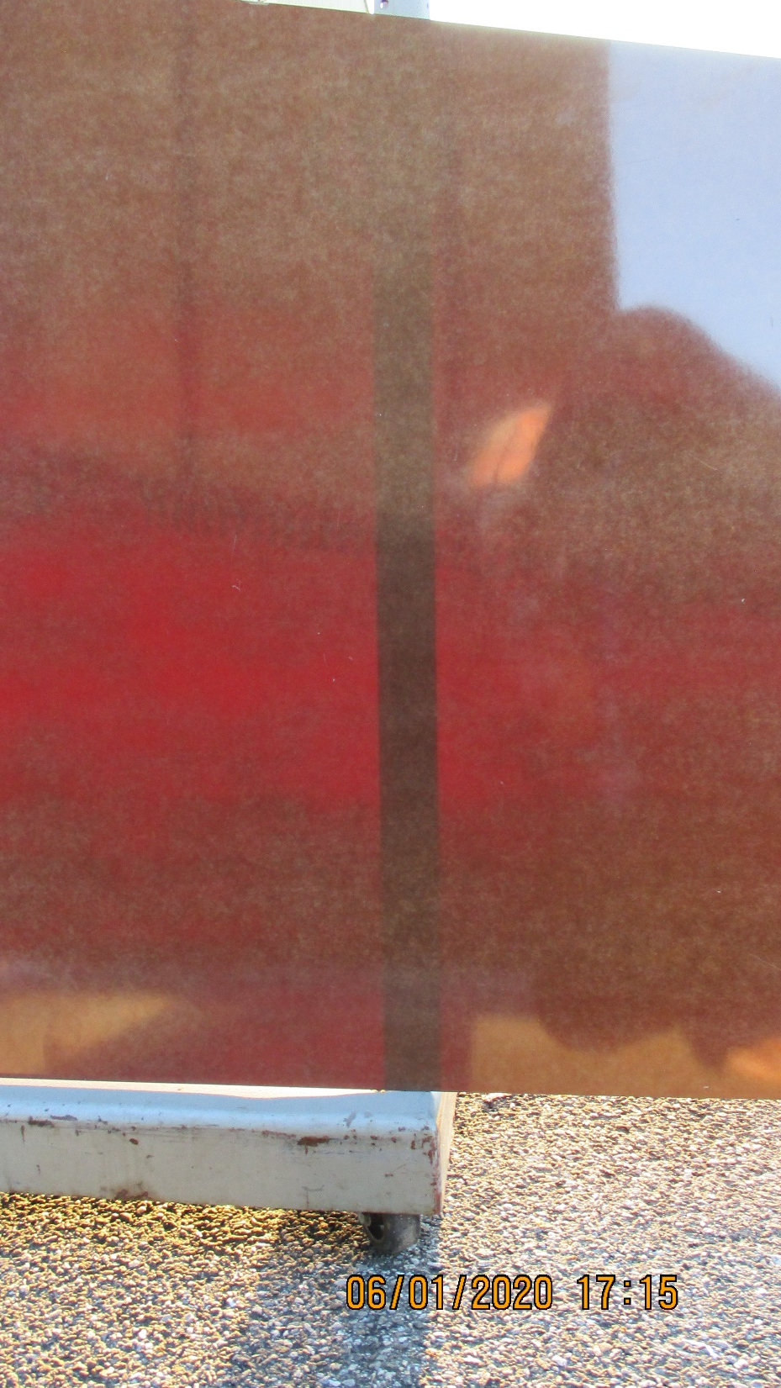
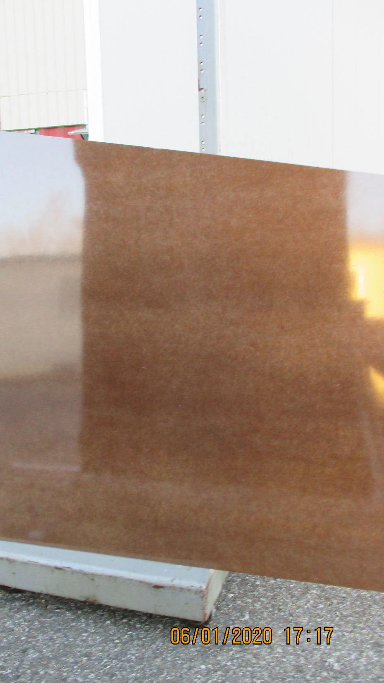
Again looking towards the sun.
On the left the panel is exposed and the two streaks, now horizontal are visible.
On the right the panel is outside but in the shadow of the building. Again the two horizontal streaks are visible with lighter areas on each side and between.
Red (LHS) corresponds to dark (RHS)

Slide 6
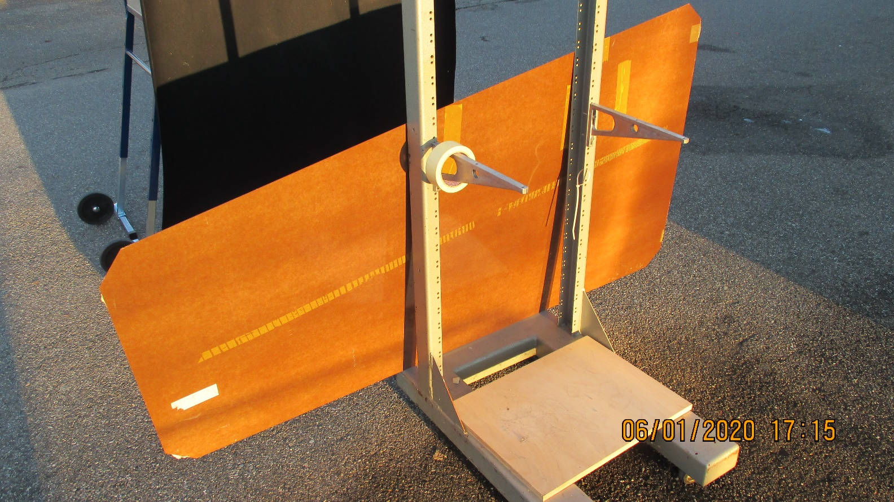
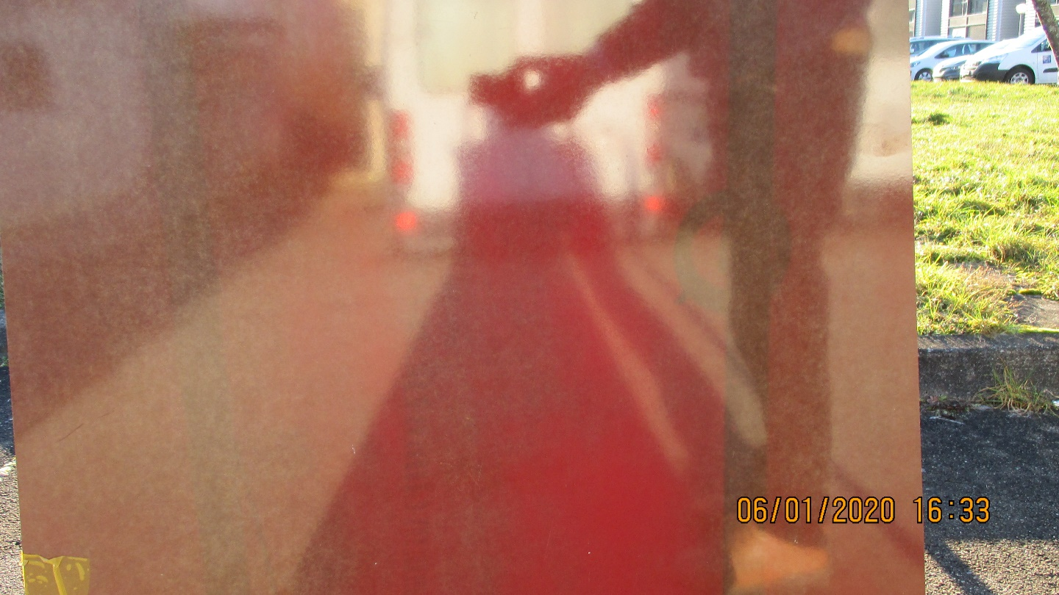
Reflections from the HPL , due to their high gloss, pose a problem in obtaining photos that clearly show the different colour grades across the panel .
A black cloth was hung downstream of the HPL in an attempt to cut out reflections but was insufficient in size and anyway the camera and operator are still there !

Slide 7
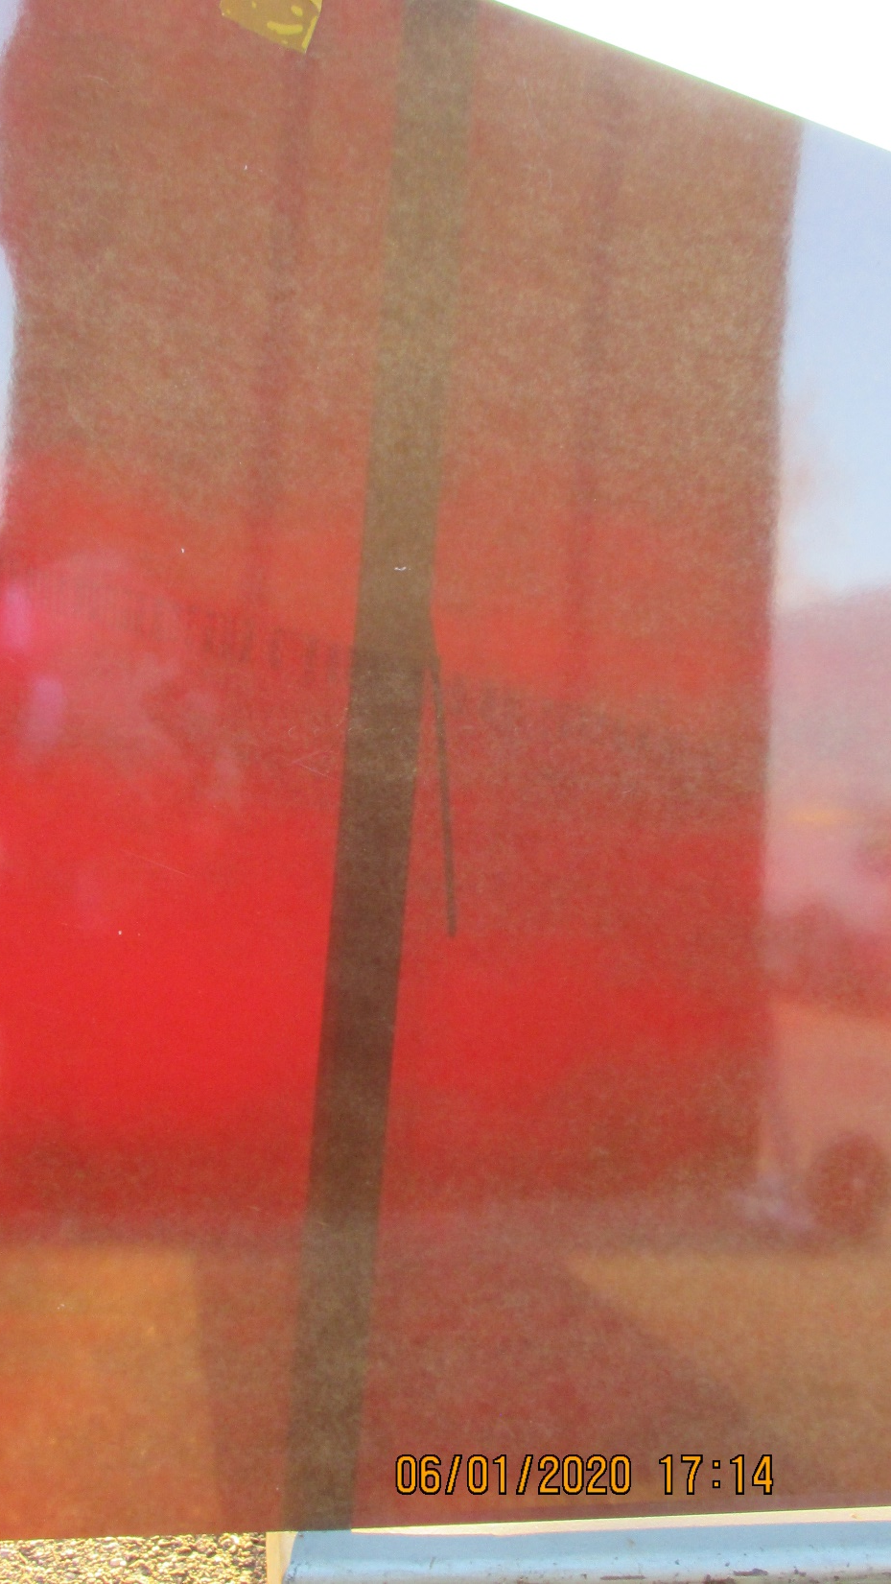
The rack frame is visible as a vertical dark line.
The yellow tape is in the top left corner, mentioned earlier.
The two red streaks are horizontal (longitudinal).
Interestingly the lighter areas are also visible, normally they appear more predominantly with incident light.
The reflection of the black cloth material is indicated.
Black cloth material

Slide 8
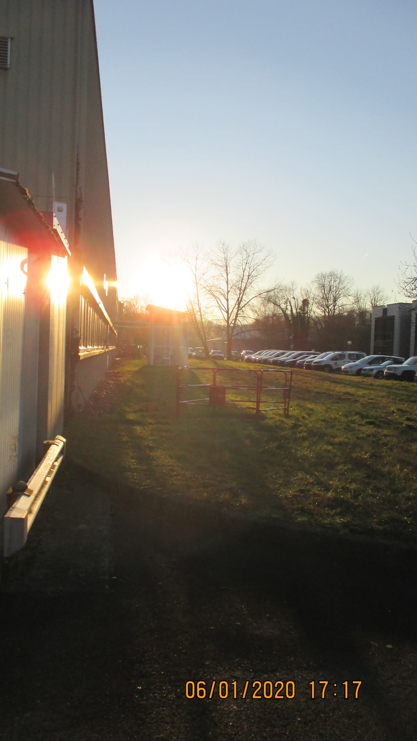
The sun has almost gone below the horizon

Slide 9
Some questions………
What does the redness in the exposed panel represent ? Is it more/excess Phenolic resin ?
Colour intensity is an “X-ray” view through the panel indicating different composition ?
It is not only the surface that shows differences of hue.
The lighter areas of the unexposed panel are indicating a higher paper cellulose concentration wrt the phenolic ?
If the above is true then how can this be explained ? The sheets of kraft paper come through a bath of phenolic resin and so could have some parallel patterns along the direction of production, is this the case ?
Is this a tool to look for homogeneity across the panel ?
The resistivity should be measured to look for correlation wrt the colour distribution
Transmitted light intensity may be used to compare panel to panel.
Older HPL panels should be looked at.

Slide 10
Ciao Ian,
With the help of a colleague of mine (expert in materials) here some measurements that your presentation inspired. Maybe they can help. If not just hide them under the mat…
In the following slide some transmission measurements as a function of the incident wavelength are shown.
The samples are:
-2 HPL (2mm) from the mass production (? I do not remember but there are labels on them- it is not important now…I think)
-2 Impregnated papers foils coming from a foreign firm (one impregnated by the firm itself and the other impregnated by Puricelli – I think…)
As you can see even if the absolute value of the transmission is very low O(fraction of % ) the samples start to “transmit” at the “red” wavelength. So what you observed, i.e in slide 7, is corroborated by measurements.
If the “filter” behavior is due to the resin or to the paper itself we cannot say it at the moment.
Then I observed that in reality all the panel in slide 7 is transmitting because you can see the rack bar behind the panel all the way large. As you said, the two streaks are transmitting more than the rest. I suppose that this comes from a mechanical different distribution of the resin in the kraft paper foils during the bath. I imagine the streaks are formed by the cylindrical rollers (that if you remember are very long) that do not squeeze the paper passing trough them in a uniform way. Suppose you have hundreds of meters like that (I mean with the streaks formed by rollers) , then you cut the long strip of paper at the end and the girls then pile the foils to form the panel. This way the streaks remain in the same position for all the foils that will be pressed and heated.
It would be very difficult to study this behavior (let’s call it “filter behavior”) vs the resistivity because in one case the transmission measurements are made on a square cm area while the resistivity measurement is done in a larger area and on different points and then averaged. Nonetheless, it seems an interesting study but it would require a long time.
Please, keep me informed of any other outcomes from your observations
Un caro saluto , Paolo

Slide 11
