Slide 1
Relation between transmitted light frequency and the Conduction of the HPL
Ian
13 Oct 2020

Slide 2
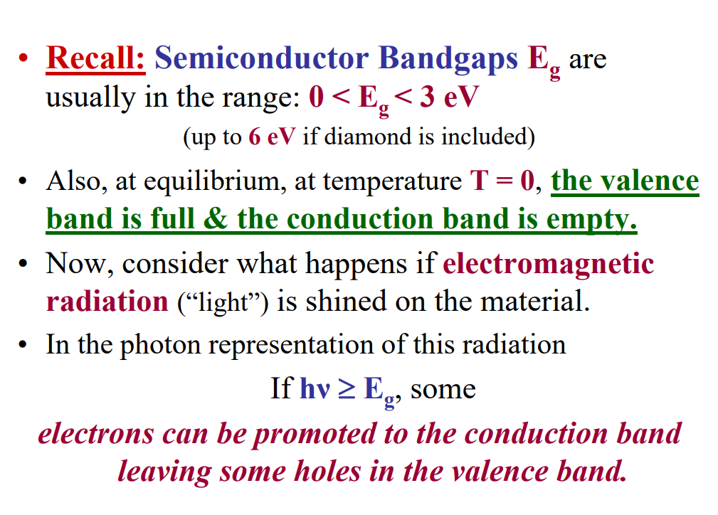
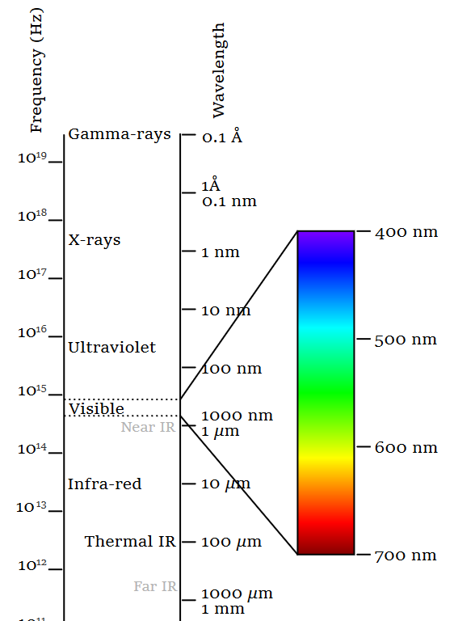

Slide 4
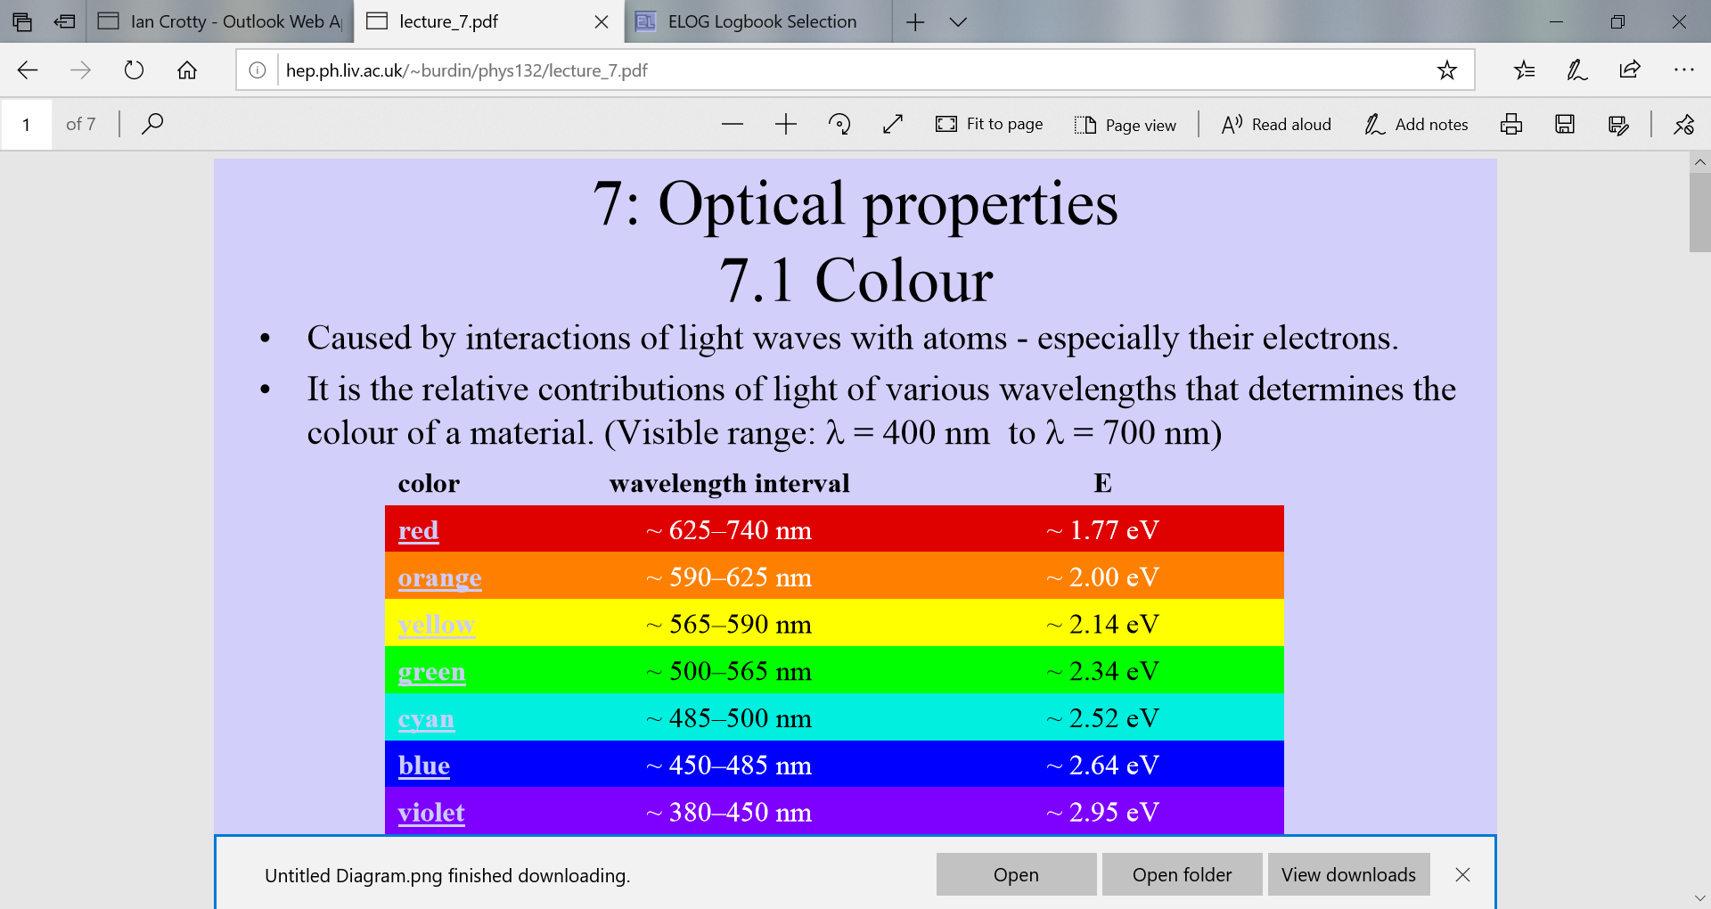
http://hep.ph.liv.ac.uk/~burdin/phys132/lecture_7.pdf

Slide 5
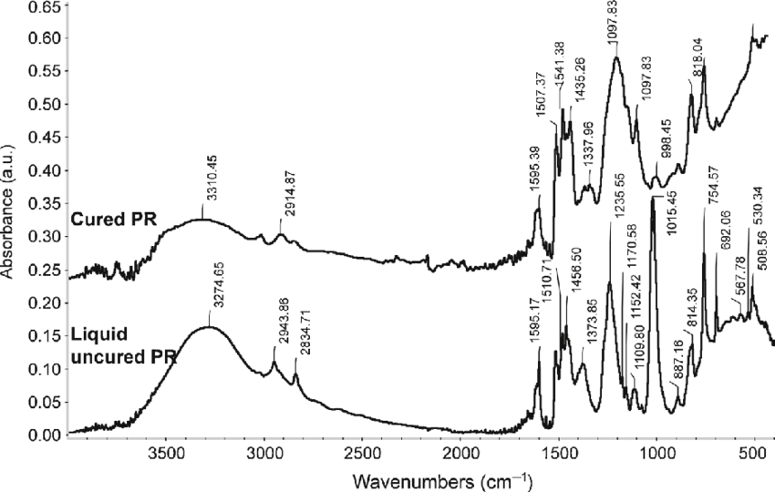
https://www.researchgate.net/profile/George_Pelin/publication/303781622/figure/fig2/AS:485603205750785@1492788234228/FTIR-spectra-of-the-uncured-and-cured-phenolic-resin.png

Slide 6
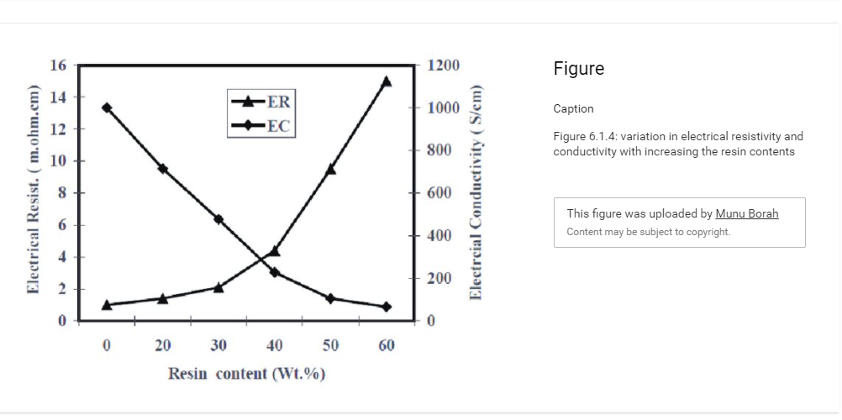
https://www.researchgate.net/publication/315646504_Expanded_Graphite_Composite_Based_Bipolar_Plate_for_PEM_Fuel_Cell_Development_of_Low_Density_and_Low_Cost_Composite_Bipolar_Plate_for_Proton_Exchange_Membrane_Fuel_Cell/figures?lo=1

Slide 7
References

Slide 8
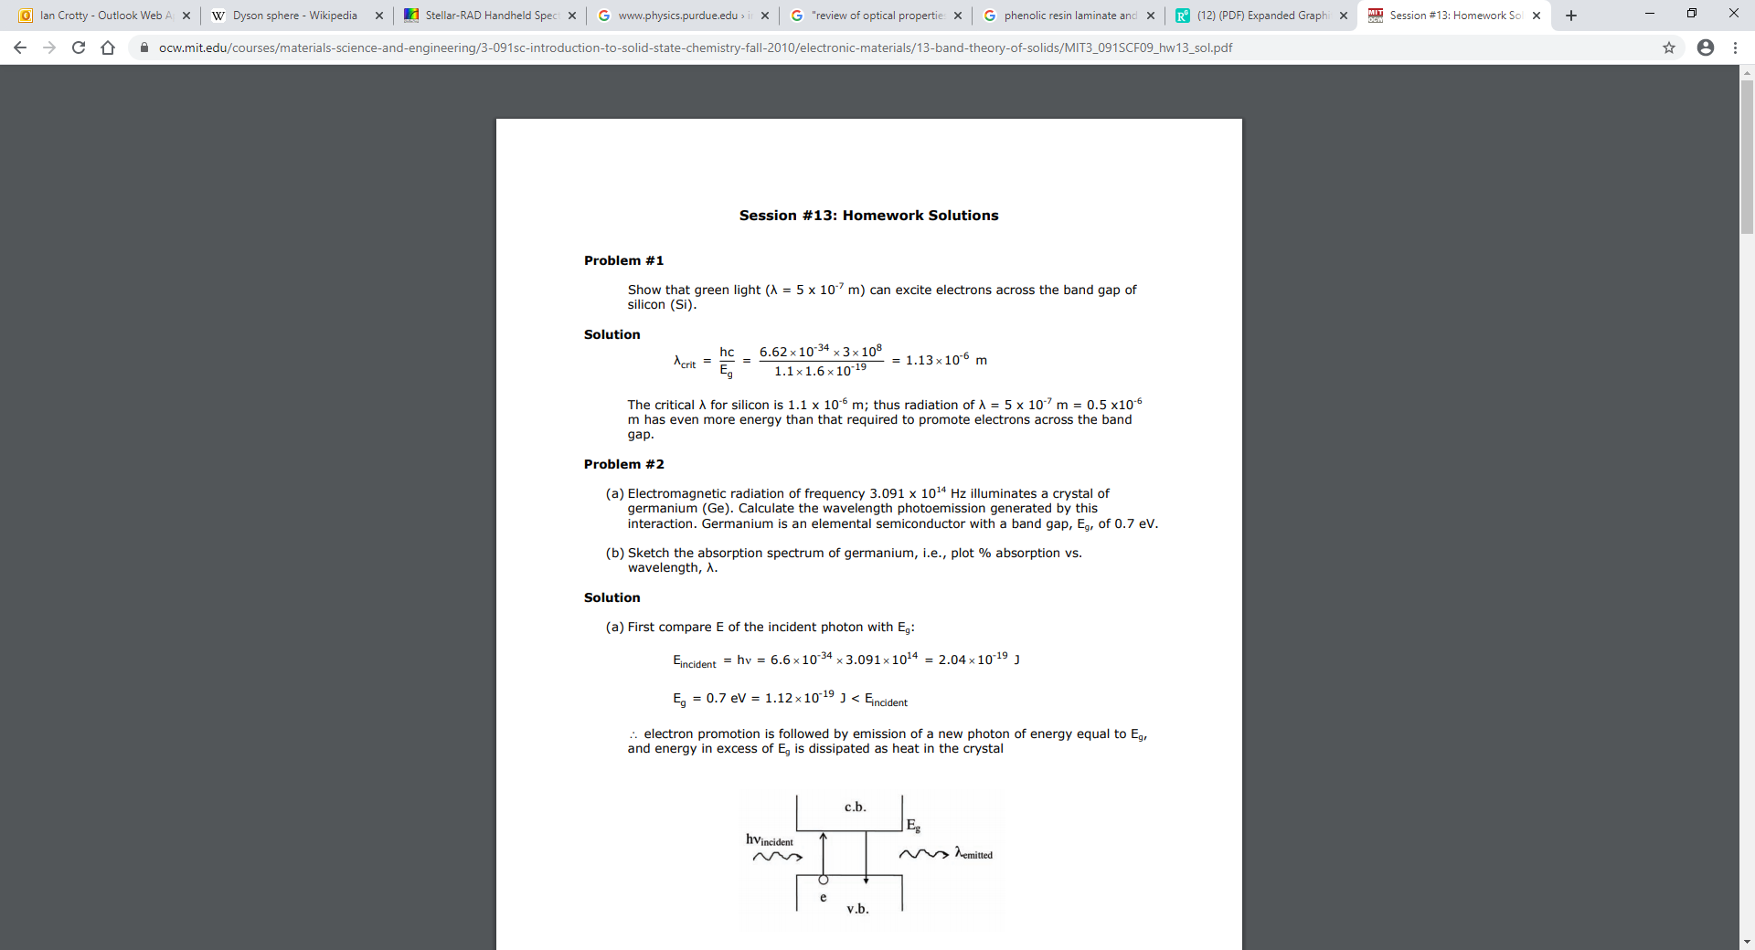
https://ocw.mit.edu/courses/materials-science-and-engineering/3-091sc-introduction-to-solid-state-chemistry-fall-2010/electronic-materials/13-band-theory-of-solids/MIT3_091SCF09_hw13_sol.pdf

Slide 9
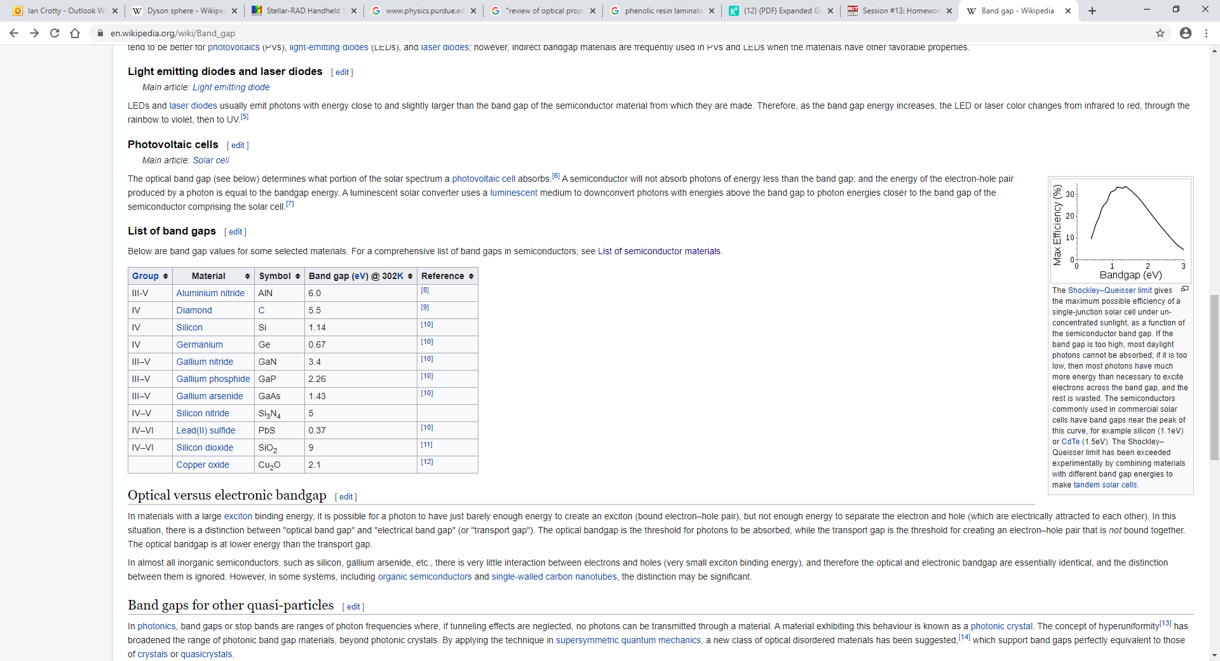
https://en.wikipedia.org/wiki/List_of_semiconductor_materials
https://en.wikipedia.org/wiki/Organic_semiconductor
https://en.wikipedia.org/wiki/Band_gap

Slide 10
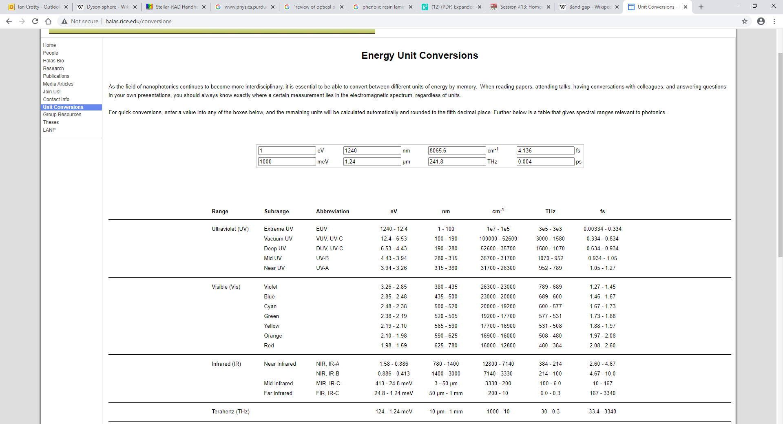
http://halas.rice.edu/conversions

