Slide 1
Light measurement
Ian
17 Feb 2020

Slide 2
https://en.wikipedia.org/wiki/Photometer
A photometer is an instrument that measures the strength of electromagnetic radiation in the range from ultraviolet to infrared and including the visible spectrum. Most photometers convert light into an electric current using a photoresistor, photodiode, or photomultiplier.
Photometers measure:
Illuminance
Irradiance
Light absorption
Scattering of light
Reflection of light
Fluorescence
Phosphorescence
Luminescence

Slide 3
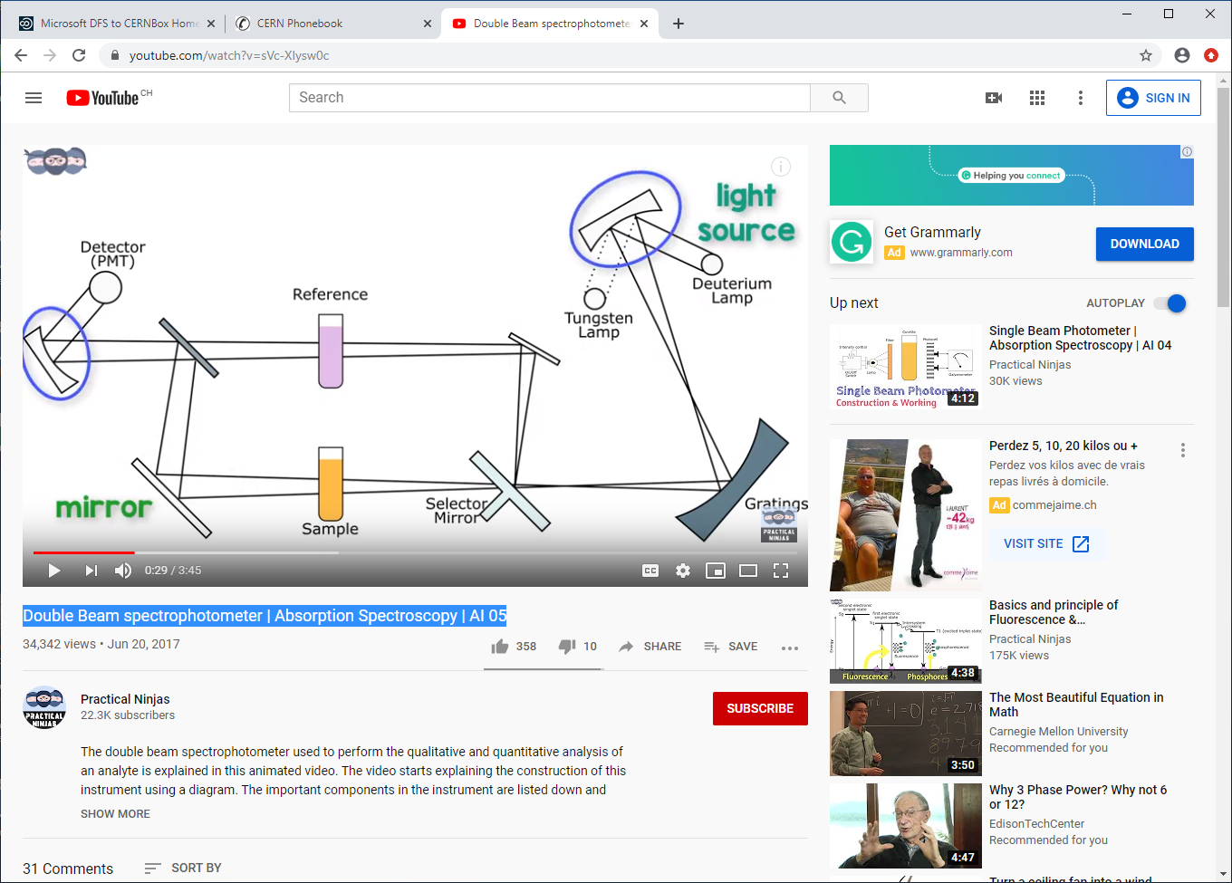
https://www.youtube.com/watch?v=sVc-XIysw0c
Double Beam spectrophotometer | Absorption Spectroscopy | AI 05

Slide 4
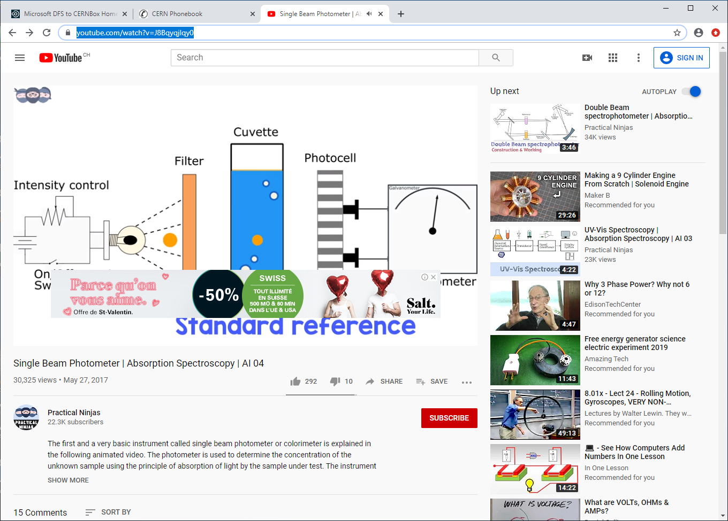
https://www.youtube.com/watch?v=J8Bqyqjlqy0

Slide 5
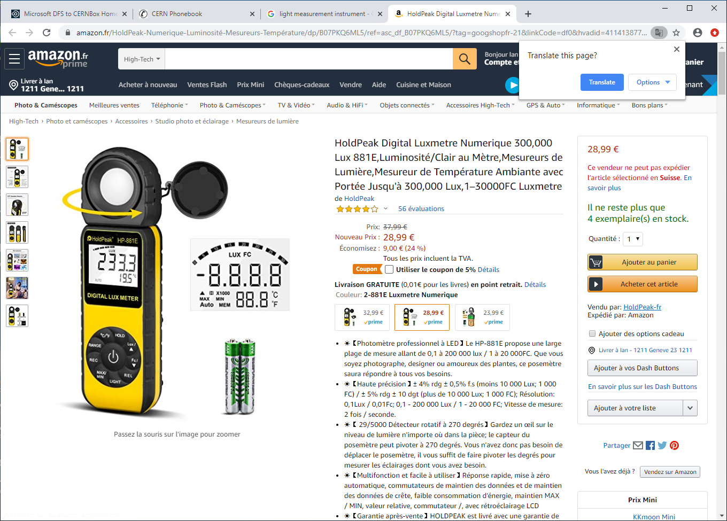

Slide 6
https://www.wikihow.com/Measure-Light-Intensity

Slide 7
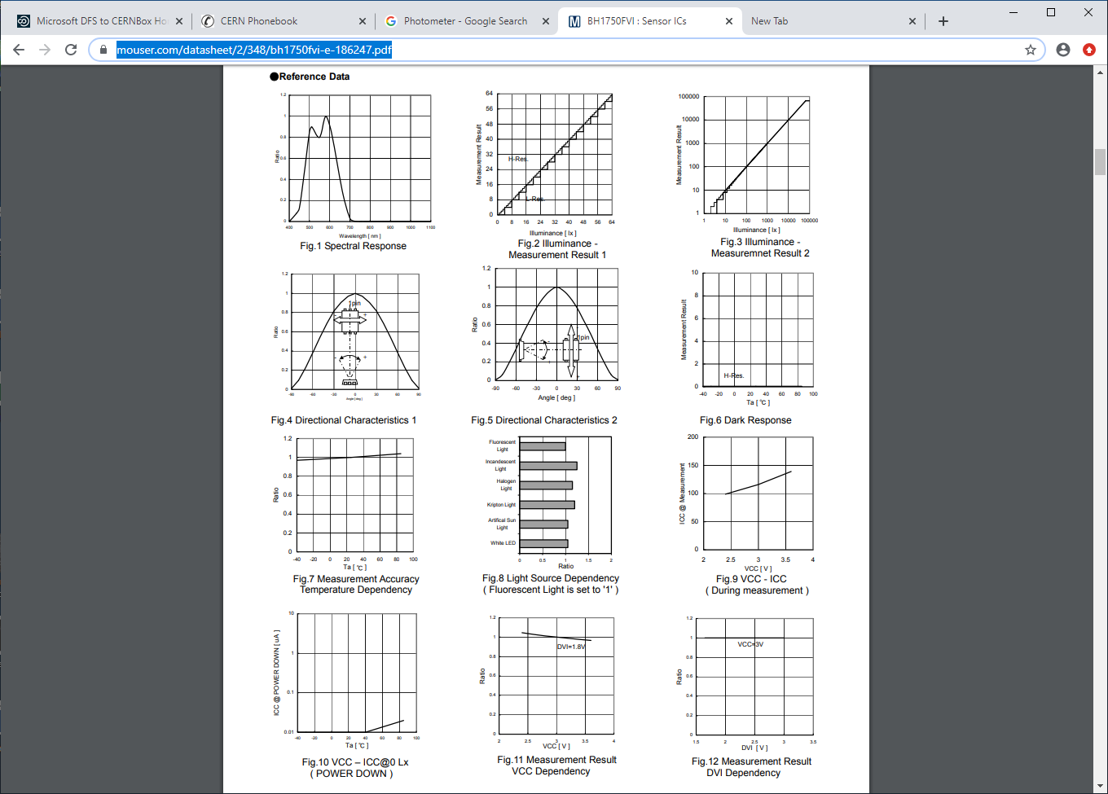
https://www.instructables.com/id/Arduino-DIY-Light-Meter-With-BH1750-Sensor/
https://www.mouser.com/datasheet/2/348/bh1750fvi-e-186247.pdf

Slide 8
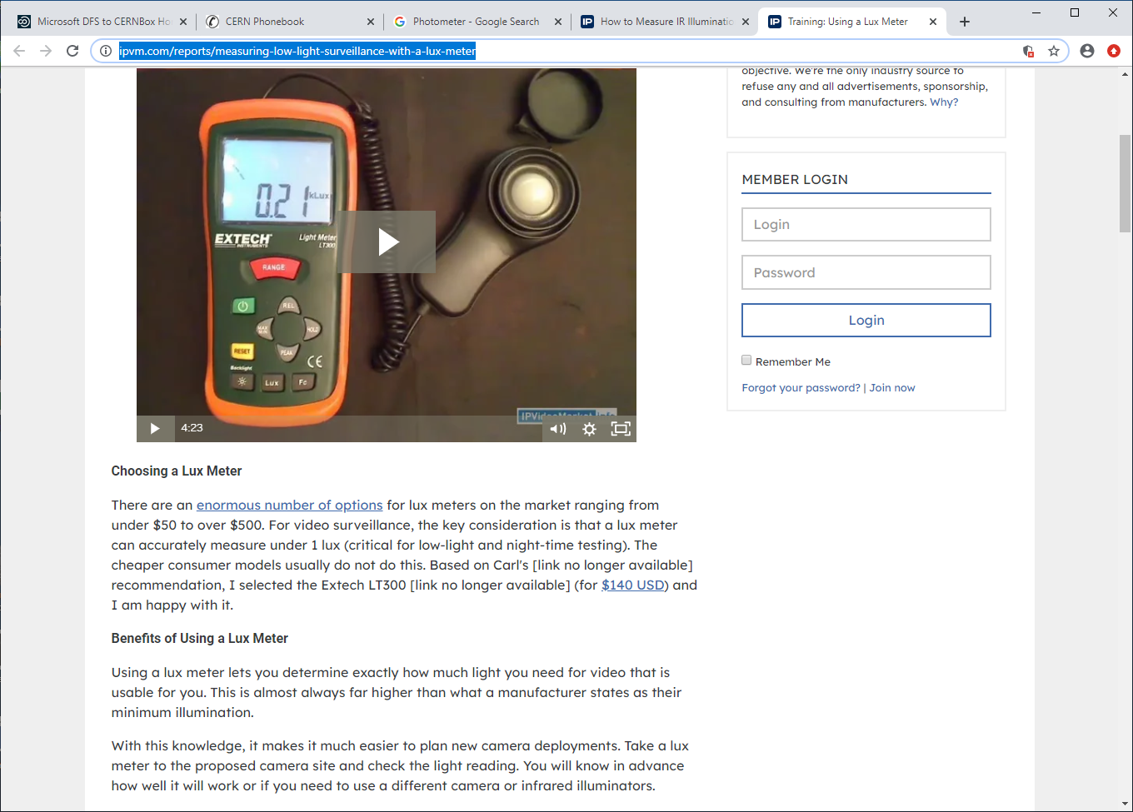
https://ipvm.com/reports/measuring-low-light-surveillance-with-a-lux-meter

Slide 9
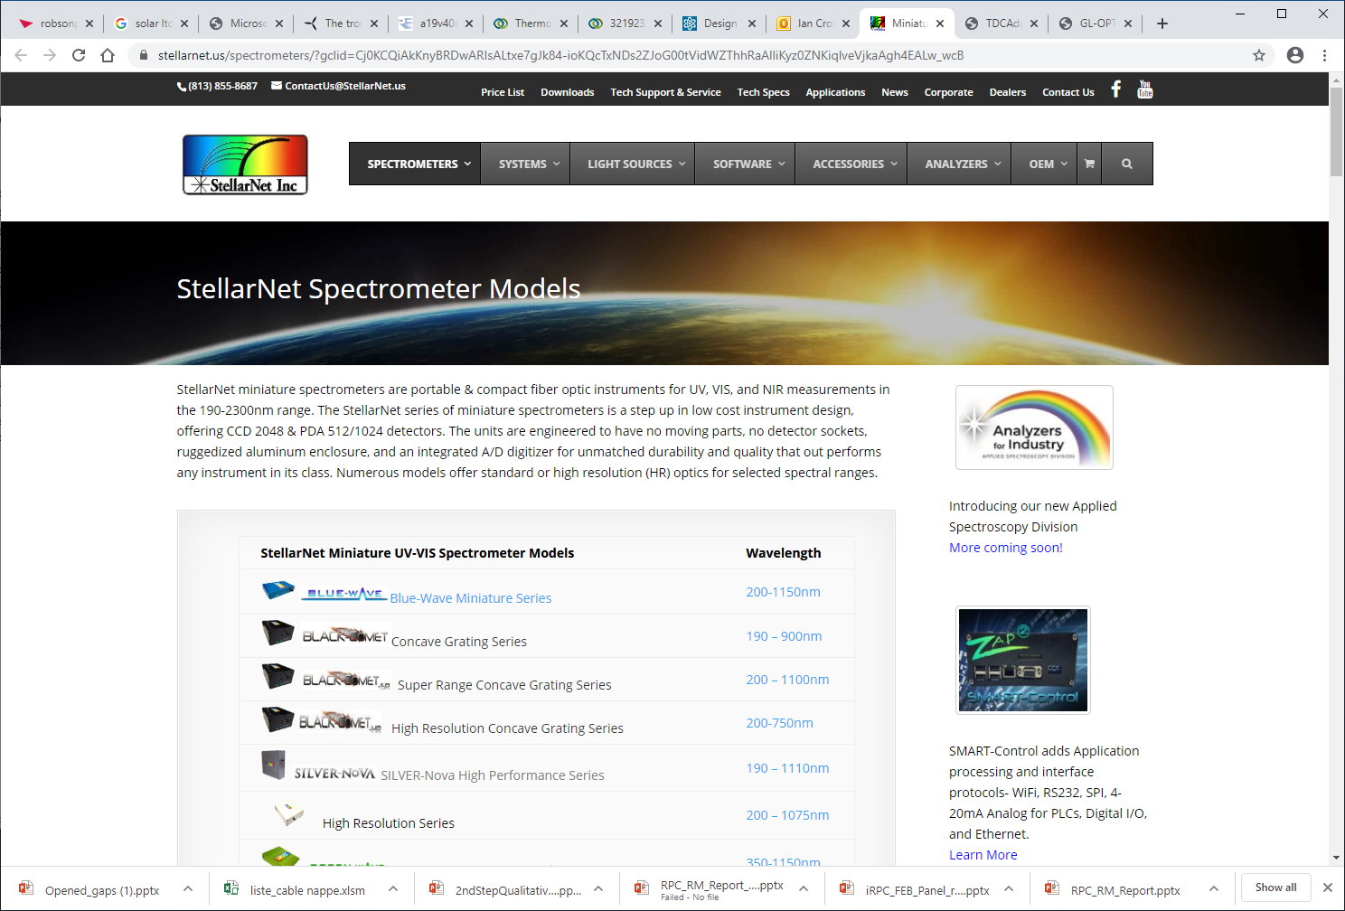
https://www.stellarnet.us/spectrometers/?gclid=Cj0KCQiAkKnyBRDwARIsALtxe7gJk84-ioKQcTxNDs2ZJoG00tVidWZThhRaAlliKyz0ZNKiqlveVjkaAgh4EALw_wcB

Slide 10
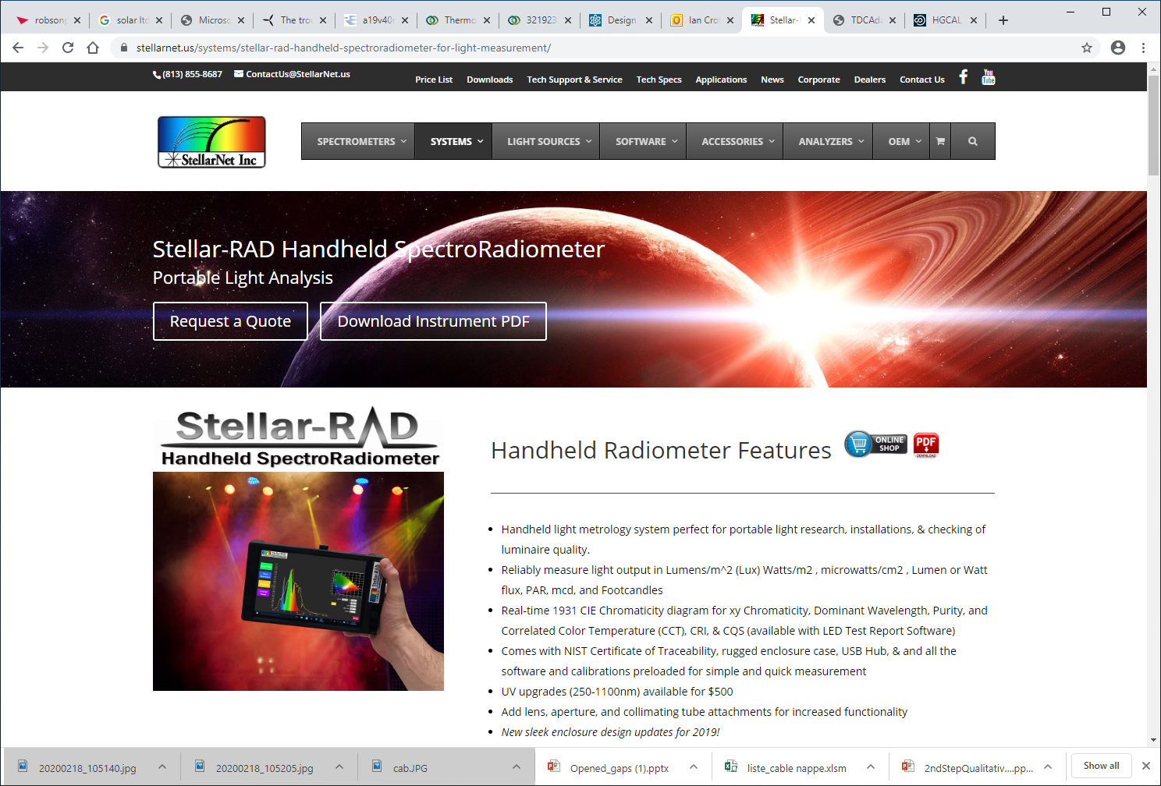
https://www.stellarnet.us/systems/stellar-rad-handheld-spectroradiometer-for-light-measurement/
3500 USD

Slide 11
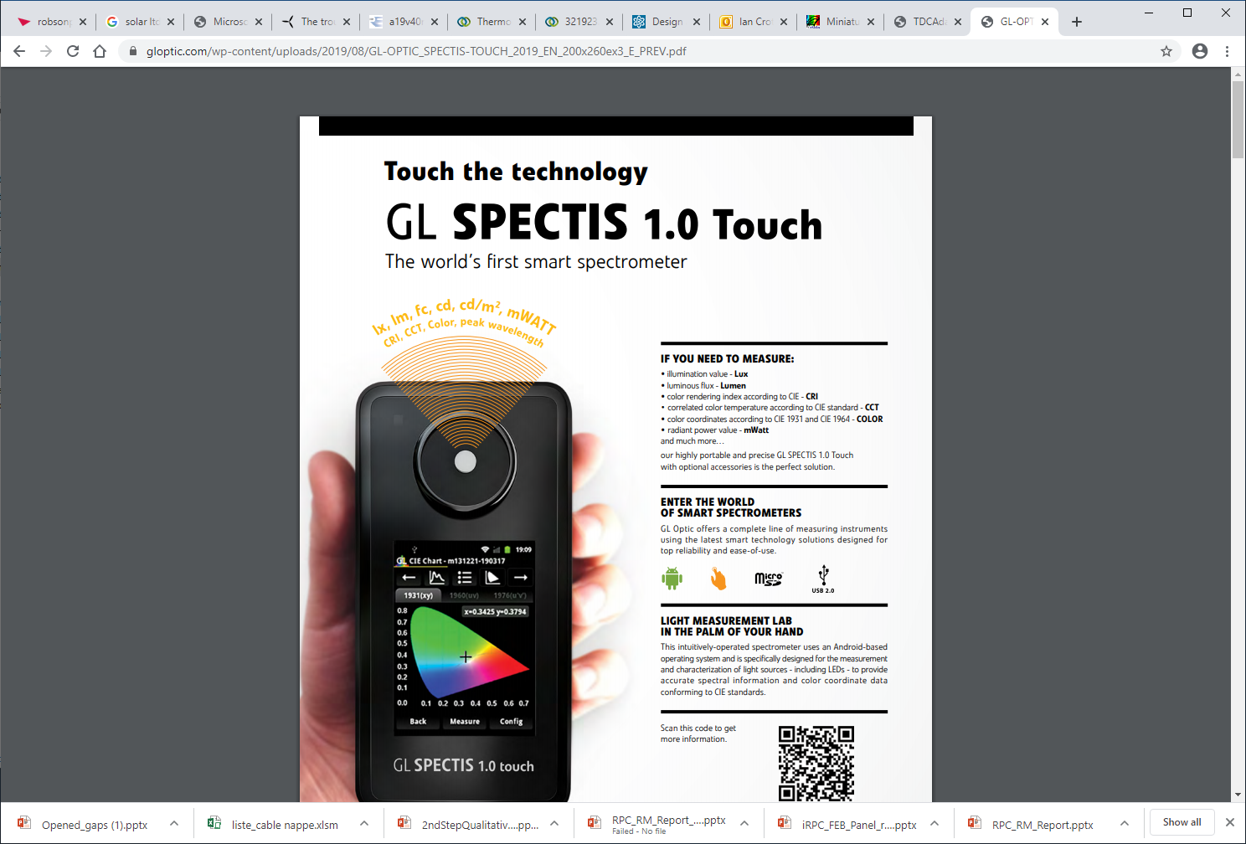
https://gloptic.com/wp-content/uploads/2019/08/GL-OPTIC_SPECTIS-TOUCH_2019_EN_200x260ex3_E_PREV.pdf
https://gloptic.com/products/gl-spectis-1-0-touch/

Slide 12
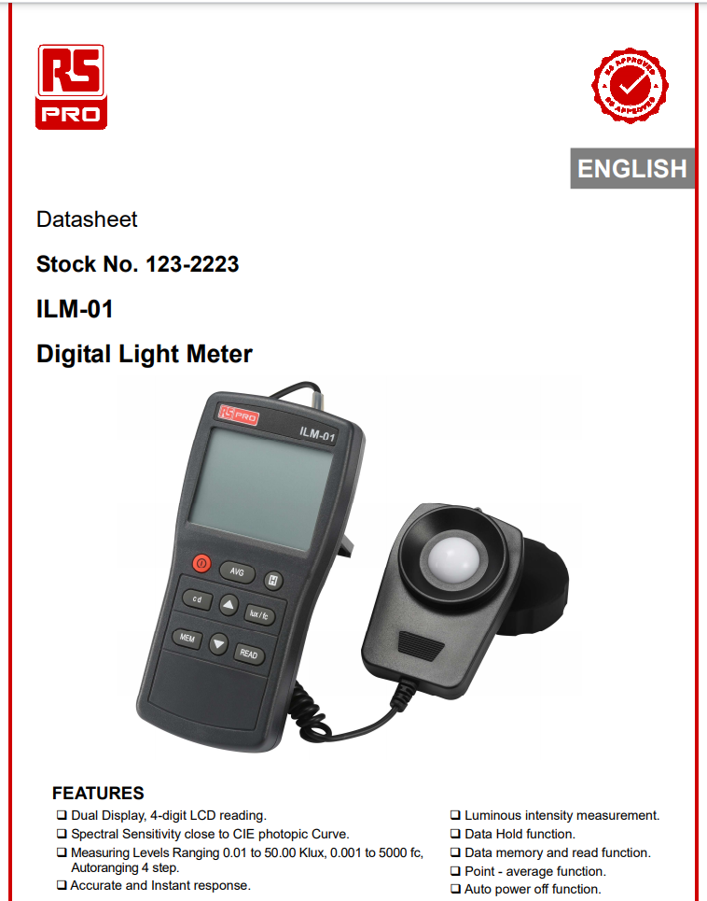
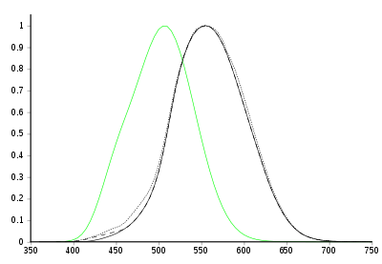
CIE photopic
https://en.wikipedia.org/wiki/Luminosity_function#:~:text=The%20CIE%20photopic%20luminosity%20function,the%20CIE%201931%20color%20space.
https://docs.rs-online.com/89b8/A700000007086200.pdf
This device was purchased on 27 Feb 2020 for the measurements.
It is a luxmeter in the visible range do there is poor overlap with the red /infrared from the HPL transmission . !
Photopic (black) and scotopic (green) luminosity functions.[c 1] The photopic includes the CIE 1931 standard[c 2] (solid), the Judd–Vos 1978 modified data[c 3] (dashed), and the Sharpe, Stockman, Jagla & Jägle 2005 data[c 4] (dotted). The horizontal axis is wavelength in nm.

Slide 13
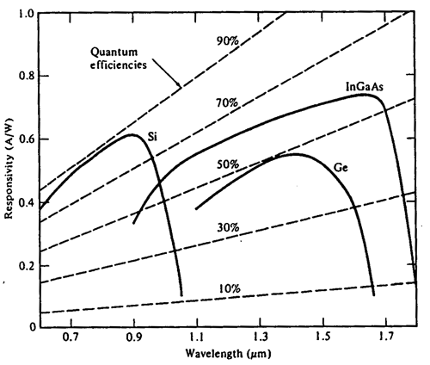
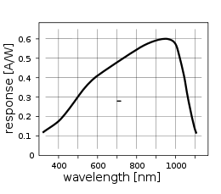
However this can be modified so that the response is far better in the IR.
In fact the spectral response is extended into the IR with greater sensitivity ! The Si Ph Di is a good choice as it covers both the visible and the near IR, unlike the Ge and InGaAs.
https://en.wikipedia.org/wiki/Photodiode
https://www.fiberoptics4sale.com/blogs/archive-posts/95046662-pin-photodetector-characteristics-for-optical-fiber-communication

