Slide 1
Light measurement
Ian
17 Feb 2020

Slide 2
https://en.wikipedia.org/wiki/Photometer
A photometer is an instrument that measures the strength of electromagnetic radiation in the range from ultraviolet to infrared and including the visible spectrum. Most photometers convert light into an electric current using a photoresistor, photodiode, or photomultiplier.
Photometers measure:
Illuminance
Irradiance
Light absorption
Scattering of light
Reflection of light
Fluorescence
Phosphorescence
Luminescence

Slide 3
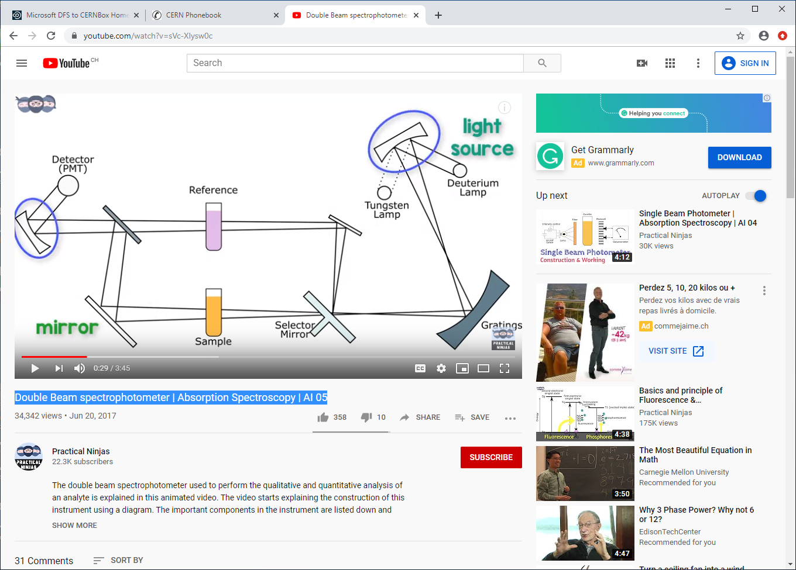
https://www.youtube.com/watch?v=sVc-XIysw0c
Double Beam spectrophotometer | Absorption Spectroscopy | AI 05

Slide 4
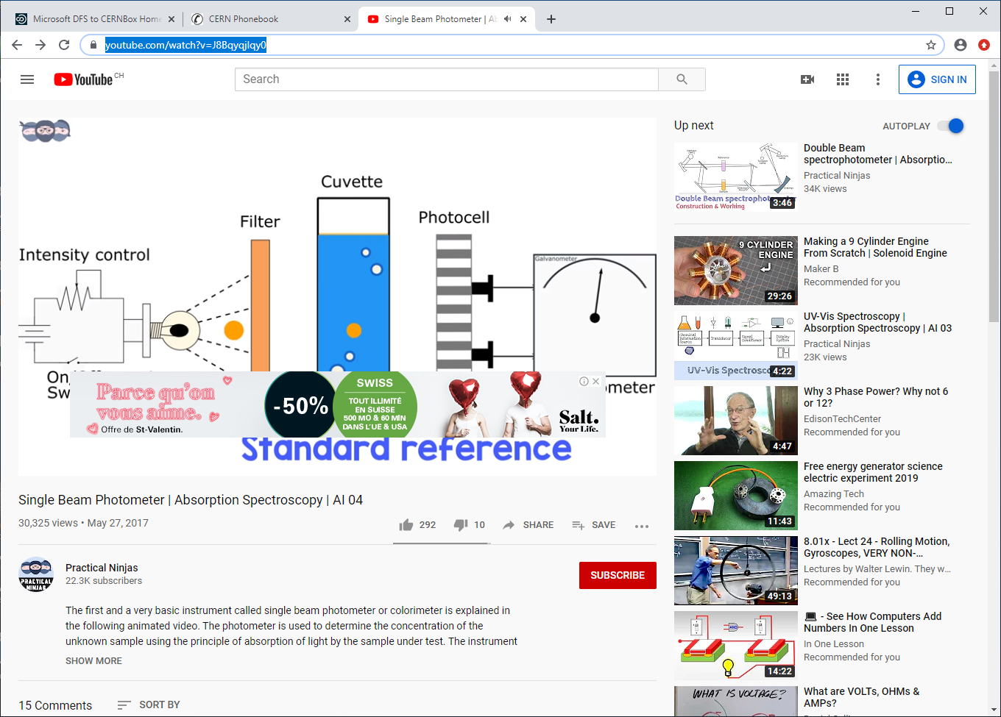
https://www.youtube.com/watch?v=J8Bqyqjlqy0

Slide 5
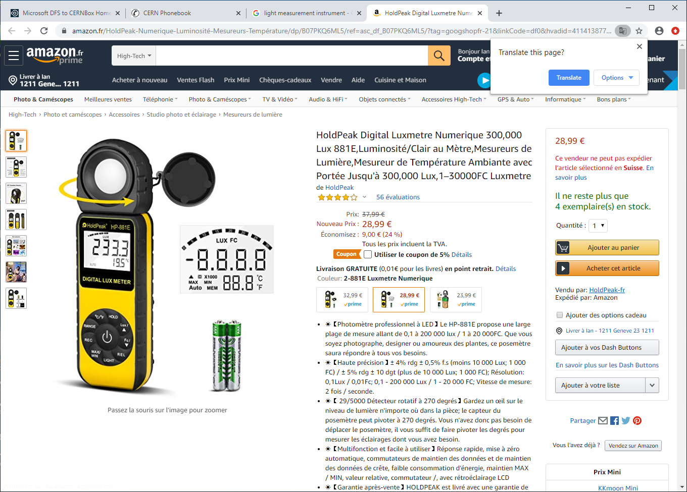

Slide 6
https://www.wikihow.com/Measure-Light-Intensity

Slide 7
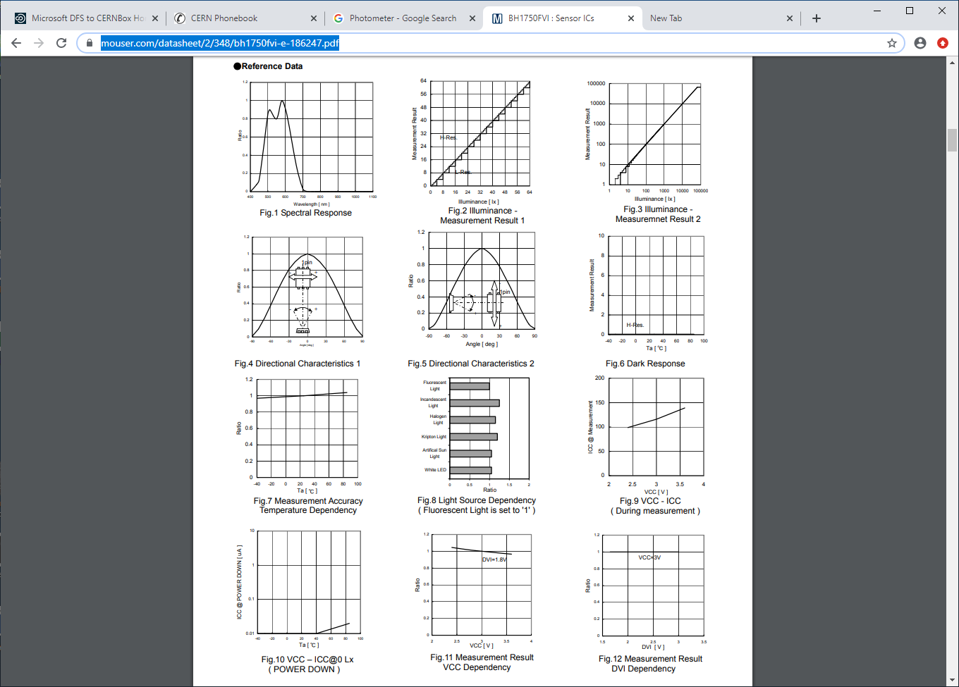
https://www.instructables.com/id/Arduino-DIY-Light-Meter-With-BH1750-Sensor/
https://www.mouser.com/datasheet/2/348/bh1750fvi-e-186247.pdf

Slide 8
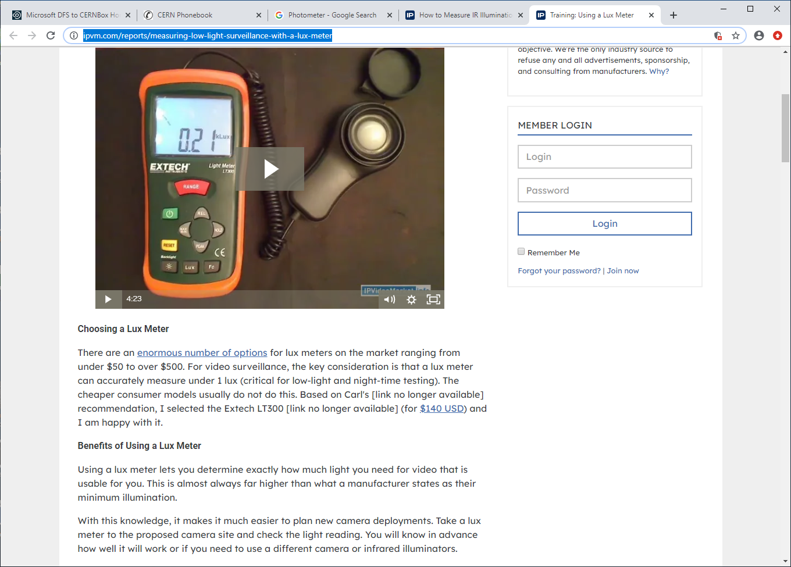
https://ipvm.com/reports/measuring-low-light-surveillance-with-a-lux-meter

Slide 9
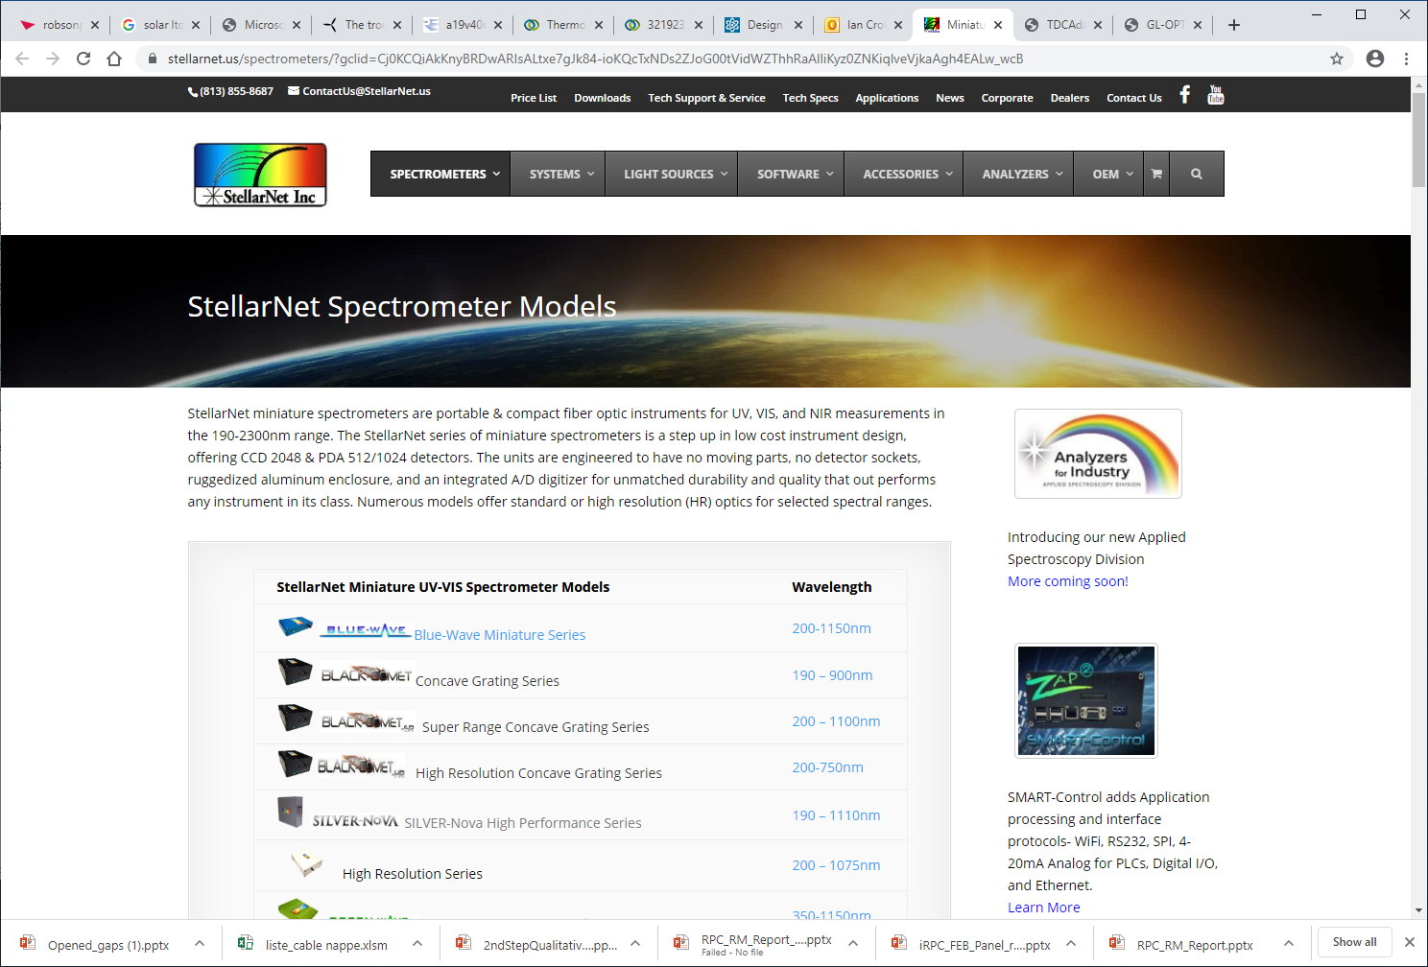
https://www.stellarnet.us/spectrometers/?gclid=Cj0KCQiAkKnyBRDwARIsALtxe7gJk84-ioKQcTxNDs2ZJoG00tVidWZThhRaAlliKyz0ZNKiqlveVjkaAgh4EALw_wcB

Slide 10
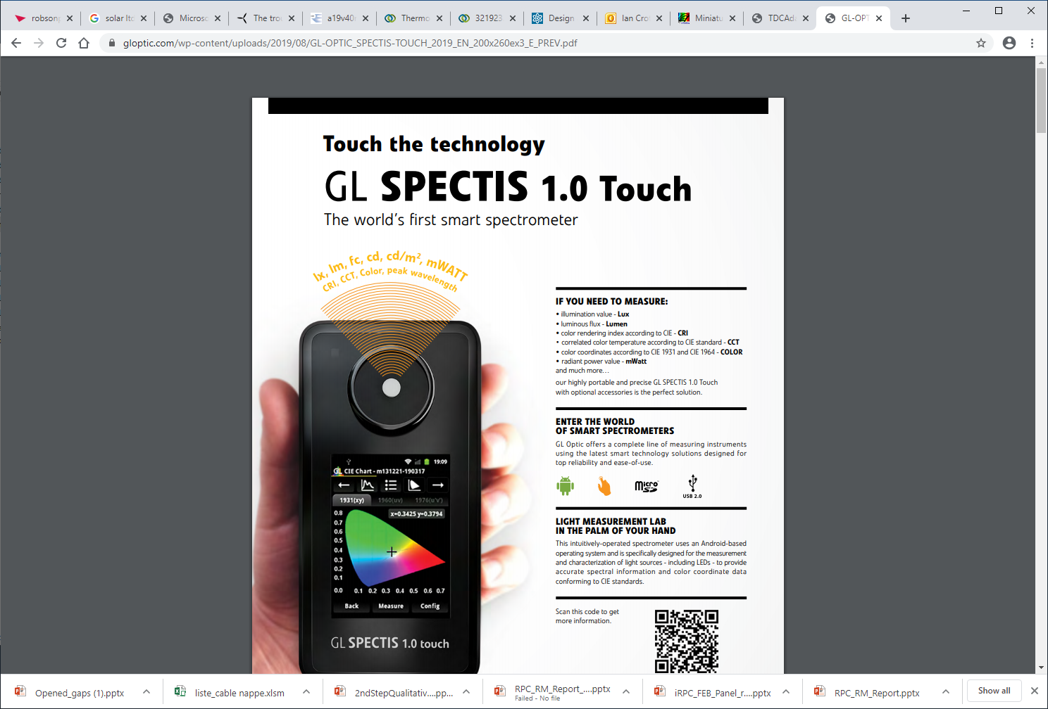
https://gloptic.com/wp-content/uploads/2019/08/GL-OPTIC_SPECTIS-TOUCH_2019_EN_200x260ex3_E_PREV.pdf
https://gloptic.com/products/gl-spectis-1-0-touch/

