Slide 1
Electronic structure/Gap and transmission colour
Ian
17 Feb 2020

Slide 2
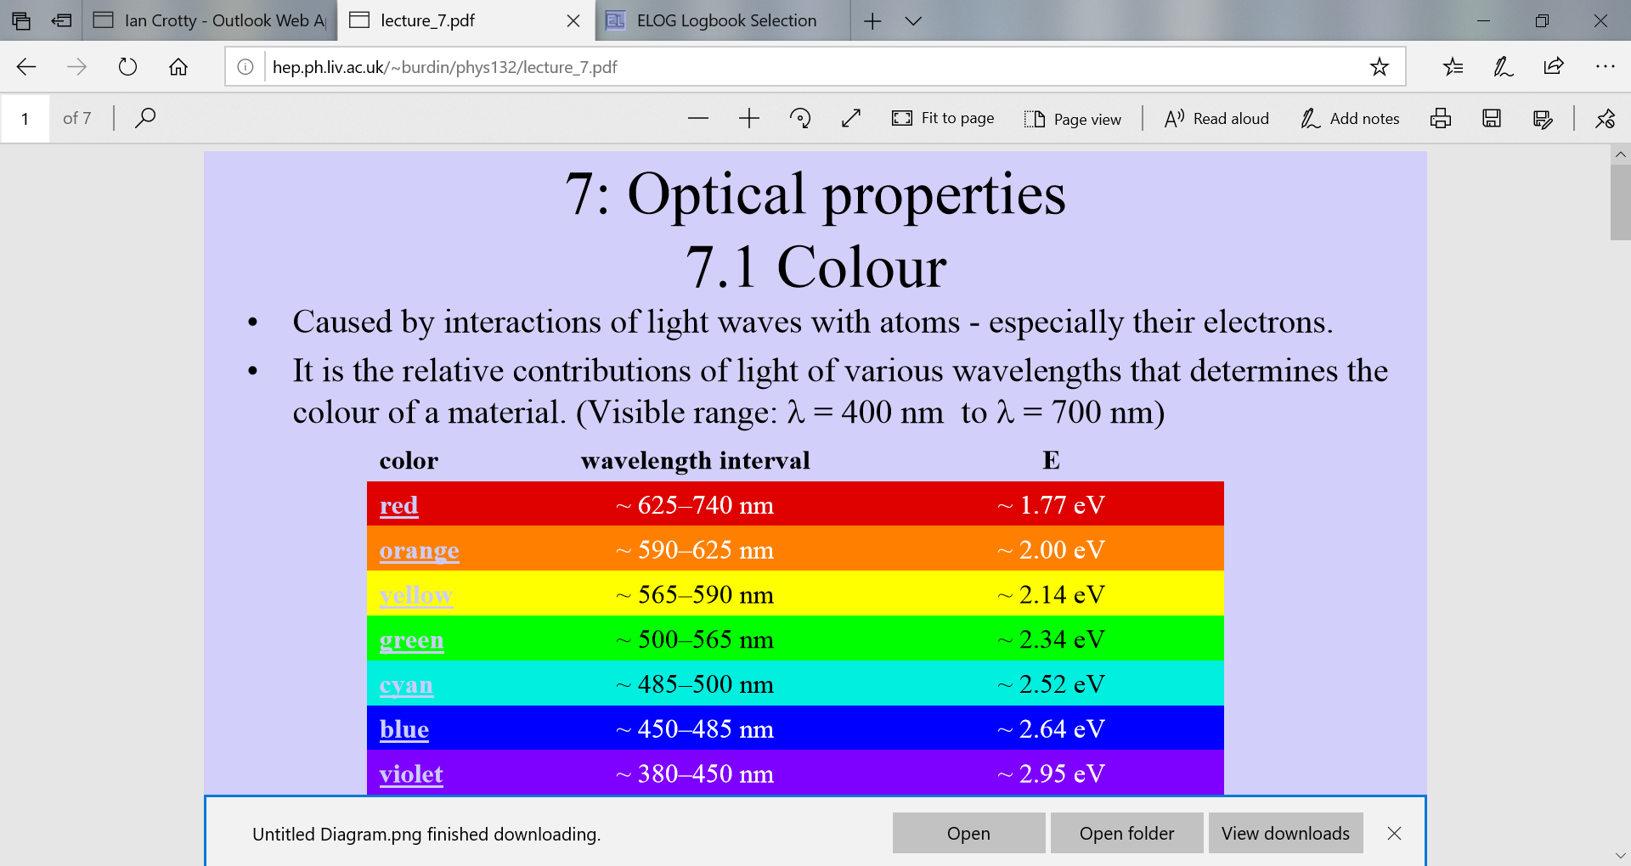
http://hep.ph.liv.ac.uk/~burdin/phys132/lecture_7.pdf

Slide 3
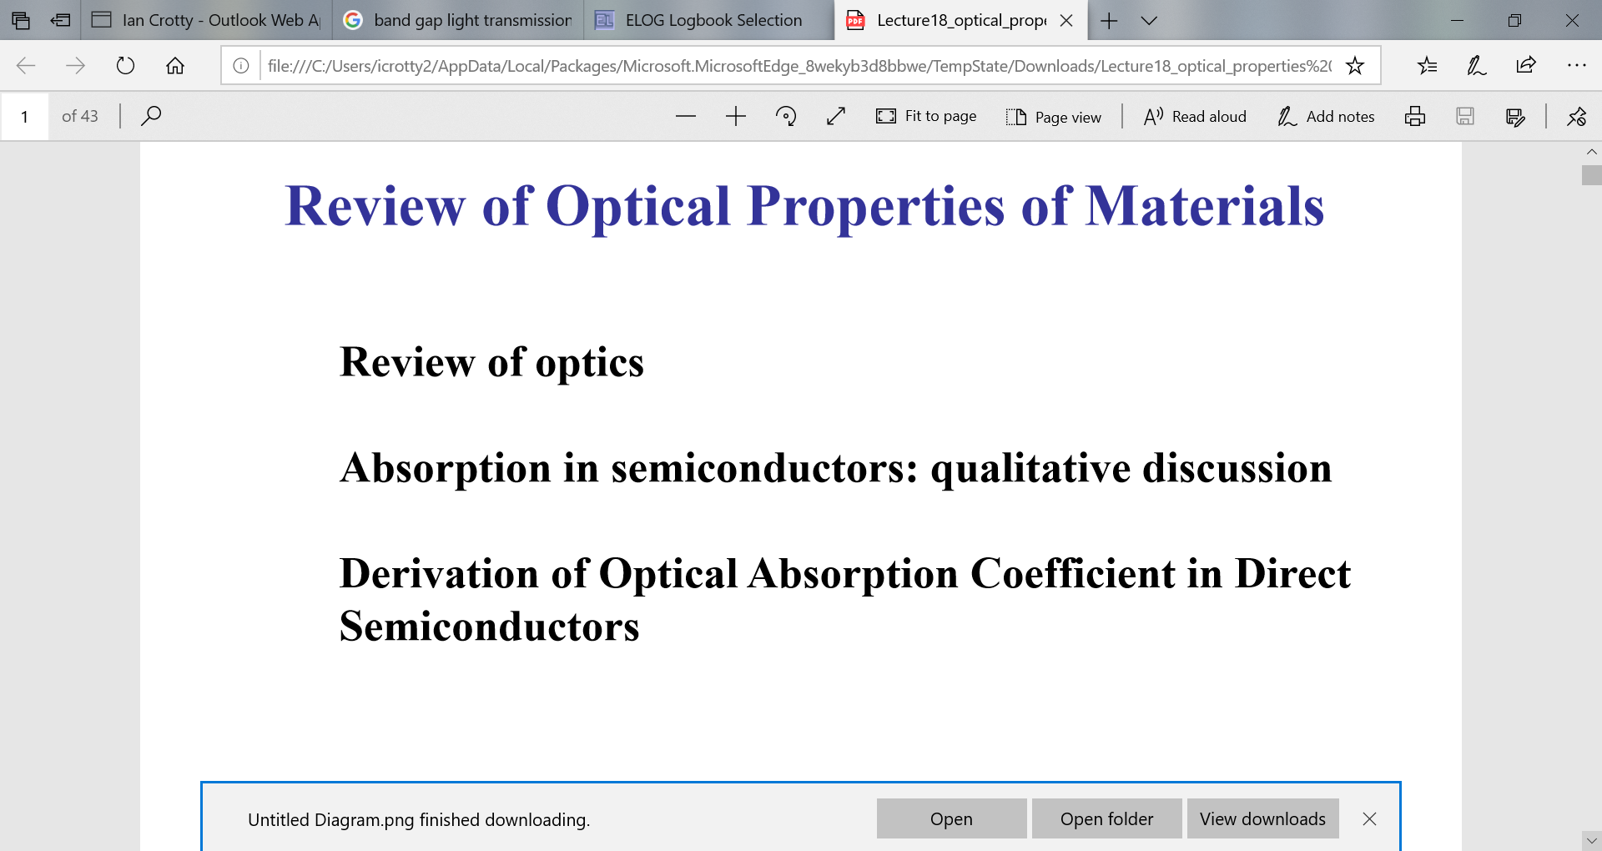
Purdue University
https://www.physics.purdue.edu/webapps/index.php/course_document/index/phys570P/1684/25/14207

Slide 4
http://www.physics.uwo.ca/~mgc/MatSci%20notes-6A.pdf

Slide 5
http://www.sixtysymbols.com/videos/energygap.htm

