Slide 1
2nd Step to Study Qualitatively the Optical Transmission of HPL
Ian
20 Jan 2020
Input from P. Vitulo

Slide 2
Different light source and lighting conditions
Neon Florescent Tube
Sun with reduced reflection from operator/camera side
LED light source from ceiling light in 904

Slide 3
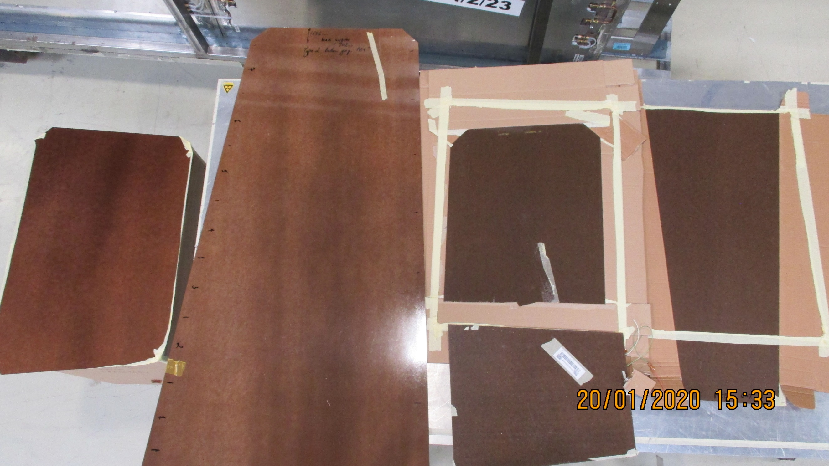
Different production batches /sources
Newer RE4 production sources
Old production sources

Slide 4
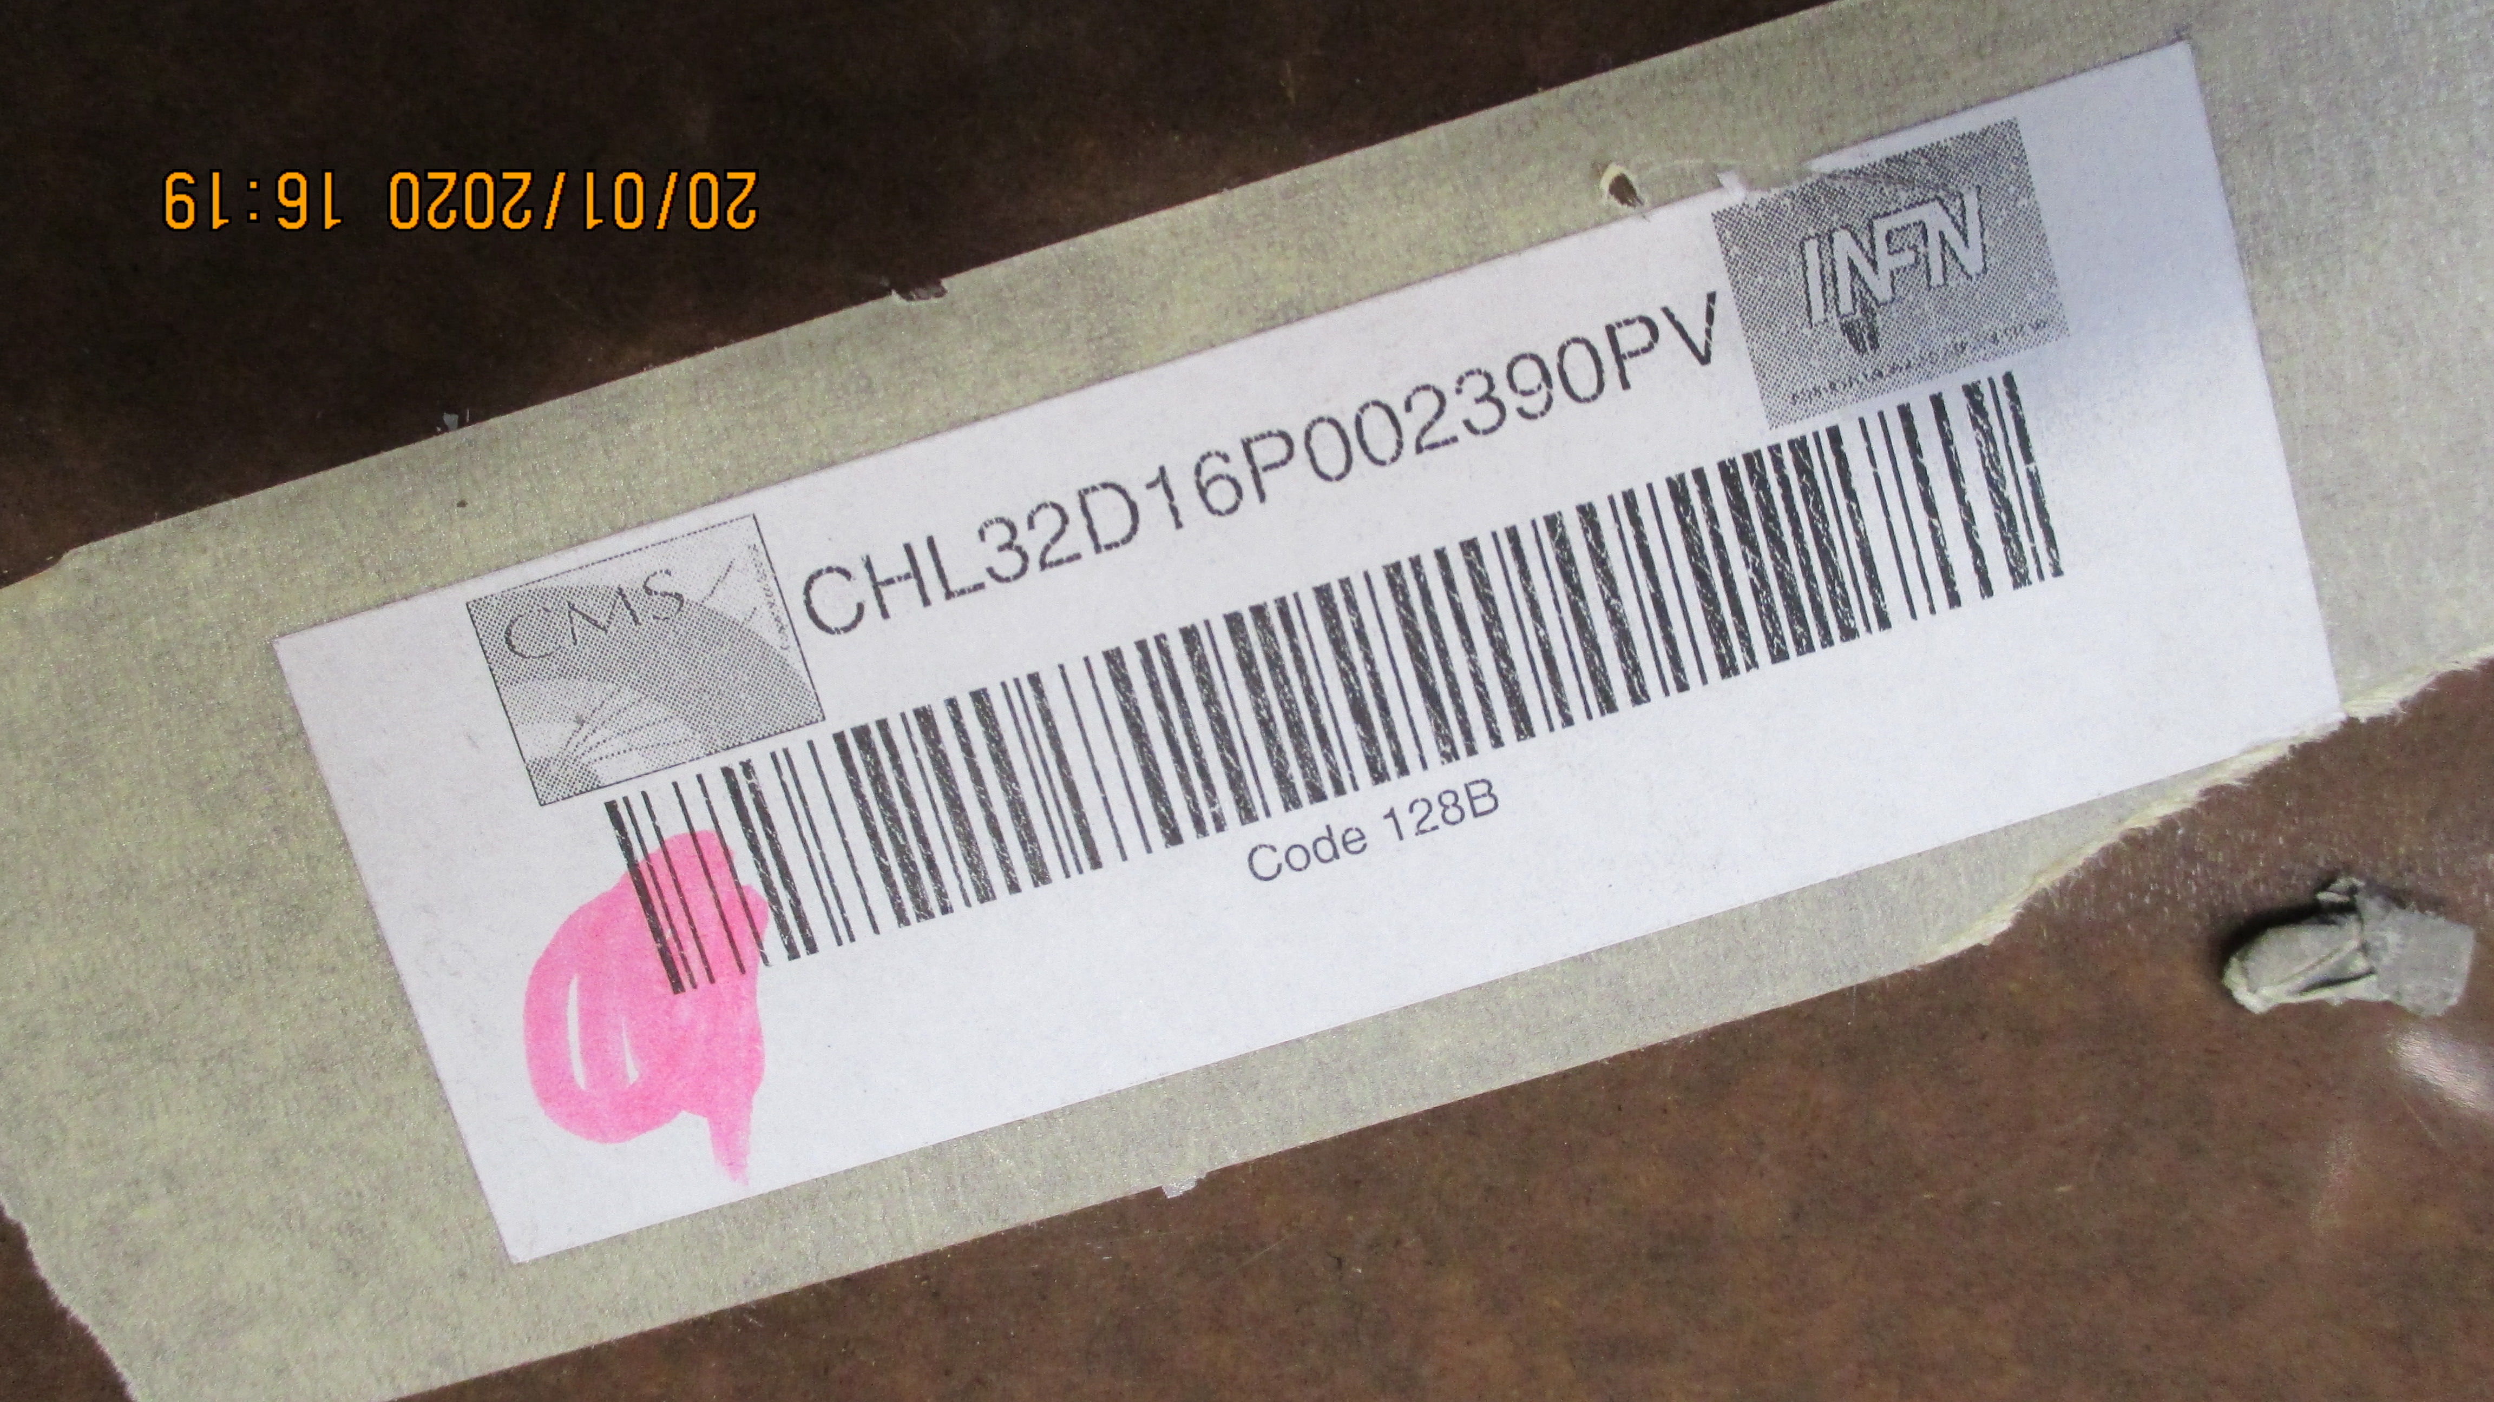
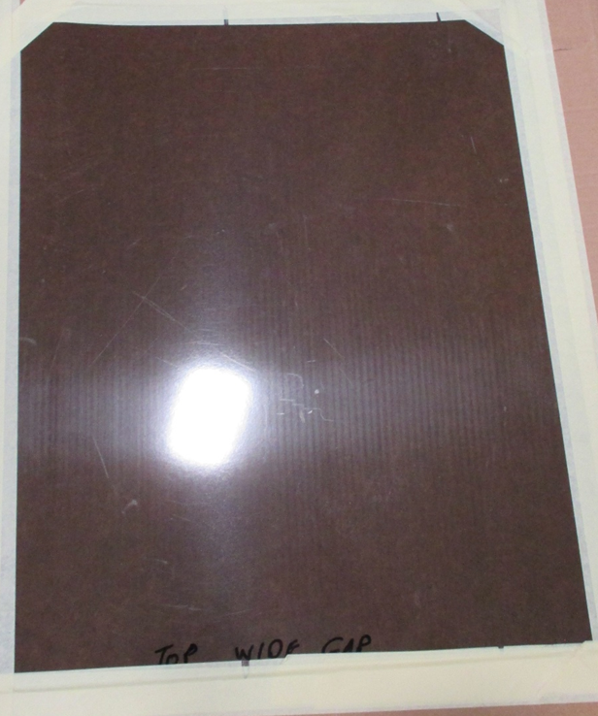

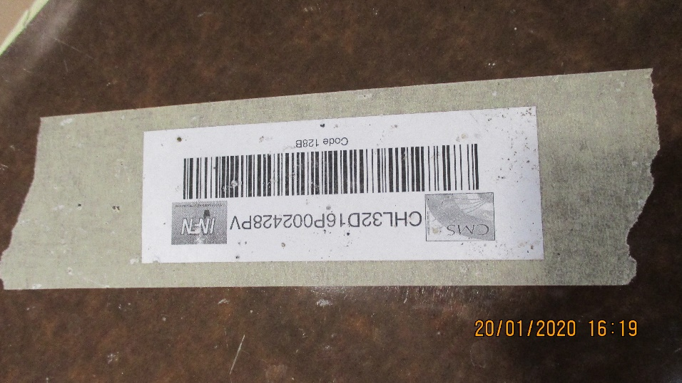
Three samples that are from the RE1, 2 and 3 stations production.
RE1/1 Bot Gap
RE Cut Top Wide Gap No ID
Very close in the production run
RE1/1 Top Wide Gap

Slide 5
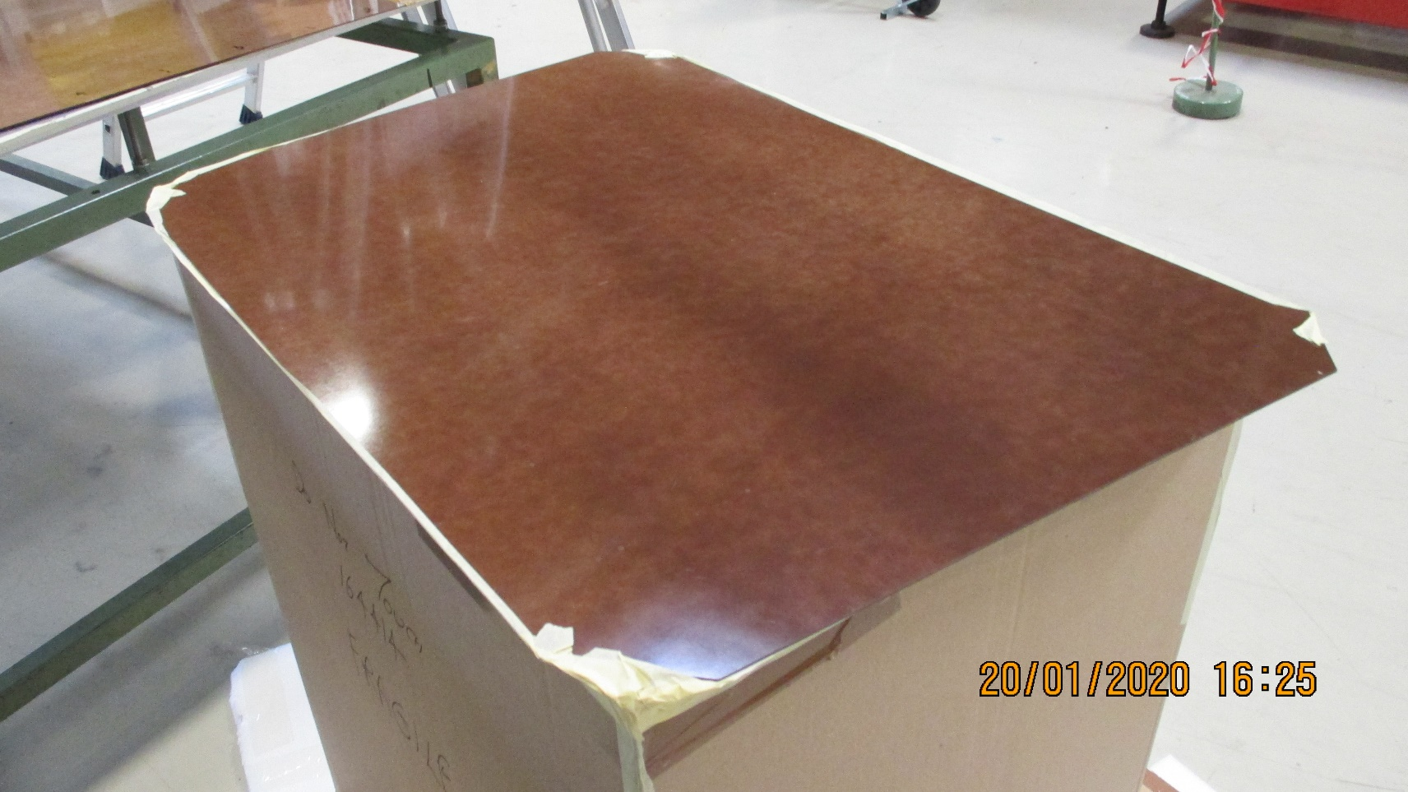
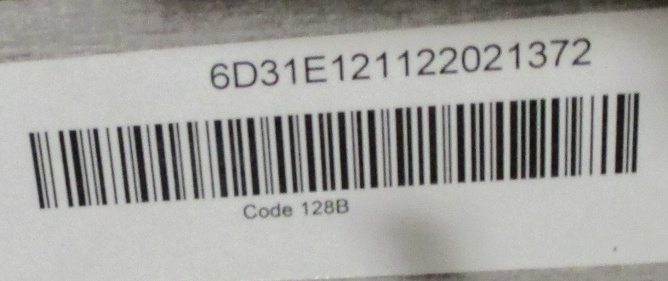
RE4/2 ? Top Wide Gap

Slide 6
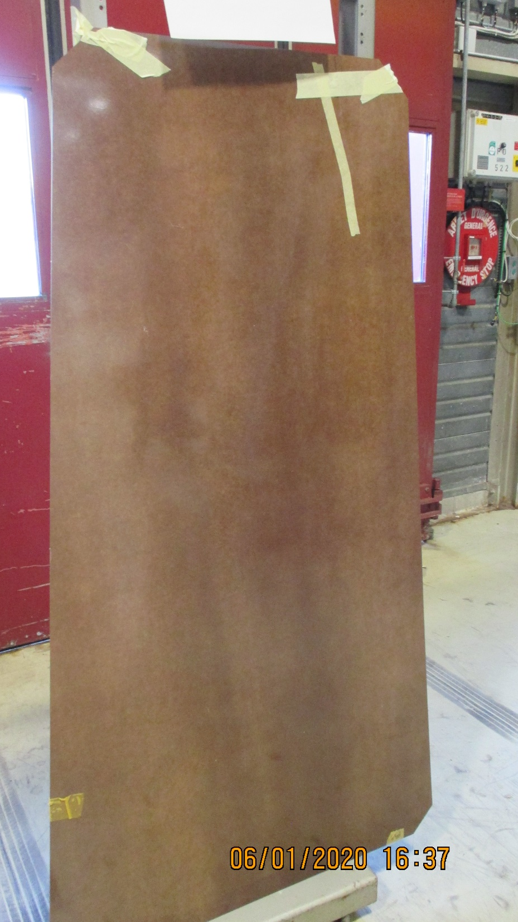
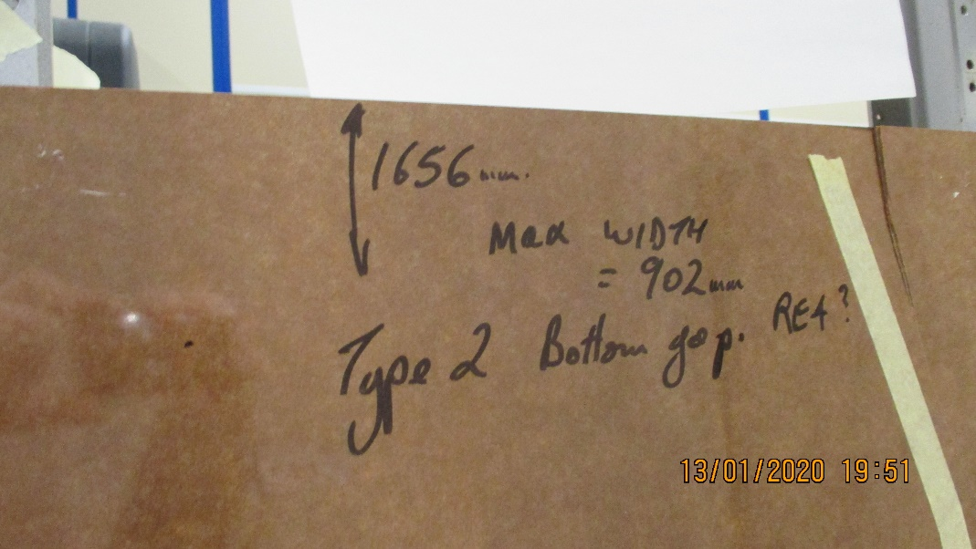
RE4/2 Bot Gap
No ID

Slide 7
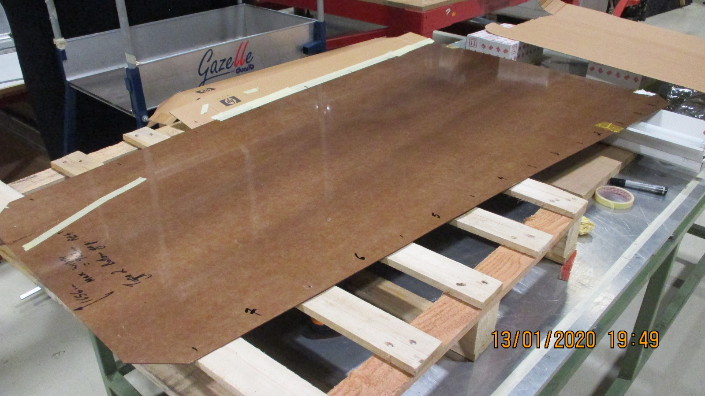
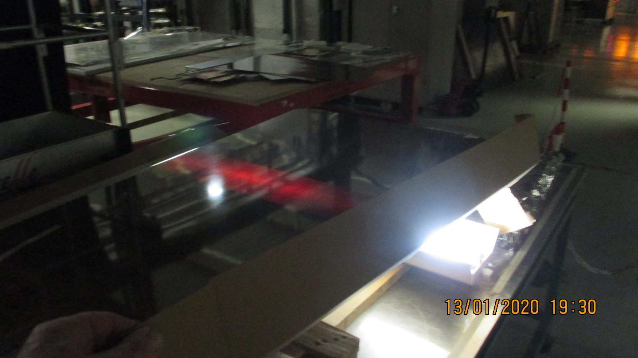
Tube source under the HPL in day light and at night
The blinding neon tube and the red transmission through the HPL

Slide 8
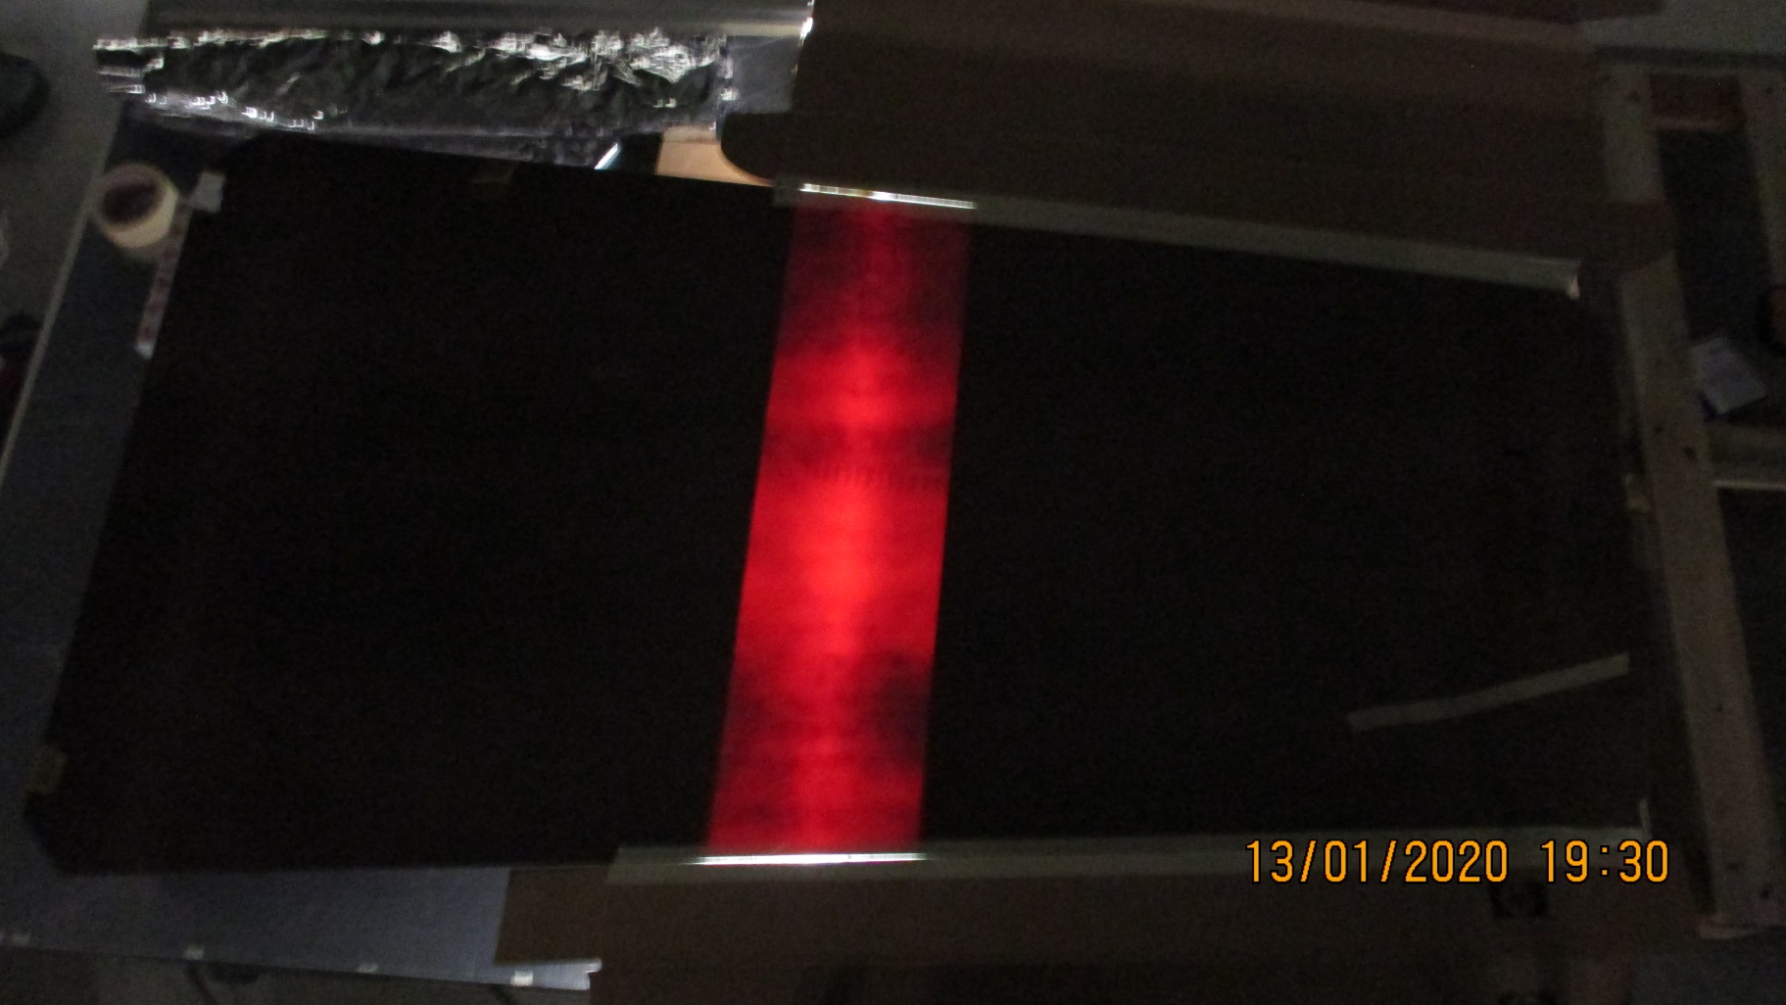
The panel is moved over the neon tube from the left to the right

Slide 9
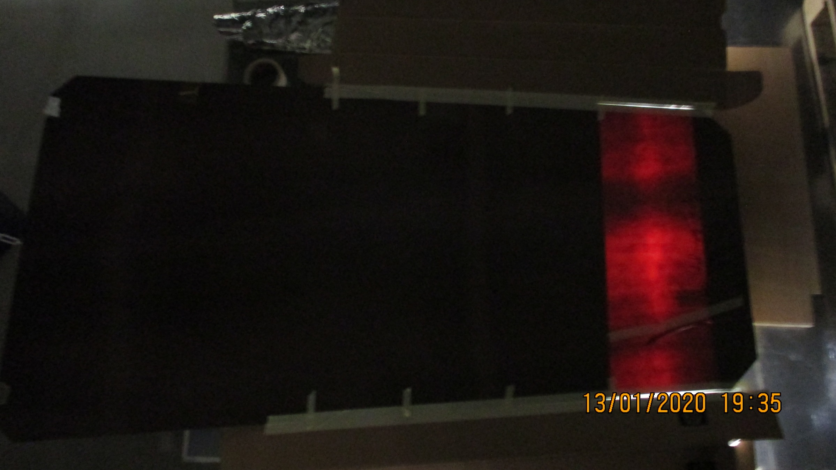
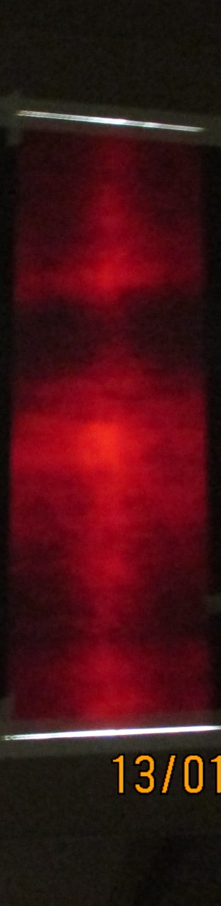
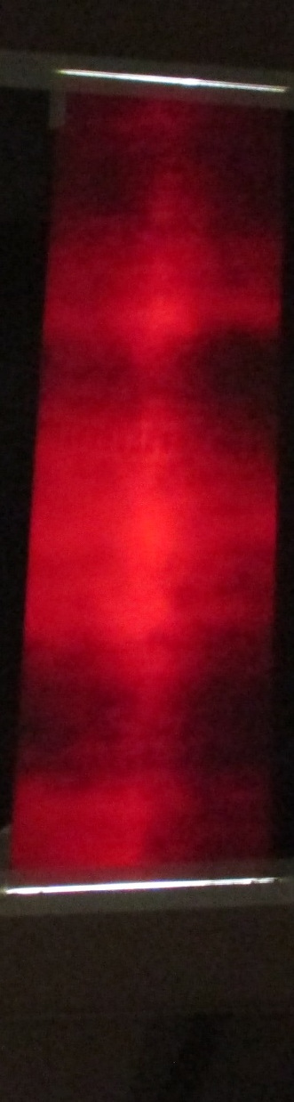
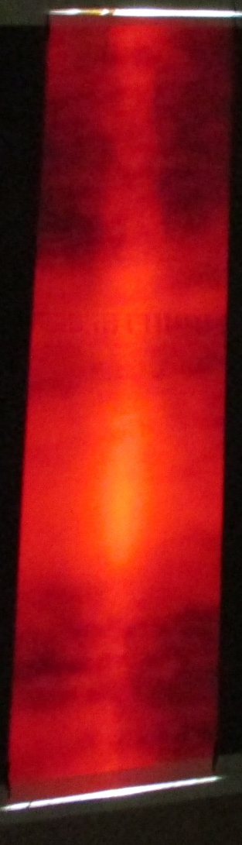
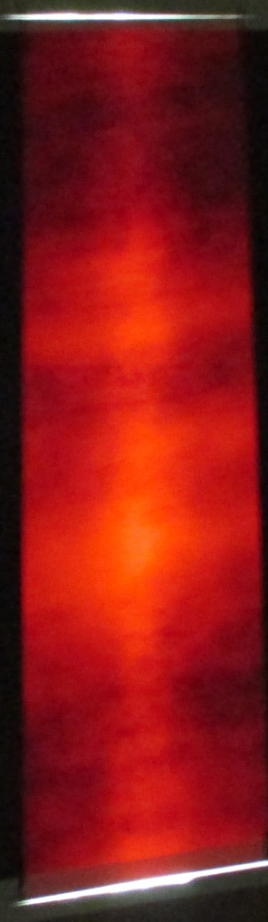
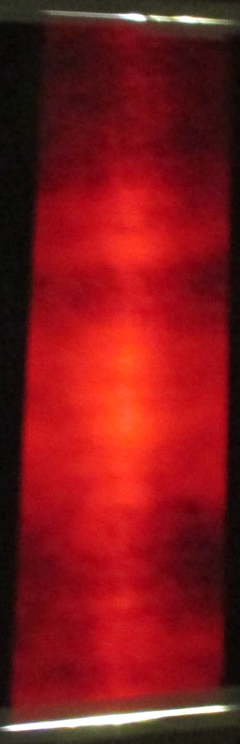
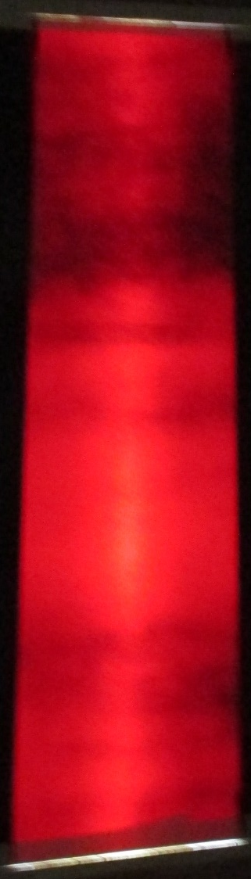
All assembled photos in one view.
2 dark bands are visible. There is an indication of higher transmission at the high “R” end (The yellow tape)
More light is transmitted in the centre of the panel rather than the top and bottom edges due to the greater thickness through which the light must travel to the camera ??

Slide 10
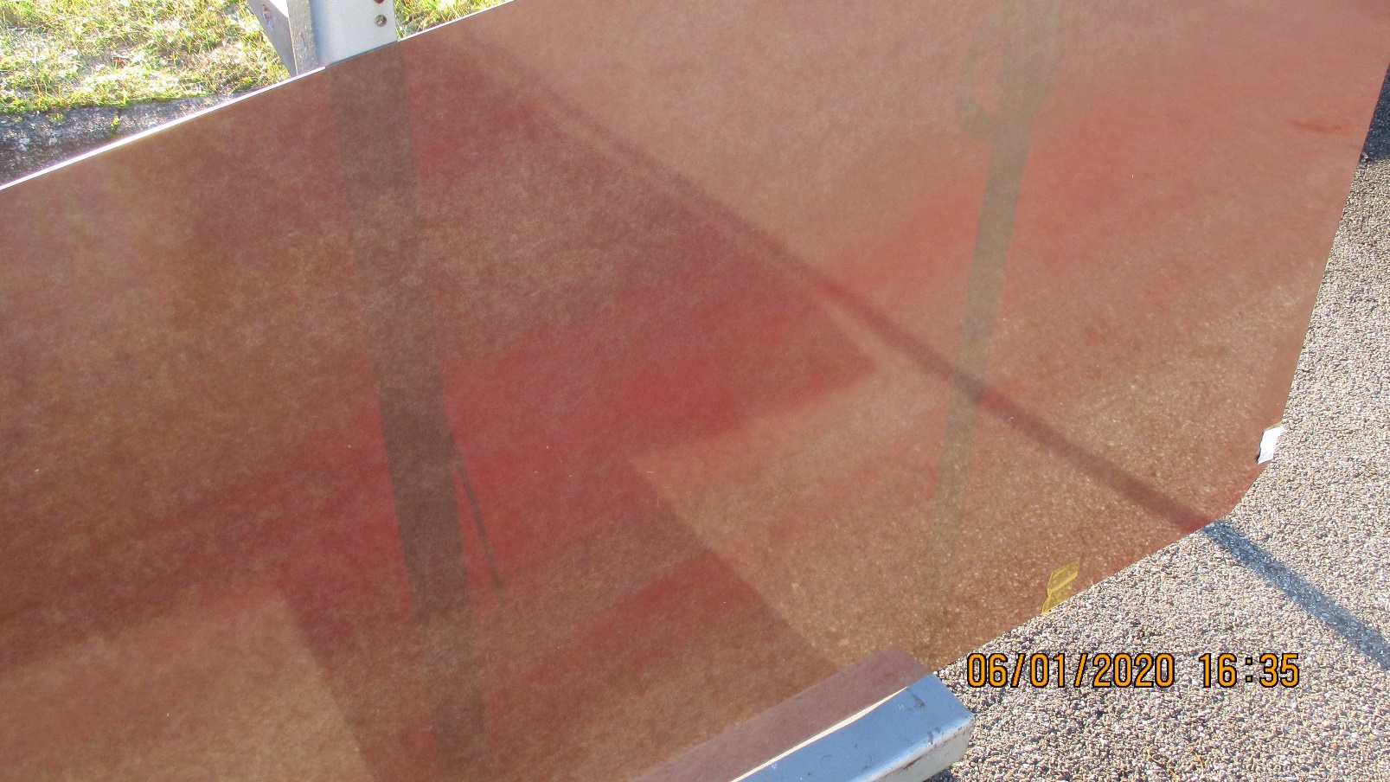
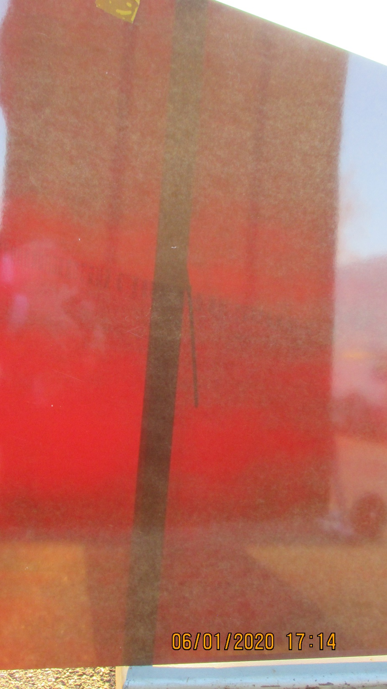
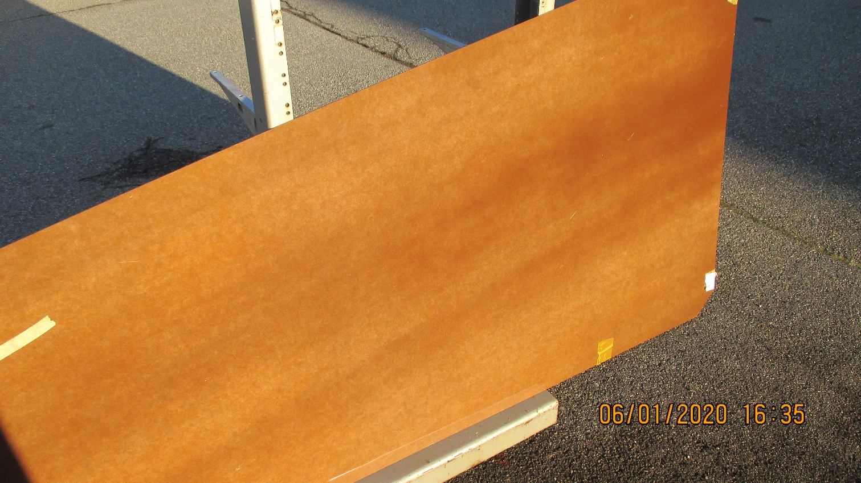
The piece of yellow tape.
Bottom RH corner.

Slide 11
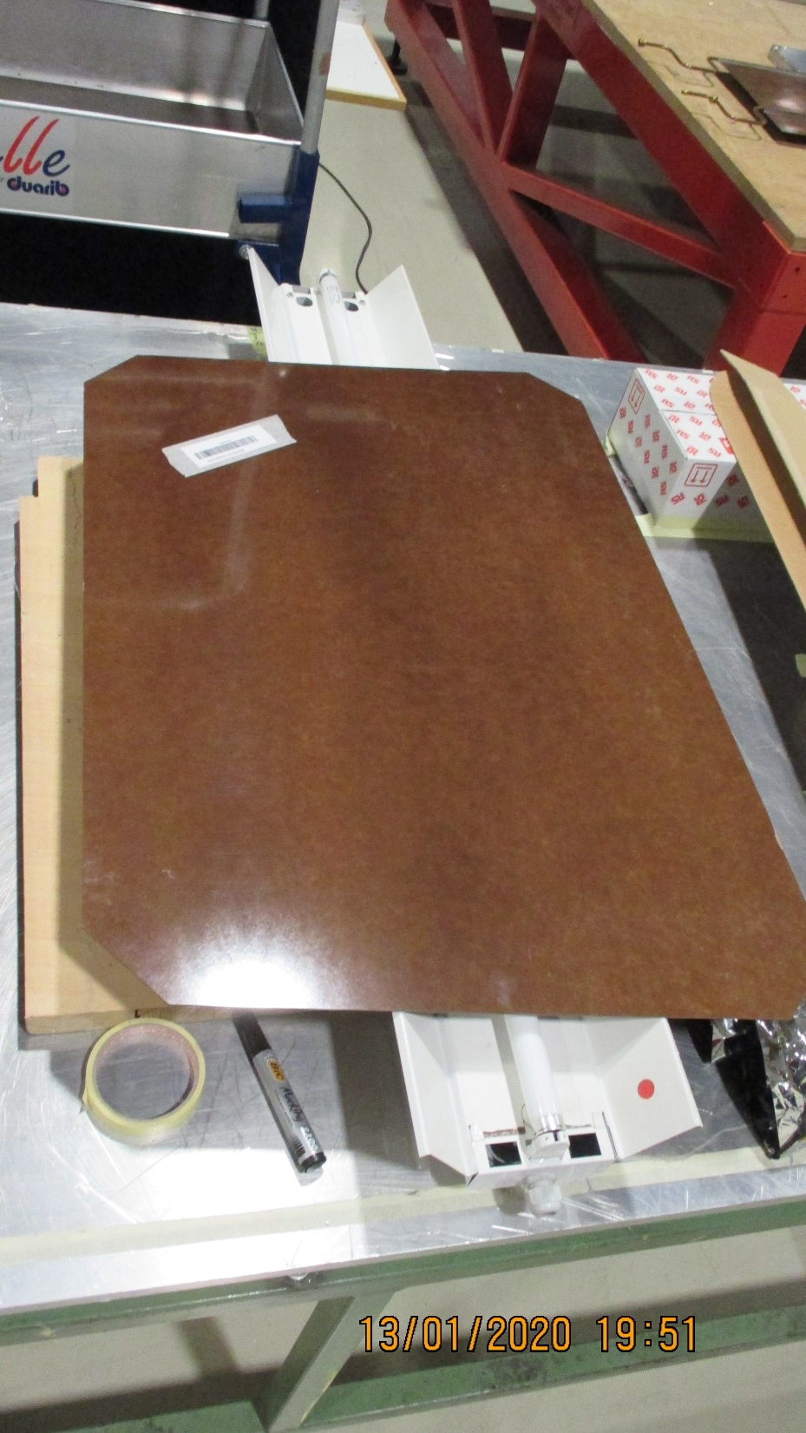
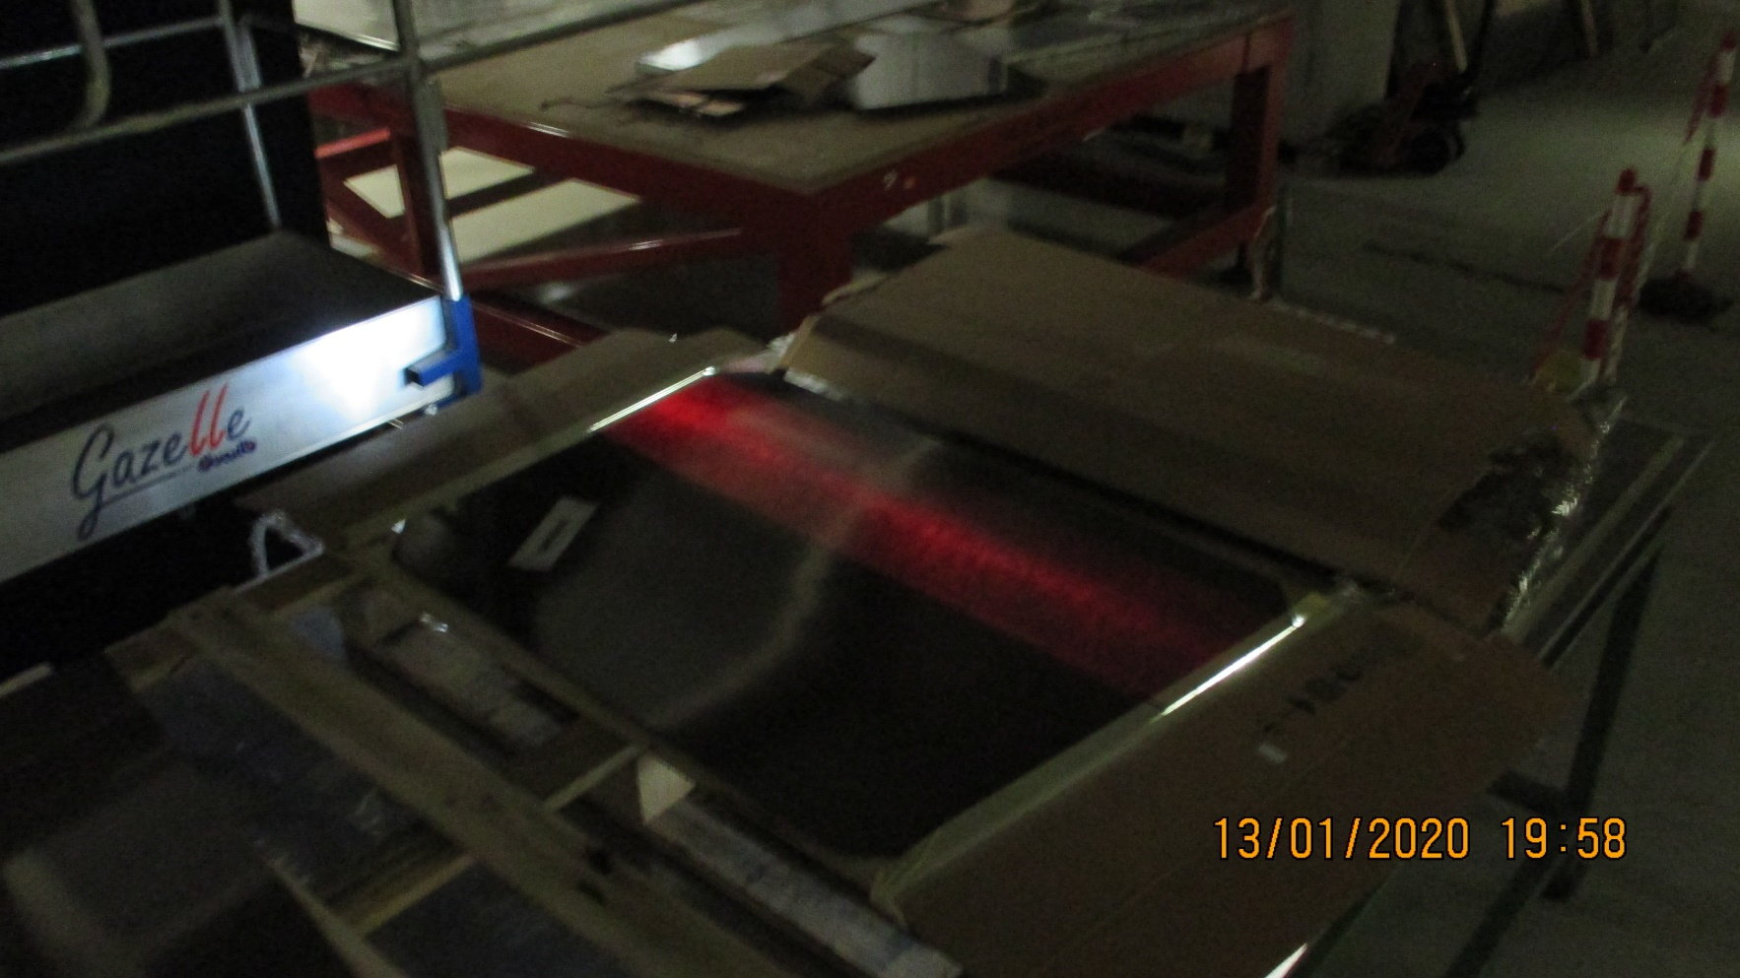
RE4/2 ? Top Wide Gap

Slide 12
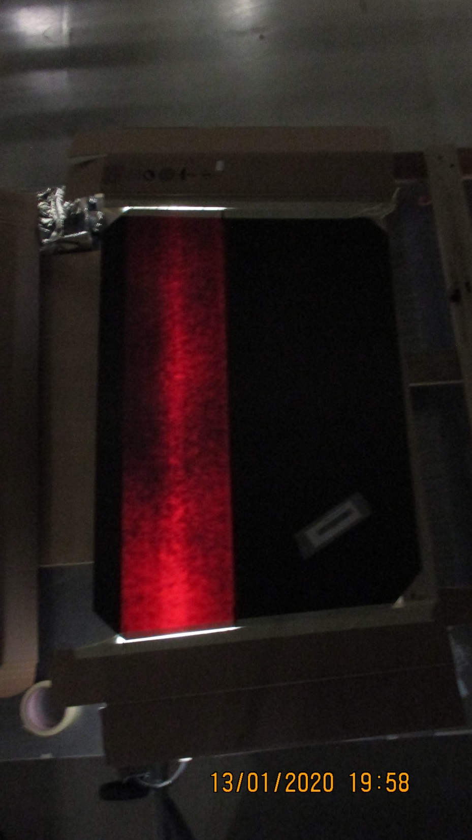
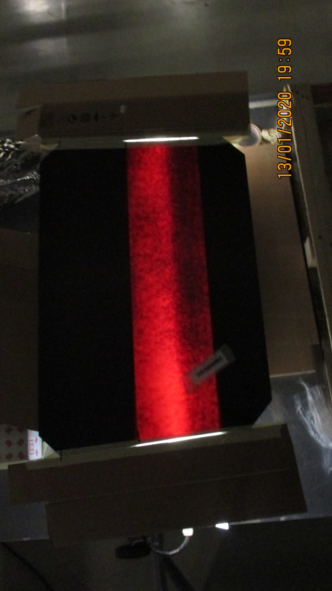
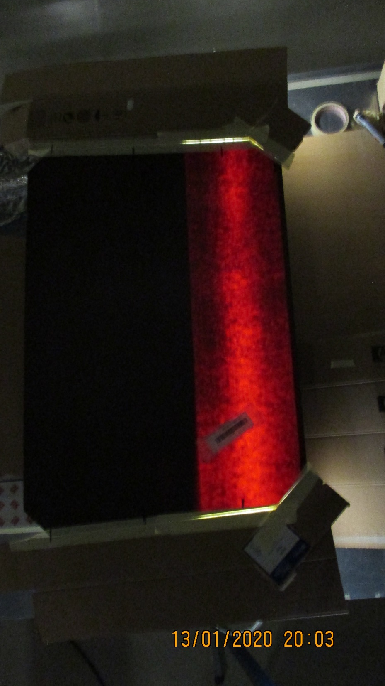
RE4/2 ? Top Wide Gap

Slide 13
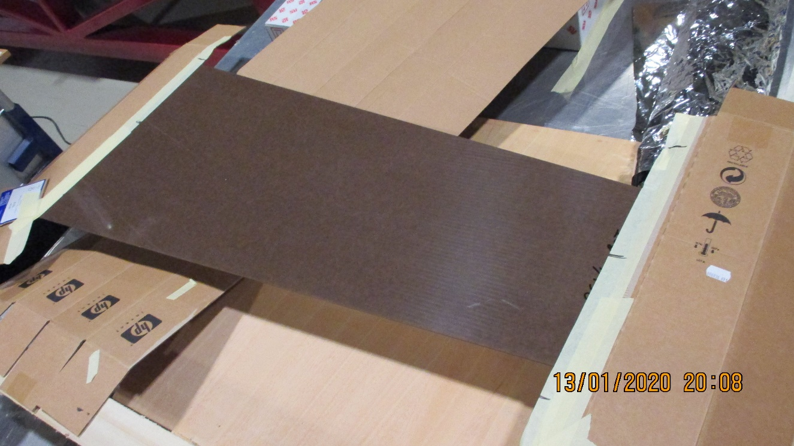
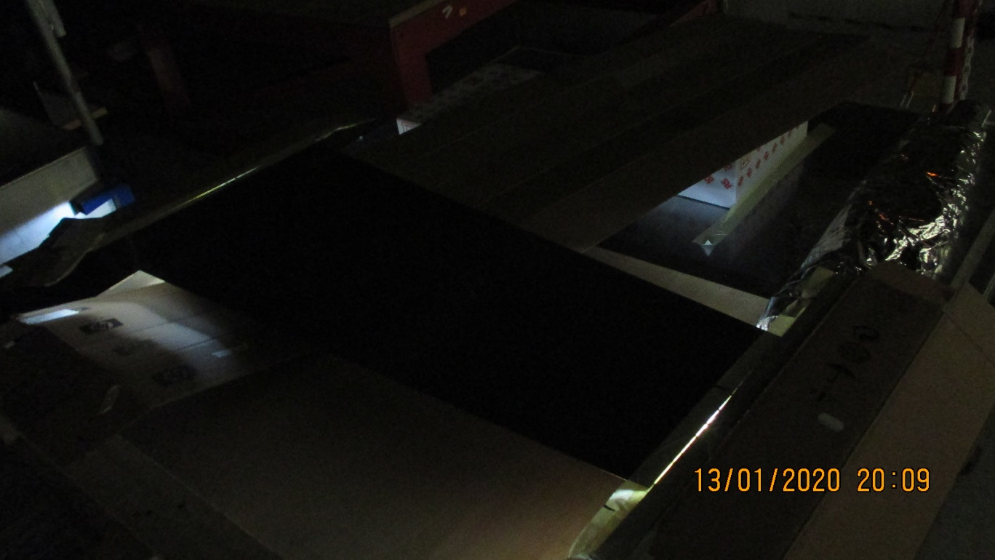
The earlier HPL is less transparent .
RE1/1 bottom panel
In day light on the left And in the dark with the light on in the dark on the right

Slide 14
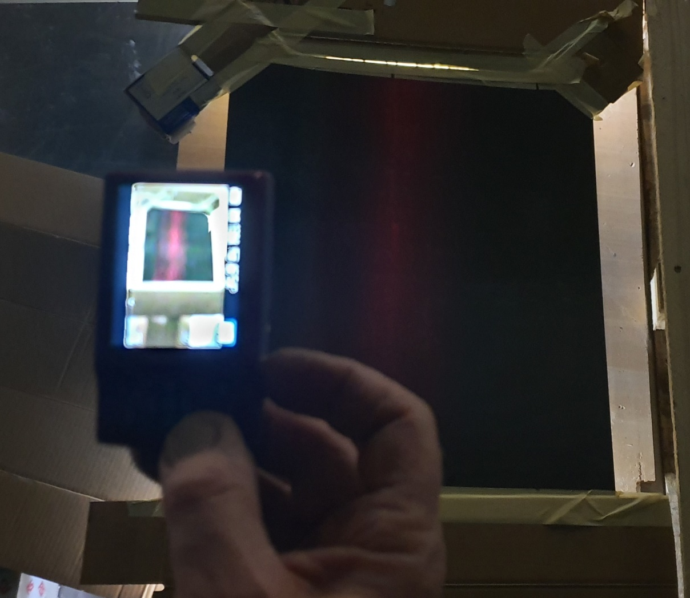
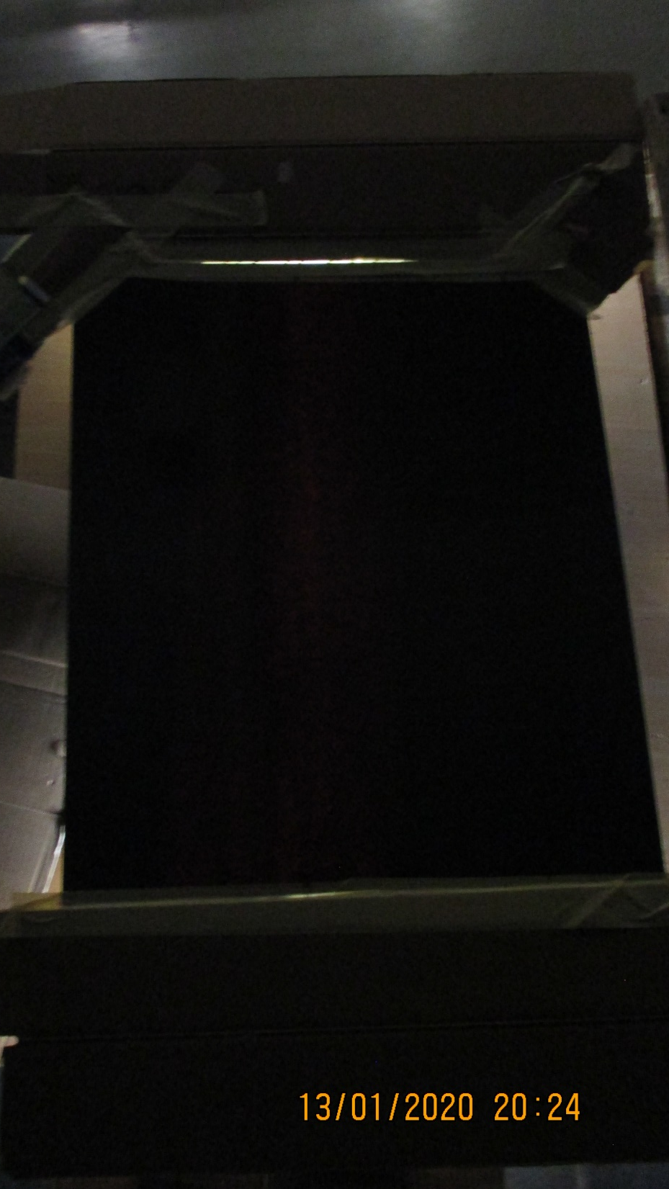
RE type2 Cut Top Wide Gap No ID
Smart phone taking a picture of the Nikon before the exposure is taken and the HPL is more luminous. The cameras have firmware that adjusts the photograph to make “the best shot” which is not necessarily what we want here.
Cheap Nikon camera, very slight transmission

Slide 15
Revert to the sun as a broad band intense and uniform light source but with reduction of the back reflection from “behind” the HPL

Slide 16
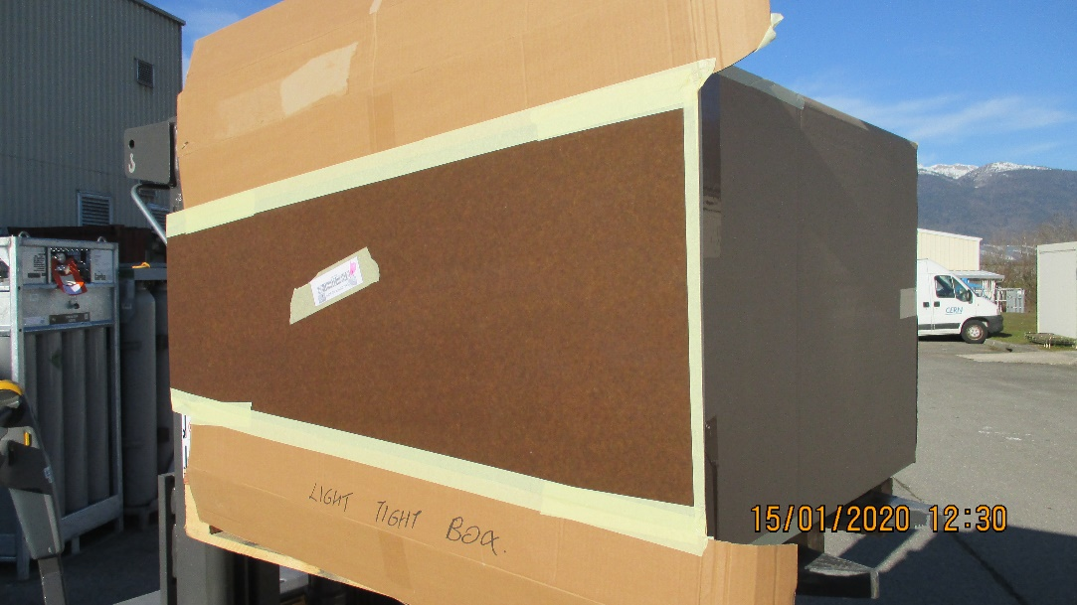
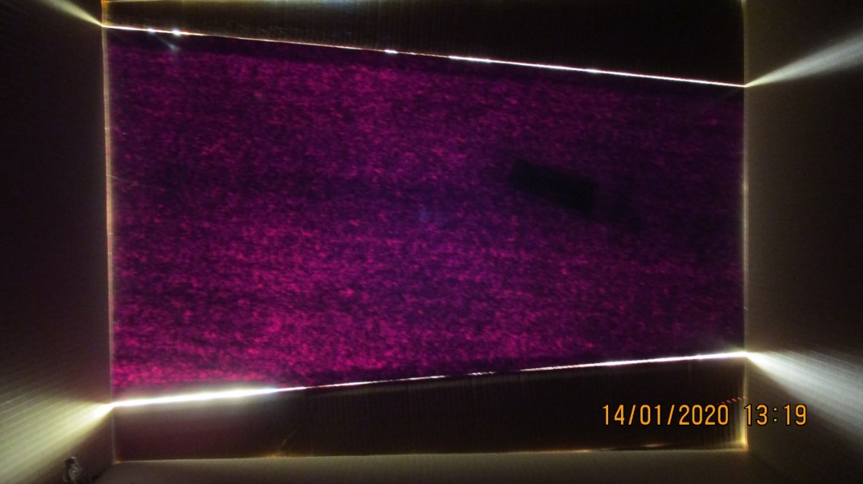
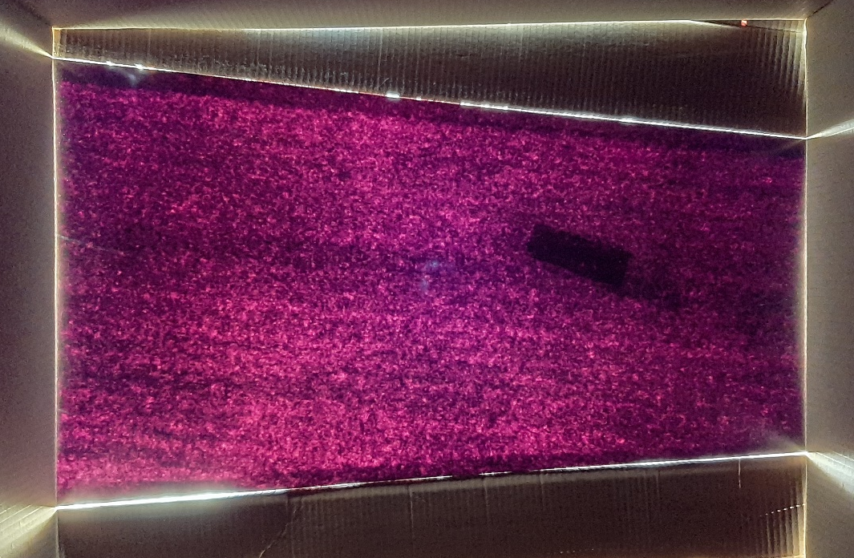
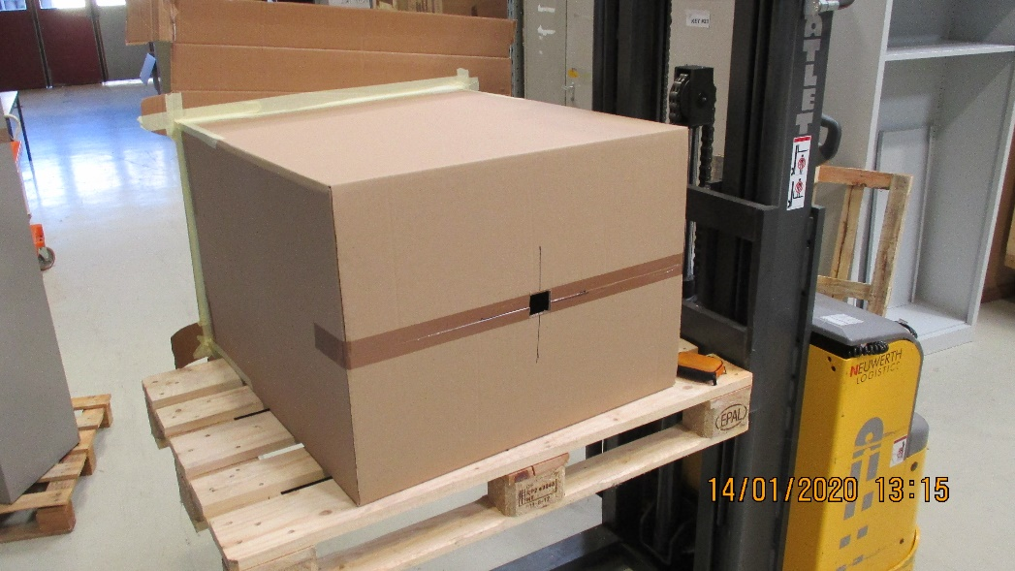
Looking through the small aperture at the HPL on the other side of the box that is facing the sun. The box is not light tight !
Nikon Camera
RE1/1 bot gap mounted on a nominally light proof box
Aperture on the opposite face of the box for the camera.
Samsung A50
The uniformity is far better than what has been observed so far, the piece is however small.

Slide 17
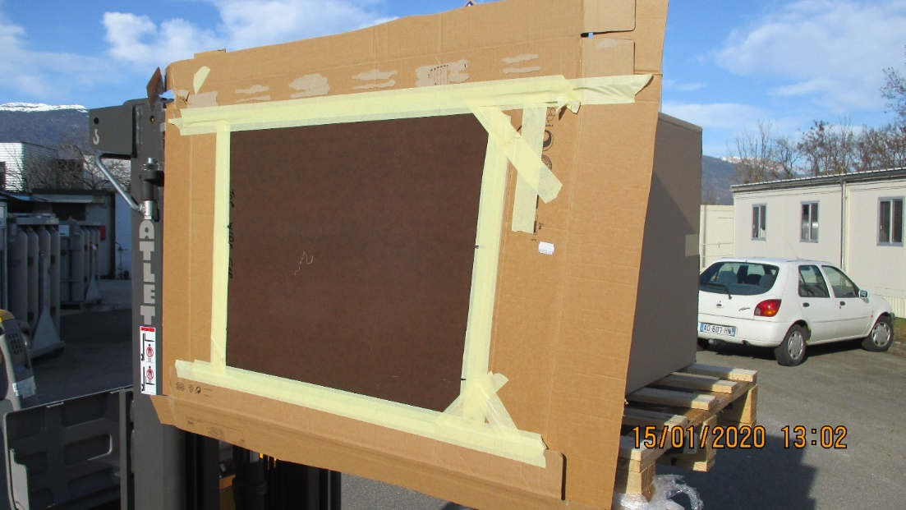
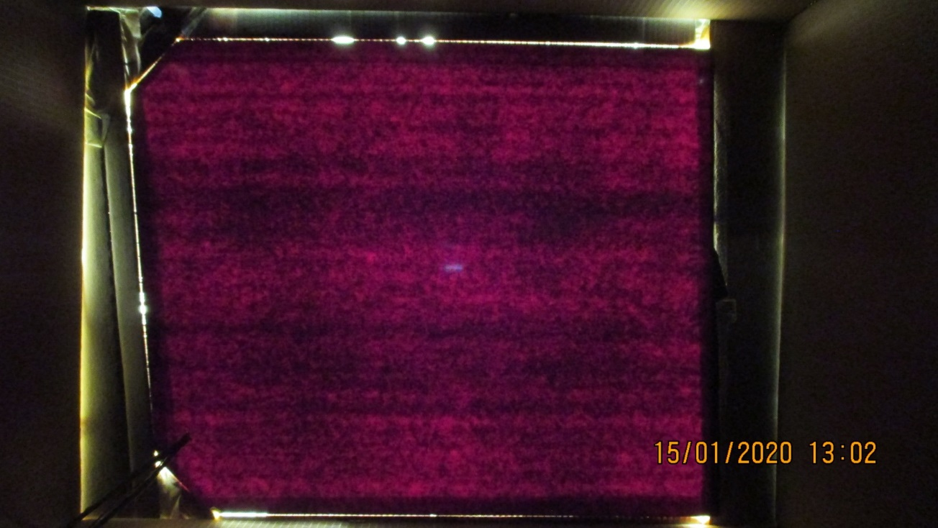
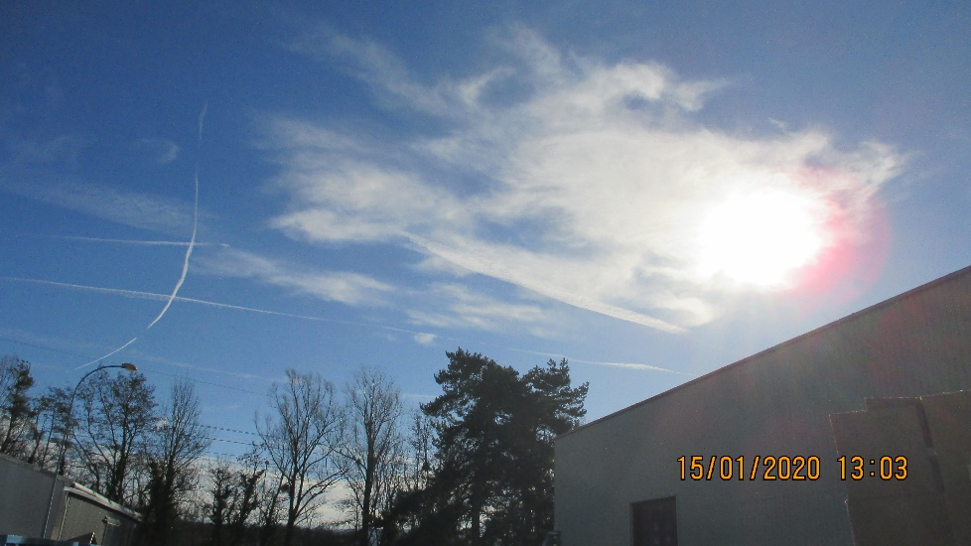
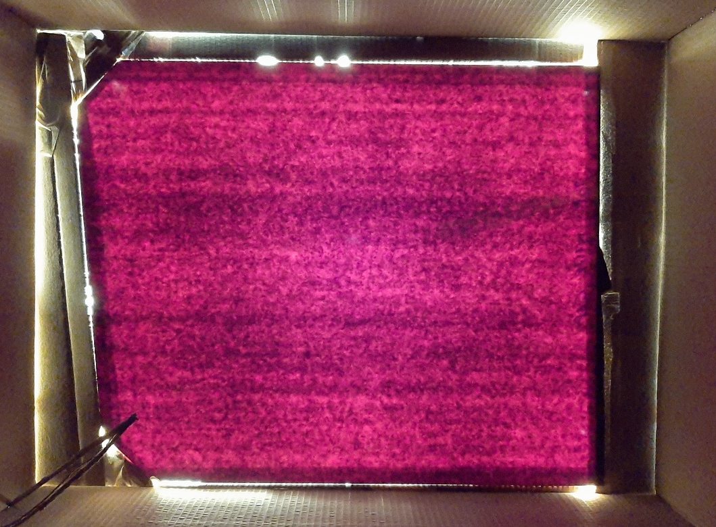
Nikon Camera
RE Cut Top Wide Gap No ID
The bright spot above, in the middle is the slit above the camera allowing light to enter and be reflected off the panel.
Slight cloud but little attenuation , especially in the red ?
Samsung A50

Slide 18
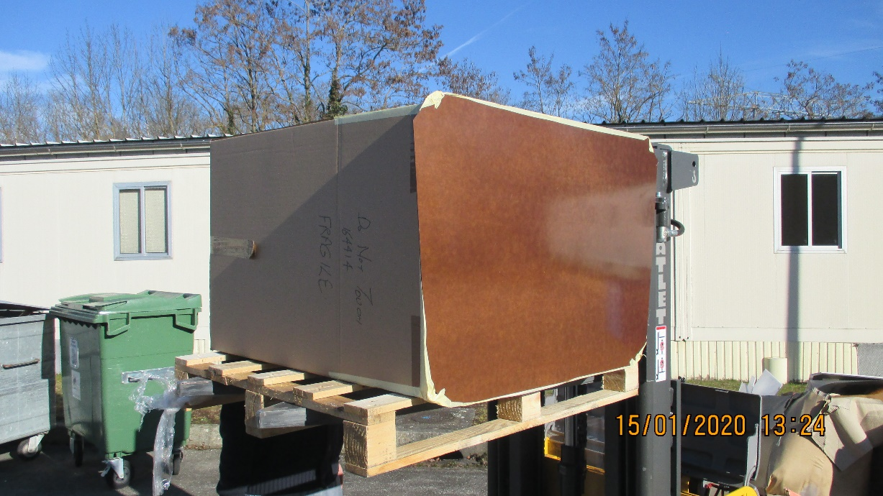
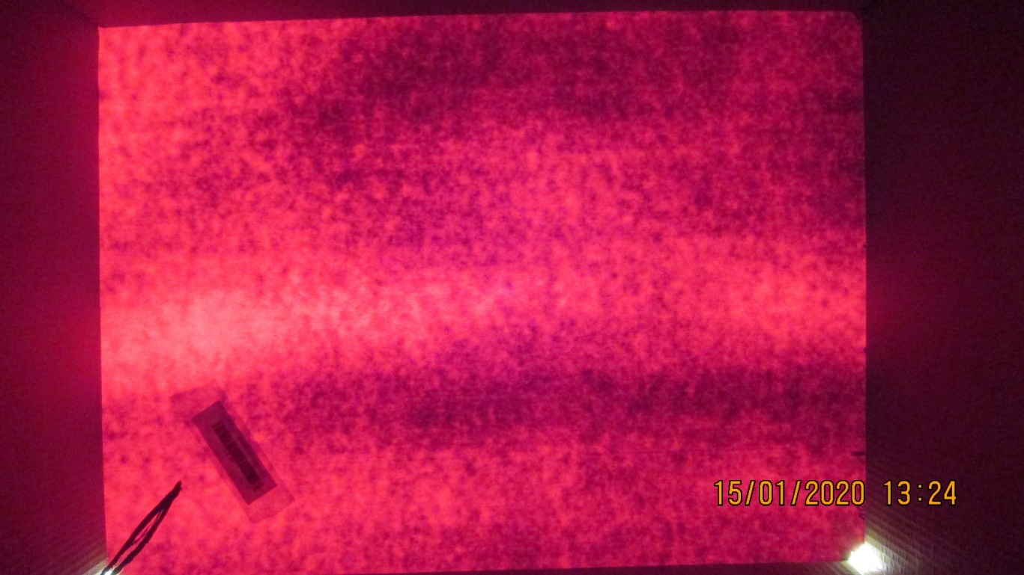
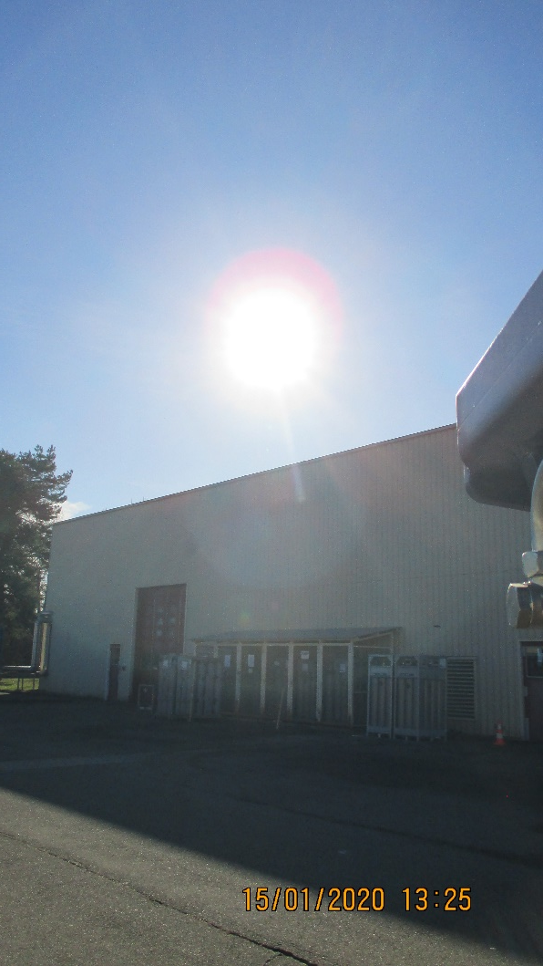
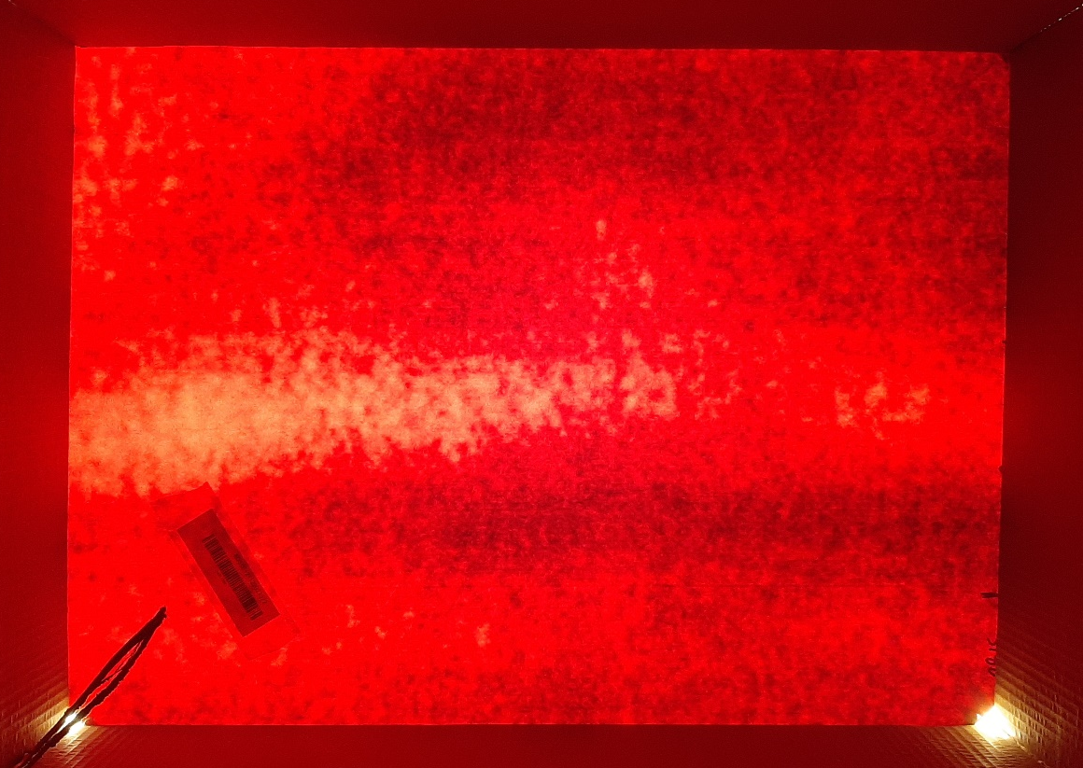
RE4/2 ? Top Wide Gap
Nikon Camera
Here the intensity is greater than the older samples. Perhaps a greater degree of dispersion is evident. The light streak on the LHS and the dark edges on the RHS and top.
The intense source
Samsung A50

Slide 19

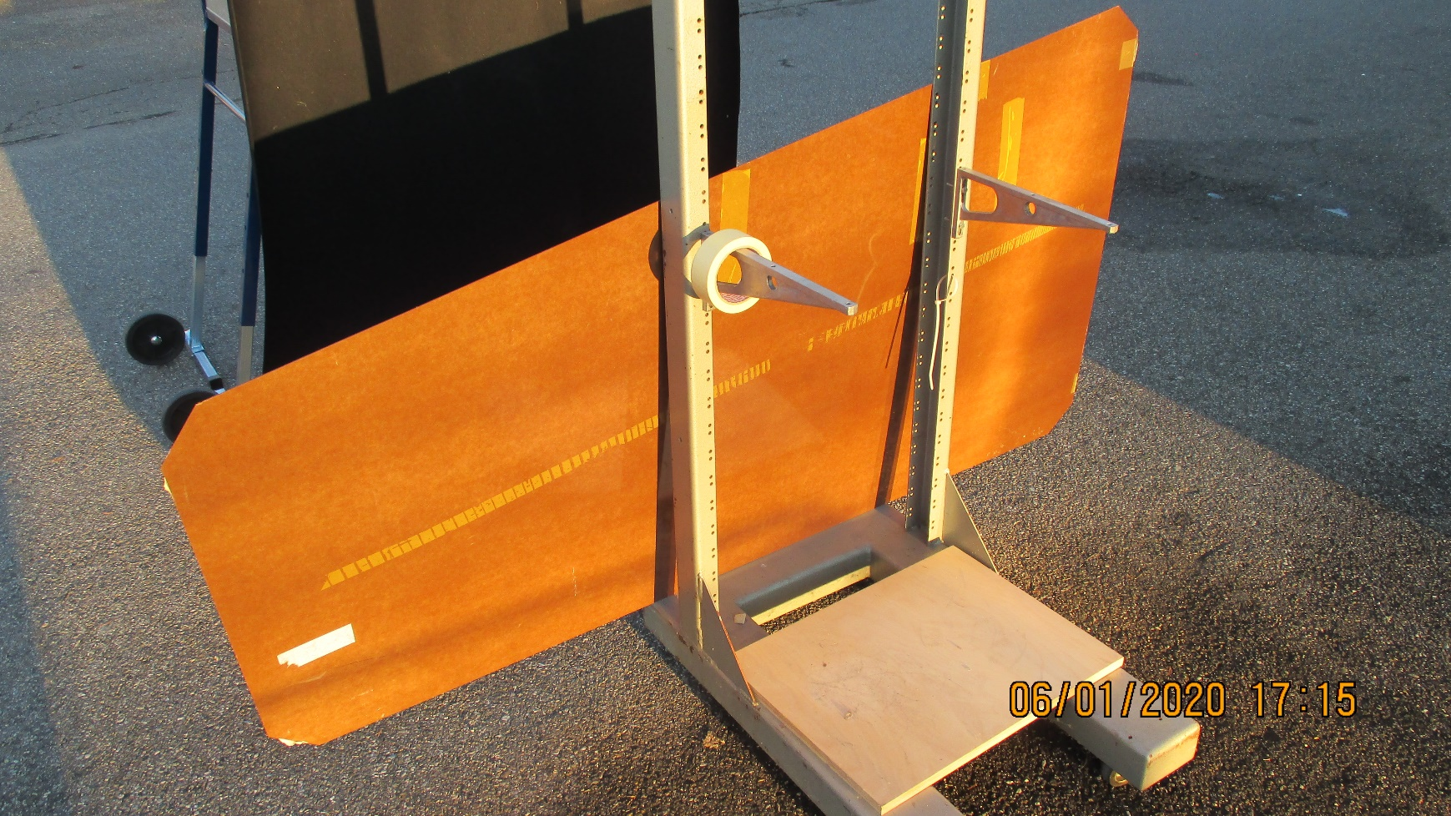
Unfortunately the largest panel was not put into a similar arrangement as a far bigger box would be required.
This was finally rectified as shown in the following slides.

Slide 20
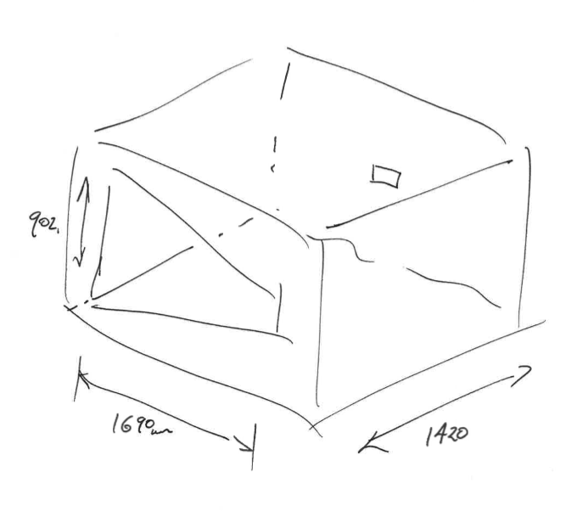
The specification of the light proof box.
The aperture angle necessary to cover the entire HPL sheet was achieved with a distance between the sheet and the camera, measured for both cameras and established at > 1420mm.
The dimensions of the HPL sheet are shown, with the aperture for the camera in the rear face.
Fortunately a suitable box was found with our CSC colleagues and kindly leant for this trial.
Dimensions; 2600 x 1370 x 1100mm. A little small on the width.

Slide 21
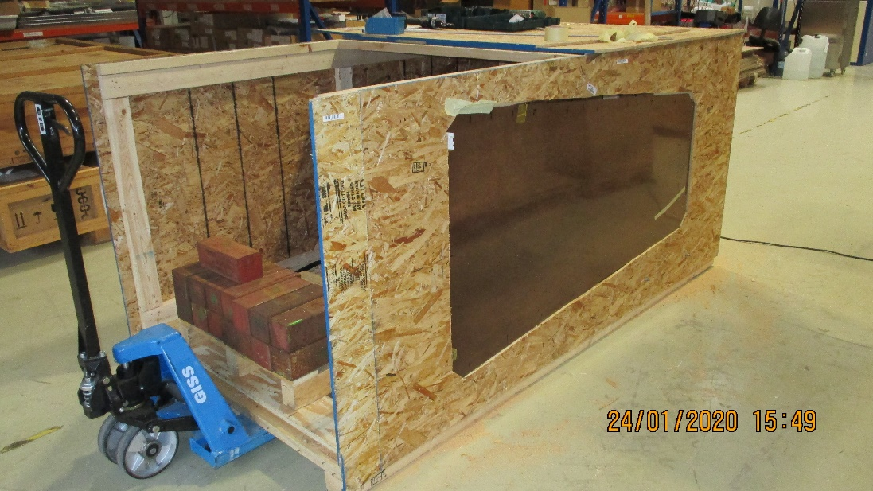
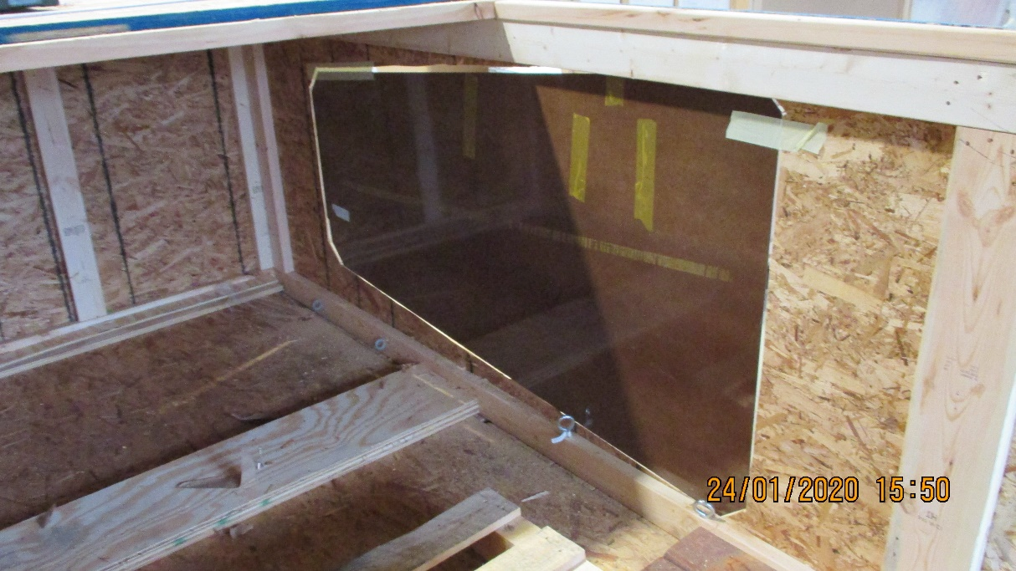
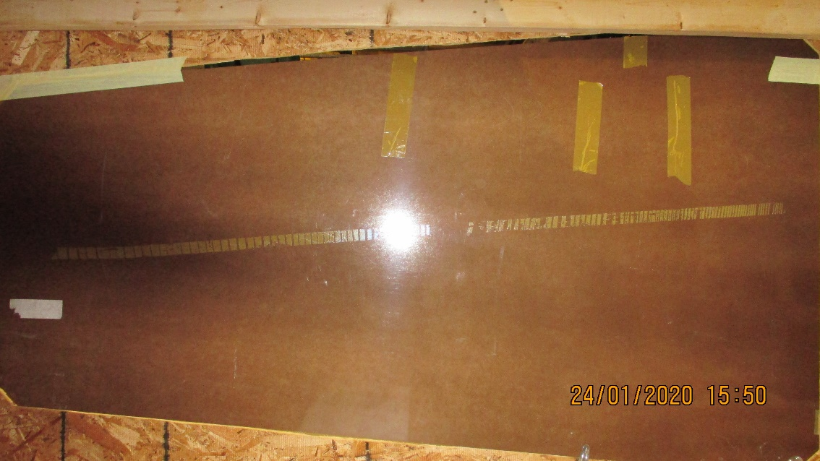
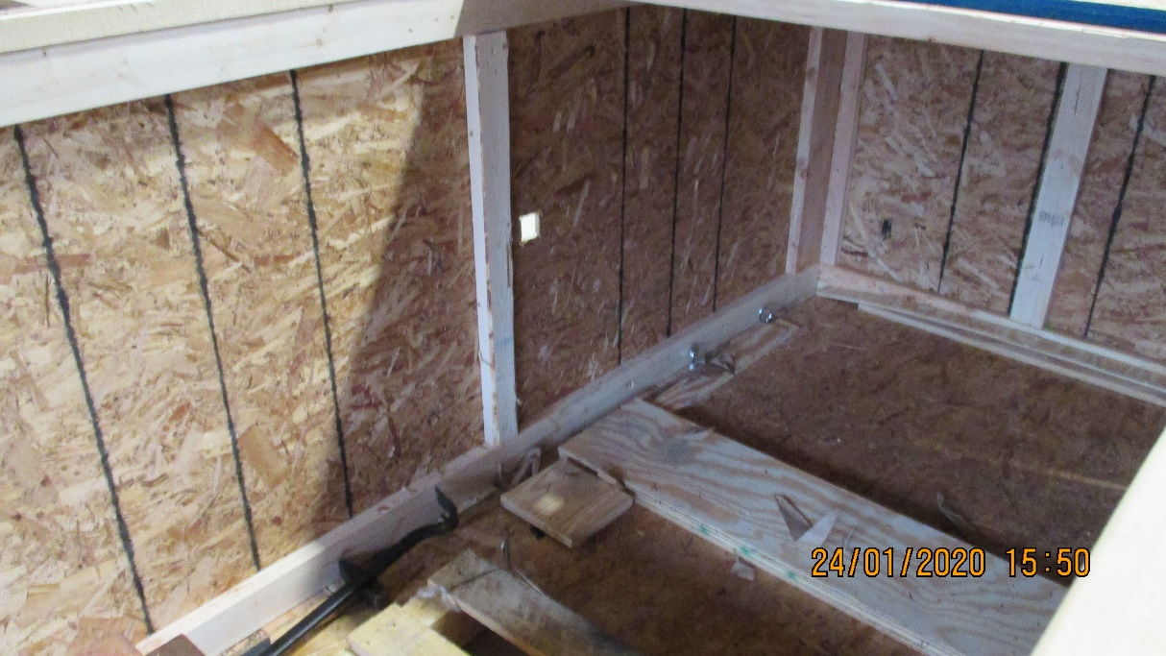
Counter weight ~ 180kg
HPL opening
The box modification.
Open up the necessary apertures, HPL and camera.
Counter weight to allow the ready movement of the large box.
Camera access on the opposite face
Distance from HPL to Camera is just sufficient, with the Nikon, to cover the full length of the RE type 2 bottom HPL panel.

Slide 22
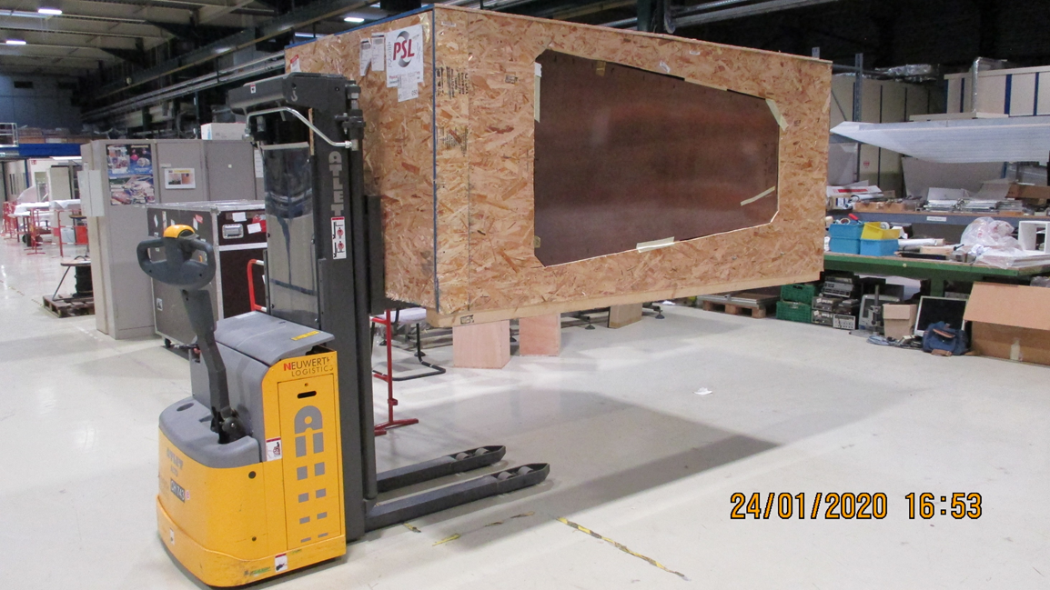
First shots taken inside as there is still no sun at this altitude.
See next slide
The yellow tape is at the top LH corner in this photo and in the top RH corner in the next slide

Slide 23
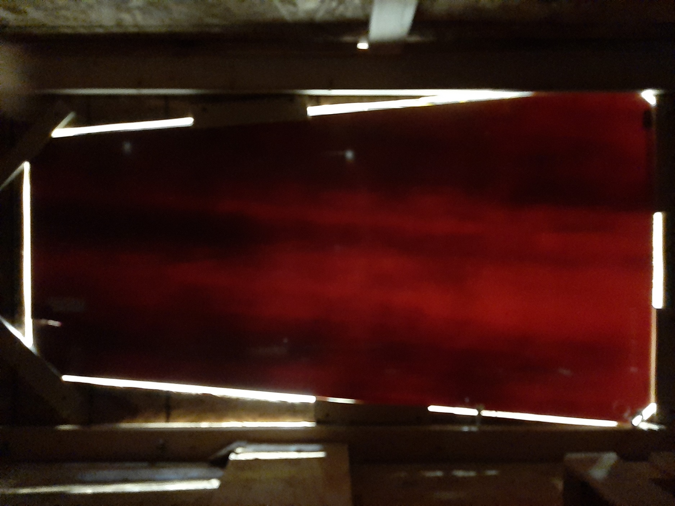
Results, qualitative so far.
Photos with Samsung A50.
The light source is the new LED lighting in the ceiling of 904 building.
The quality is poor perhaps due to the lack of light sealing around the edges of the panel.
Referring back to the multiple shots taken with the Neon light source (slide 9) a similar light distribution is seen, namely high transmission on the high “R” end (RHS) and two dark bands on the low “R” end (LHS).
No comparison for transmission intensity can be made as the source has changed

Slide 24


Finally the box in sealed AND the sun came out.

Slide 25


Nikon Camera
Using the sun as source, comparing cameras.
Samsung A50
RE4/2 Bot Gap
No ID

Slide 26


Nikon Camera
Compare the RE4/2 Bottom panel to RE4/2 Top wide gap Panel with the Nikon Camera.
Nikon Camera
RE4/2 Bot Gap
No ID
RE4/2 ? Top Wide Gap

Slide 27

Compare the RE4/2 Bottom panel to RE4/2 Top wide gap Panel with the Samsung A50.
RE4/2 Bot Gap
No ID
Samsung A50
What is this straight line formation ? See next slide.
RE4/2 ? Top Wide Gap

Slide 28

In addition the other pieces of yellow tape, here , can just be seen in the transmission view below, here.
The yellow tape applied to the HPL sheet has been removed but has left traces of the adhesive. Curiously the adhesive of this tape appears to leave more of a shadow than the full tape (x3) and adhesive………

Slide 29


Similar lighting from the Sun and Samsung Camera. Old production on the RHS and new on the left. The wave length of transmitted light through the panel on the RHS is higher (more Purple) than that on the LHS more red/orange/yellow. Question is the band gap higher on the RHS than the LHS ? If yes then the resistance of the RH panel is higher than on the LHS.

Slide 30



Slide from Paolo Vitulo showing red and infra red transmission
The difference, both intensity and wavelength shift, between the polymerised and unpolymerised samples is not clear. Ian’s comment.

Slide 31
Conclusion
The neon light gives a good idea of the transmittance over a long narrow section of the panel. It’s intensity is insufficient with the Nikon camera available.
There are different sensitivities of cameras and phone based cameras. A good knowledge of their operation is necessary. Choose a good smart phone !
The sun is a very good source when it is visible and there is no cloud movement.
Alternative light sources (Neons, LEDs etc) that are more readily available at least in this part of Europe, during winter, could be chosen.
The RE4/2 HPL panel is less homogeneous in light transmission than older production HPL. Assuming a correlation between the transmission and the panel composition it is clear that there are “streaks“ of non uniformity along the length of the HPL panel. As they are along the length, panel length ~ 1.7m which forces the length of the RE2 Bot panel to be orientated along the length of the HPL that is 3.2 x 1.6m, then they could be produced by the production of the kraft paper sheets. This then implies that the rollers of the machine running the paper through the phenolic resin are not producing a homogeneous pressure across the paper. Possibly there could be a non homogeneous mixture of resin in the bath the paper goes through but given the speed of this process I would assume that there is mixing action given by the movement of the paper alone. The higher resin content the higher the conductivity (see Ref)
The HPL sheets , old and new, give different transmission spectra indicating different chemical and or physical composition.
Can this principle be used as a Quality assurance instrument ? It would require some form of digitising to allow analysis.
There is still no correlation between the conductivity and transparency.
And in addition no correlation between variation of transmission (intensity & spectra) or conductivity and density, the phenol to paper proportions.
The humidity absorbtion could also be correlated to transmission intensity. Comment from Iuri Bagaturia
A means to measure the resistivity on a “small” dimension, few centimetres, is required .

Slide 33
Appendix
Camera types
Samsung A50 in “low light mode”
Nikon IXUS PC2048
Light sources
Neon Osram L 36W/865, Lumil UX “Cool daylight” (Hg) dated 08, 2018
Sun see following slide
904 LEDs no details

Slide 34
This document can be found here;
http://project-cms-rpc-endcap.web.cern.ch/project-cms-rpc-endcap/rpc/Production/Oil%20&%20Bakelite/Quality/Transparency/2ndStepQualitativeHPLOpticalTransmissionV3.pptx
The previous document is here;
http://project-cms-rpc-endcap.web.cern.ch/project-cms-rpc-endcap/rpc/Production/Oil%20&%20Bakelite/Quality/Transparency/TranparencyHPL6Jan2020V2.pptx
Paolo’s comment
http://project-cms-rpc-endcap.web.cern.ch/project-cms-rpc-endcap/rpc/Production/Oil%20&%20Bakelite/Quality/Transparency/TranparencyHPL6Jan2020V2_Paolo.pptx
Sources Light;
http://project-cms-rpc-endcap.web.cern.ch/project-cms-rpc-endcap/rpc/Production/Oil%20&%20Bakelite/Quality/Transparency/TransmissionWaveLengthSources.pptx
All photos;
http://project-cms-rpc-endcap.web.cern.ch/project-cms-rpc-endcap/rpc/Production/Oil%20&%20Bakelite/Quality/Transparency/Photos/

Slide 35

The Sun Characteristics
http://www.eng.uc.edu/~beaucag/Classes/SolarPowerForAfrica/BookPartsPVTechnical/Sunlight_01.pdf

Slide 36

https://www.researchgate.net/publication/315646504_Expanded_Graphite_Composite_Based_Bipolar_Plate_for_PEM_Fuel_Cell_Development_of_Low_Density_and_Low_Cost_Composite_Bipolar_Plate_for_Proton_Exchange_Membrane_Fuel_Cell/figures?lo=1

