Slide 1
Water Vapour and Resistivity and BaBar
Ian
18 Feb 2020

Slide 2
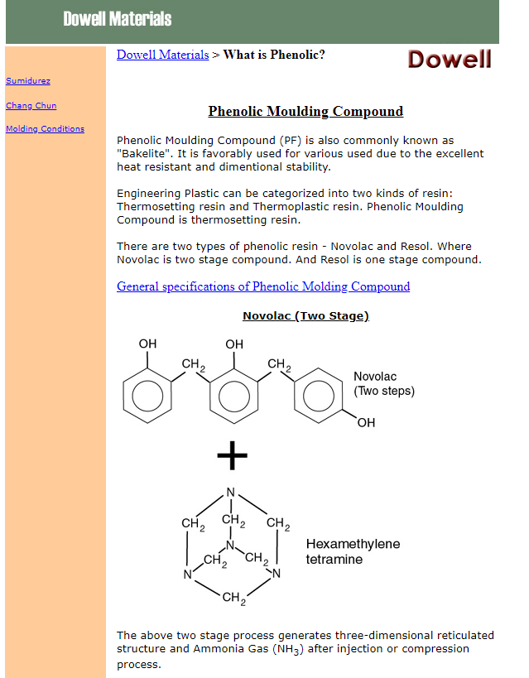
http://www.dowell.com.hk/whatisphenolic.htm

Slide 3
https://scholar.google.ch/scholar?q=water+permeability+of+plastics&hl=en&as_sdt=0&as_vis=1&oi=scholart

Slide 4
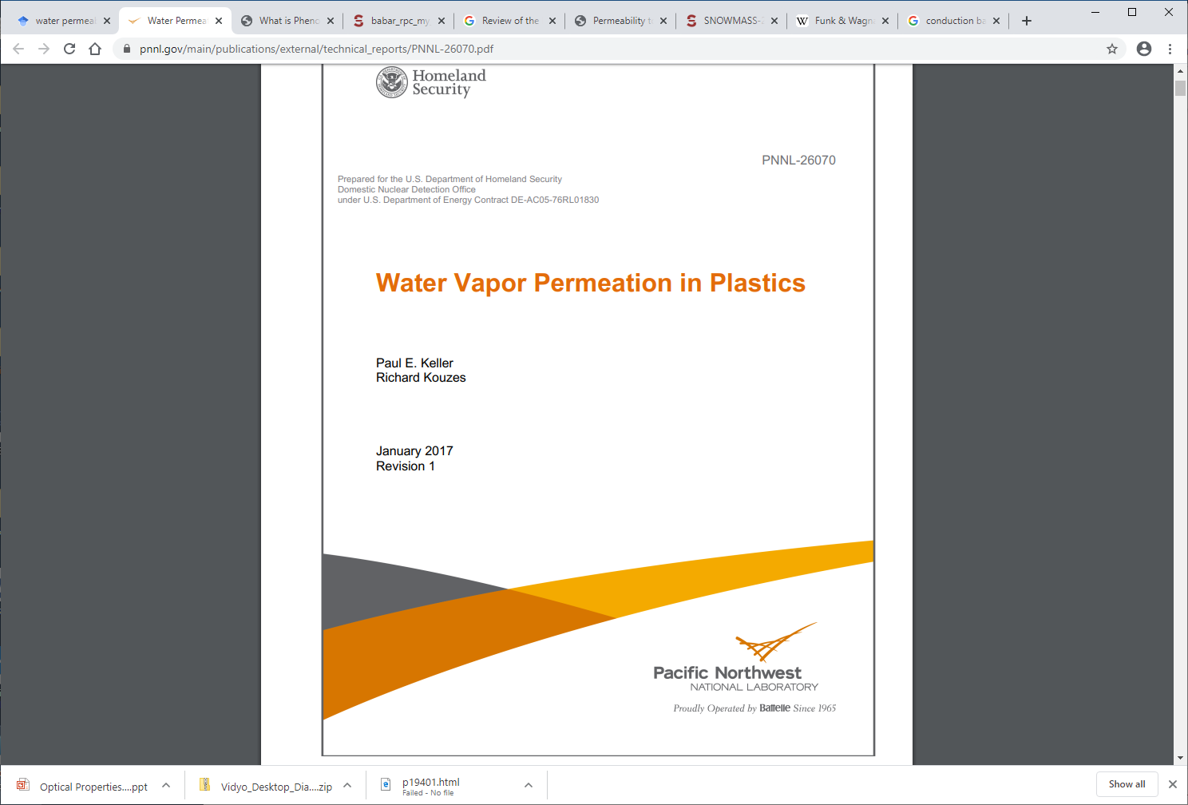
Water vapour into Scintillators
https://www.pnnl.gov/main/publications/external/technical_reports/PNNL-26070.pdf

Slide 5
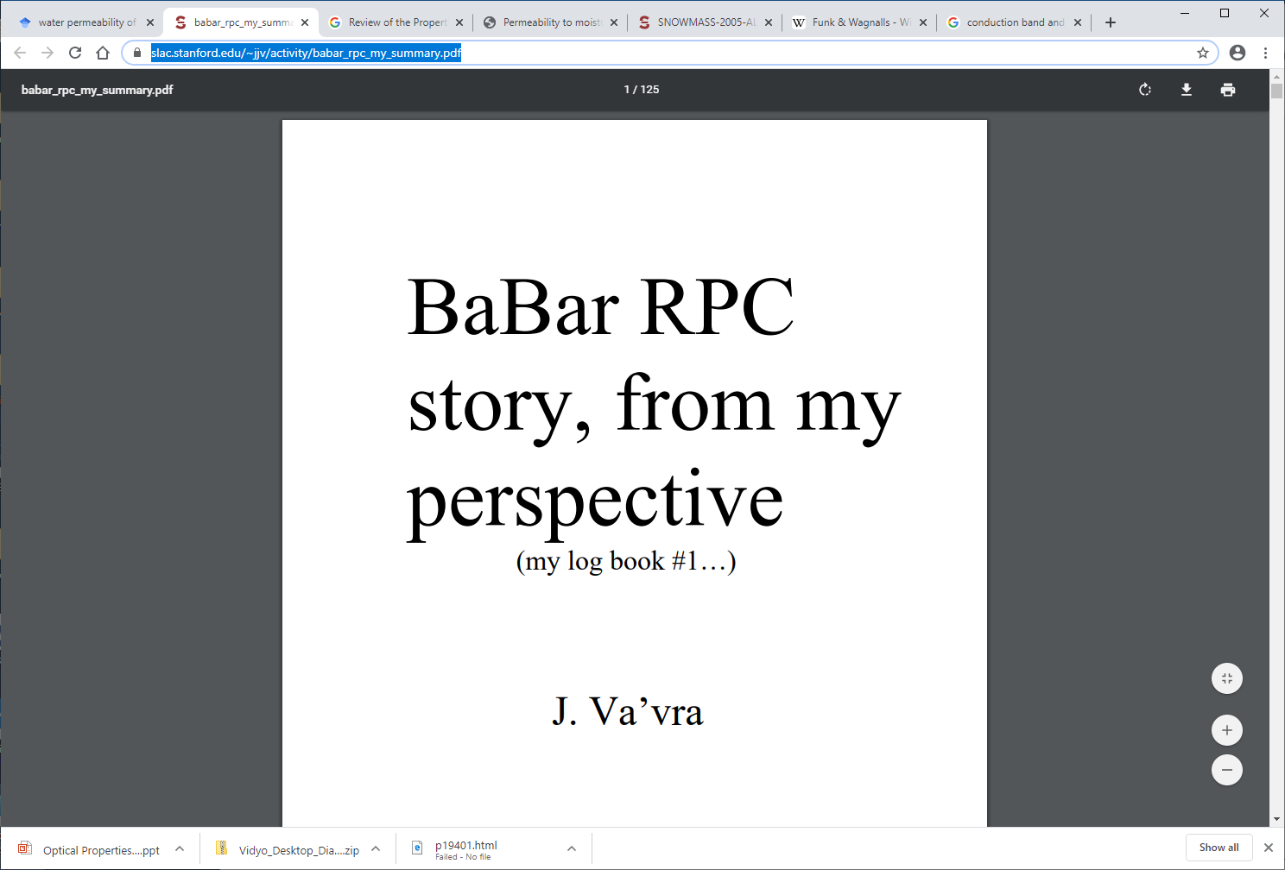
https://www.slac.stanford.edu/~jjv/activity/babar_rpc_my_summary.pdf
125 pages with photos

Slide 6
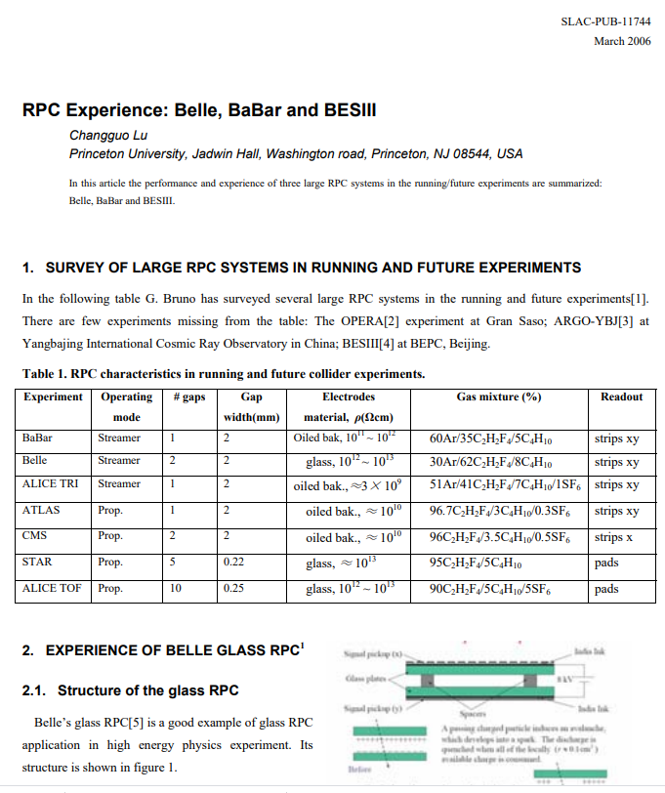
https://www.slac.stanford.edu/pubs/slacpubs/11500/slac-pub-11744.pdf

Slide 7
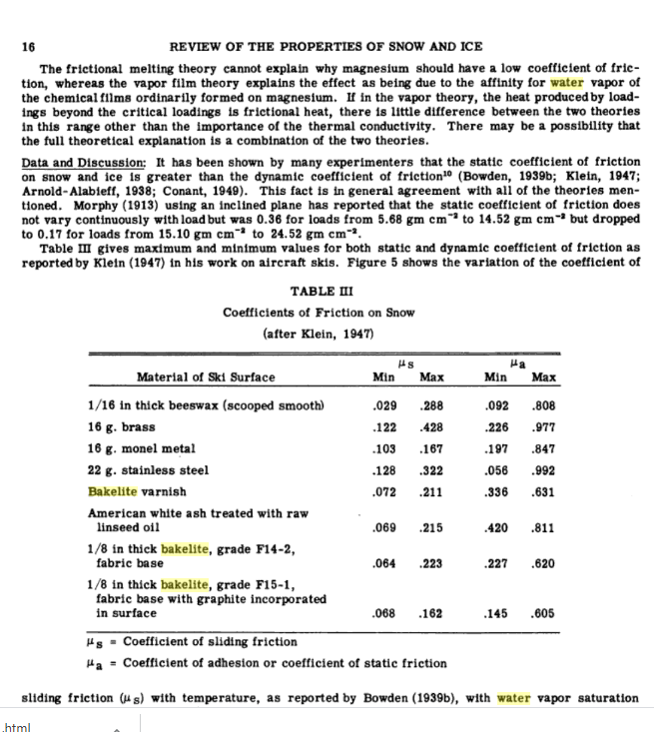
https://books.google.ch/books?id=Pfn0eS83DgIC&pg=PA16&lpg=PA16&dq=water+vapour+bakelite&source=bl&ots=EY2HU294rA&sig=ACfU3U0XGo6zP1PZafqyzPiclqrAaM2gZQ&hl=en&sa=X&ved=2ahUKEwixyLaivbjnAhWry6YKHeEkDPsQ6AEwDHoECAwQAQ#v=onepage&q=water%20vapour%20bakelite&f=false
Review of the Properties of Snow and Ice

Slide 8
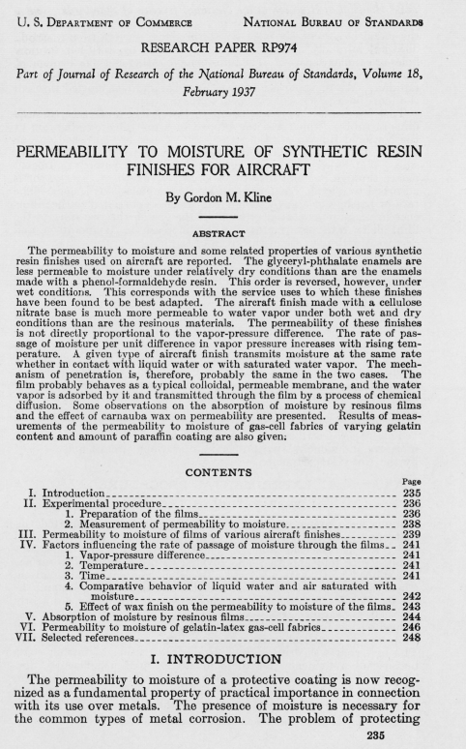
https://nvlpubs.nist.gov/nistpubs/jres/18/jresv18n2p235_A1b.pdf

Slide 9
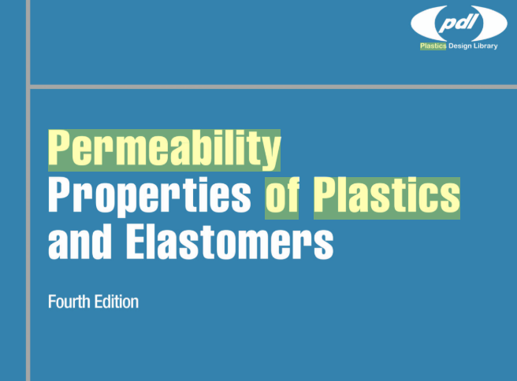
https://books.google.ch/books?hl=en&lr=&id=bUV5DAAAQBAJ&oi=fnd&pg=PP1&dq=water+permeability+of+plastics&ots=U4oBTB-wlE&sig=lV7oosM-ExYbJ2AalIfpQVfhysQ#v=onepage&q=water%20permeability%20of%20plastics&f=false
Permeability Properties of Plastics and Elastomers
By Laurence W. McKeen

Slide 10
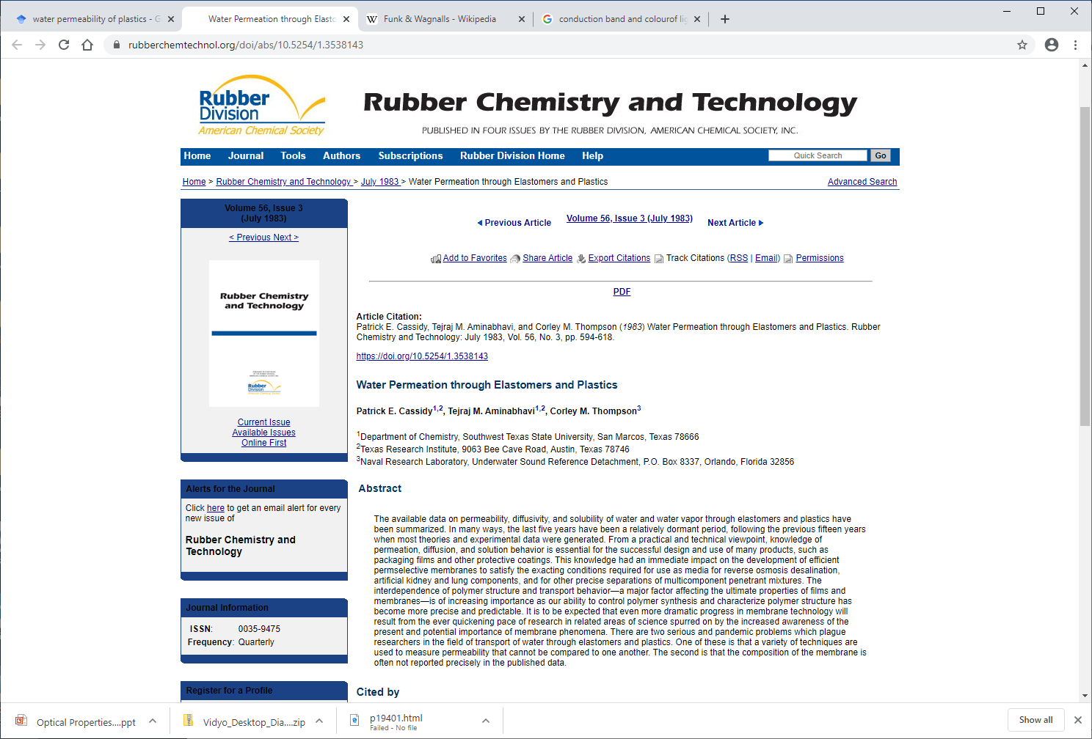
https://www.rubberchemtechnol.org/doi/abs/10.5254/1.3538143
Water Permeation through Elastomers and Plastics
Patrick E. Cassidy1,2, Tejraj M. Aminabhavi1,2, Corley M. Thompson3
The available data on permeability, diffusivity, and solubility of water and water vapor through elastomers and plastics have been summarized. In many ways, the last five years have been a relatively dormant period, following the previous fifteen years when most theories and experimental data were generated. From a practical and technical viewpoint, knowledge of permeation, diffusion, and solution behavior is essential for the successful design and use of many products, such as packaging films and other protective coatings. This knowledge had an immediate impact on the development of efficient permselective membranes to satisfy the exacting conditions required for use as media for reverse osmosis desalination, artificial kidney and lung components, and for other precise separations of multicomponent penetrant mixtures. The interdependence of polymer structure and transport behavior—a major factor affecting the ultimate properties of films and membranes—is of increasing importance as our ability to control polymer synthesis and characterize polymer structure has become more precise and predictable. It is to be expected that even more dramatic progress in membrane technology will result from the ever quickening pace of research in related areas of science spurred on by the increased awareness of the present and potential importance of membrane phenomena. There are two serious and pandemic problems which plague researchers in the field of transport of water through elastomers and plastics. One of these is that a variety of techniques are used to measure permeability that cannot be compared to one another. The second is that the composition of the membrane is often not reported precisely in the published data.

