Slide 1
Large gap produced using Puricelli Bakelite
Small gap produced using Pampla Bakelite
Applied the exactly same procedure of gluing gaps
Applied the exactly same oiling procedure (quick double oil coating)
Oil varnishing and drying at T = 31 C
Rate of compressed air = 100 liter / hour
Air drying hours = 156 hours
Puricelli gap:
Bakelite: dark red colored and is dotted/spotted and not uniform
Found continuous condensation bubbles over the whole surface in spite of applying quick double coating
There are many thin oiled layered area at the regions near gap edge, spacers, and gas pipes
Pampla gap:
Bakelite: dark brown colored and uniform
Found no condensation bubbles
Found no defect on the oil layer

Slide 2
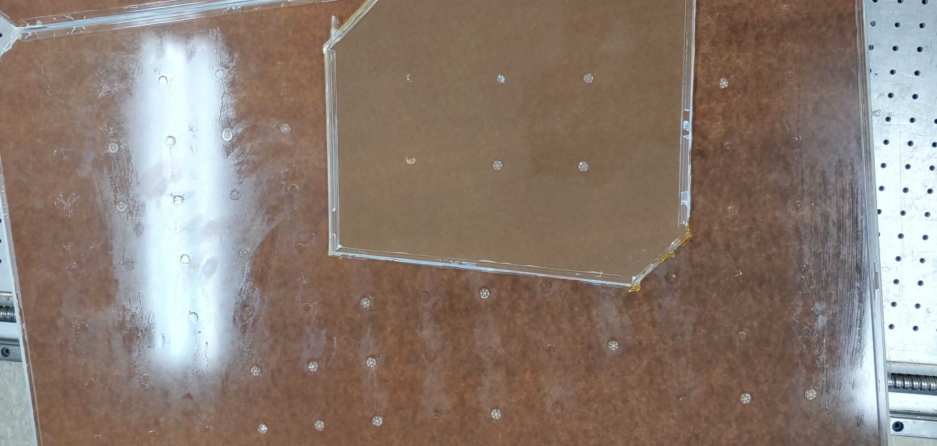
Puricelli (large gap) vs Pampla (small gap)

Slide 3
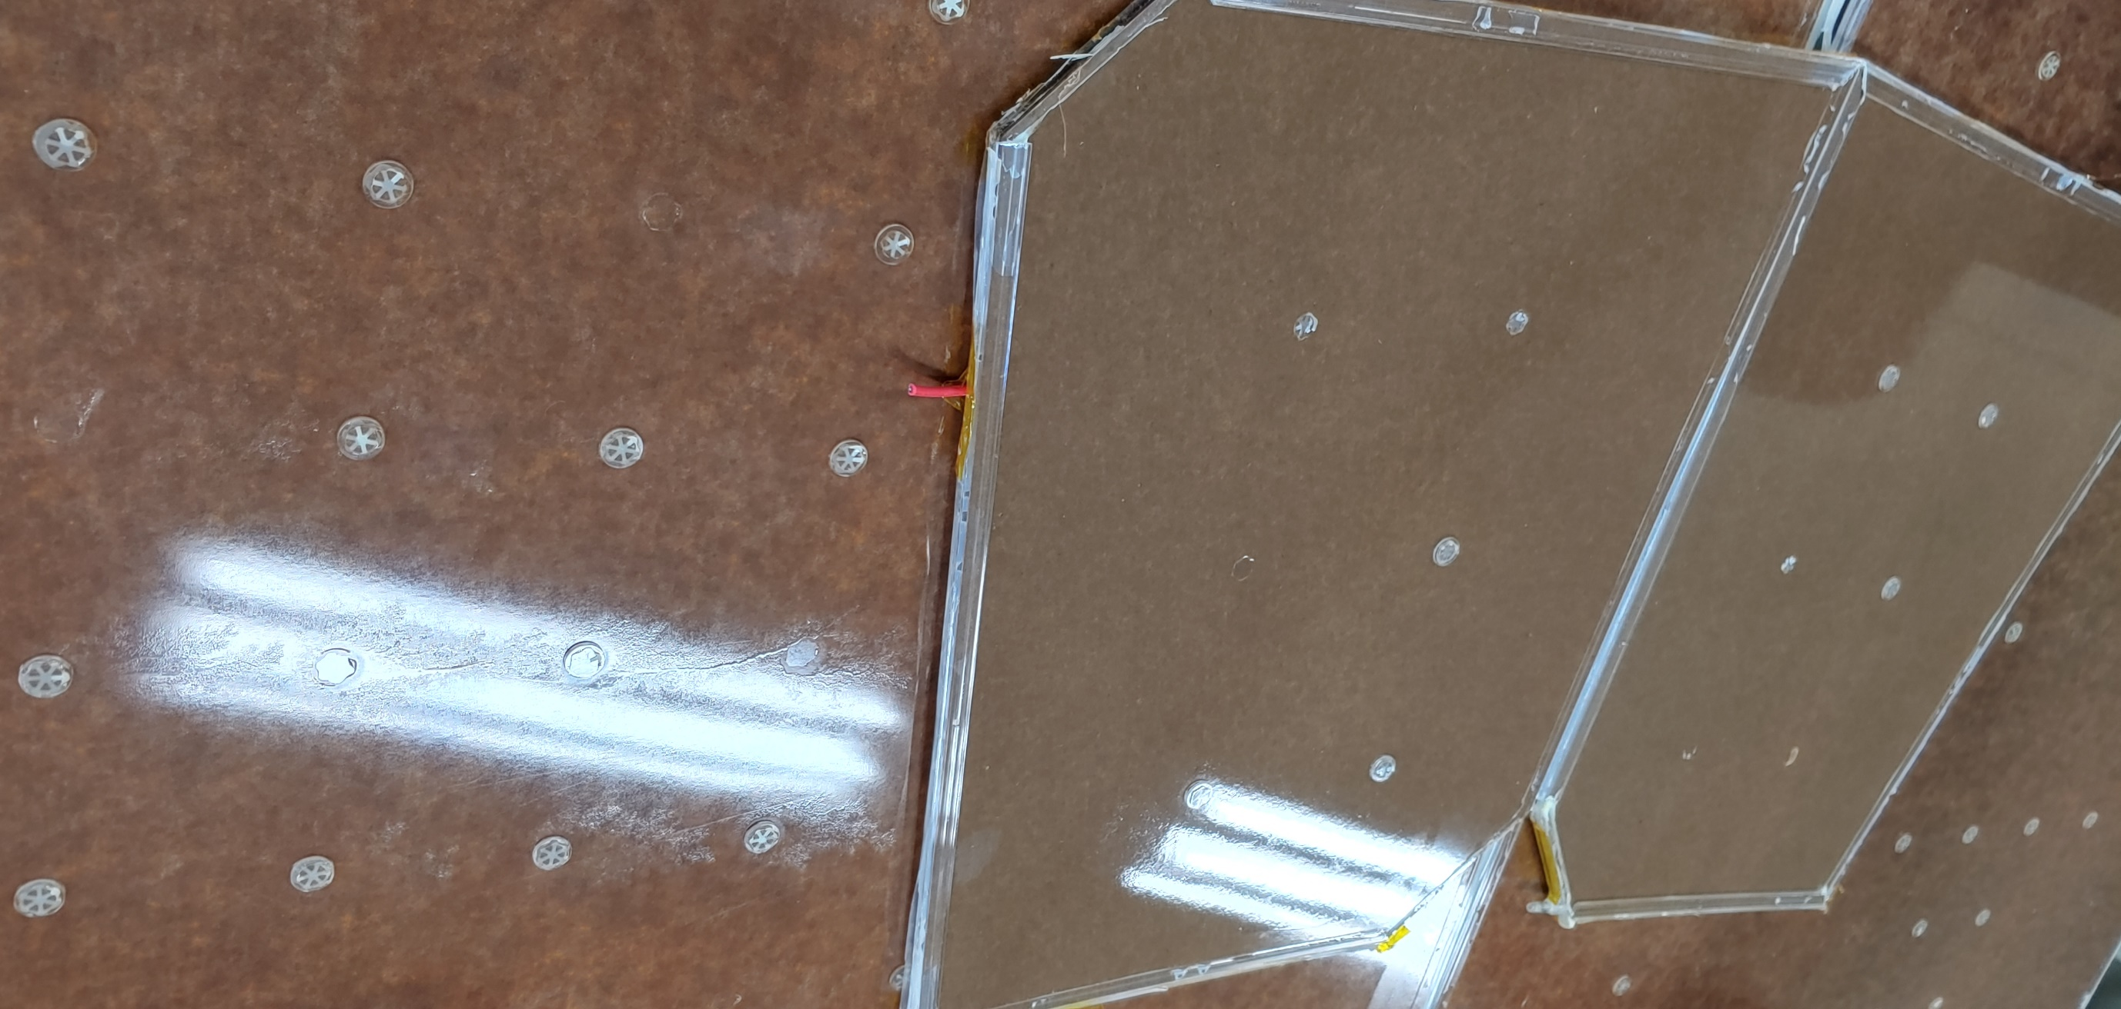
Puricelli (large gap) vs Pampla (small gap)

Slide 4
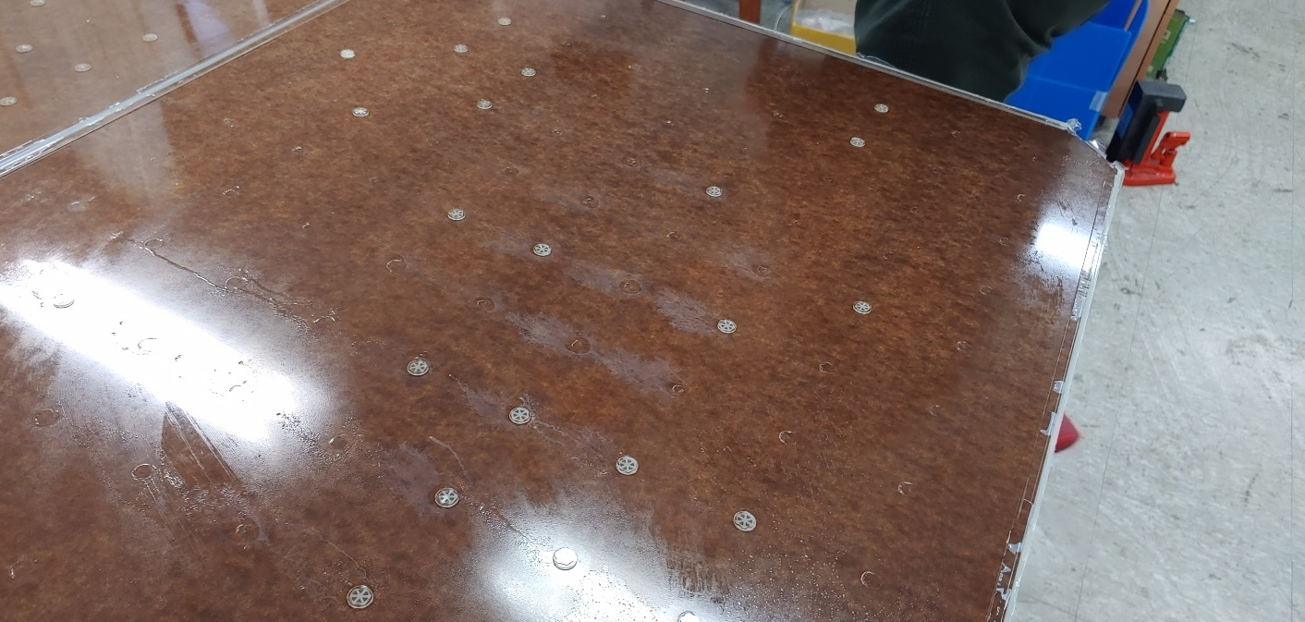
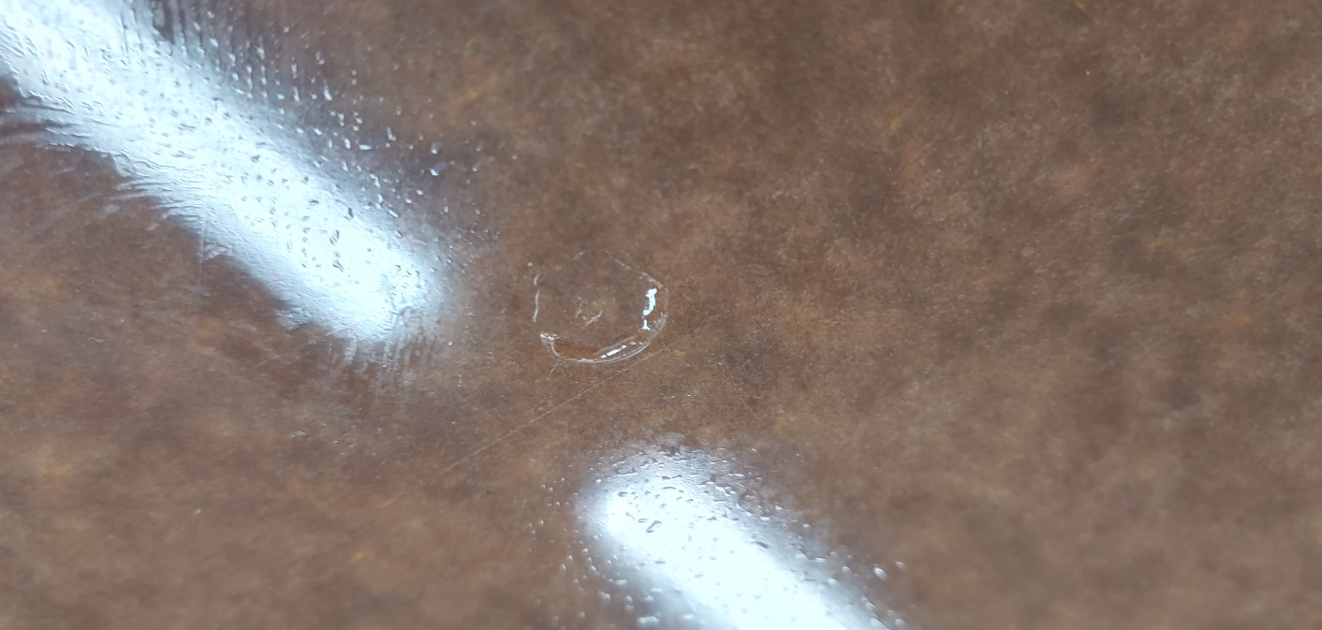
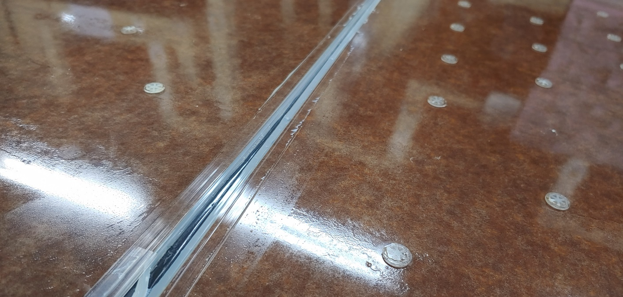
Puricelli gap (Large)

Slide 5
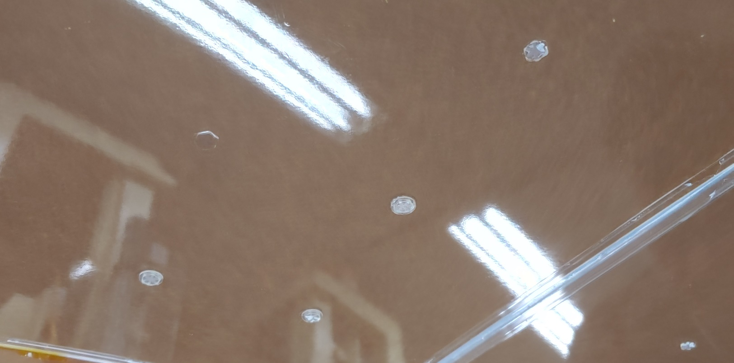
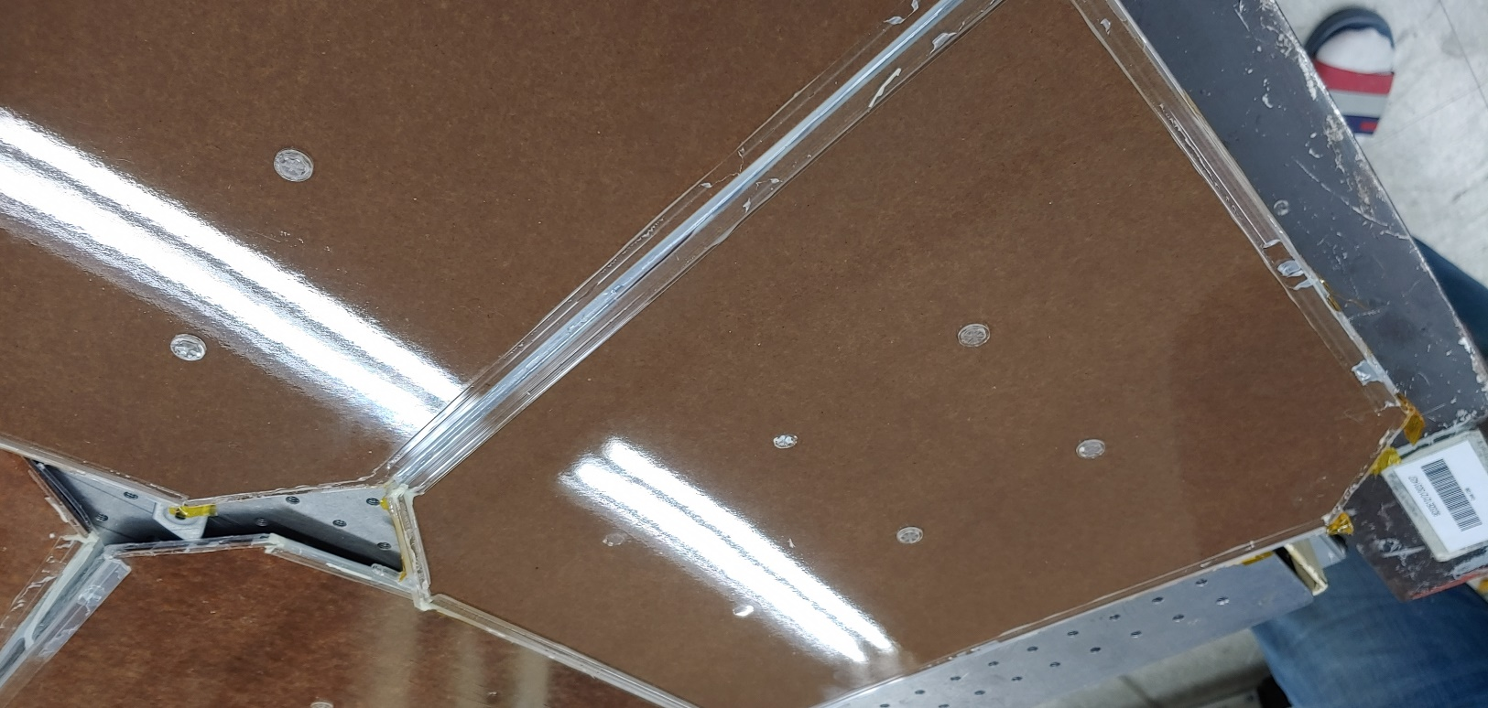
Pampla gap (small)

Slide 6
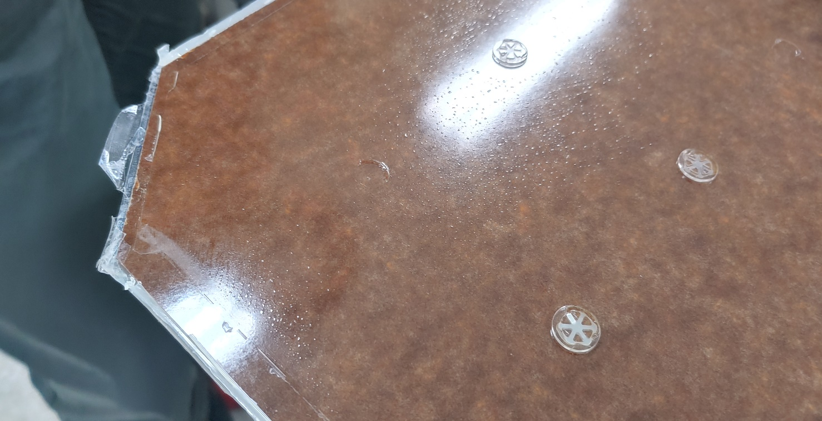
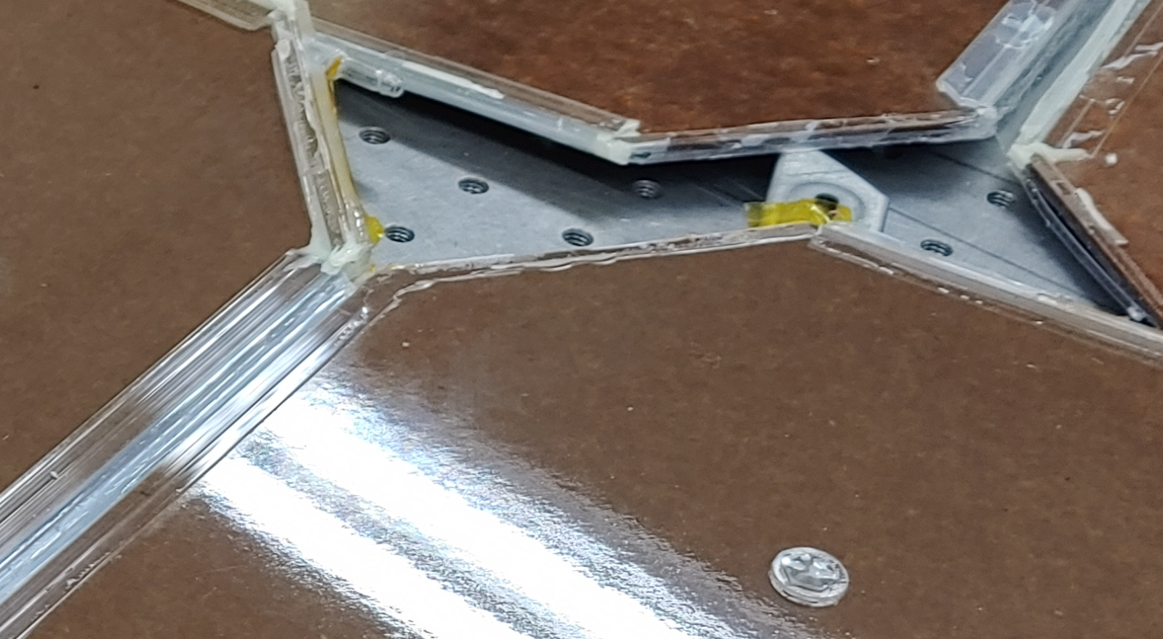
Puricelli (Large gap):
Thin oil-layered area near the gas input pipe
-> makes gap sensitive to gas humidity and causes the high noise problem at this region
Pampla (small gap):
There is no thin oil-layered area near the gas input pipe
No thin oil problem near the gap edge gas pipe or spacer

