Slide 1
Oil thickness
Ian
10 Feb 2020

Slide 2
http://hyperphysics.phy-astr.gsu.edu/hbase/phyopt/oilfilm.html

Slide 3
https://nepis.epa.gov/Exe/ZyNET.exe/9100M95W.txt?ZyActionD=ZyDocument&Client=EPA&Index=Prior%20to%201976&Docs=&Query=&Time=&EndTime=&SearchMethod=1&TocRestrict=n&Toc=&TocEntry=&QField=&QFieldYear=&QFieldMonth=&QFieldDay=&UseQField=&IntQFieldOp=0&ExtQFieldOp=0&XmlQuery=&File=D%3A%5CZYFILES%5CINDEX%20DATA%5C70THRU75%5CTXT%5C00000013%5C9100M95W.txt&User=ANONYMOUS&Password=anonymous&SortMethod=h%7C-&MaximumDocuments=1&FuzzyDegree=0&ImageQuality=r75g8/r75g8/x150y150g16/i425&Display=hpfr&DefSeekPage=x&SearchBack=ZyActionL&Back=ZyActionS&BackDesc=Results%20page&MaximumPages=1&ZyEntry=9
Page 10 for details of thicknes wrt the colour !!!

Slide 4
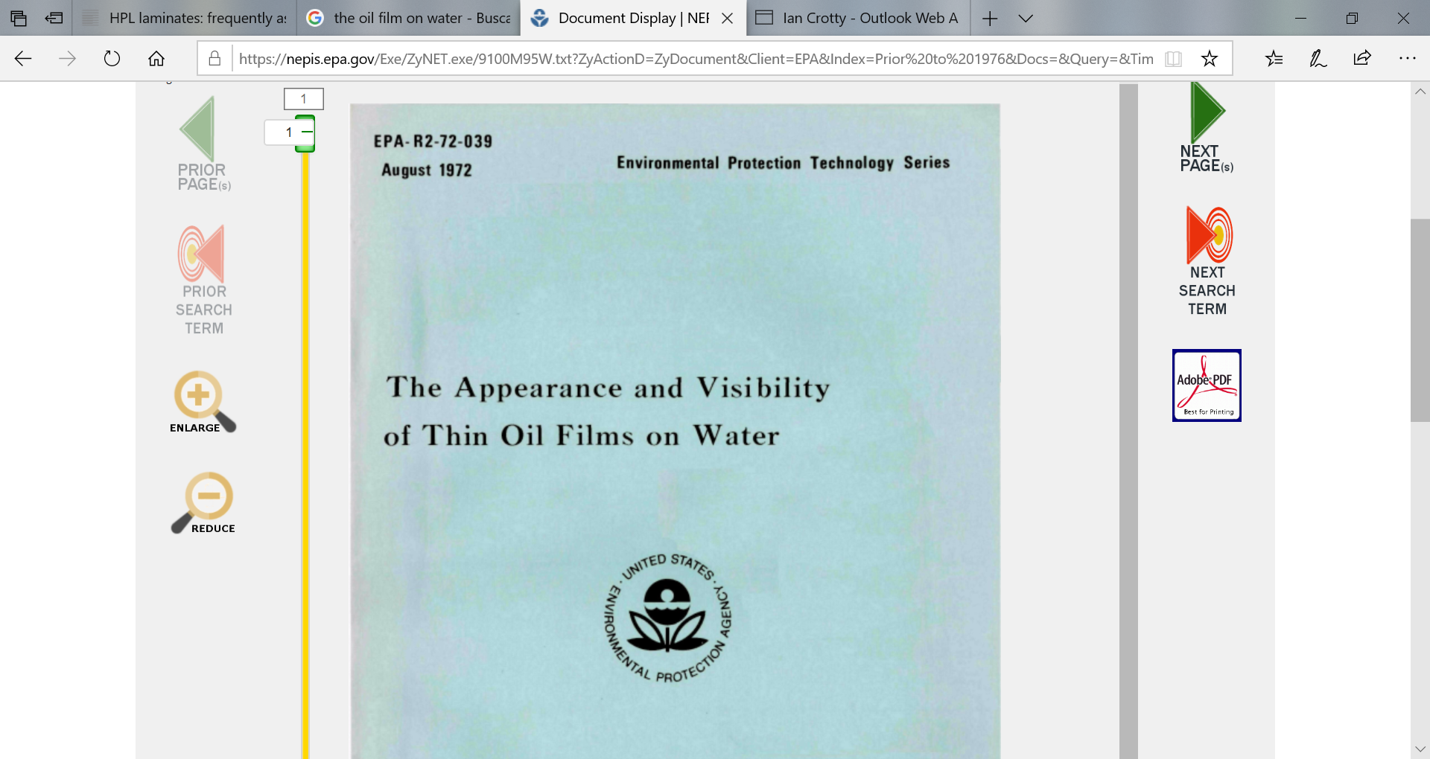

Slide 5
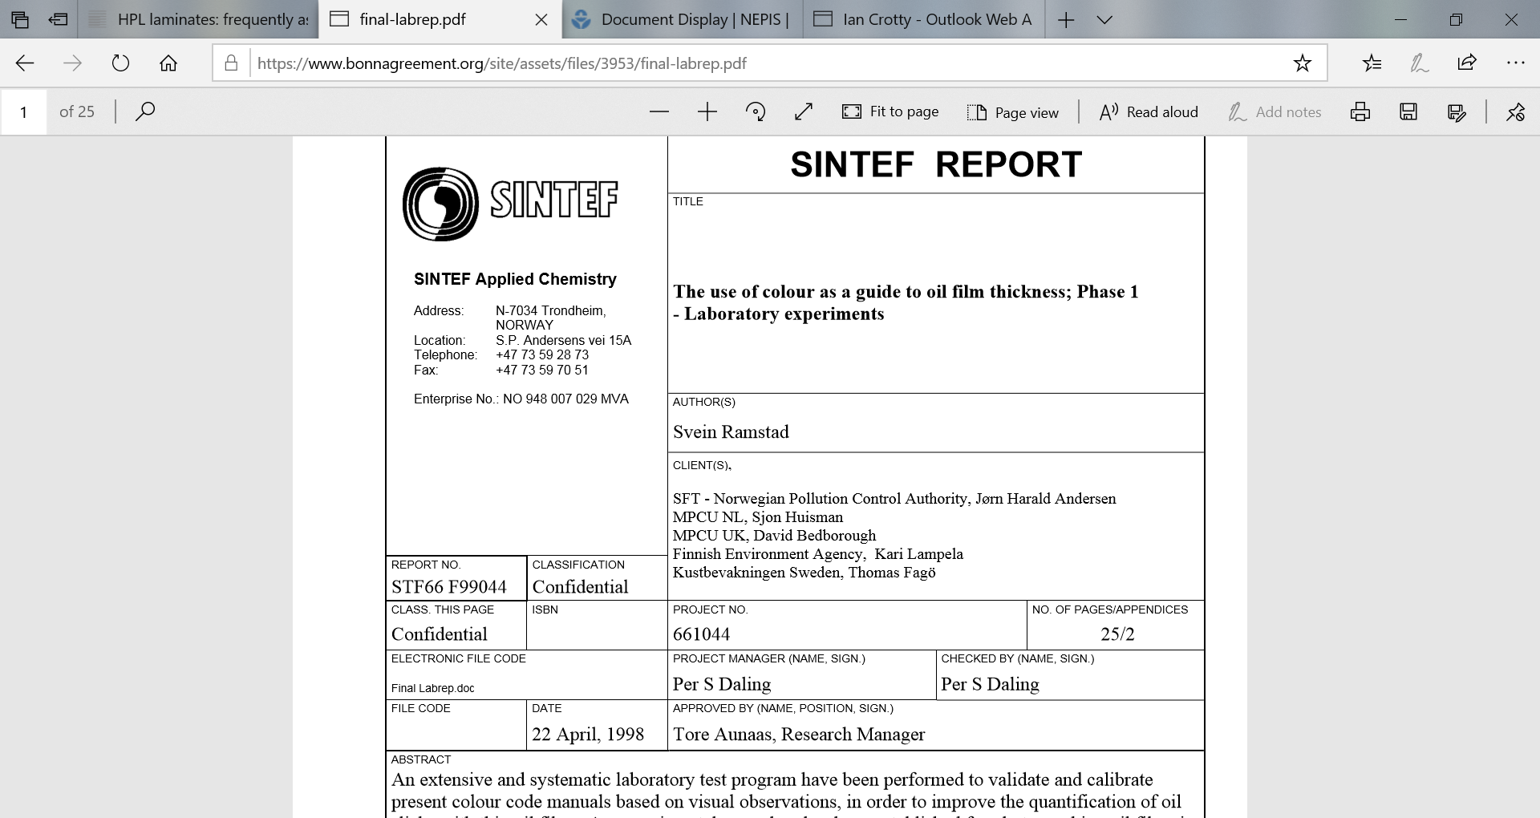
https://www.bonnagreement.org/site/assets/files/3953/final-labrep.pdf

Slide 6
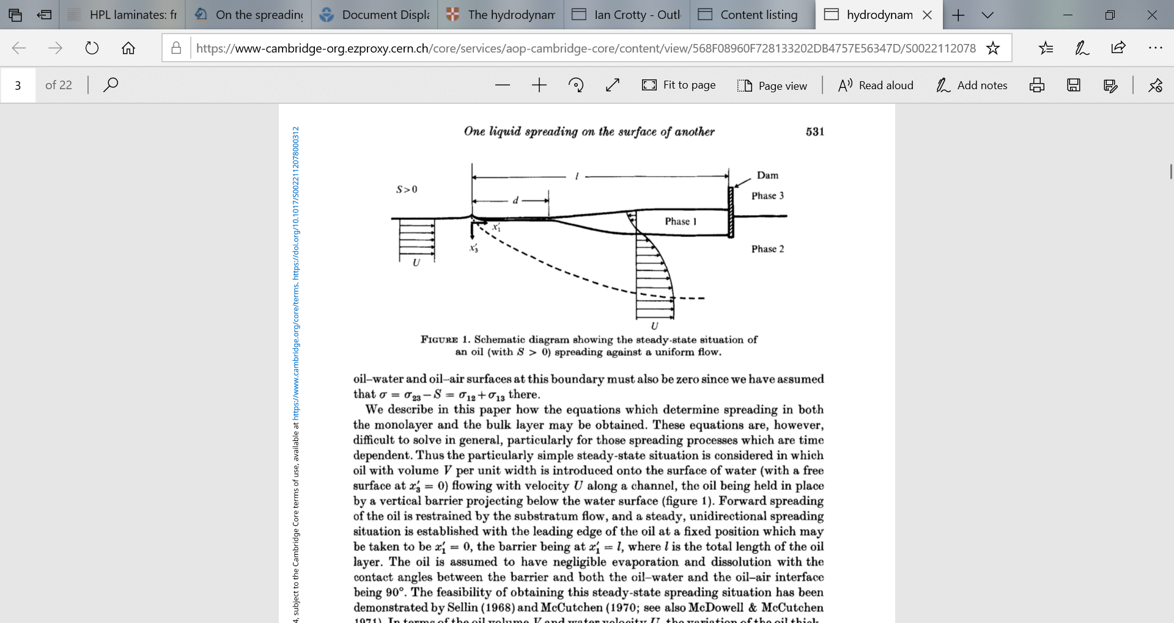
DiPietro, N.D., Huh, C. and Cox, R.G., The hydrodynamics of the spreading of one liquid on the surface of another,J. Fluid Mech. 84 (1978) 529–549.
https://www-cambridge-org.ezproxy.cern.ch/core/services/aop-cambridge-core/content/view/568F08960F728133202DB4757E56347D/S0022112078000312a.pdf/hydrodynamics_of_the_spreading_of_one_liquid_on_the_surface_of_another.pdf

Slide 7
https://www-cambridge-org.ezproxy.cern.ch/core/journals/journal-of-fluid-mechanics/listing?q=The+hydrodynamics+of+the+spreading+of+one+liquid+on+the+surface+of+another&_csrf=K8JjWDDd-Tghi8j_Rasp_h5PmbRpksY0VaIg&searchWithinIds=1F51BCFAA50101CAF5CB9A20F8DEA3E4

