Slide 1
Time resolution of silicon sensors
Werner Riegler, CERN, werner.riegler@cern.ch
October 15, 2021
Abstract
Precision timing with solid state detectors is being employed in many areas of particle physics instrumentation. Applications for pileup rejection and time of flight measurements at the LHC are just two of many notable examples.
During the past years the principal contributions to the time resolution for various types of silicon sensors have been studied. The principal contributors to the time resolution are Landau fluctuations, electronics noise, signal shape fluctuations due to a varying pad response function as well as gain fluctuations.
We discuss silicon pad and silicon pixel sensors, LGAD sensors as well as SPADs and SiPMs. These sensors have been simulated using the Garfield++ toolkit. The analytic statistical analysis of the contributions to the time resolution has been performed, resulting in elementary expressions for the timing performance of these sensors. These expressions show the basic directions for optimization of these sensors as well as the fundamental limits to the time resolution.

Slide 2
Outline
Time resolution of ‘standard’ planar silicon detectors
Signal processing and center of gravity (c.o.g.) time of a signal
Contribution from noise, optimum filters
Contributions from ‘weighting fields’
Time resolution of MAPS sensors
Time resolution Low Gain Avalanche Diodes (LGADS)
Single Photon Avalanche Diodes (SPADs), Silicon Photomultipliers (SiPMs)
SPAD time resolution and efficiency for photons and charged particles

Slide 3

References for this talk
W. Riegler and G. Aglieri Rinella, Time resolution of silicon pixel sensors, JINST 12 (2017) P11017
W. Riegler and G. Aglieri Rinella, Point Charge Potential and Weighting field of a Pixel or Pad in a Plane Condenser, NIMA 767 (2014) 267-27
W. Riegler, P. Windischhofer, Time resolution and efficiency of SPADs and SiPMs for photons and charged particles, NIMA 1003 (2021) 165265
P. Windischhofer, W. Riegler, The statistics of electron–hole avalanches, NIMA 1003 (2021) 165327
W. Blum, W. Riegler, L. Rolandi, Particle Detection with Drift Chambers,
Springer 2008, ISBN: 978-3-540-76683-4
Signal Processing, Noise, optimum filters etc.

Slide 4
Time resolution of ‘standard’ silicon sensors

Slide 5
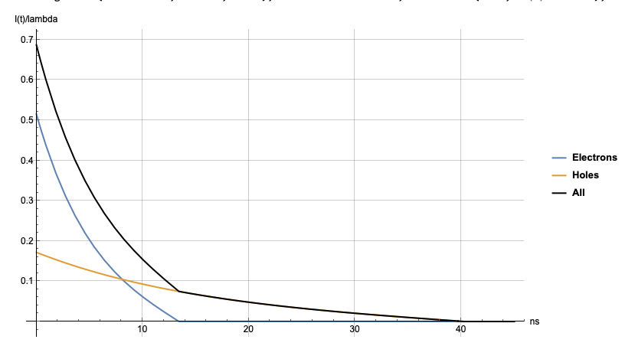
Intrinsic time resolution of a ‘large’ silicon pad detector
n+
n-
p+
Example: d = 300um, V_{dep} = 58V, V=1.2 V_{dep} = 68V
d₀ = 330um, 𝜏_{e} = 5.6ns, 𝜏_{h} = 16.8ns
x
electrons
d
holes
E
-V
In silicon sensors the signal edge is instantaneous (i.e. sub ps level)
acceleration of electrons to 10⁷cm/s in vacuum is 0.14ps
passage of the particle through a 50um sensor takes 0.16ps
In Wire Chambers the electrons first have to move to the wires before an avalanche at the wire leads to an appreciable signal
→ intrinsic resolution limit.
In RPCs the avalanche starts instantly, but it still takes some time until the signal reaches the threshold
→ intrinsic resolution limit.
The intrinsic time resolution of a silicon sensor is infinite (sub ps).
→ The time resolution in a planar silicon sensor without gain is a question of signal/noise/electronics and specifically the Landau fluctuations within the electronics integration time.

Slide 6
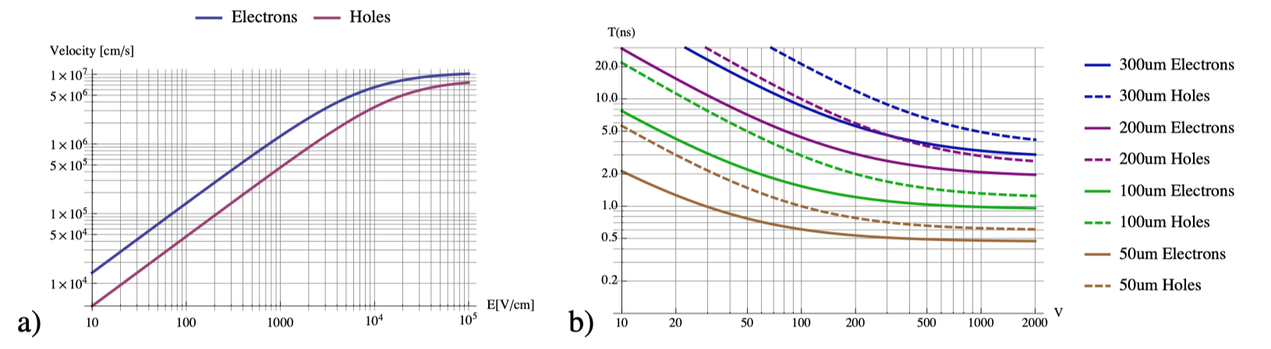
Total drift time of electrons and holes in the silicon sensor
In a 50um sensor at very high voltage the electrons and holes take around 500ps to move through the sensor.
At high electric fields, the drift-velocity saturates around 10⁷ cm/s = 0.1μm/ps for both, electrons and holes.
At high fields (thin sensors, large voltage), the electric field in the sensor is close to constant, e and h velocities become saturated and the average signal becomes a triangle.
Example: d = 300um, V_{dep} = 58V, V=1.2 V_{dep} = 68V
d₀ = 330um, 𝜏_{e} = 5.6ns, 𝜏_{h} = 16.8ns

Slide 7
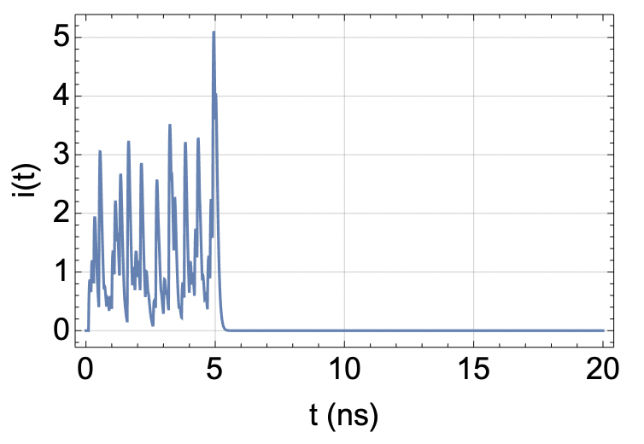
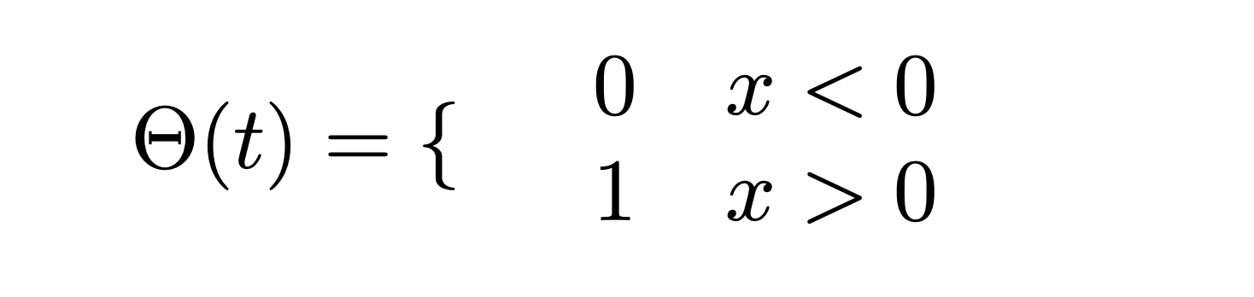
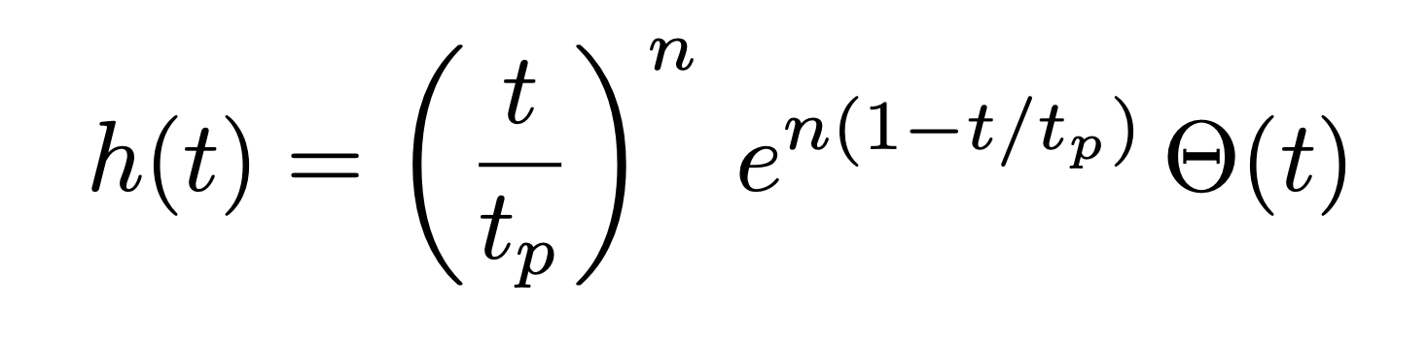
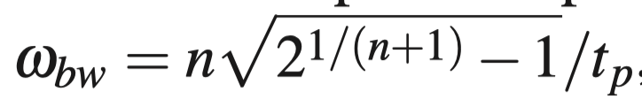
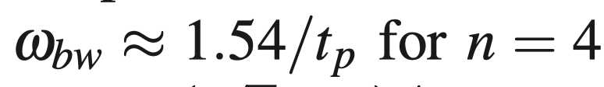
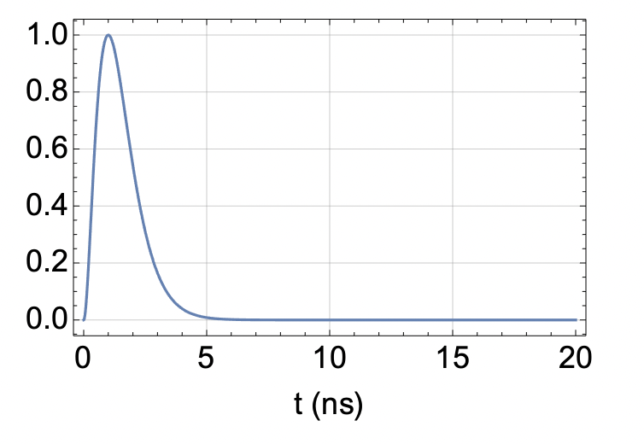
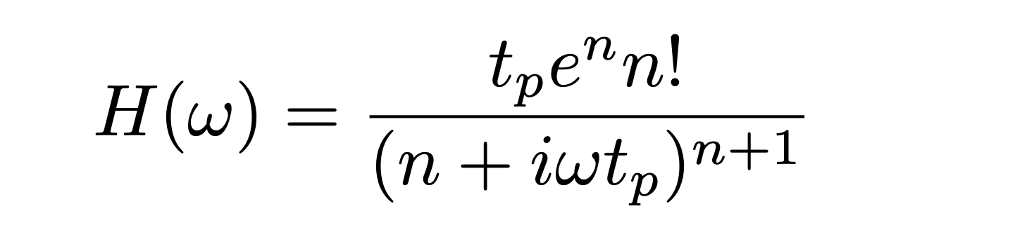
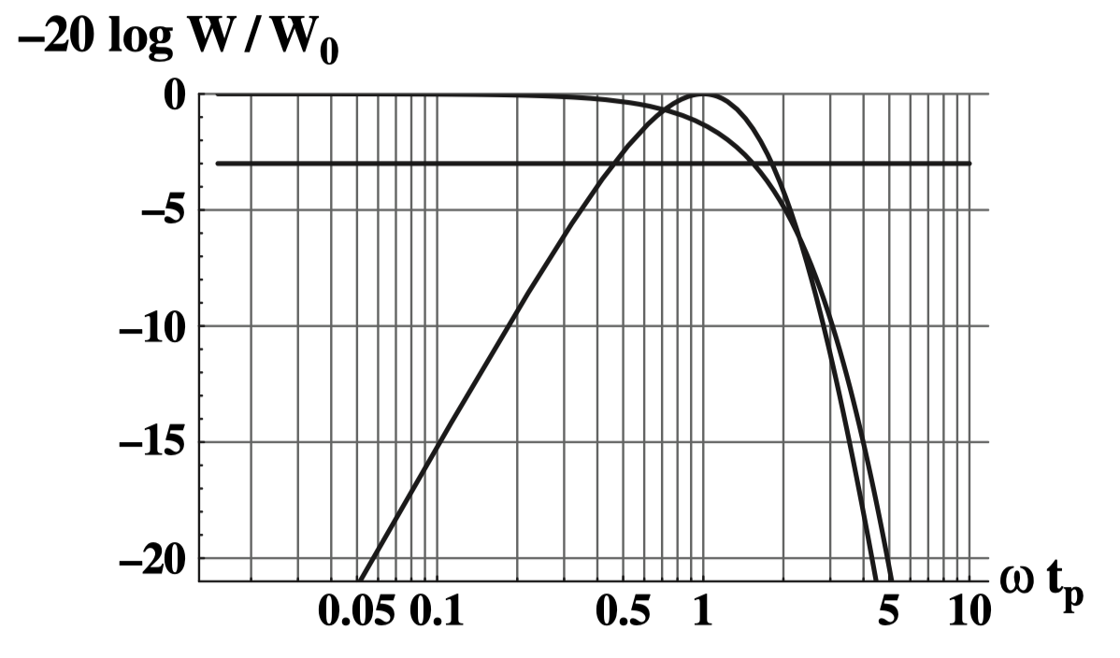
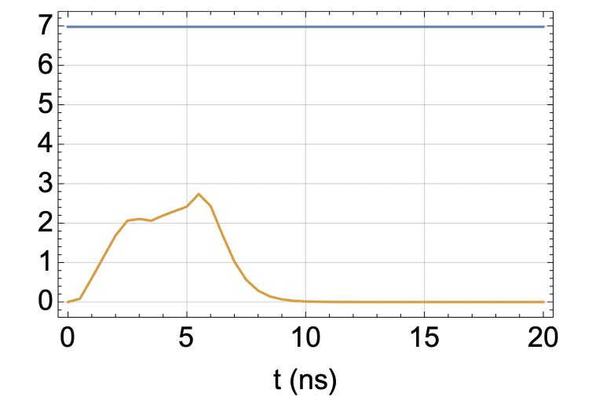
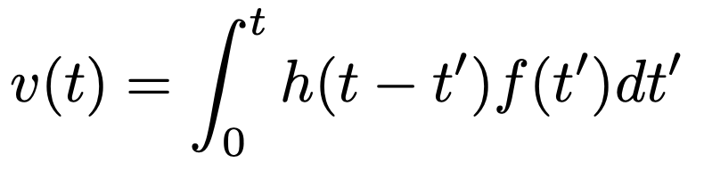
Electronics processing of a detector signal
Frontend delta response:
f(t)
Corresponding transfer function:
h(t)
t_{p}=1ns f_{bw} ~250MHz
-20 log |H(ω)|/|H(0)|
v(t)

Slide 8
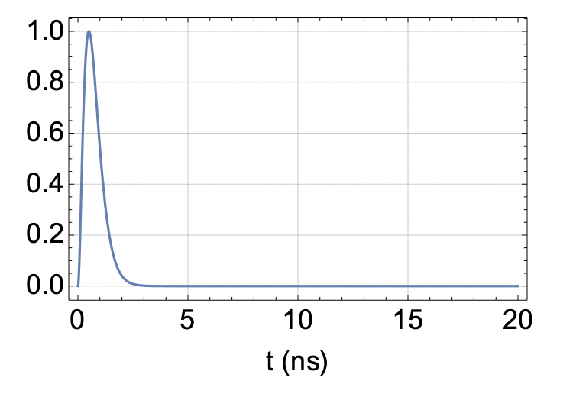
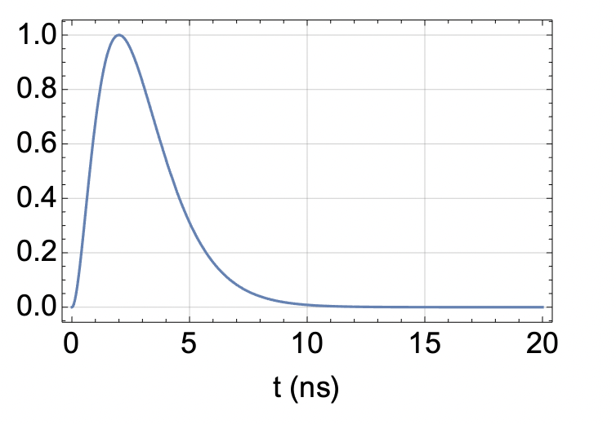
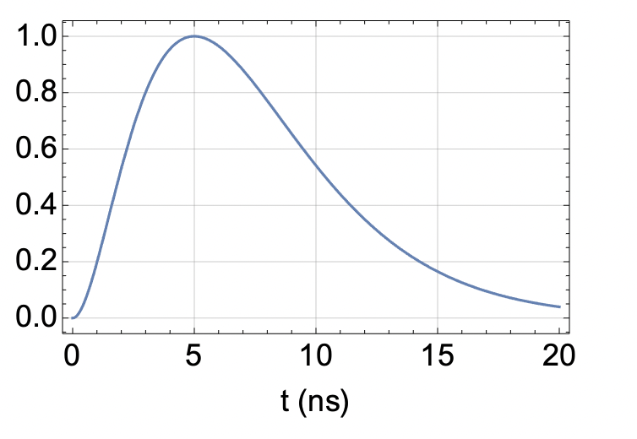
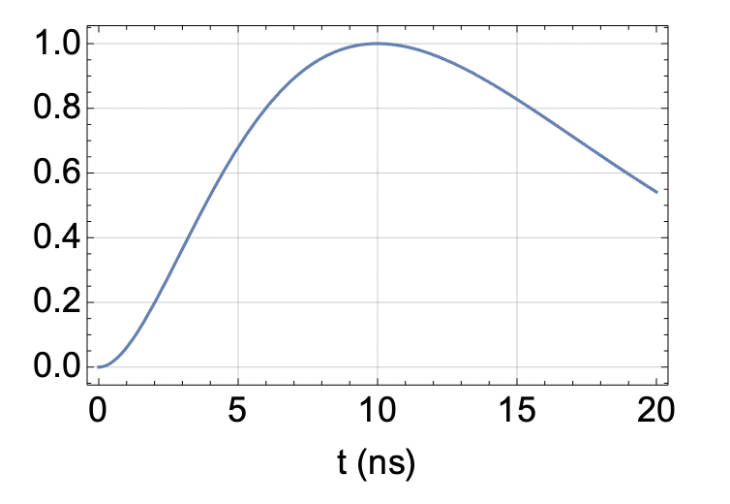
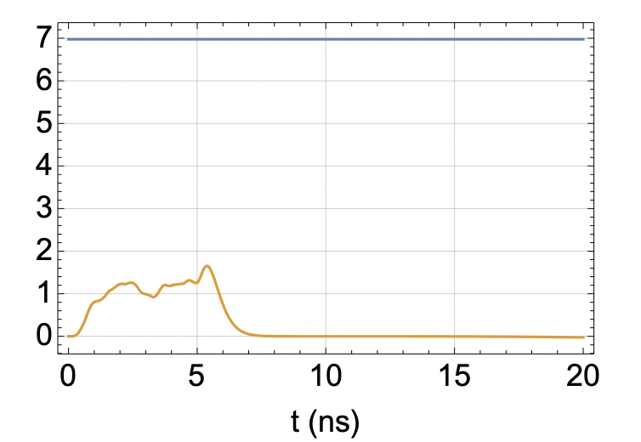
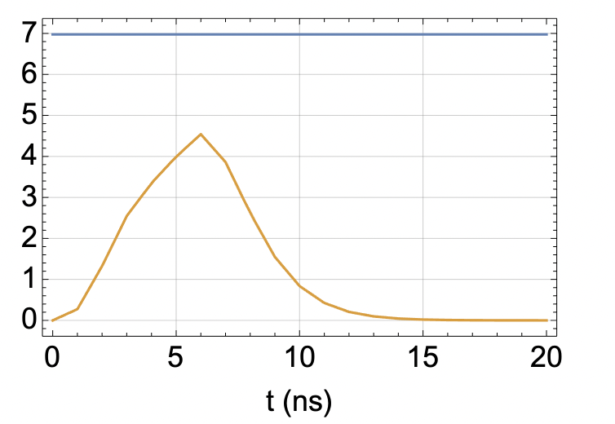
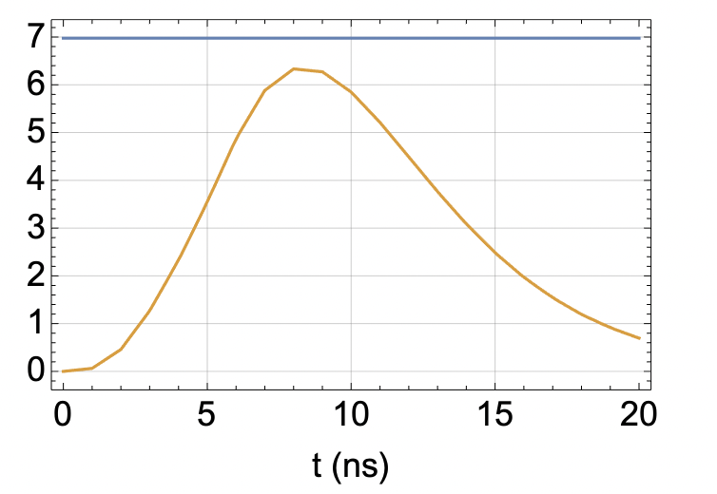
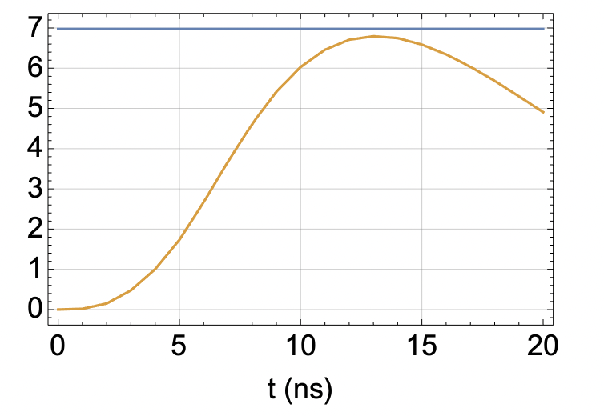
Electronics processing of a detector signal
f(t)
h(t)
t_{p}=0.5ns
t_{p}=1ns
t_{p}=2ns
t_{p}=5ns
t_{p}=10ns
v(t)
If the peaking time t_{p} becomes larger than the signal length, the peak of the output signal approaches the total charge. What else … ?

Slide 9
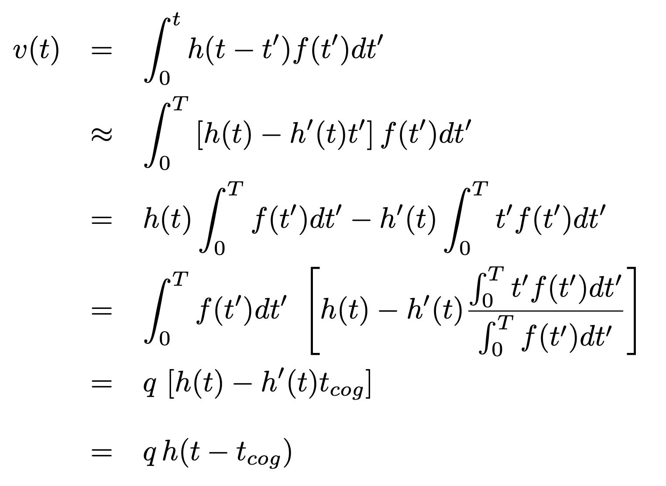
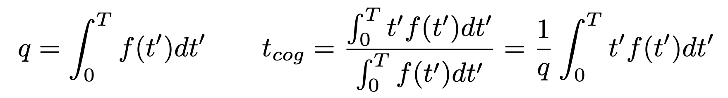
Electronics processing of a detector signal
Signal duration of T i.e. f(t) = 0 for t>T
Electronics peaking time t_{p} >> T
We are interested in times t>T
In case the electronics peaking time t_{p} is longer than the signal duration T, the electronics output signal has
the same shape as the delta response
a pulse-height equal to the total charge of the signal
a ‘time displacement’ of this delta response by the center of gravity time t_{cog} of the signal.
An amplifier that is ‘slower’ than the signal measures the center of gravity time of the signal

Slide 10
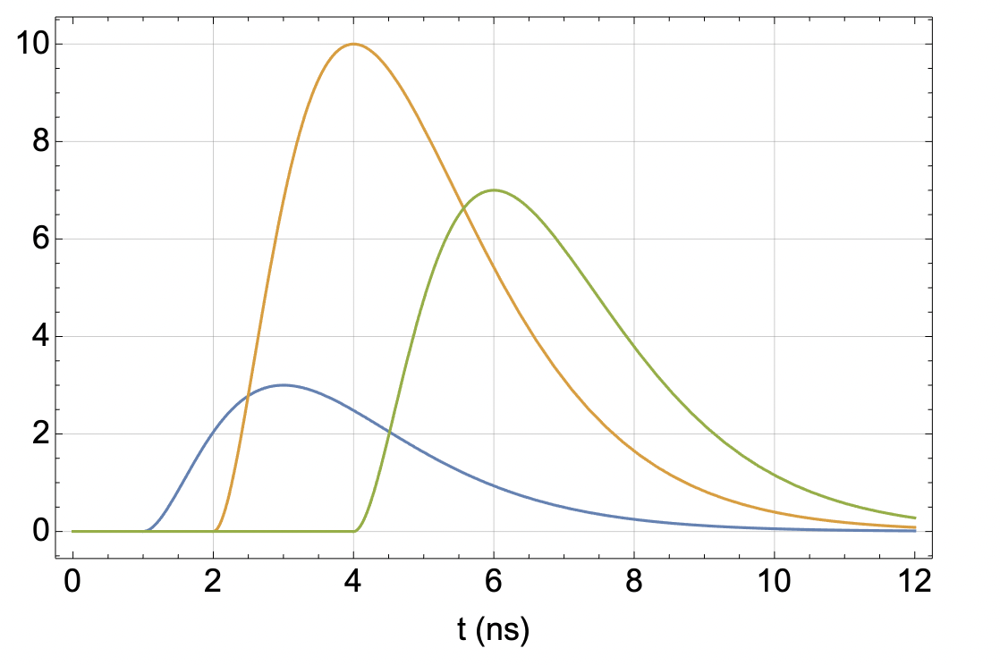
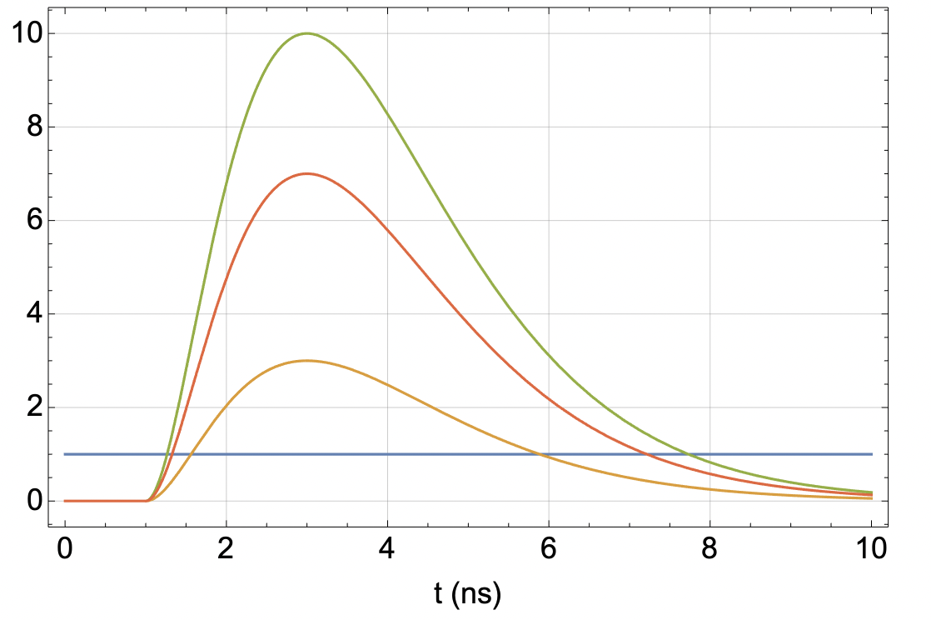
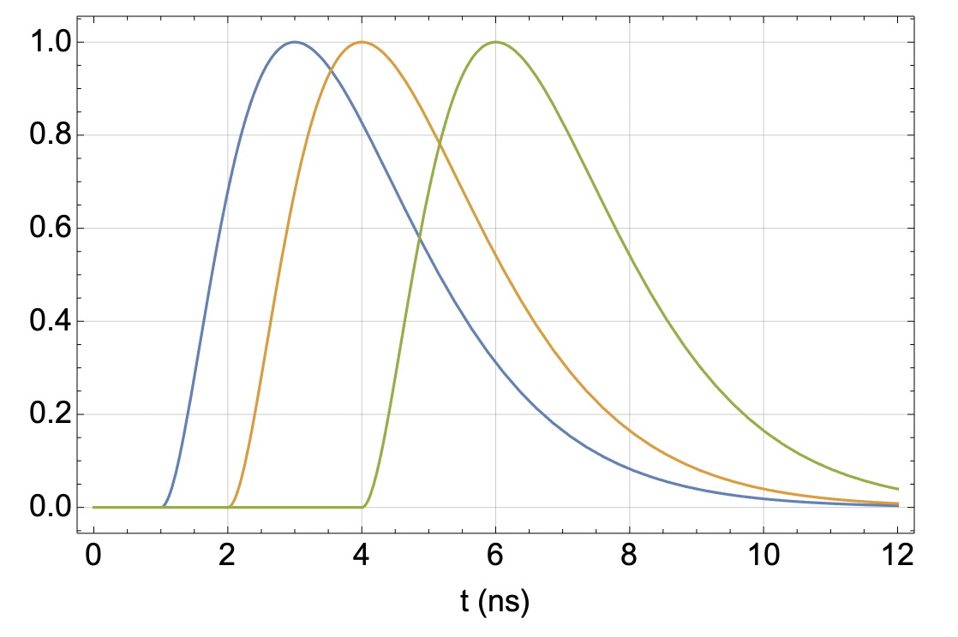
Electronics ‘slower’ than the detector signal, time slewing
Delta response shifted by t_{cog} and scaled by Q
‘time slewing’
Signal normalized to same amplitude → time
There are many different ways to correct for this slewing effect
Constant Fraction discrimination
Standard discrimination using time over threshold to correct for pulse-height
Standard discrimination + pulseheight to correct for pulse-height
Standard discrimination + total charge to correct for pulse-height
Multiple sampling and ‘fitting’ the know signal shape
….
→ What is the c.o.g. time resolution of a silicon sensor ?

Slide 11
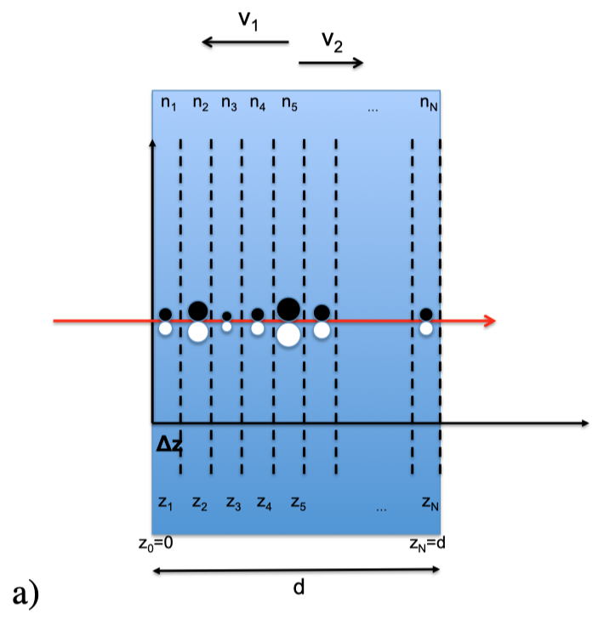



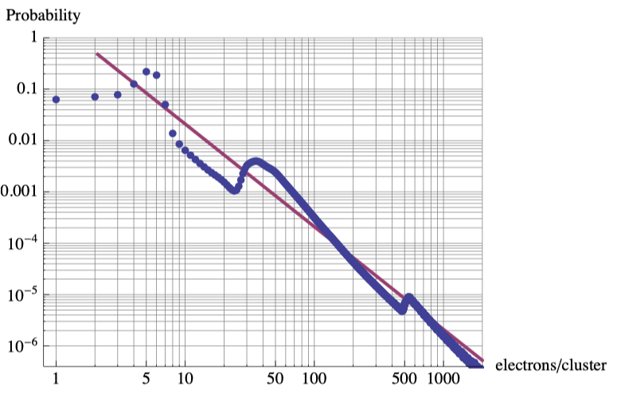



Energy deposit in silicon
A high energy particle passing the sensor will experience primary interactions, with an average distance of around λ=0.21μm. In each interaction there is a probability p_{clu}(n) to produce a cluster of n electrons. The probability p(n, Δz) have n e-h pairs in Δz is therefore
The probability to have n e-h pairs in the sensor of thickness d, p(n, d) is then
The cluster size distribution is p_{clu}(n) is typically calculated using the PAI model.
Landau’s approach assumes a 1/E² distribution for the energy transfer in accordance with Rutherford scattering, which leads to an 1/n² distribution for the e-h pairs
→ Landau distribution
PAI model,
‘plasmon peak’

Slide 12
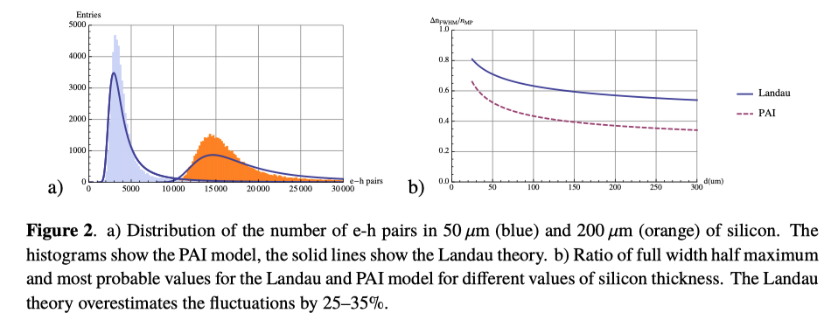


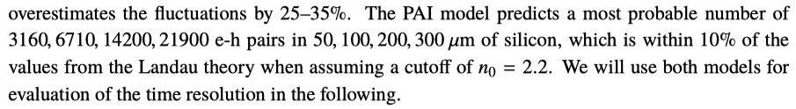
Energy deposit in silicon
3160 e-h pairs
Most probable number of e-h pairs:
Full width of half maximum
14200 e-h pairs

Slide 13
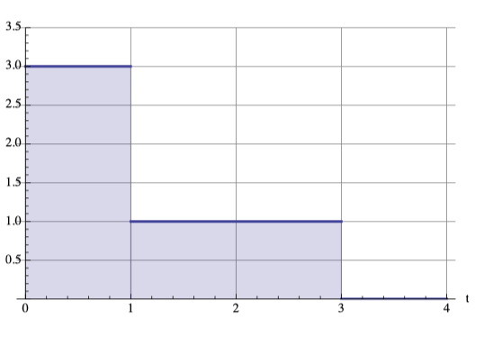
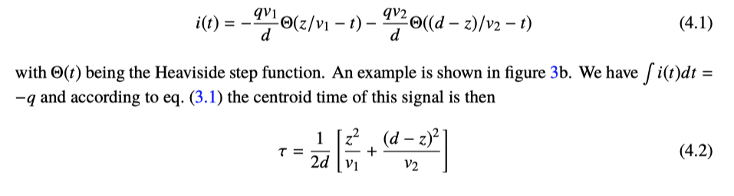
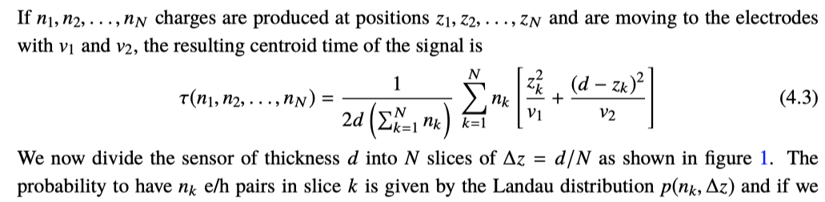
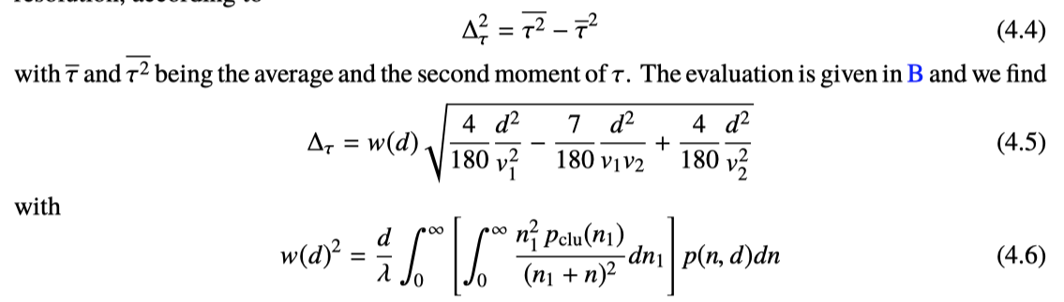
Center of gravity time of a silicon detector signal
Single e-h pair
After some lengthy evaluation:

Slide 14
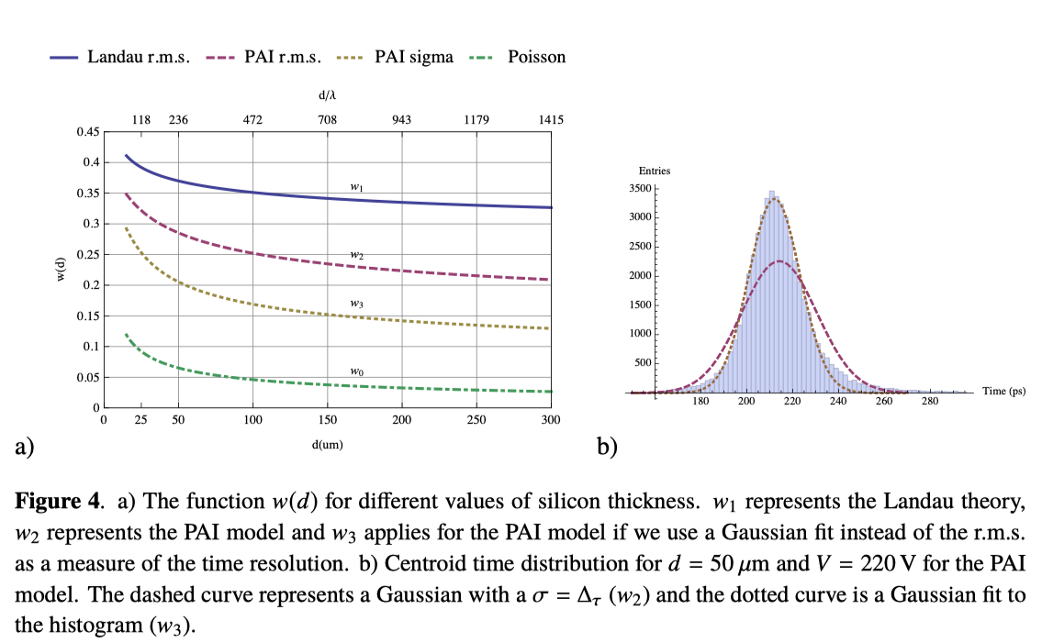
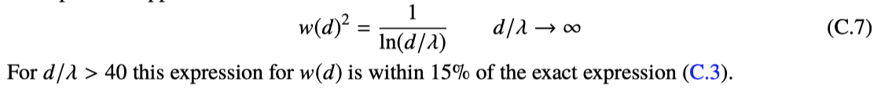
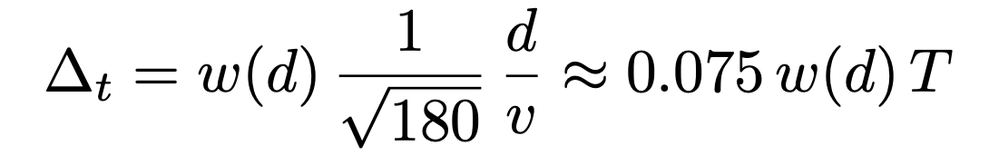
Centroid time of a silicon detector signal
For Si sensors: Important difference between r.m.s. time resolution and the σ of the core of the distribution.
For the Landau Theory
PAI model, Gauss fit
For v₁=v₂
For a thinner sensor – the contribution from Landau fluctuation increases.
This worsening of the resolution is superseded by the decrease of e-h drift times.
50um sensor: 0.075 x 0.2 x 650ps = 10ps
T= total e- drift time = total h drift time
= total width of the ‘triangle’

Slide 15
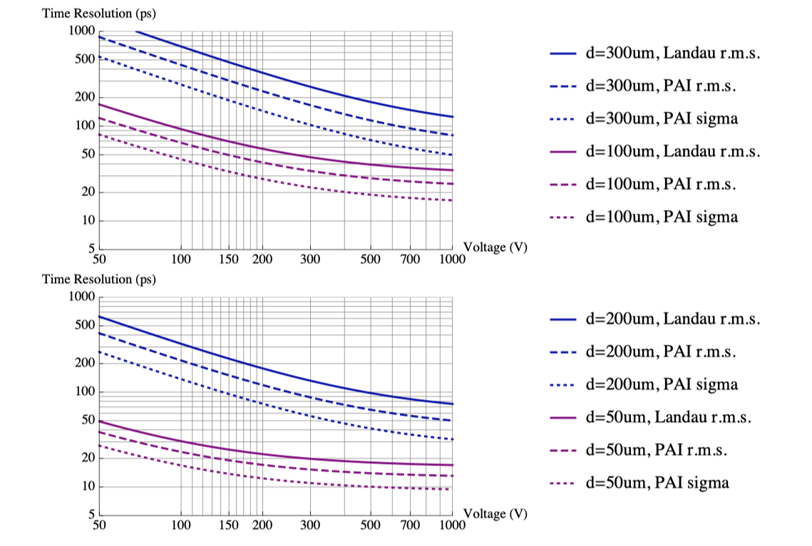
Center of gravity time resolution for silicon sensors
50um sensor, 10ps

Slide 16
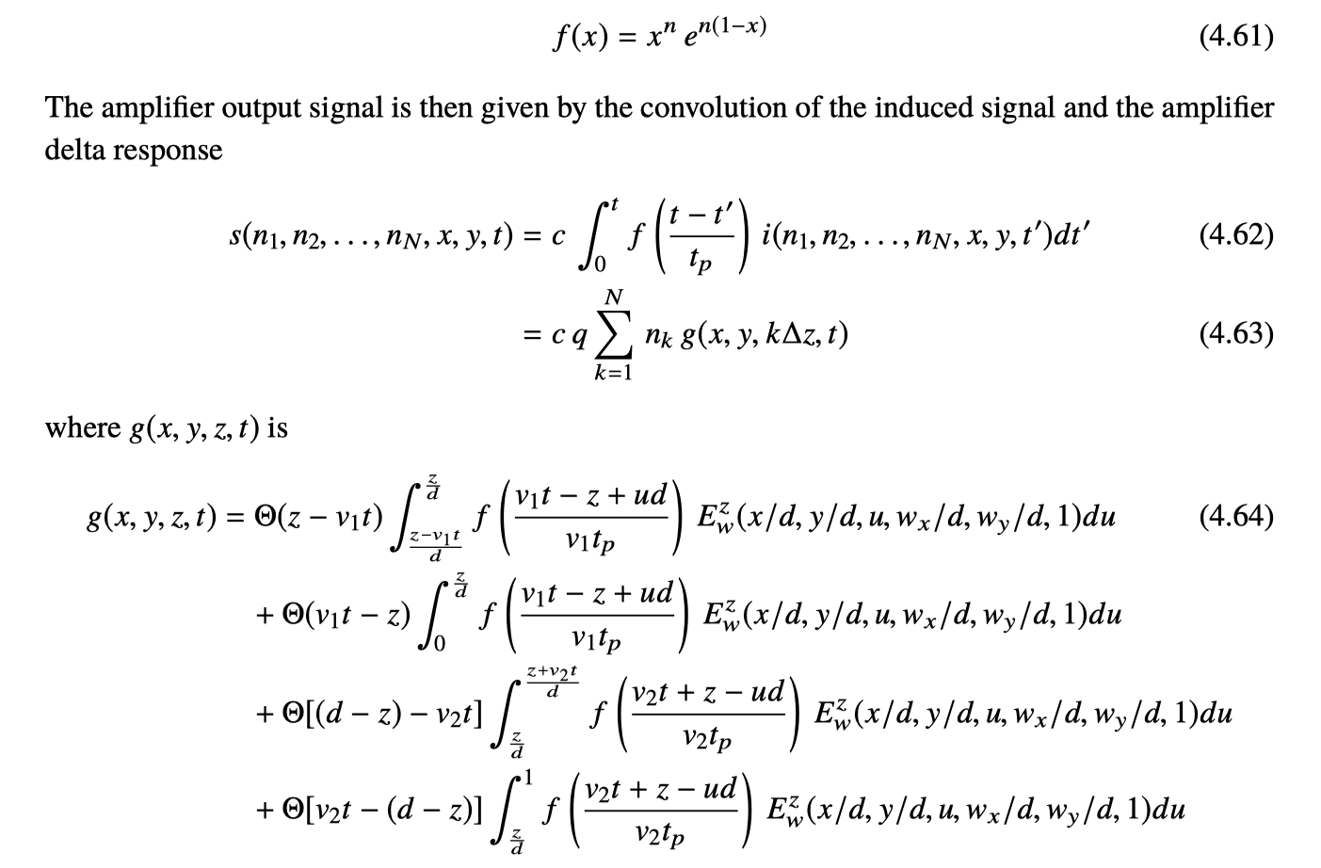
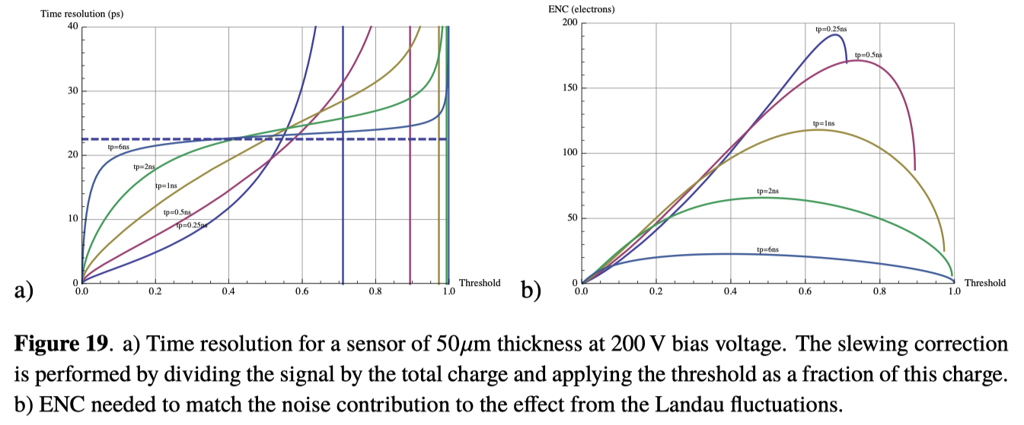
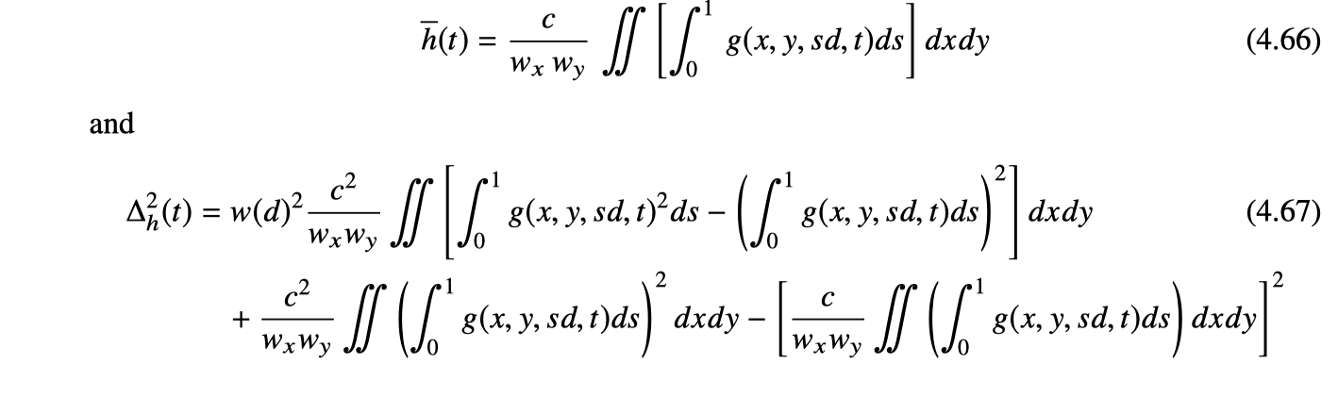
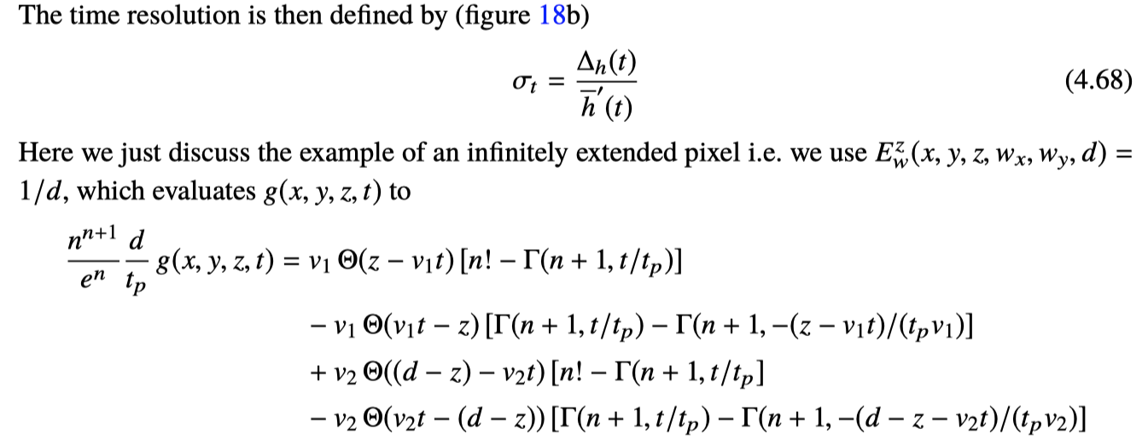
Leading edge discrimination
50um sensor at 200V for different peaking times
and constant fraction discrimination T=0.8ns
c.o.g. time resolution
Leading edge discrimination on the signal that is normalized to the total deposited charge.
50um sensor, t_{p}=0.5ns, threshold at 30% of the charge
5ps time resolution BUT this is unrealistic since S/N becomes too small → Noise will dominate !

Slide 17
Noise
For a sensor that is represented by a capacitance, the noise is determined by the amplifier only. The amplifier noise can be characterized by the parallel and series noise power spectrum.
In case the parallel and series noise power spectra are ‘white’ we can formulate this as noise resistance R_{s} and R_{p}.
The level of this noise is a specification of the amplifier, there is no intrinsic noise in the sensor.
This noise level is very specific to the technology, but in general, lower noise requires more power (current through the input transistor etc.).
This places practical limits on the achievable noise level in systems with high granularity i.e. many channels on a small surface.
R_{s}
e_{n}²
C_{D}
R_{p}
i_{n}²

Slide 18
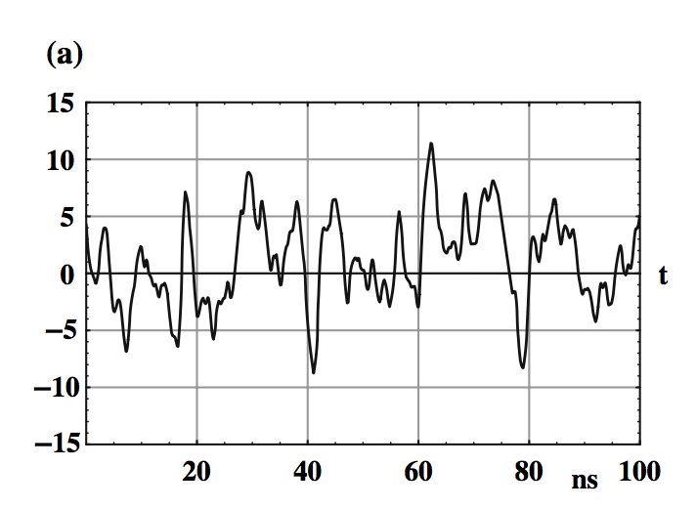
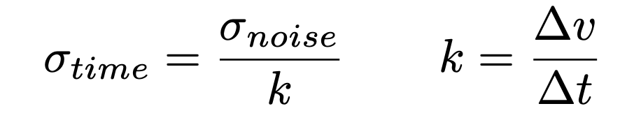
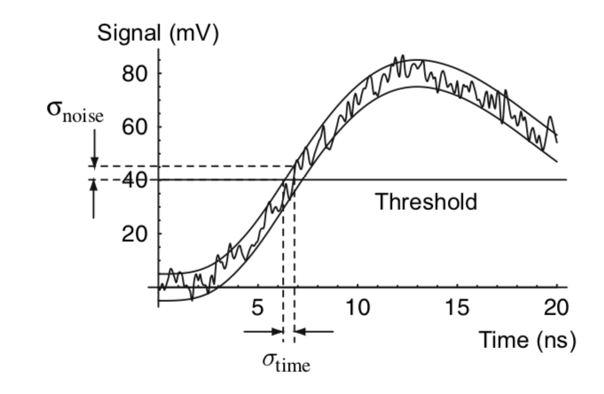
Noise and Optimum filters
Let us assume we have a signal f(t) with superimposed noise of a given noise power spectrum and we want to find the amplifier transfer function that maximizes
the signal to noise ratio for the best amplitude measurement, or
the slope to noise ratio for the best time measurement
→ Theory of optimum filters

Slide 19
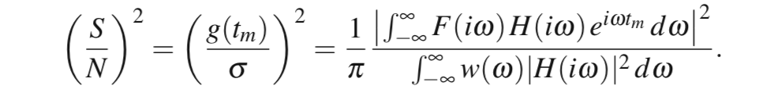
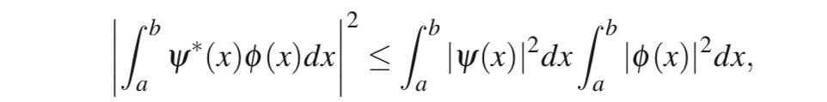
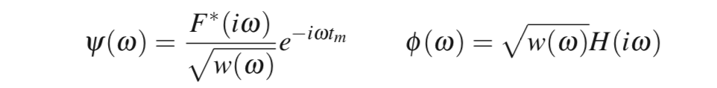
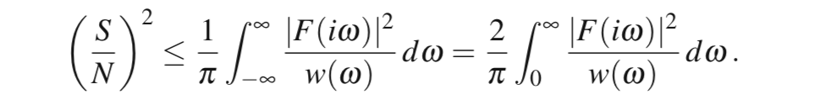
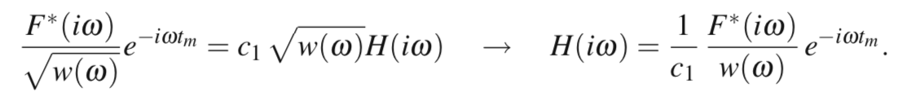
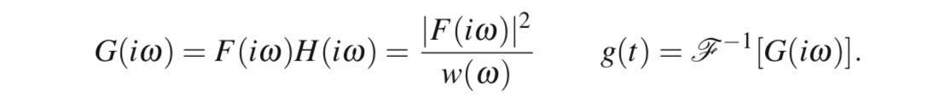
Optimum filter for best signal to noise ratio
A signal f(t) superimposed to a noise with a noise power spectrum w(ω) is processed by a filter with transfer function H(iω). The output signal and output noise r.m.s. are
The signal to noise ration is then
The expression has an upper limit given by the Schwartz inequality, which relates two complex valued functions according to
We insert
and have
The equal sign applies if ψ = c₁ ϕ and we have the optimum filter transfer function
The output signal is
f(t) → F(ω)
w(ω)

Slide 20



Optimum filter for best slope to noise ratio
We want to minimise the time resolution i.e. maximise the slope to noise
Following the steps from before we find an upper bound for the slope to noise ratio of
And the optimum transfer function as well as the output signal are
Since multiplication with iω refers to the derivative in the time domain we have the following relation:
The filter maximising the slope to noise ratio, i.e. the filter giving the best time resolution, is equal to the time derivative of the filter that maximises the signal to noise ratio !

Slide 21








Optimum filter for best timing
R_{s}
e_{n}²
Assuming a silicon sensor with negligible depletion voltage and saturated drift-velocity, the signal shape is a triangle:
For the noise we assume series noise and parallel noise together with a detector capacitance C_{D}
The maximum slope to noise ratio is
If we neglect parallel noise we have
This filter is a-causal and can only be approximated in practise.
C_{D}
R_{p}
i_{n}²
Input signal
Delta response of optimum filter
Output signal

Slide 22









Realistic preamp transfer function
e_{n}²
C_{D}
R_{p}
i_{n}²
Preamp delta response
For the noise we assume series noise and parallel noise together with a detector capacitance C_{D}
The output signal is
And the maximum slope evaluates to
To find the optimum peaking time and best time resolution we therefore have to minimise the function
n=2
n=1
n=4

Slide 23
Realistic preamp transfer function
e_{n}²
C_{D}
R_{p}
i_{n}²
Time resolution for ‘standard’ preamp delta response.
n=1, 2, 3, 4
Time resolution with optimum filter
Neglecting parallel noise (which is a good approximation in most practical applications) the optimum electronics peaking time t_{p} is between T and 1.5T.
The achieved time resolution is only about 30% worse than the best achievable one with the optimum filter !
This will give the smallest noise contribution to the time resolution.
n=2
n=1
n=4

Slide 24
Combined effect of Landau fluctuations and noise
If the noise dominates, the optimum peaking time is about t_{p} ~ 1-1.5T
If the noise is at a similar level to the contribution from Landau fluctuations, the optimum peaking time is still around the same level t_{p} ~ 1-1.5T and the time resolution is equal to the the c.o.g. time resolution of the silicon sensor.
If the noise is subdominant, shorter peaking times can be improve the time resolution, but with the divergence of the noise contribution at low t_{p} this will not reach far below the c.o.g. time resolution.
In short: t_{p} ~ T and σ = σ_{c.o.g.} ⊕ σ_{noise} give a good order of magnitude for the achievable time resolution
Noise
scales with
e_{n}C_{D}
c.o.g. time resolution
Landau Fluctuations
Landau Fluctuations ⊕ Noise

Slide 25
Time resolution of ‘standard’ silicon sensors
In case noise is not dominant, the time resolution of a silicon sensor is somewhere between zero and the c.o.g. time resolution.
For a silicon detector signal with total duration T, the series noise contribution is minimised for amplifiers of t_{p} ~ T.
For very low noise a time resolution better than the c.o.g. time resolution can be achieved, but the divergence of the noise contribution for t_{p} → 0 will limit this improvement.

Slide 26
Effects of finite Pixel Size
Up to now we discussed the situation of a very large pad of size w>>d i.e. and ‘infinitely extended parallel plate geometry’.

Slide 27










Weighting field of a strip in a parallel plate geometry
A uniform charge distribution
Charge moving towards the strip:
Charge moving away from the strip:
Total induced current on the strip
For very wide strips (parallel plate geometry) the induced charge from the movement of +λ and –λ is the same and equal to λd/2.
For small strips, the fraction of the signal due to the charges moving towards the strip increases.
v₁ = 3v₂ e.g. electrons moving to the strip and holes moving away from the strip
+λ
v₂
d
v₁
-λ
w>>d
w=d
w=d/2

Slide 28





Weighting field of a strip in a parallel plate geometry
v₁ = v₂/3 e.g. holes moving to the strip and electrons moving away from the strip
+λ
v₂
d
v₁
-λ
w>>d
w=d
w=d/2
Different positions of the particle inside the pixel will lead to different pulse-shapes.
The varying signal shape will lead to variations in the c.o.g. time and therefore affect the time resolution.
This is also called the ‘weighting field effect’.

Slide 29




Weighting field fluctuations
This weighting field effect is strongly correlated with the Landau fluctuations.
The structure of the expression for the resolution is however similar to the one before.
w/d = pixel size/detector thickness

Slide 30

Weighting field fluctuations
Because electrons and holes have different velocities, it makes a significant difference whether the electrons or the holes move to the pixel.
For higher fields (thinner sensors) this difference will decrease.
The dependence on the different parameters is complex.
These fluctuations can dominate the time resolution !

Slide 31
Time resolution of ‘standard’ silicon sensors
Good time resolution demands thin sensors.
Thin sensors give small charge and large capacitance i.e. unfavorable S/N and k/N.
Capacitance can be reduced by making the pixels small.
If the pixel size is in the same order as the sensor thickness, the weighting field fluctuations start to dominate … and there will be many channels …
… between a rock and a hard place …
Sensors with internal gain to overcome the noise limit (like gas detectors !)
Turn the by sensor 90 degrees and realise a parallel plate geometry in 3D !
(see slide 62, 63)

Slide 32


Time resolution of MAPS with small readout diodes
Up to now we have investigated silicon sensors with e-h drift in a homogeneous electric field perpendicular to the readout electrodes.
One flavour of MAPS sensors uses a small ‘collection’ electrode to minimise the capacitance and therefore the noise → E.g. ALPIDE
Since the ‘weighting field’ of the ‘readout electrode’ is concentrated around the diode, the signal consists to a good approximation of a sequence of delta pulses for each electron arriving at the diode.
Arrival time distribution.
The time resolution will be somewhere between the arrival time statistics of the first electron and the center of gravity time of all electron arrival times.
GARFIELD++ simulation
→ Thesis Jan Hasenbichler, to be defended Nov. 2021

Slide 33



Time resolution of MAPs with small readout diodes
Very fast amplifiers allow in principle excellent time resolution.
Of course – the ballistic deficit is high and the signal/noise and slope/noise ratio are low.
This puts extreme demands on noises performance of the amplifiers, resulting in significant power consumption.
In practise, fast charge collection and amplifier peaking times similar to the total charge collection time will be needed.
400ps seem achieveable in these simulations.
GARFIELD++ simulation
Optimized hexagonal pixel geometries:
E.g. Fastpix with <200ps time resolution
→ See slide 63
GARFIELD++ simulation

Slide 34
Time resolution of LGADs

Slide 35


Avalanche Photo Diode, Low Gain Avalanche Diode
Idea goes back to the 1960ies.
A high field region is implemented in a silicon sensor by doping.
Electrons will produce an avalanche in this high field region.
The high field region is implemented by doping and related ’space-charge’ in the volume.
The sensor is operated in a region where there is electron multiplication but not yet hole multiplication.
This allows to have thin sensors (high field, short signal) but still have enough signal charge to overcome the limitation from noise.
For higher fields → electron+hole multiplication → avalanche divergence → quench resistor → SiPM
Electron (alpha) and hole (beta)
multiplication coefficient in silicon

Slide 36



AvalanchePhotoDiode
Gain holes
holes
electrons
Total drift time for a given sensor thickness
A high field region is implemented in a silicon sensor by doping.
Electrons will produce an avalanche in this high field region.

Slide 37


LGAD
An e-h pair is produced at position z.
The electron arrives at z=0 at time T=z/v₁.
The electron multiplies in the high field in the layer at z=0 (infinitely thin).
The holes move back to z=d inducing the dominant part of the signal (all in this approximation).
Centroid time resolution for standard silicon sensor:
Centroid time resolution for LGAD
The signal is now defined by the arrival time distribution of the electrons at the gain layer.

Slide 38


LGAD
LGAD centroid time resolution
Standard silicon sensor centroid time resolution
50um sensor at 200V: 30ps
200um sensor at 200V: 140ps
50um sensor at 200V: 13ps
200um sensor at 200V: 70ps
The c.o.g. time resolution of LGADs is worse than the one for standard silicon sensors due to the very different signal characteristics – essentially an electron arrival time distribution.
Of course – the fact that the signal is larger by a factor 10-15 allows much more relaxed noise requirements, larger pixels etc. …

Slide 39


LGAD Leading edge discrimination
Standard silicon sensor
For LGADs the time resolution does not improve over the centroid time resolution when using leading edge discrimination on the signal normalized to the total deposited charge.
While for standard silicon sensors, the leading edge of the signal is proportional to (equal to) the total amount of charge in the sensor, for the LGADs there is no relation between the leading edge and the total charge deposit.

Slide 40


Weighting field fluctuations
T₁=d/v_{e} = total electron drift time
T₂=d/v_{h} = total hole drift time
The effect of finite pixel size and varying signal shape with the weighting field is de-correlated from the Landau fluctuations, in contrast to the standard silicon sensors.
The expression very basic and universal !
The Landau fluctuations are related to the total electron drift-time
The weighting field fluctuations are related to the total hole drift time.
w/d = pixel size/detector thickness
These expressions are valid for perpendicular tracks

Slide 41
Time resolution of LGADs
Centroid time resolution is around factor 2 worse than for standard silicon sensors.
The big advantage is of course the much increased signal charge and therefore much relaxed noise specification, which allows very thin sensors for excellent time resolution as well as large pads.
The resolution cannot be significantly improved when using faster. The centroid time resolution is essentially THE time resolution of the LGAD sensor.
Weighting field fluctuations and Landau fluctuations are de-correlated.

Slide 42
Time resolution of Single Photon Avalanche Diodes
(SPADs)

Slide 43






Single Photon Avalanche Diodes
For very large electric fields, also the holes start to contribute to the avalanche.
α dx = probability for an electron to produce an additional e-h pair along a distance dx
β dx = probability for a hole to produce an additional e-h pair along a distance dx
d
elec.
hole
x=0
x=d

Slide 44




SPADs Breakdown Condition
α dx = probability for an electron to produce an additional e-h pair along a distance dx
β dx = probability for a hole to produce an additional e-h pair along a distance dx
d
elec.
hole
x=0
x=d

Slide 45






Solution for the average Signal
A number of n_{e}⁰ electrons and n_{h}⁰ holes are placed at x=x₀ at time t=0.
What is the average distribution of electrons n_{e}(x,t) and holes n_{h}(x,t) in the sensor at time t ?
What is the total number of electron N_{e}(t) and holes N_{h}(t) in the sensor at time t ?
Average signal I(t) = E_{W} [ N_{e}(t) v_{e} + N_{h}(t) v_{h} ]
λ is must satisfy the ‘Eigenvalue’ equation:
The equation has a finite number >=1 of real solutions and an infinite number of complex valued solutions.
→ For long times, the largest real Eigenvalue λ dominates.

Slide 46




Solution for the average Signal

Slide 47





Solution for the average Signal

Slide 48


Quenching
The average signal will increase until the number of charges that are deposited on the capacitor lowers the voltage across the diode below the breakdown voltage.
The ‘quench’ resistor will determine the rate of recharging of the SPAD.
The voltage drop represents the SPAD signal.
This is the same principle as the Geiger counter, where the divergence of the avalanche is due to electrons and photons (produced in the avalanche and producing more ionization electrons).
V
R
ΔV=Q/C
SPAD
C
Rutherford and Geiger 1908

Slide 49


SPAD time resolution
Time measurement by setting a threshold to the diverging avalanche signal.
First investigate a SPAD without boundaries:
Exact solution exists
Features are similar to the (much more complicated) SPAD with boundaries

Slide 50







Fluctuations of the avalanche, SPAD without boundary
Time response function when placing a threshold of n electrons to the signal.
Approximation for ‘large thresholds’
Time resolution is independent of the threshold
Time resolution is inversely proportional to the ‘risetime’ of the signal
For a single e-h pair, A=1 and = π/√6 = 1.28=O(1)

Slide 51


Avalanche fluctuations, SPAD with boundary
Equations for the average electron and hole densities
Equations for second moment of the electron and hole densities
… surprisingly complex.
Solution gives important insights:

Slide 52



Time resolution of SPAD
γ determines the exponential growth of the avalanche for long times
1/γv* determines the time resolution when setting a ‘high’ threshold to the signal !
The coefficient is O(1) → 1/γv* IS the approximate time resolition of a SPAD
The electron and hole densities become fully correlated over the timescale of 1/γv* i.e. there are no more fluctuations. The fluctuations take place in the very beginning of the avalanches – from there on there is only deterministic grow of the avalanche.

Slide 53

Time resolution aSPAD
Approximate r.m.s. SPAD time resolution 1/γv*
<10ps is in the cards …

Slide 54





Other contributions to the time resolution of SPADs
Up to now we assumed a given number of electrons and holes at a given position x_{0.}
→ Only avalanche fluctuations are contributing to the time resolution.
For the measurement of single photons, the conversion point in the gain layer can vary.
For SPADs with a conversion layer, the arrival time distribution of the electrons at the gain layer will contribute.
For the measurement of charged particles, the Landau fluctuations of the charge deposit will contribute to the time resolution.
Conclusion (see paper): for all these scenarios, the time resolution stays around with c₀ in the order of 1-3.
Expect excellent time resolution for MIPs
Photon interacting at a random position inside the gain layer
c₀
c₀
MIP

Slide 55



Efficiency of SPADs
Applying a voltage below the breakdown voltage, the avalanche will never diverge and a finite number of electrons and holes will be produced in the avalanche.
Applying a voltage above the breakdown voltage, some avalanches will diverge and some avalanches will only produce a finite amount of charge, typically much too small to be detected.
A SPAD is considered efficient only in case an avalanche diverges.
Probability P_{e}(x) for single electron at position x to produces a diverging avalanche and
Probability P_{h}(x) for single electron at position x to produces a diverging avalanche

Slide 56


Efficiency of SPADs
Solution for a SPAD of thickness d
d
elec.
Efficiencies for single electrons and holes.
hole
x=0
x=d

Slide 57




Efficiency of SPADs for MIPS
Solution for a SPAD of thickness d
Once a MIP leaves a cluster in a SPAD that is biased above the breakdown voltage, there is a quite high probability that a diverging avalanche is produced.
Efficiency ~ 1-exp[-d/λ]

Slide 58



Garfield and Garfield++
https://garfield.web.cern.ch/garfield/
https://cds.cern.ch/record/1500583
https://garfieldpp.web.cern.ch/garfieldpp/

Slide 59


Magboltz and Heed
https://magboltz.web.cern.ch/magboltz/
https://doi.org/10.1016/j.nima.2005.08.064

Slide 60





Timing simulations for silicon with GARFIELD++
Interfacing to GEANT:
Jan Hasenbichler (CERN TU-Vienna): monolithic silicon detectors (ALIPIDE), cluster size, efficiency, time resolution
Ann Wang (Harvard University): time resolution of silicon detectors, LGADs, frontend electronics, noise
Francesca Carnesiecchi (Bologna): time resolution of LGADs
Marius Maehlum Halvorse: time resolution of silicon sensors
H. Schindler & EPFL group of E. Charbon: time resolution and efficiency of SPADs
D. Janssens & INFN Torino group of N. Cartiglia: time resolution and efficiency of AC-LGADs
ALPIDE
LGAD

Slide 61
Thank You !

Slide 62




3D sensor realising a parallel plate geometry, TimeSPOT
For a perfectly perpendicular track:
‘box’ signals from electrons and holes.
Landau fluctuations affect just the total pulse-height, which can be corrected.
d
Total charge from the 200um sensor but timing characteristics from a 25um sensor !
Evaluation of the formula
c.o.g. time of the signal
L. Anderlini et al., Intrinsic time resolution of 3D-trench silicon pixels for charged particle detection. JINST 15, P09029, 2020.
D. Brundu et al., Accurate modelling of 3D-trench silicon sensor with enhanced timing performance and comparison with test beam measurements. JINST 16, P09028, 2021.
Variance of the c.o.g. Time for uniform distribution of tracks
10-20ps achievable and indeed achieved !

Slide 63


FASTPIX: a monolithic CMOS Sensor with <200ps timing
< 200ps achieved with a MAPS sensor !
WORKSHOP ON PICO-SECOND TIMING DETECTORS FOR PHYSICS
9–11 Sep 2021
University of Zurich
Eric Buschmann
https://indico.cern.ch/event/861104/contributions/4503032/

