Slide 1
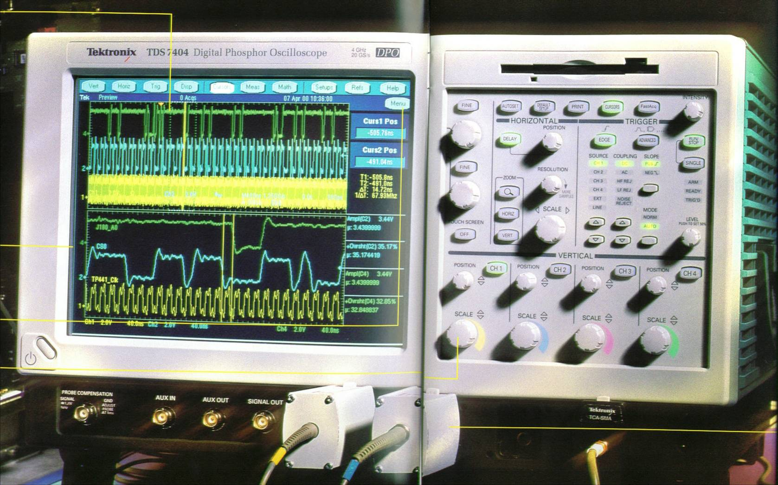
Signal Processing

Slide 2
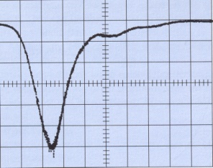
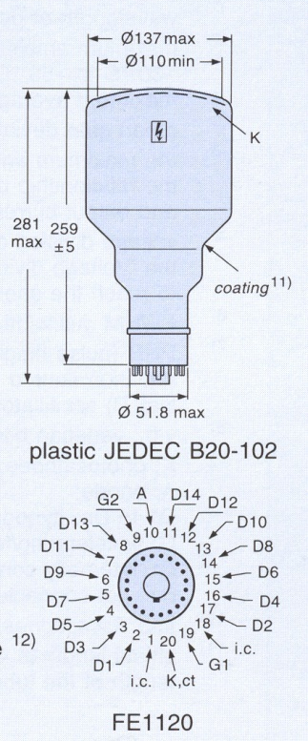
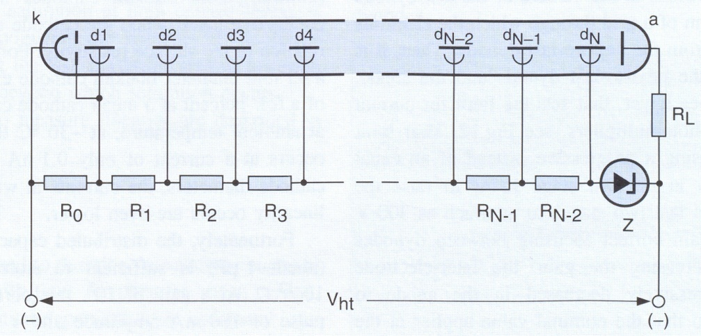
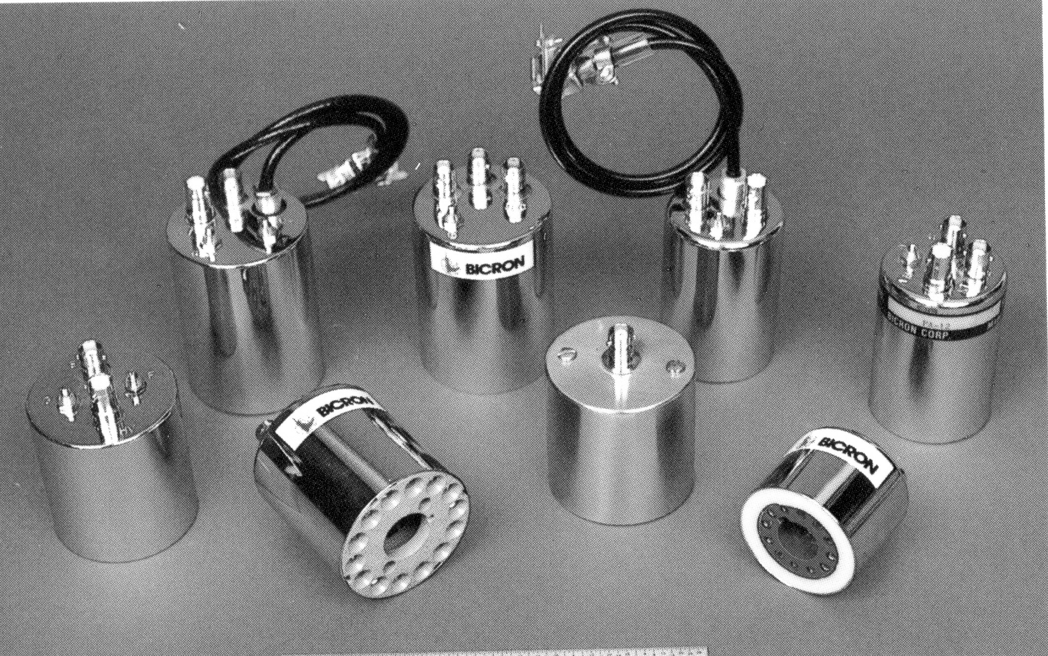
PM Operation
Fast PM: pulse rise time ~2ns, gain: 3.10⁷
U(t)
Philips XP2041
5” dia cathode
14 dynodes
+ focussing electrodes
PM schematic
t
c
a
PA
Socket FE1120 pin connections
PM Voltage divider (progressive)
U₀=2000V
Sockets
mu-metal shield tube provides protection from external B field.
PM
Sc
mu metal
soft iron

Slide 3
Pre-Amplifiers
Amplify weak detector signals (mV) → 1V, transmit through cable.
Main types: charge-sensitive or voltage-sensitive
Charge sensitive preamps integrate directly Q(t)  E_{deposit}
For semiconductor IC diodes (small signals).
Voltage sensitive preamps amplify U(t) = Q(t)/C, C = const.! → PM, PC
Detector: capacitor C_{d},
→ charge Q(t), current I=dQ/dt
For E measurement, integrate Q
For t measurement, differentiate Q
Use operational amplifiers (op-amp) for both.
-
C_{d}
Q
+
R
R,C
U₀
Replacement circuit for detector and decoupling
R
C
C_{d}

Slide 4
Basic Counting System
Charge sensitive preamplifier: Voltage output pulse height (1V) independent of detector C
Bias (U₀)
R
C
DAQ
Pulse Height Analysis →
Digitization
PreAmp
Amp
Shaper
-+ - - +-+ +- -+++
Detector
unipolar
t
Ground
ΔU
Binary data to computer
R: Load resistor C: Insulate electronics from HV (det. Bias)
Pulse height ~100 mV
bipolar
0
t
Amplifier/Shaper: differentiates (1x or 2x)
Final amplitude 2-10V

Slide 5
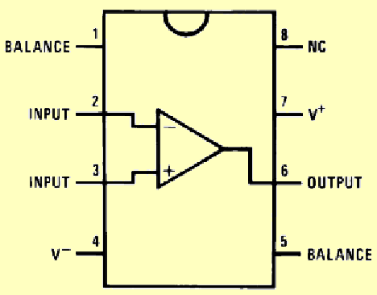
Operational Amplifier Principle
Op Amp inputs:
Inverting (-), non-inverting(+)
Integrated Circuit Chip (IC)
411 Op Amp
-
G
+

Slide 6
Operational Amplifiers
U_{in}
-
Inverting amplifier (gain G~10⁶).
Properties of amp determined by feedback:
Feed back negative of input signal to the summation point cancels the signal at Σ,
G
- 10⁶ · U_{in}
+
I_{f}
I_{in}
R_{f}
-
Σ
R_{in}
G
+
C_{f}
-
Σ
R_{in}
G
+
Integrator
R_{f}
-
Σ
C_{in}
G
+
Differentiator

Slide 7
Comparator/Digitizer
Functionality:
0≤ U_{out} ≤ +5V
Initially (U_{in} open, not connected)
+ input at U_{Thr} =+2.5 V
If U_{in} < +2.5 V → R₃ no current
→ U_{out} = 5V
If U_{in} > +2.5 V → R₃ max current
→ U_{out} = 0V
R₂
R₃
-
>
+
R₁
U
5 V
Device essentially digitizes analog pulse amplitude.
Stack of several → ADC
2.5 V
t
0 V

Slide 8
Charge Sensitive Preamp
Inverting, integrating preamp
Pulse decay governed by t_{dec}1/R_{f}C_{f}.
Additional amplifier necessary for pulse shaping and gain.
R_{f}
R_{in}
C_{f}
Σ
G
U
C_{d}
t

Slide 9
Main/Shaping Amplifiers
Tasks: 1) Linear amplification to pulse heights of U (1-10)V
2) Improvement of signal/noise ratio (integration)
3) Pulse shaping (Gaussian shape is best)
C_{d1}
C_{d2}
R_{I}
R_{d1}
C_{I}
R_{d2}
1st diff integr 2nd diff
More versatility: RC-circuits → active filters

Slide 10
NIM Signal Standards
(National Instruments Methods)
+10V
Linear analog NIM signals
0V
Slow logical NIM (TTL) pulses:discriminators, gates,…
+10V
“1”
“1”
“0”
+5V
“0”
0V
0V
TTL-Logic
2ns
NIM-gate/trigger signal
Fast logical NIM signals for fast timing/triggering
-16mA
-0.8V/50Ω

Slide 11
Discriminator/Trigger
U_{in}
Task: Produce a logical signal, whenever analog signal exceeds threshold U_{disc}. Use for logical decisions (open acquisition,...).
Exists for slow and fast pulses.
U_{disc}
t
U_{out}
t
R_{f}
R₁
Σ
-
U_{disc}
+
Mono
Vibrator
+10V
Input
Potentiometer
Output
For fast timing, use negative NIM logic units

Slide 12
Zero-Crossing Triggering
Produce fast, bipolar linear pulse. Possible: different gains for positive and negative parts → zero crossing at different times (fraction of time to maximum)
t
t
Produce “saturated” uniform pulse
t
Differentiate saturated pulse, use triplet pulse as input for trigger (negative pulse polarity).
Trigger output appears at zero crossing
(Internal delays here neglected)
U_{trig}
Trigger output signal
t

Slide 13
Constant-Fraction Discriminator
E pulse amplitude spectrum
“walk”
Zero crossing timing
(@ fraction f of amplitude): always at same physical t
independent of amplitude (fixed pulse shape):
No “walk” with energy
U_{disc}
Amplitude dependent leading edge discr. output timing
t pulse time jitter
U_{cftd}
-1
Delay T_{d}
Splitter
U_{in}
Σ
Trigger
U_{f}=f·U_{in}
Can utilize for PSD!

Slide 14
Logic Modules
Overlap Coincidence
Or (inclusive)
U₁
U₁
U₂
U_{out}=U₁ΛU₂
U₂
U_{out}=U₁VU₂
U₁
U₁
U₂
t
U₂
t
For fast timing: use fast negative logic
t
t
U_{out}
U_{out}
t
t
U
U₁
complement
U_{out}=
U₁Λ¬U₂
¬U
U₂
¬U₂
Anti-Coincidence/Veto

Slide 15
Signal Transmission
outer
casing
outer conductor/shield
inner conductor
dielectric
medium
outer conductor
z
Coaxial cables/transmission lines ←→ traveling waves in cavity resonators
L: inductivity/length
C: capacity/length
depend on diameter and dielectric
Wave equation (R=0):
signal propagation speed (speed of light):
typically c⁻¹=5 ns/m
characteristic resistance
Z₀=Ohmic resistance!
For R≠0, Z₀(ω) complex
Z₀ = 50 Ω or 93 Ω
used for timing, spectroscopy, resp.

Slide 16
Impedance Matching
For impedance matching, R_{load}=Z₀, cable looks infinitely long: no reflections from end.
R_{d}
R_{load}
sender
receiver
For mismatch, R_{load} ≠ Z₀, reflection at end, traveling back, superimpose on signal → terminate with R_{term}.
R_{d}
R_{load}
R_{term}
Polarity of reflected signal R_{load}=0, ∞

Slide 17
Cable Reflections
Receiver input impedance R_{load} ≠ Z₀, → use additional Ohmic termination in parallel
R_{load}
R_{term}
Open end: R_{load}= ∞ Input and reflection equal polarity, overlap for t > 2T_{cable}
T_{cable} = 2L/c
L
L
Short: R_{load}=0, Input and reflection opposite polarity, superposition = bipolar
Multiple (n) reflections attenuated by R^{-n}

Slide 18
The End

