Slide 1
Target & Support
First attempt
Ian
18 Nov2022

Slide 2
Target sketch
Very approx
25mm
1mm
25mm
7.5mm
1mm
5mm

Slide 3
Principle required actions
Target simulation sheared from sheet alu.
Target pressed into slot with soft metal, as a clamp.
Small 1mm tab, delicate milled from the 5mm sheet.
Slot across 5mm sheet width.
Support width given to 0.1mm (24.9actual as opposed to 25.0 nominal)
Securing hole dia. 2.3 drilled before milling of 1mm tab.
Mistake with above action

Slide 4
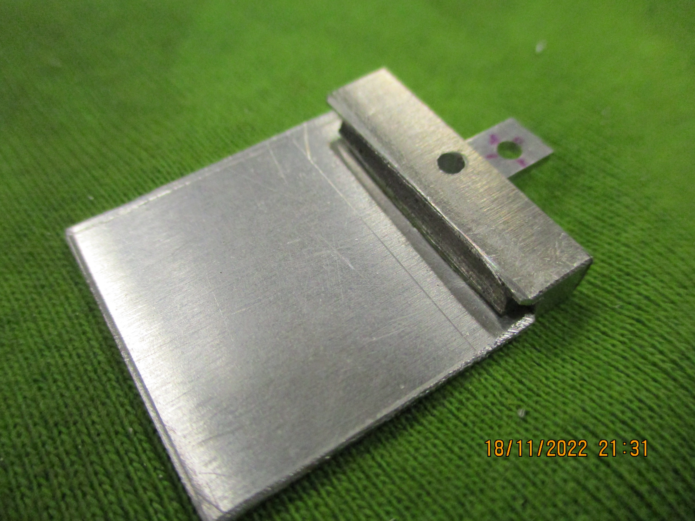
General View

Slide 5
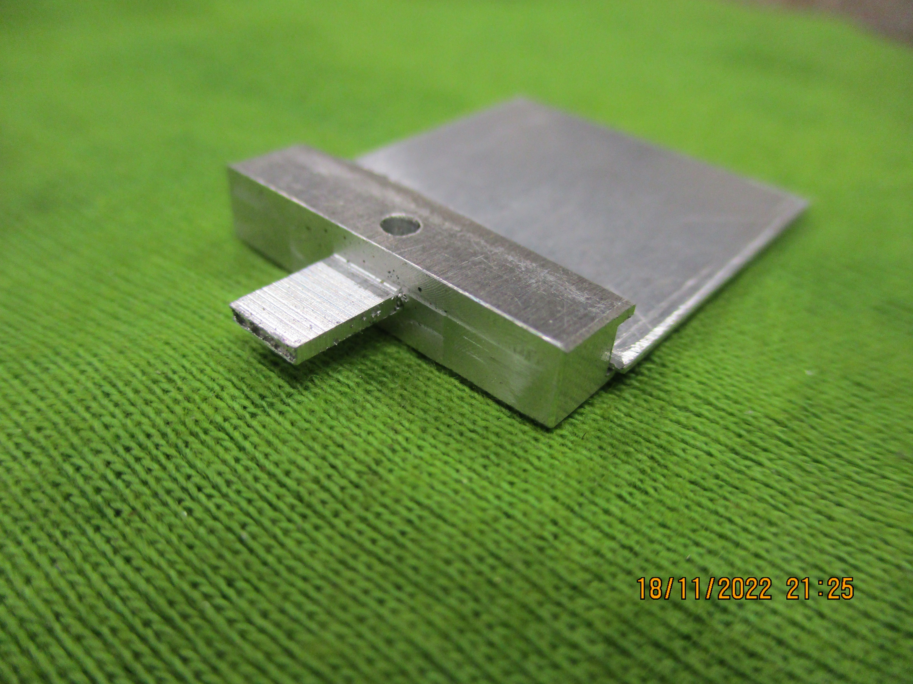
Precision
Width = 24.9mm

Slide 6
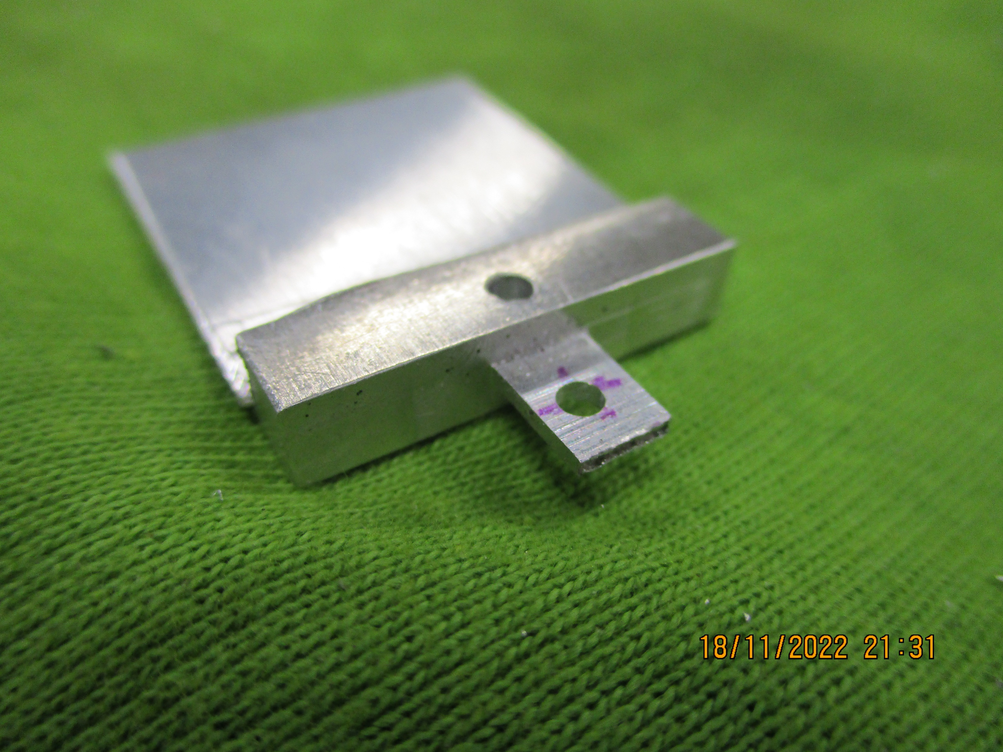
Small tab
5 x 7.5 x 1mm
Machined from solid

Slide 7
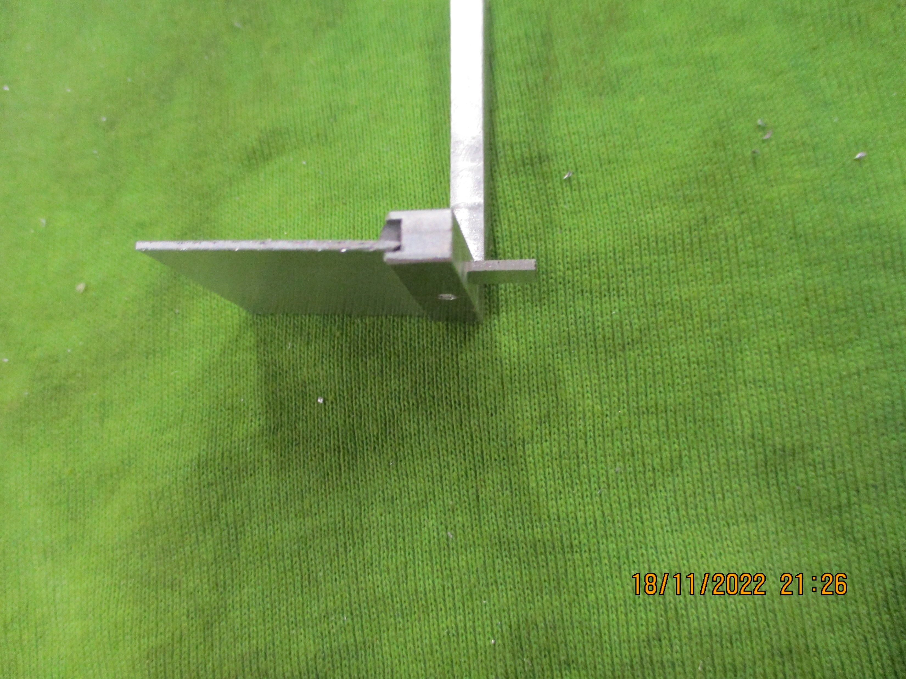
Small slot
3mm wide
To secure the target

Slide 8

Securing hole
2.3mm diameter
Drilled in wrong place.
Correction badly centered

Slide 9
Support height
Should be 3 or 5mm.
A dedicated shim to support the piece in the vice (that could have been made) would be required as the shim choice I had was not suitable.

Slide 10
Conclusion
I was able to perform the actions necessary to machine a target support as used by NA61.
What has been done is not intended as a copy.

