Slide 1
NA61 colleagues names from meetings
Ian
6 Dec 2022

Slide 2
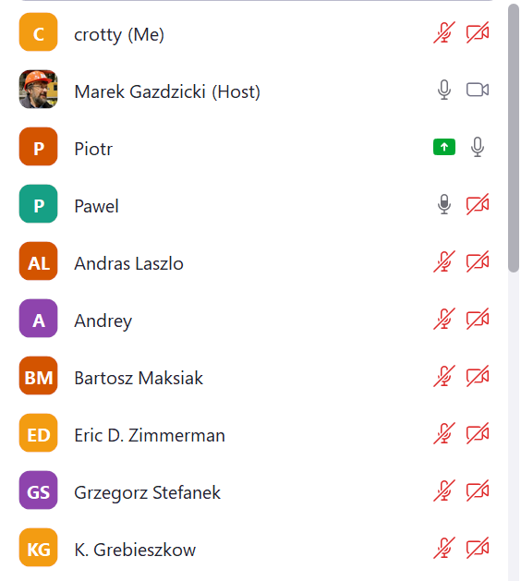
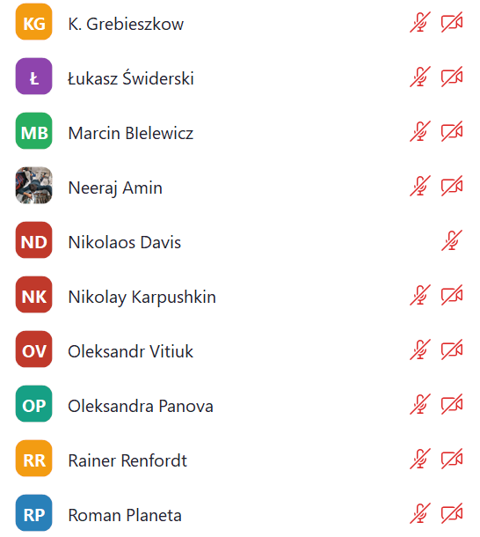
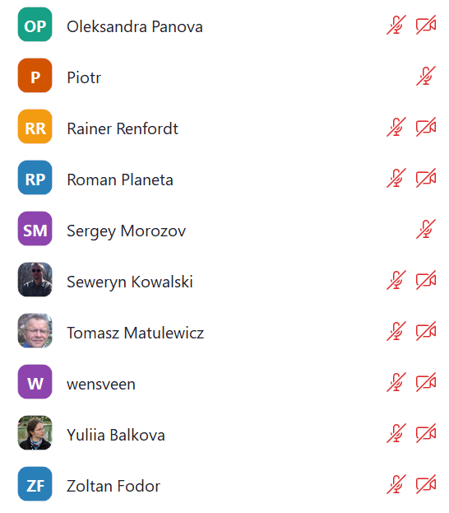

Slide 3
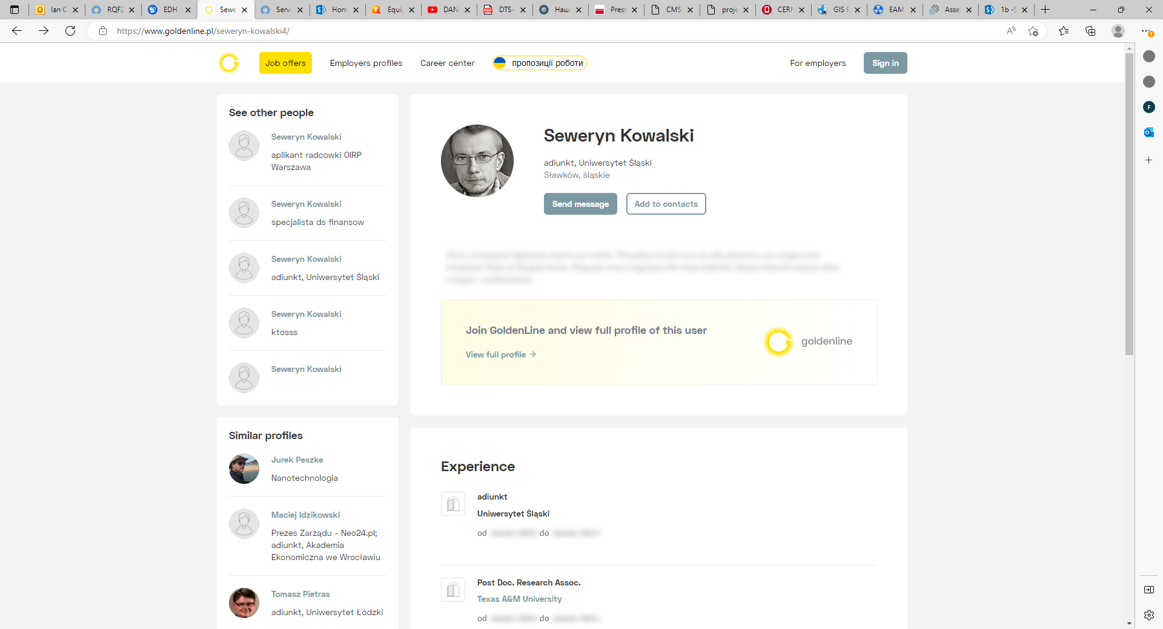

Slide 4
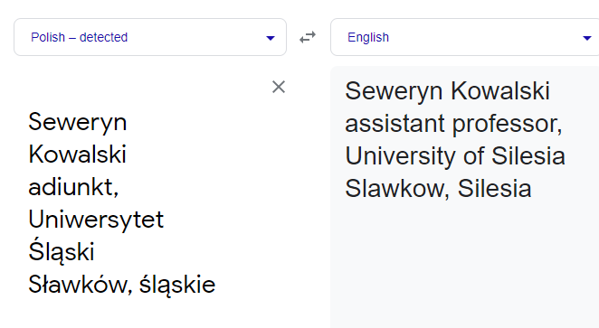
Seweryn Kowalski
adiunkt, Uniwersytet Śląski
Sławków, śląskie
Seweryn Kowalski
assistant professor, University of Silesia
Slawkow, Silesia

