Slide 1
Infor Kiosk for storage in B.947
Elsa CLERC
25-06-2021

Slide 2
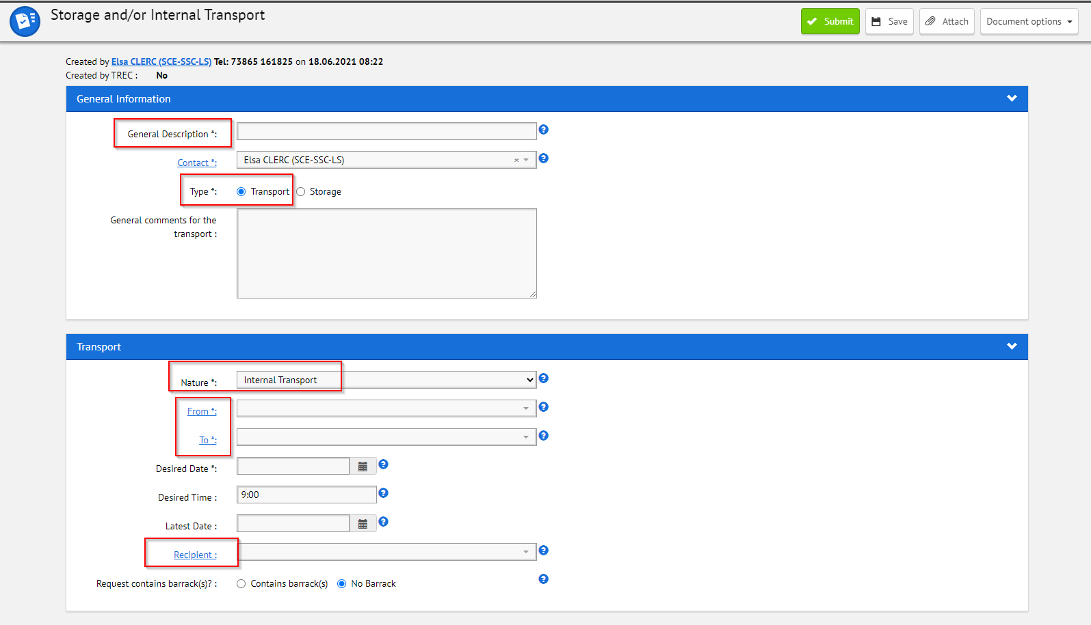
Inbound process
Action for users :
EDH SIT Internal transport request https://edh.cern.ch/Document/SupplyChain/SIT

Slide 3
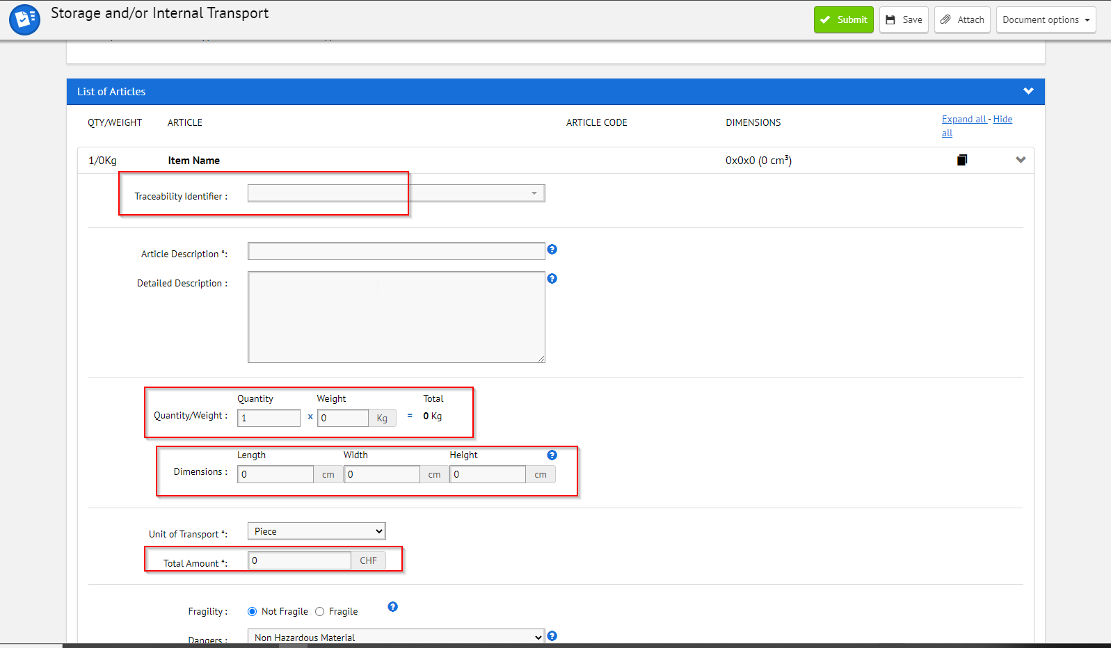
Inbound process
EDH SIT Internal transport request
* If an infor code exists already it has to be indicated in the traceability identifier field.
* If there is no code existing thanks to kiosk, we will be able to create a common CR- code thanks to the description in EDH

Slide 4
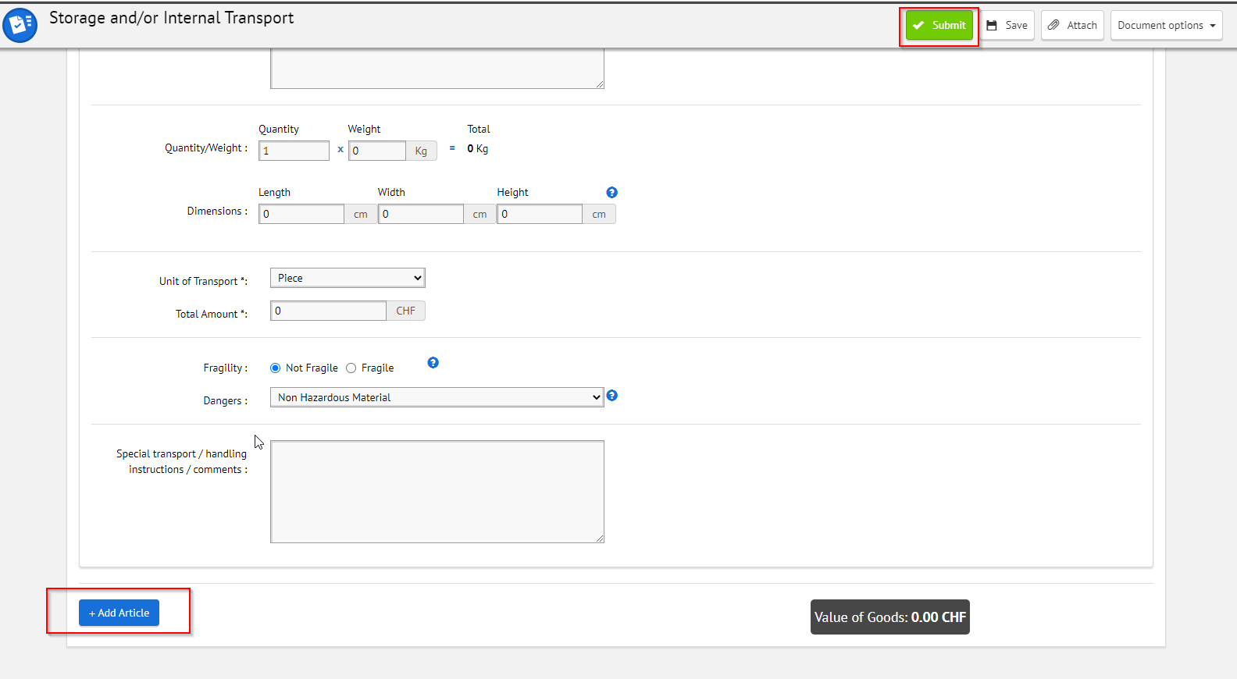
Inbound process
EDH SIT Internal transport request

Slide 5
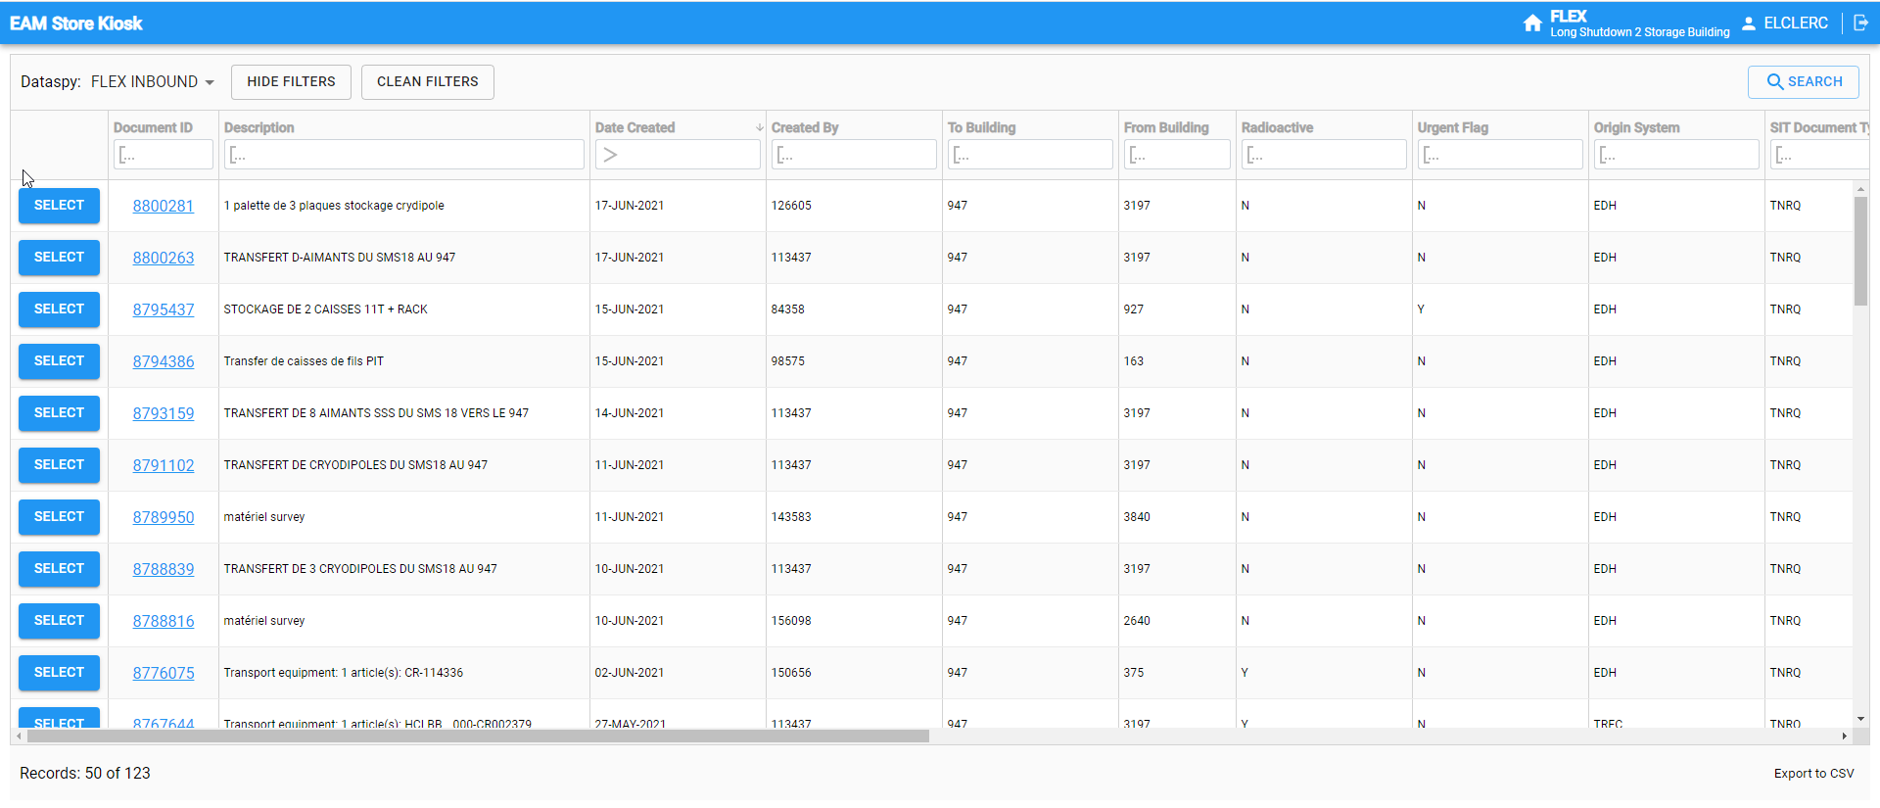
Inbound process
Kiosk view for storekeepers - Inbound

Slide 6
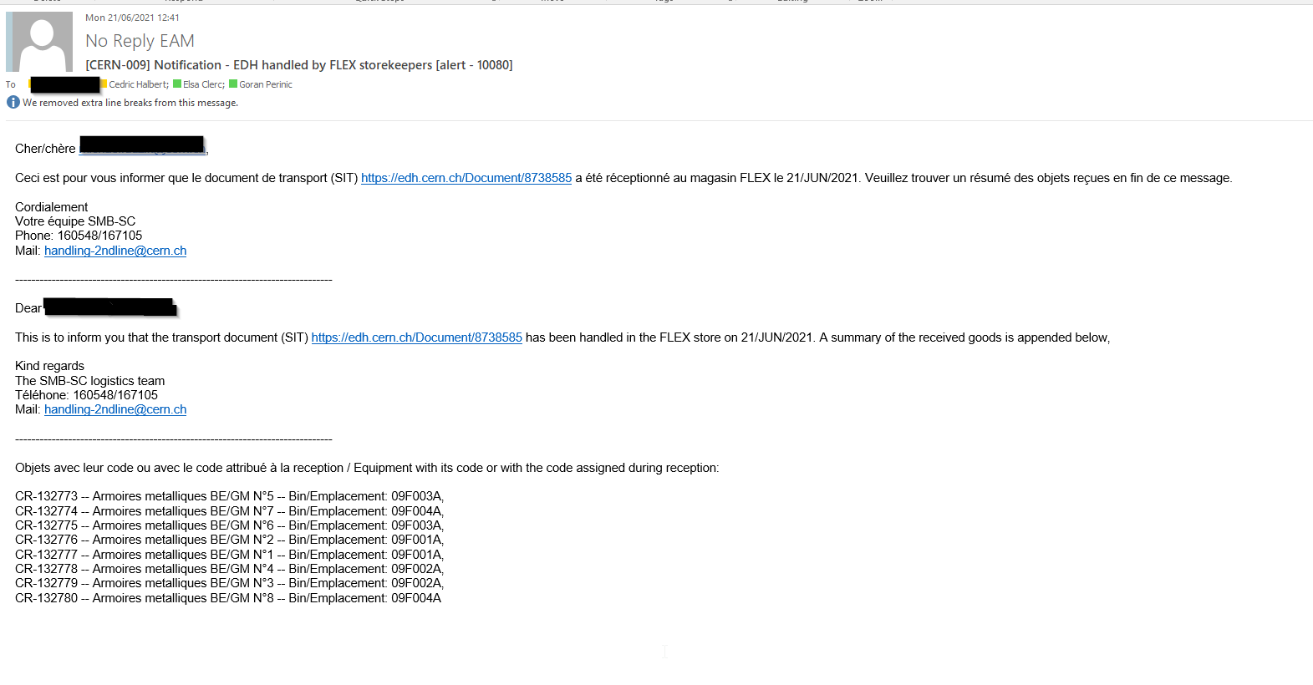
Inbound Process
Once goods are received informatically you will be informed by email

Slide 7
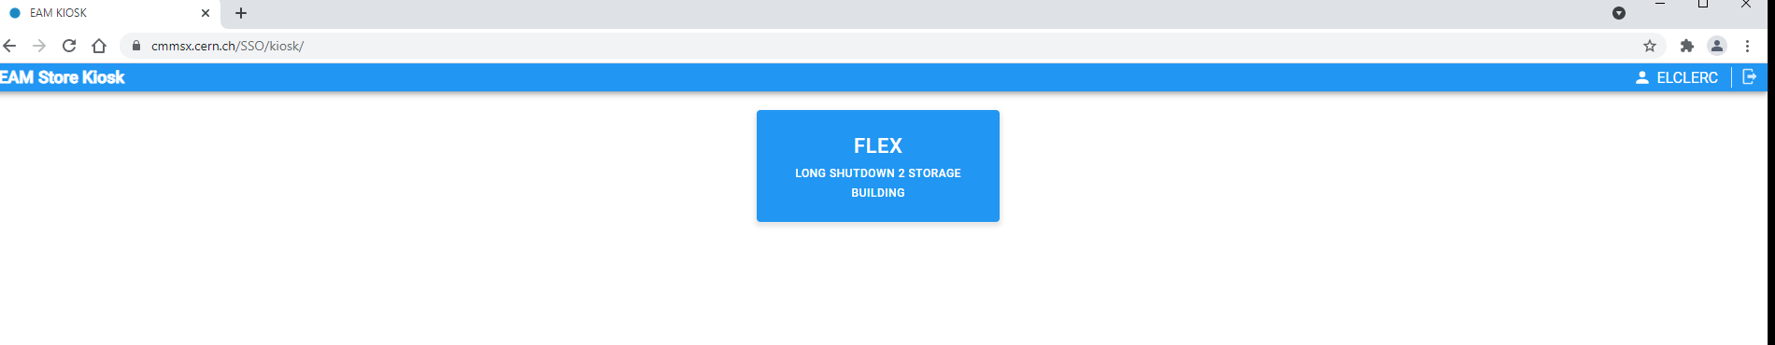
Outbound process
Action for users – Go to Kiosk application
https://cmmsx.cern.ch/SSO/kiosk/
Select FLEX

Slide 8
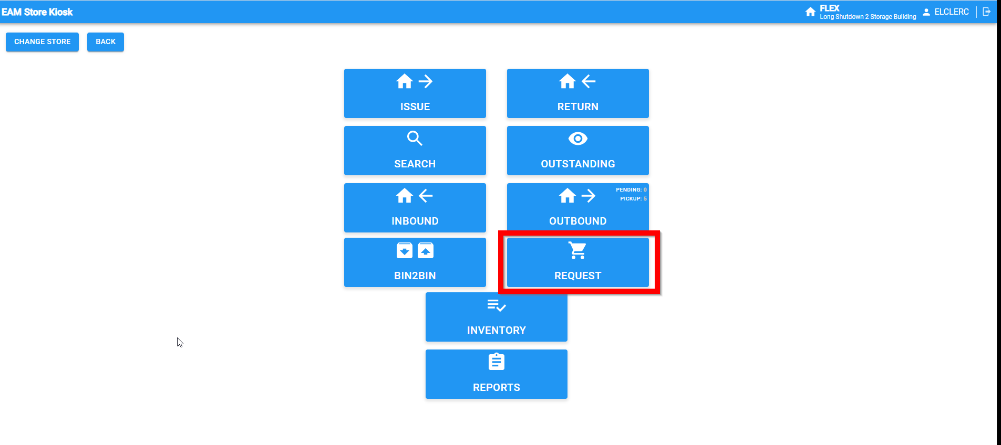
Outbound process
Select REQUEST

Slide 9
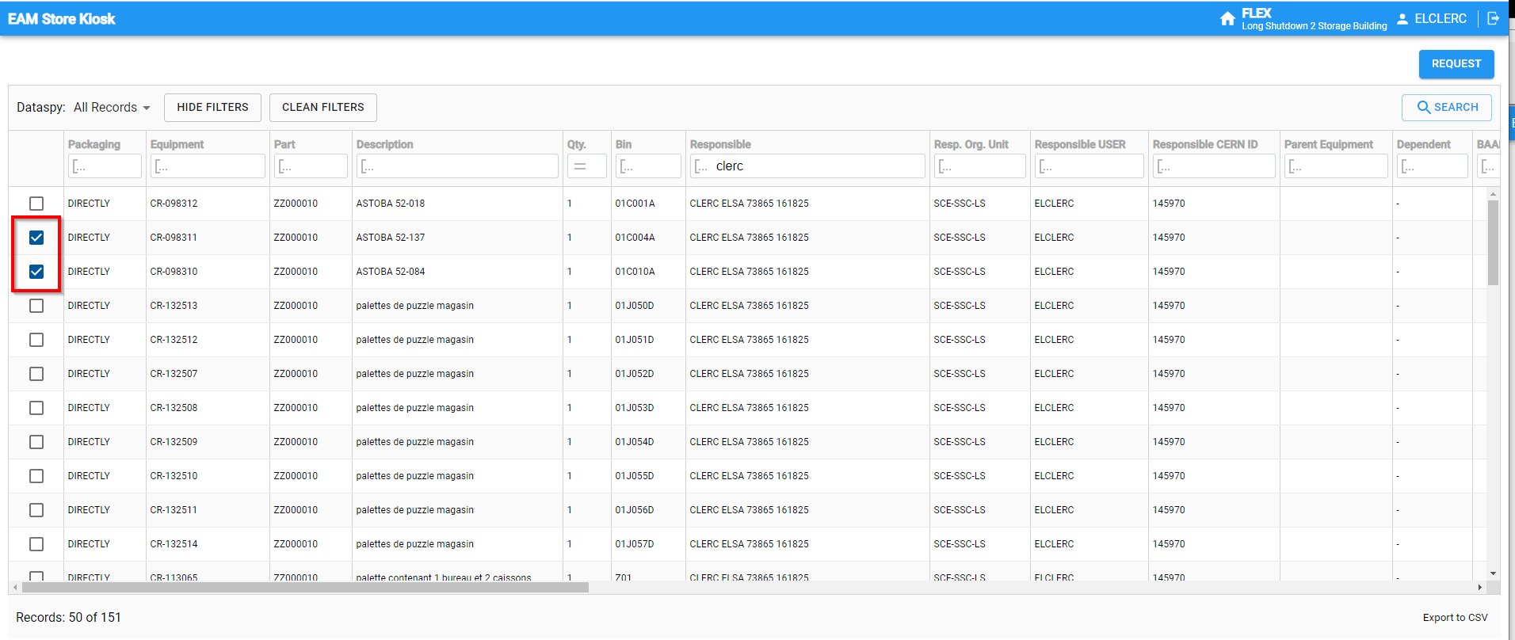
Outbound process
Choose by code or by owner name and select the desired equipments

Slide 10
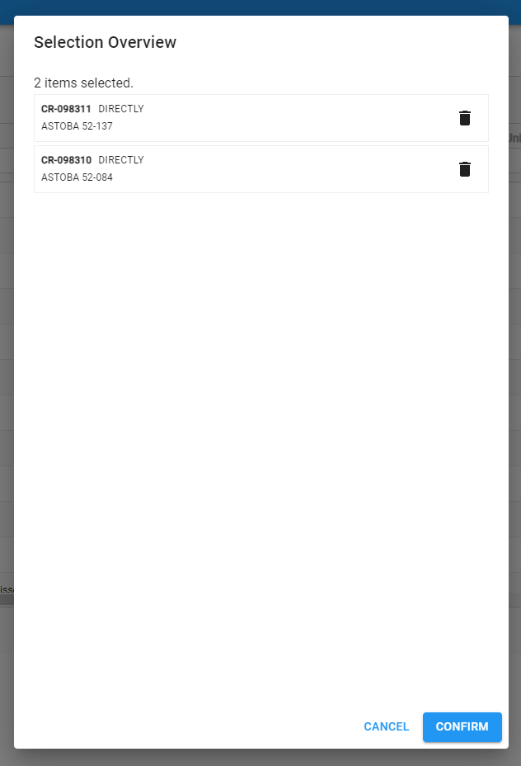
Outbound process

Slide 11
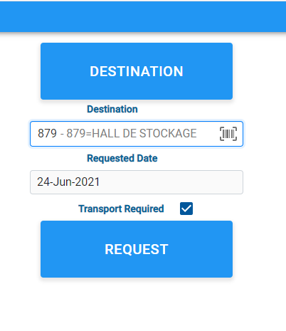

Slide 12
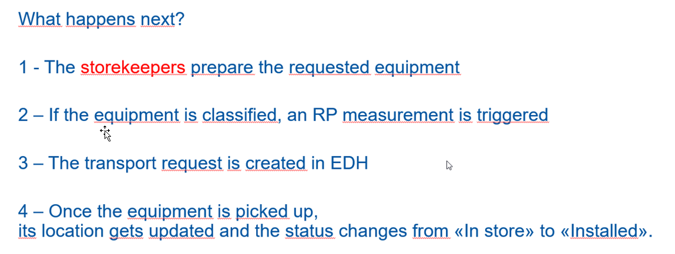
Outbound process

Slide 13
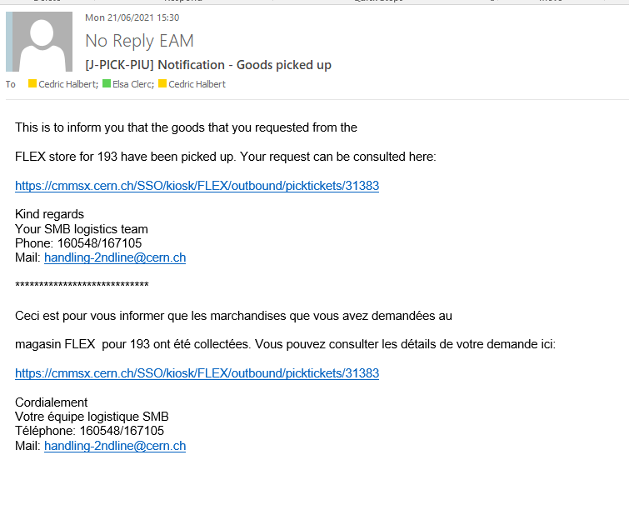
Outbound process
Once equipment are picked-up by transport you will receive an email to inform you

