Slide 1
Overall storage for NA61
Ian
31 Oct 2022

Slide 2
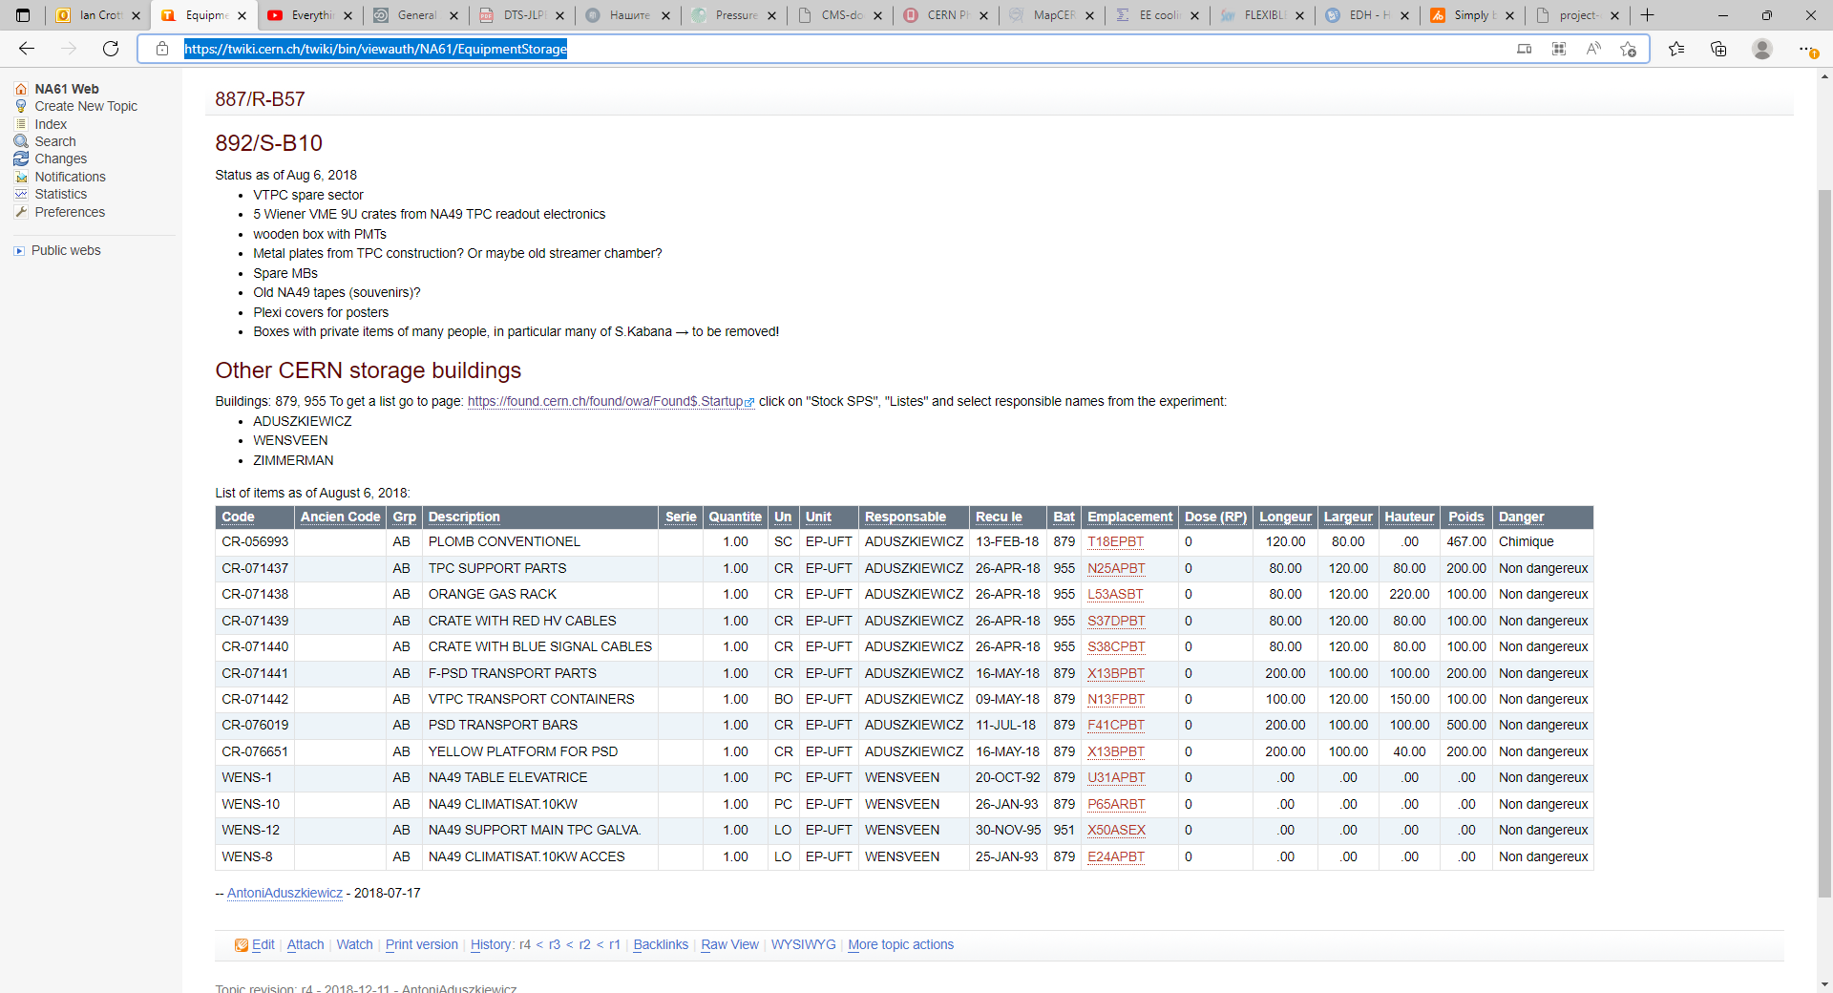
https://twiki.cern.ch/twiki/bin/viewauth/NA61/EquipmentStorage

Slide 3
What is this material ?
Where is it ?
Is it still stored ?
Are (all) the DB up to date.
Is the material identified ?
Is it stored an adequate manner ?
Is it to be kept for some foreseeable future ?

Slide 4
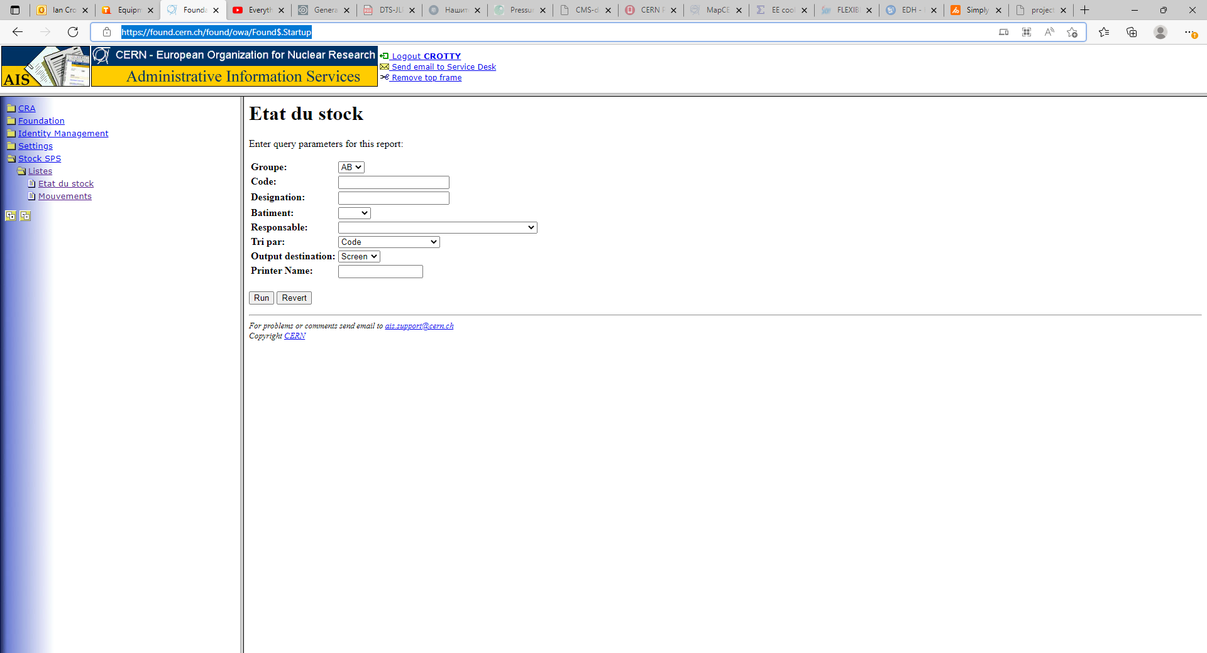
https://found.cern.ch/found/owa/Found$.Startup
Choose “Etat du stock” or “ Movements”
Put one of the names in “responsible” and press “run”
ADUSZKIEWICZ
WENSVEEN
ZIMMERMAN

Slide 5
For all six combinations
Of names and “Etat du Stock” and “movements”

Slide 6
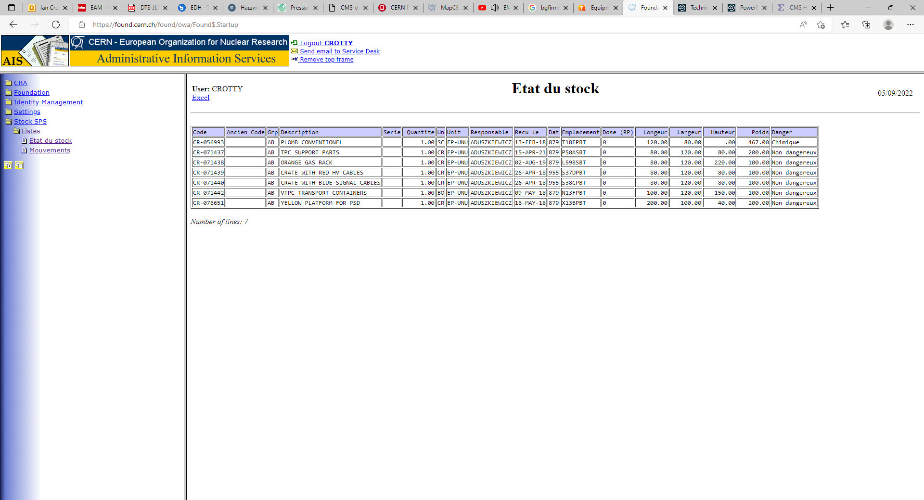
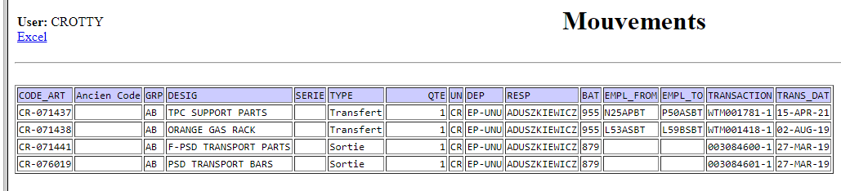
https://found.cern.ch/found/owa/Found$.Startup

Slide 7
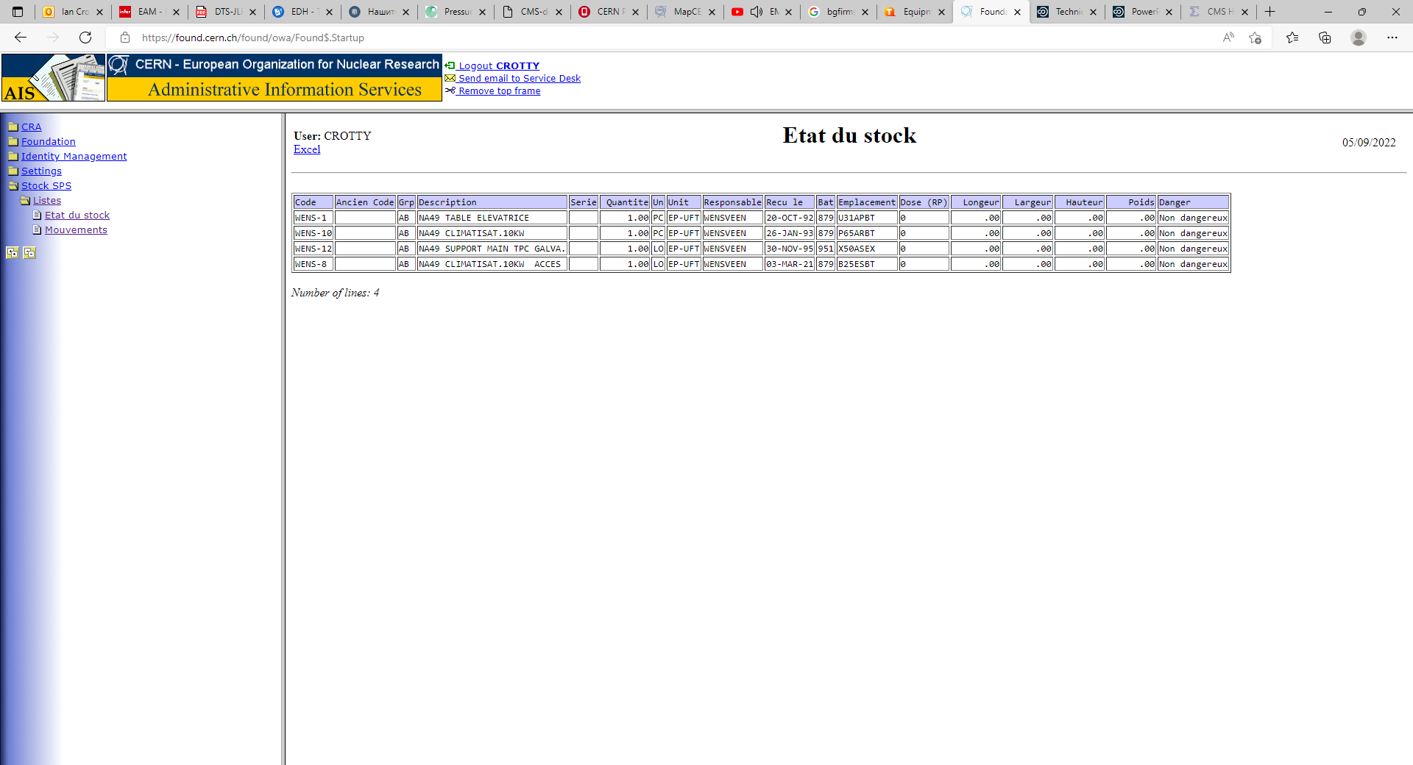
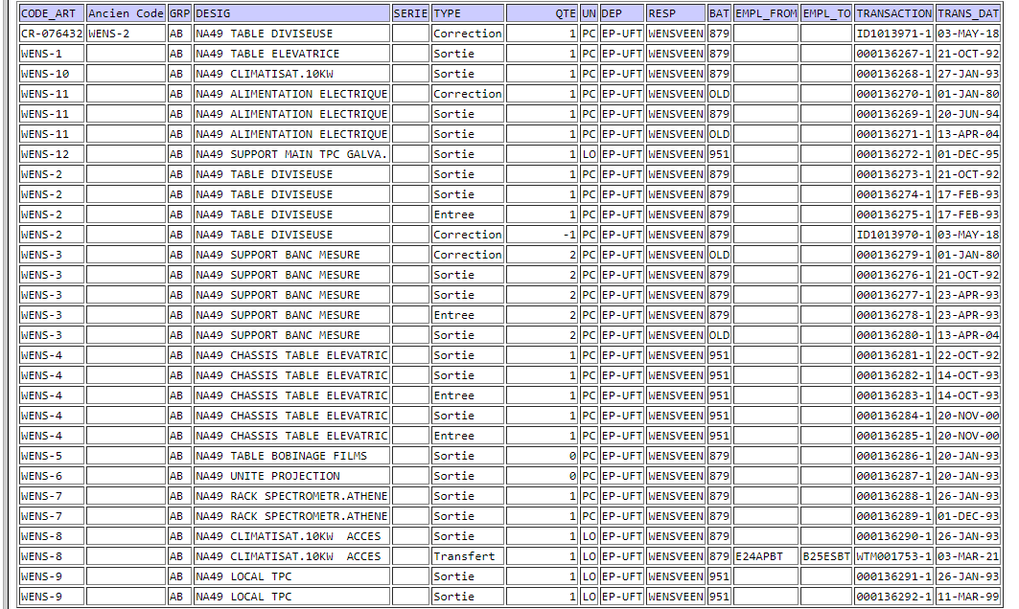
Movements

Slide 8
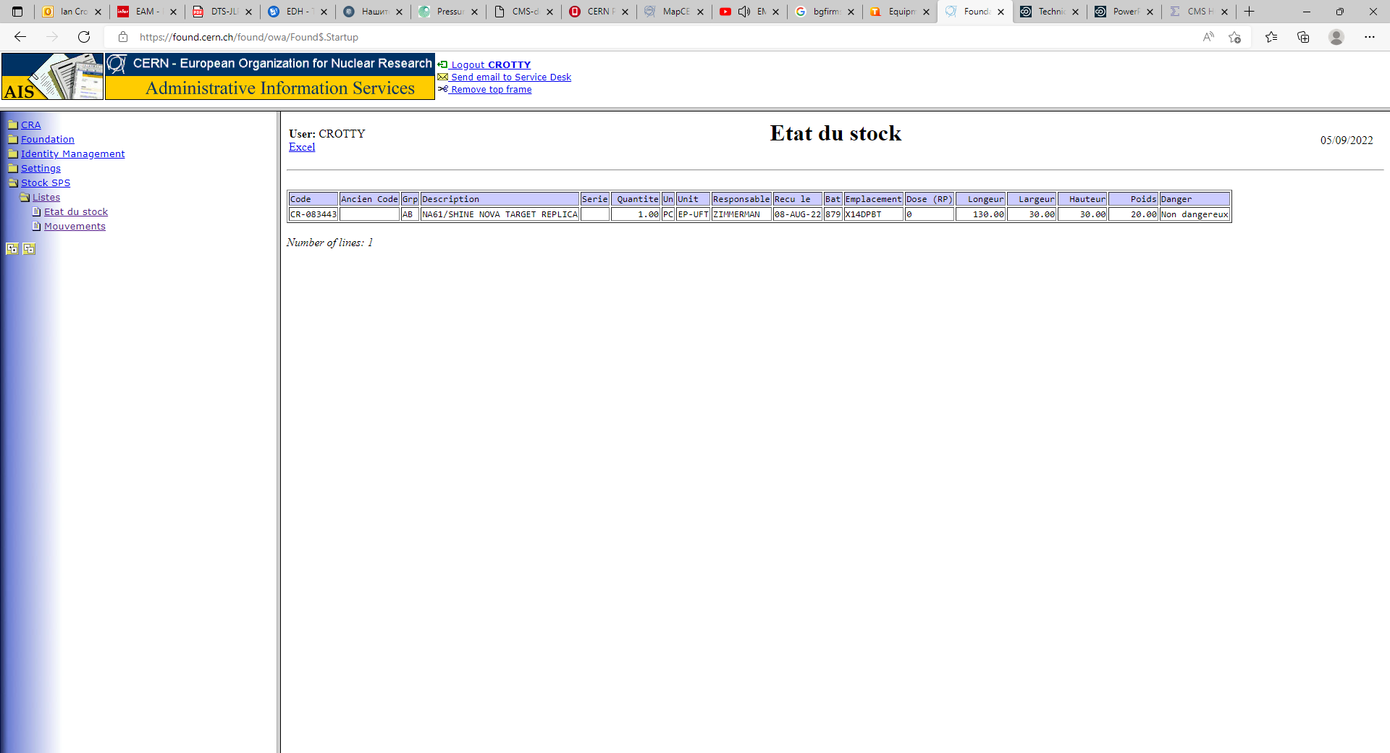


Slide 9
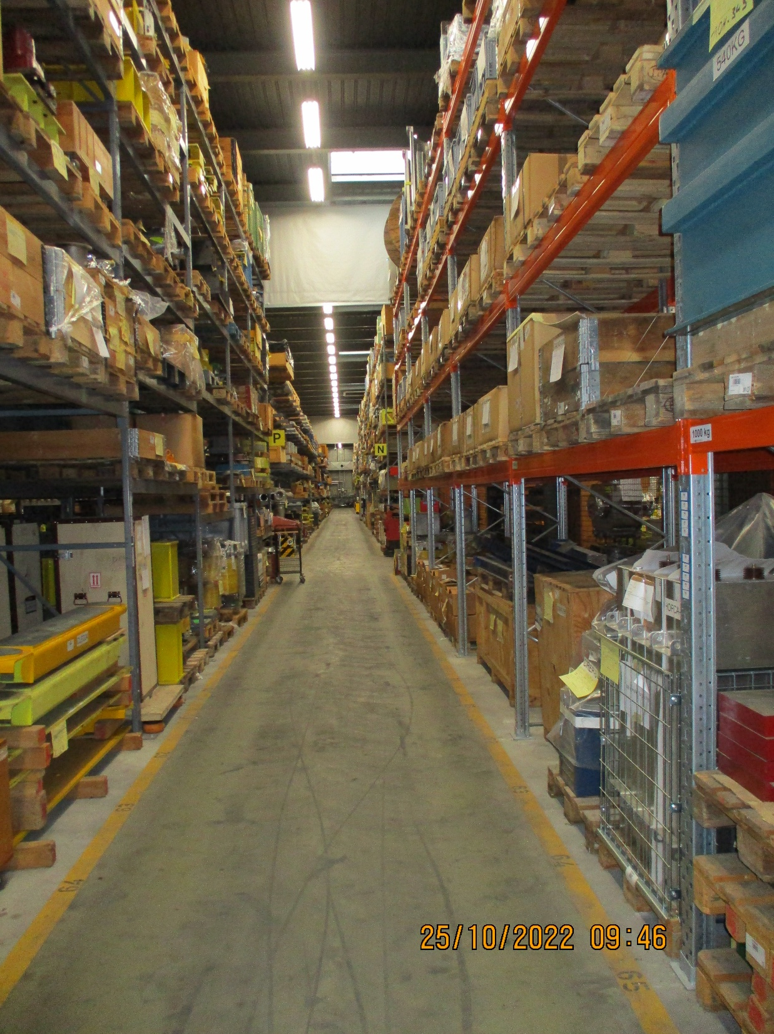
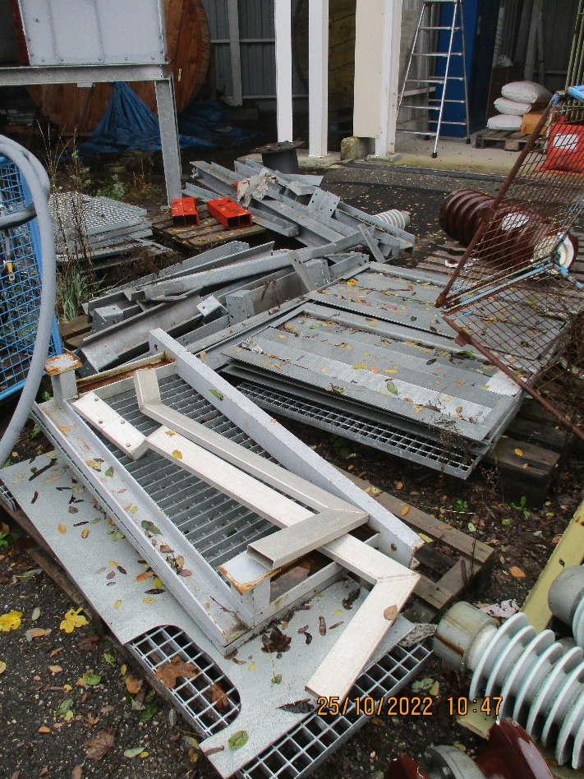
Storage areas and buildings
892
879
951
947 “Flex”
947 Flex
879
951

Slide 10
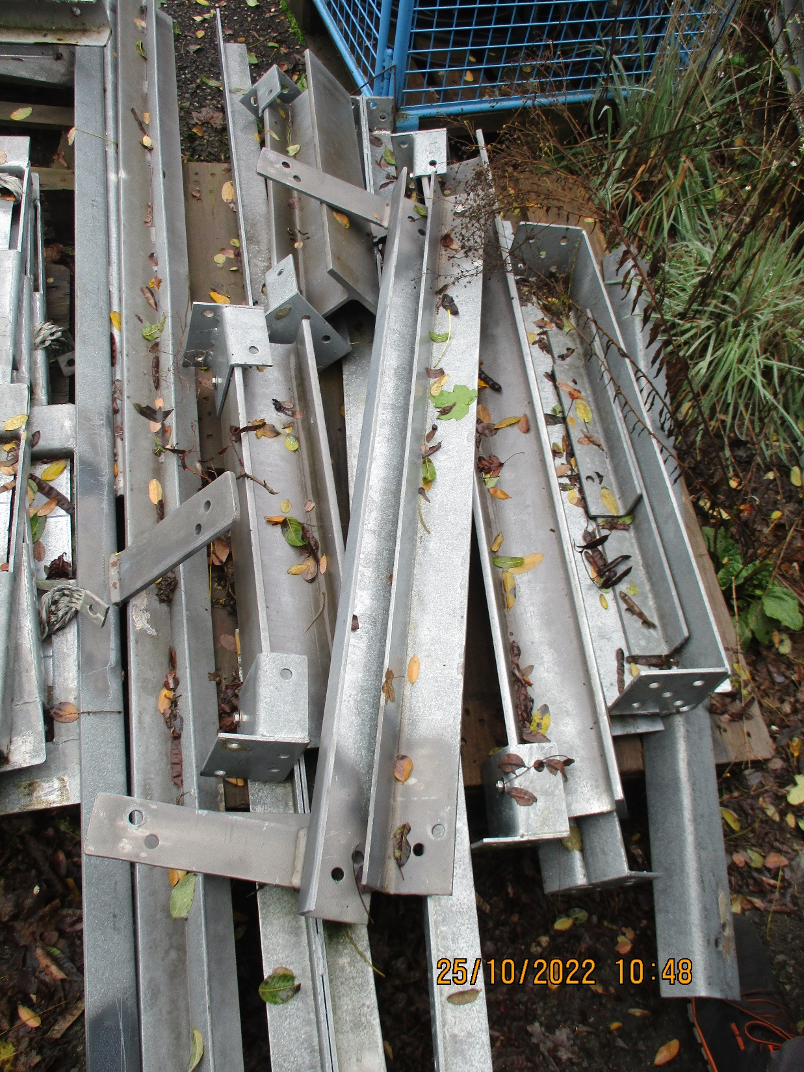
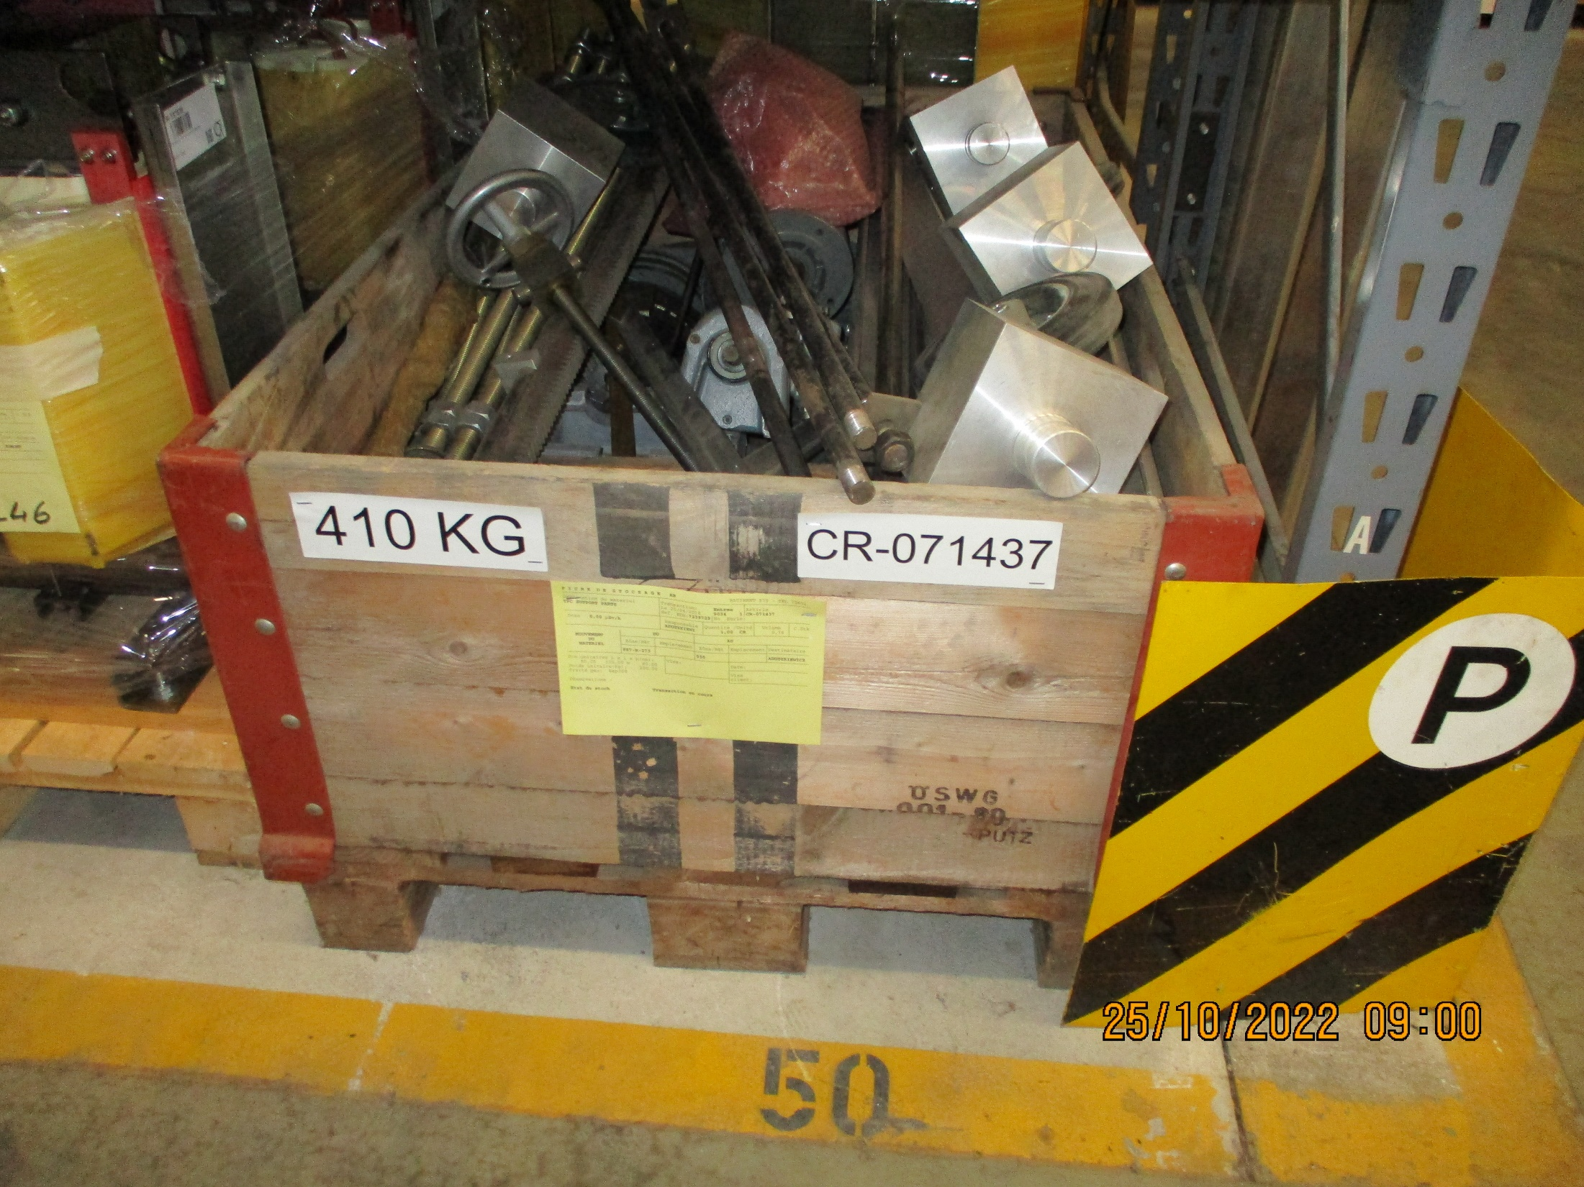
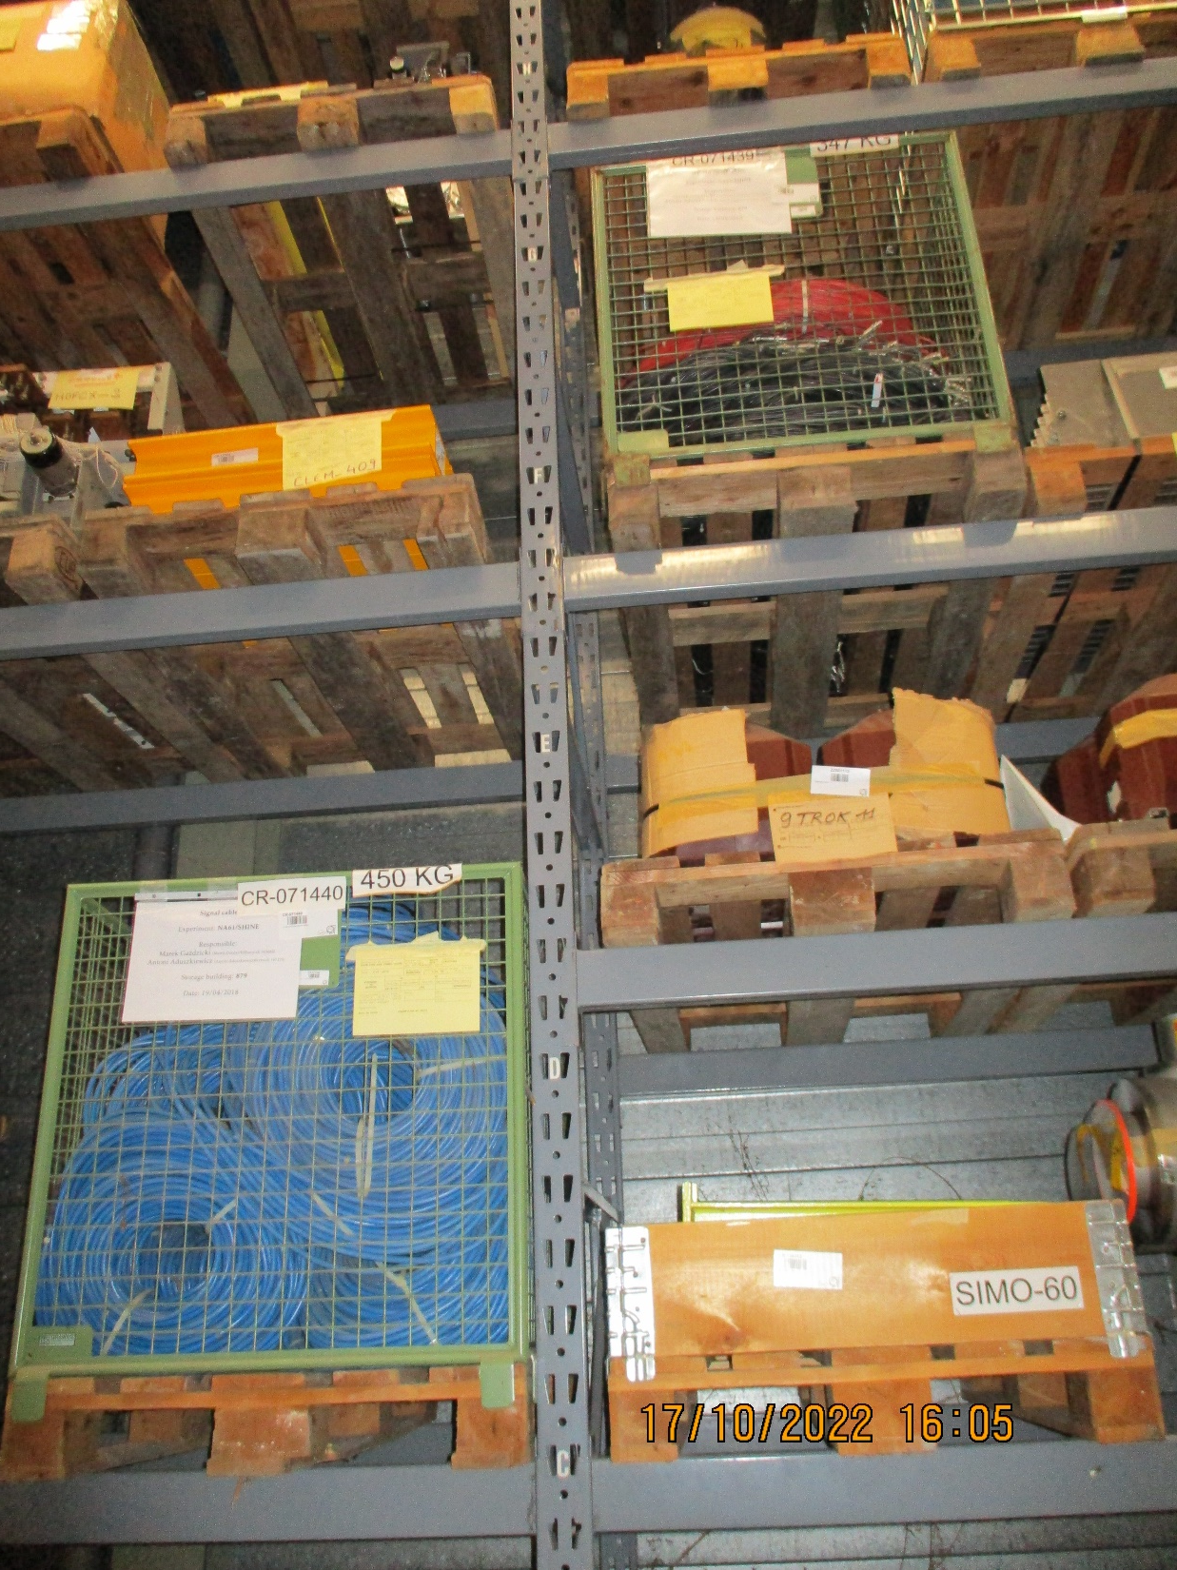
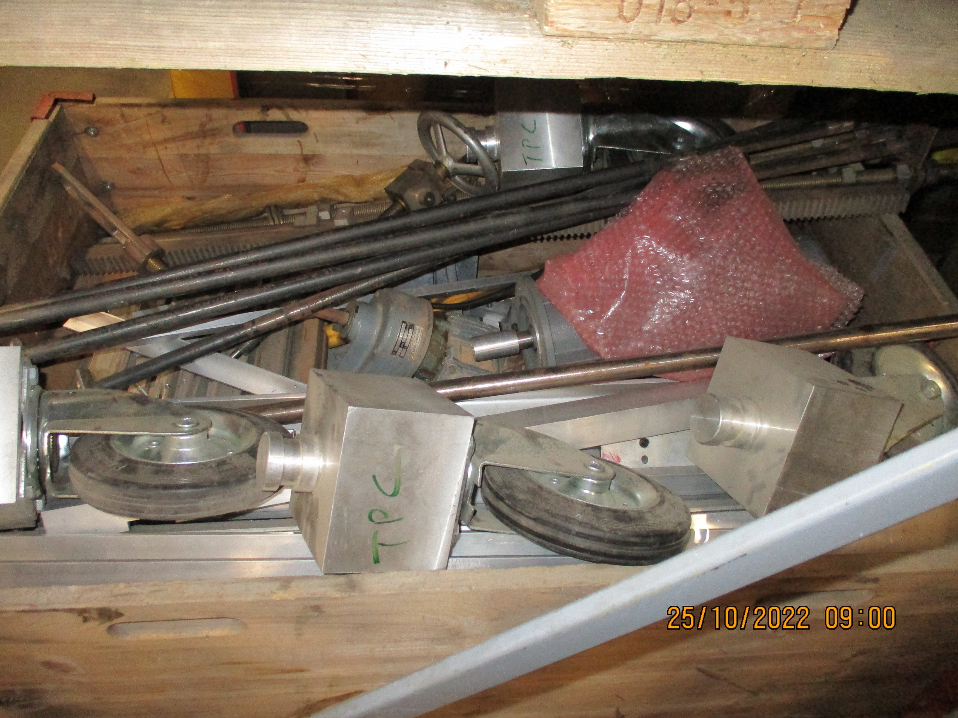
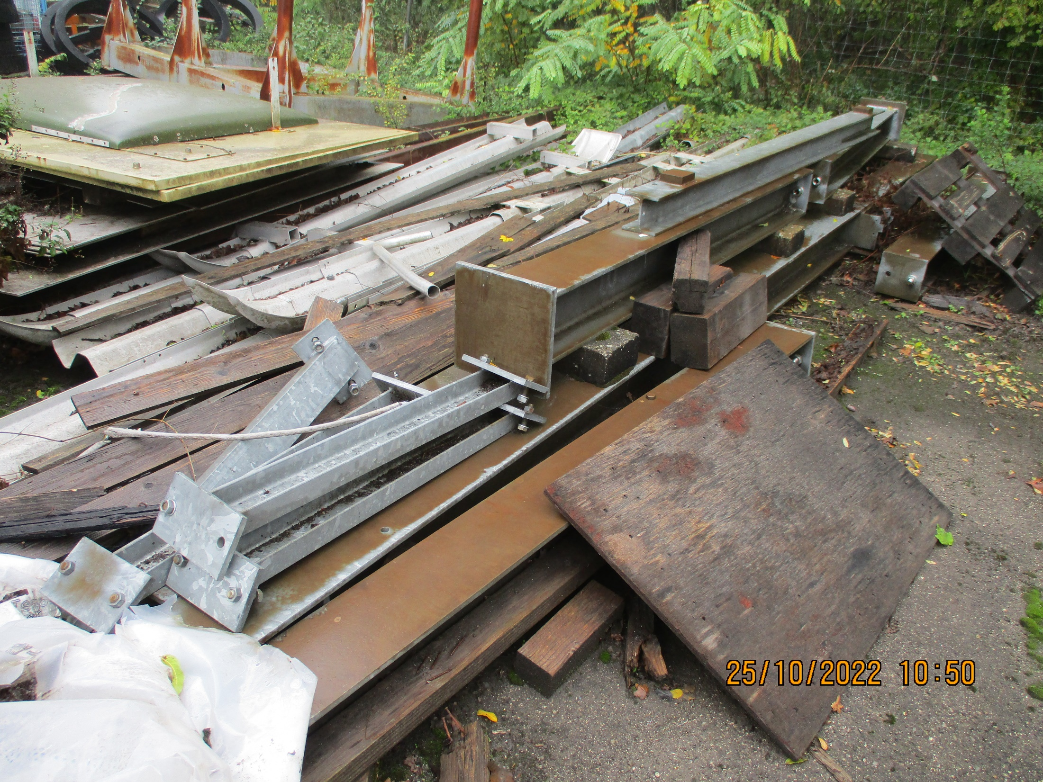
Material with identification ?
CR code for TPC supports
CR code for Cables. Which type of cables, length etc ?
No CR code for NA49 Support. Is it this ? Bat 951

Slide 11
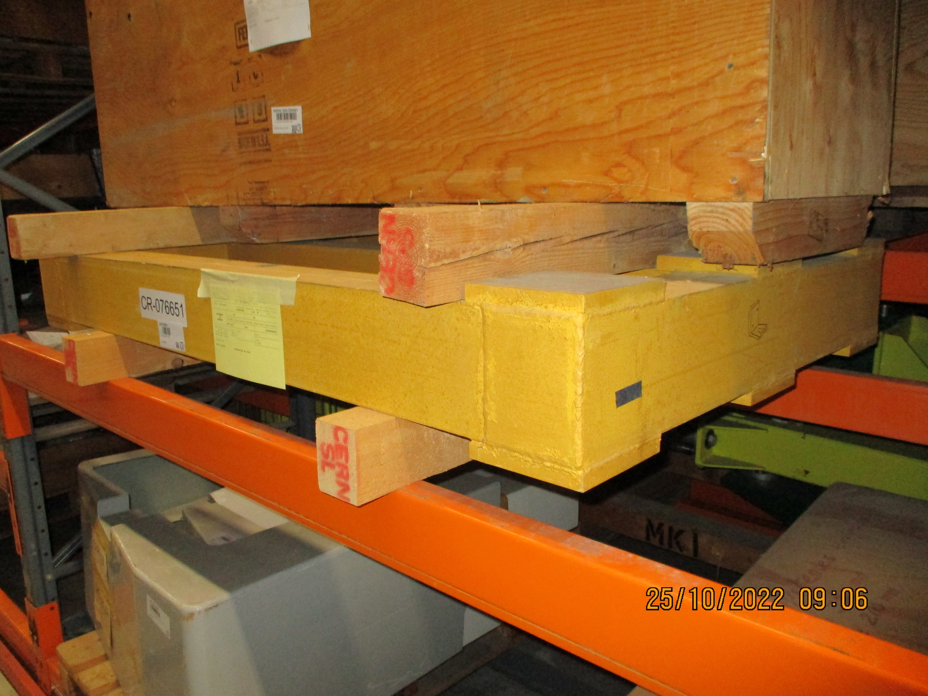
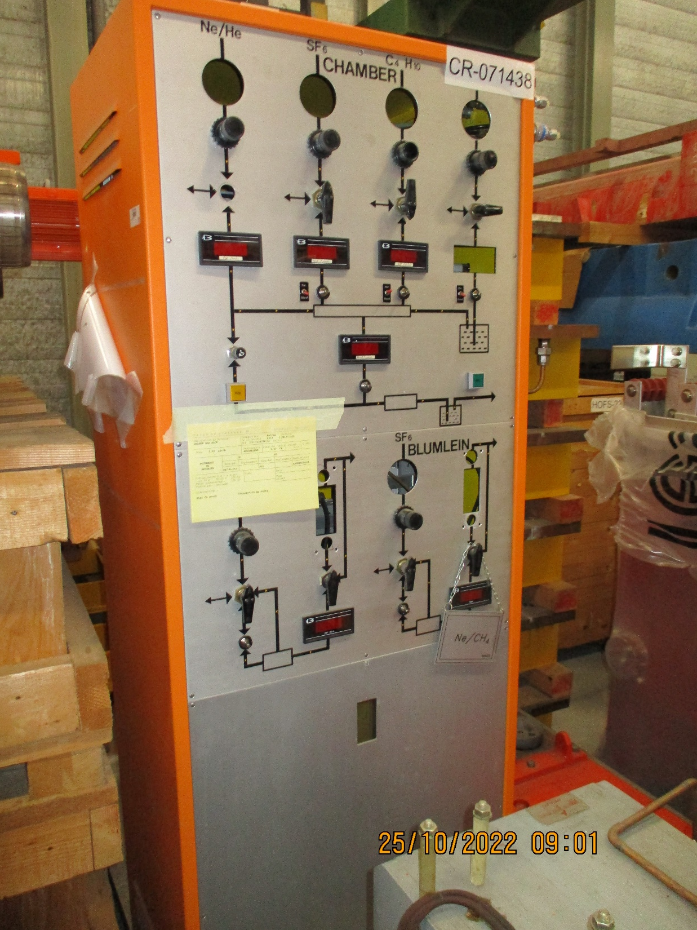
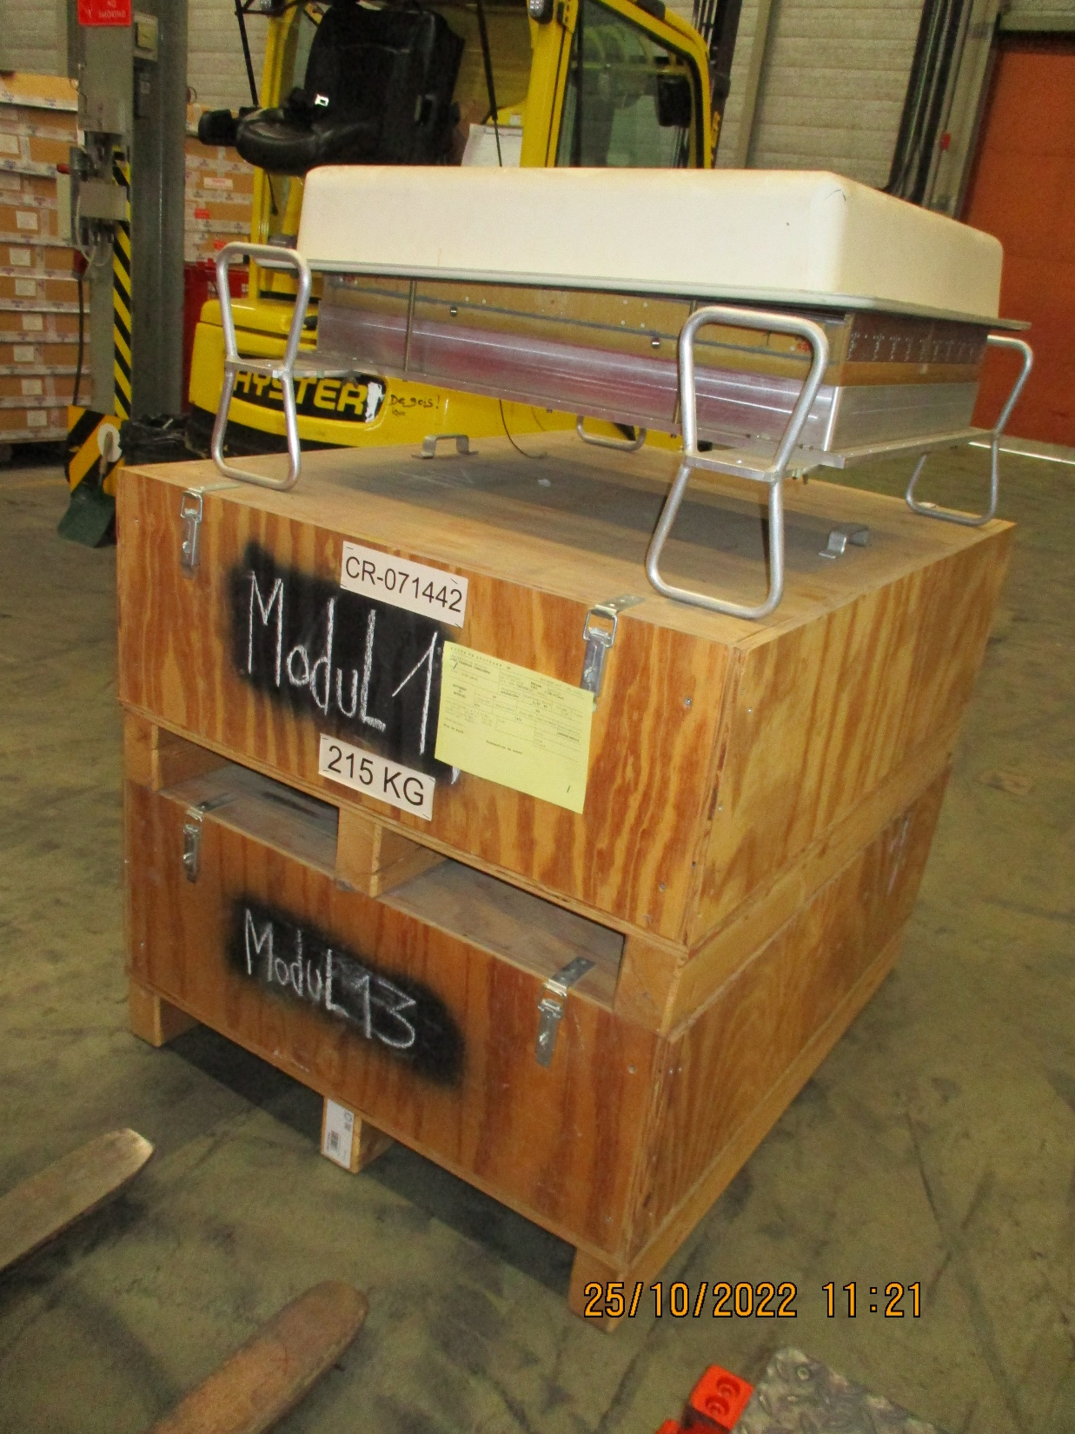
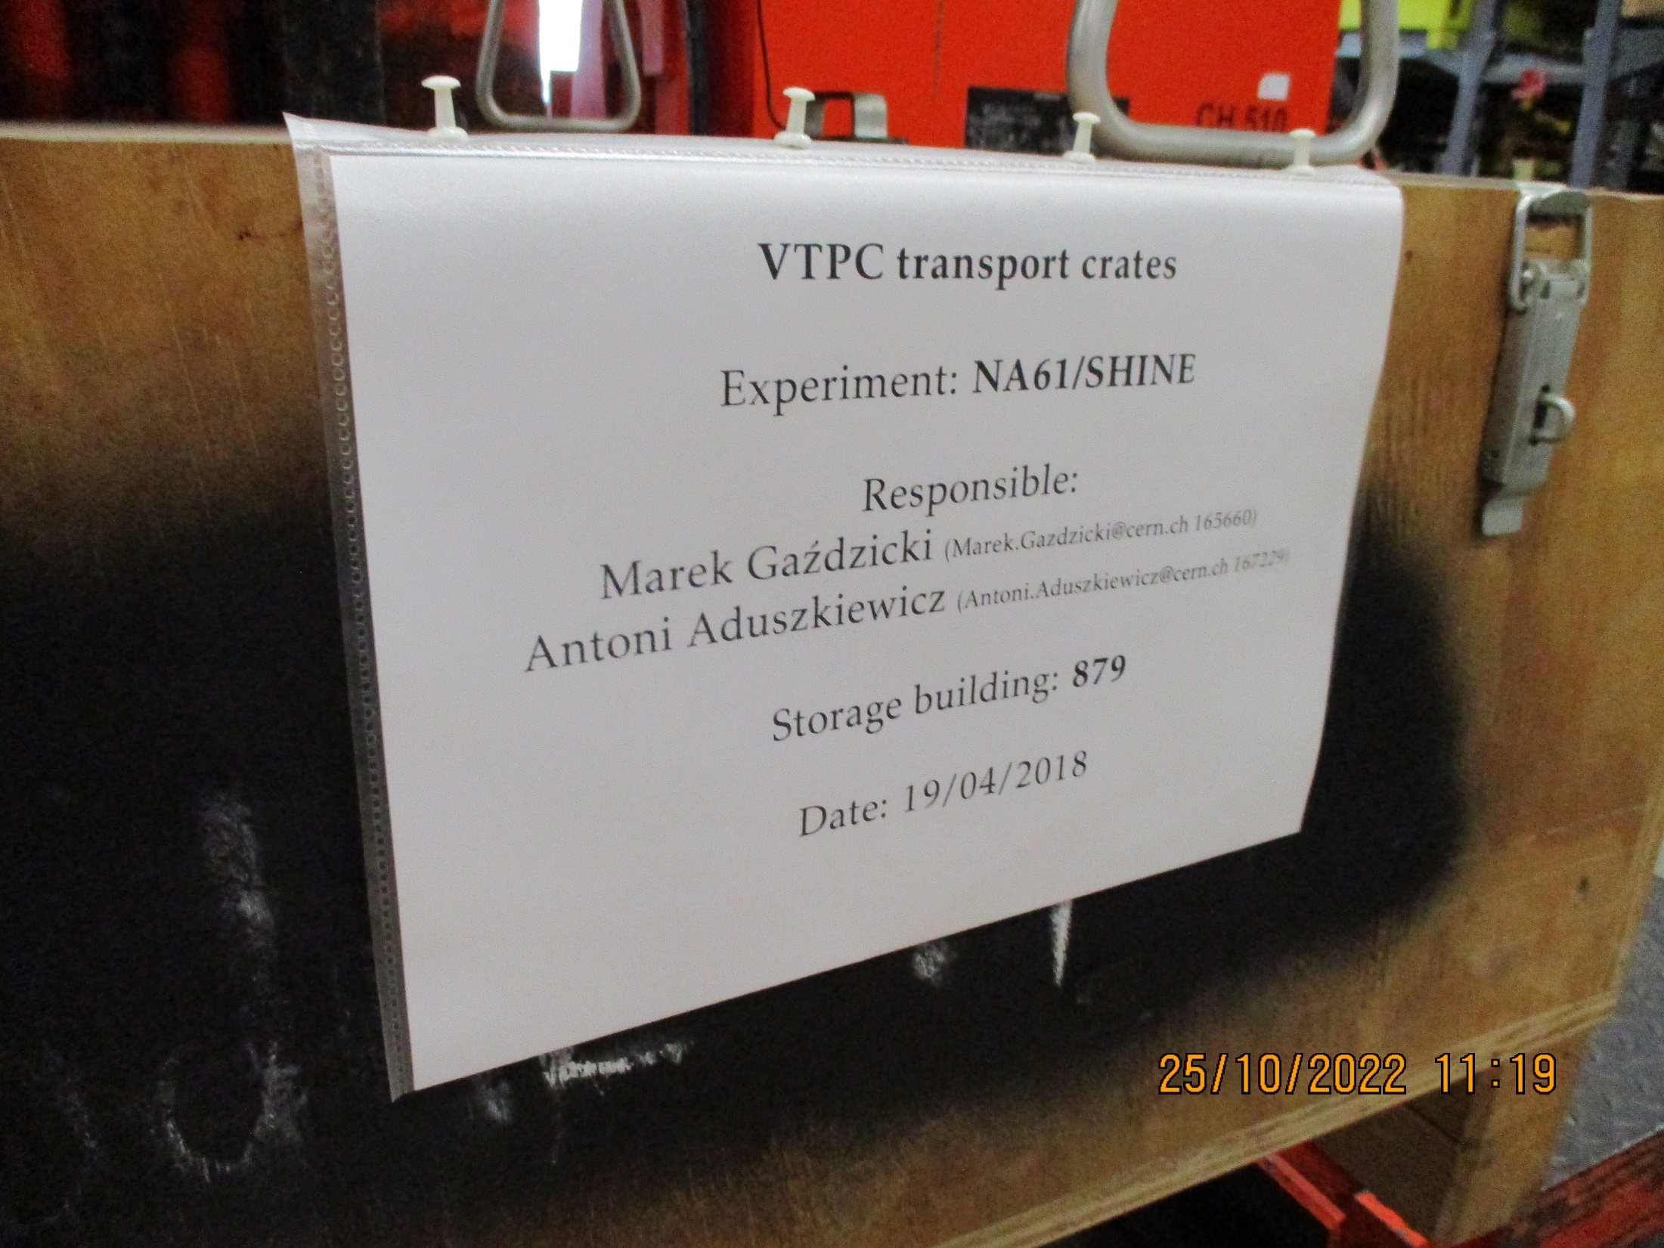
CR code for PSD platform
CR code for Orange gas rack
CR code for VTPC transport

Slide 12
These two elements have not been found in 879 nor in the 947 Flex.

Slide 13
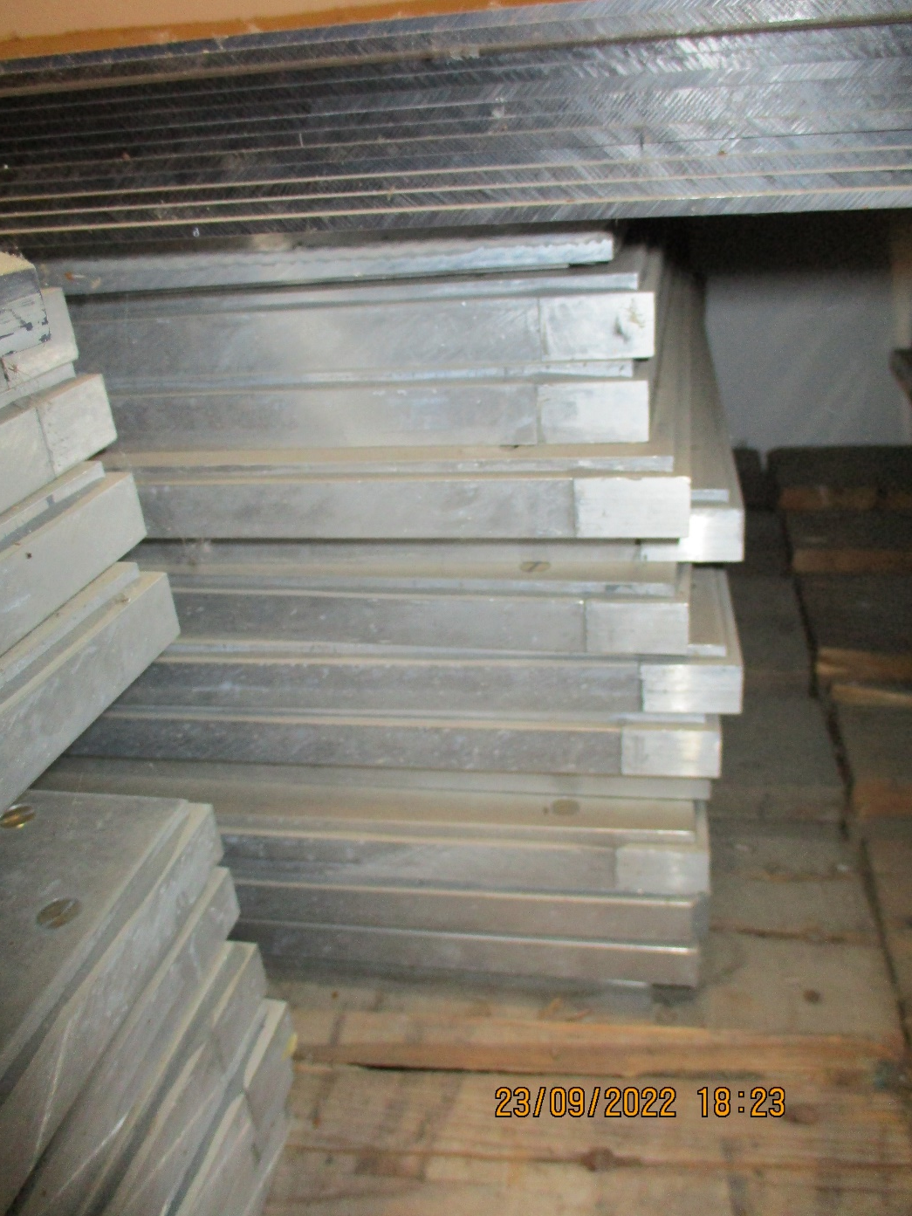
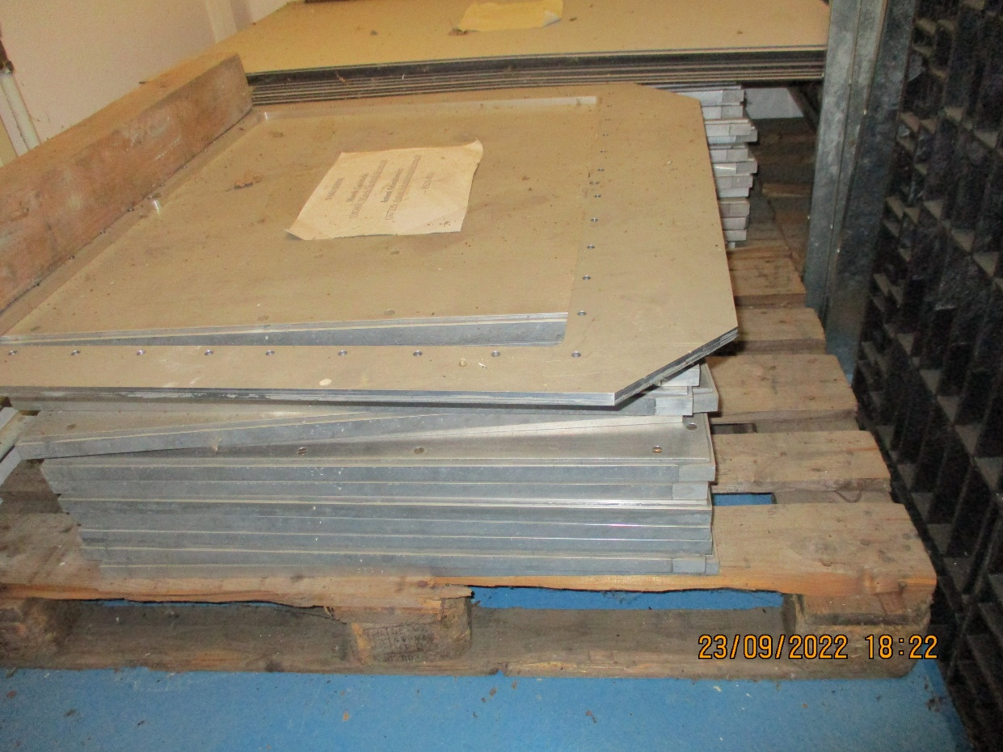
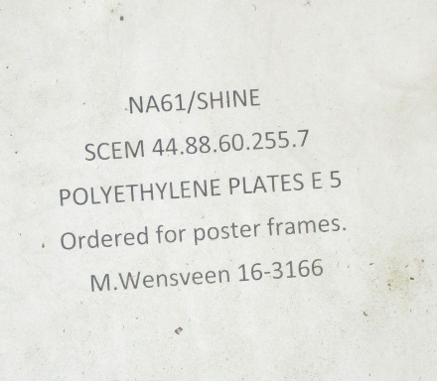
Bat 892 Basement
Area in front of the shelving system.
Aluminium plates and frames

Slide 14
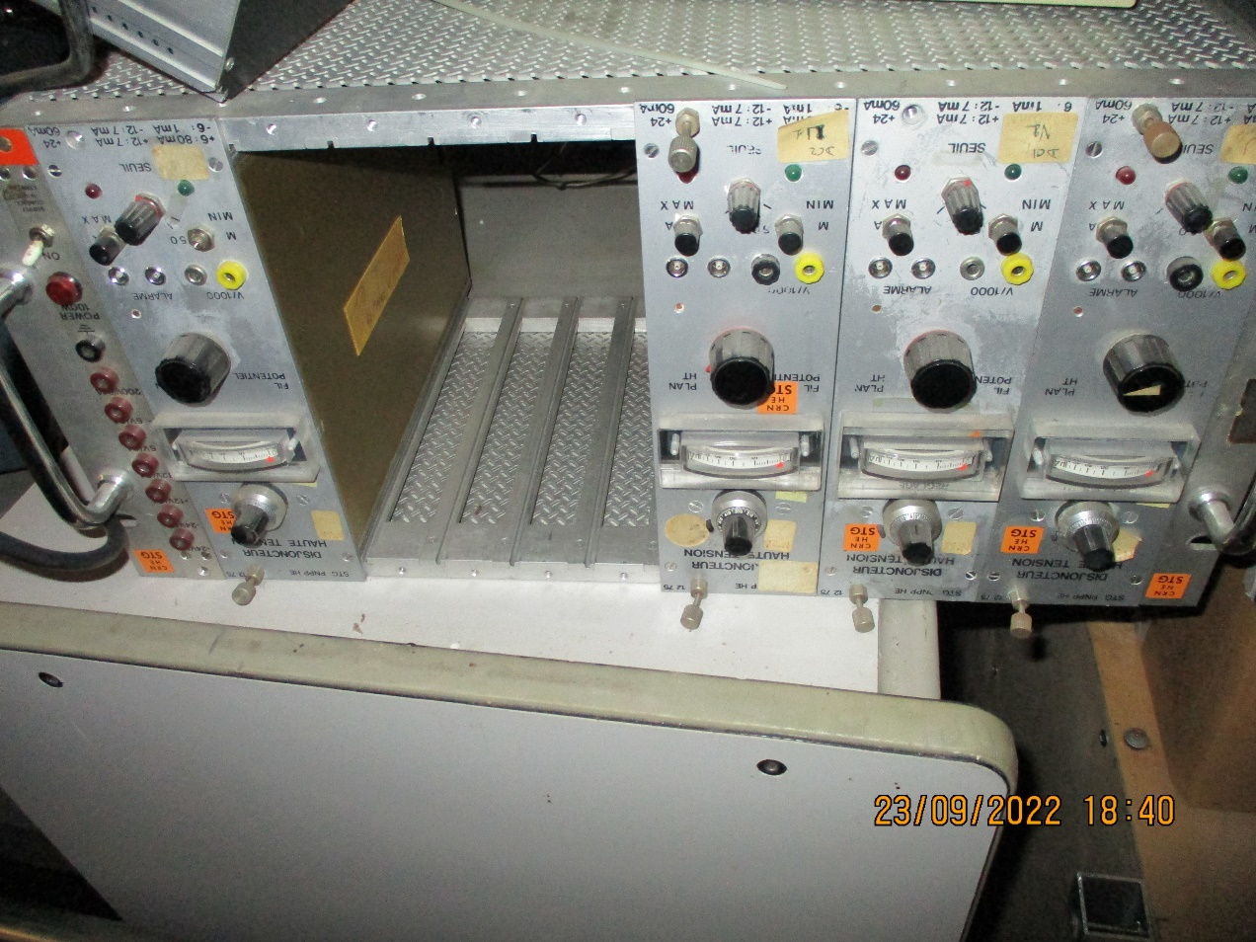
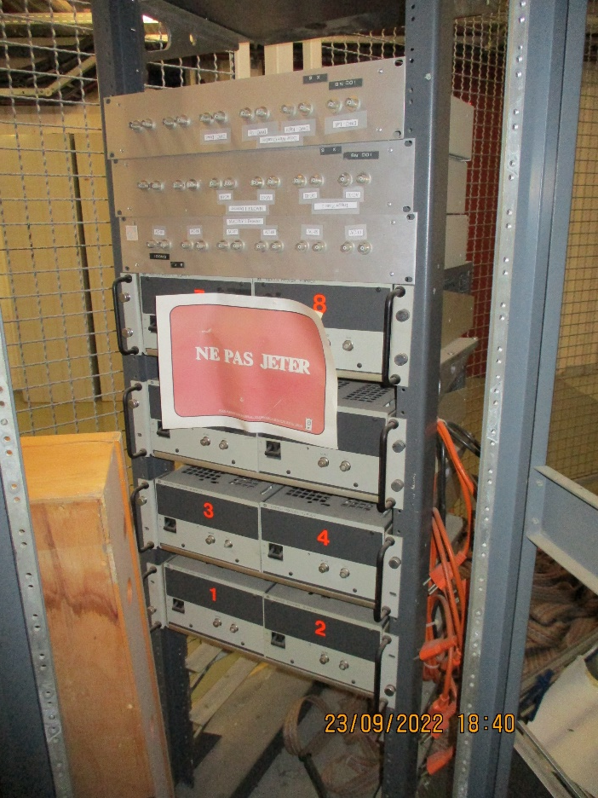
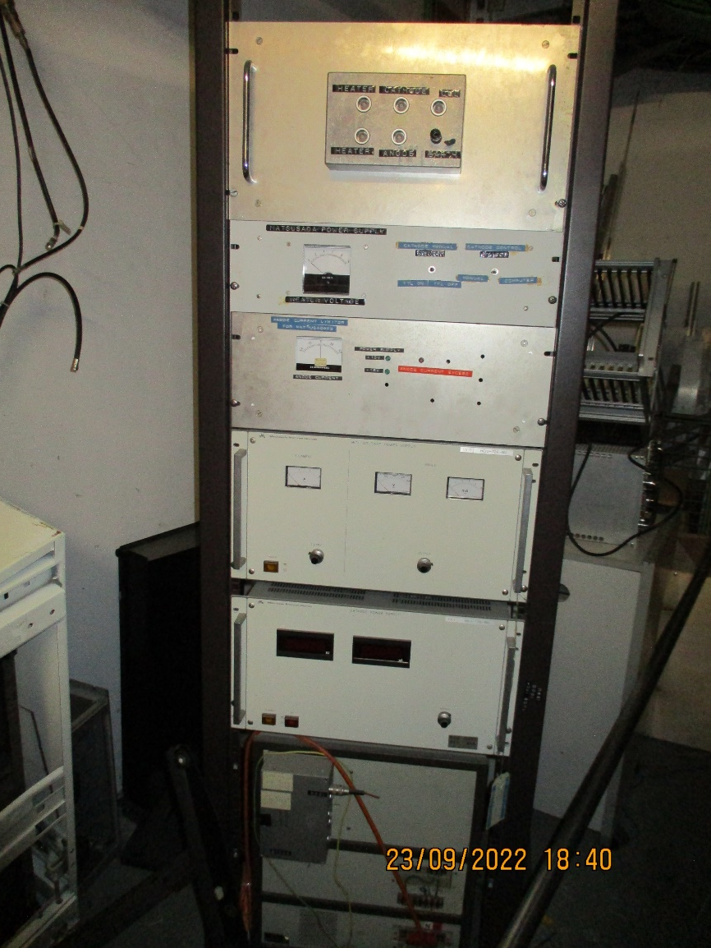
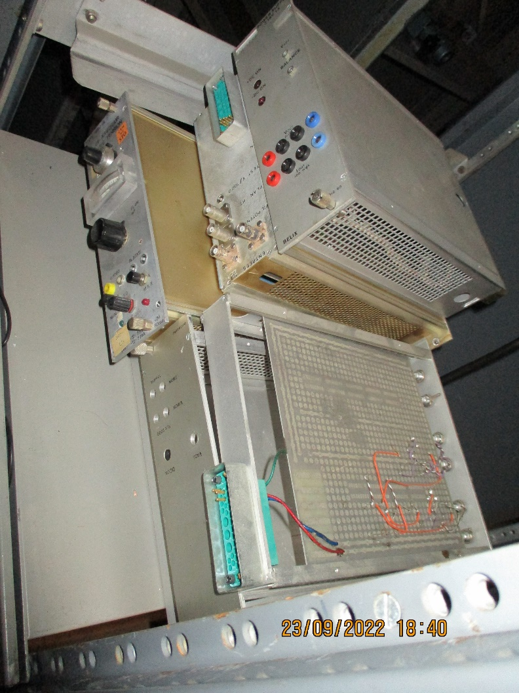
Caged area in the middle of the building.
Is any of this belonging to NA61/NA49 ?

Slide 15
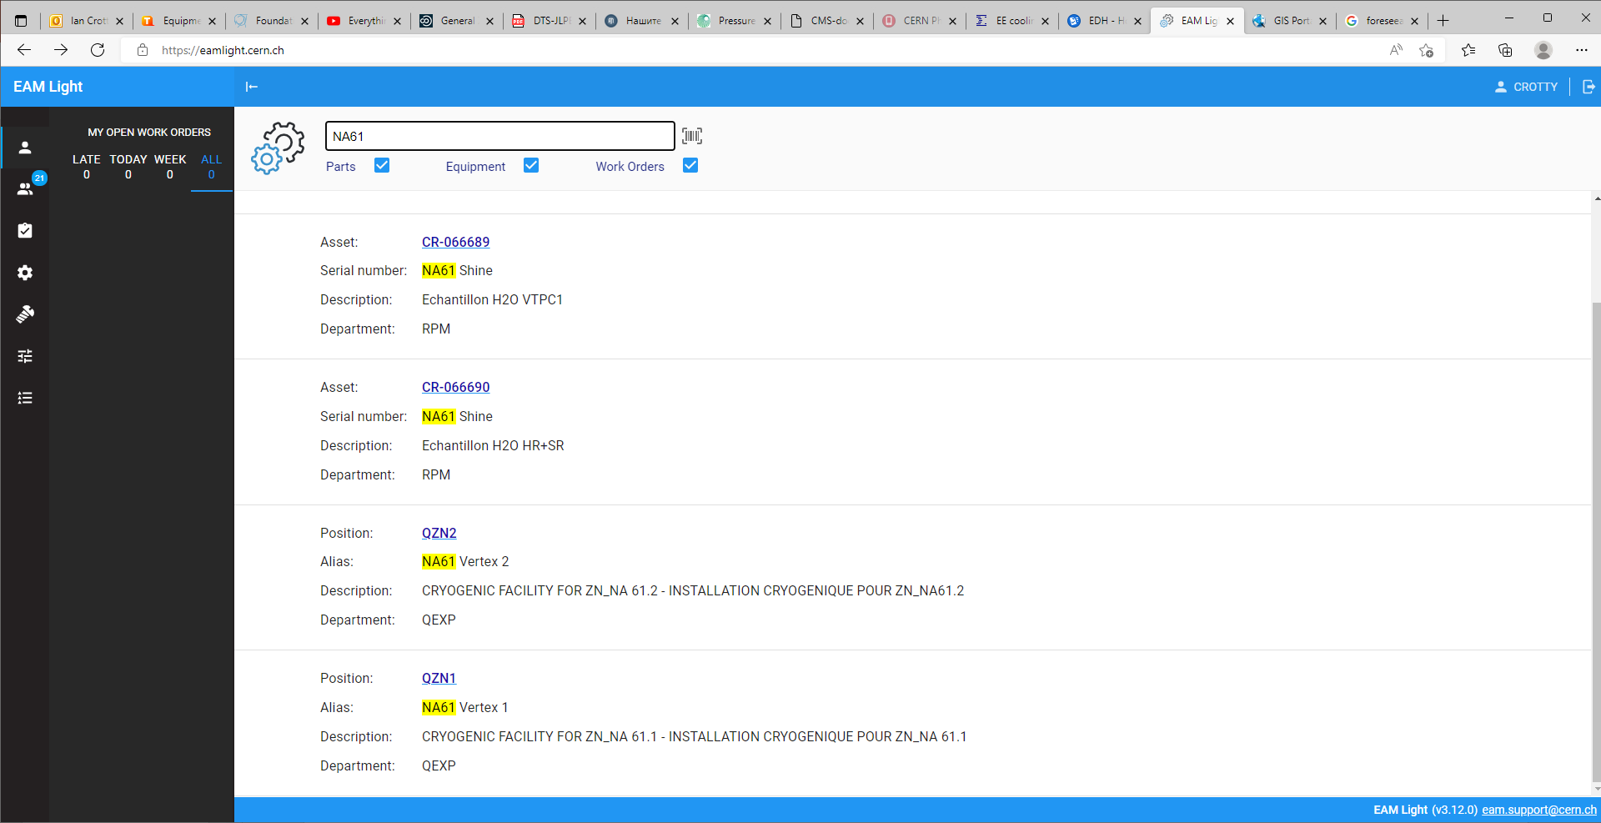

Slide 16
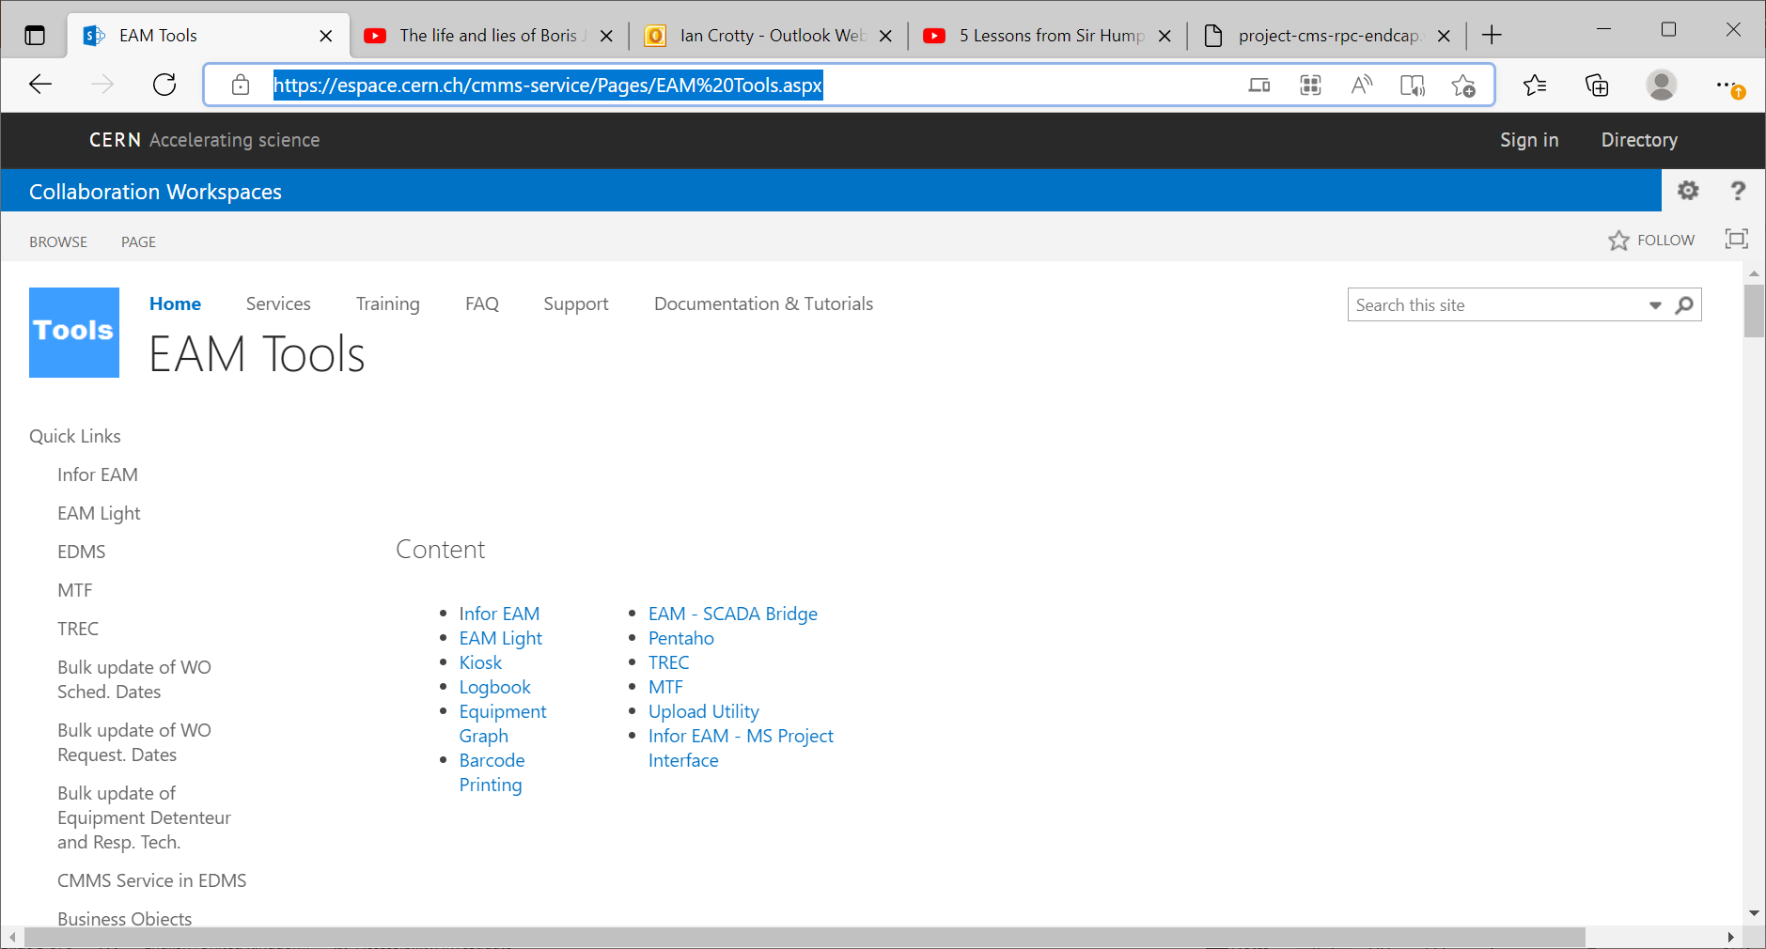
New resource management termed EAM Tools

Slide 17
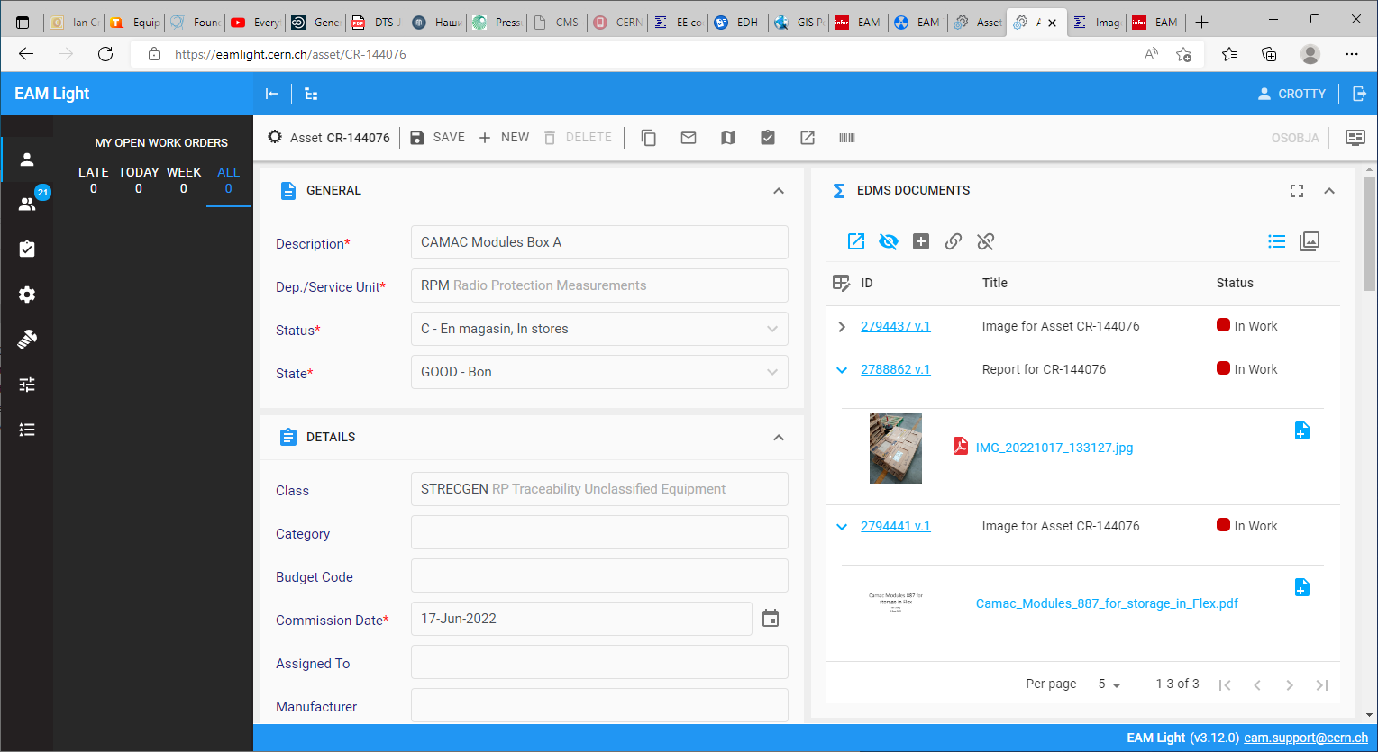
Here is a photo of the packing
Here is a document (pdf) of the contents

Slide 18
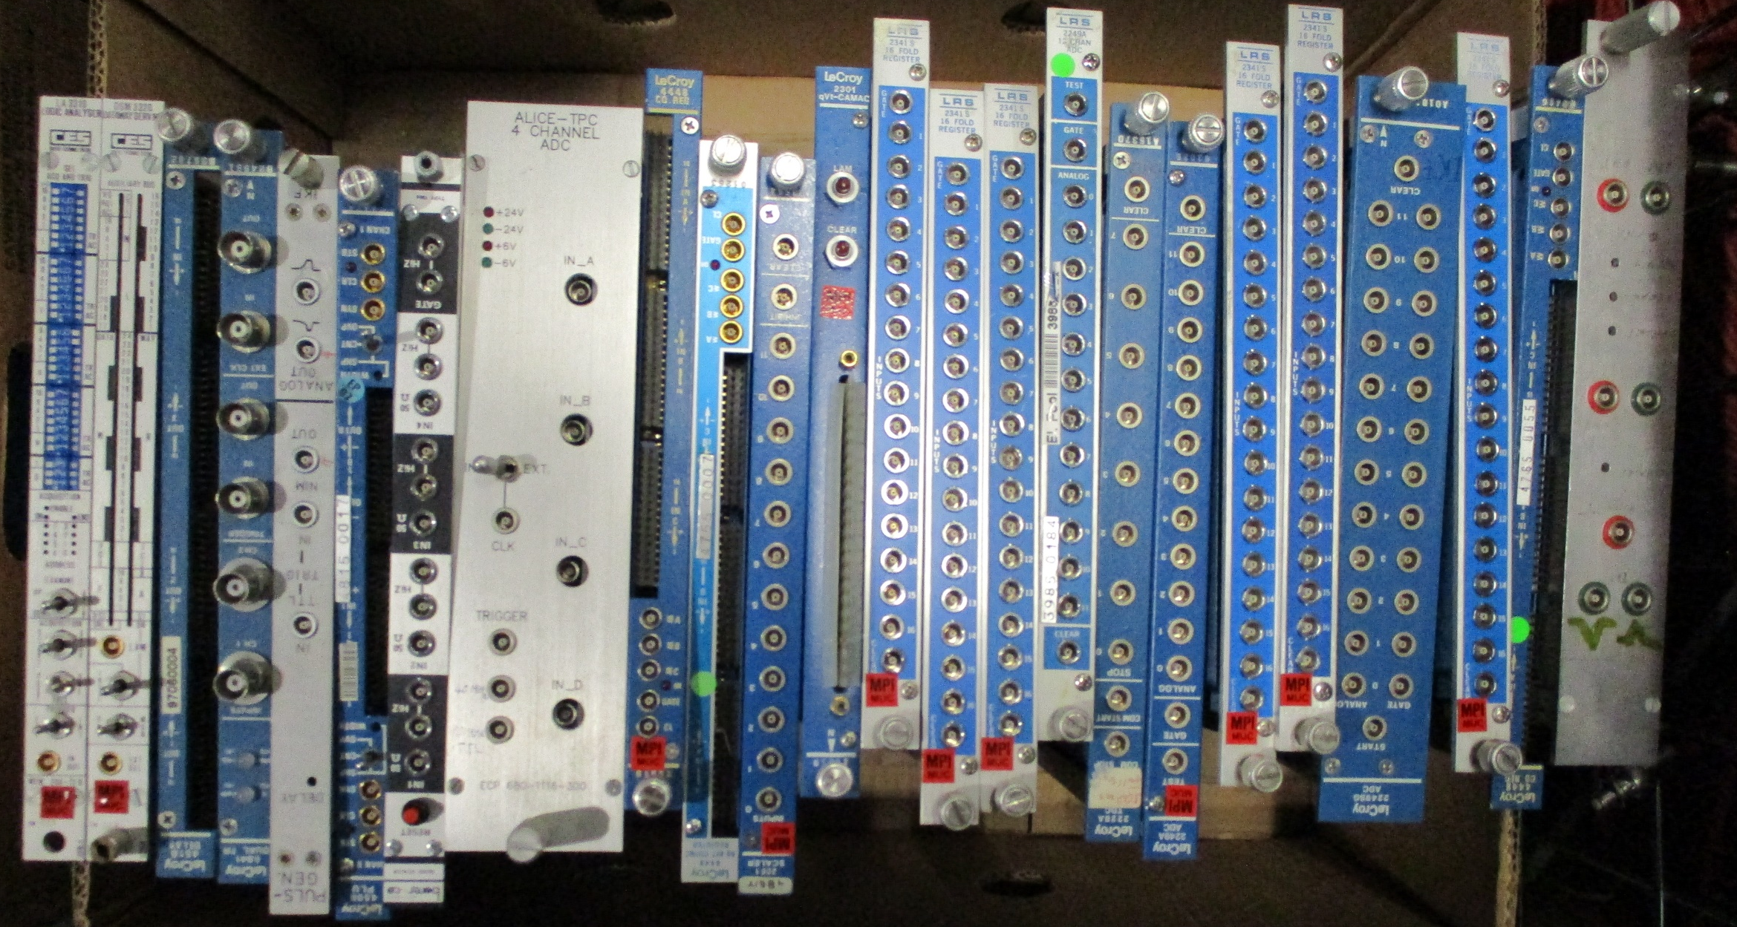
Box D

Slide 19
Other sources of information

Slide 20
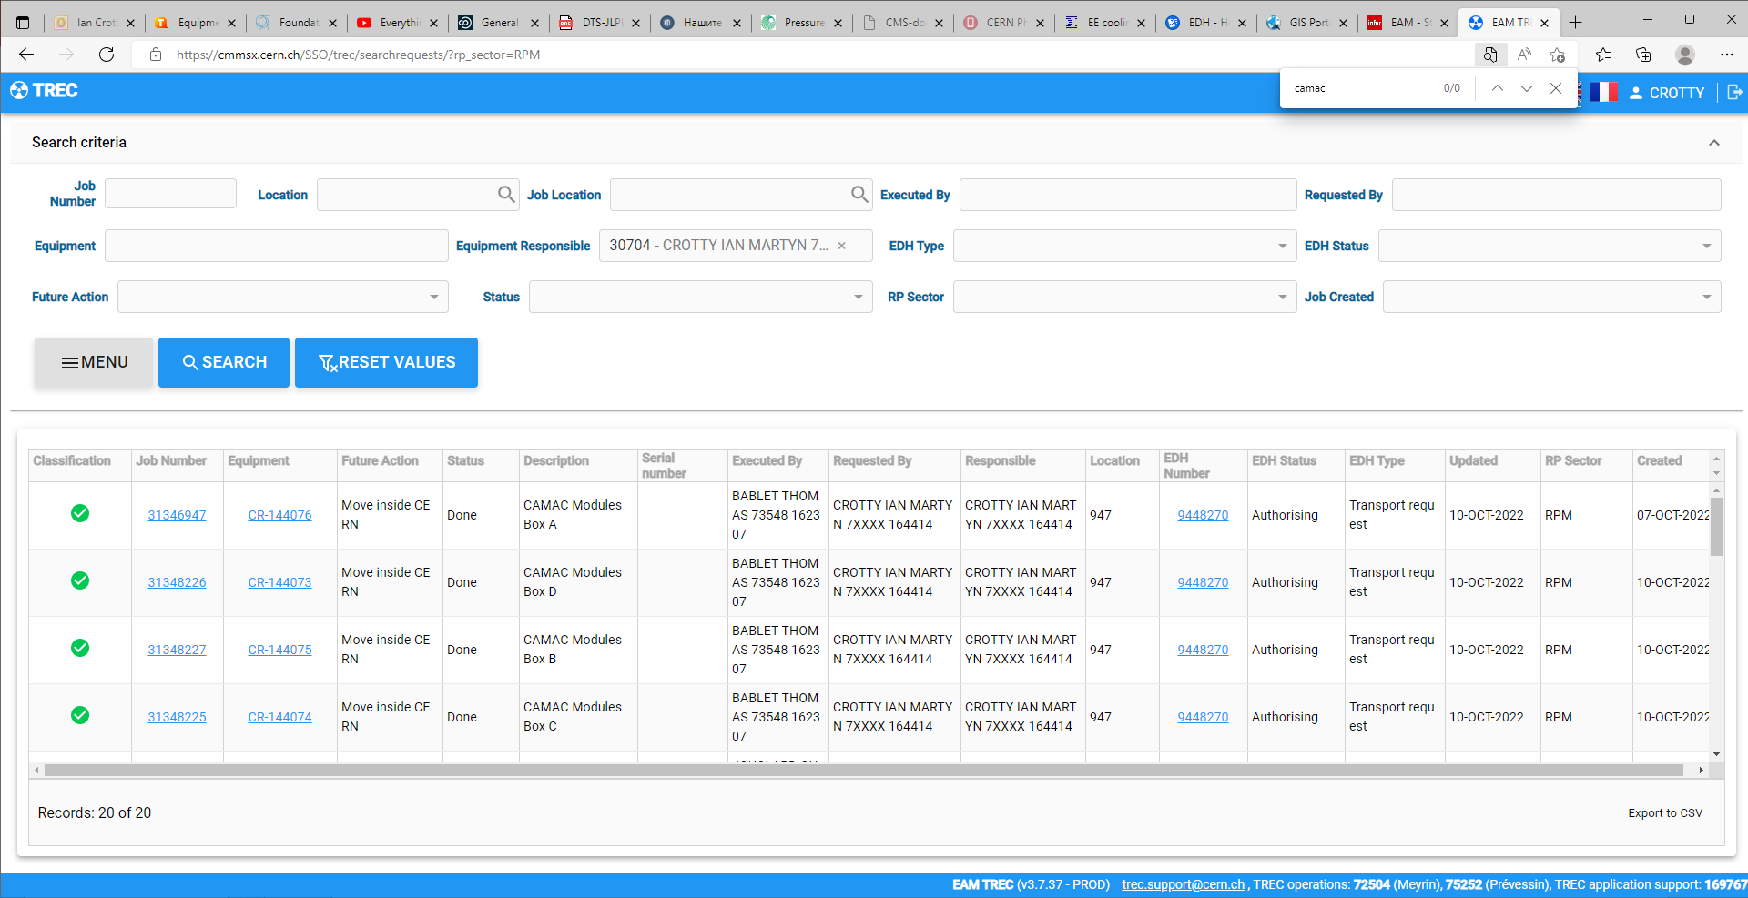

Slide 21
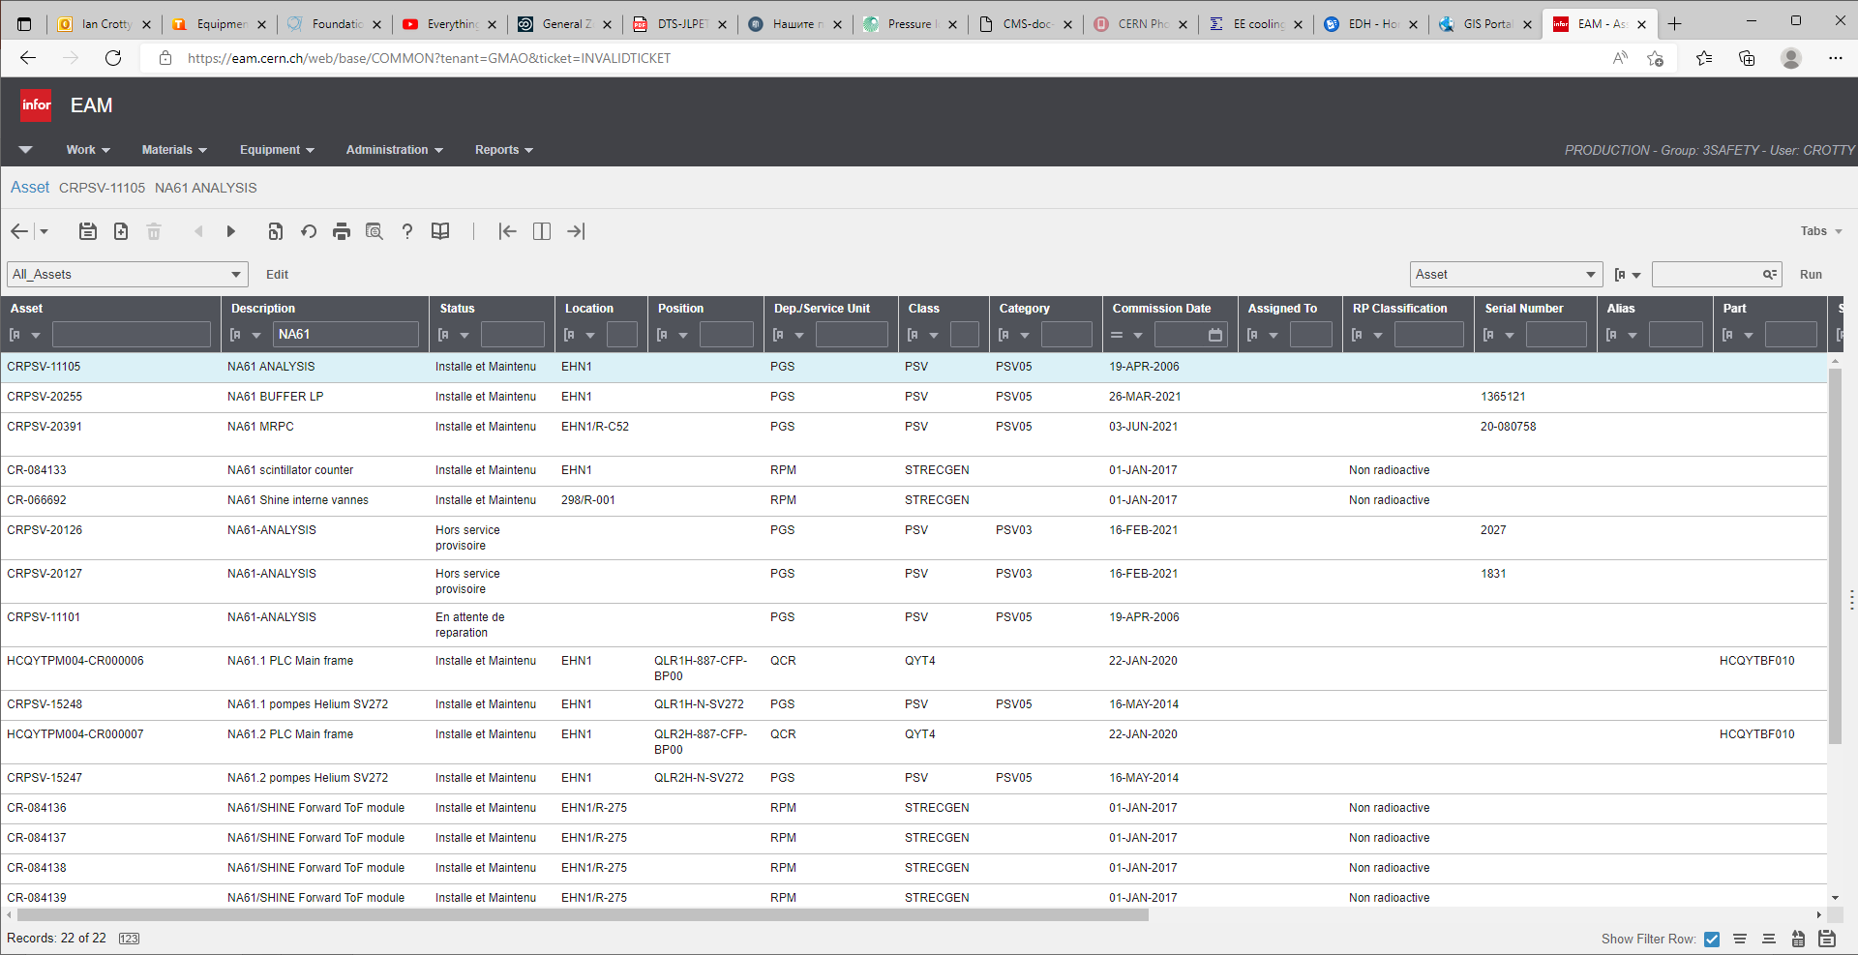

Slide 22
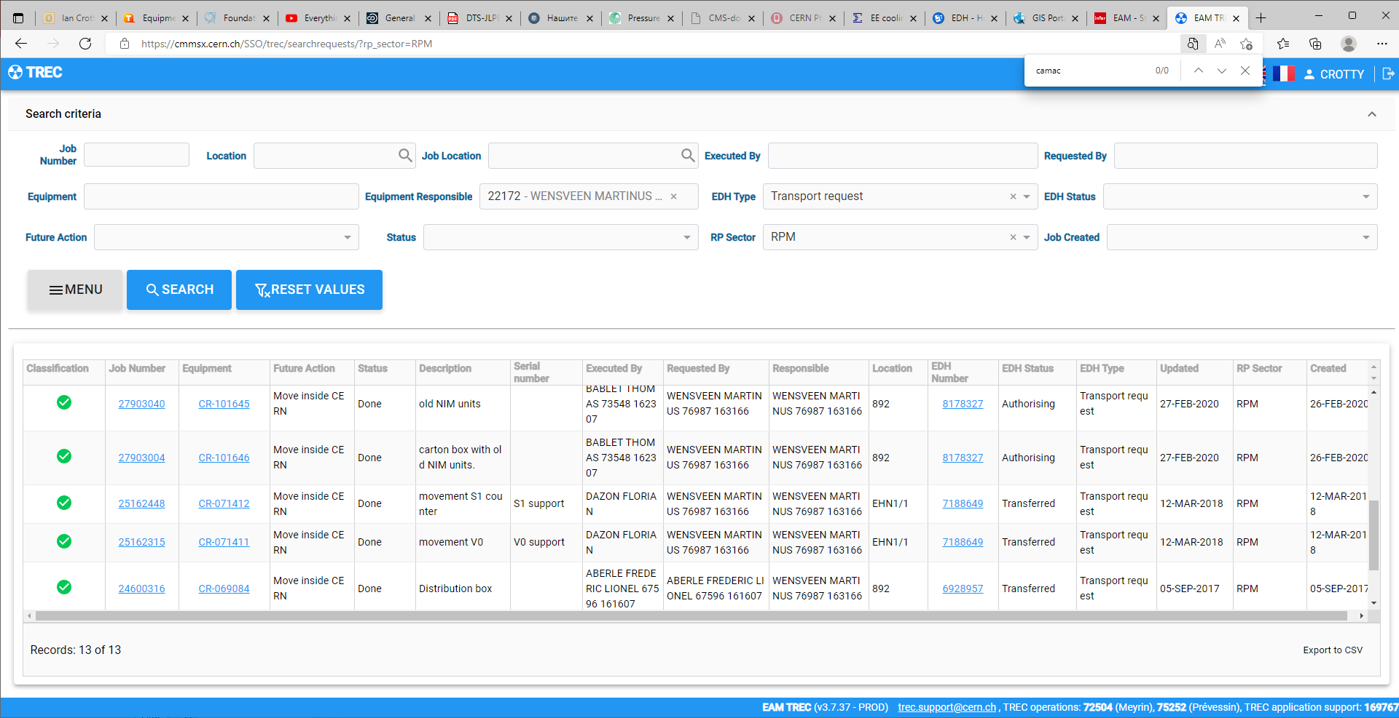

Slide 23
Conclusions.
“Found.cern.ch” does not allow any description
EAM tools units TREC, transport requests in EDH and documented details
Materials still to be found that are in “found.cern.ch”
Other DBs to be looked into.

Slide 24
Additional slides

Slide 25
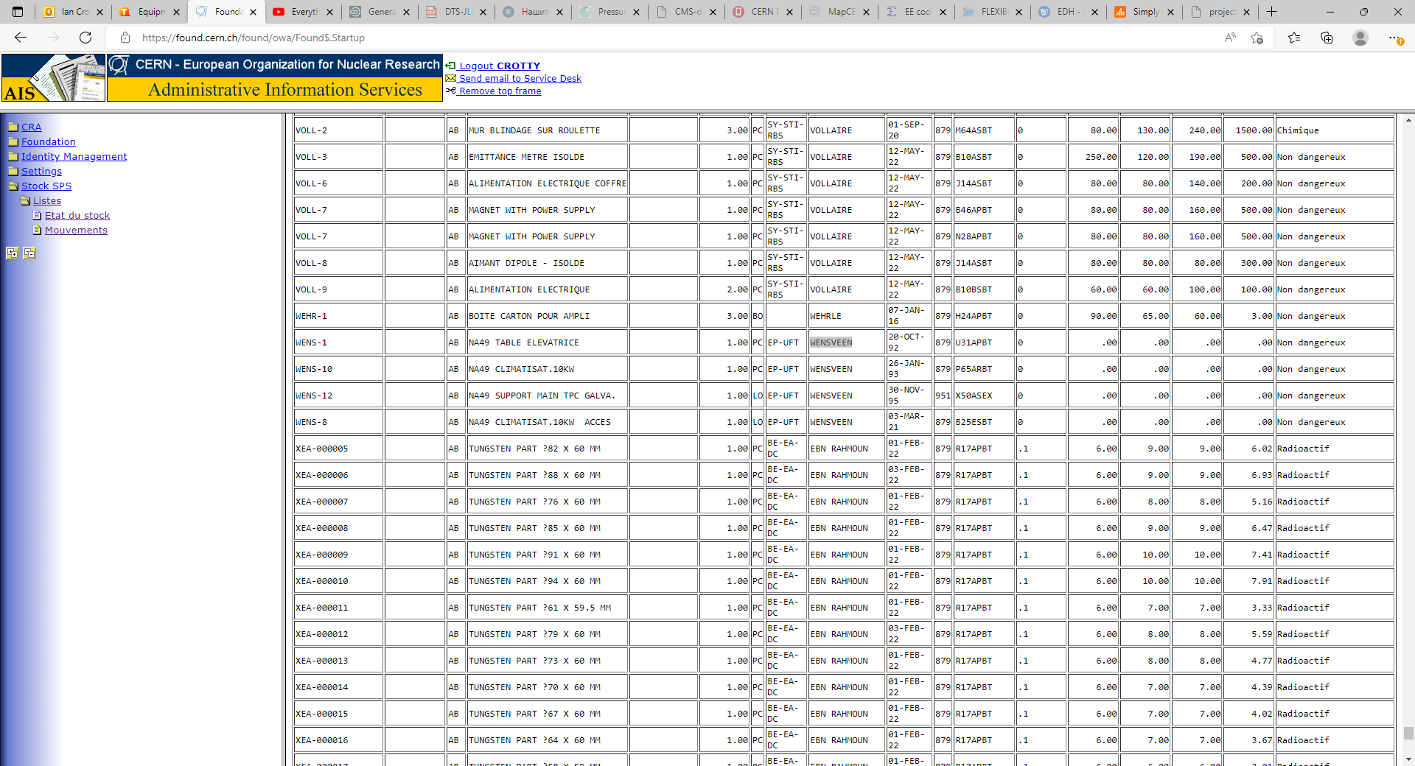
Not putting any name reveals many items
Use control “F” to find key words

Slide 26
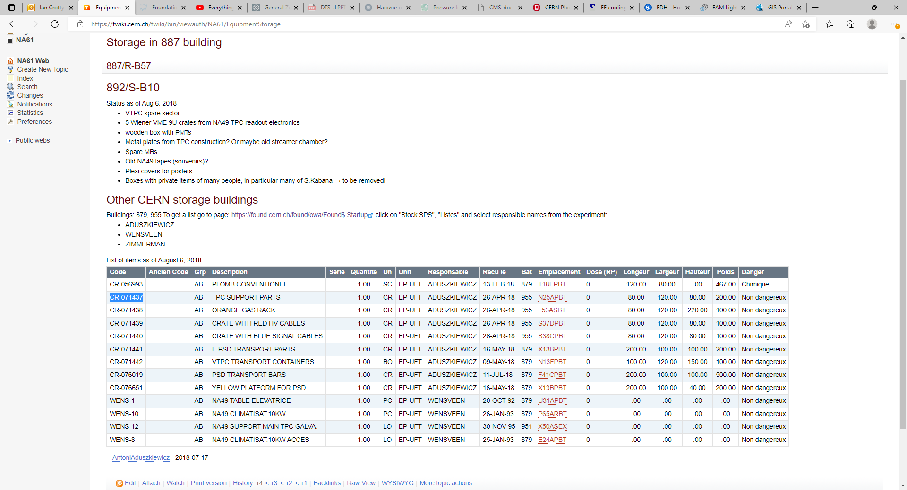
If I take this example of CR-071437 it is not in 955 as indicated here but has moved to 879 as given in “found.cern.ch” and in https://eamlight.cern.ch/asset/CR-071437
But “last location” is EHN1/R-273 as seen in next slide.

Slide 27
