Slide 1
NA61 storage lists, DB and how to access
Martin & Ian
I was given a print of a twiki page by Martin

Slide 2
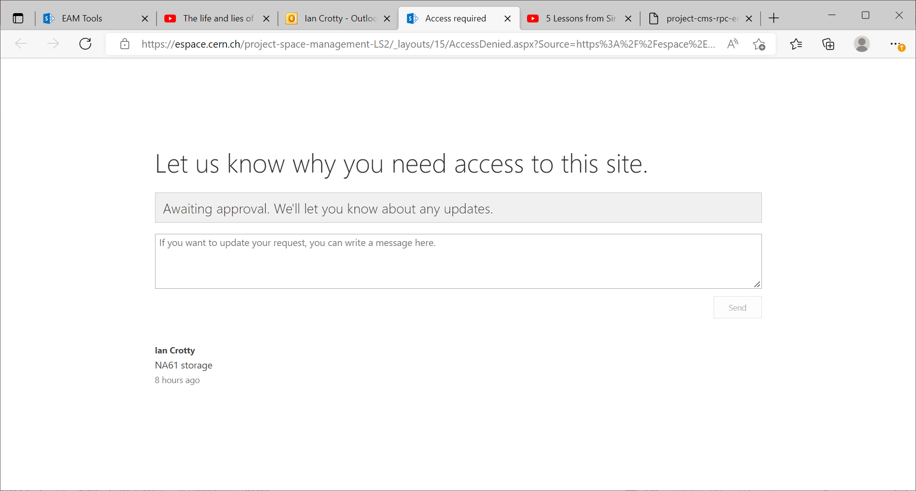
1b -Storage LS3 - List of equipment - 1-All Items (cern.ch)

Slide 3
FLEX
Bat
May 166696
Elsa Clerc 161825
Eric Halbert 166502. I think he has built the system.
Paula Barrier ?? In an email ?
What is extant with NA61
https://twicki.cern.ch/twicki/bin/viewauth/NA61/EquipementStorage (does not work ??)
https://twiki.cern.ch/twiki/bin/viewauth/NA61/WebHome
https://twiki.cern.ch/twiki/bin/view/NA61/EquipmentStorage
https://espace.cern.ch/cmms-service/Pages/EAM%20Tools.aspx

Slide 4
1b -Storage LS3 - List of equipment - 1-All Items (cern.ch)

Slide 5
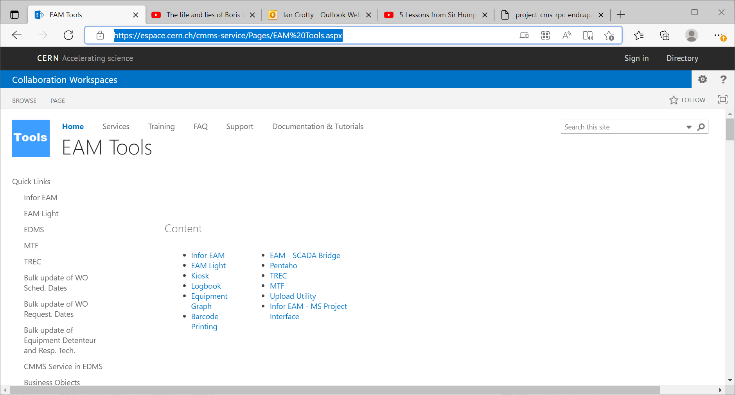

Slide 7
Automatic reply: Ian Crotty wants to access 'Space management and logistics'
Germana Riddone
Sent: 04 August 2022 10:08
To:
Ian Crotty
I am currently on holidays and I will be back to CERN on 22 August.
I will answer to your email as soon as possible.
For questions on collaborations, please contact P. Barrière.
For questions on FAIR at B180, please contact M. Charrondiere.
For questions on HFM, please contact N. Tara.
For questions on Graduate program - Origin, please contact A. Cardinaux and C. Hervet via the generic email box: ORIGIN.GP@cern.ch.
For questions on AFC-2022-2, please contact A. Cardinaux.
For questions on TTE-2022-3, please contact C. Hervet.
Best regards,
Germana

Slide 9
The case of the NA61 target

Slide 10
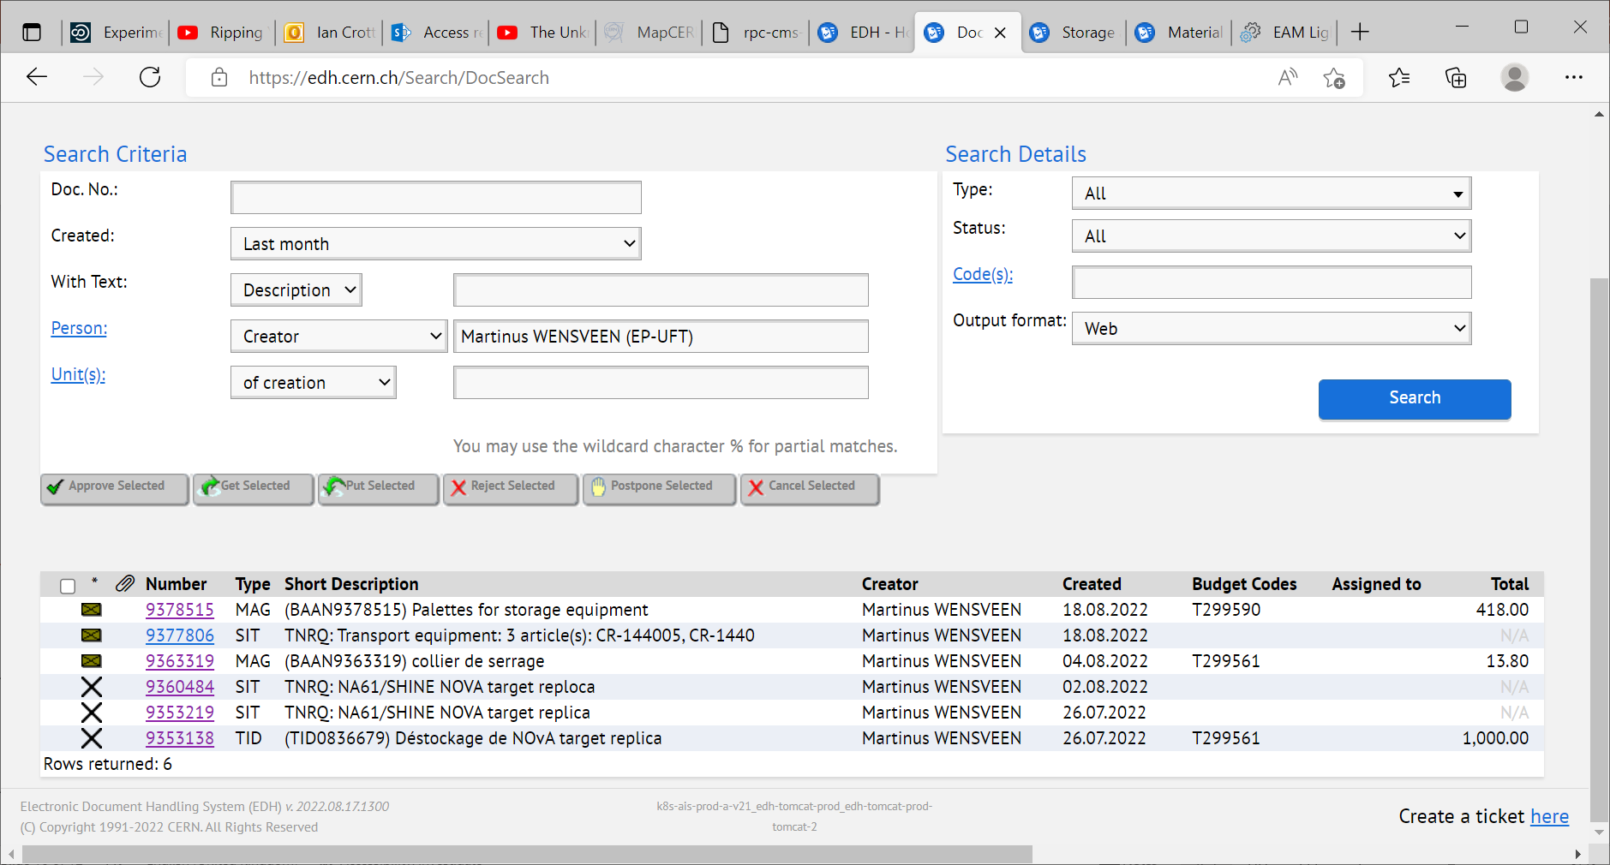

Slide 11
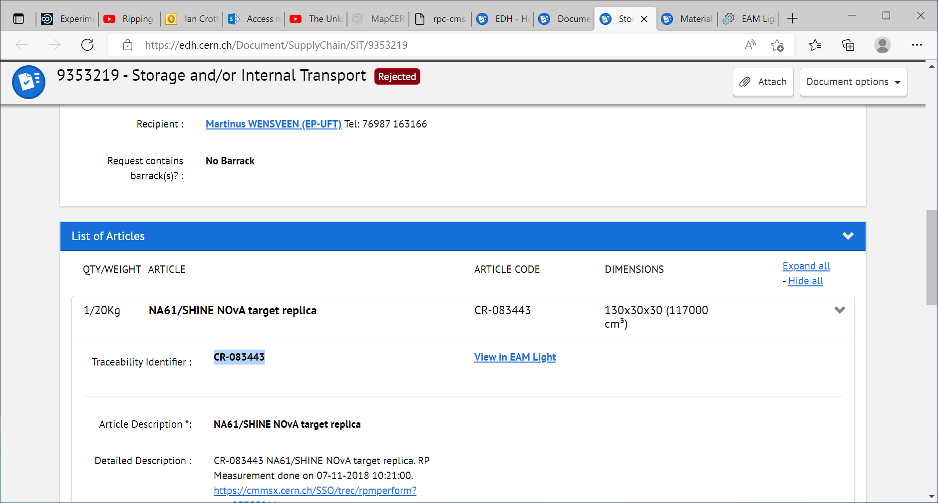
CR-083443
From :
879-R-001 NON DEFINIE PREVESSIN
To *:
887-1-202 COULOIR / DEGAGEMENT PREVESSIN
This is on the first floor

Slide 12
After 3 attepts it was done by Christian lacroix

Slide 13
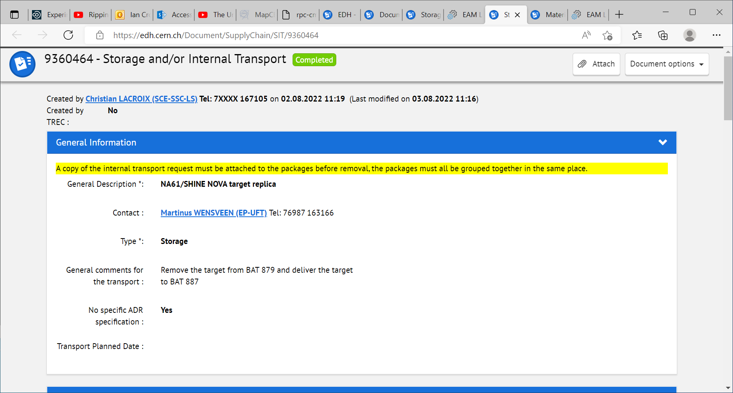

Slide 14
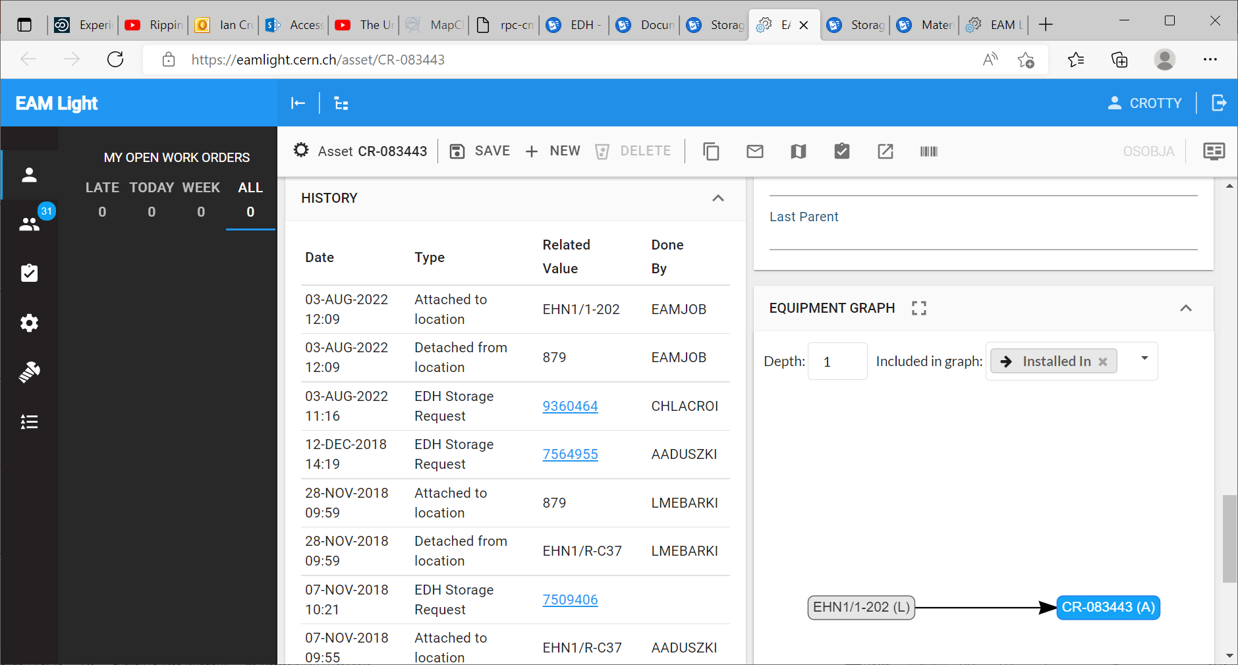
EHN1 = 887 not 879
So now where is it and if in 879 where ? Can it be located.Need Photo
Notice there is no record of it leaving 879….

Slide 15
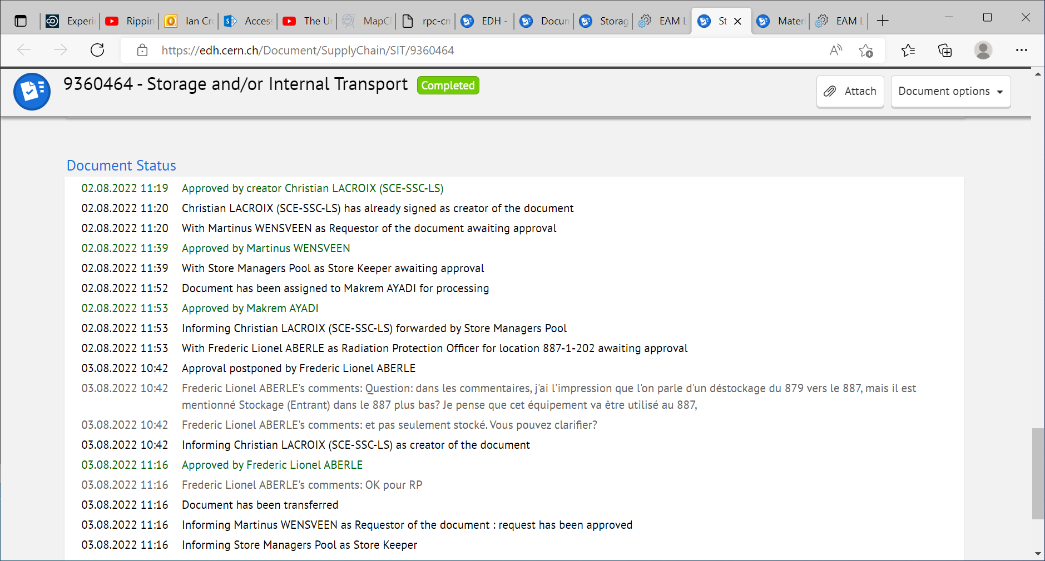

Slide 16
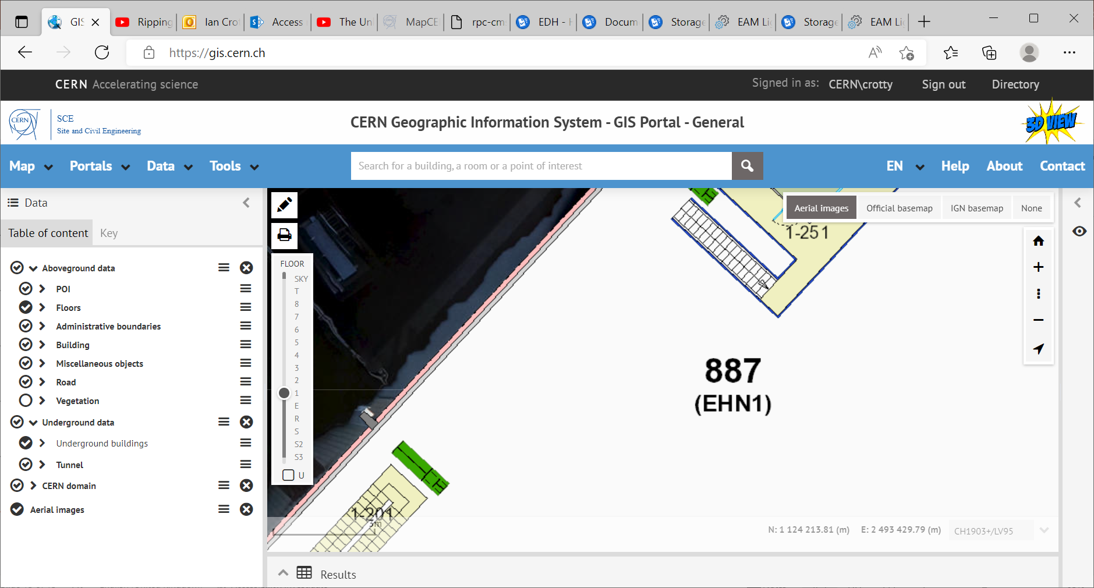
Address EHN1 1-202
Is not found .But 1-202 is next to and above the Buffer zone.

Slide 17
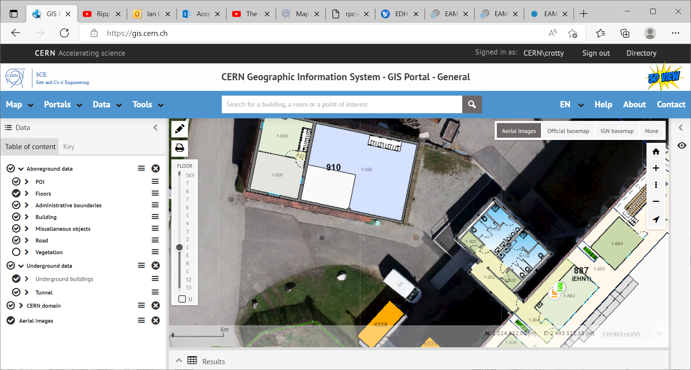
887/1-202
Is here near the coffee mchines

Slide 18
When writing an address into the CERN map the following format is required
887/R-C37
Or
887/1-202

Slide 20
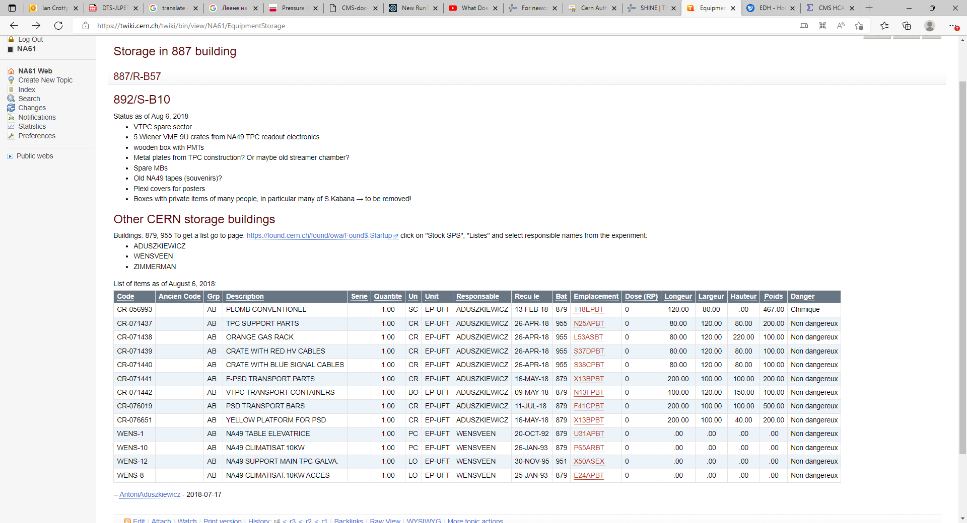
https://twiki.cern.ch/twiki/bin/view/NA61/EquipmentStorage
Buildings: 879, 955
887/R-B57
892/S-B10

Slide 21
Buildings: 879, 955 To get a list go to page: https://found.cern.ch/found/owa/Found$.Startup click on "Stock SPS", "Listes" and select responsible names from the experiment:
ADUSZKIEWICZ
WENSVEEN
ZIMMERMAN
https://found.cern.ch/found/owa/Found$.Startup

Slide 22
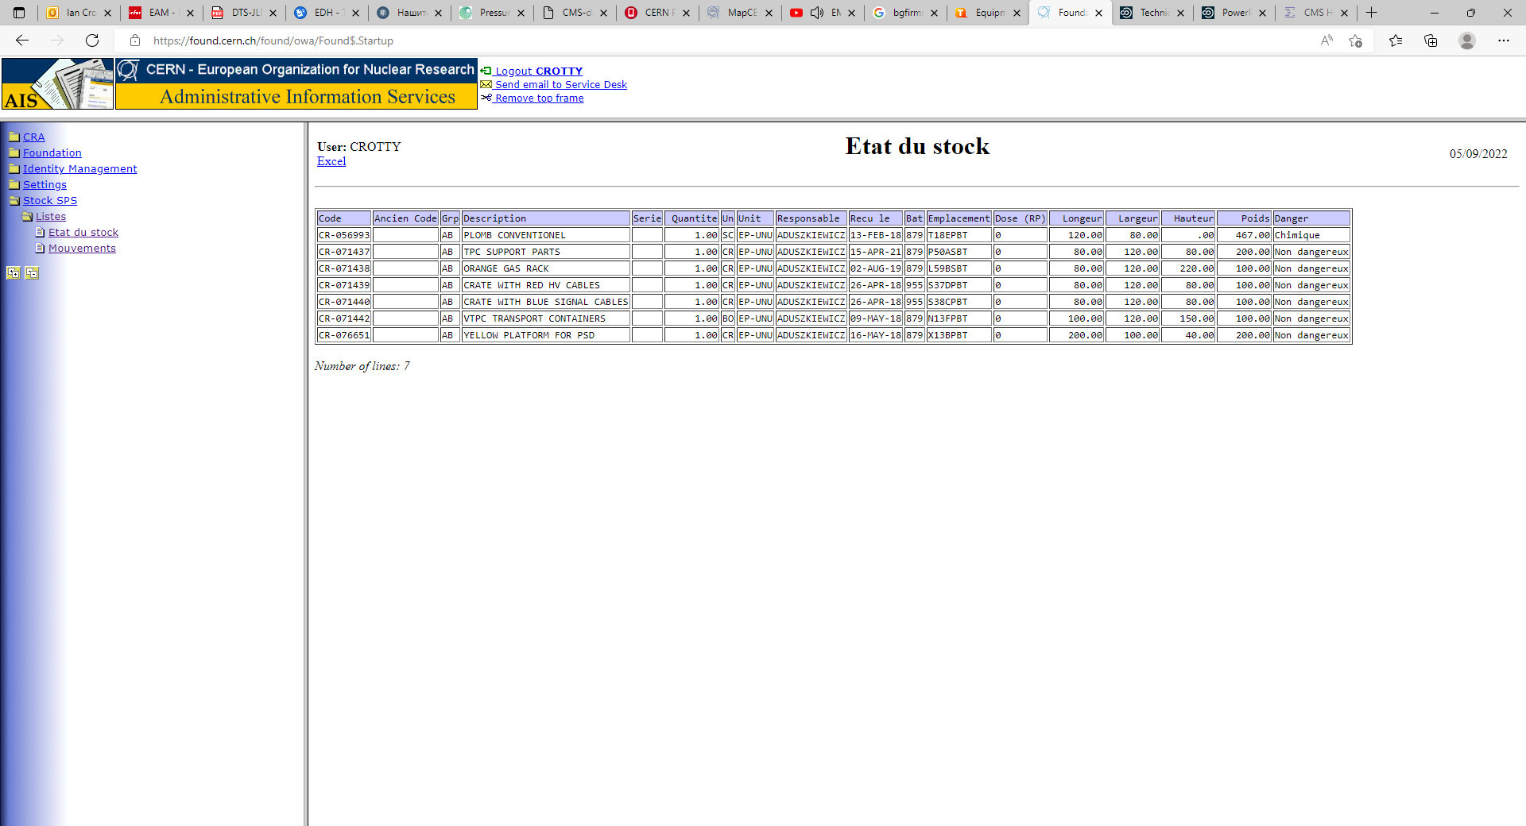
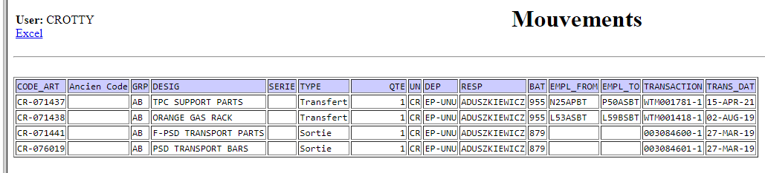
https://found.cern.ch/found/owa/Found$.Startup

Slide 23
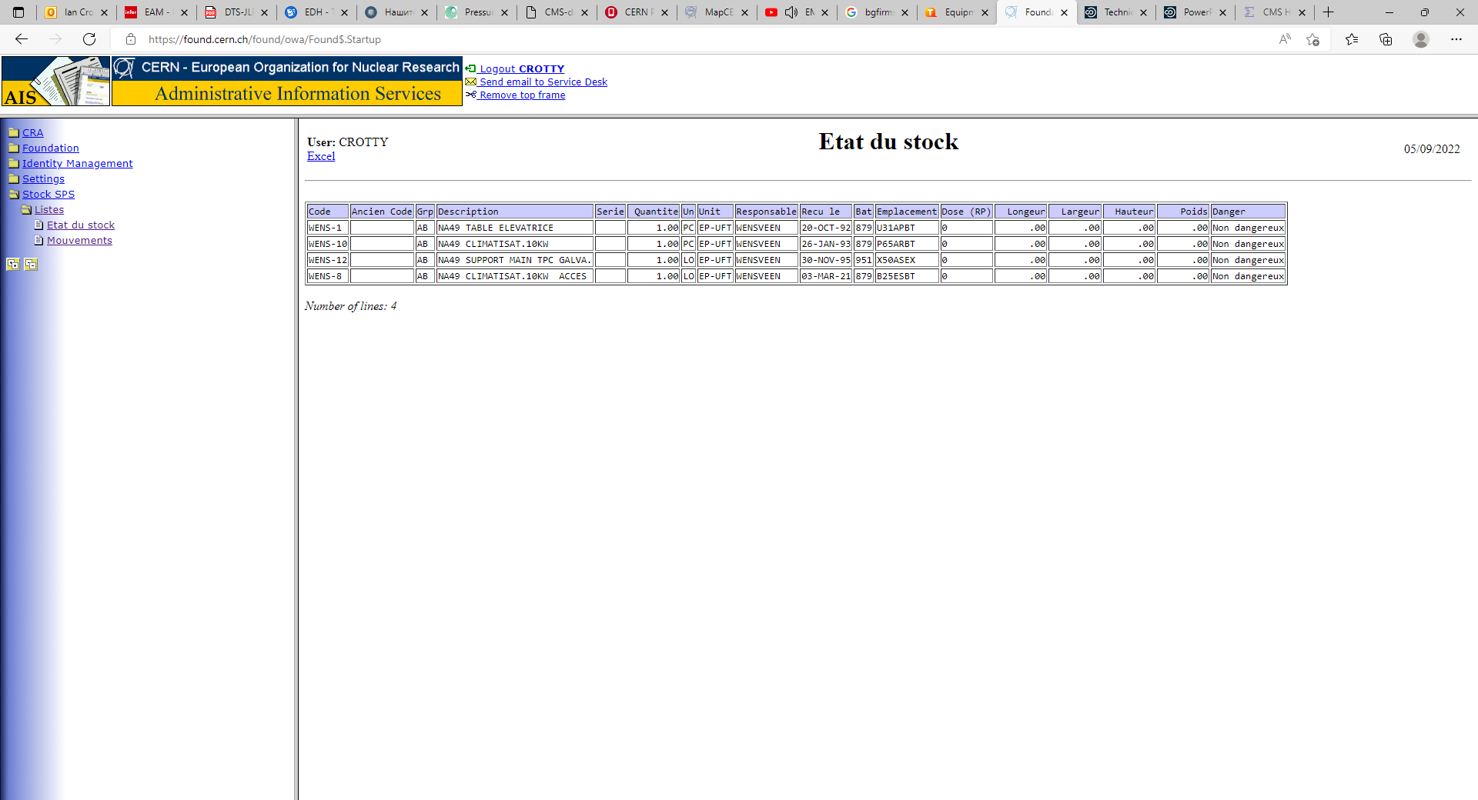
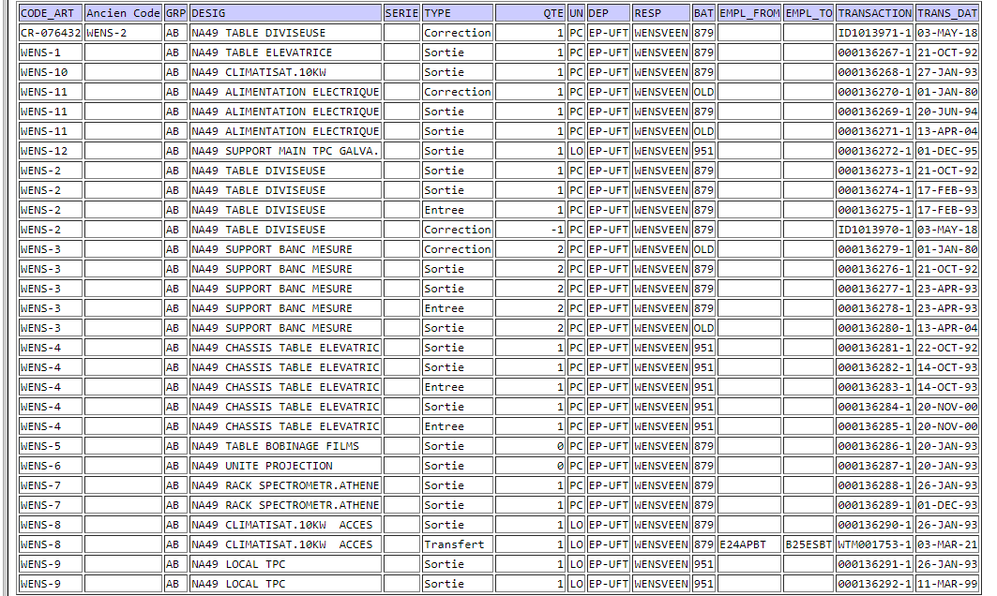
Movements

Slide 24
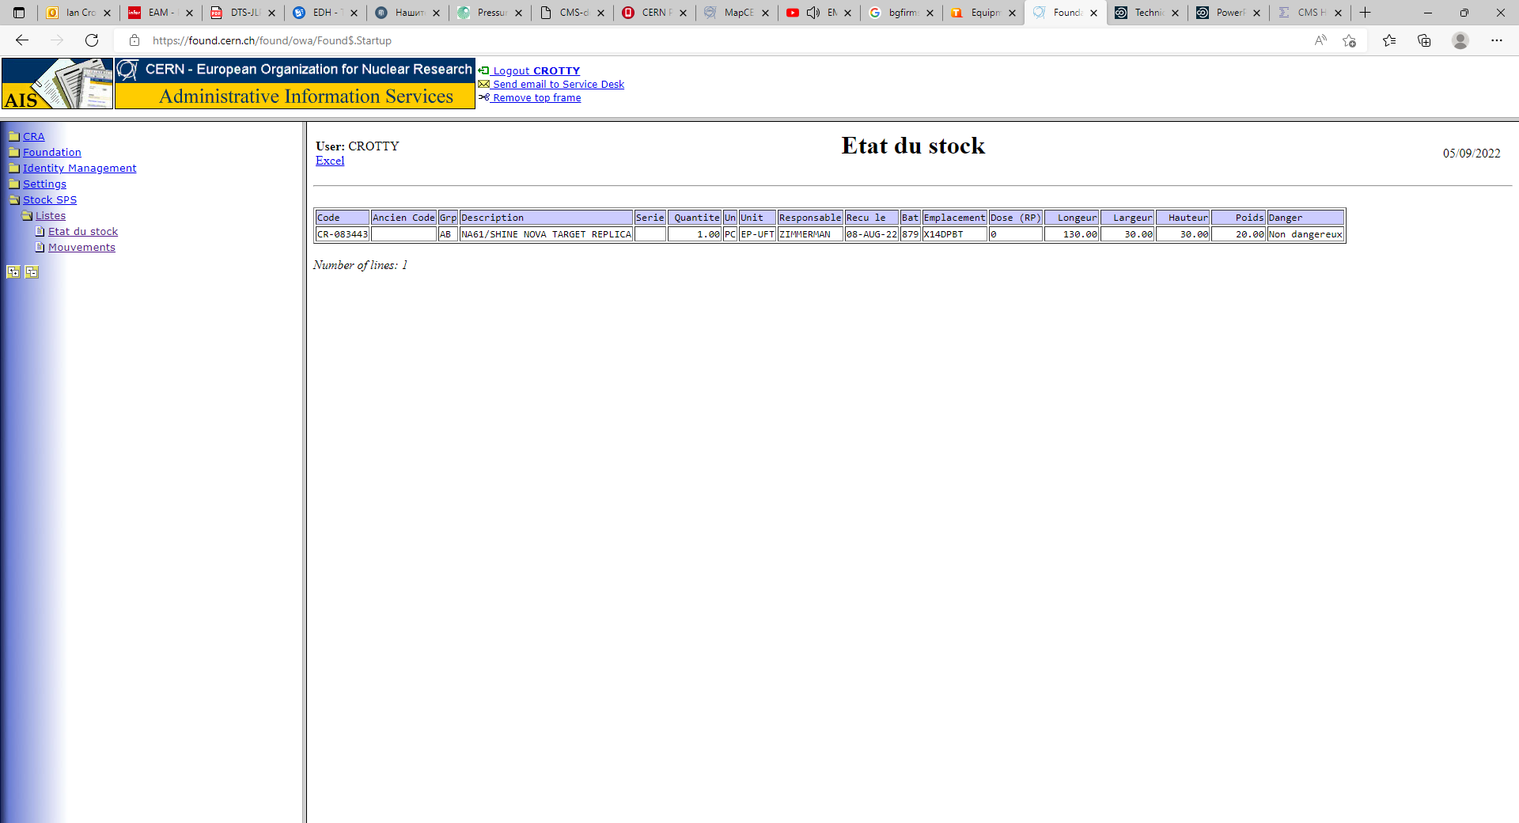


Slide 25
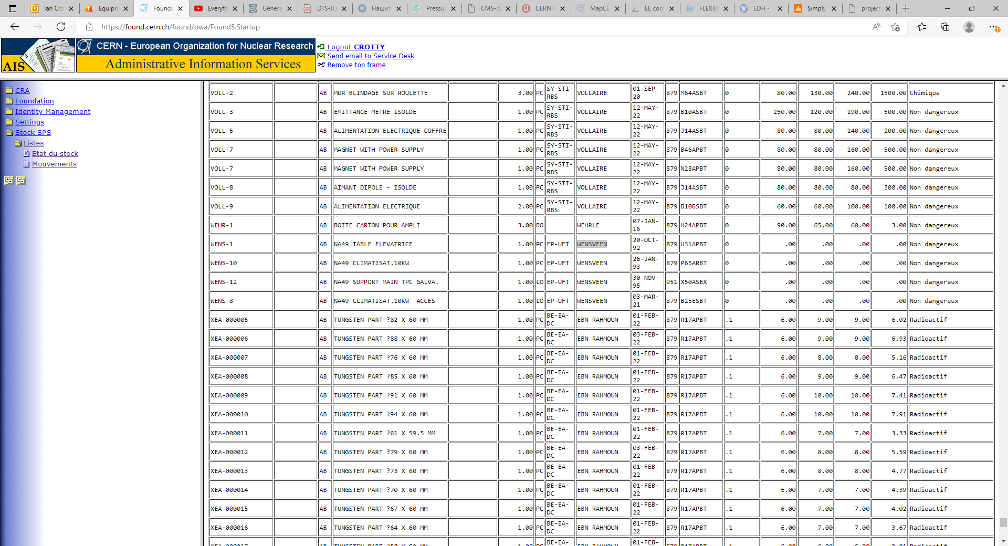
Do not put any name reveals many items
Use control “F” to find key words

Slide 27
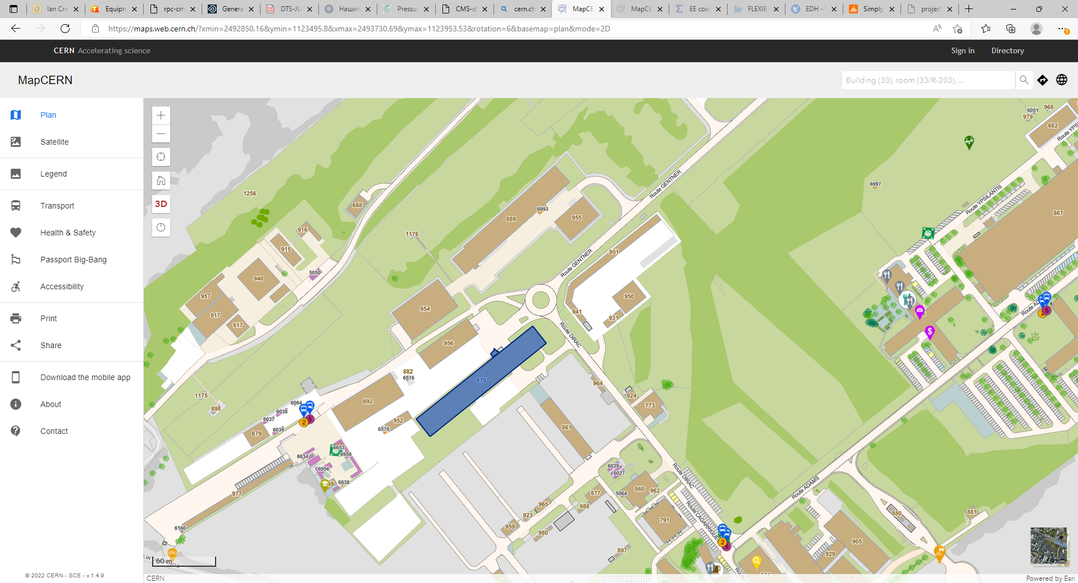
Bat. 879

Slide 28
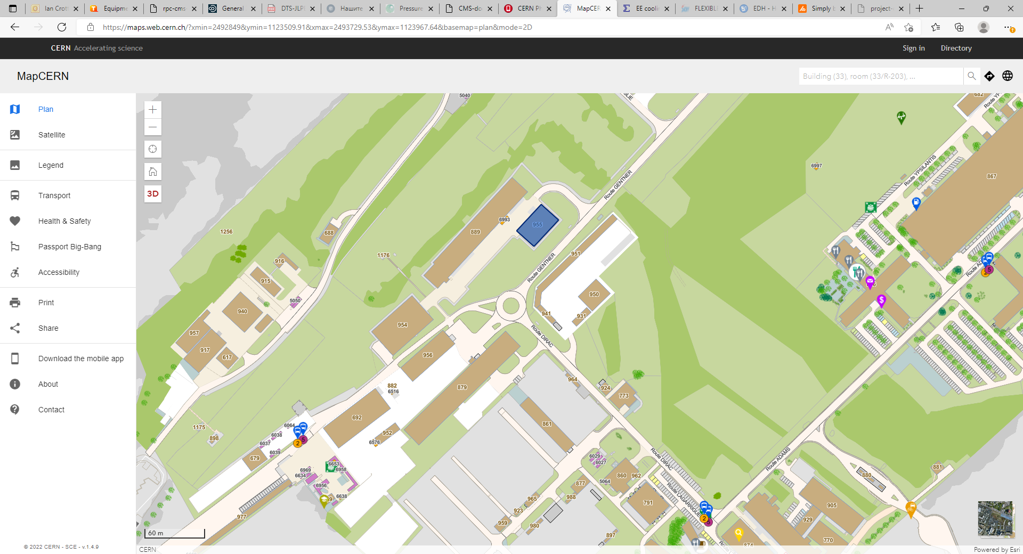
Bat. 955

Slide 29
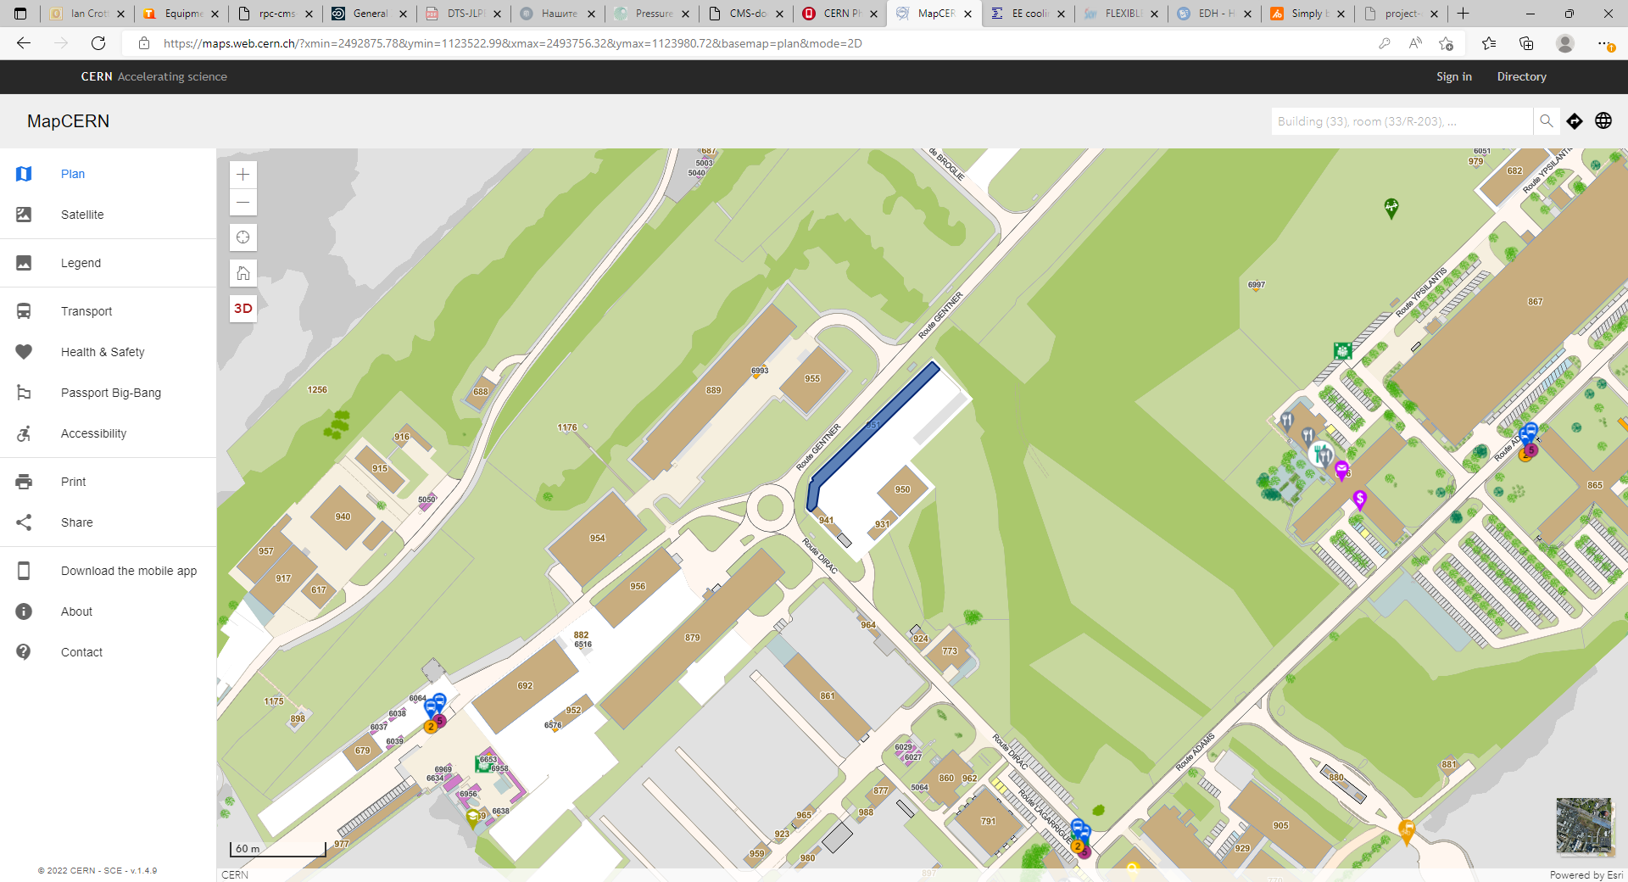
Bat. 955
Bat. 951
Bat. 879

Slide 30
Viste to Bat 955
Met Mario Cudde 165958 who will leave in Nov 2022
He suggests Elsa Clerk 161825 for access to the 10 or so storage buildings
He says 160548 G. Seraphin for the movement of material, he is based in The Flex. guillaume.seraphin@cern.ch
I tried by chance 2 of the lines from the list below on next slide
Buildings on this first list; 879, 955 and 951

Slide 31
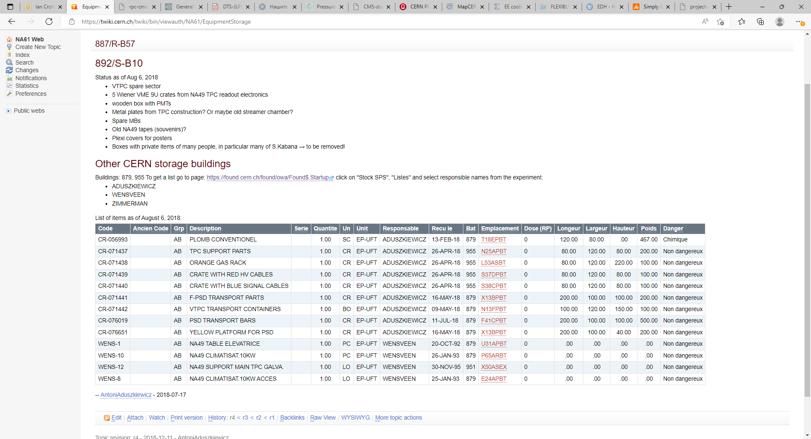
https://twiki.cern.ch/twiki/bin/viewauth/NA61/EquipmentStorage

Slide 32
S37DTBT (3D corrdinate system)
S is the row in the building
37 or 38 is the distance along the row
DTBT gives the height position
CR-071439 |  | AB | CRATE WITH RED HV CABLES |  | 1.00 | CR | EP-UFT | ADUSZKIEWICZ | 26-APR-18 | 955 | S37DPBT | 0 | 80.00 | 120.00 | 80.00 | 100.00 | Non dangereux
CR-071440 |  | AB | CRATE WITH BLUE SIGNAL CABLES |  | 1.00 | CR | EP-UFT | ADUSZKIEWICZ | 26-APR-18 | 955 | S38CPBT | 0

Slide 33
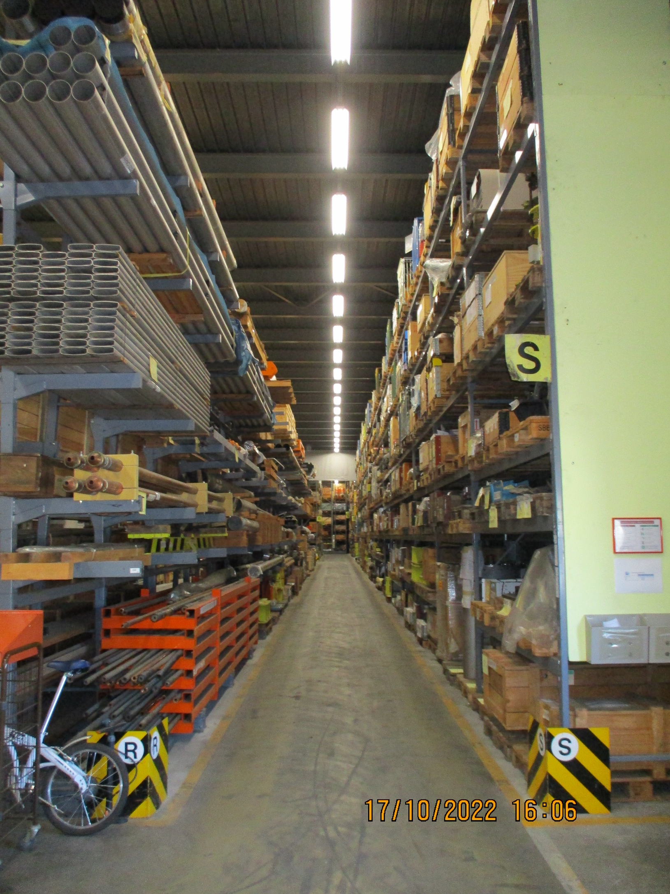
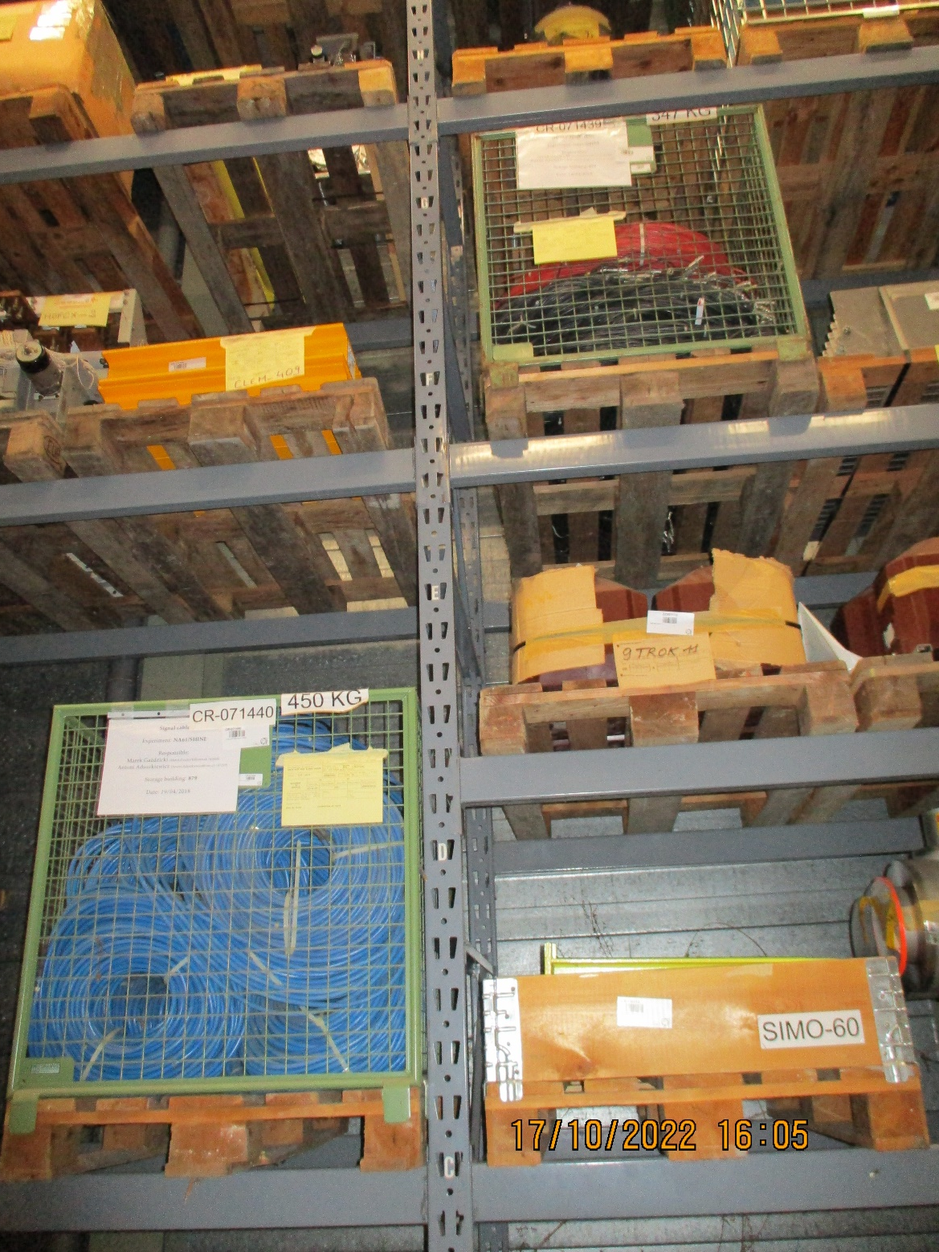
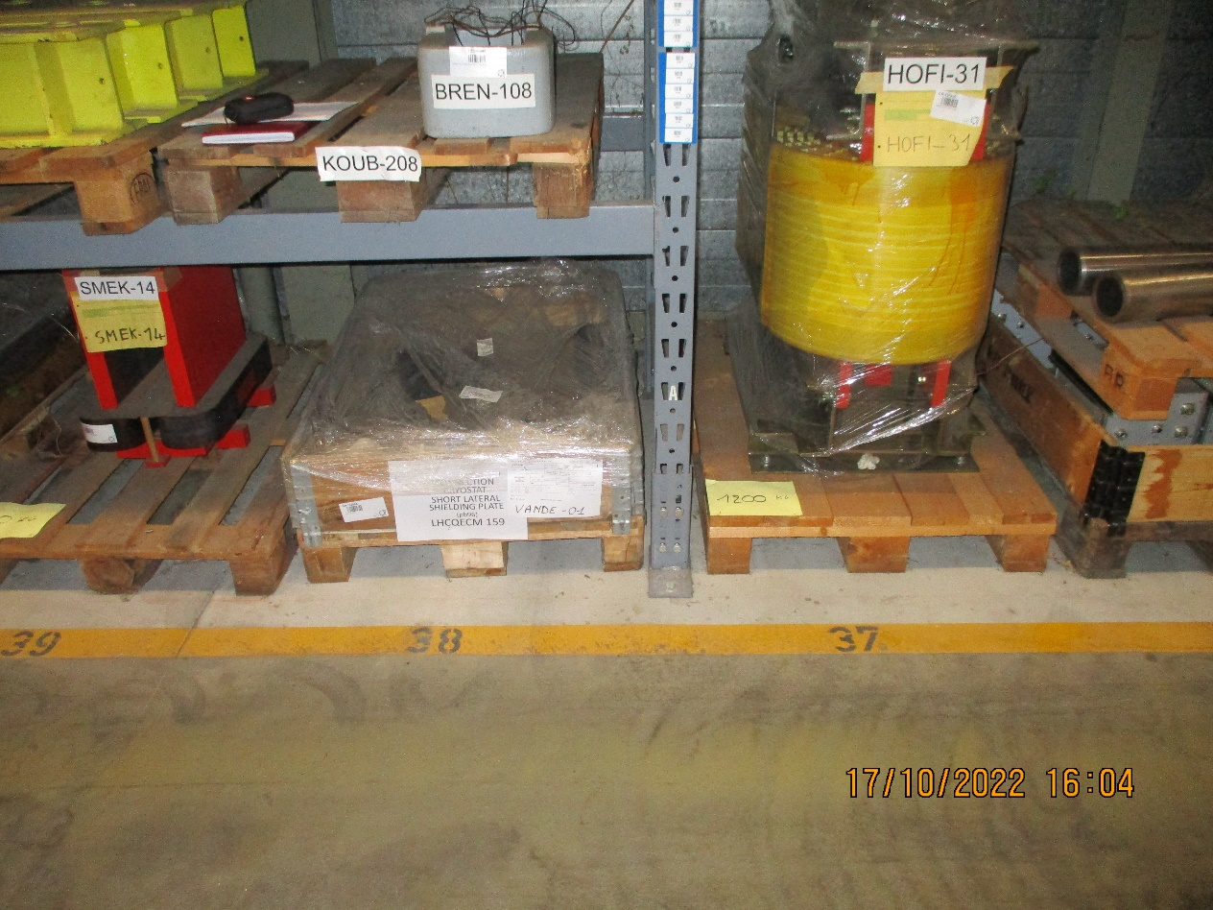
Where did I find the references .
S37DPBT
S37DPBT
S38CPBT

Slide 34
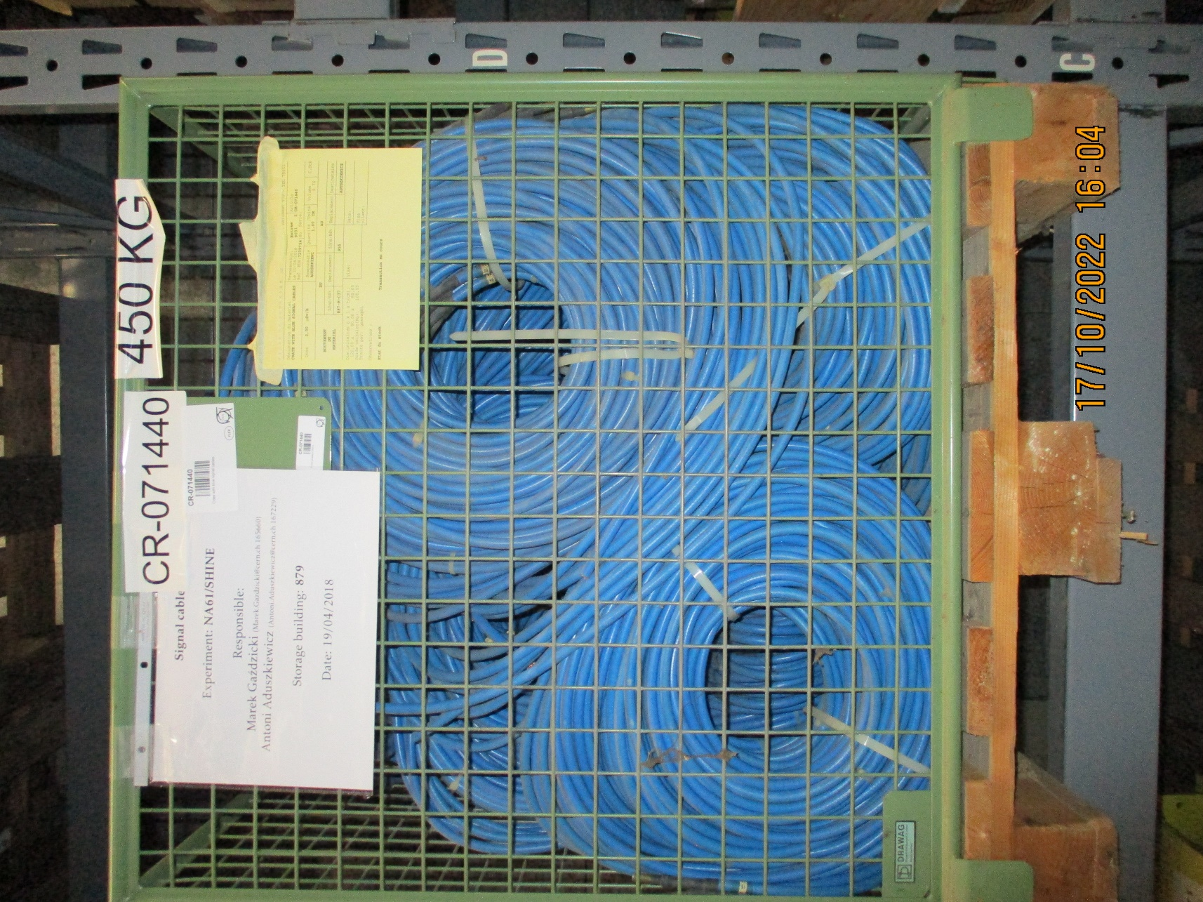
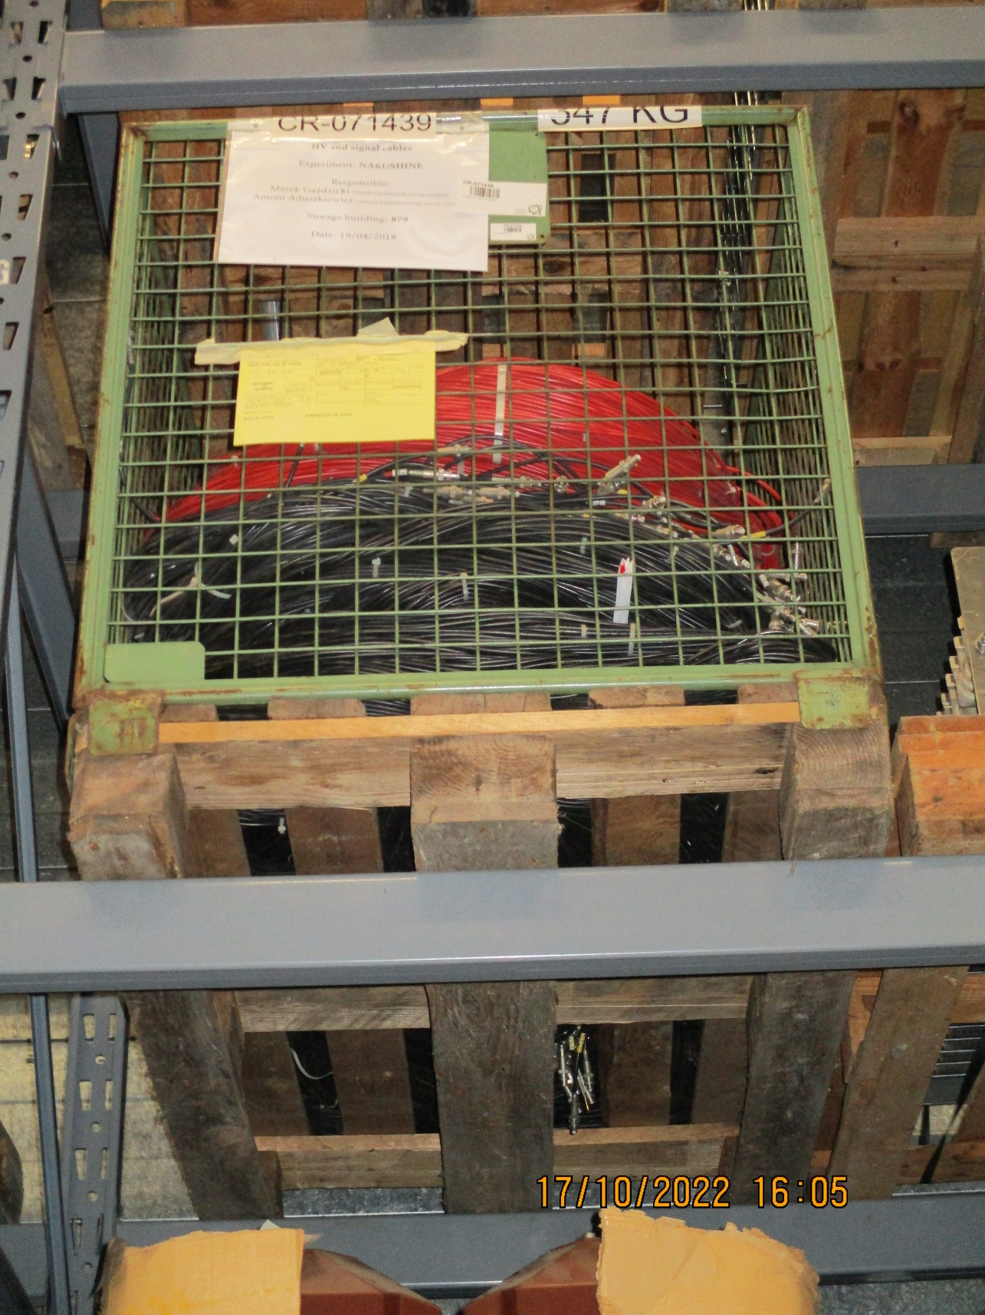
Present description, to be detailed….
Quantities, connector & cable type and lengths (or at least an idea 1m or 100m)
CR-071440
CRATE WITH BLUE SIGNAL CABLES
CR-071439
CRATE WITH RED HV CABLES

