Slide 1
All stored material for NA61
Ian
18 Oct 2022

Slide 2
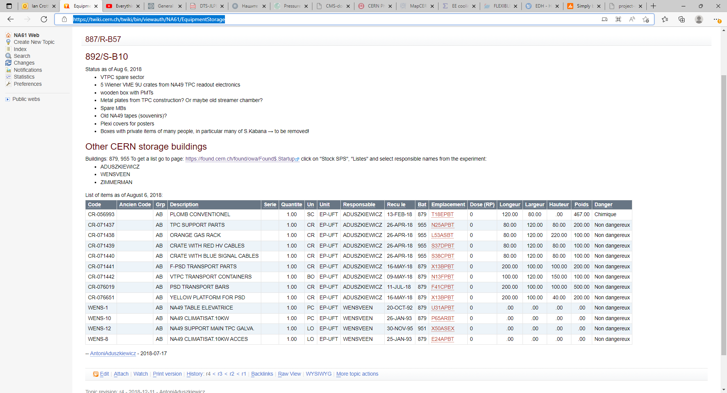
https://twiki.cern.ch/twiki/bin/viewauth/NA61/EquipmentStorage

Slide 3
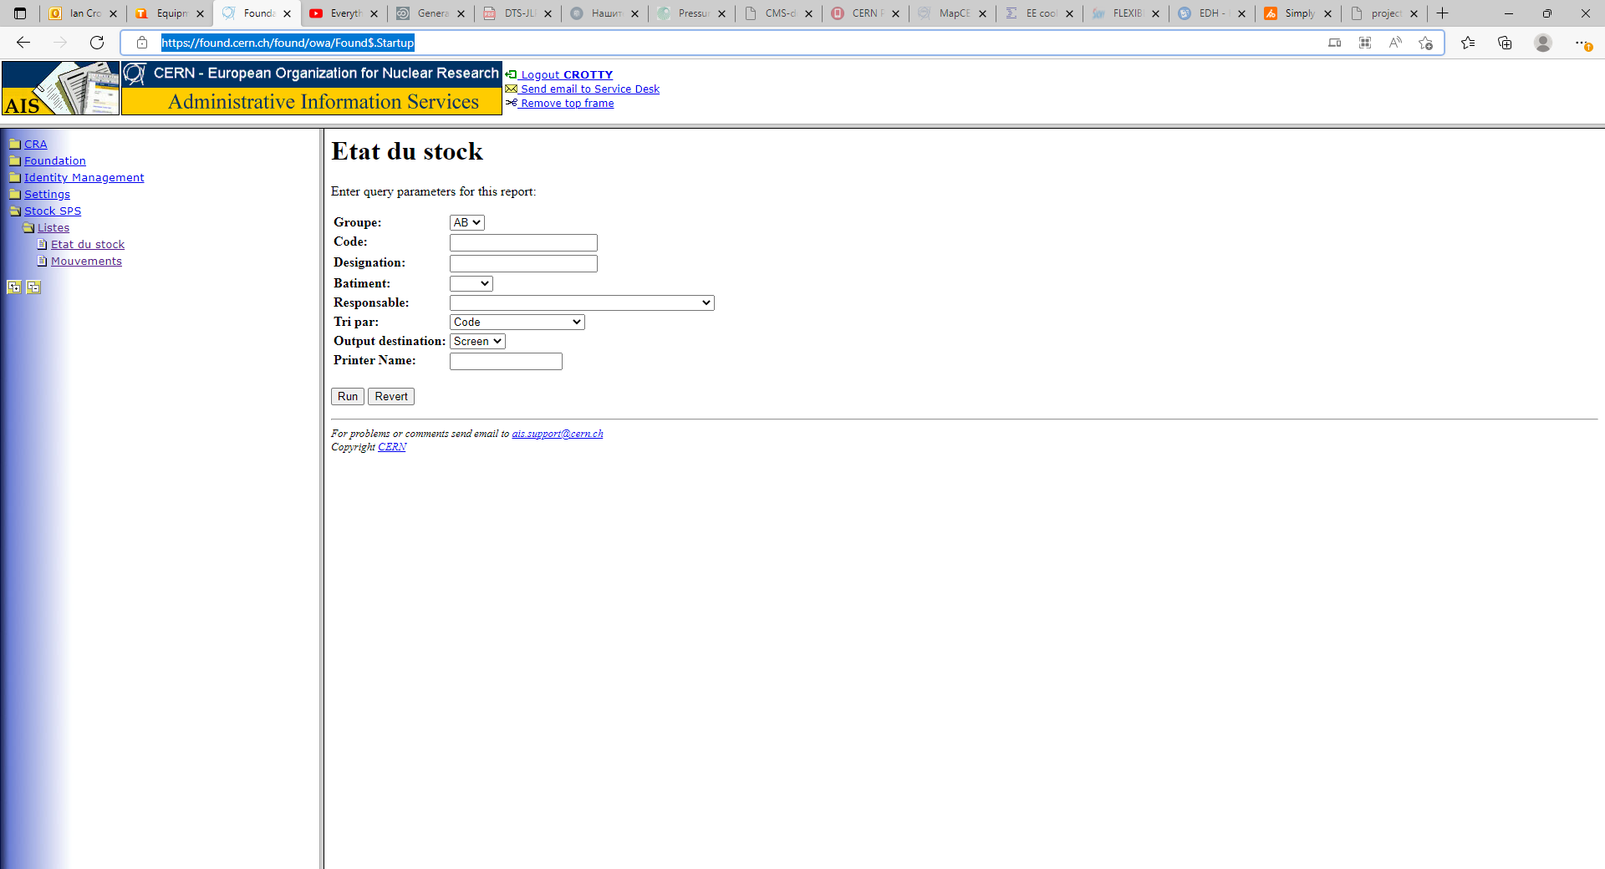
https://found.cern.ch/found/owa/Found$.Startup
Choose “Etat du stock” or “ Movements”
Put one of the names in “responsible” and press “run”
ADUSZKIEWICZ
WENSVEEN
ZIMMERMAN

Slide 4
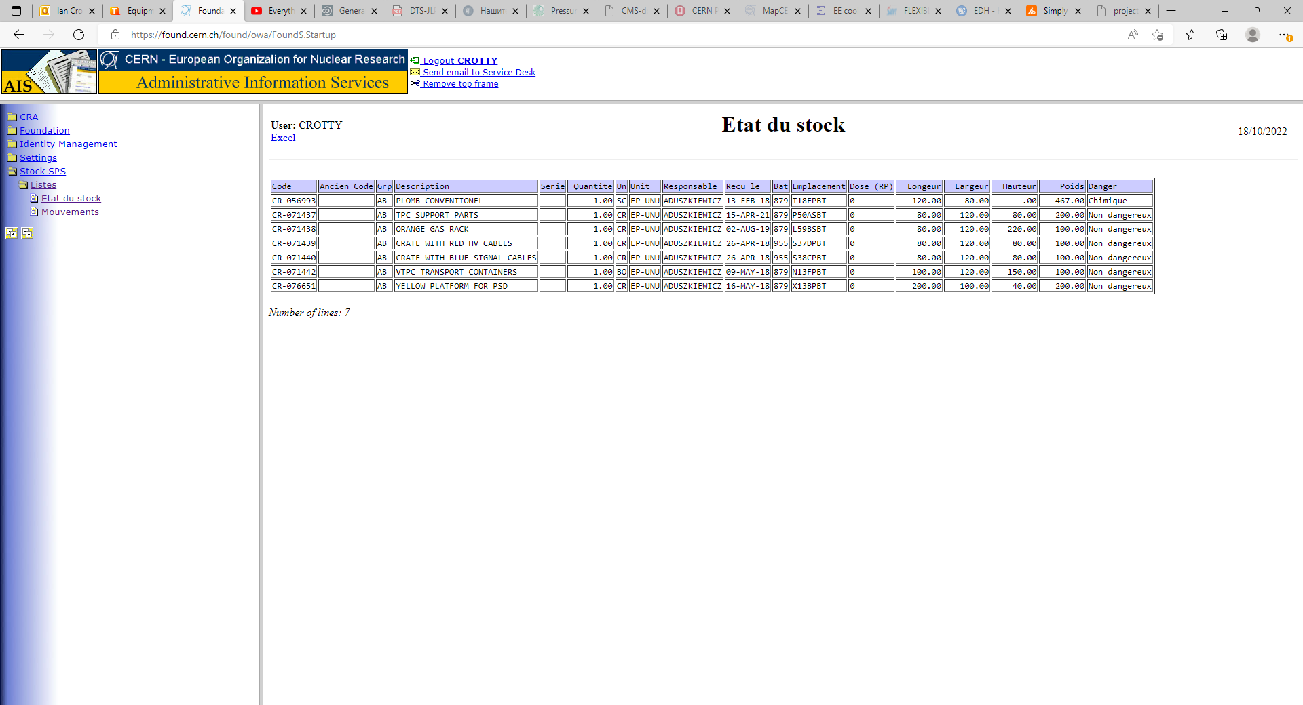

Slide 5
For all six combinations

Slide 6
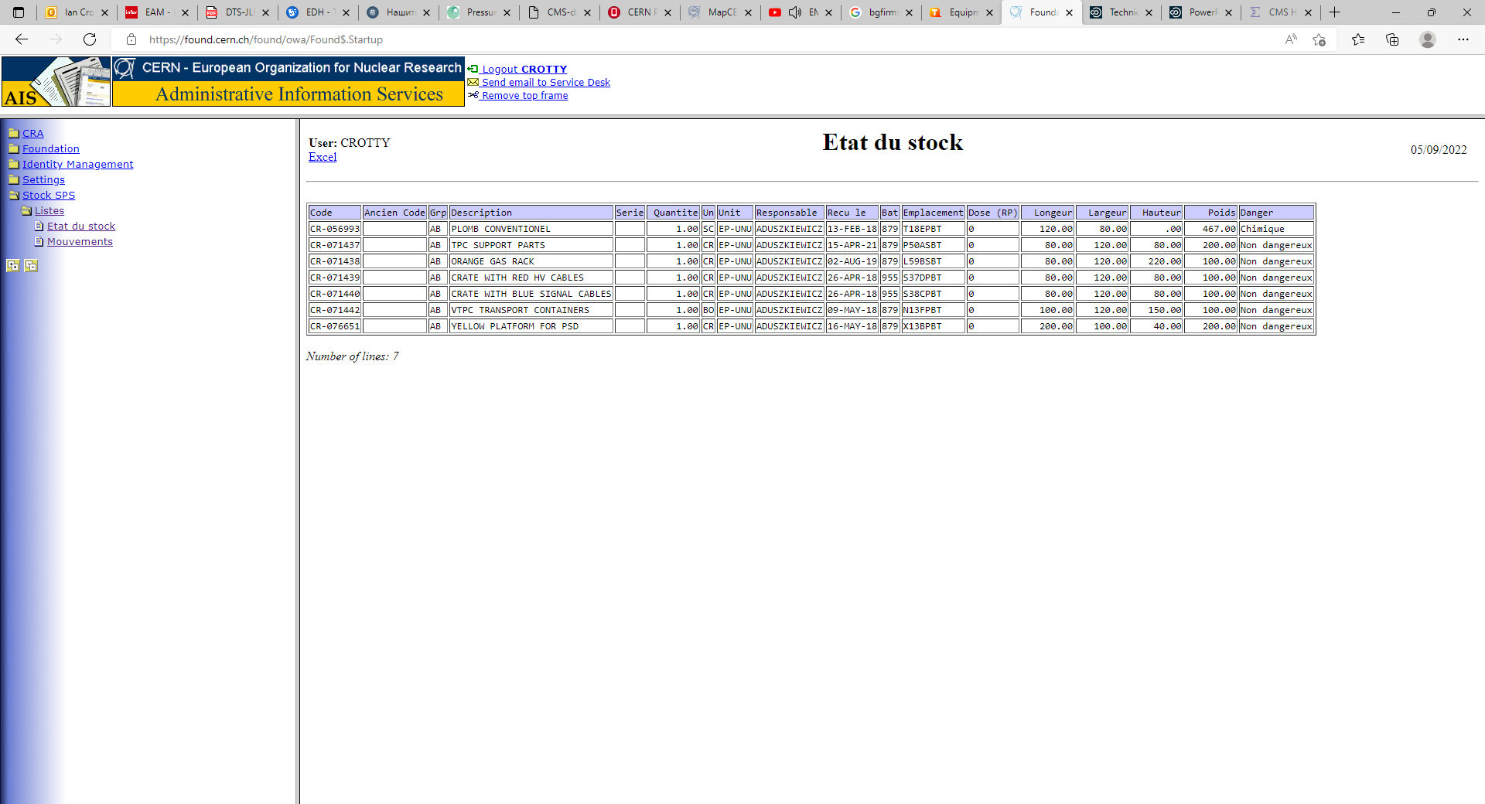
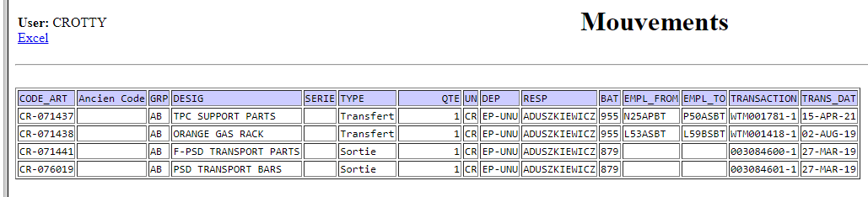
https://found.cern.ch/found/owa/Found$.Startup

Slide 7
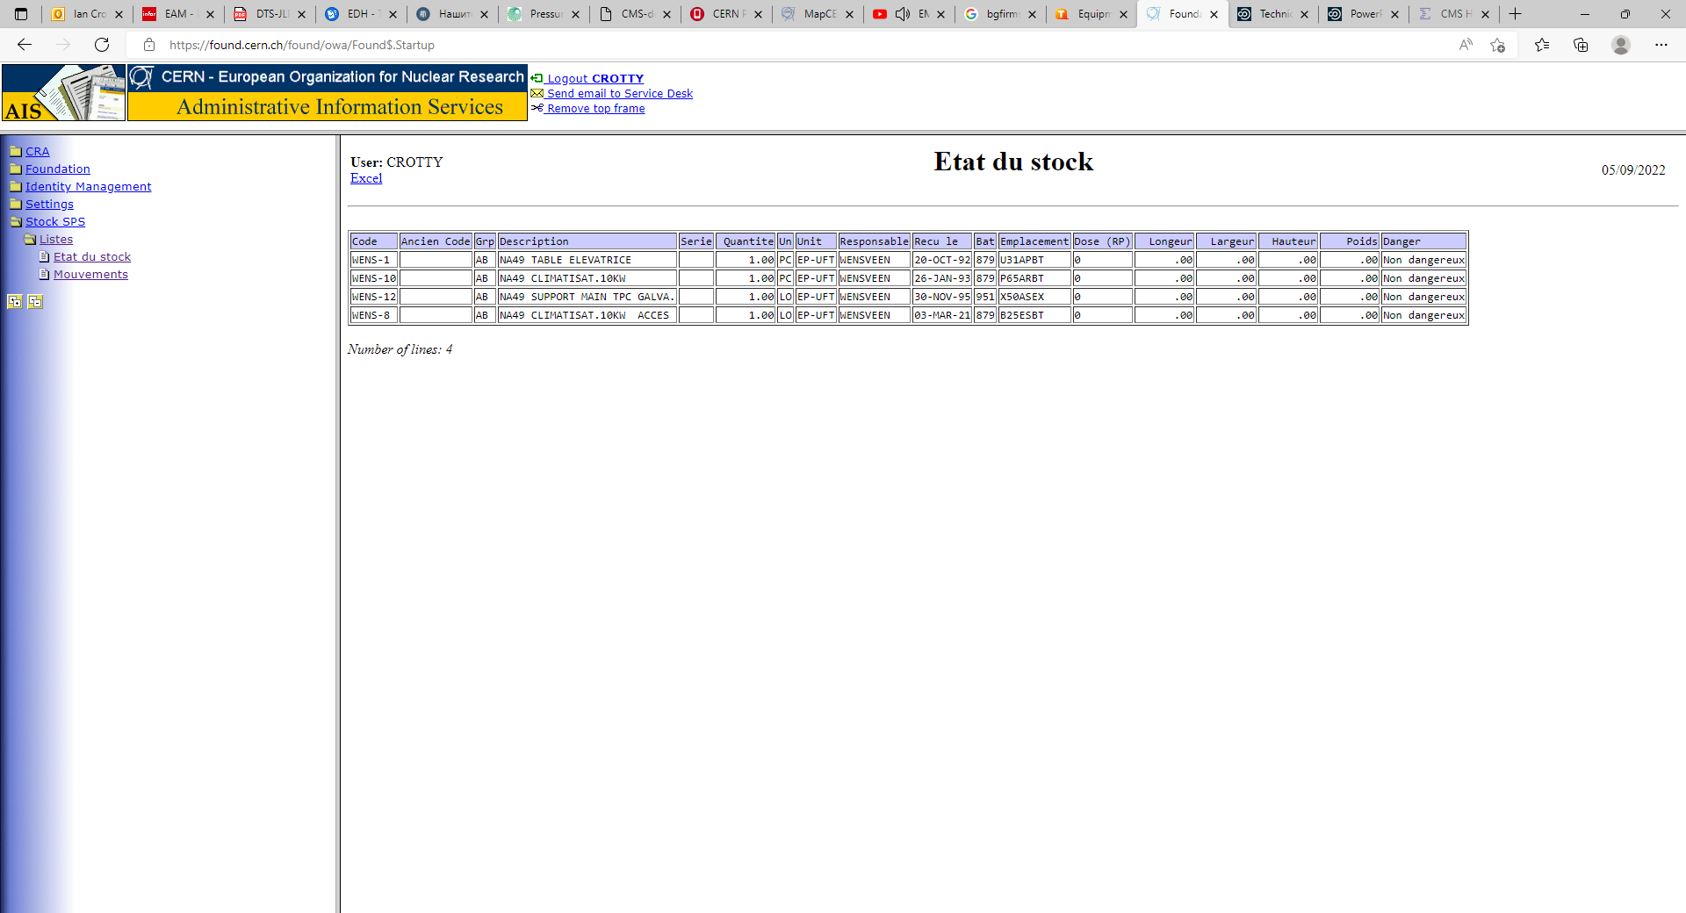
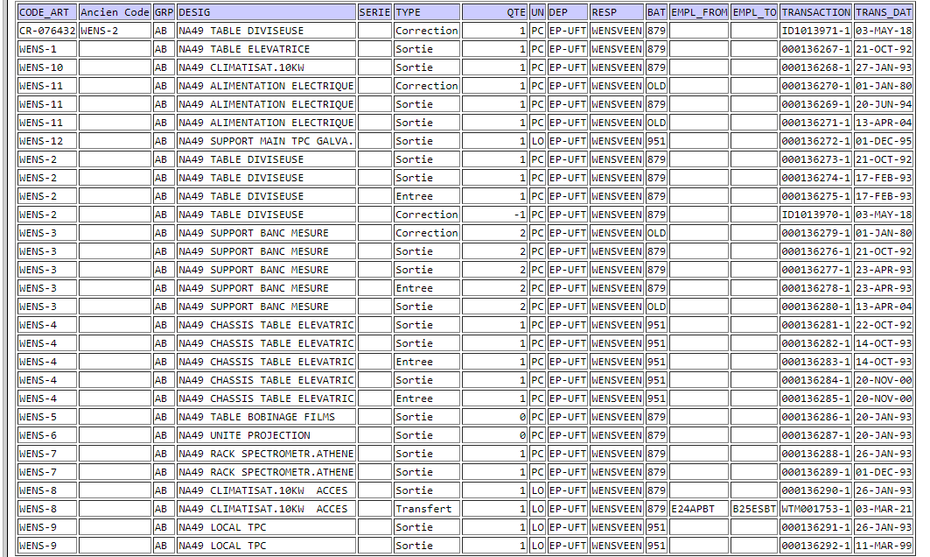
Movements

Slide 8
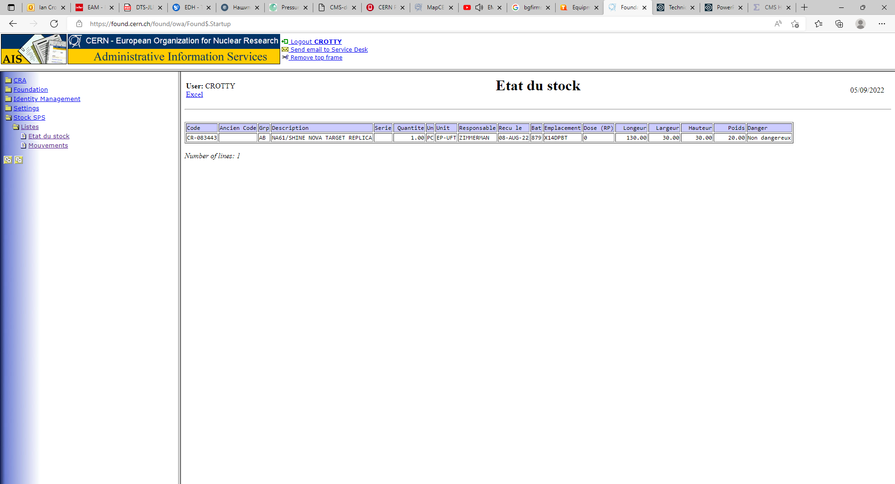


Slide 9
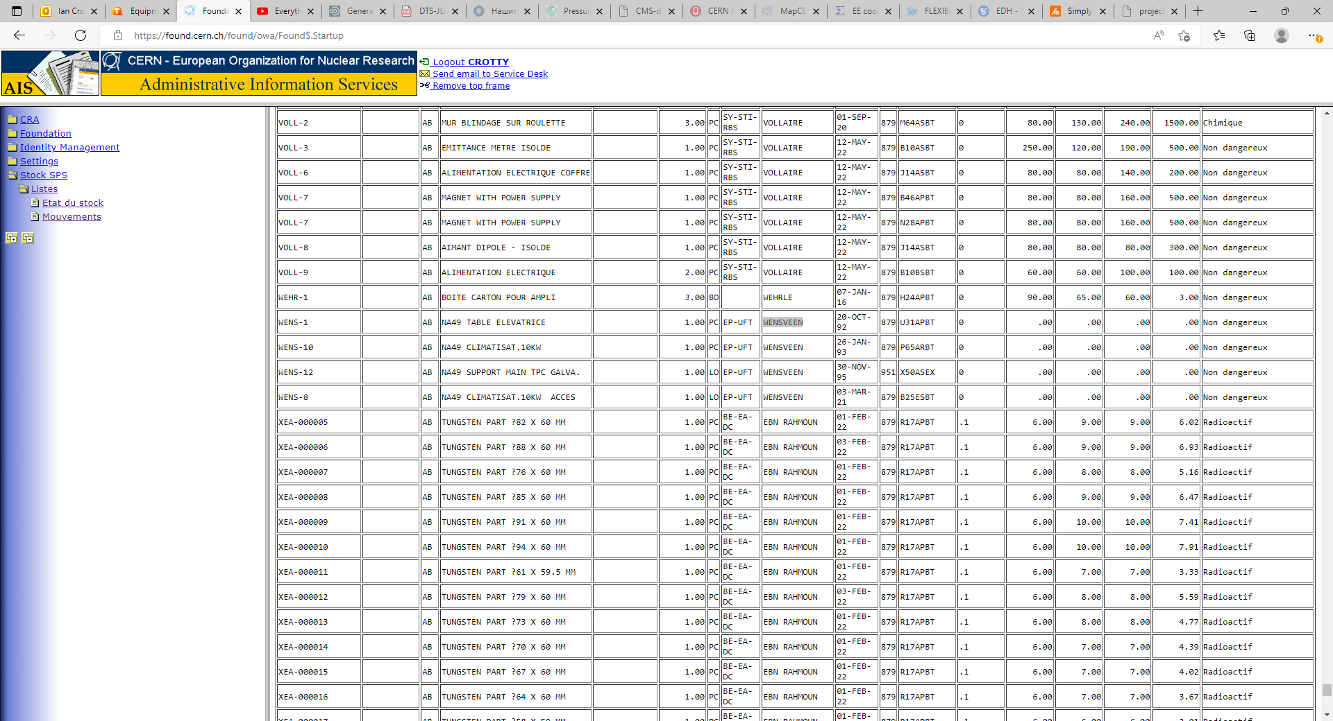
Not putting any name reveals many items
Use control “F” to find key words

