Slide 1
B904, Storage Tents, and B947, i.e., Flex Building
Updates on the upgrade of B904 and organization of the storage tents
Explaining the process of sending an item and having it stored in B947

Slide 2
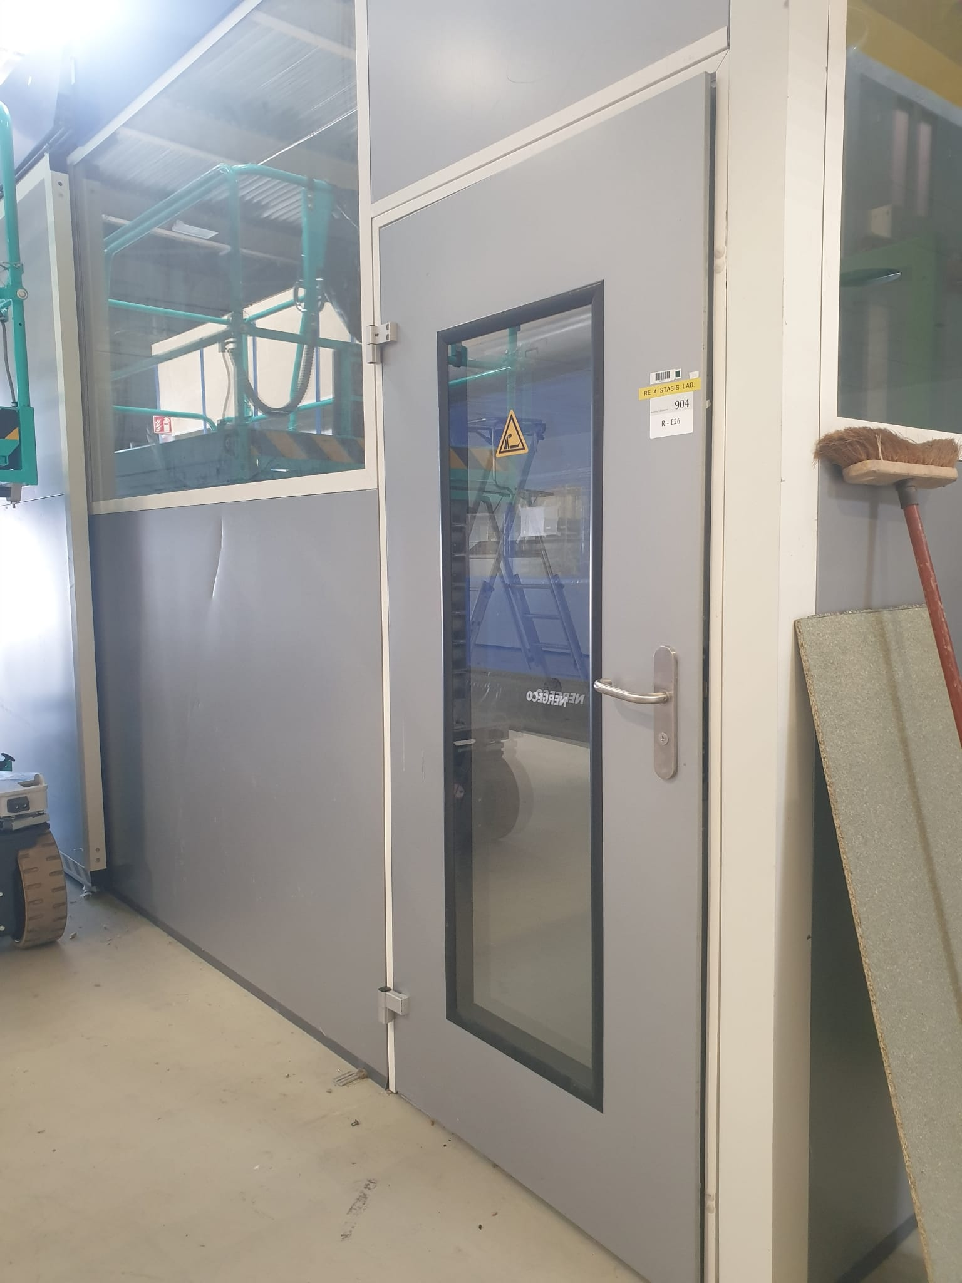
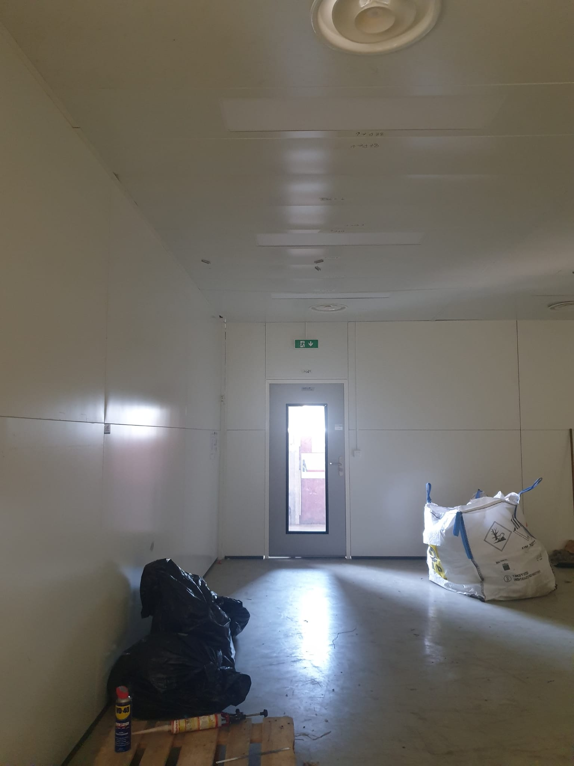
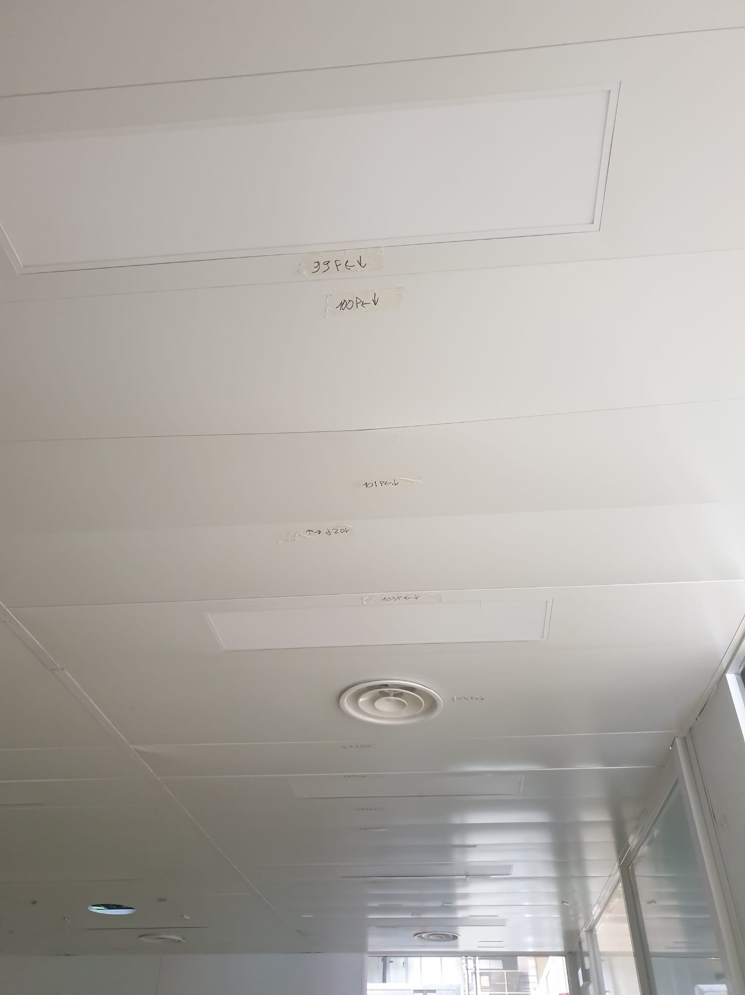
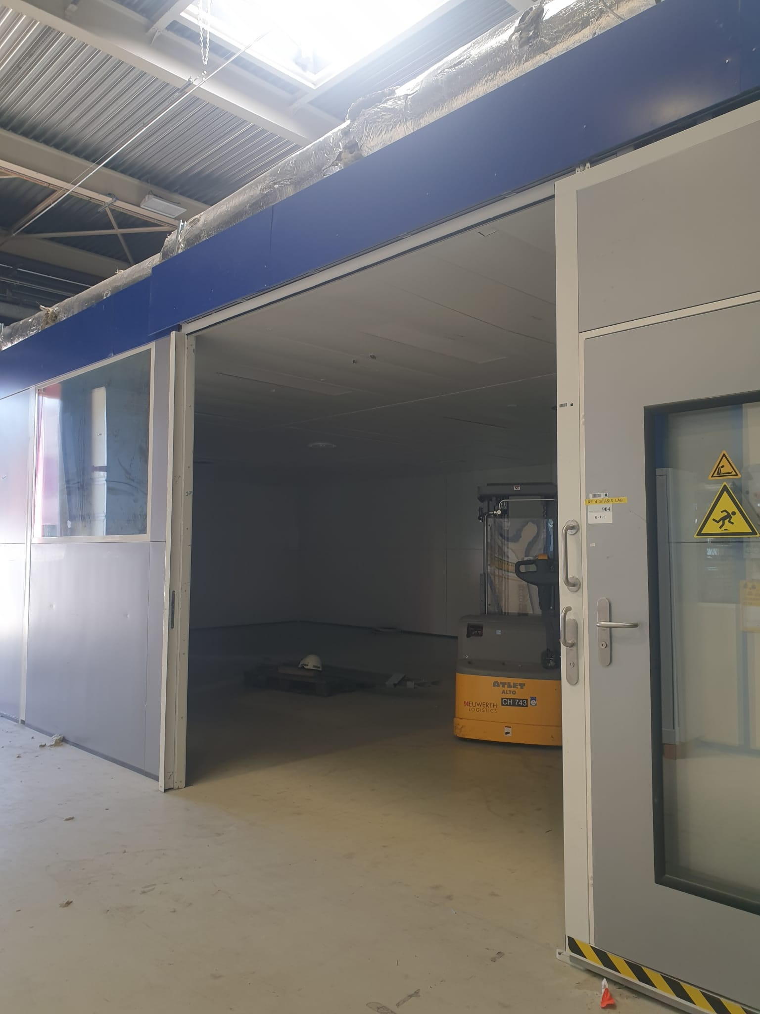
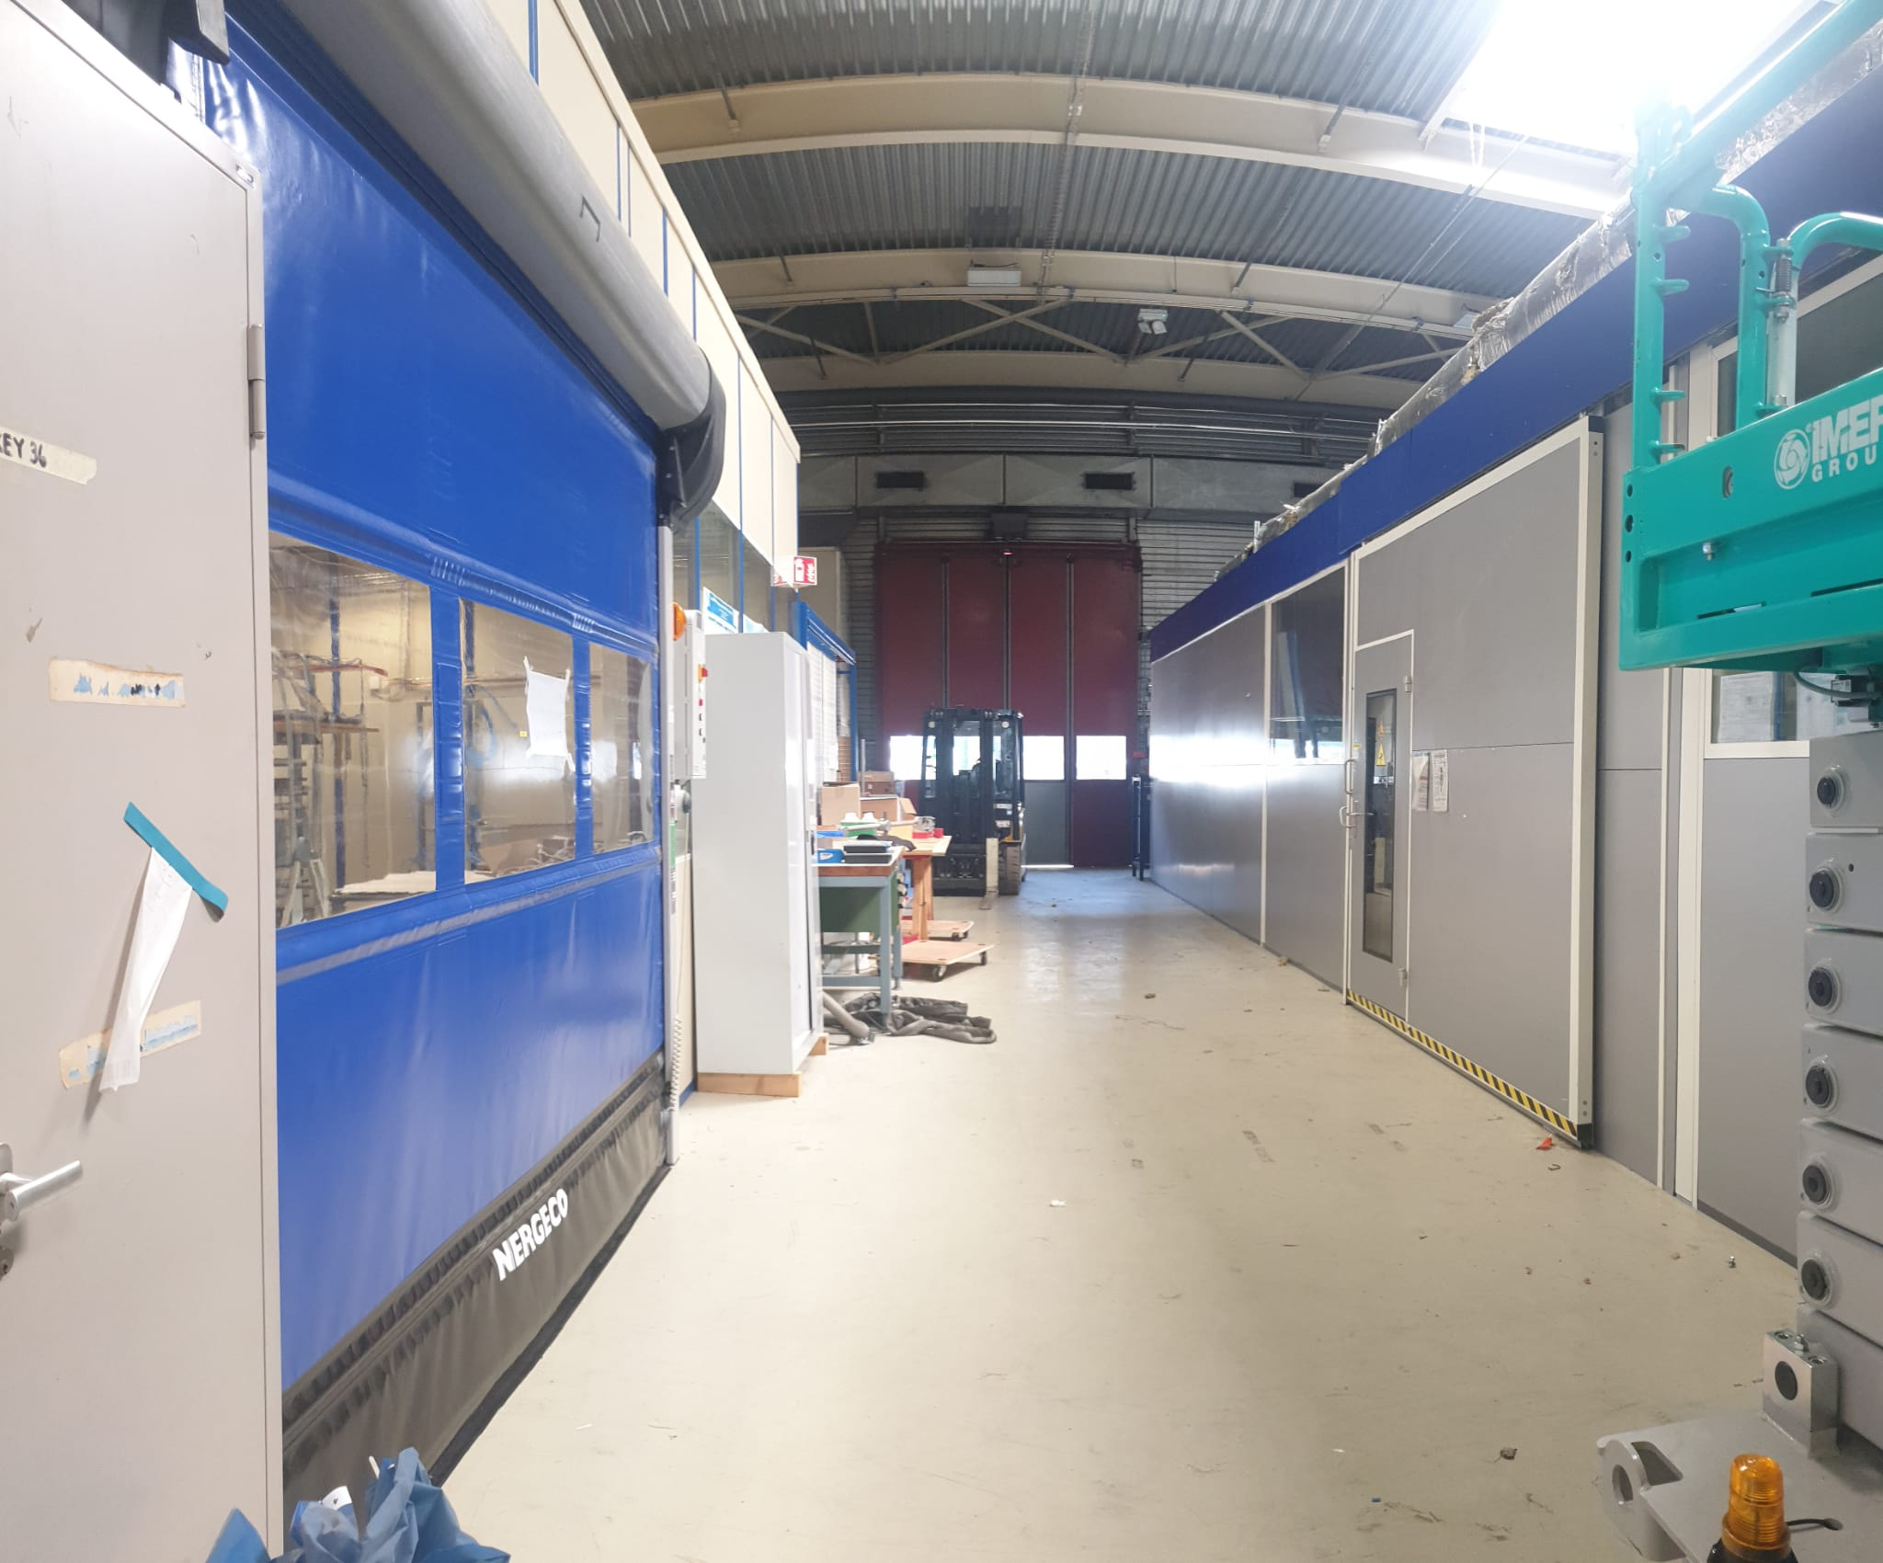
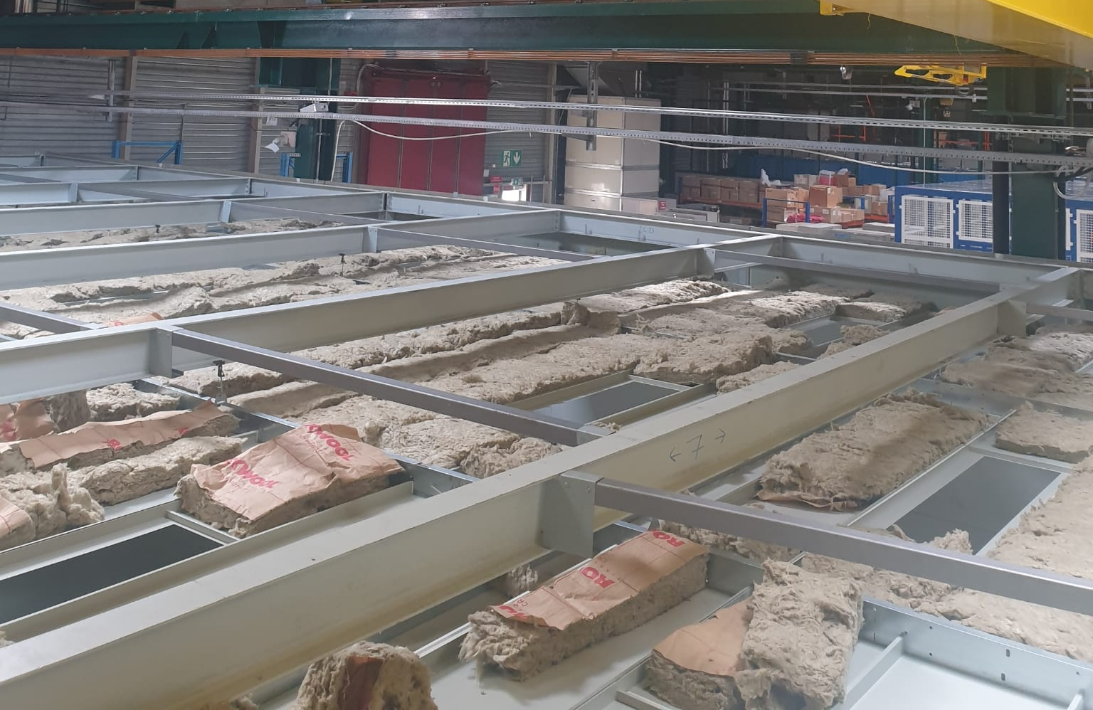
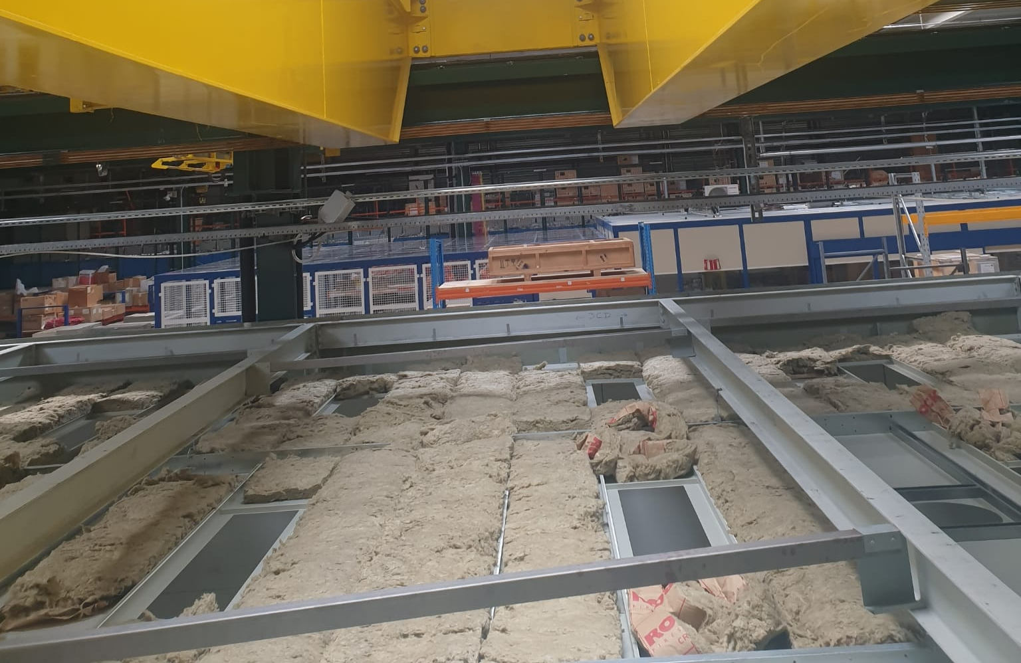
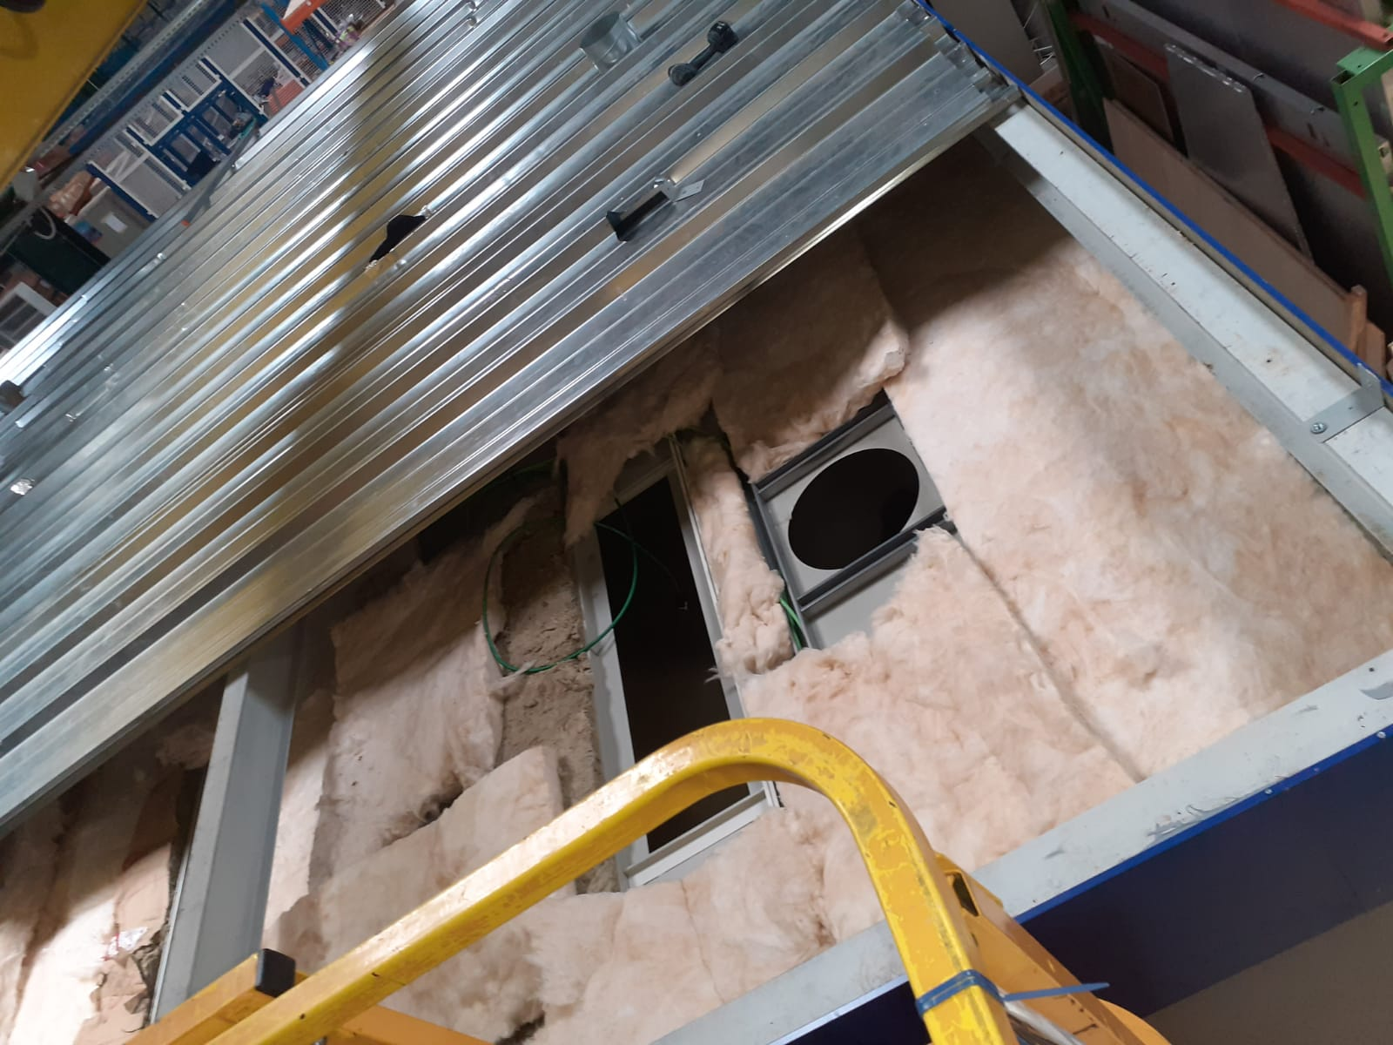
Stasis Lab in 904, i.e., R-E26
The assembly of the cabin by Foselev and the electrical cabling by SCE are done.
Foselev added more insulation materials where needed.
The sliding door of R-E26 is facing the roll-up door of the other RPC lab in 904.
Ceiling of R-E26 in 904 with the preexisting insulation material.
Ceiling of R-E26 in 904 with the preexisting insulation material.
The newly added insulation material on R-E26

Slide 3
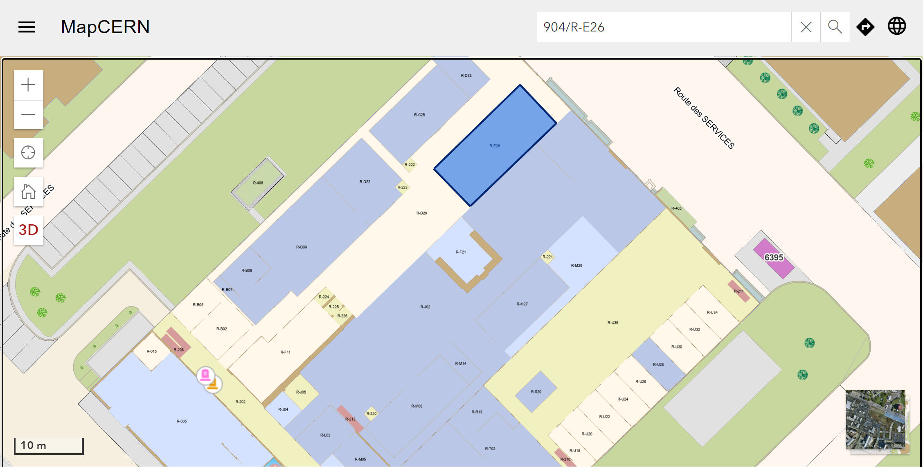
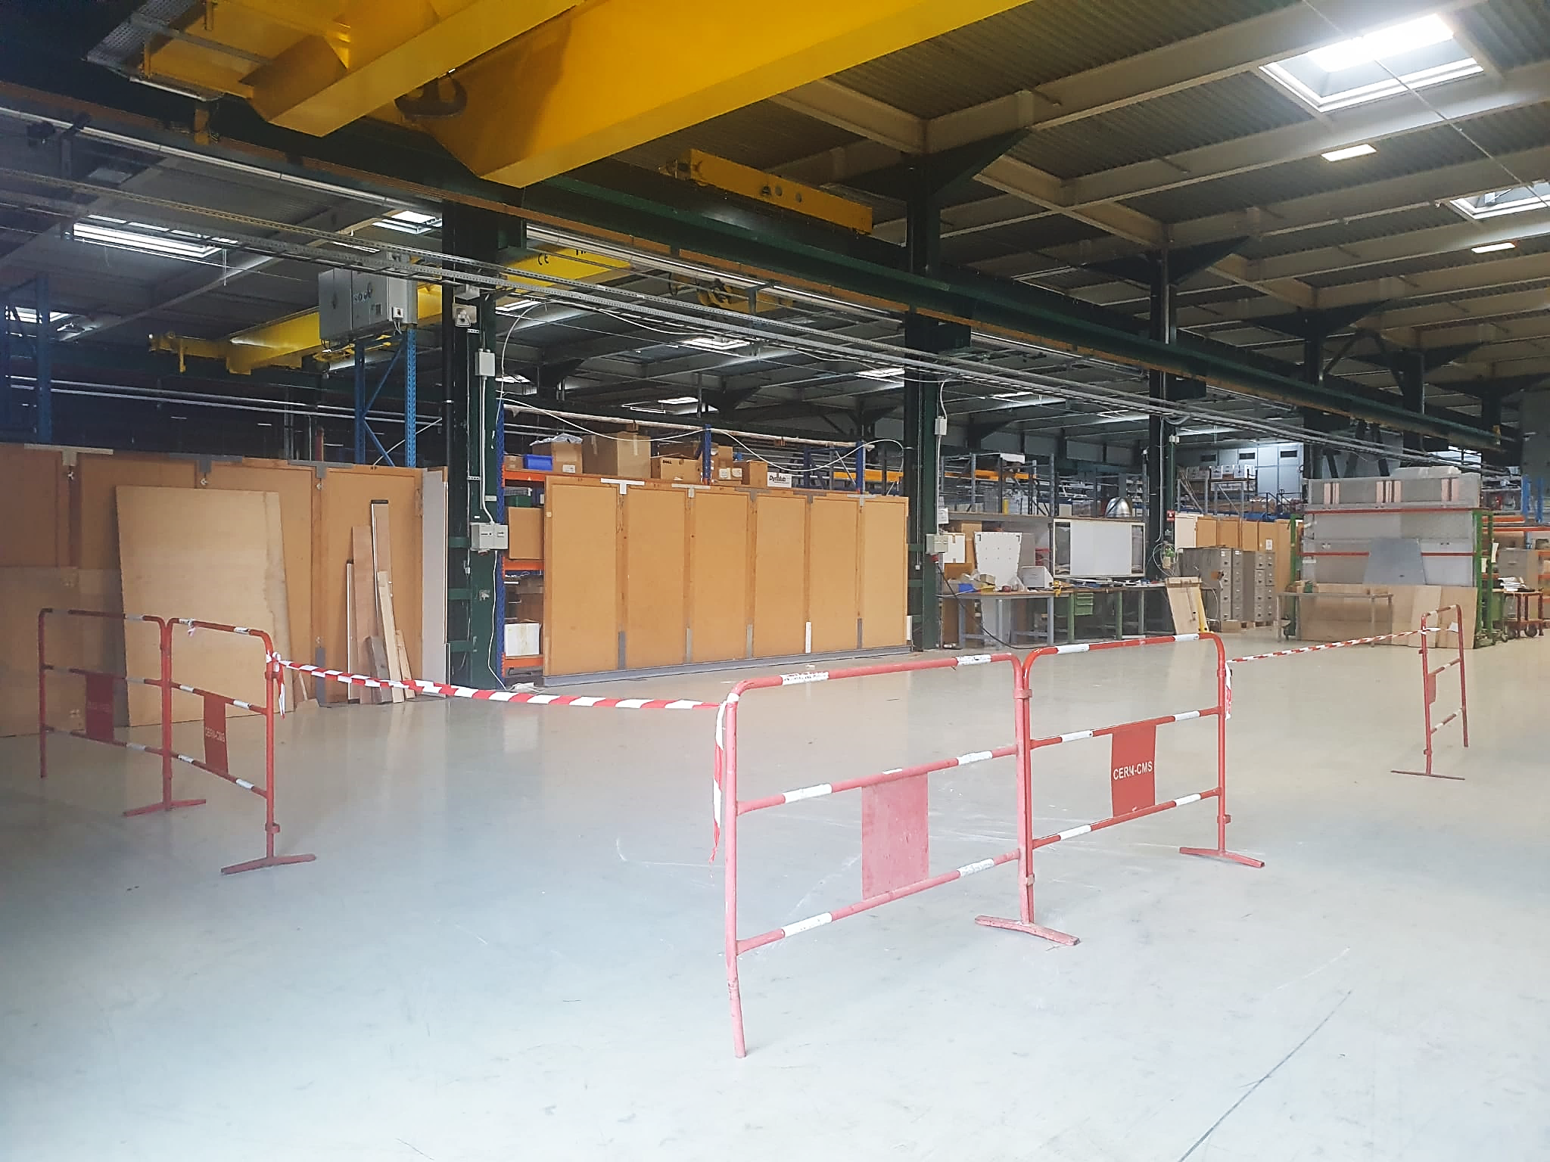
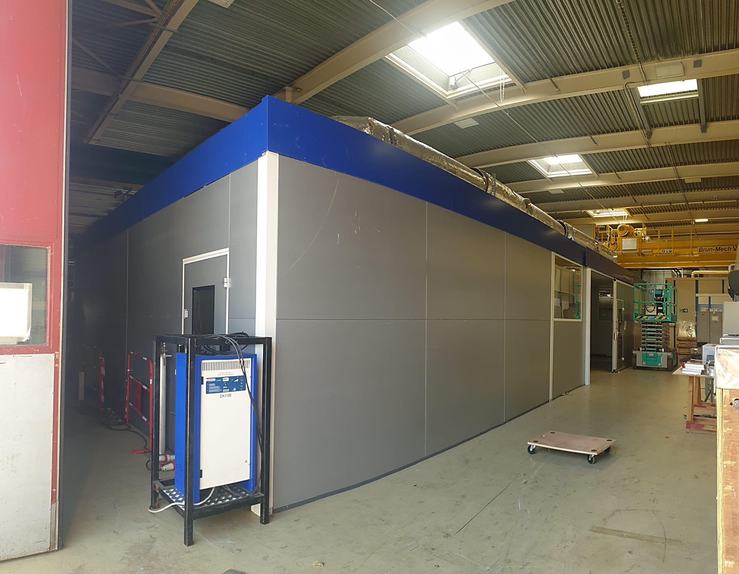
Stasis Lab in 904, i.e., R-E26
Sades started installing the HVAC ducts on the roof today.
Lab and HVAC commissioning: 1st week of September.
Space on the 904 wall has been made available for the box of the fire detection alarm, which will be installed at the end.
Should we add kaba22 locks on all labs in 904?
The Stasis lab is now visible on the 904 CERN map as R-E26.
Previously: RPC open area in 904.
Currently: RPC R-E26 lab in 904.

Slide 4
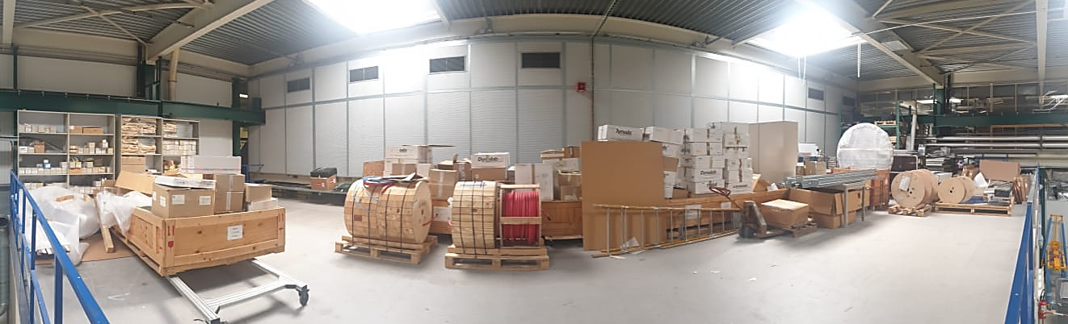
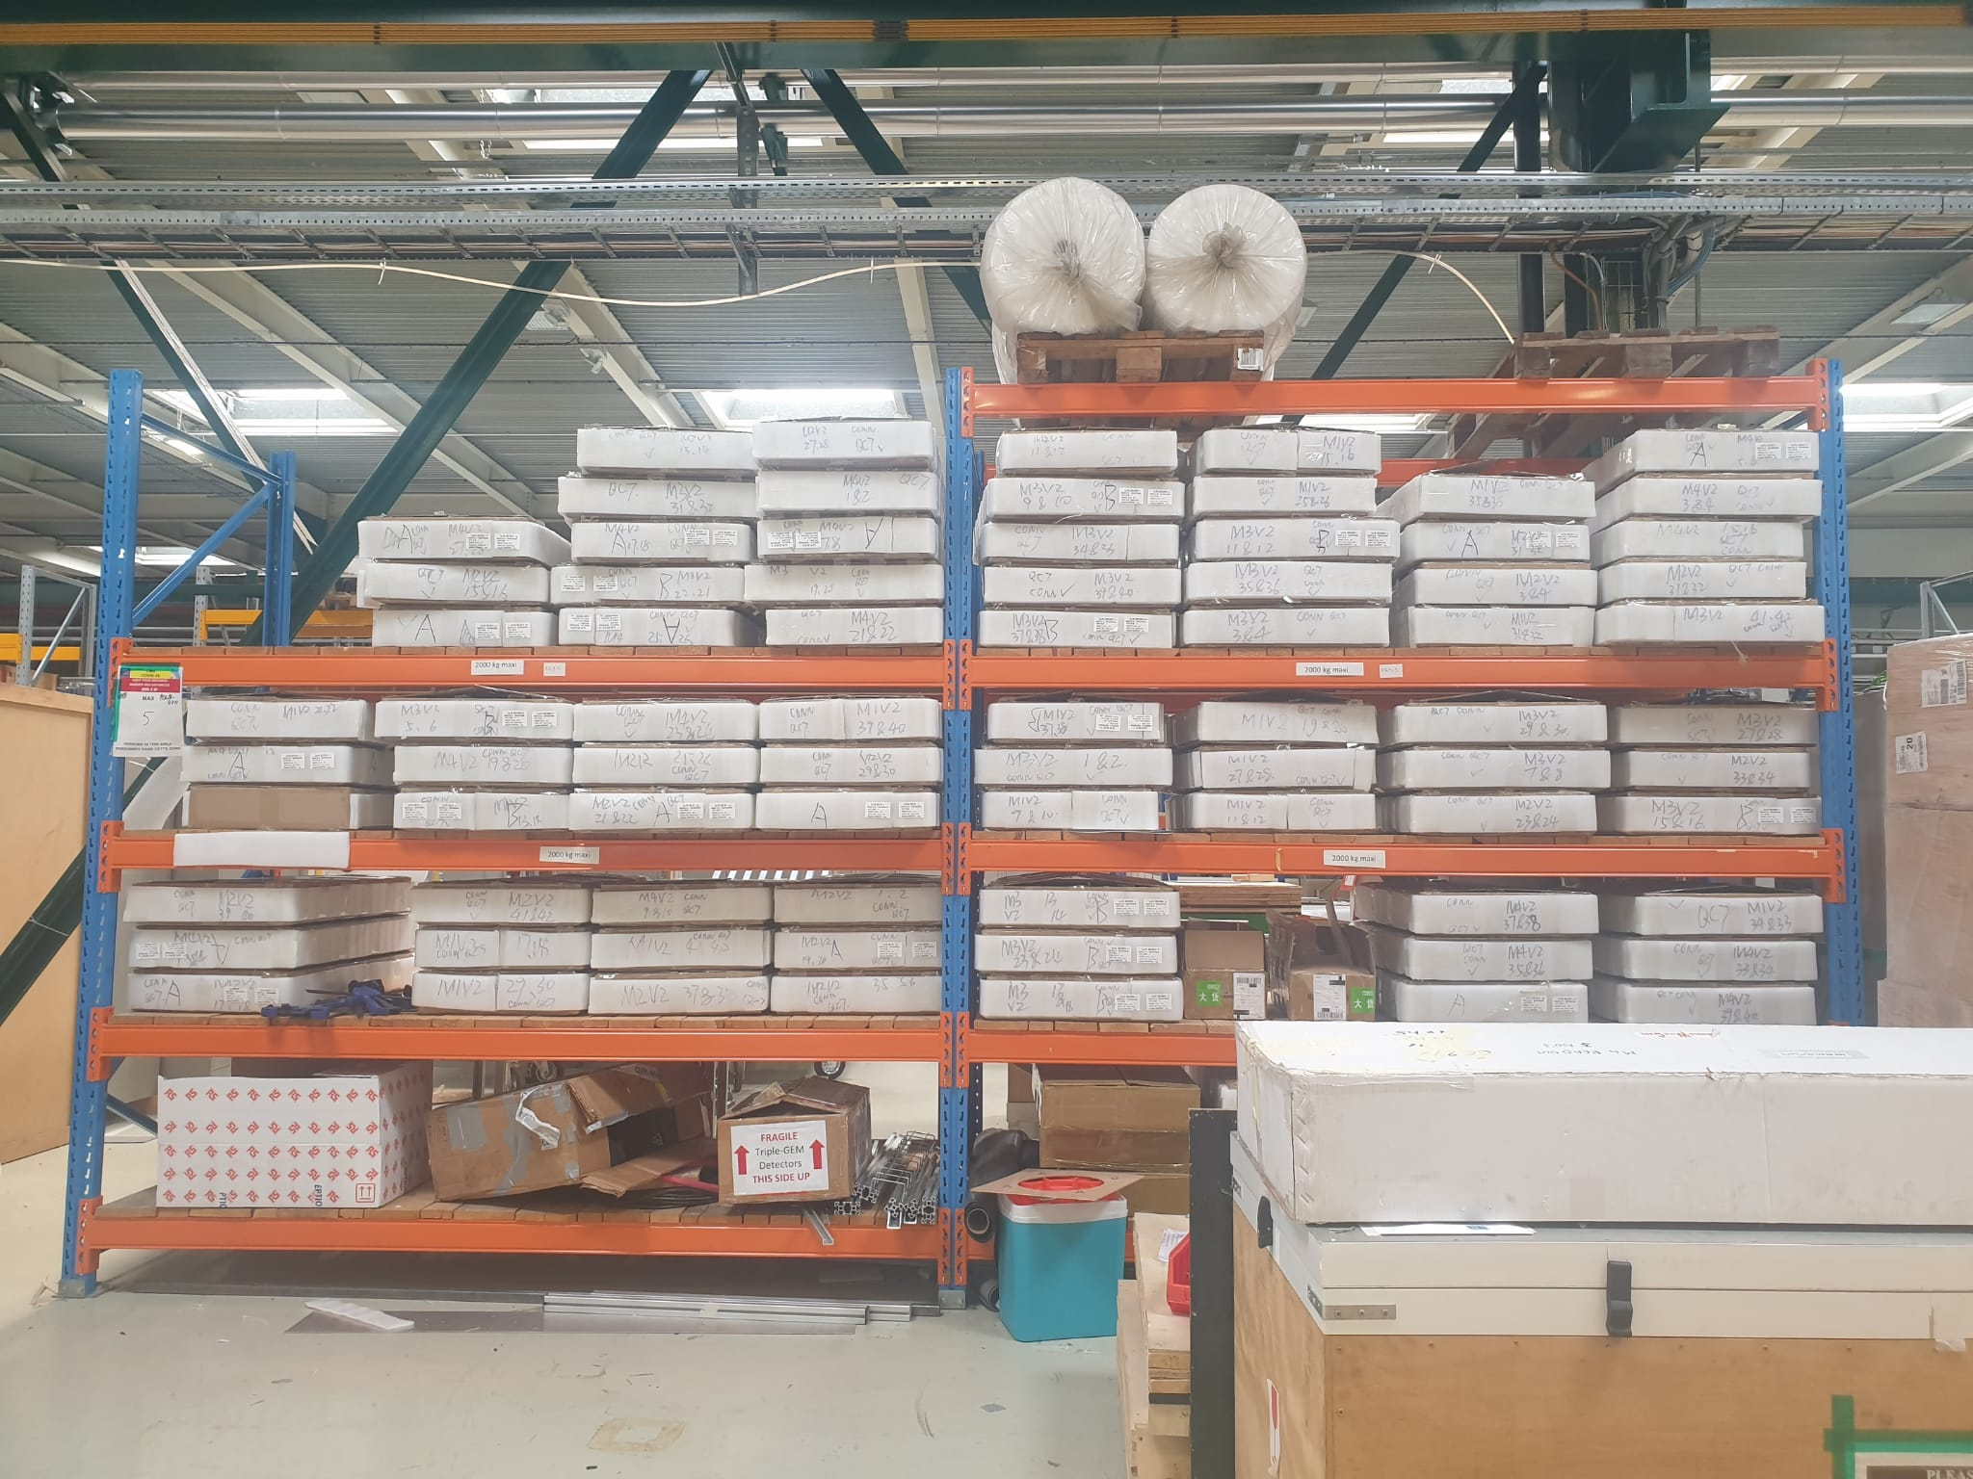
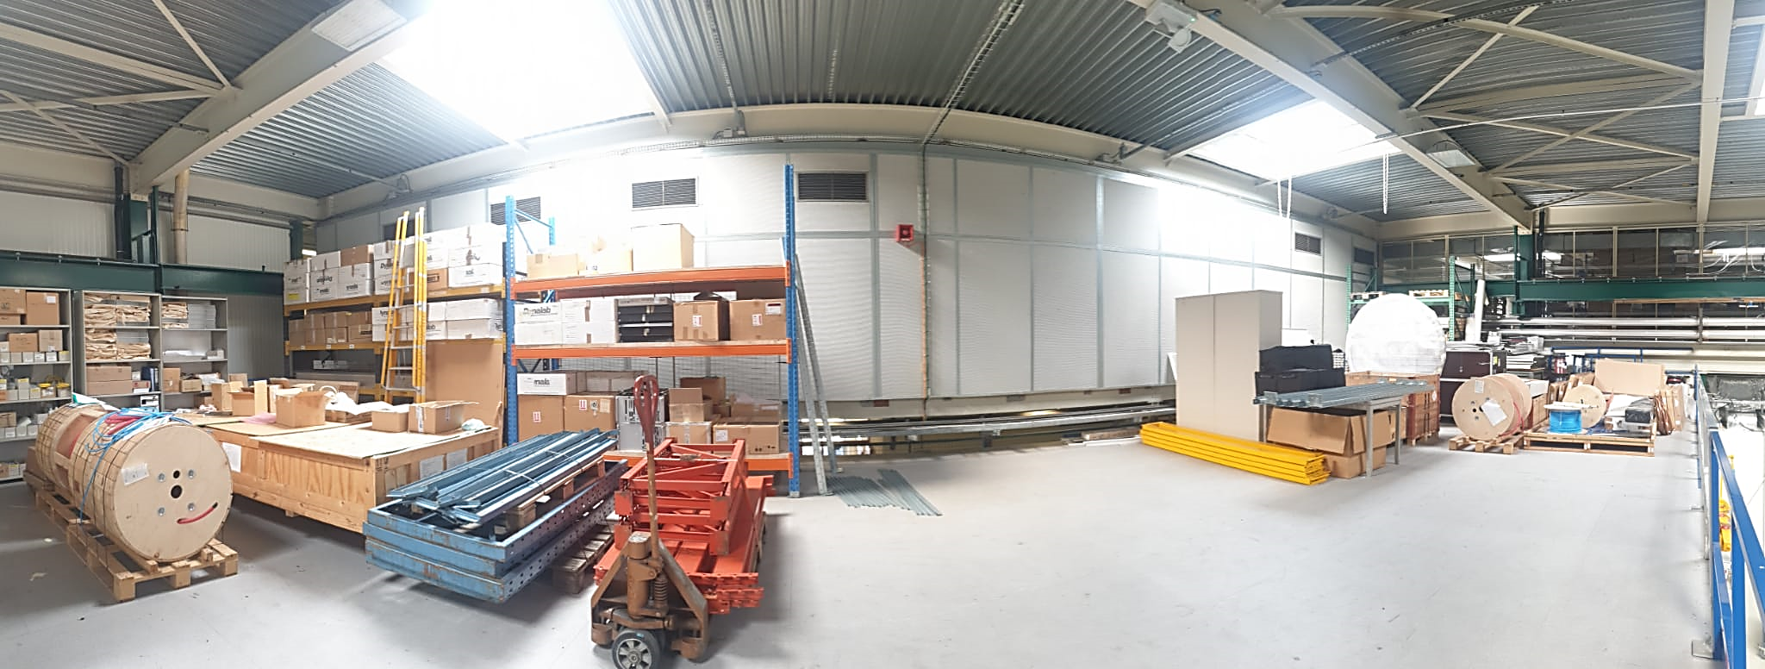
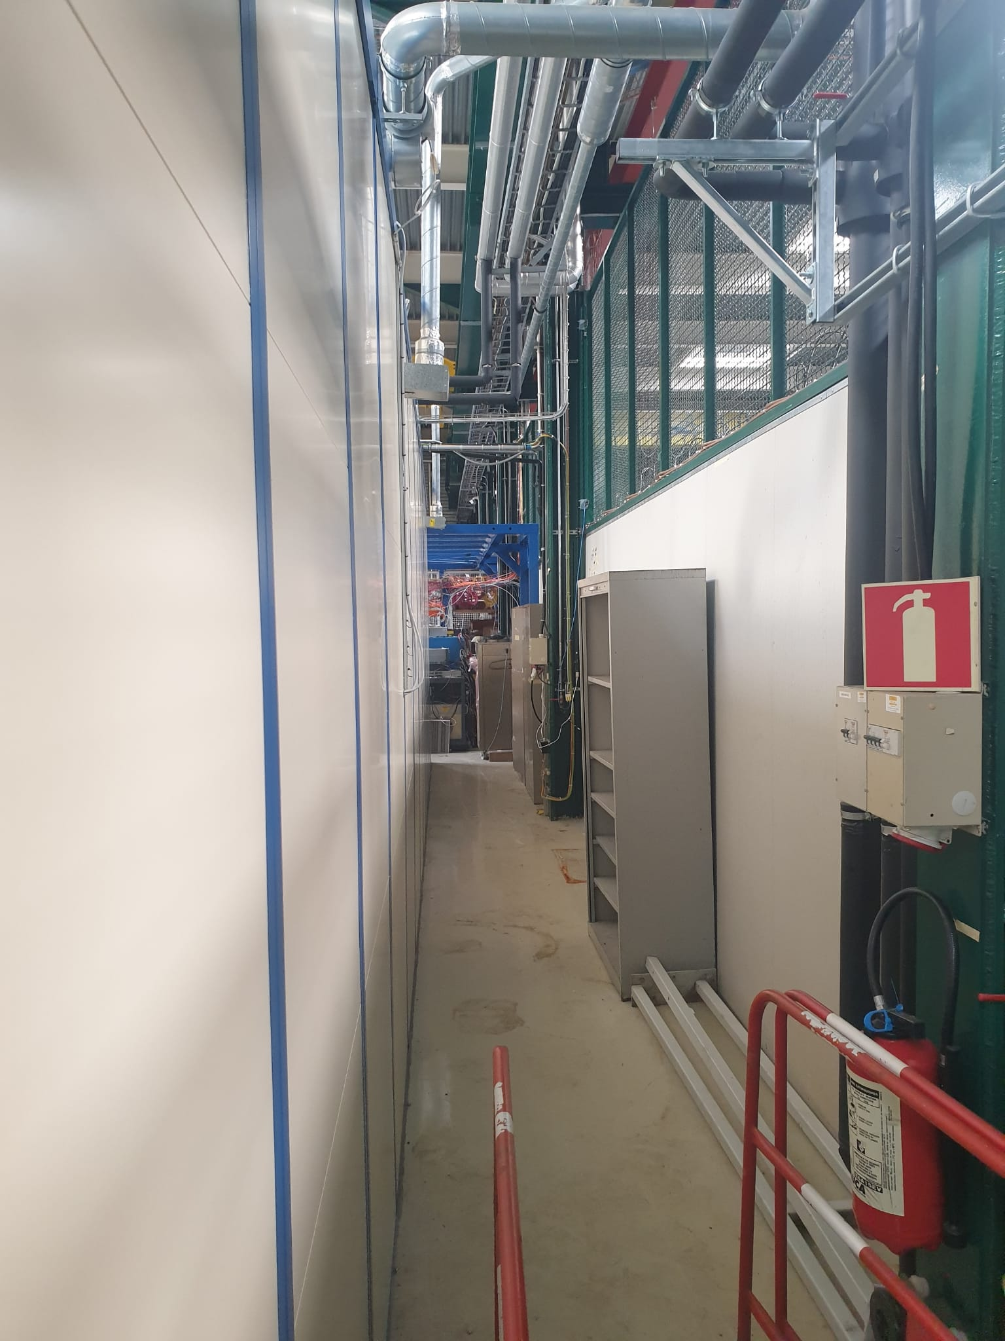
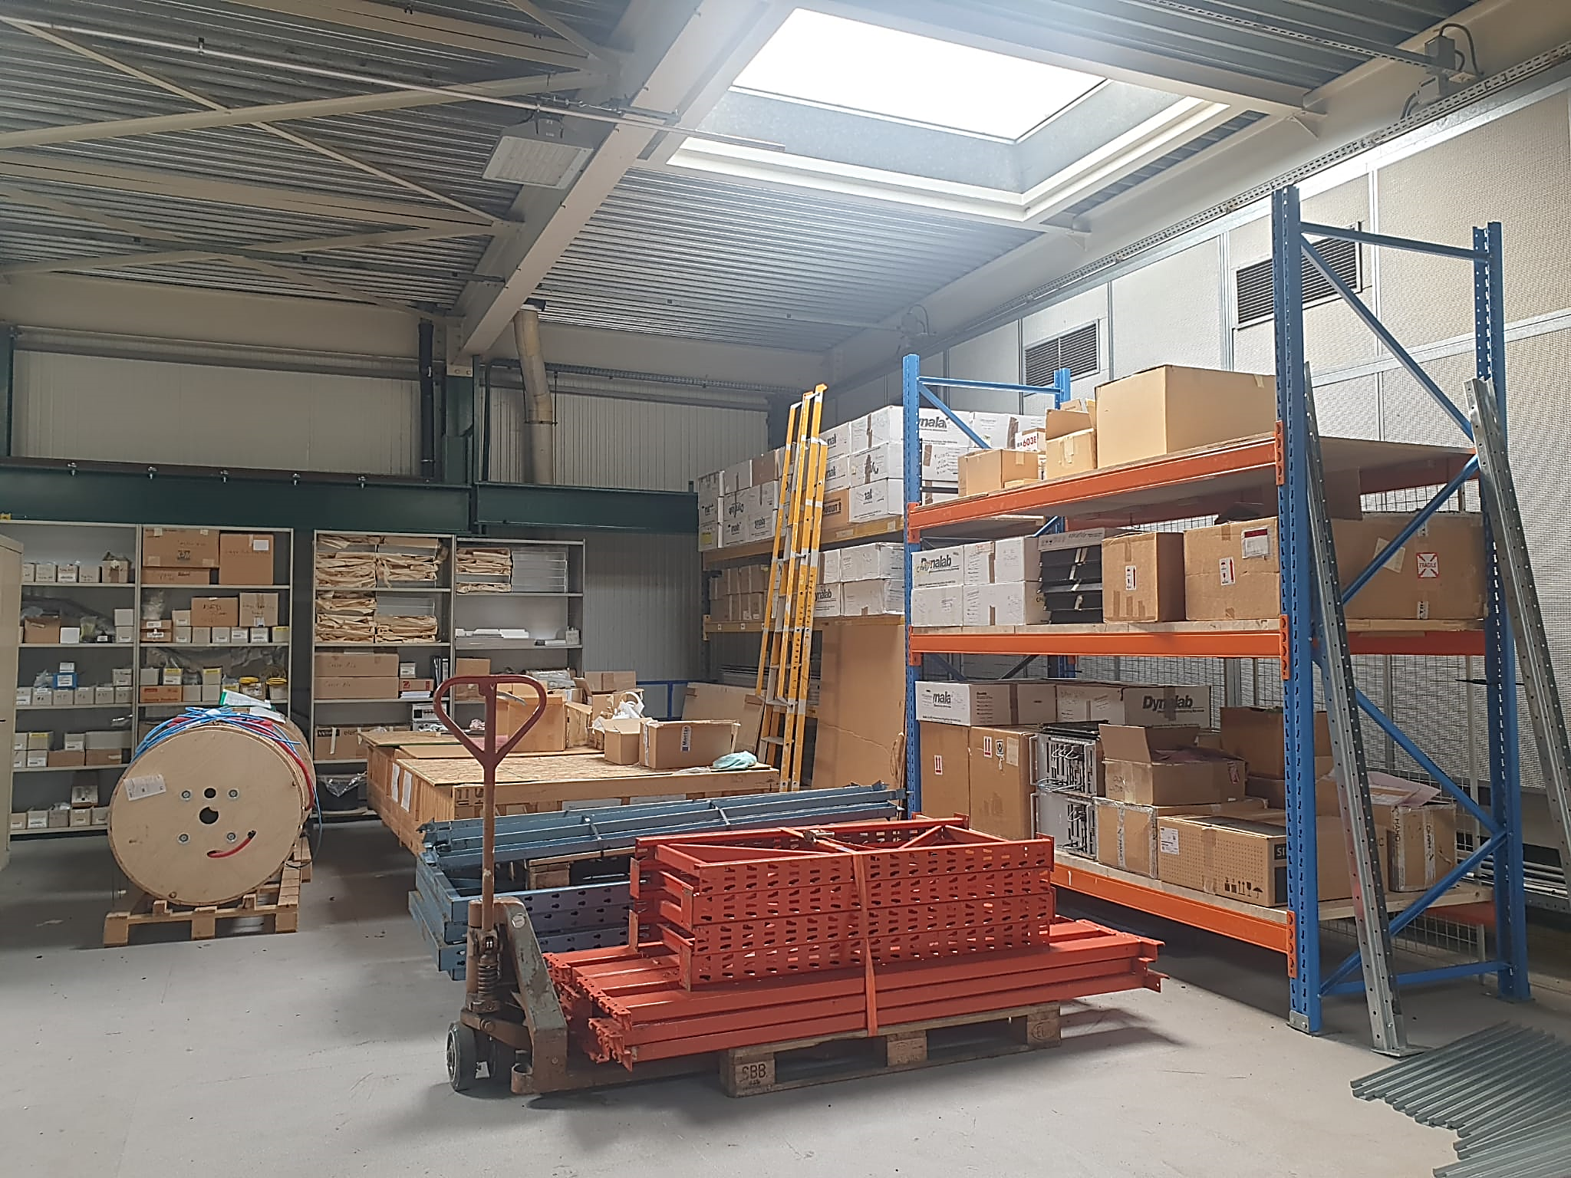
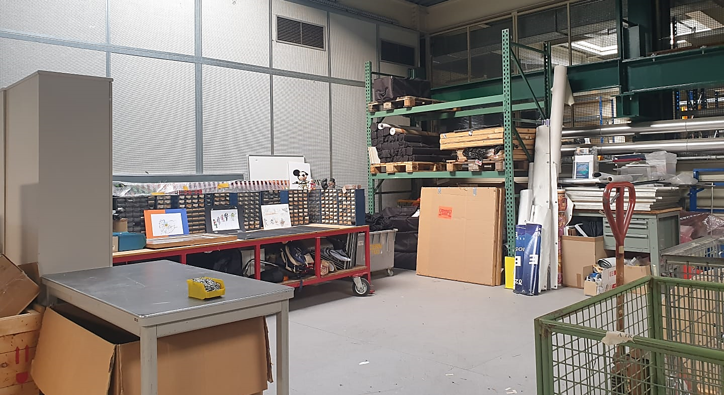
Mezzanine in 904
2 shelves were installed for CSC.
1 more shelf will be installed for GEM to move half of their items shown here.
Previously: Mezzanine on July 07, 2022.
HCAL Room in 904
Currently: Mezzanine on August 25, 2022.
HCAL put 3 cabinets in the corridor behind R-M27 and will probably add more since CSC removed their cabinets from that area.

Slide 5
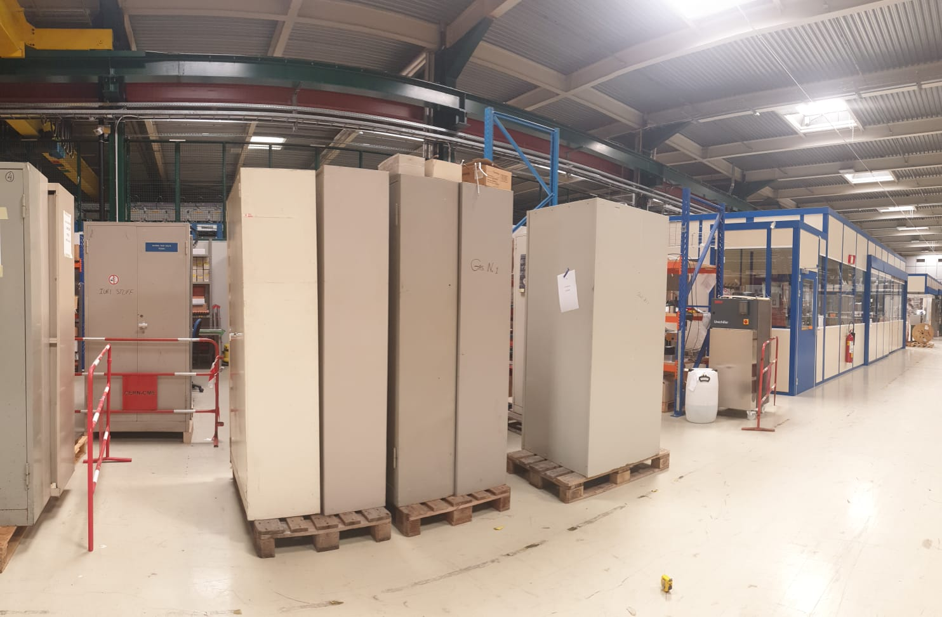
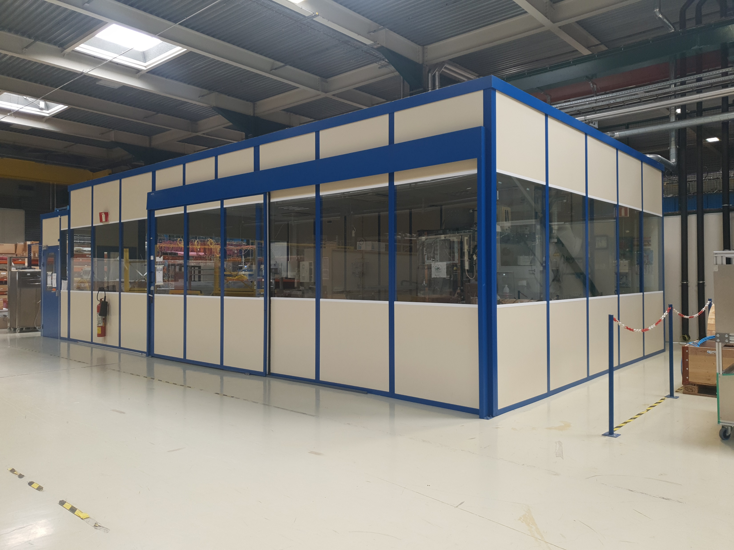
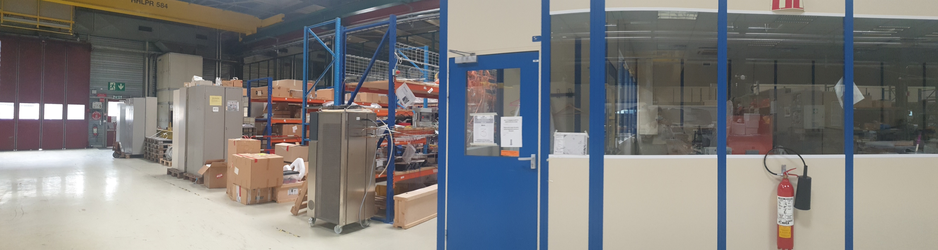
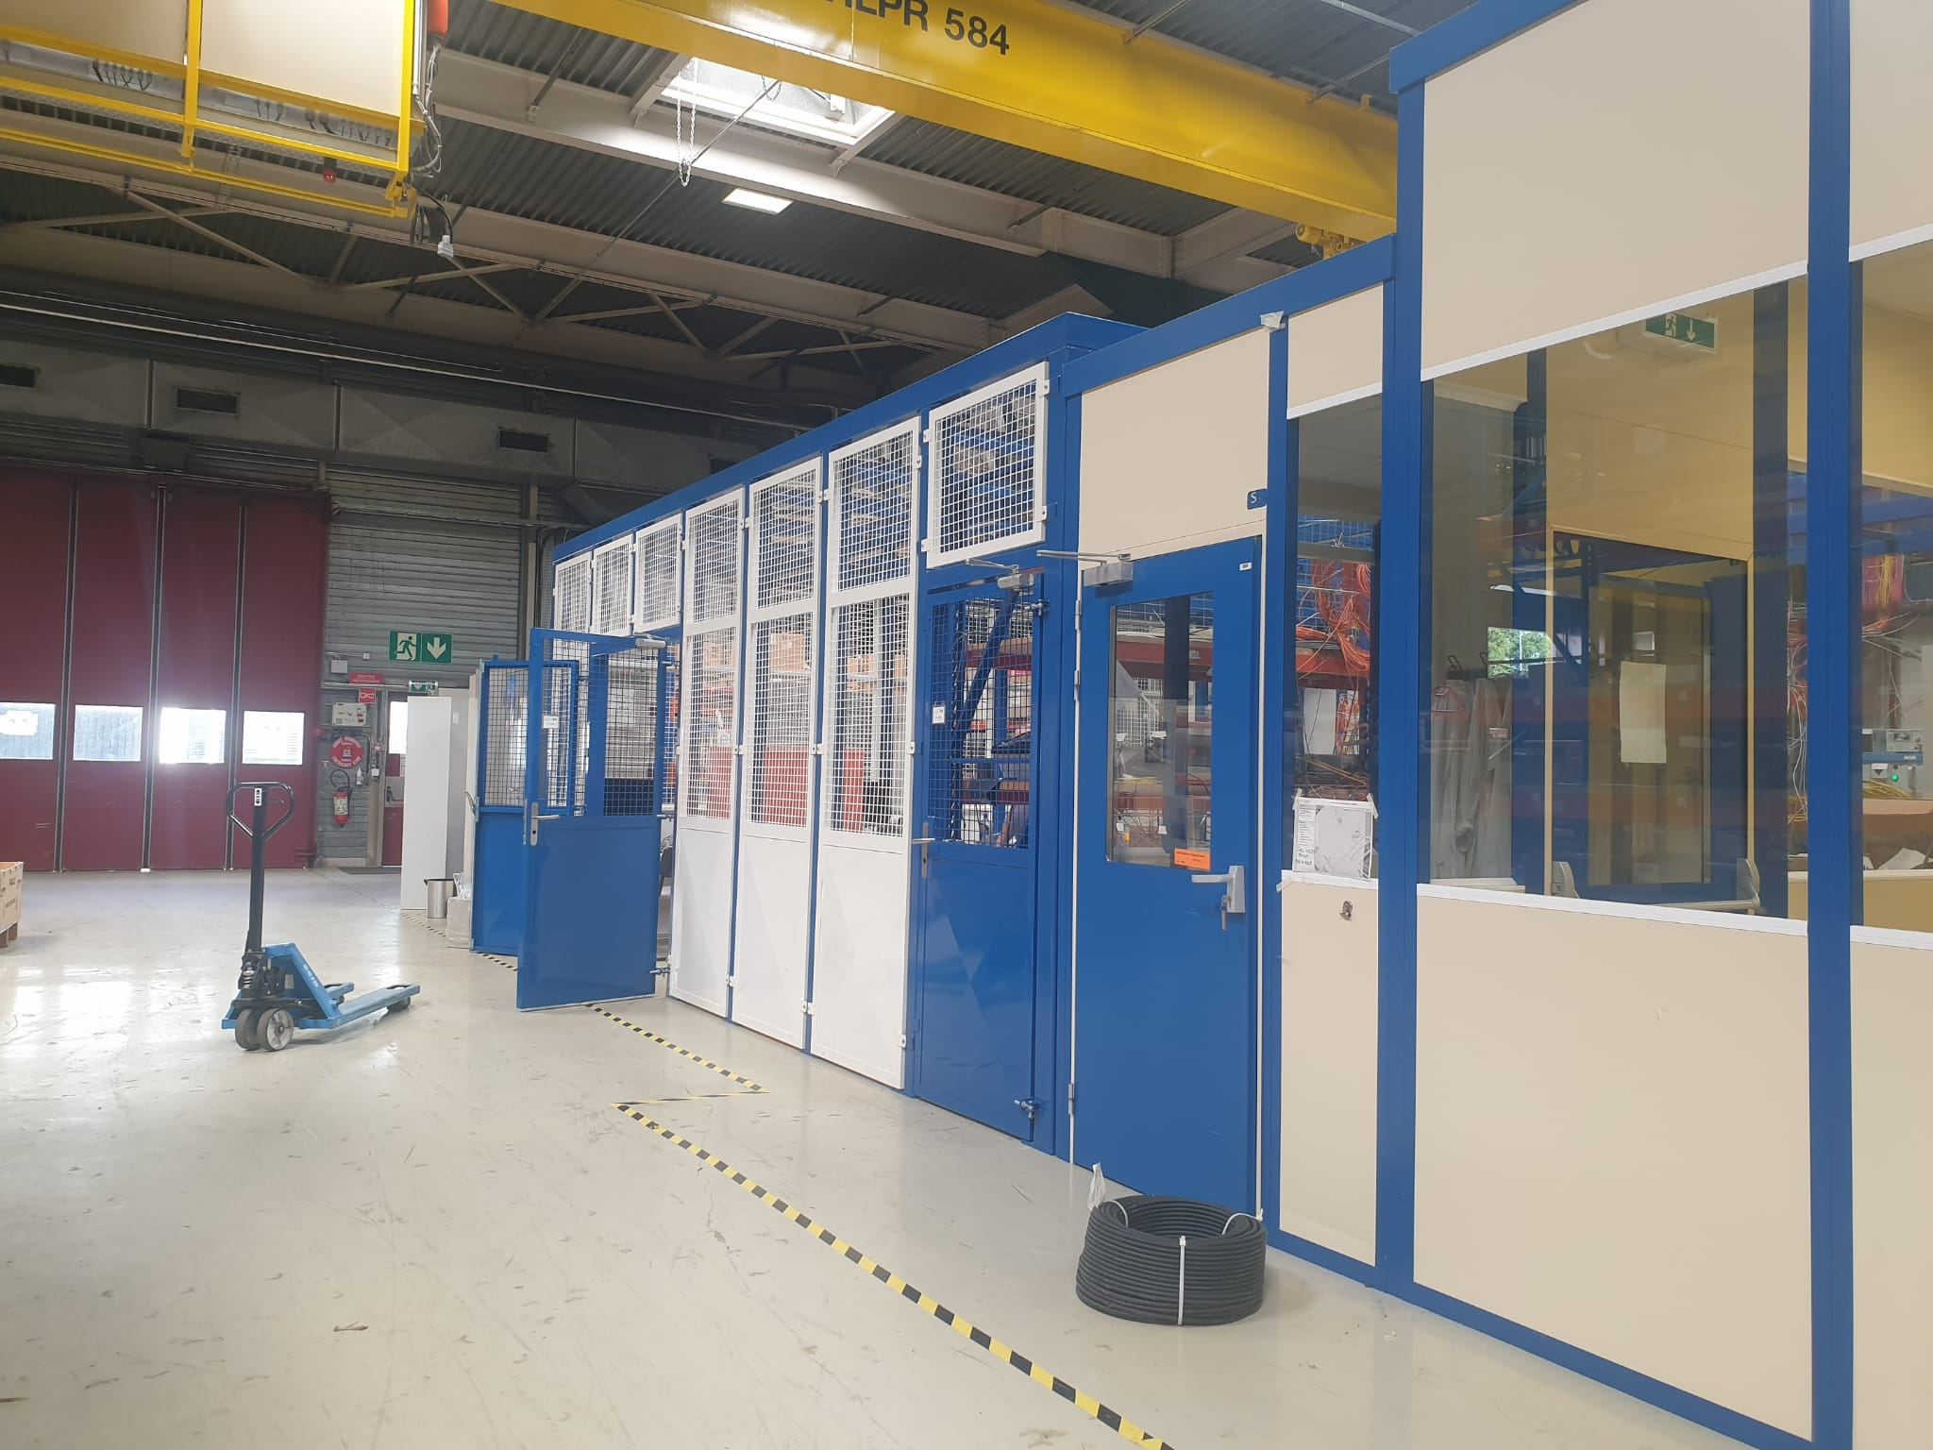
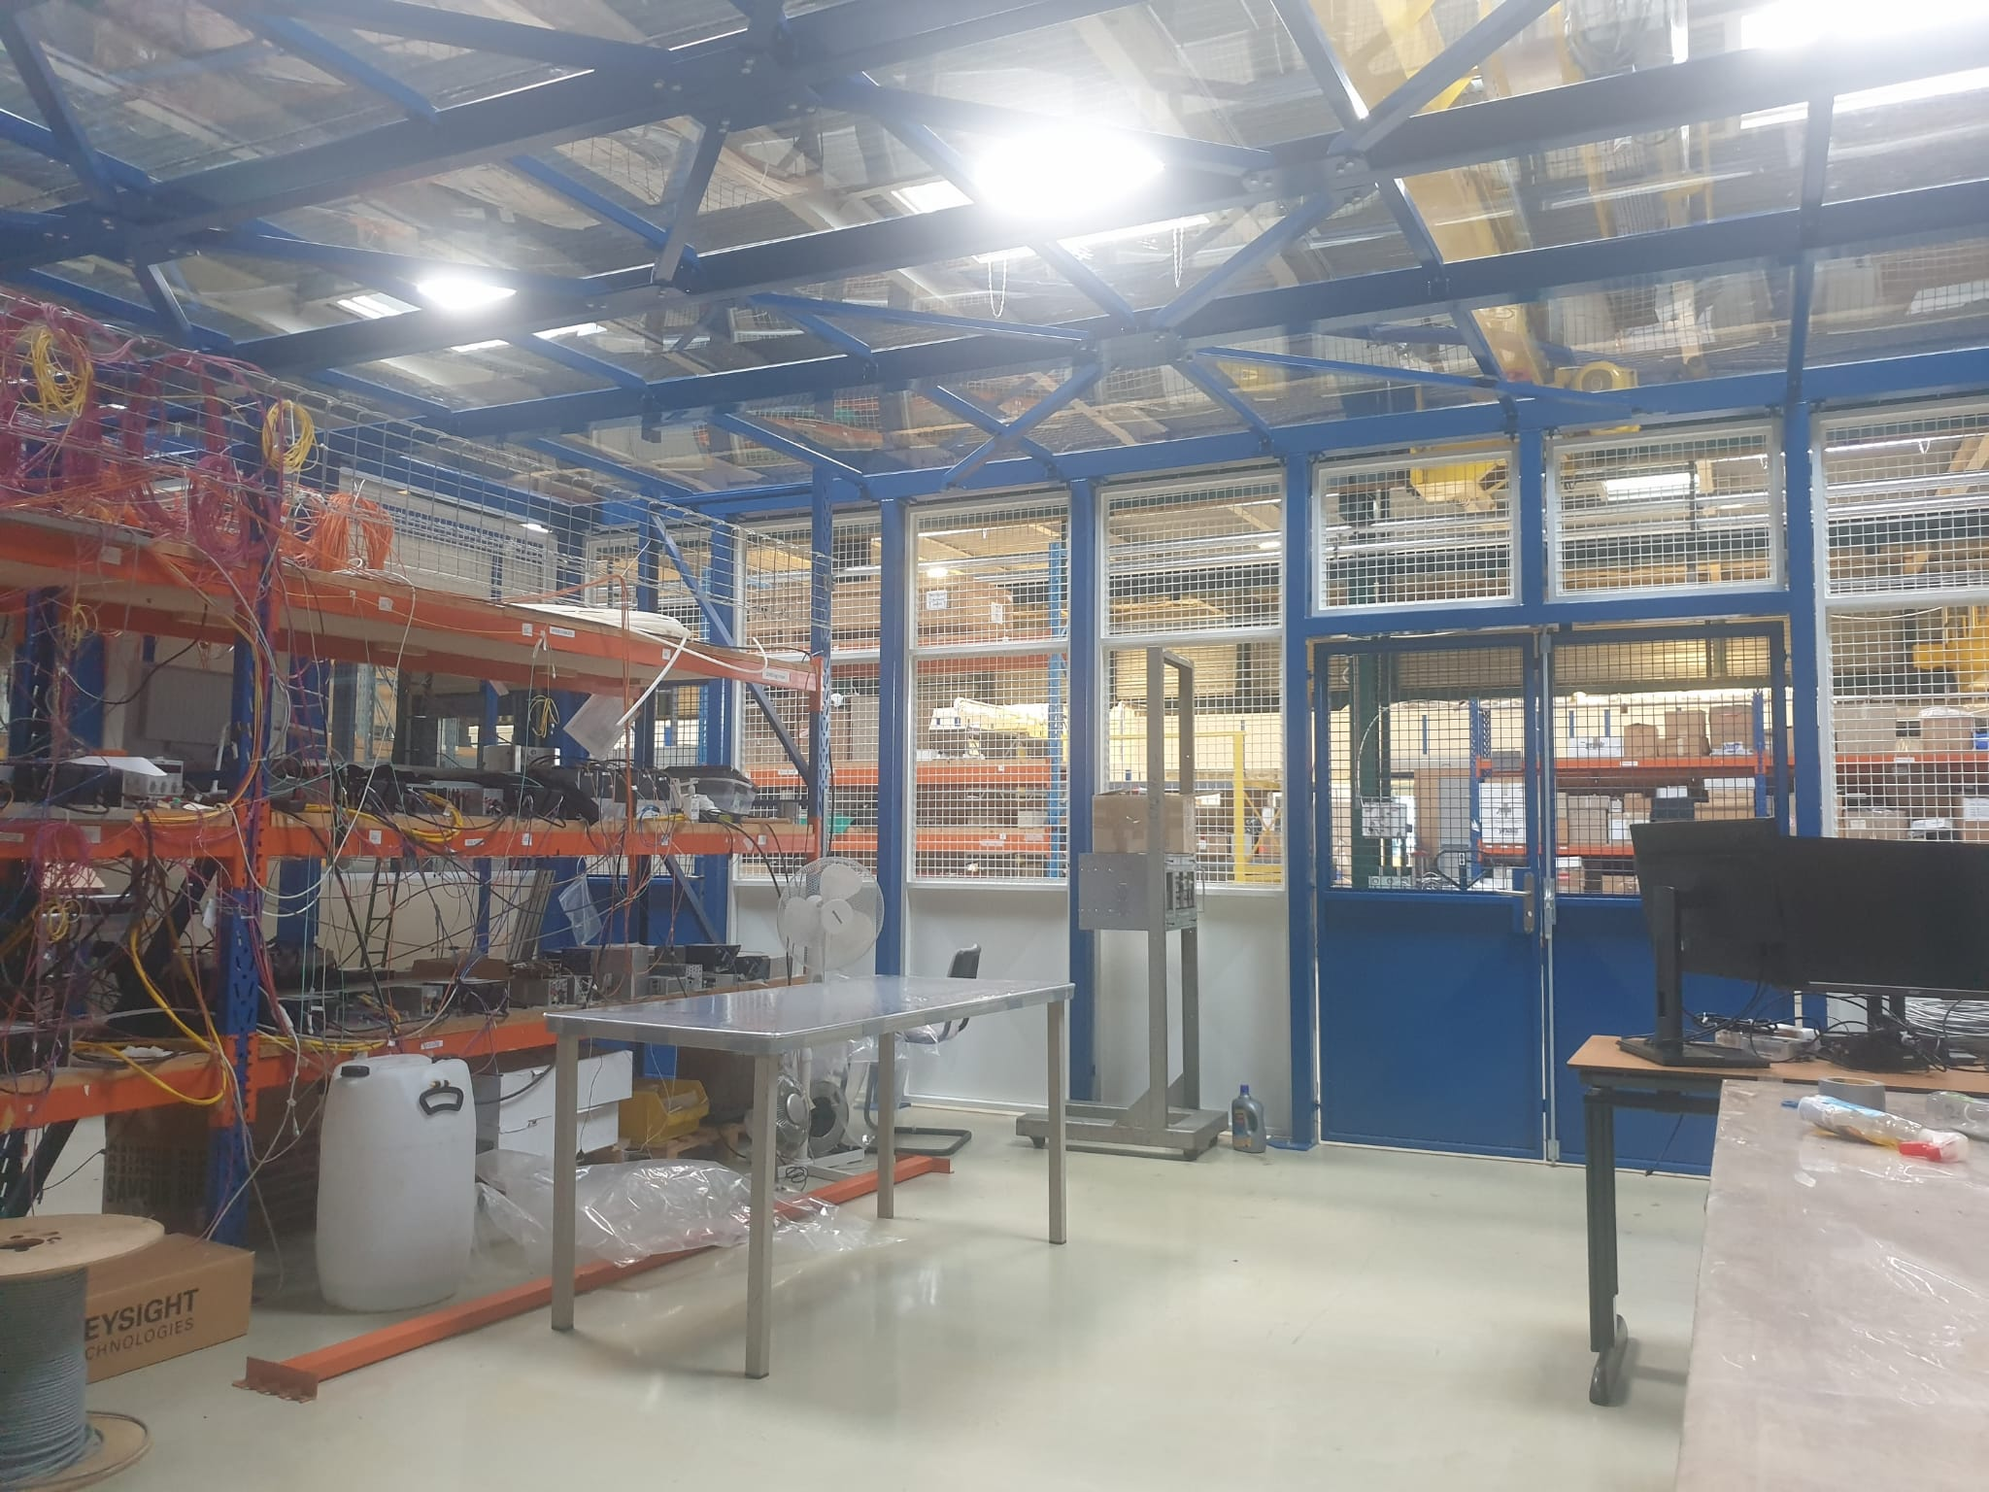
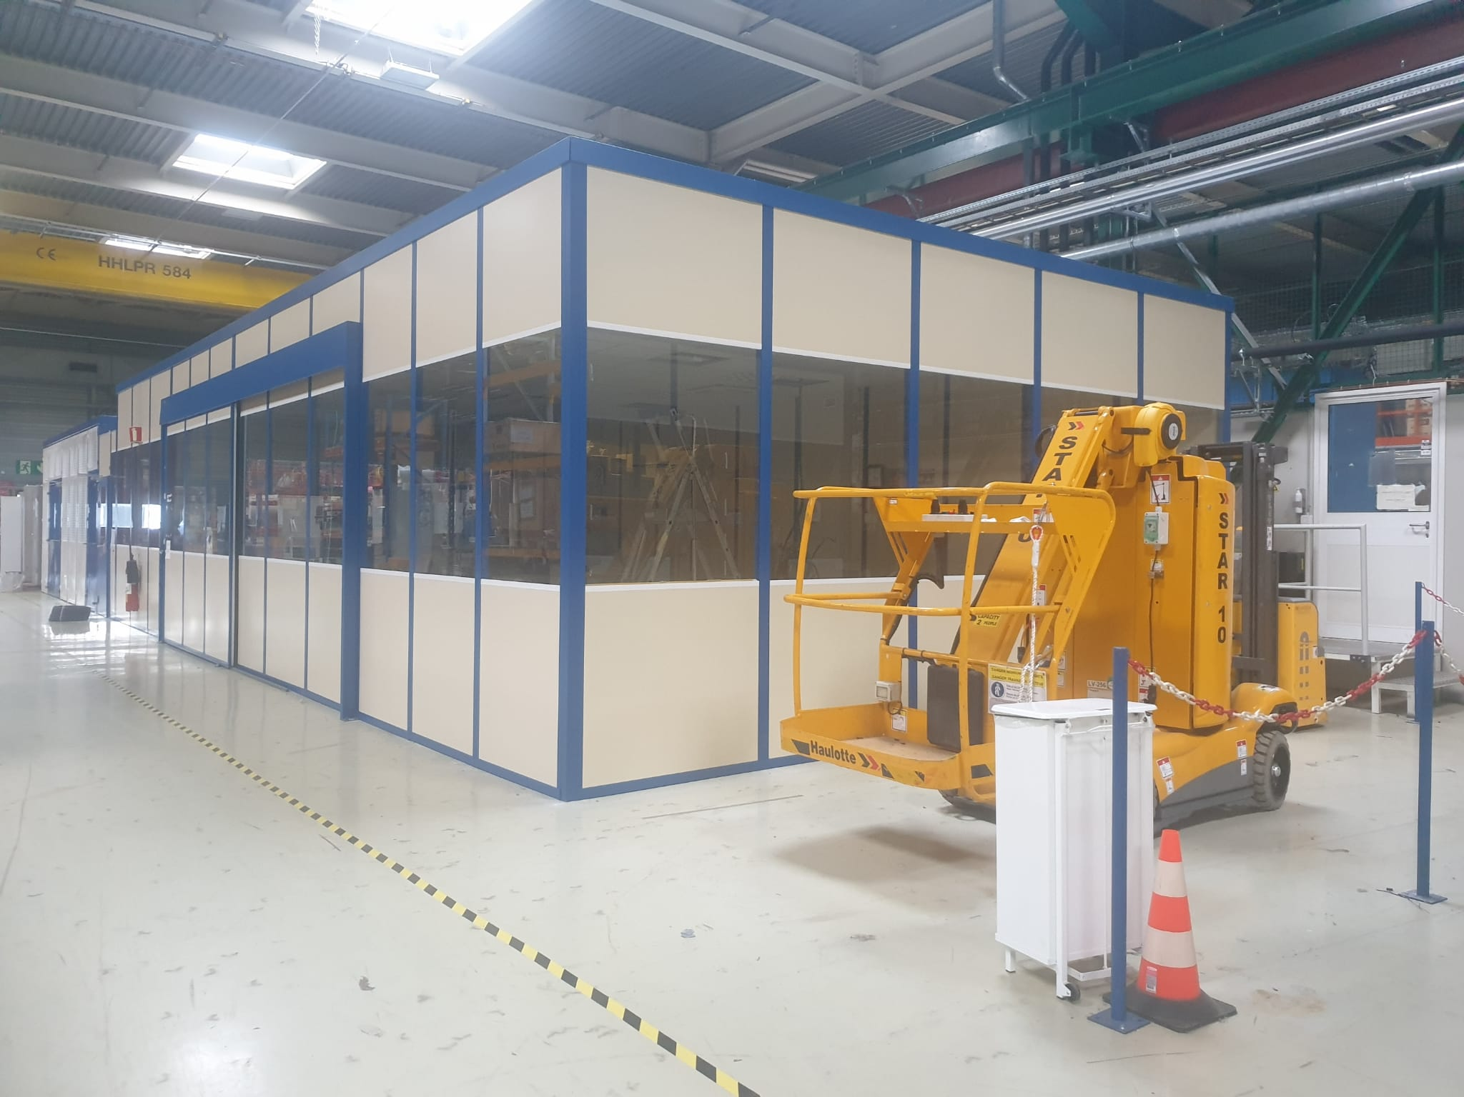
904: HCAL Room & DT Lab Extension
Previously
.
This space was occupied by CSC shelves and cabinets.
This lab was 60 m² and was used by HCAL.
Currently
The HCAL fenced room with polycarbonate transparent ceiling.
The inside of the new HCAL space.
This lab is now 80 m² and will soon be occupied by DT.
9
May M. Alali

Slide 6
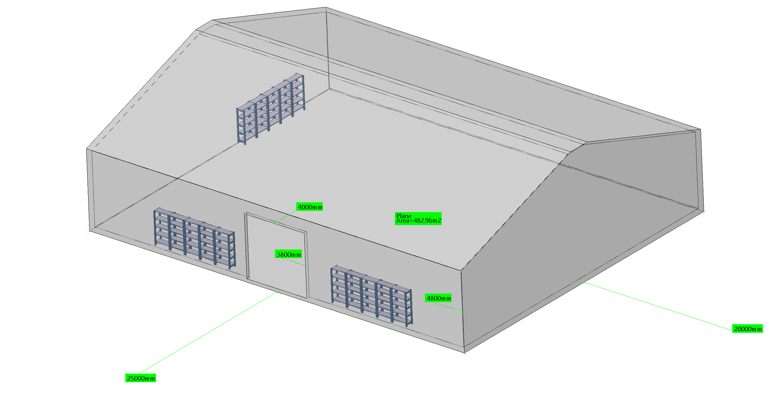
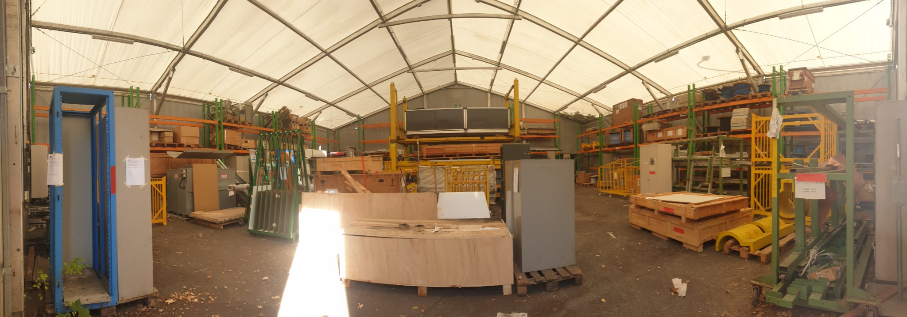
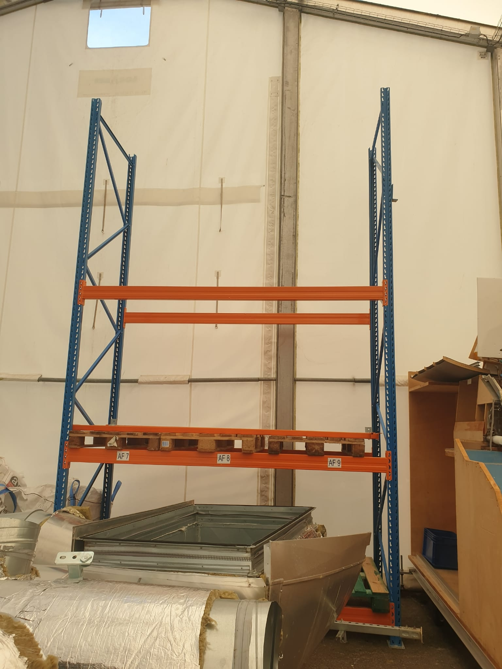
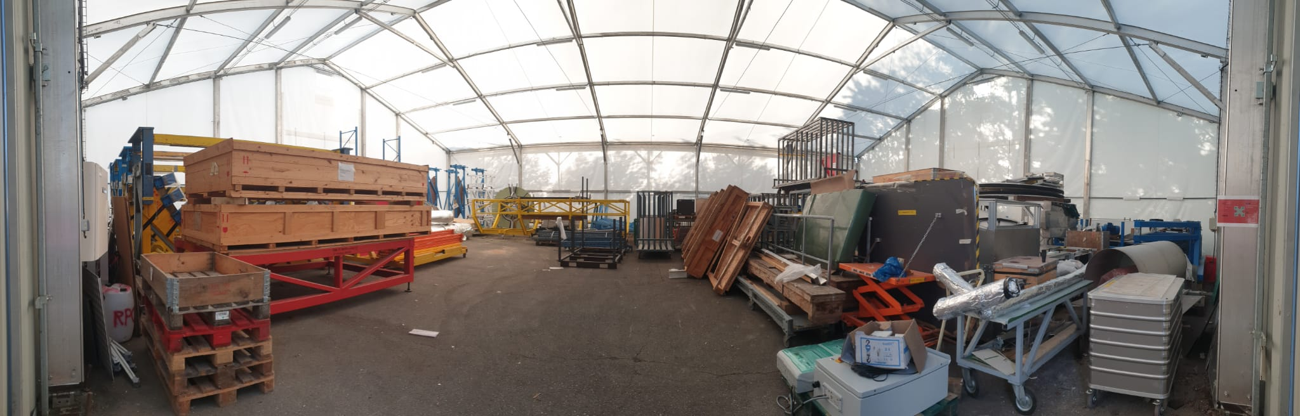
Tent 678
Tent 683
One shelf has been installed here.
More shelves will be installed after the HVAC ducts of the stasis lab are moved to B904, which started today.
Submitted 7 item inquiries. Awaiting response.
Cleared 2 shelves.
Sent away 9 RPC items.
4 wooden boxes will be sent to recycling.
Many RPC items will go back to B904 once the stasis lab is commissioned.
Tent 683 today.
Tent 678 today.

Slide 7
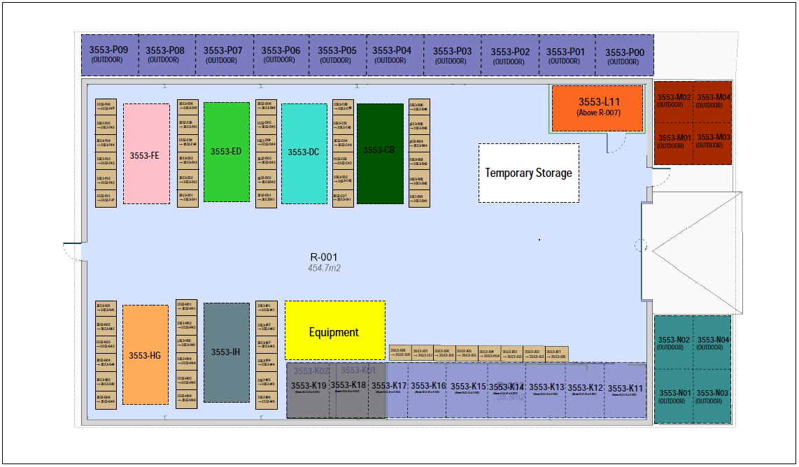
Storage Management at B3553 (P5)
At the stage of contacting subgroups to start labelling the equipment already in B3553
Request for items going IN/OUT of B3553: Storage and/or Internal Transport (cern.ch) (on EDH).
Next Steps: Barcode scanner to be used when you are removing and placing items into B3553.
(Requires current items in B3553 to be labelled)
B3553 Layout - BIN system
EDH request
Approval from Nadya / Lars
If accepted, transport will receive EDH request and will move item.

Slide 8
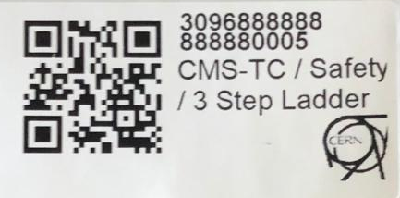
Sample Label
Equipment ID
Equipment Description
Equipment Barcode

Slide 9
Information Needed per Equipment
  Required Information to label equipment
    Description of the item in the following format Subgroup/Title of the Object.
      Example: CMS-TC/Safety/ 3 Step Ladder
      Description must be indicative of the object in order to make it easy to search for the item.
    Responsible Owner (CERN ID or name)
    Length(cm), width(cm), height(cm), and weight(kg) of the equipment
  Optional Information to label equipment
    Pictures of the equipment
    EDMS document if one already exists for the equipment

Slide 10
Sending Items to the Flex Building
The process

Slide 11
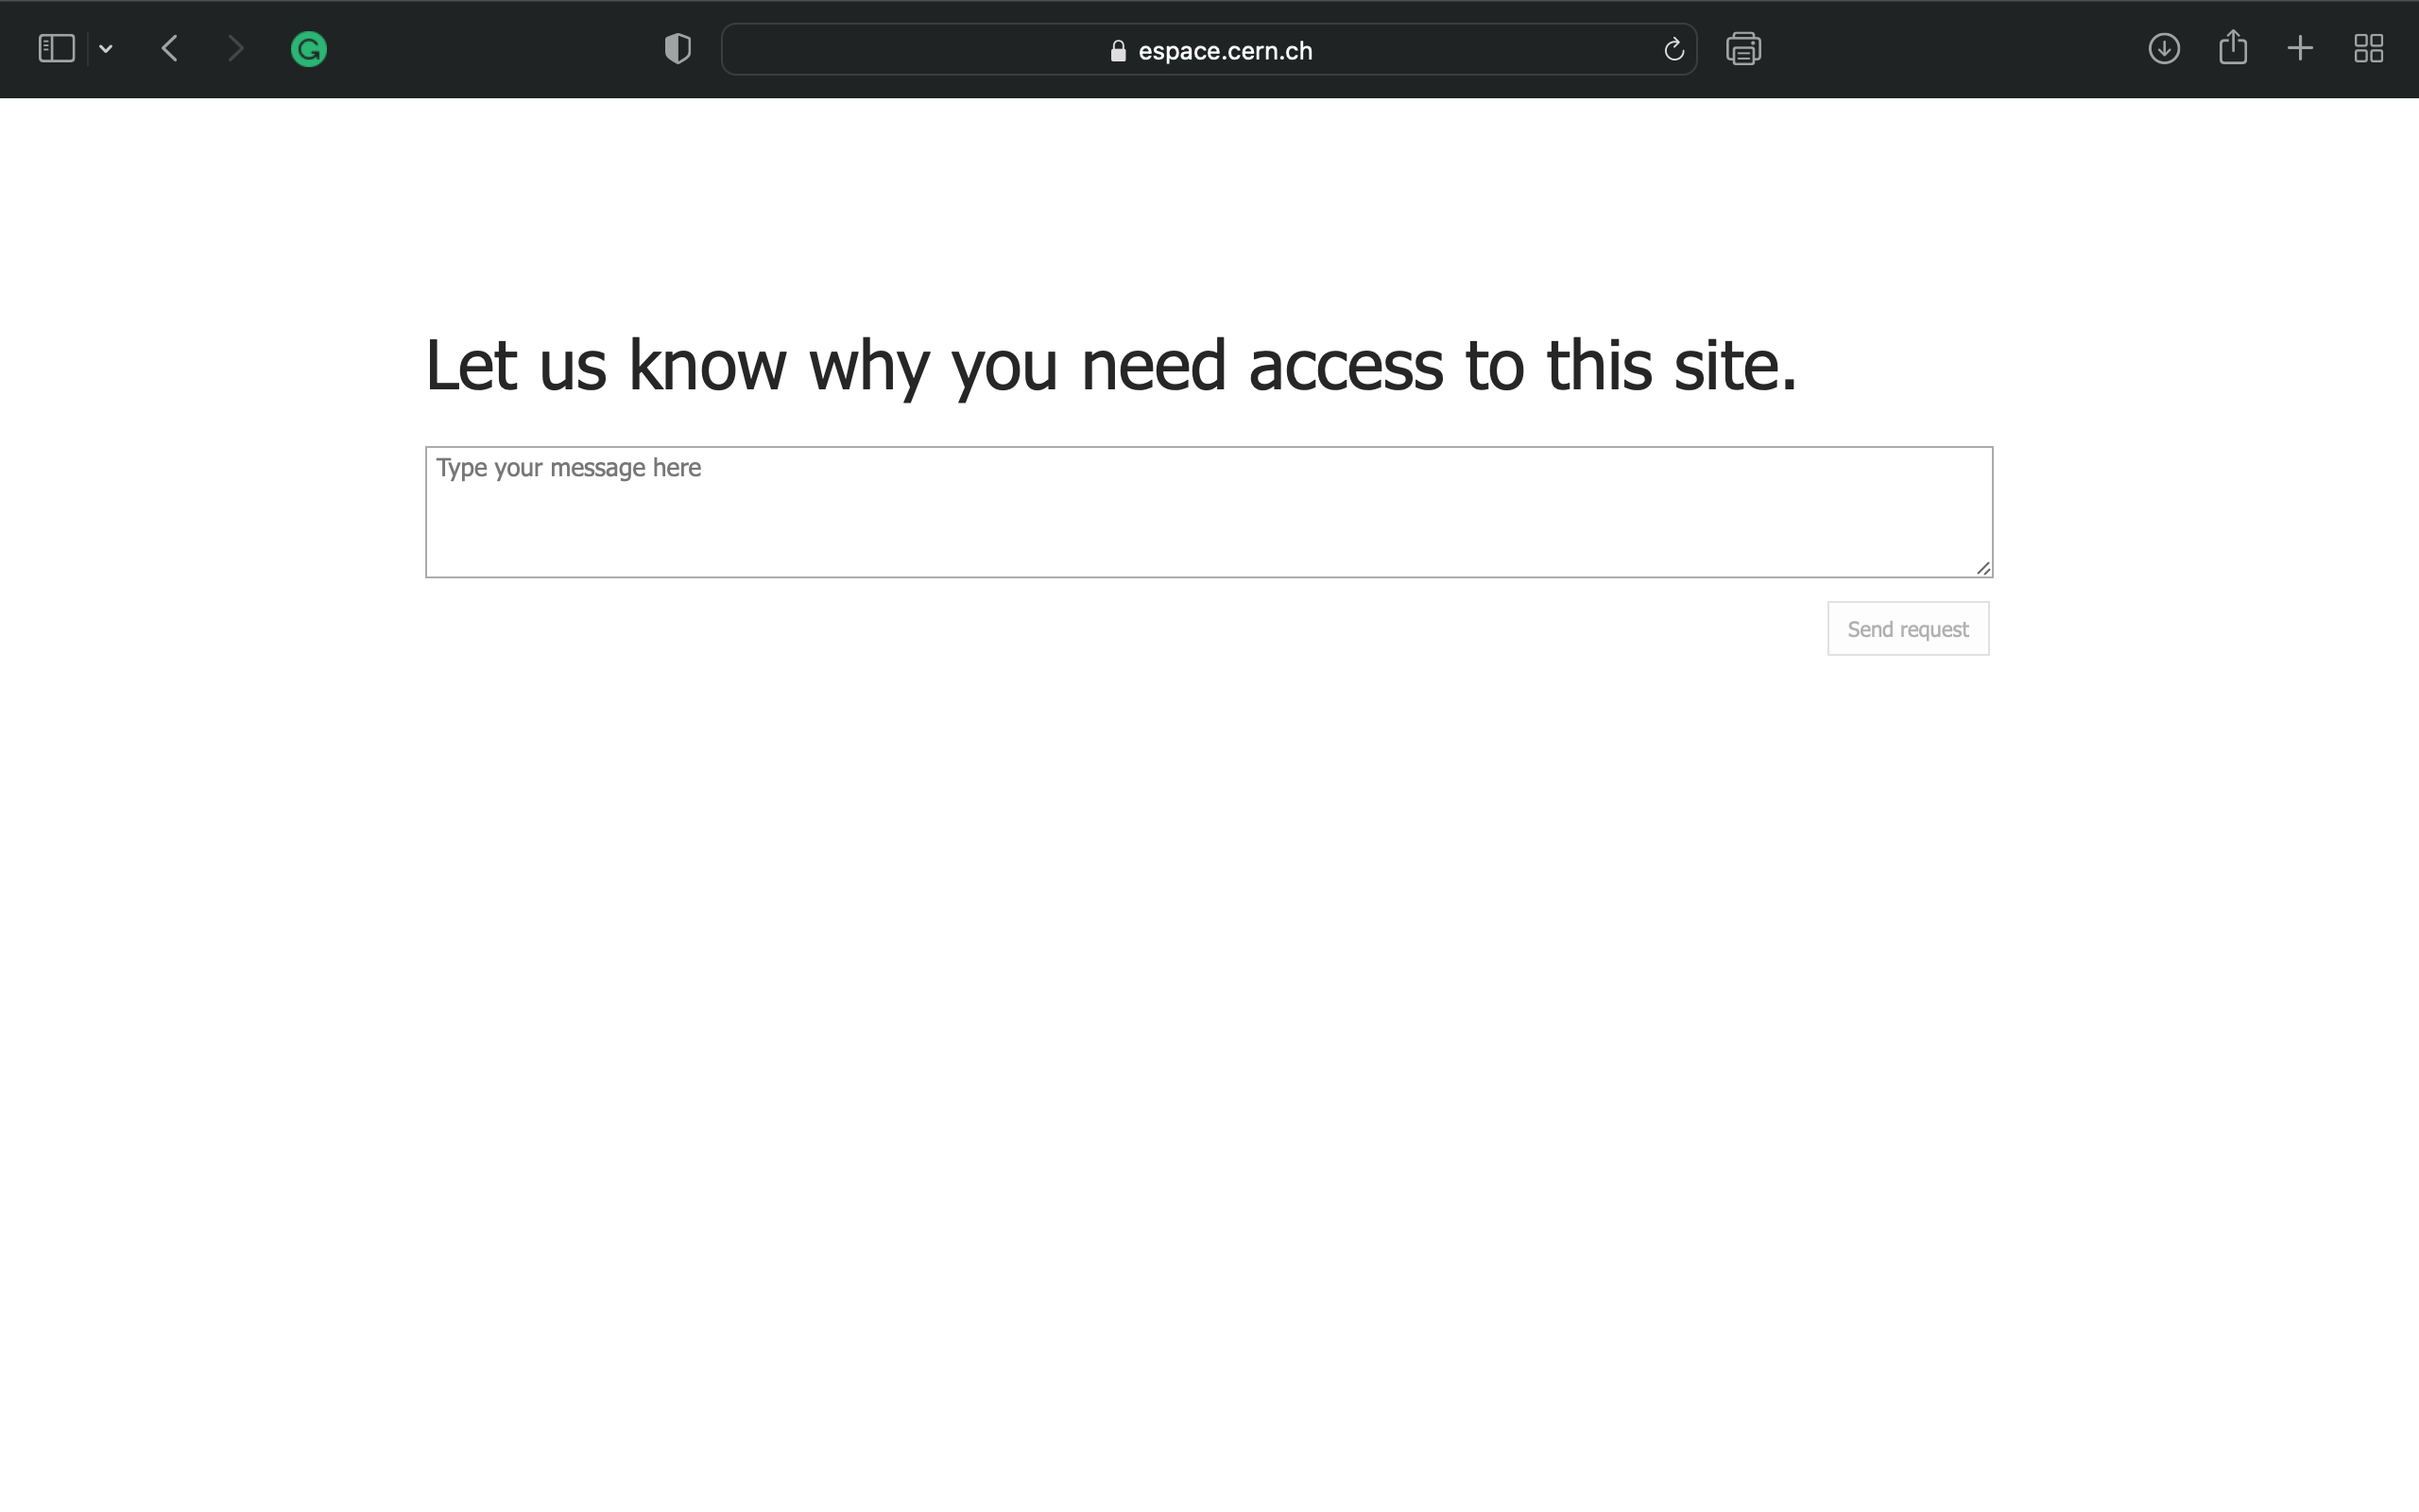
Request Access
When you press on this link for the first time 1b -Storage LS3 - List of equipment - 1-All Items (cern.ch), you will see this:
Type in that you need access to submit requests to store your items in B947, the Flex building.
Access will be granted within 1-3 days.

Slide 12
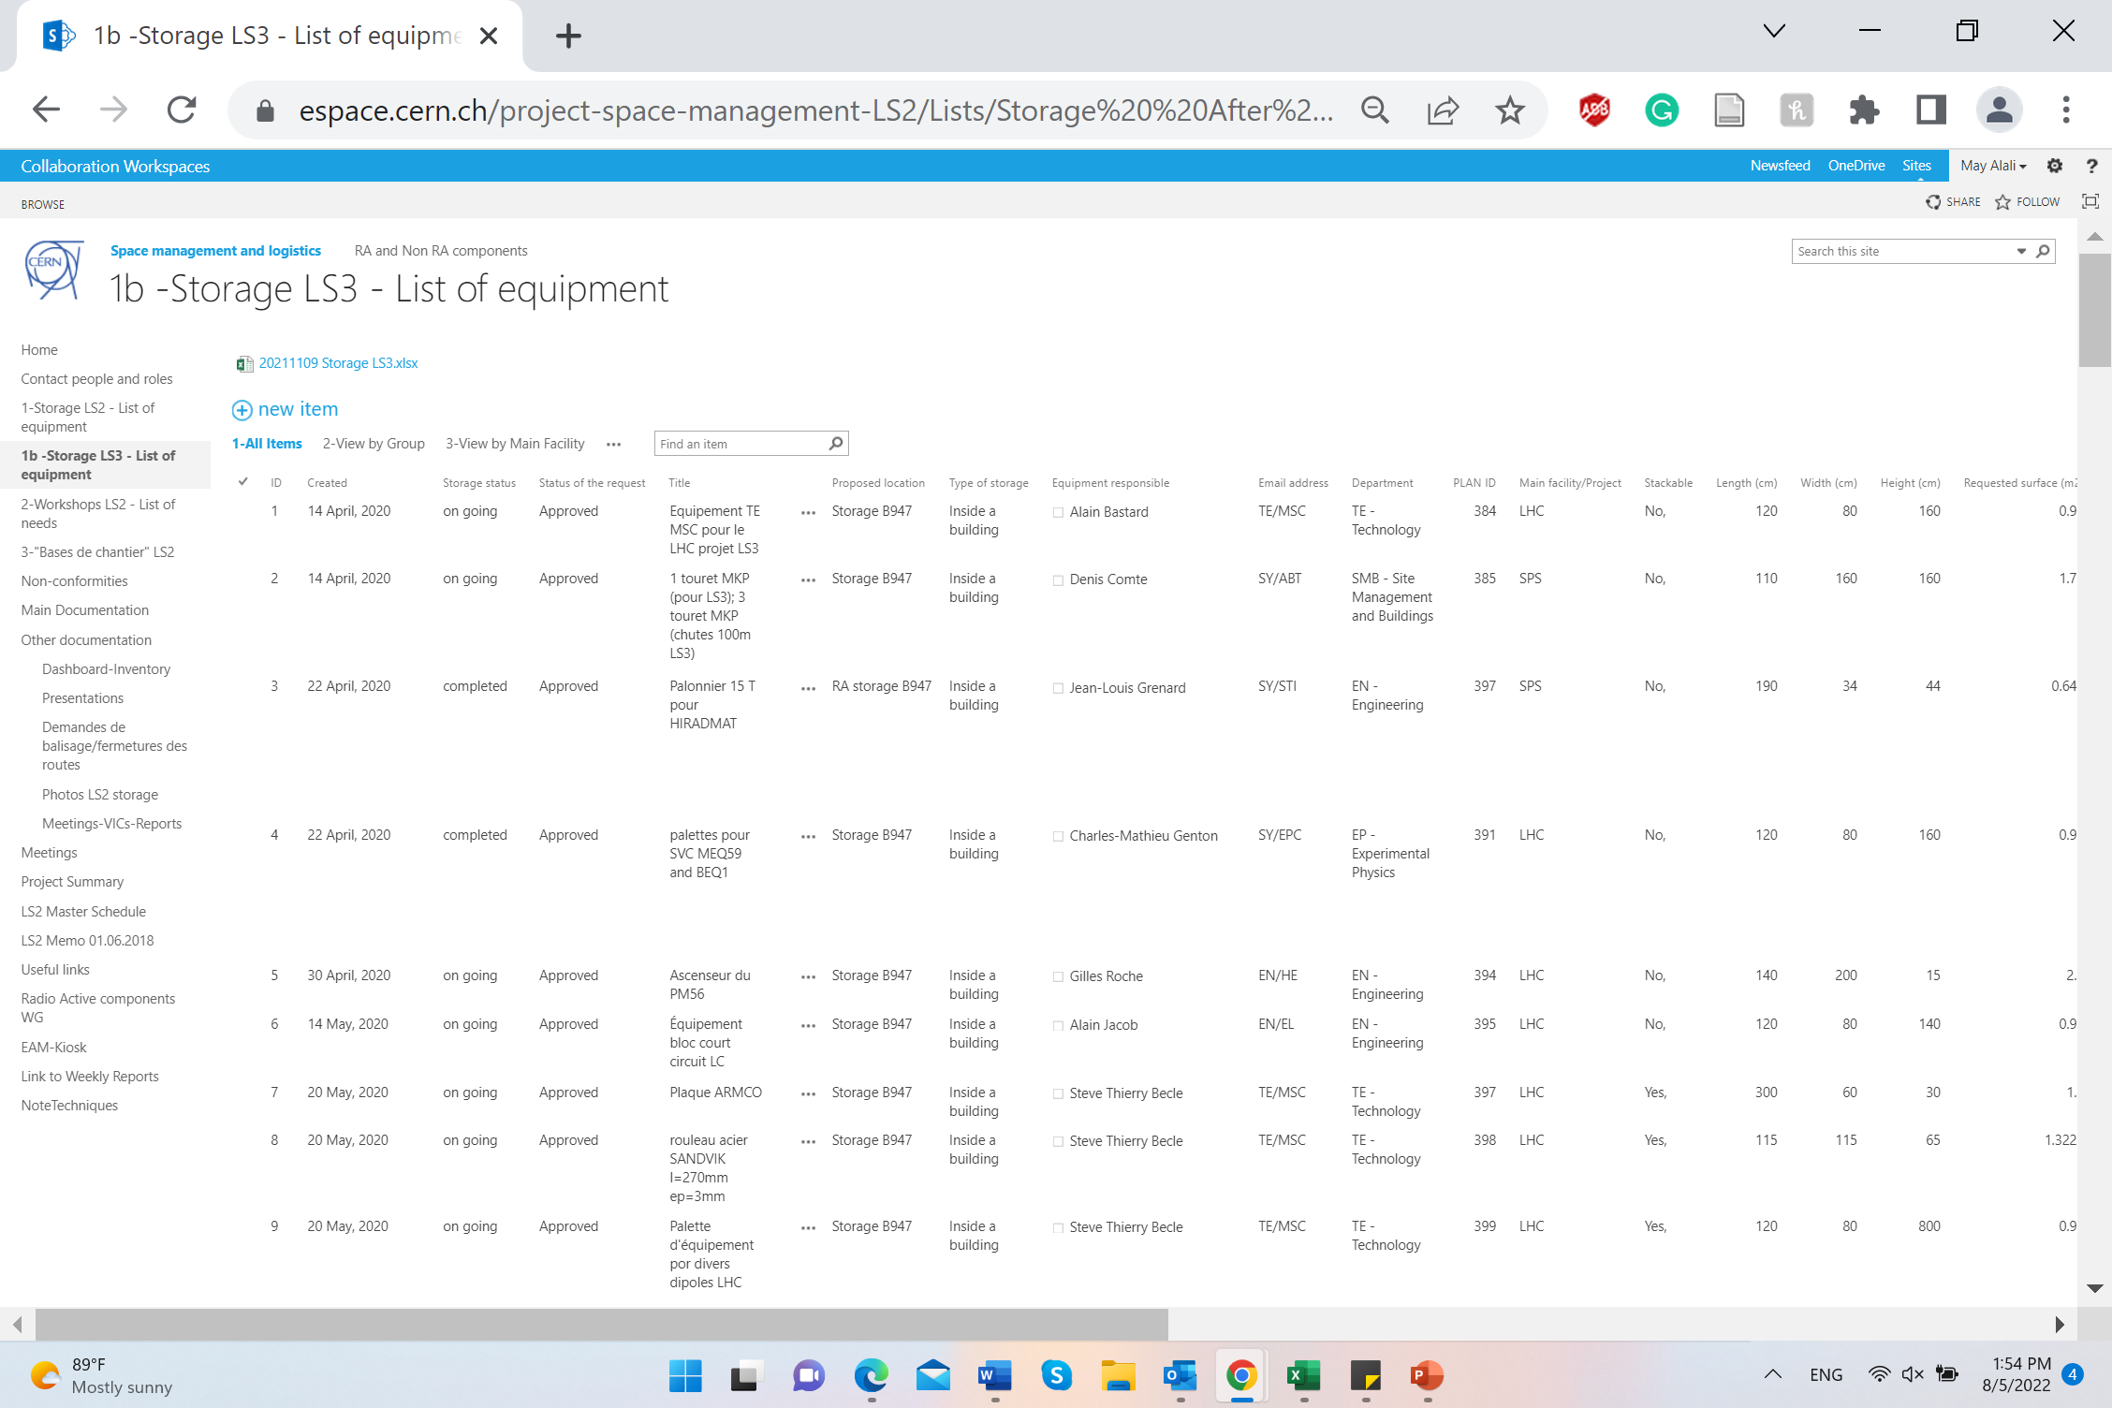
Access Granted
Now that you have access, when you press on this link 1b -Storage LS3 - List of equipment - 1-All Items (cern.ch), you will see this:
Make sure you are on the 1b -Storage LS3 - List of equipment.

Slide 13
Submit a Storage Request
BEFORE you submit a Transport Request of your item to the Flex, you MUST first submit a storage request.
Click on + new item.

Slide 14
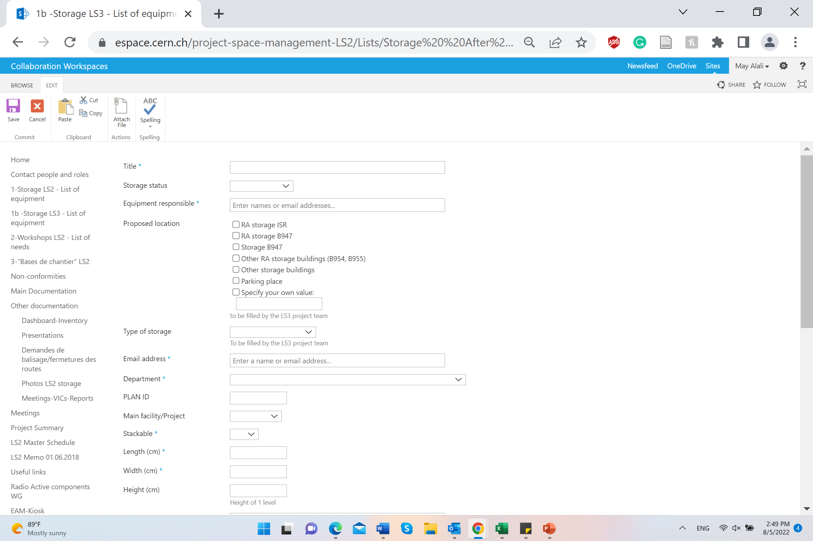
Submit a Storage Request
Title: CMS [Subdetector’s Name] [Item’s Name]
Storage Status: Put “To start” ALWAYS
Equipment Responsible: You can add MULTIPLE people (preferably)
Proposed Location: Storage B947
Type of Storage: Inside a building
Email Address: Of the person submitting the request
Department: EP - Experimental Physics
Main Facility/Project: LHC CMS
Fill in the dimensions
Attach Pictures of your item(s) ALWAYS

Slide 15
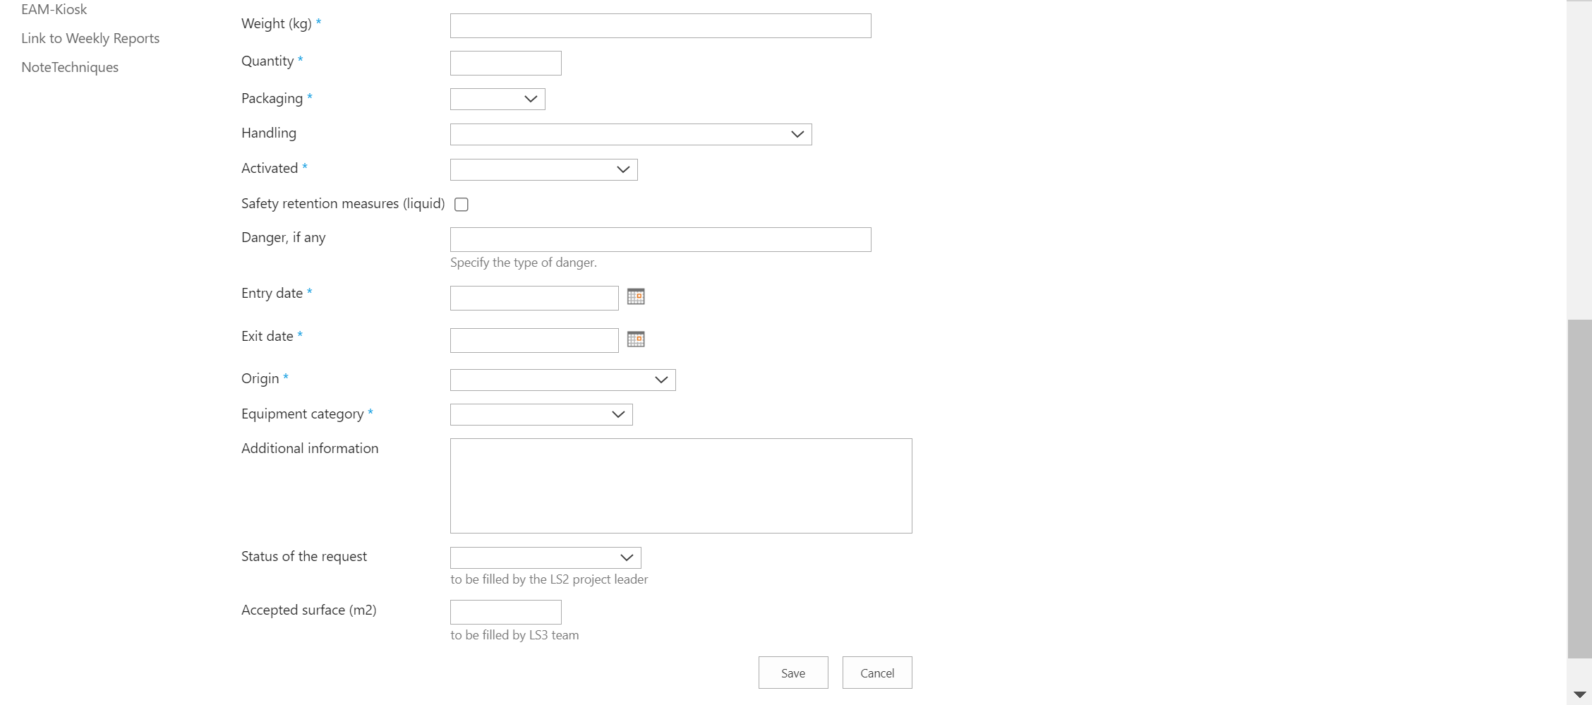
Submit a Storage Request
Exit Date: the Flex is meant to store items till LS3. Your exit date can be till then. Whatever your exit date is, whenever it approaches, you will be contacted to decide what to do with the item.
Additional Information: Add as many details as possible.
Status of the Request and Accepted Surface: Leave EMPTY

Slide 16
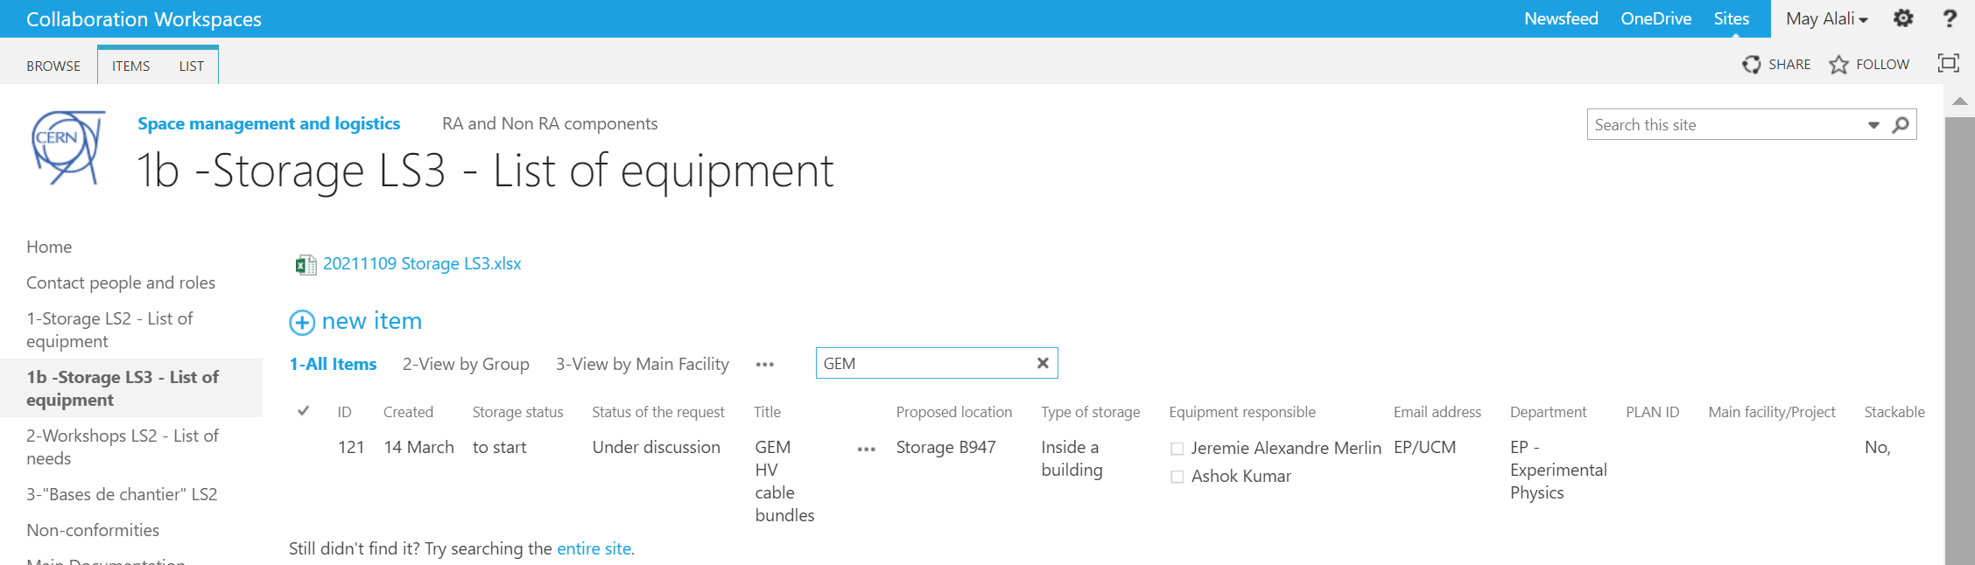
Submit a Storage Request
Find an Item: You can find any item in the Flex database by writing any key word here (e.g., CMS, responsible name, your name, subgroup’s name, etc.)
In my example, I looked for “GEM” items.

Slide 17
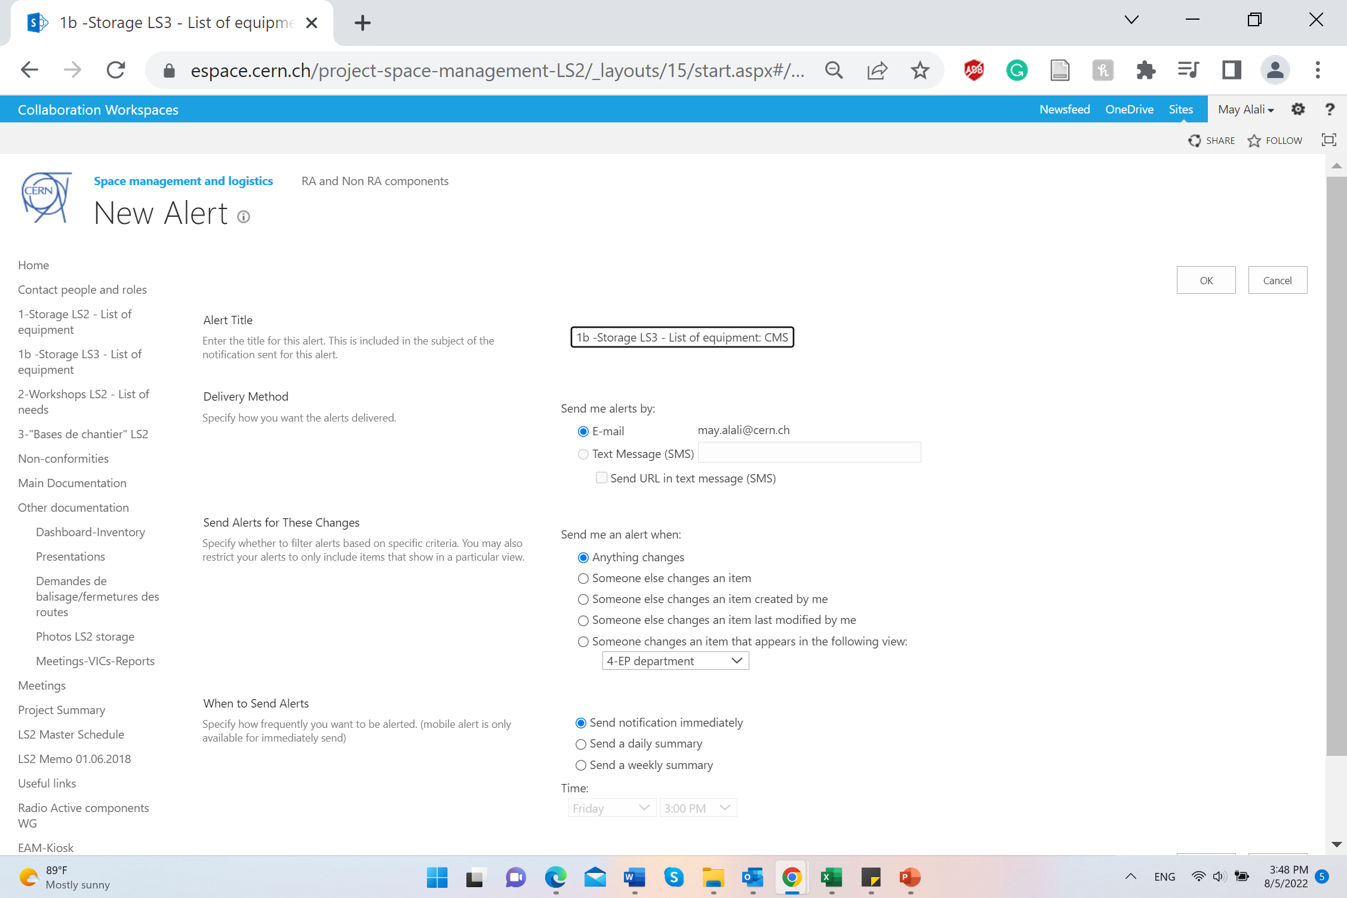
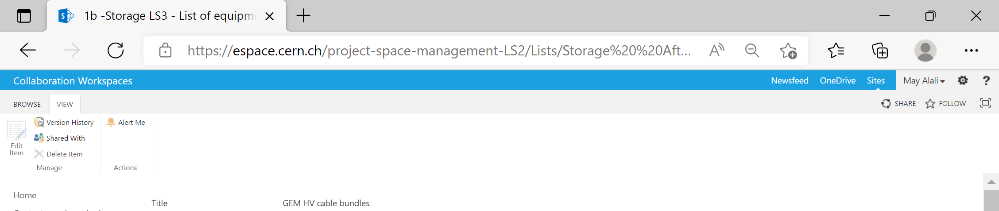
Submit a Storage Request
Alert Me: Receive an email or mobile notifications when something changes.

Slide 18
Request Approval
Cedric Halbert, the person in charge of granting and organizing storage space in the Flex,
will either approve or reject your request.
Floor storage is full (for bulky items); shelf space is available for items on euro-pallets.
There are no quotas per experiment/department/subgroup/. First requester, first storage granted.

Slide 19
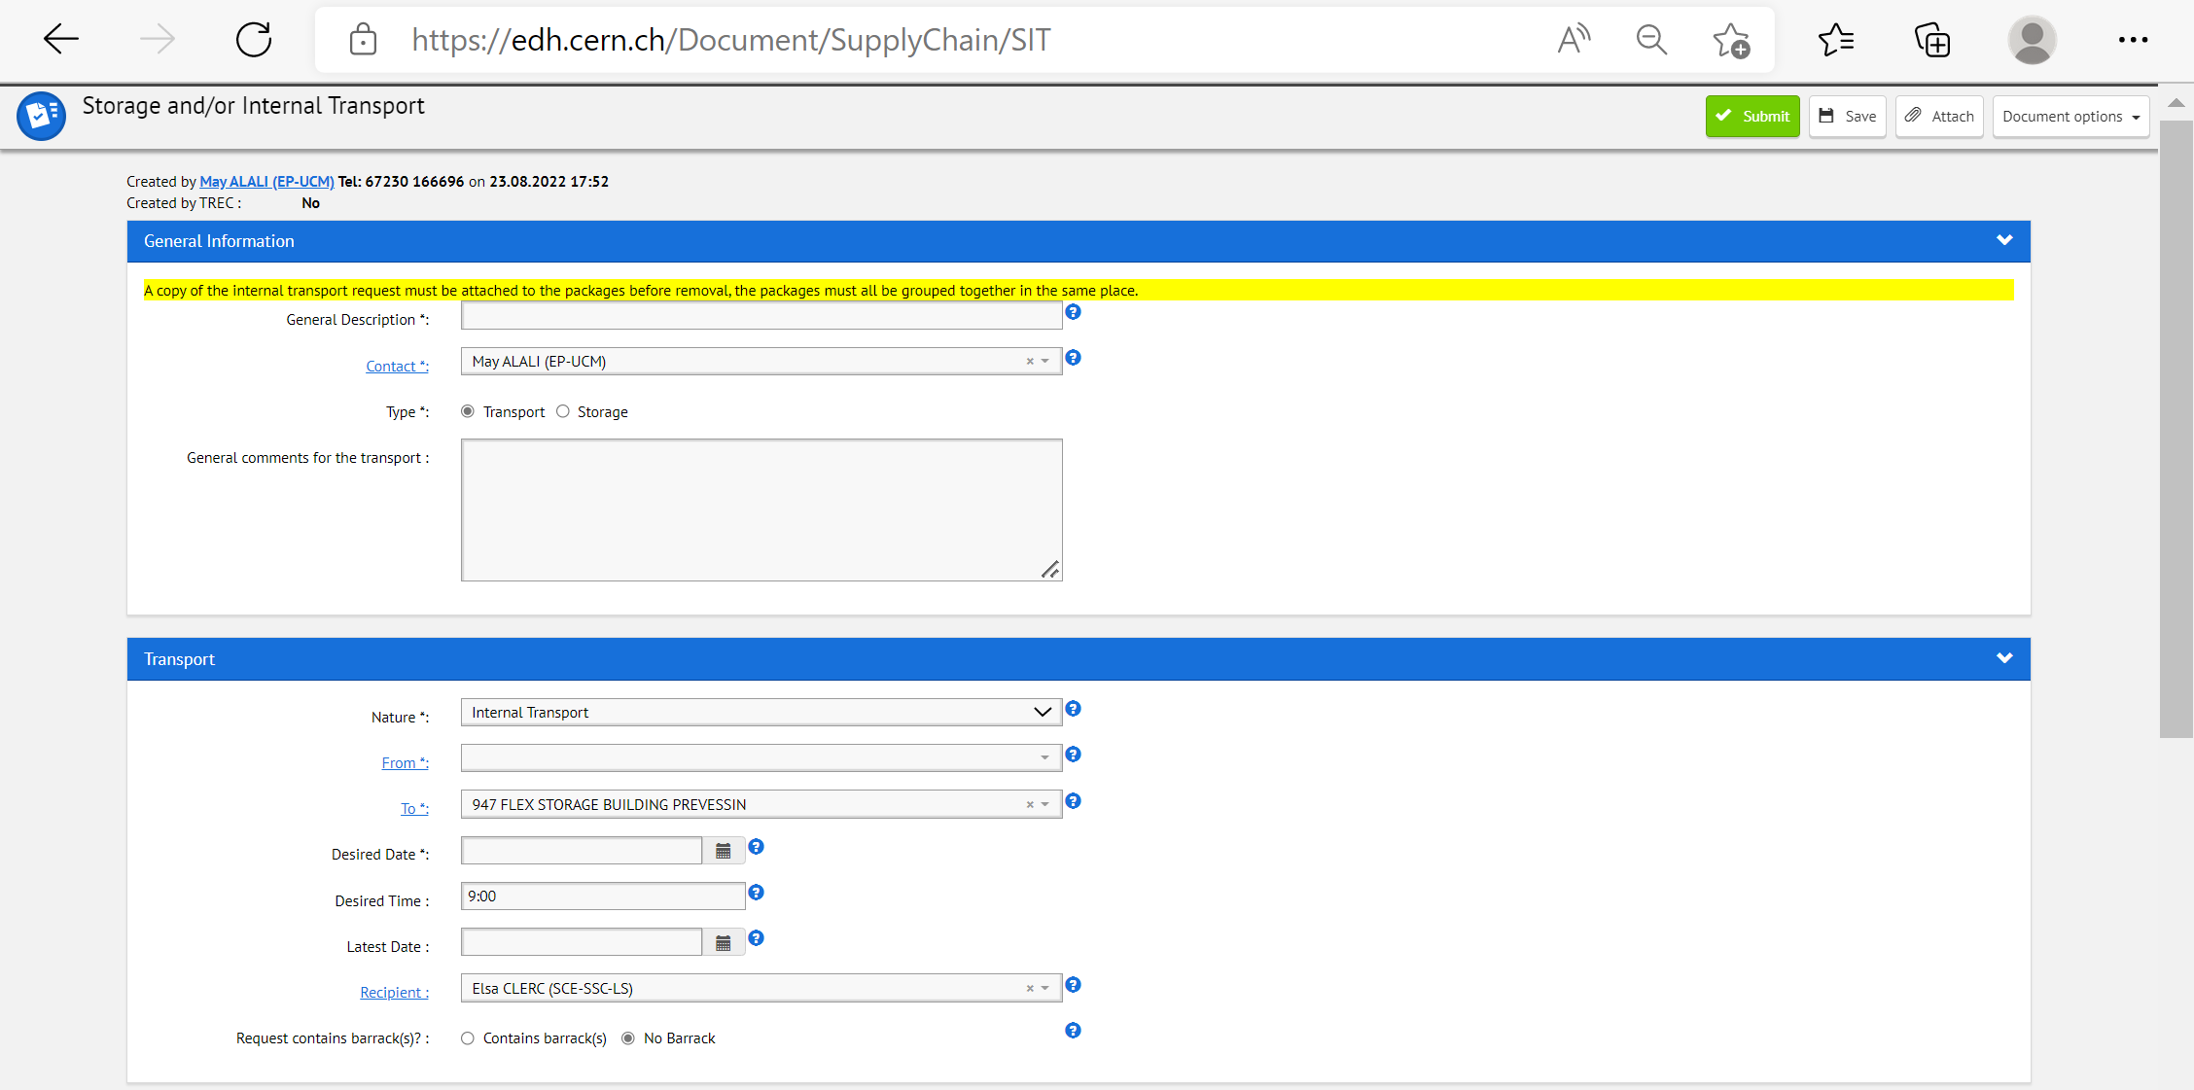
Request Approved → Time to Ship
Submit your Storage and/or Internal Transport request: https://edh.cern.ch/Document/SupplyChain/SIT.

Slide 20
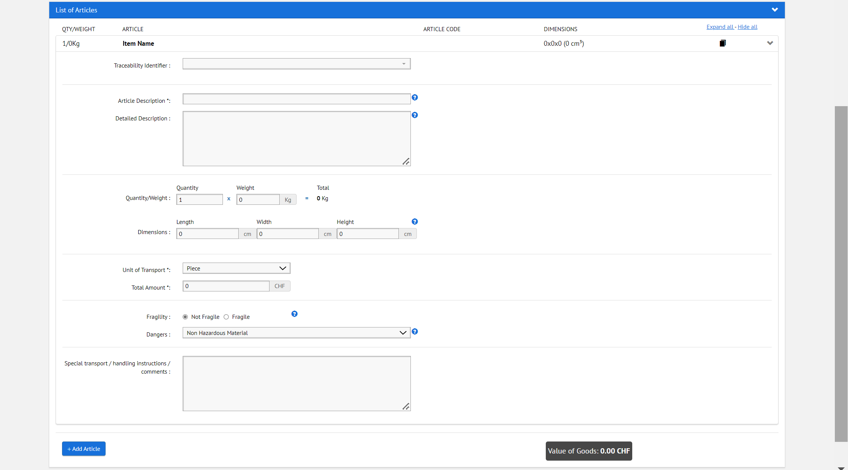
Request Approved → Time to Ship
Add in the traceability identifier field the infor code if it already exists.
If no code exists, a common CR code will be created by the Flex people.

Slide 21
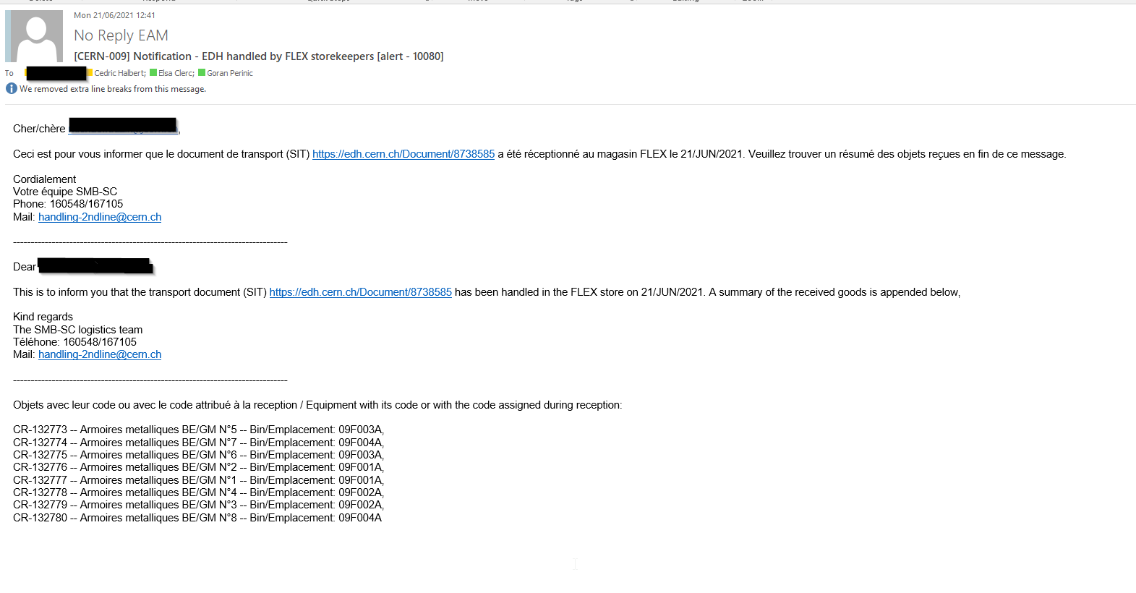
Items Received in the Flex
Once items are received, you will be informed by email.

Slide 22
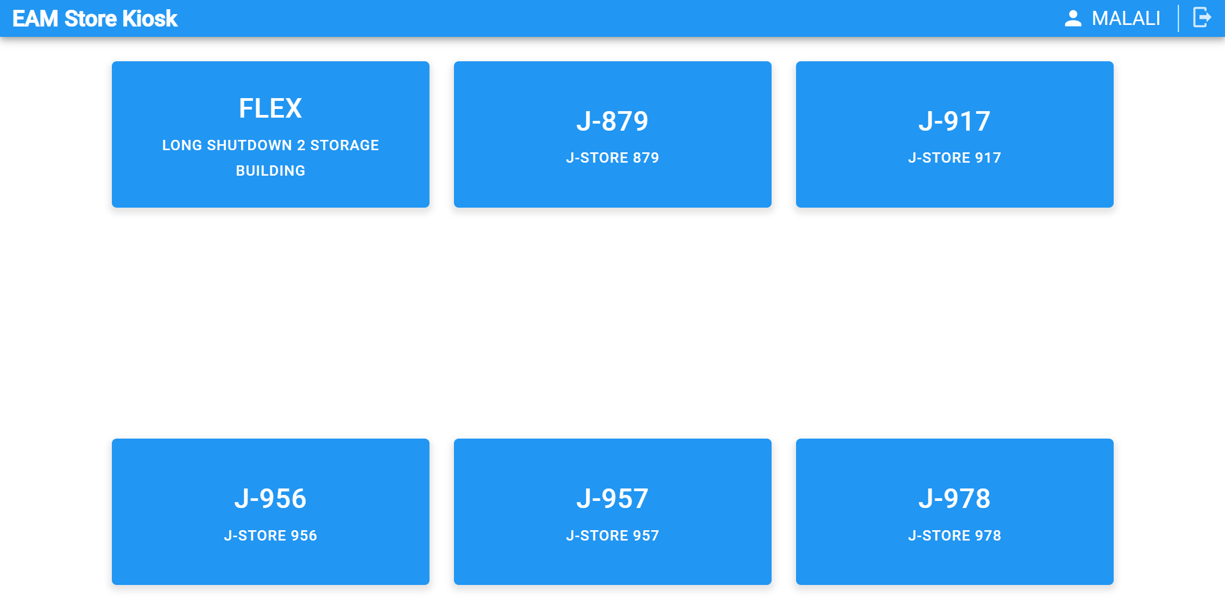
Retrieve an Item
To retrieve an item/items, press on this link: https://cmmsx.cern.ch/SSO/kiosk/, and you will see this:
Click on “FLEX”.

Slide 23
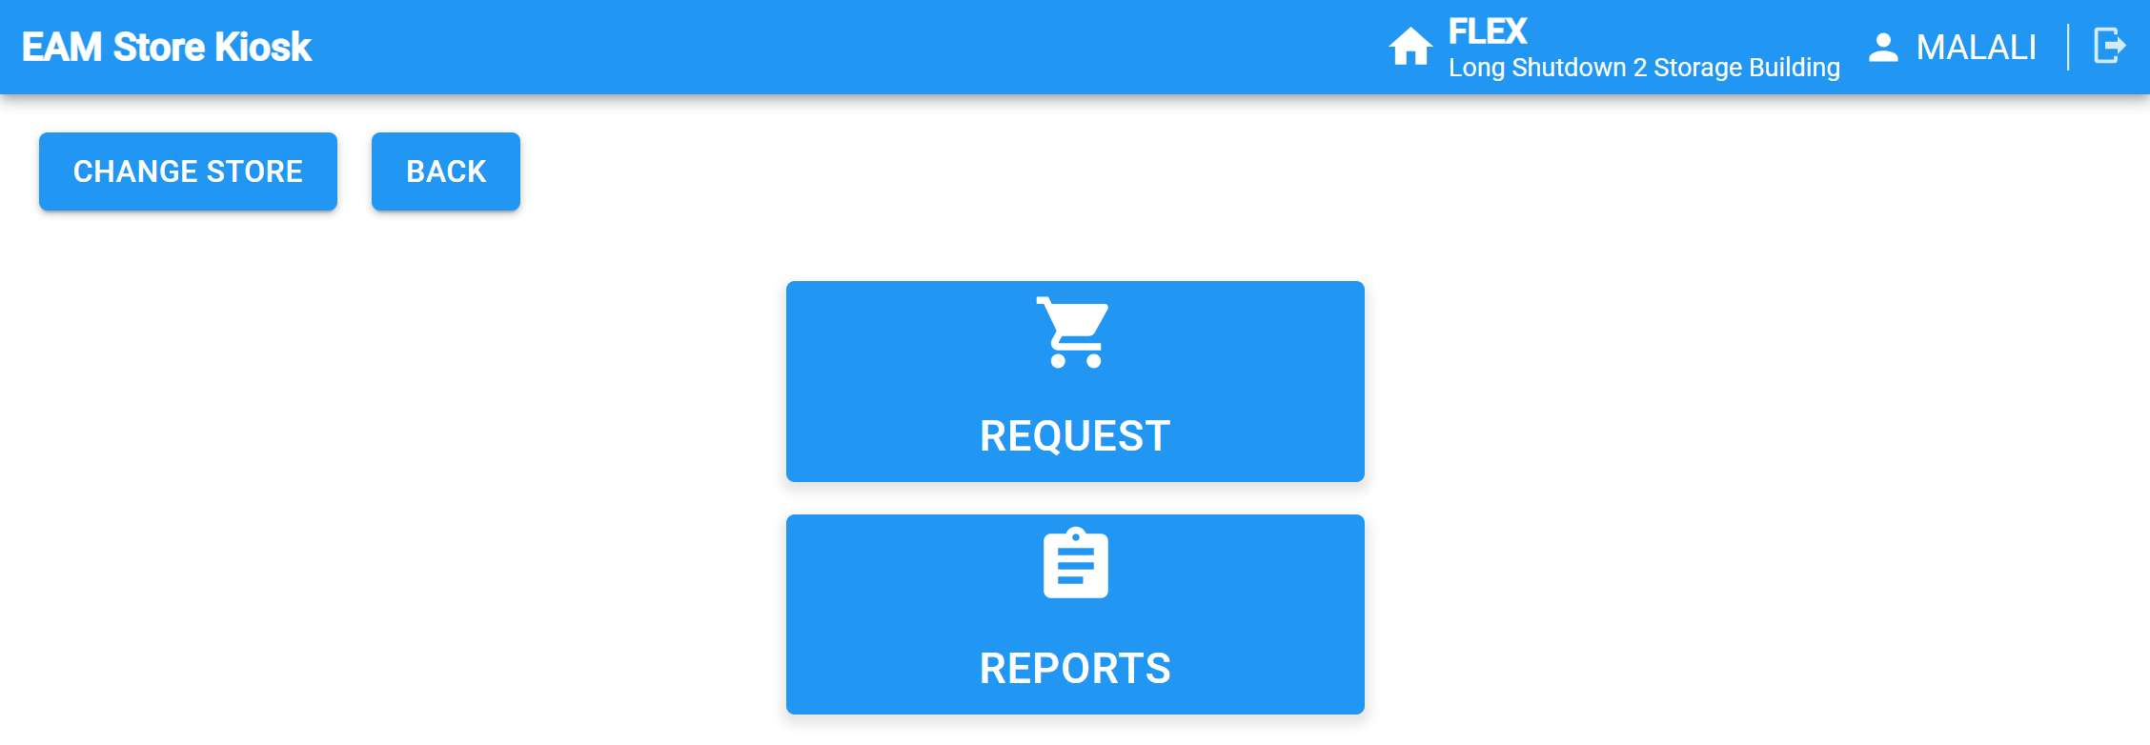
Retrieve an Item
To retrieve an item/items, click on REQUEST.

Slide 24
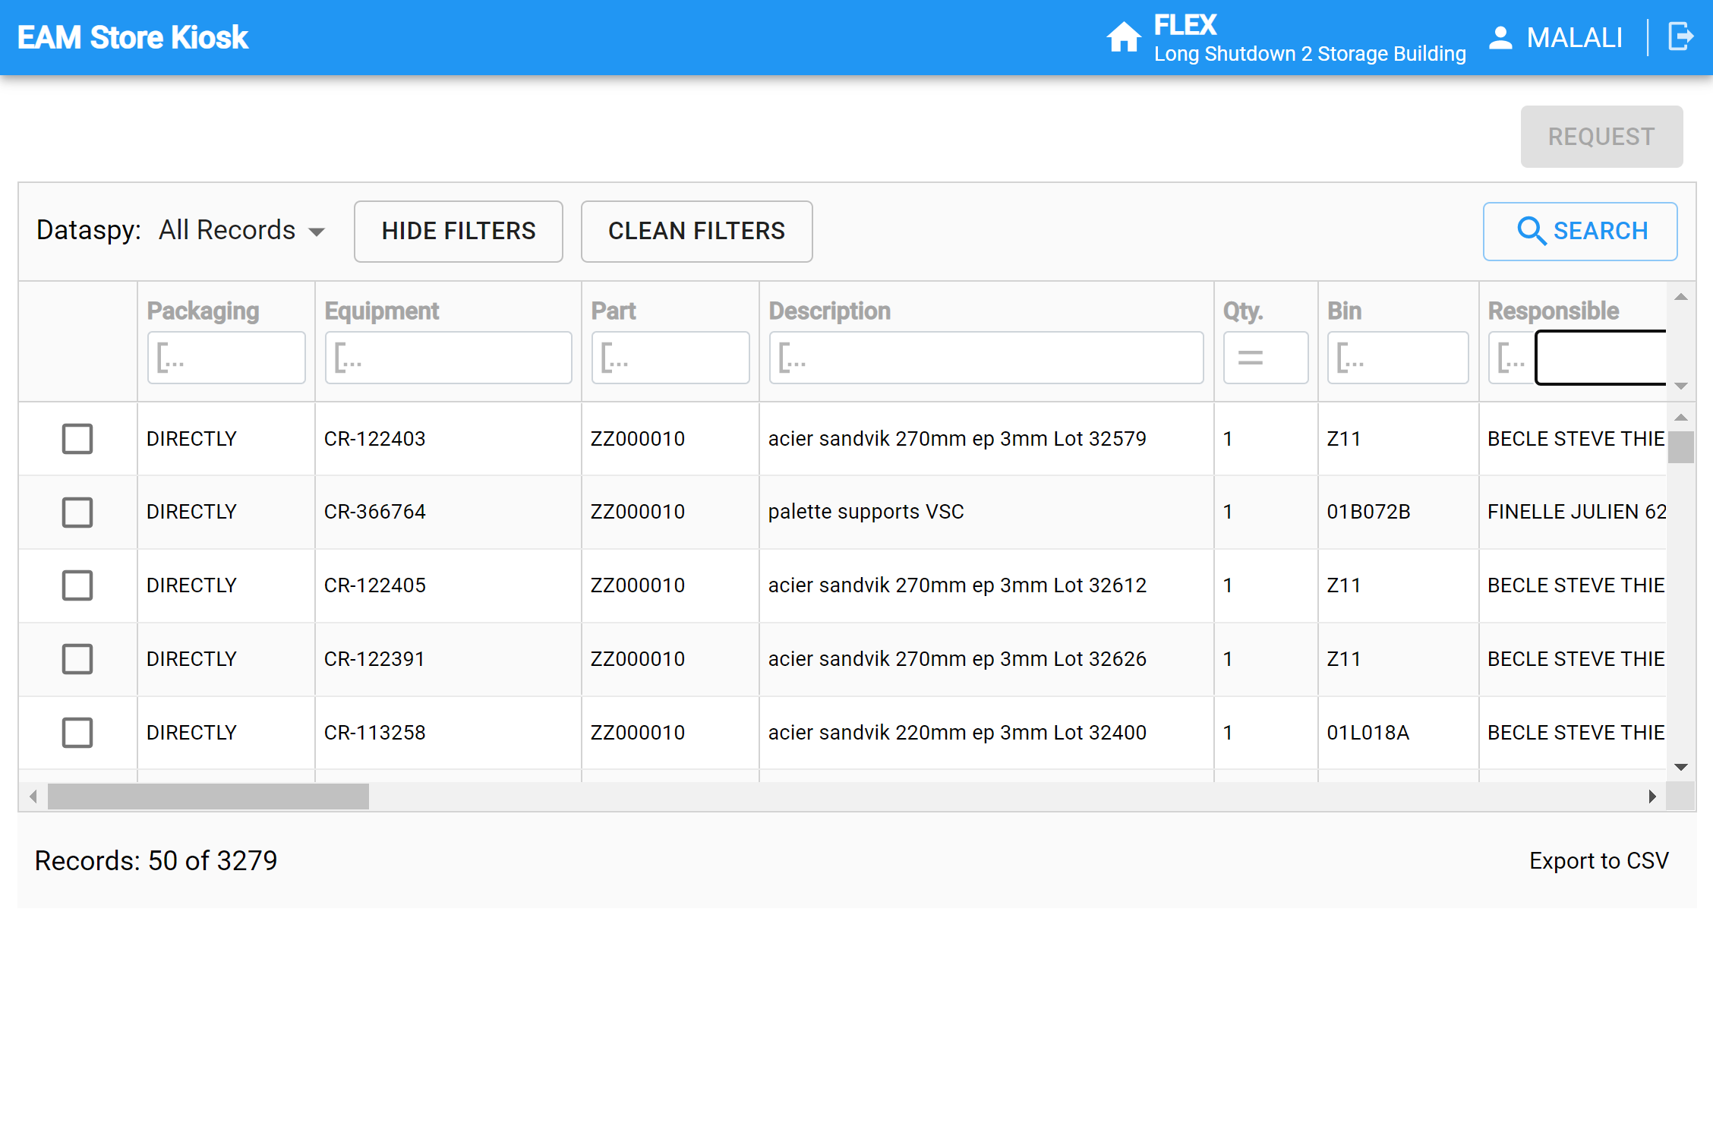
Retrieve an Item
There are many filters that help you find your item.

Slide 25
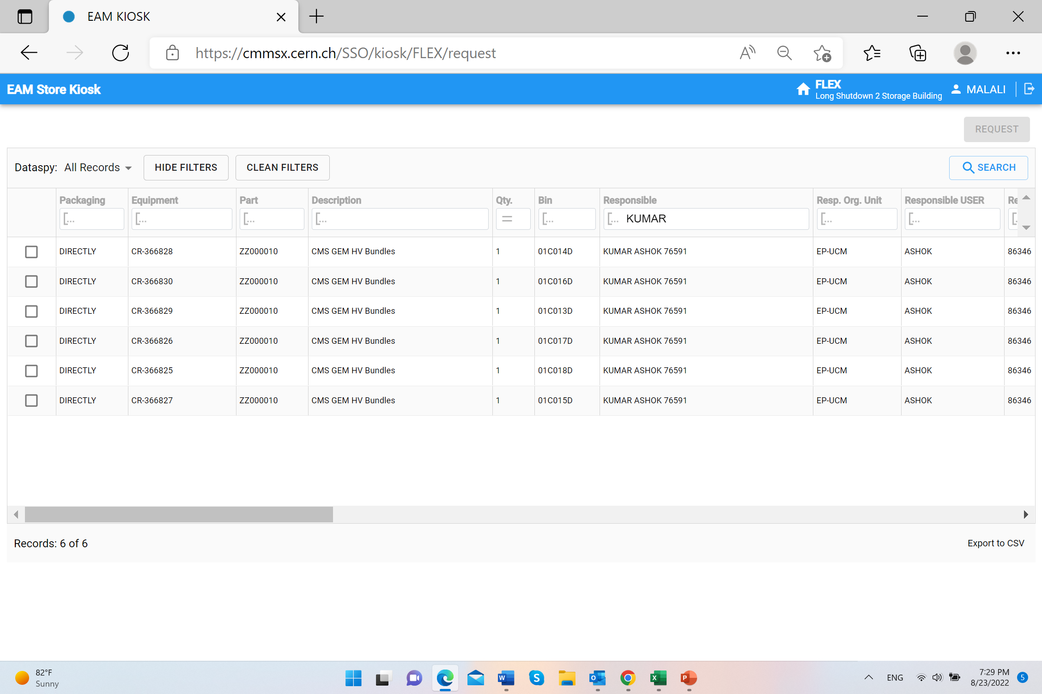
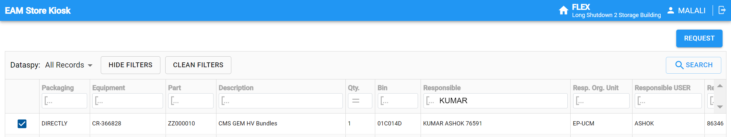
Retrieve an Item
Type in “Responsible” the LAST NAME of the person responsible or their USERNAME for example.

Slide 26
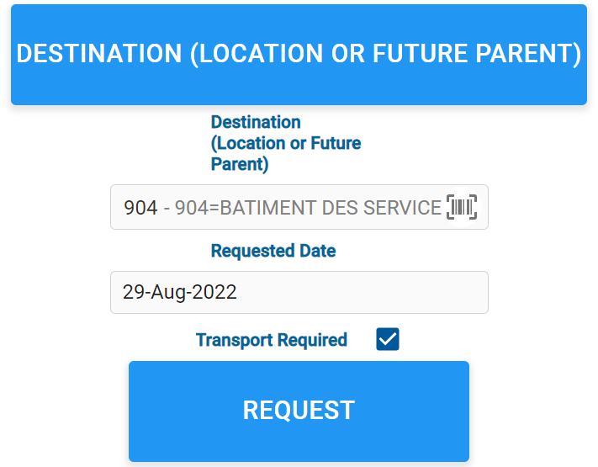
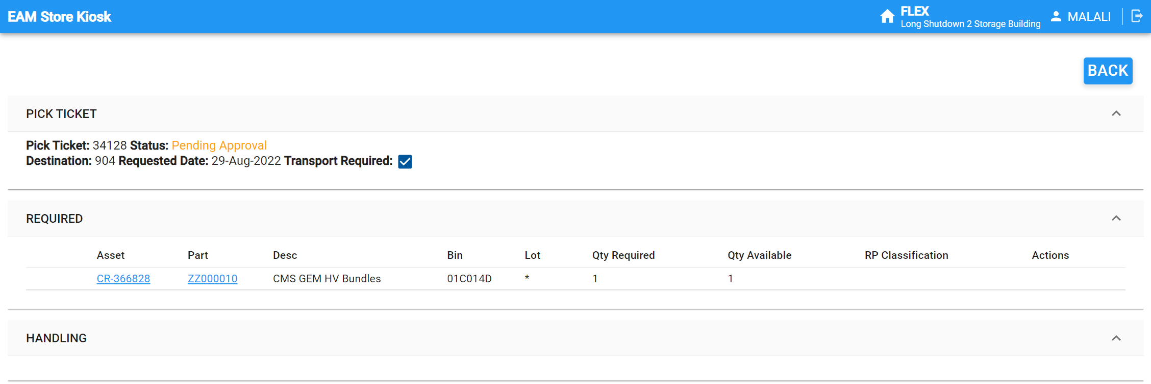
Retrieve an Item
Type in where you want to receive your item and tick “Transport Required”.

Slide 27
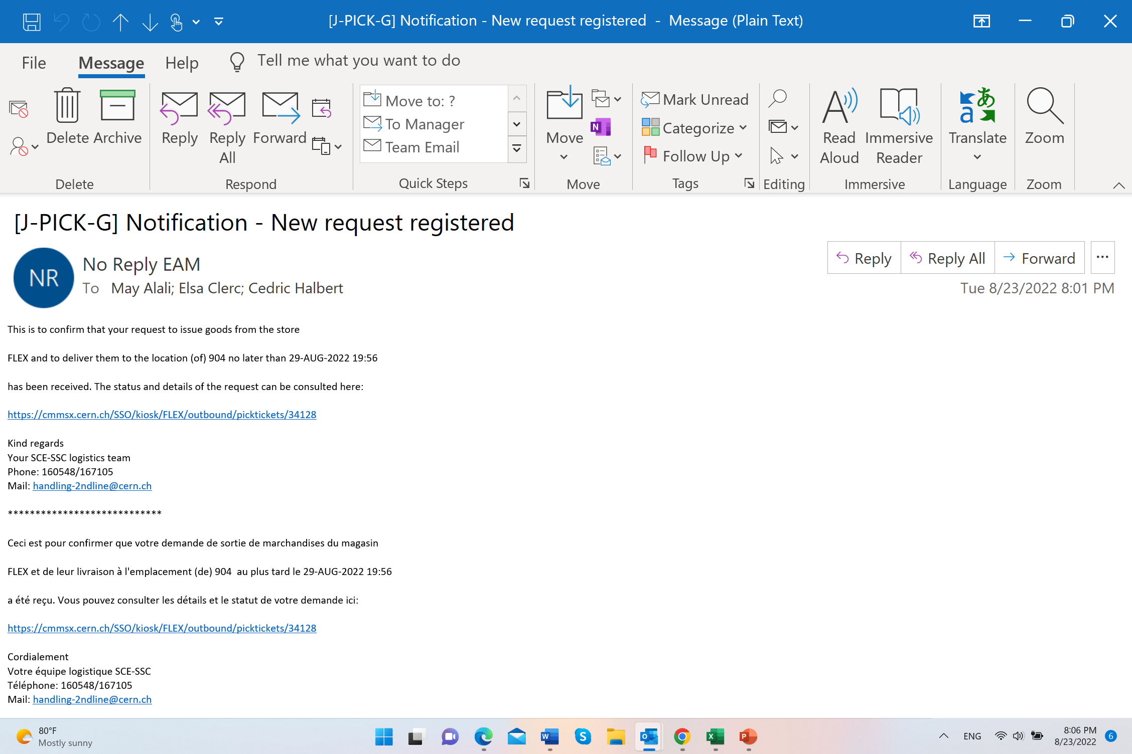
Item Retrieval: Email Confirmation
Once the retrieval request is made, a confirmation email will be sent to the requester.
In our example, the request was made on 23/08/2022, and the delivery to B904 is promised to happen no later than 29/08/2022, i.e., within a week from the request date.

Slide 28
What Happens Next?
The storekeepers prepare the requested item.
If the item is classified as radioactive, an RP measurement will be triggered.
The transport request will be created in EDH.
Once the equipment is picked up by transport,
  an email will be sent to the requestor to inform them, and
  the item's location gets updated, and the status changes from "in-store" to "installed".

Slide 29
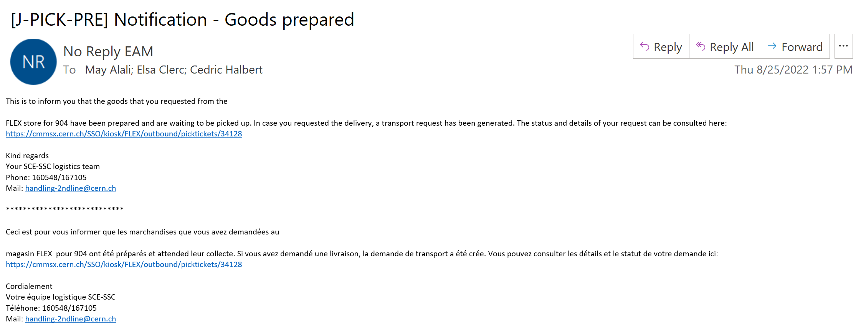
Item Ready for Transport: Email Confirmation
The retrieval request was made on 23/08/2022, and the item was prepared in 2 days to be transported from the Flex to B904.
As the request included “delivery”, a transport request was immediately generated with the email below for me as a requester to sign.

Slide 30
Thank you!
Questions

