Slide 1
Bat. 892 Cupboards
Ian
24 Jan 2023

Slide 2
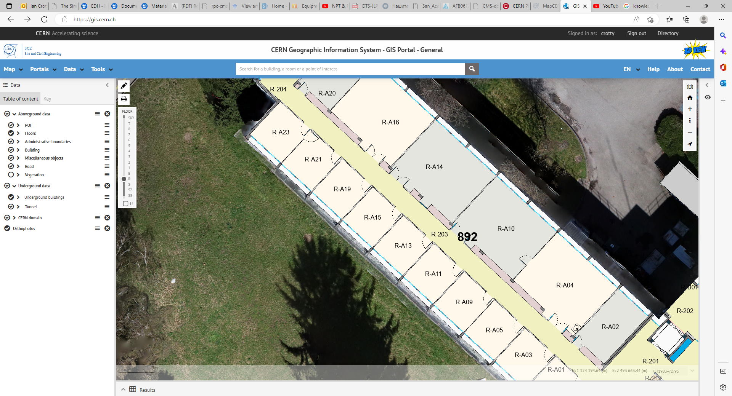

Slide 5
