Slide 1
Basement Bat 892
Storage
Ian
29 Sept 2022

Slide 2
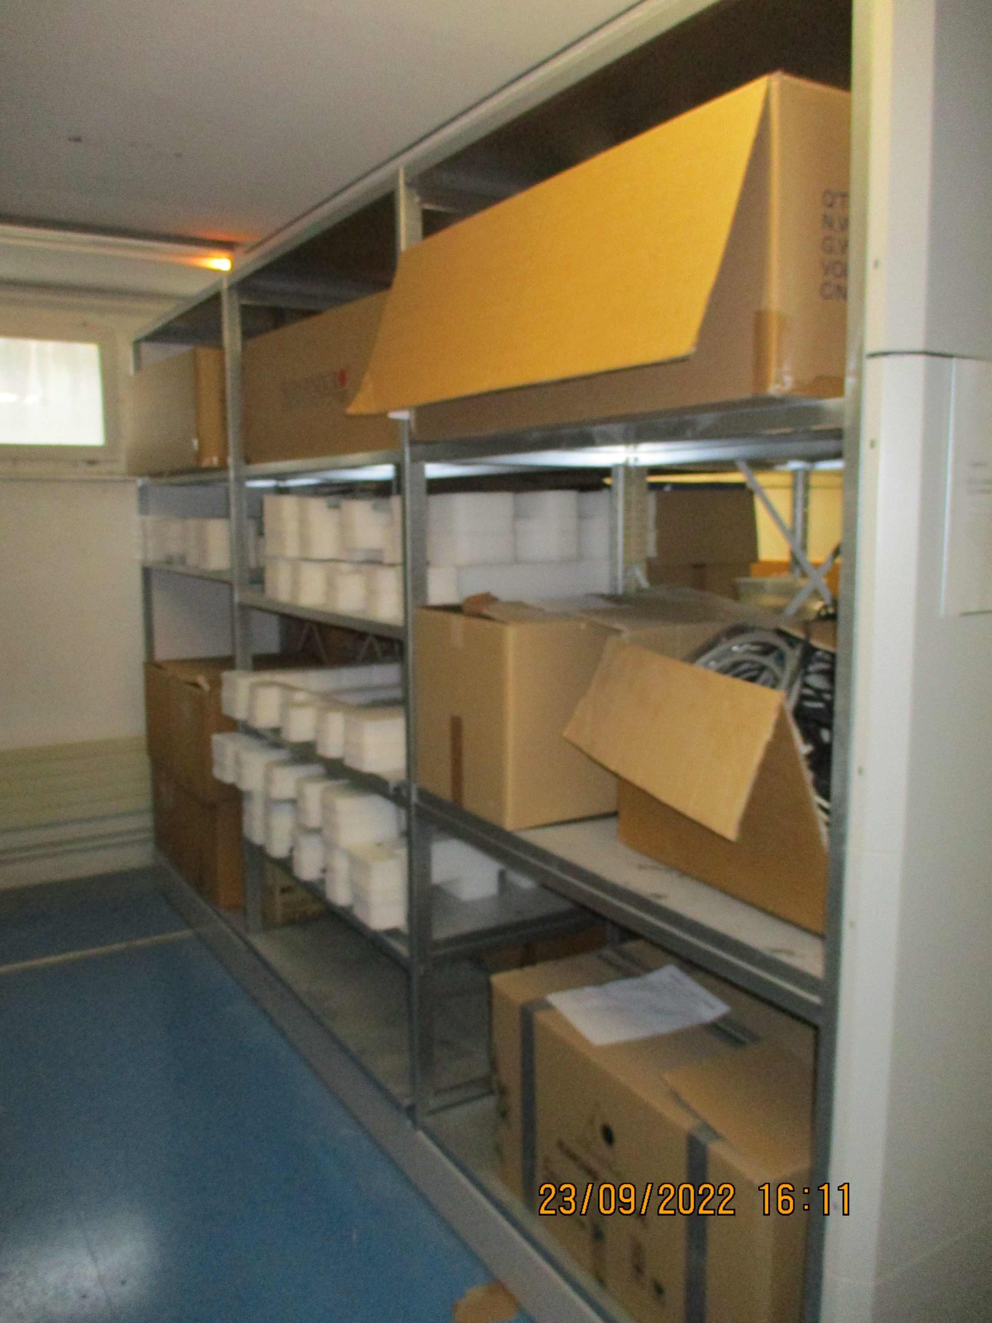
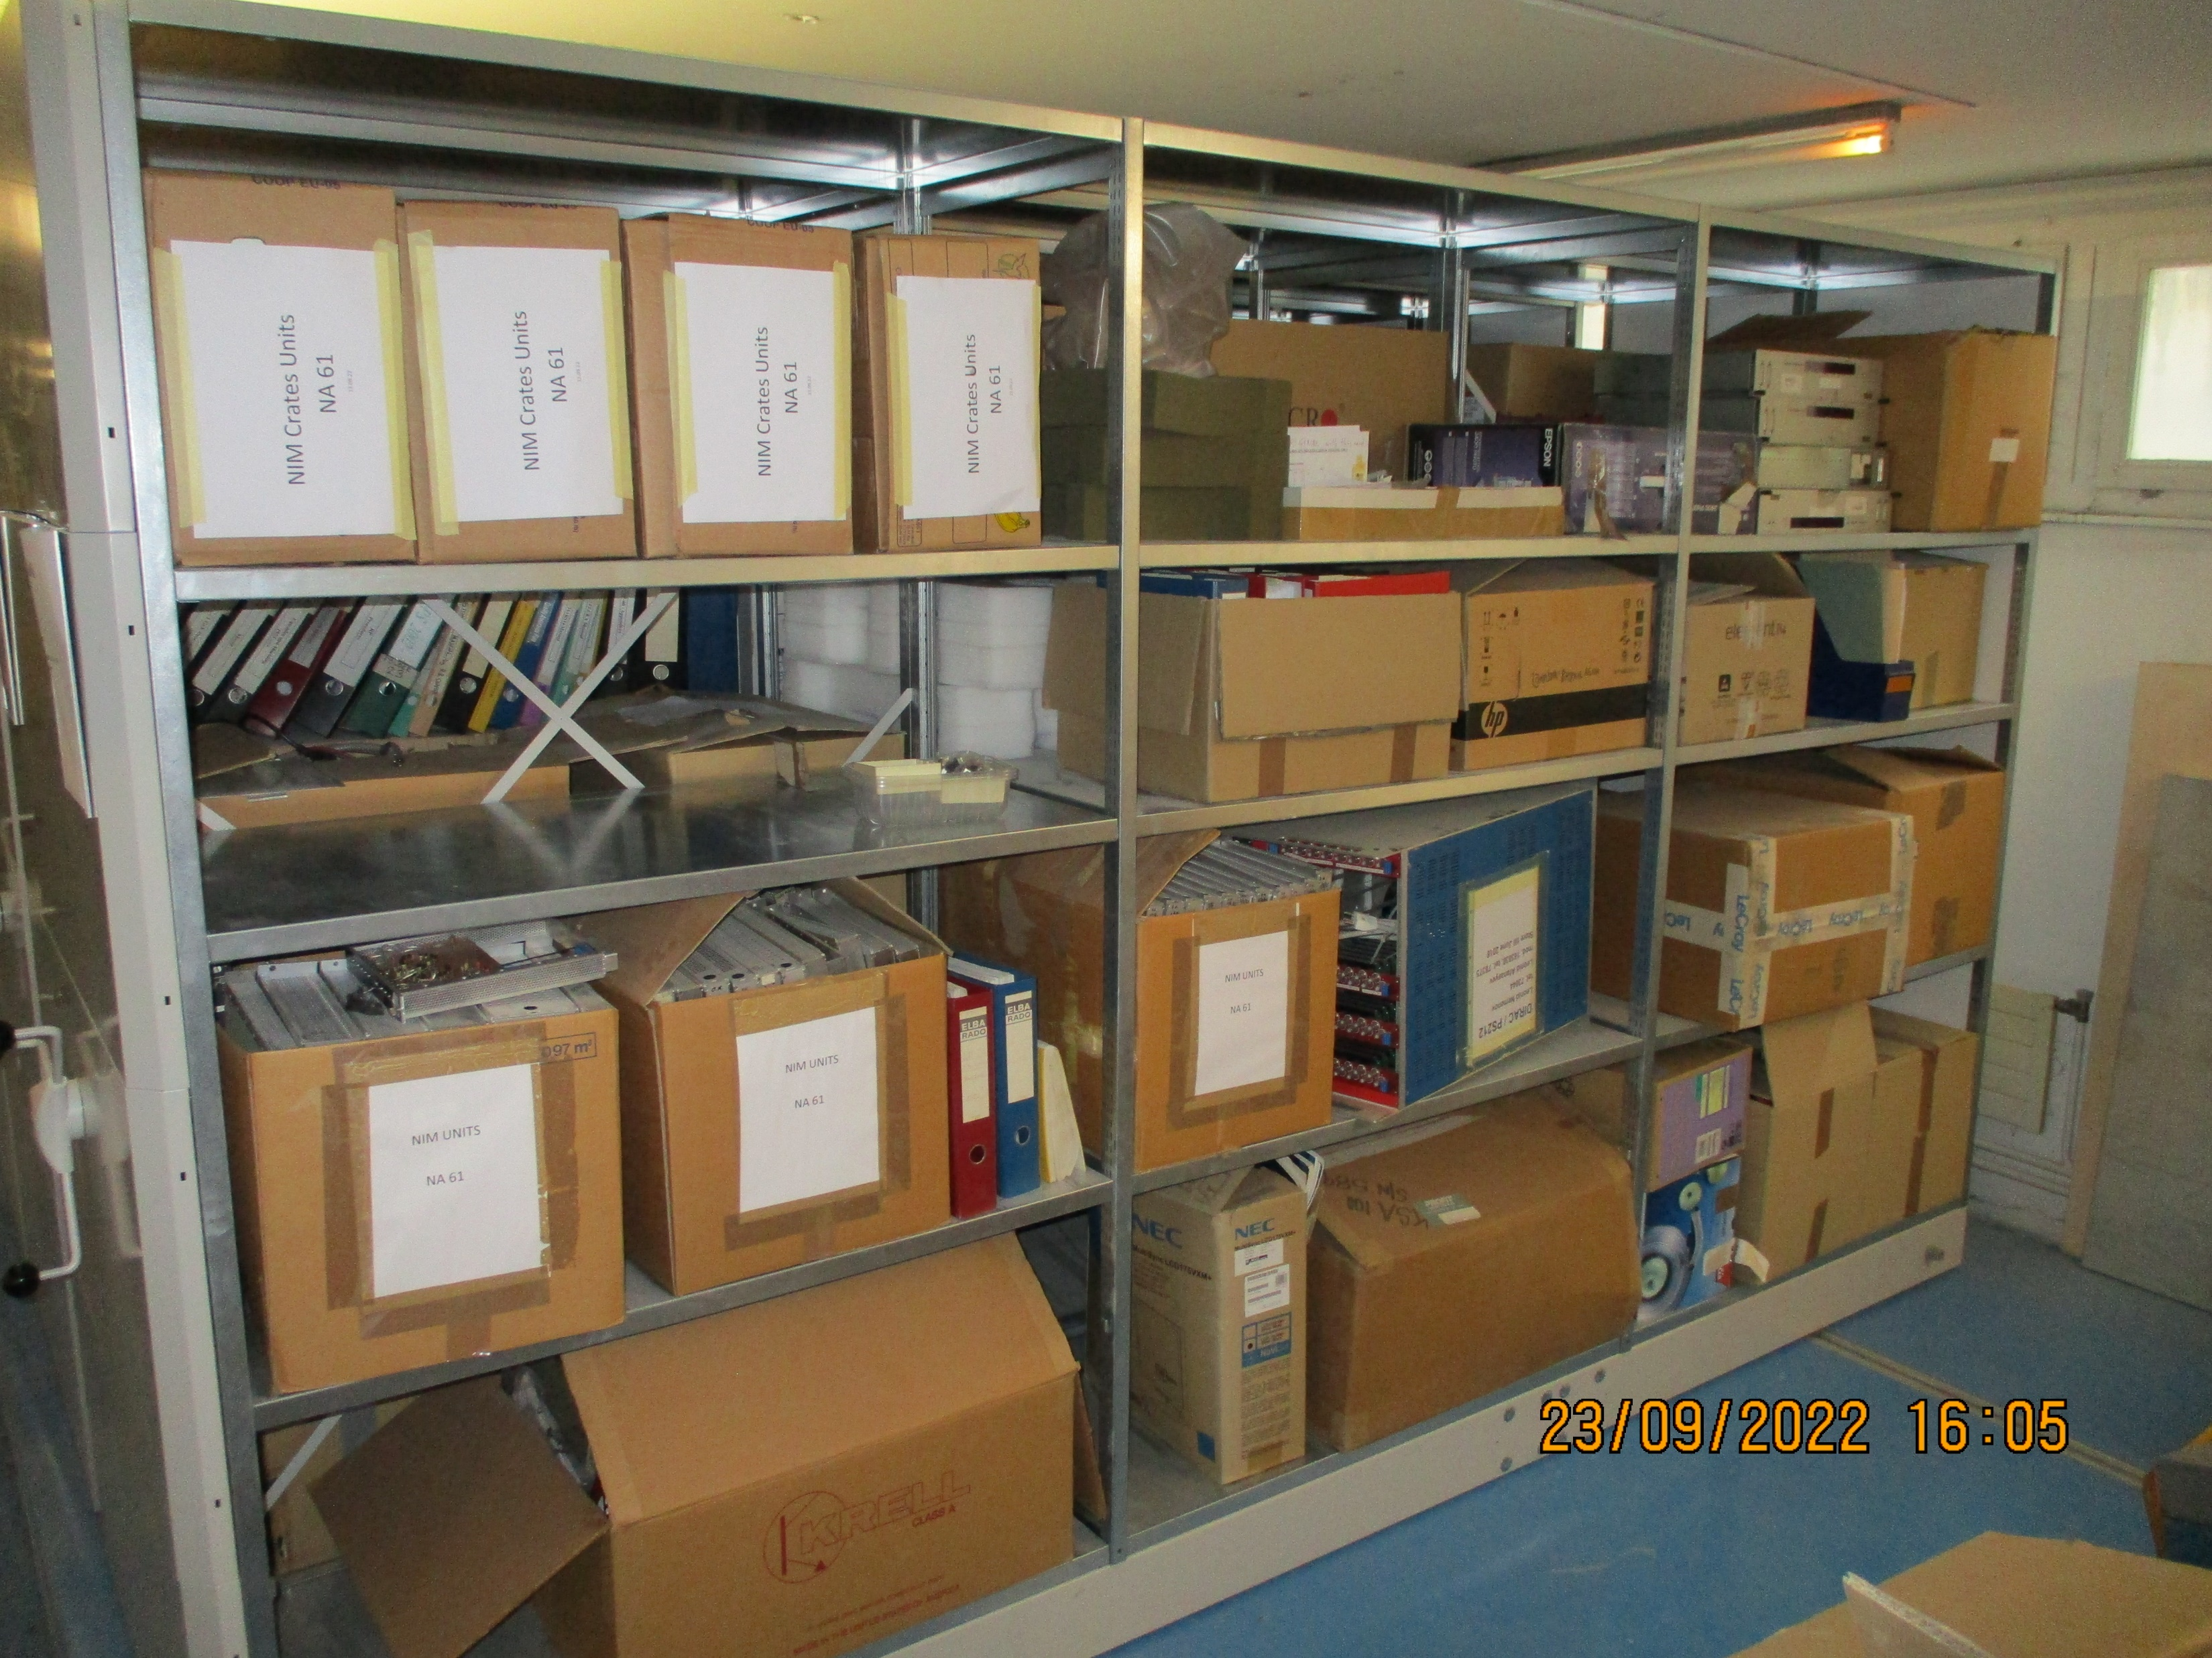
Shelf area.
The 4 Wiener fan units to go
Large card boxes with foam to go except one box with foam filling . Box of cables filtered.

Slide 3
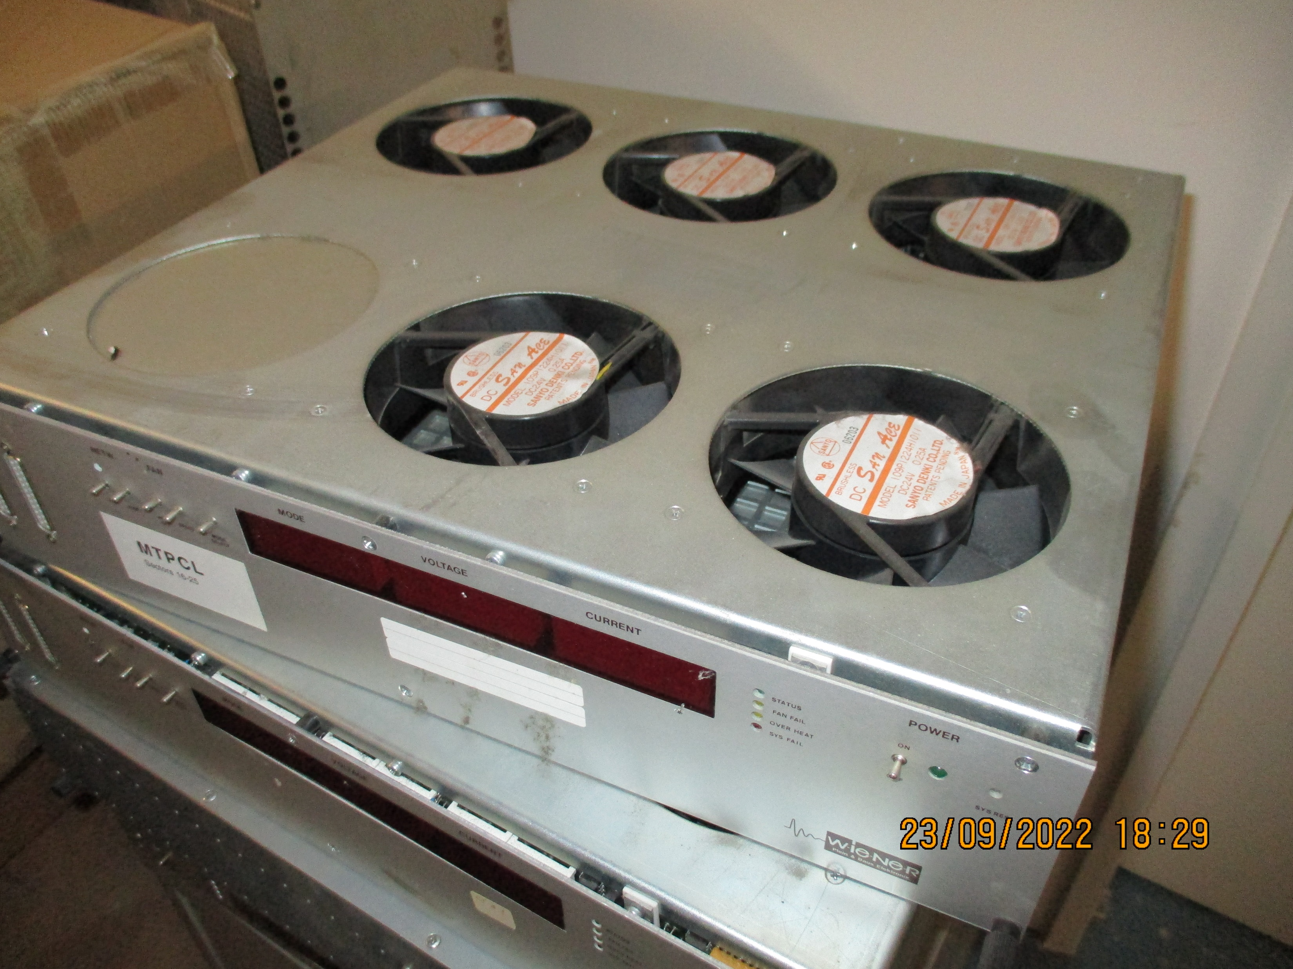
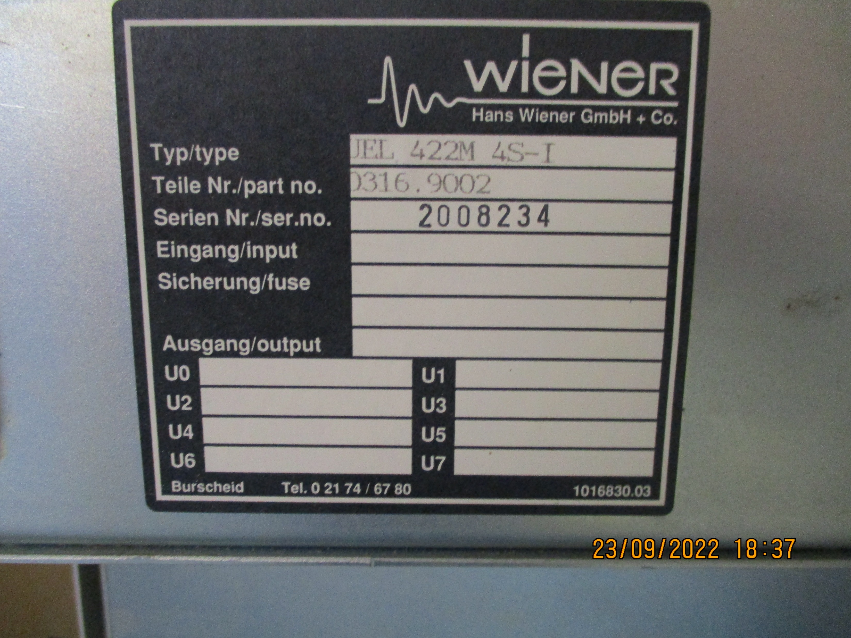
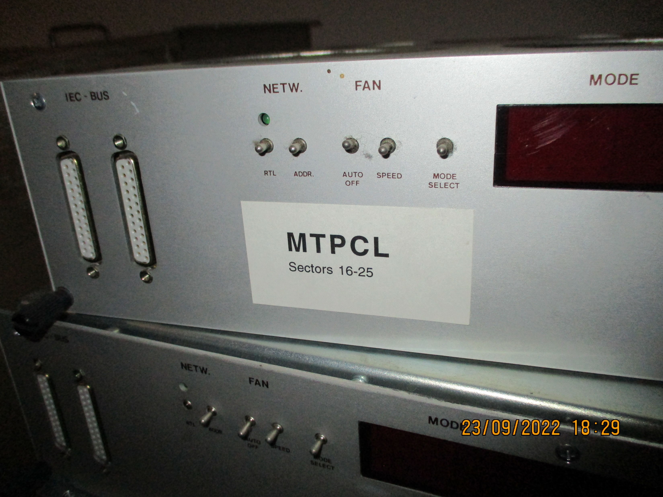
The 4 Wiener fan units to go

Slide 4
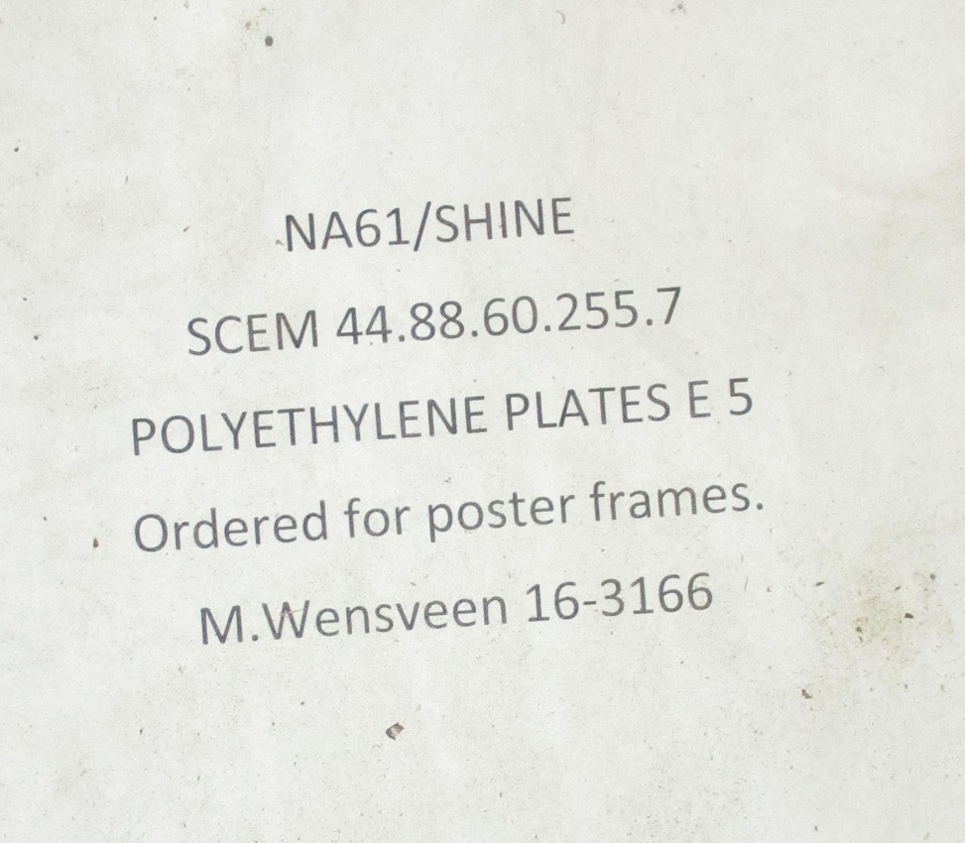
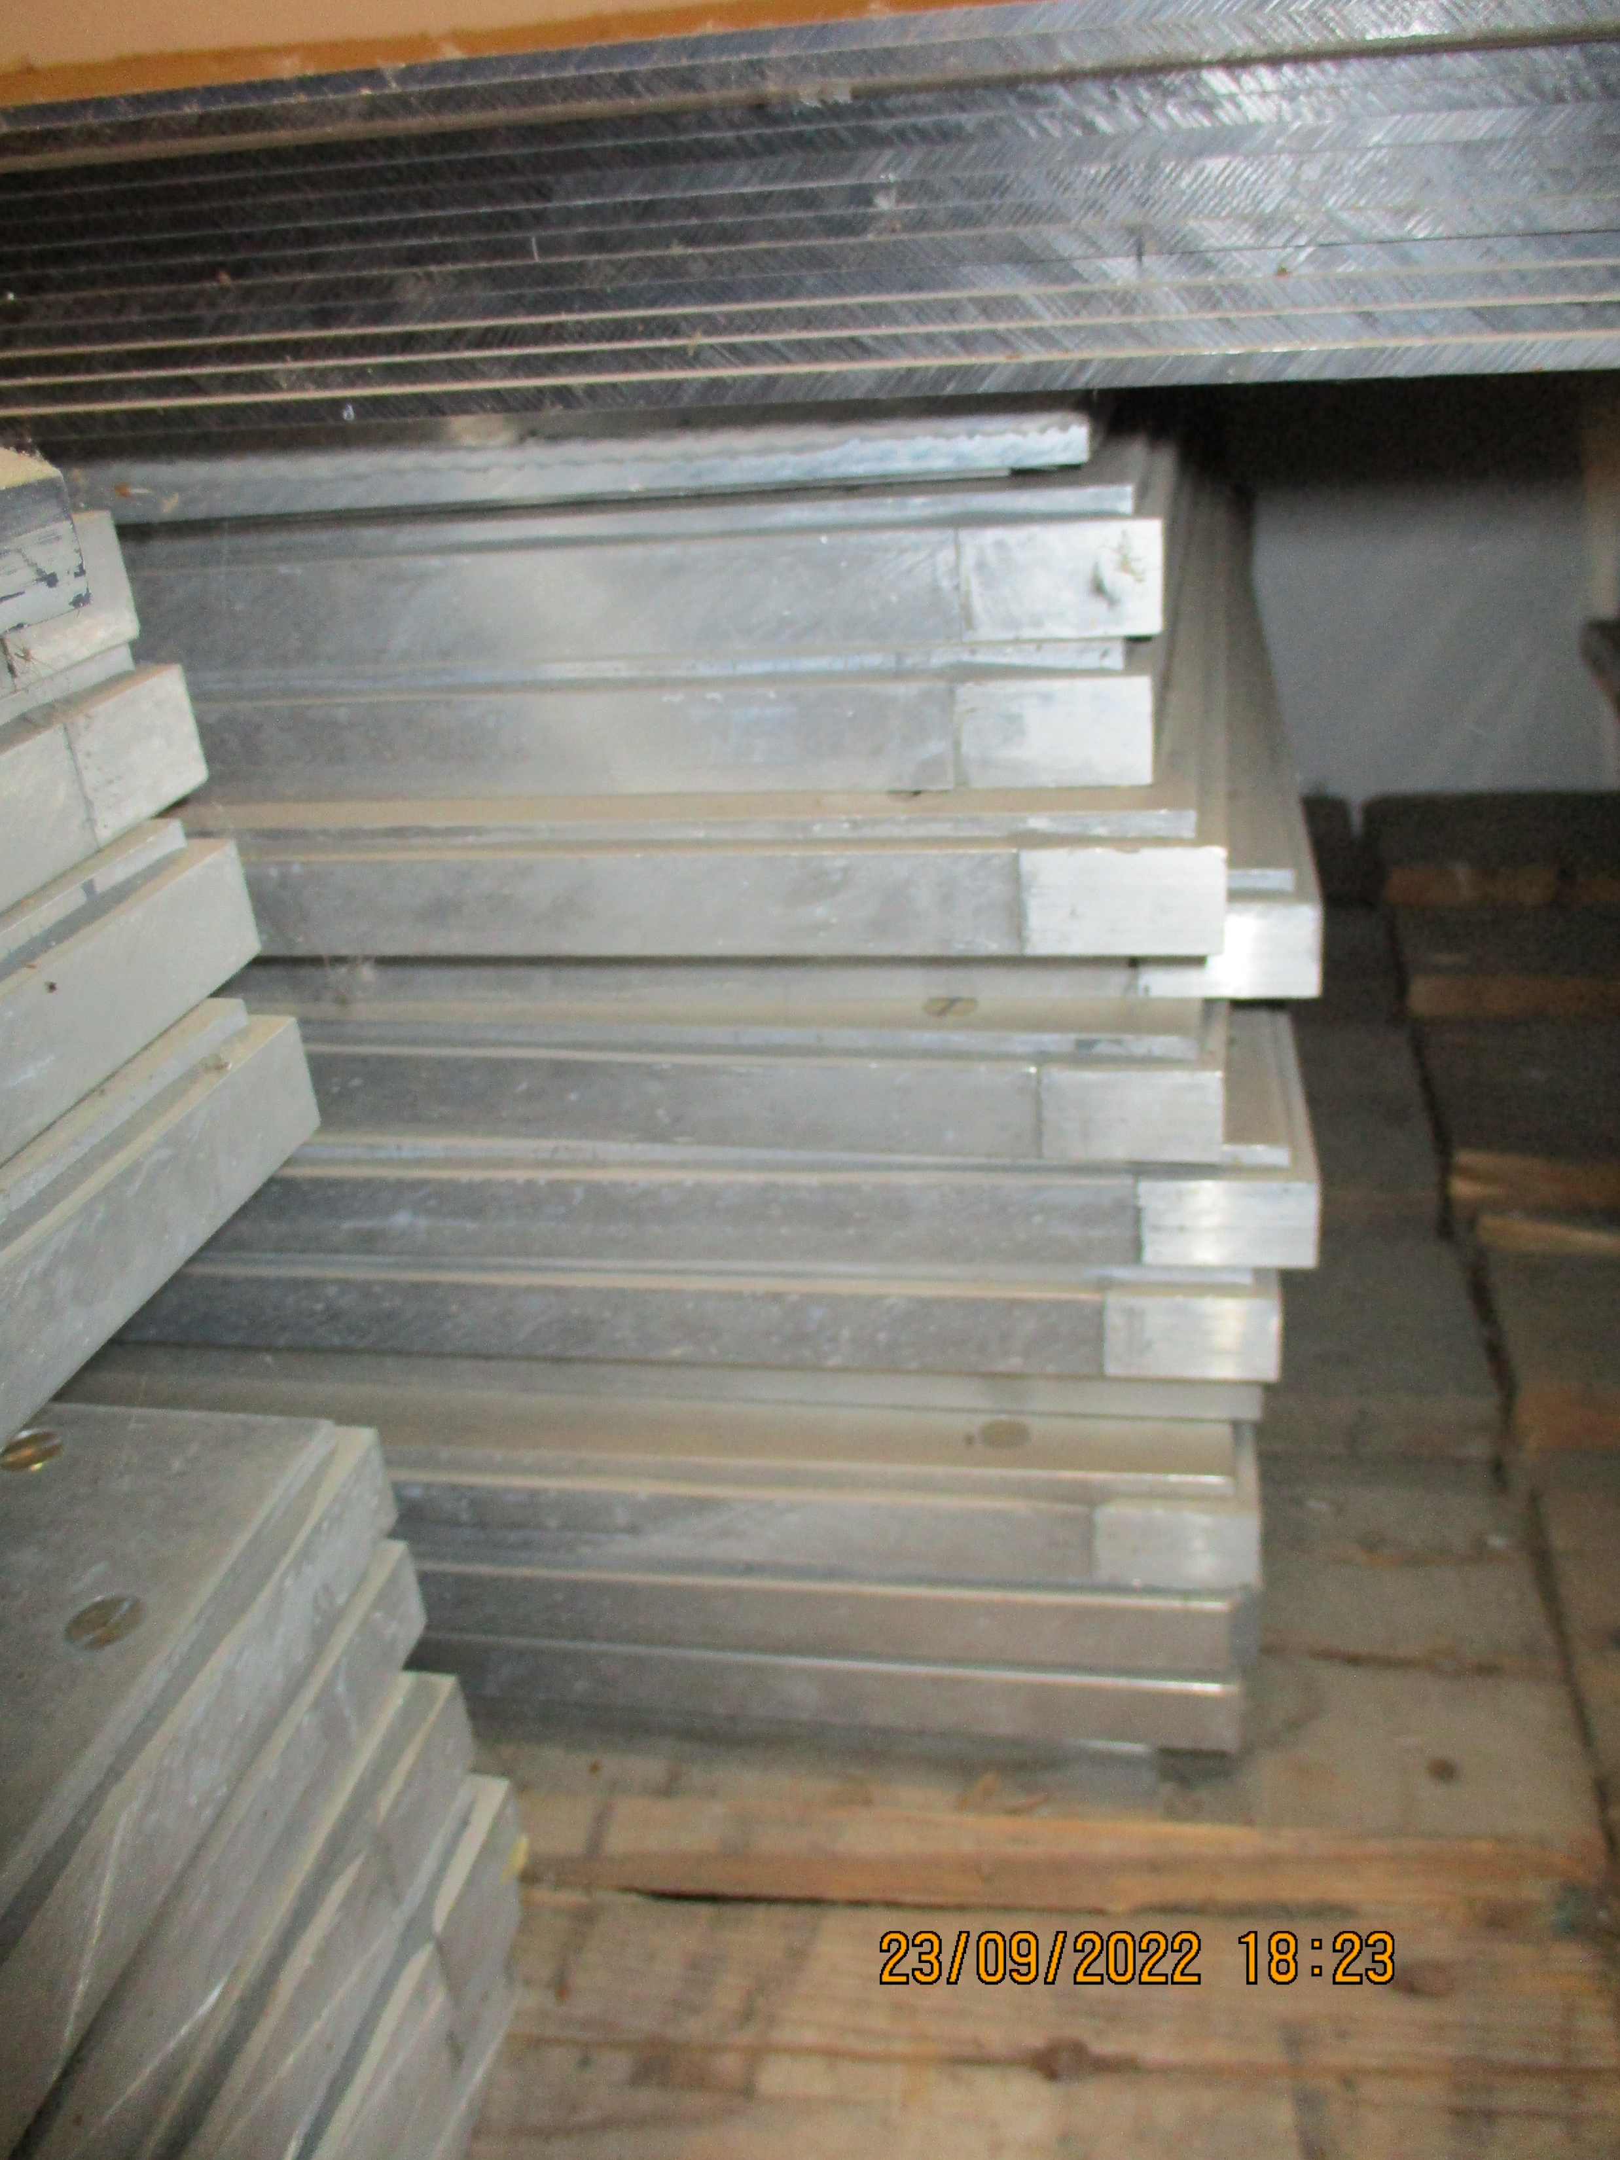
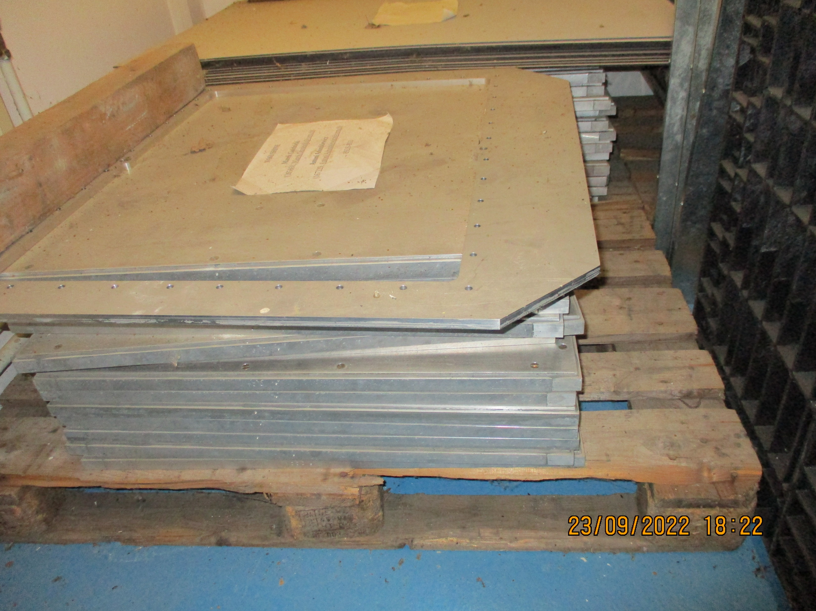
Area in front of the shelving system.
Aluminium plates and frames

Slide 5
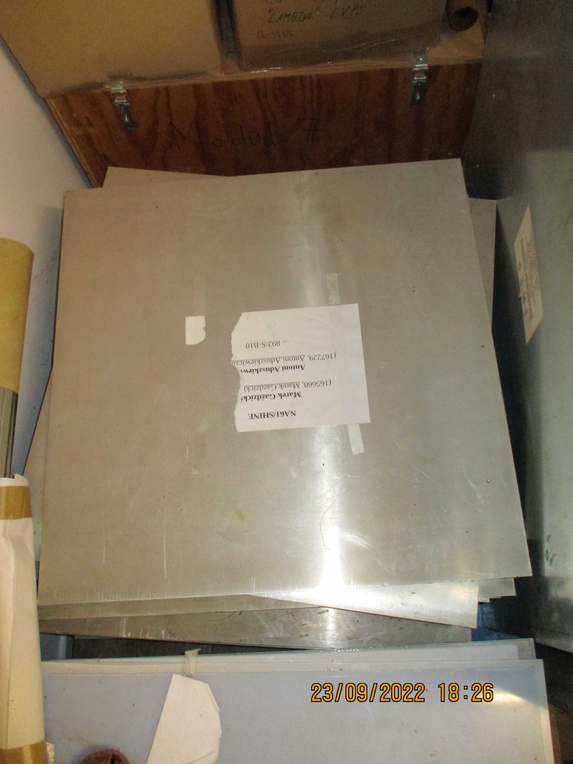
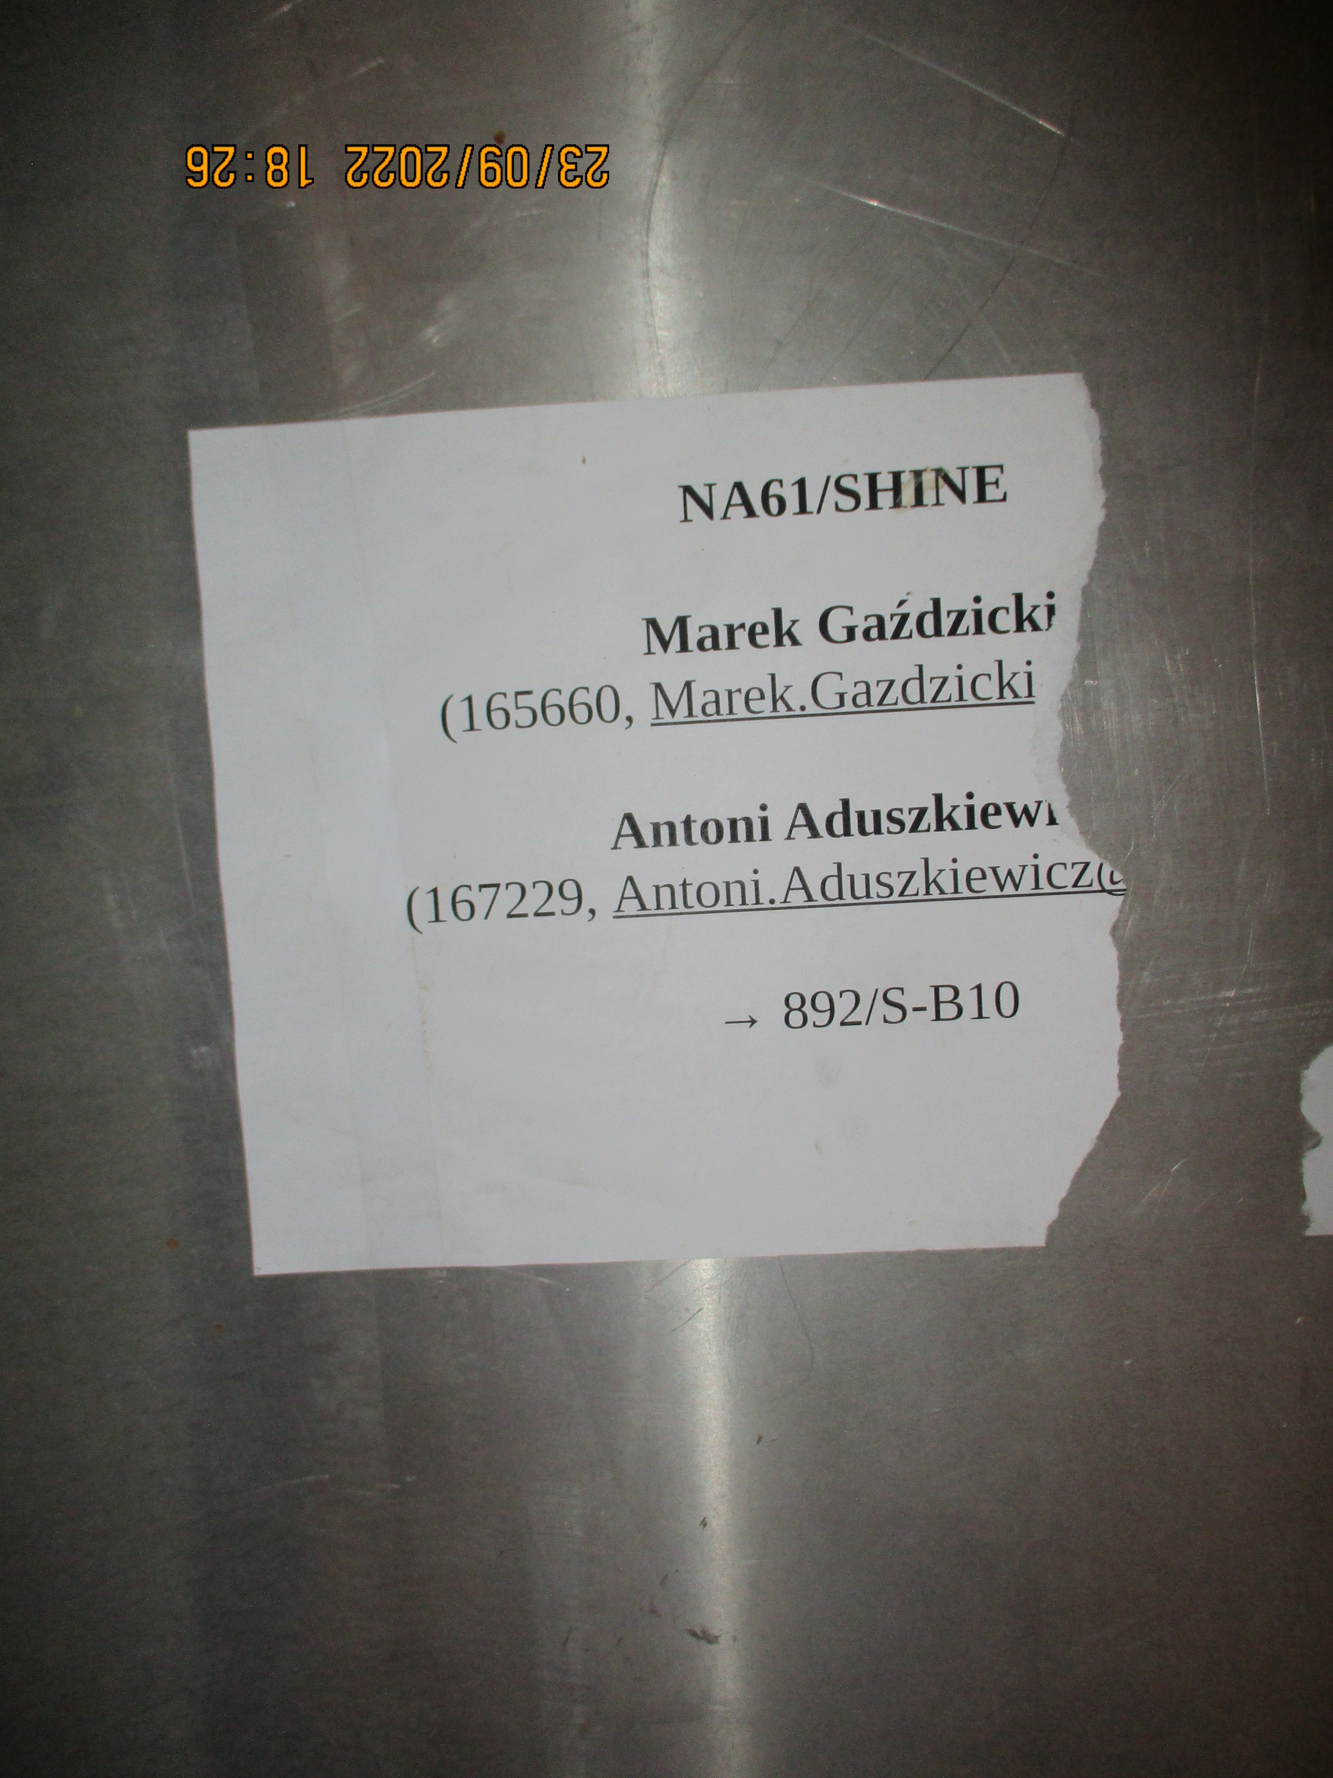
Area in front of the shelving system. bis.
3rd pile of aluminium plates or frames

Slide 6
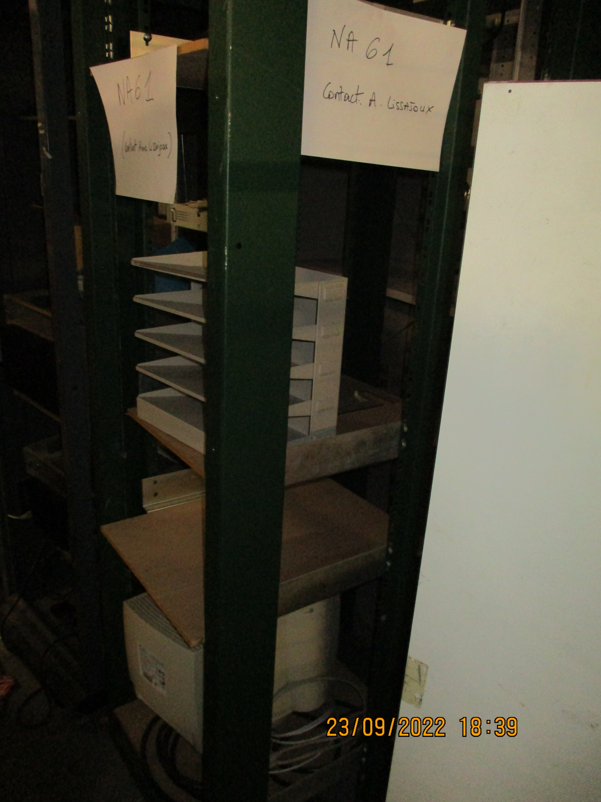
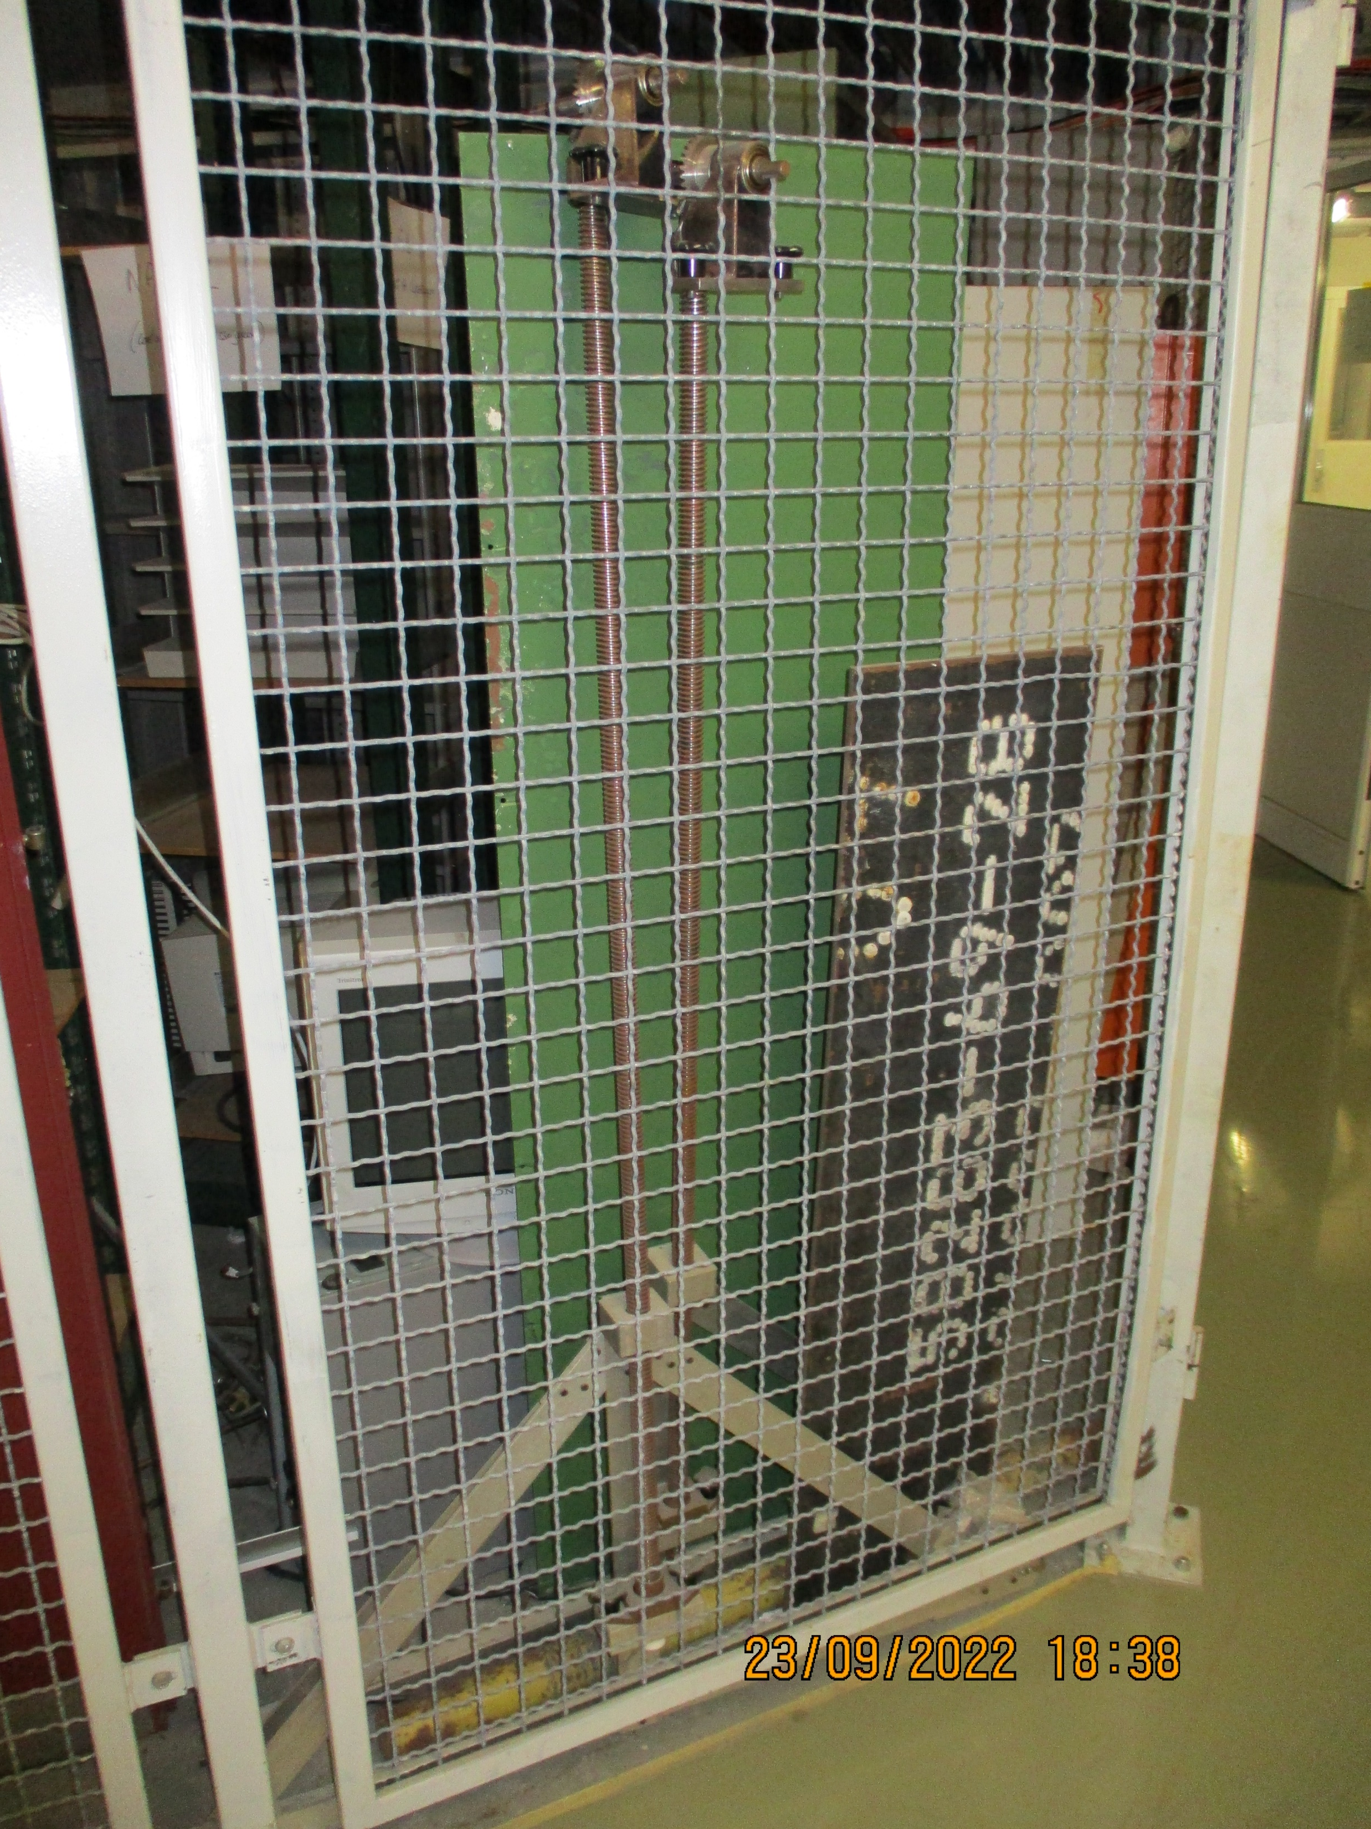
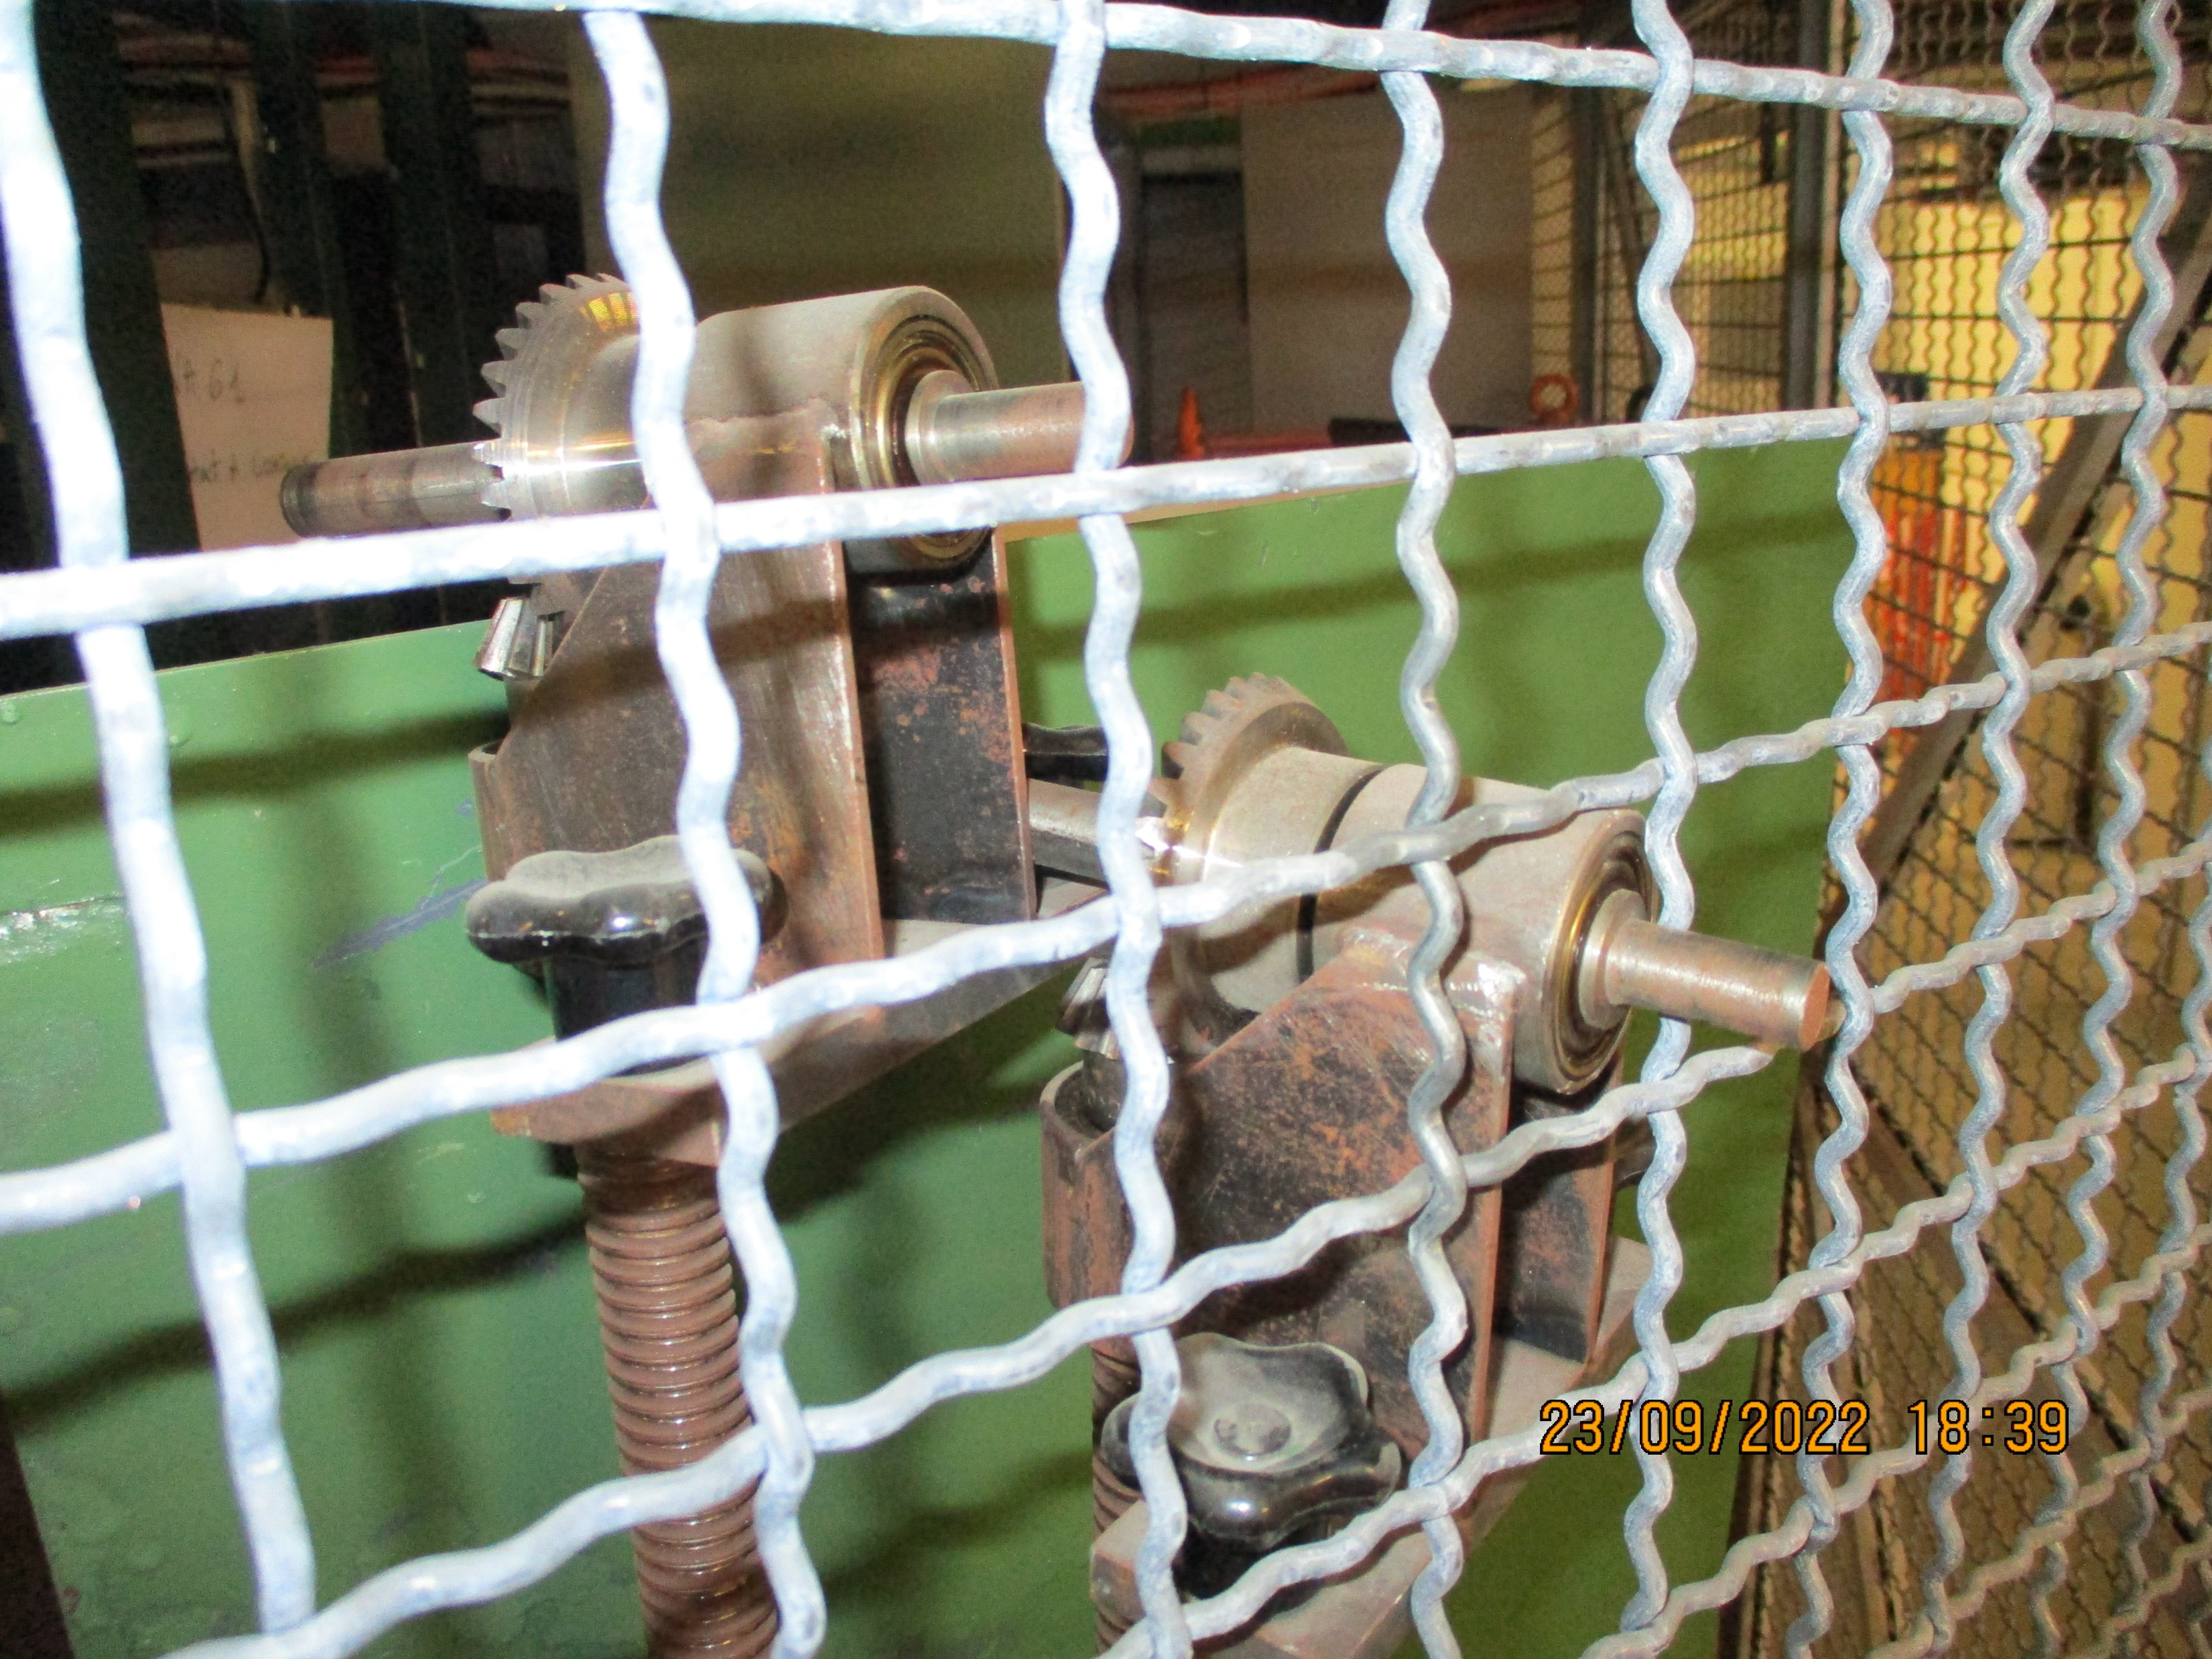
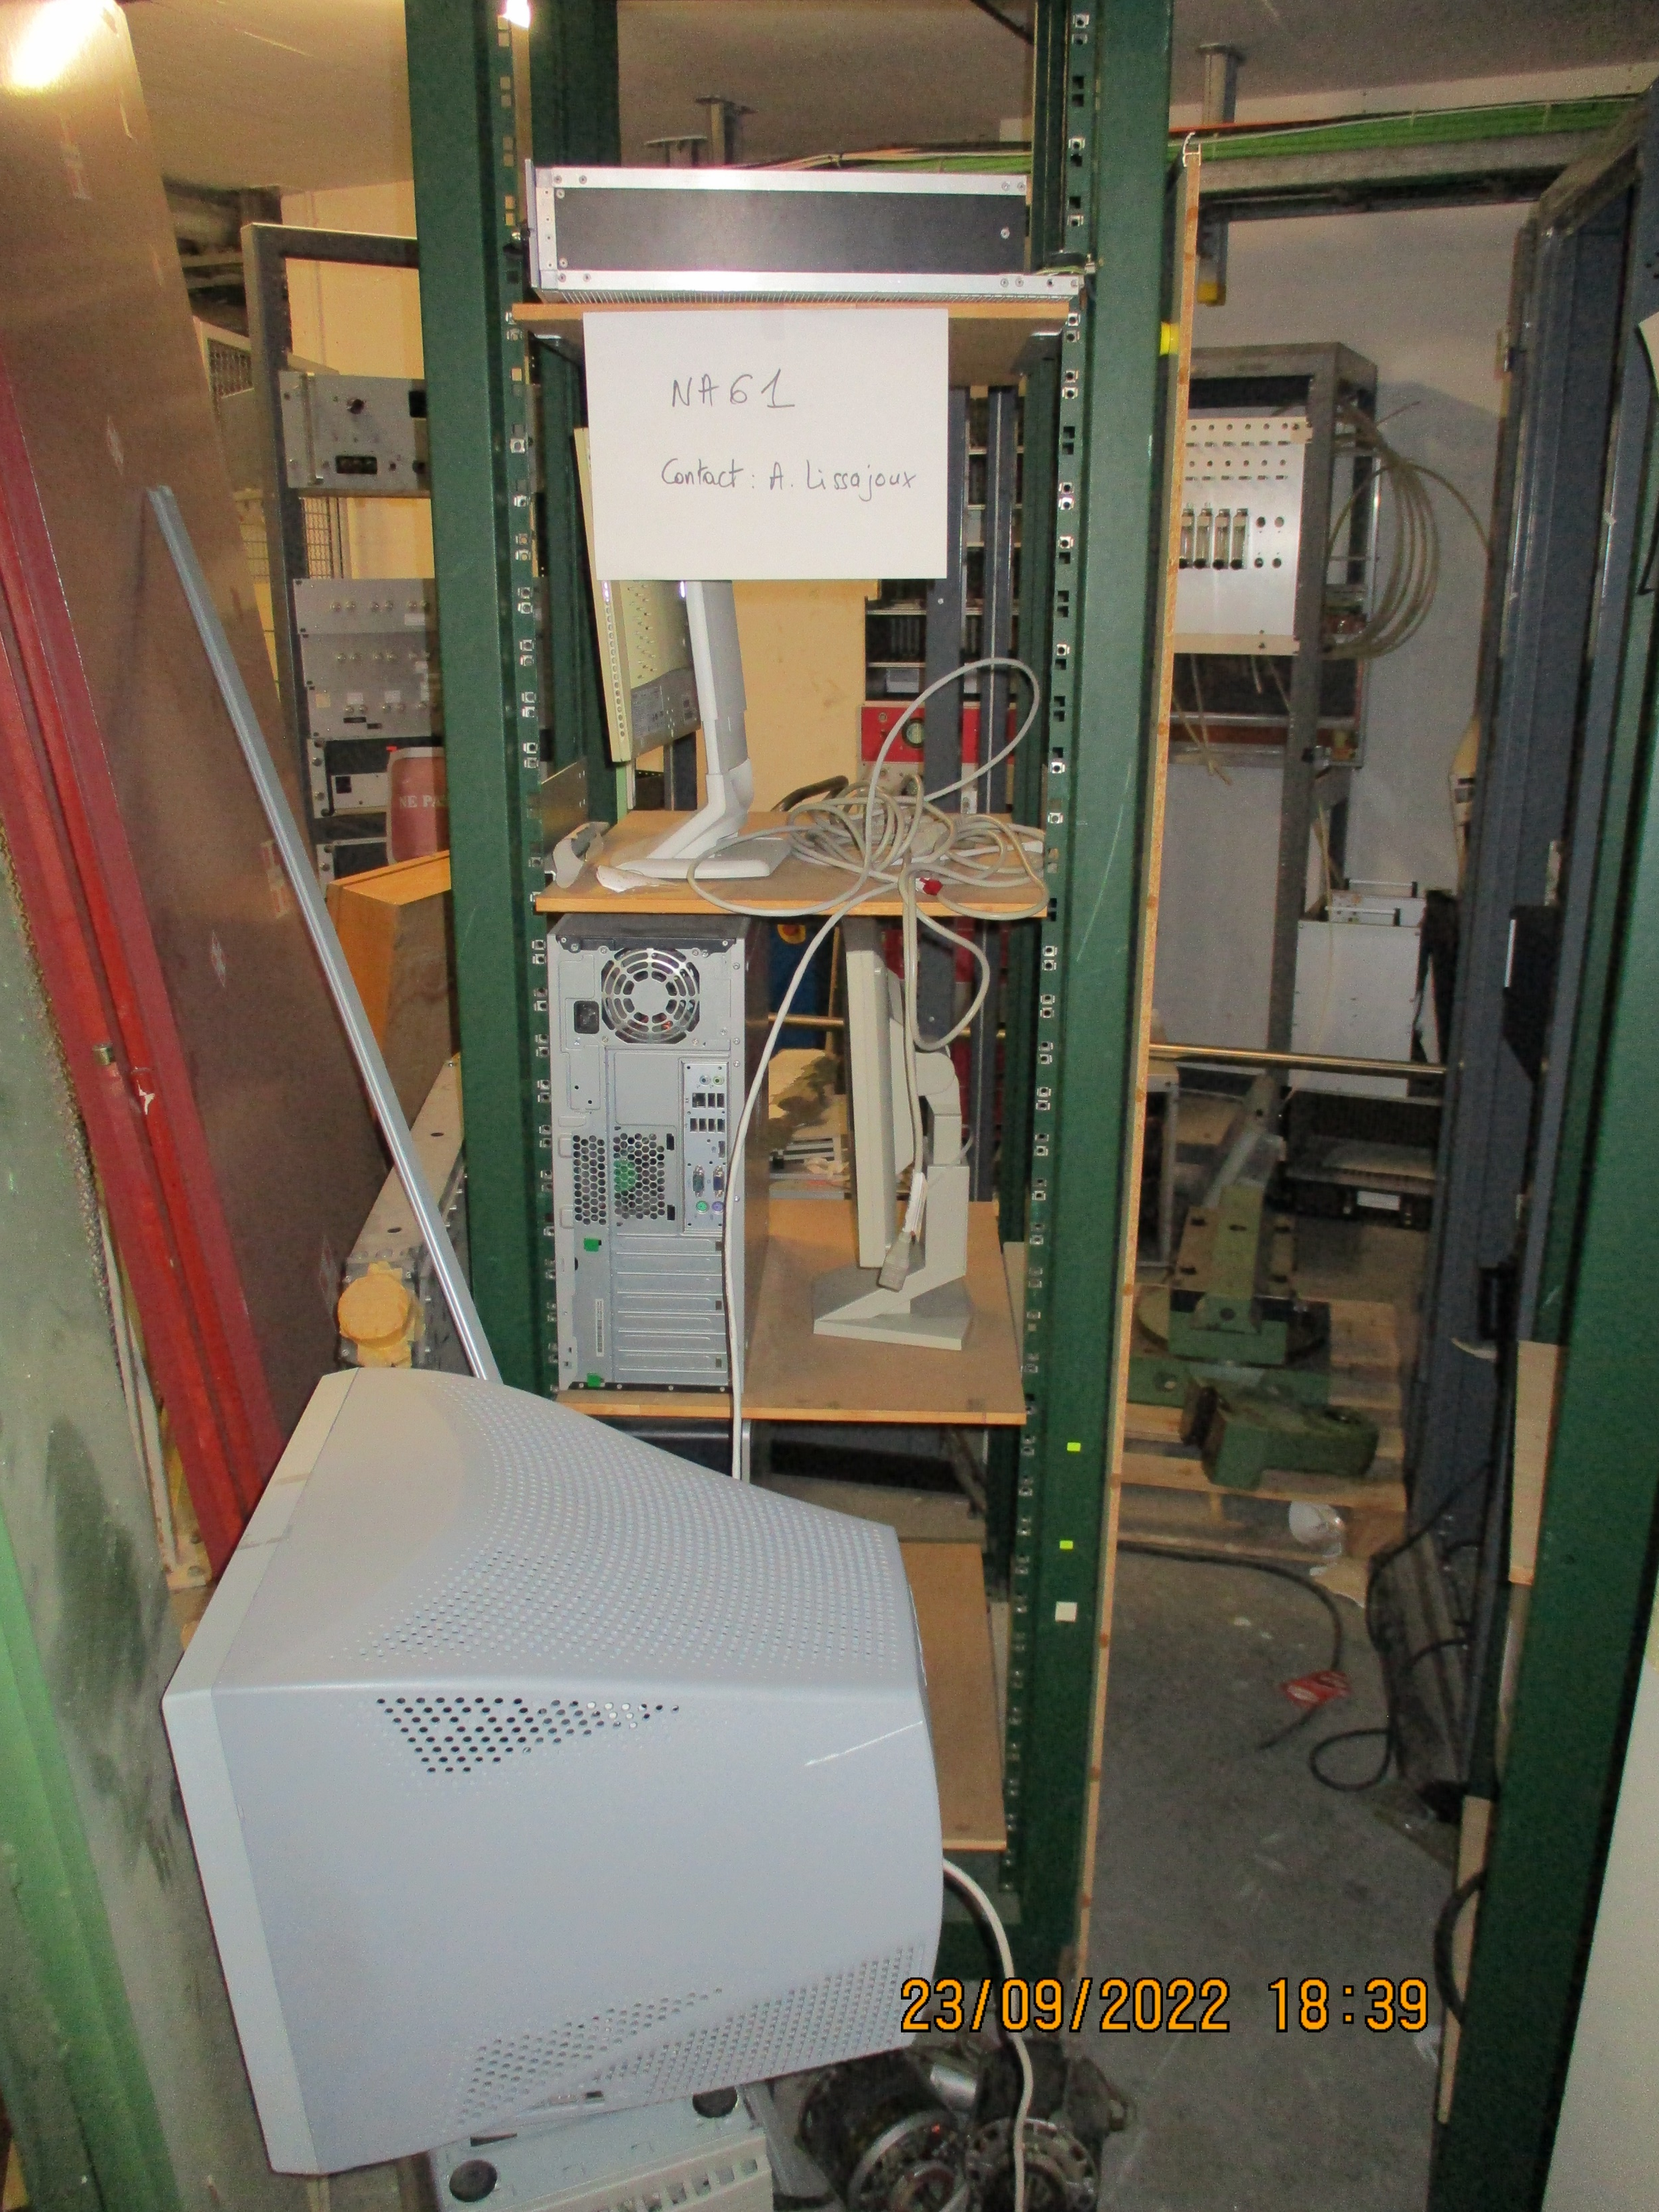
Caged area in the middle of the building.
Racks, PCs and crates
Tooling to lift a TPC
Informed by Martin

Slide 7
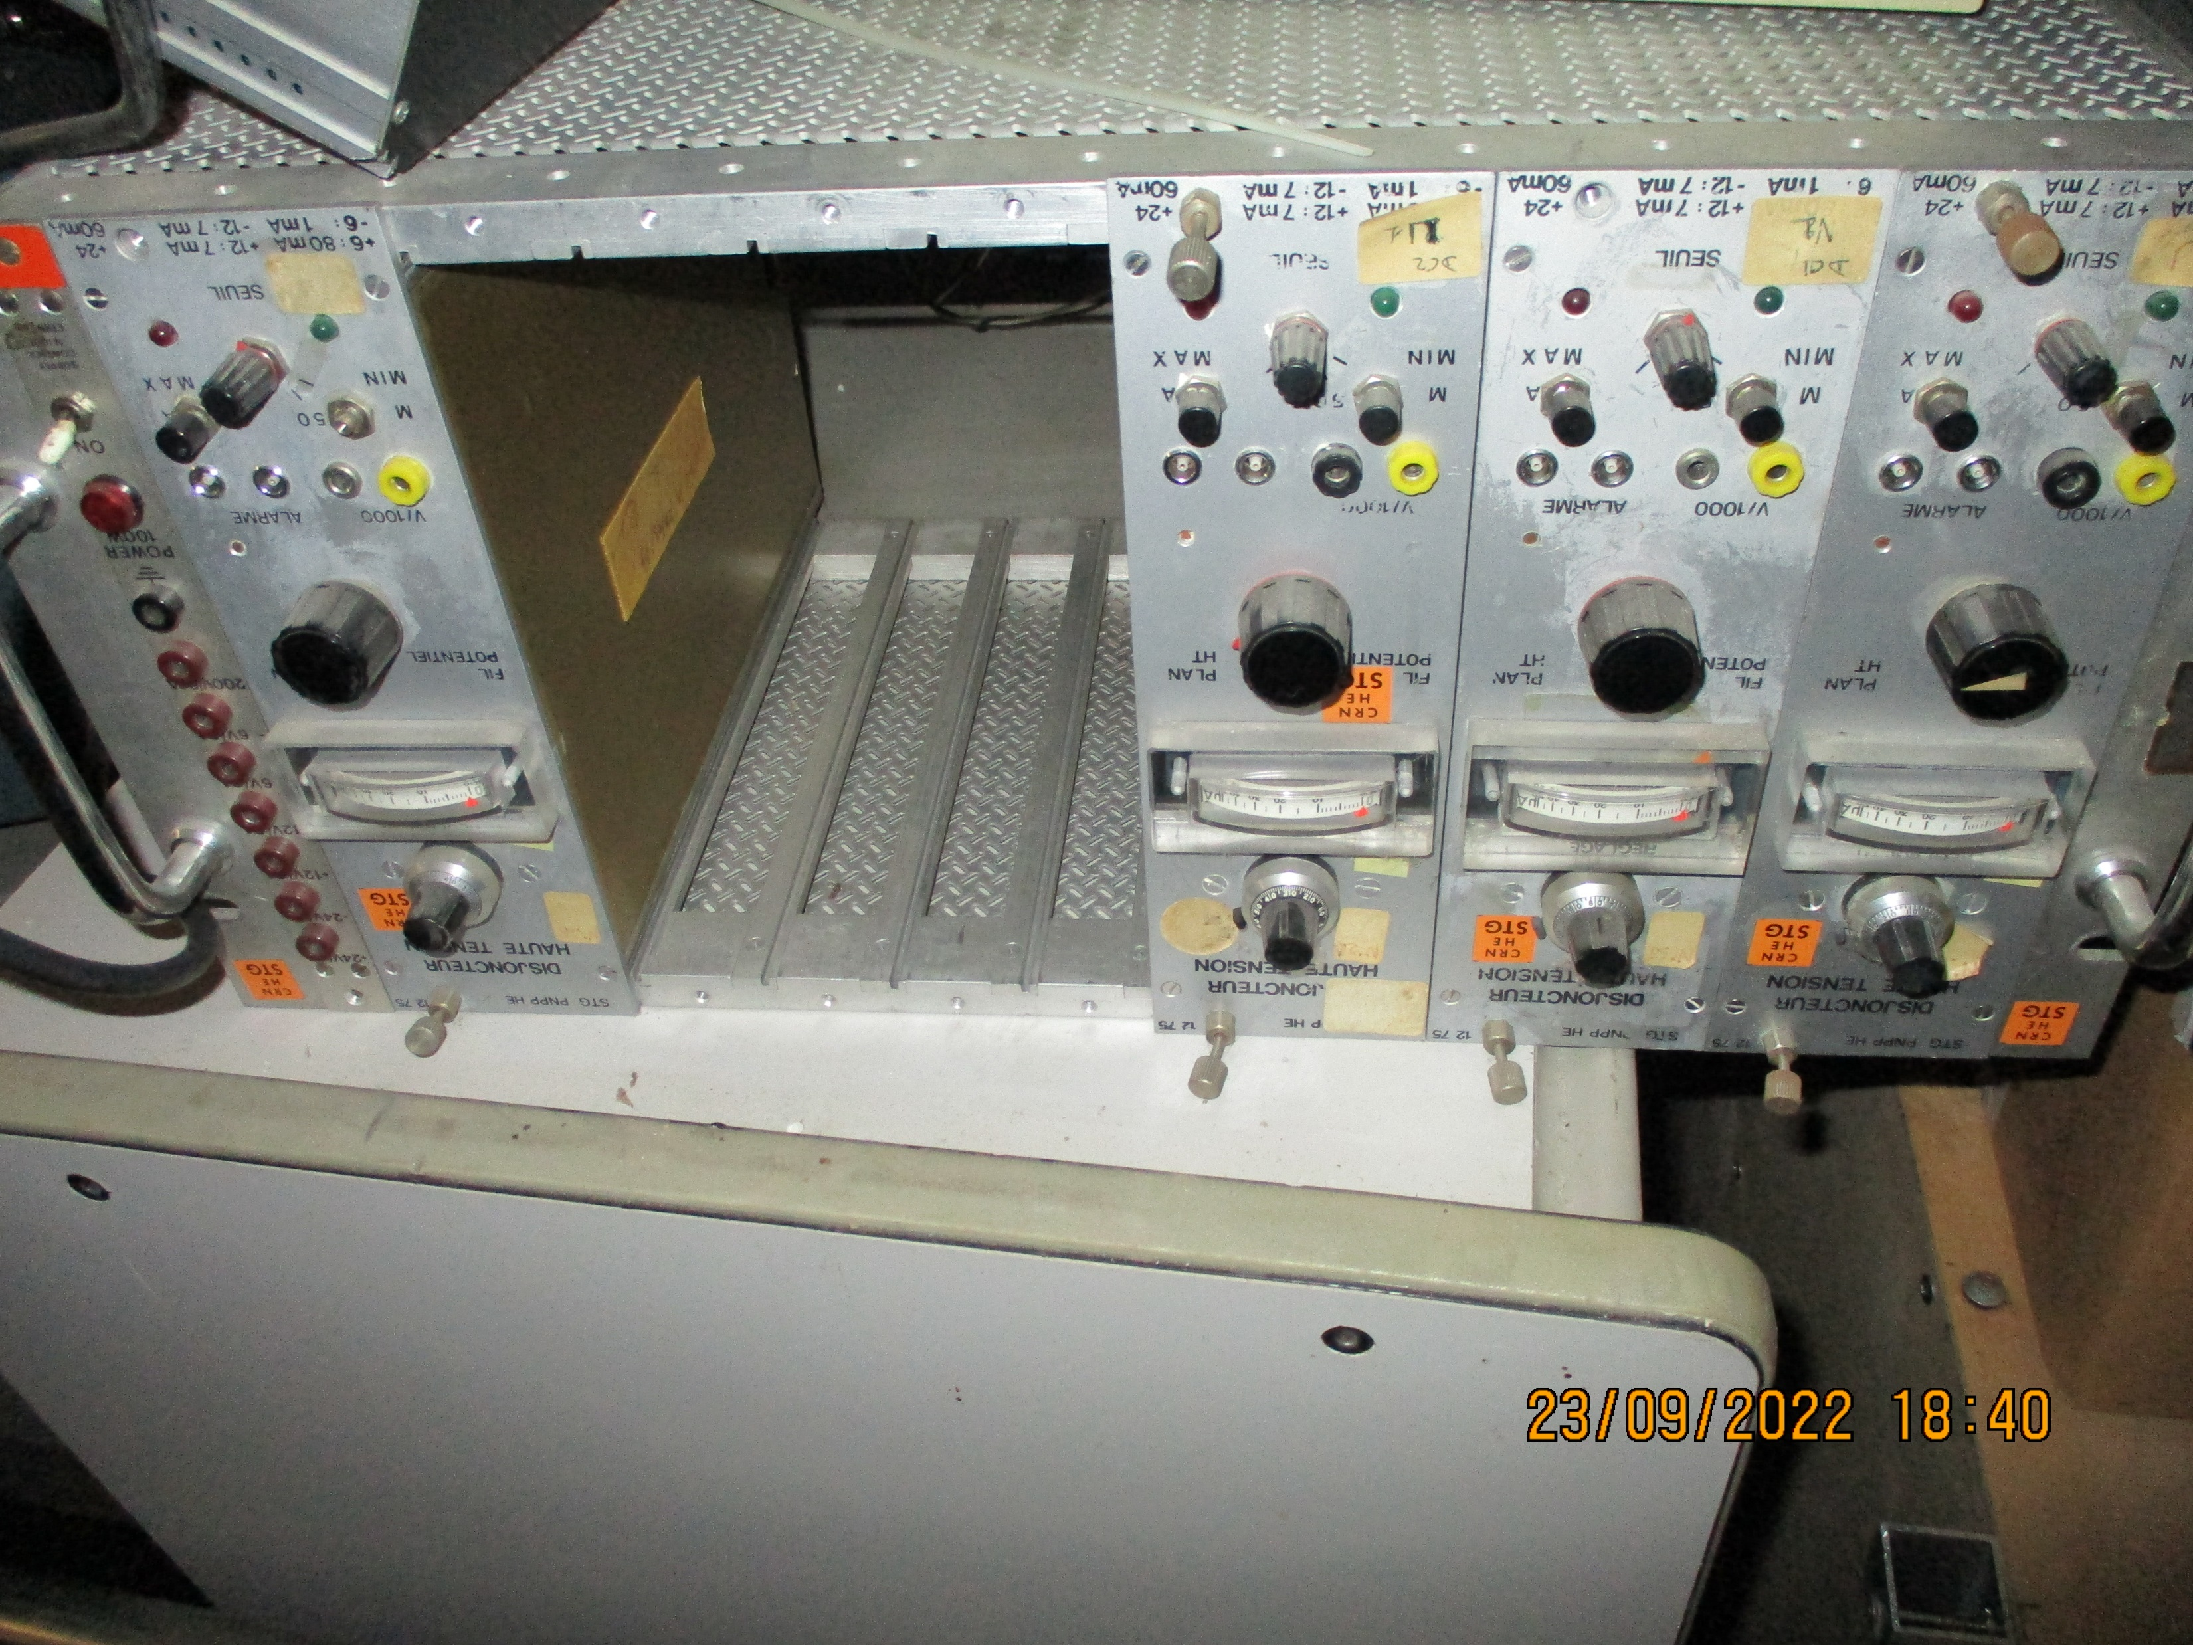
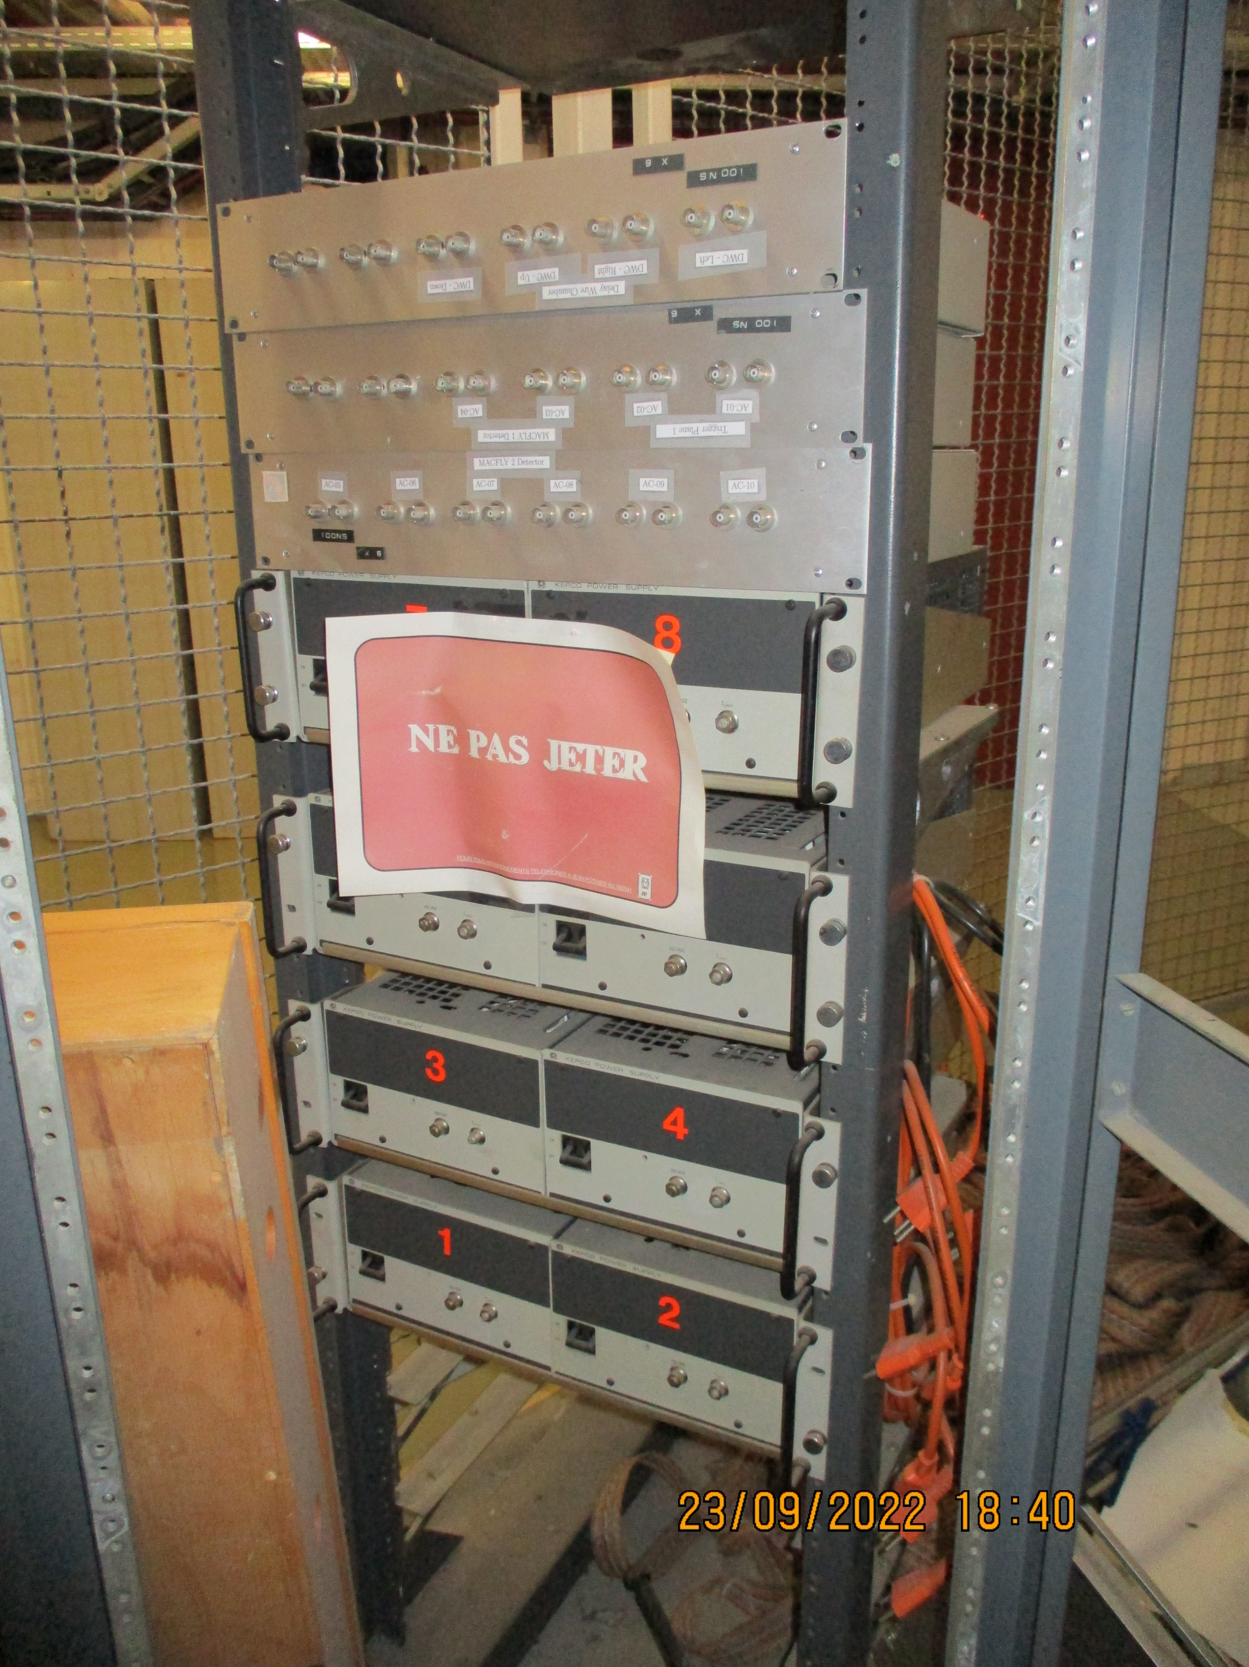
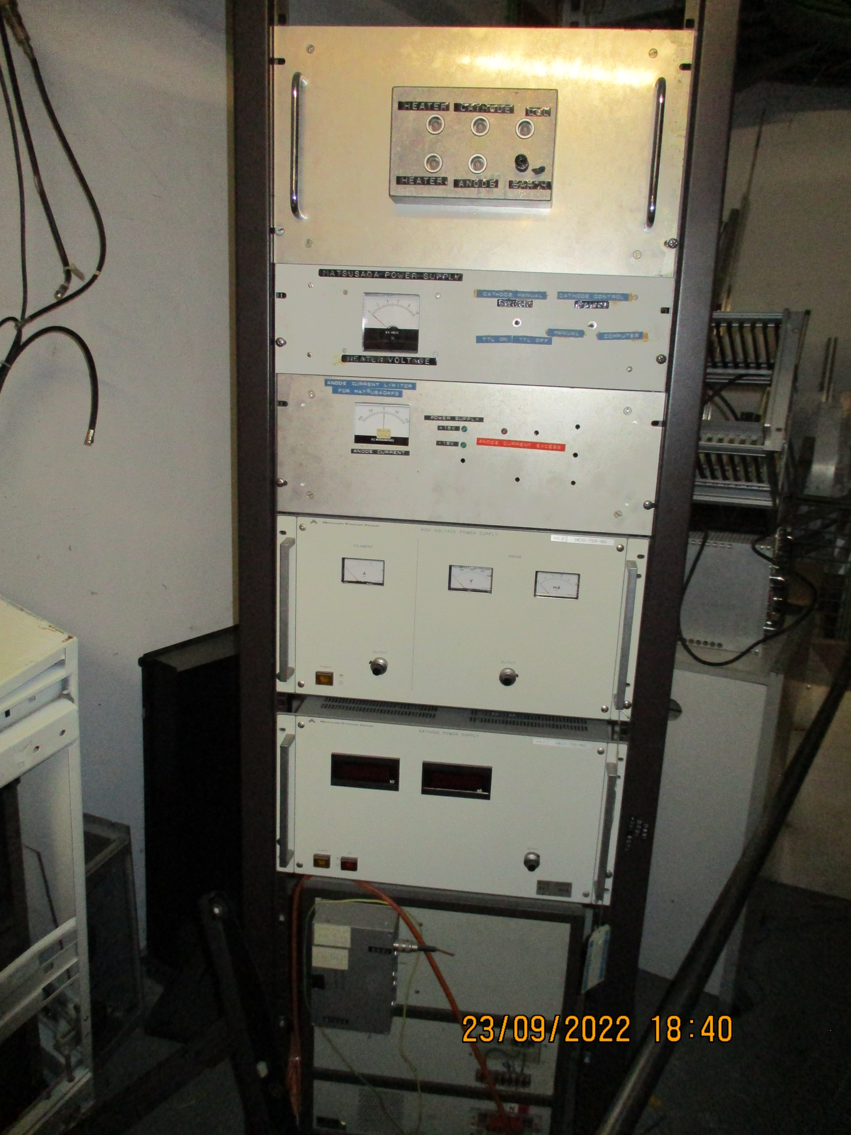
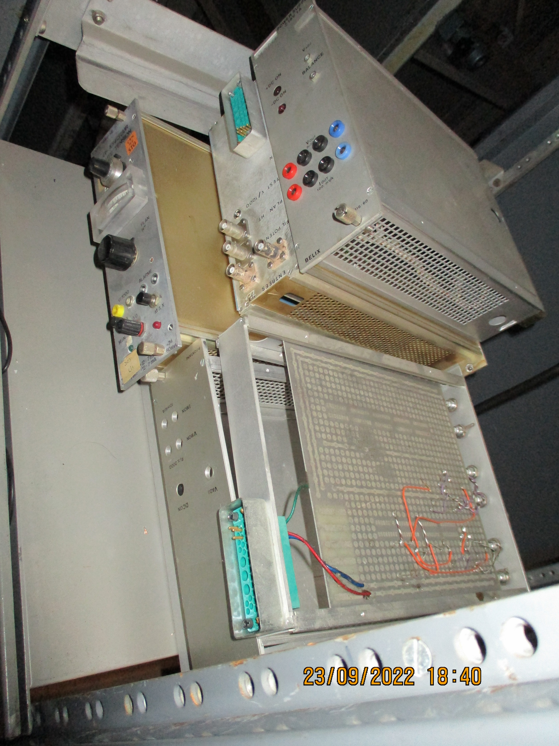
Caged area in the middle of the building.
Is any of this belonging to NA61/NA49 ?

Slide 8
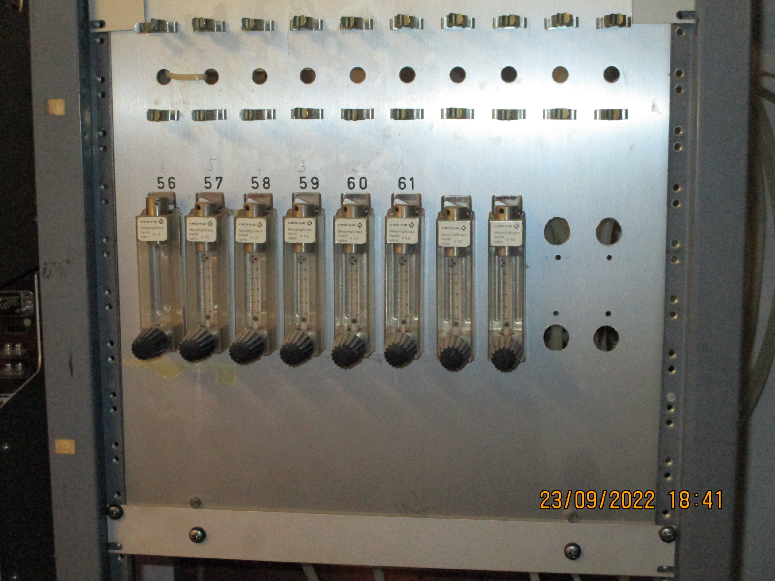
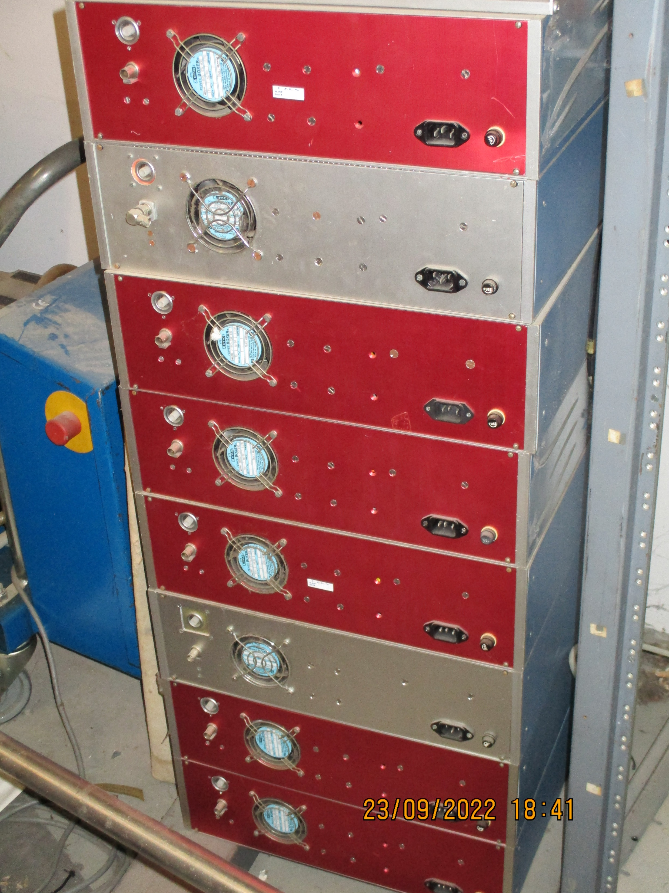
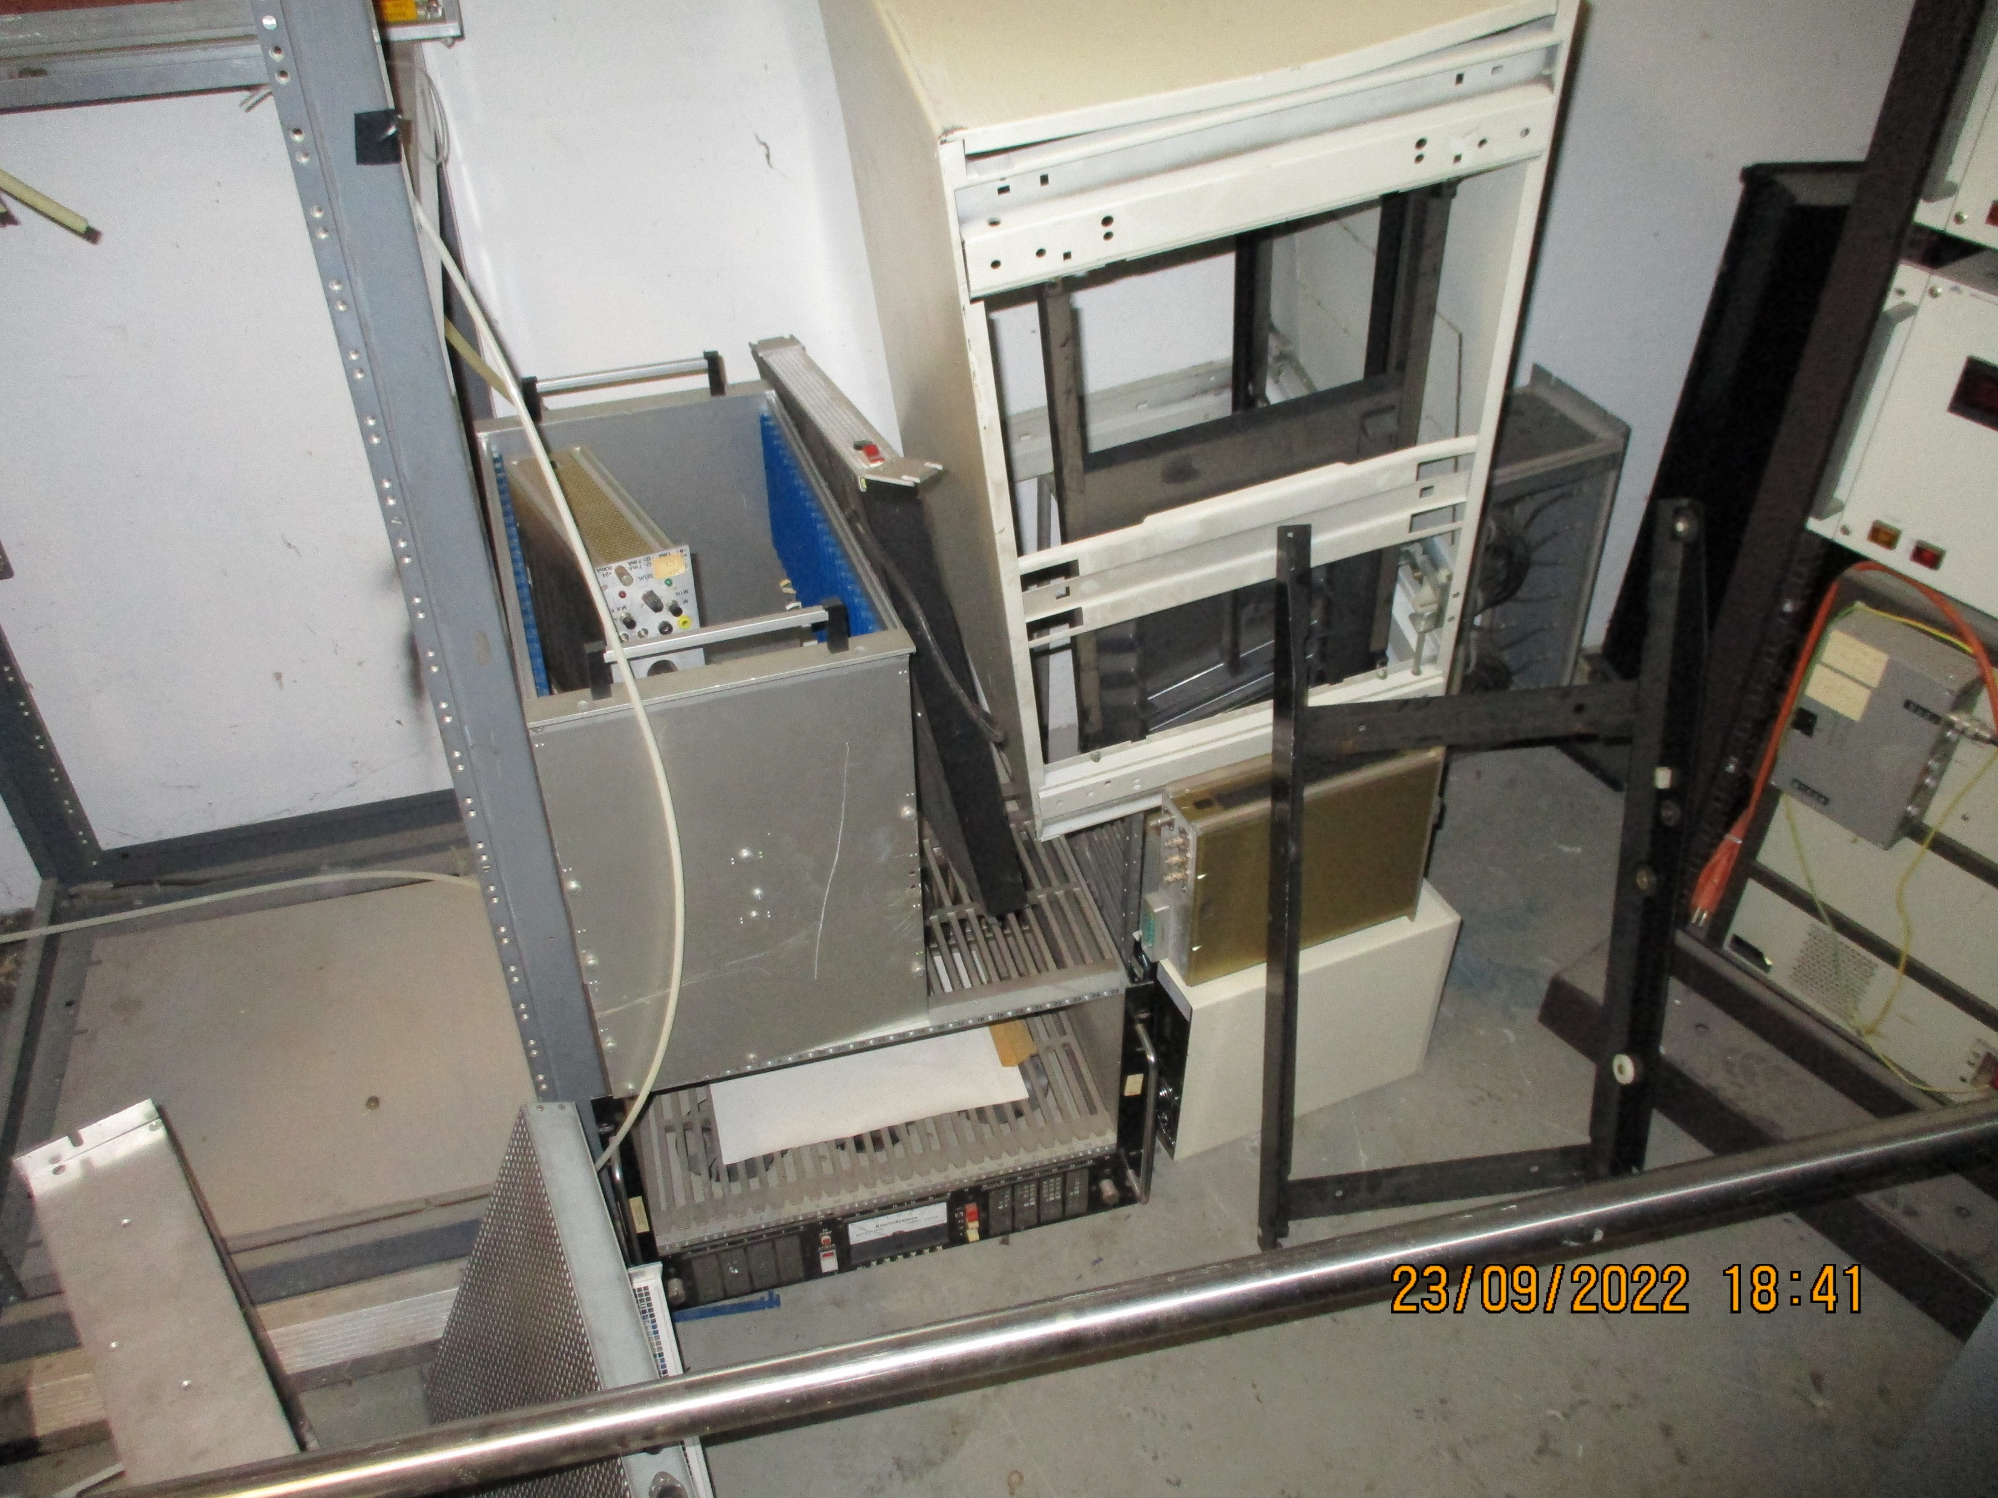
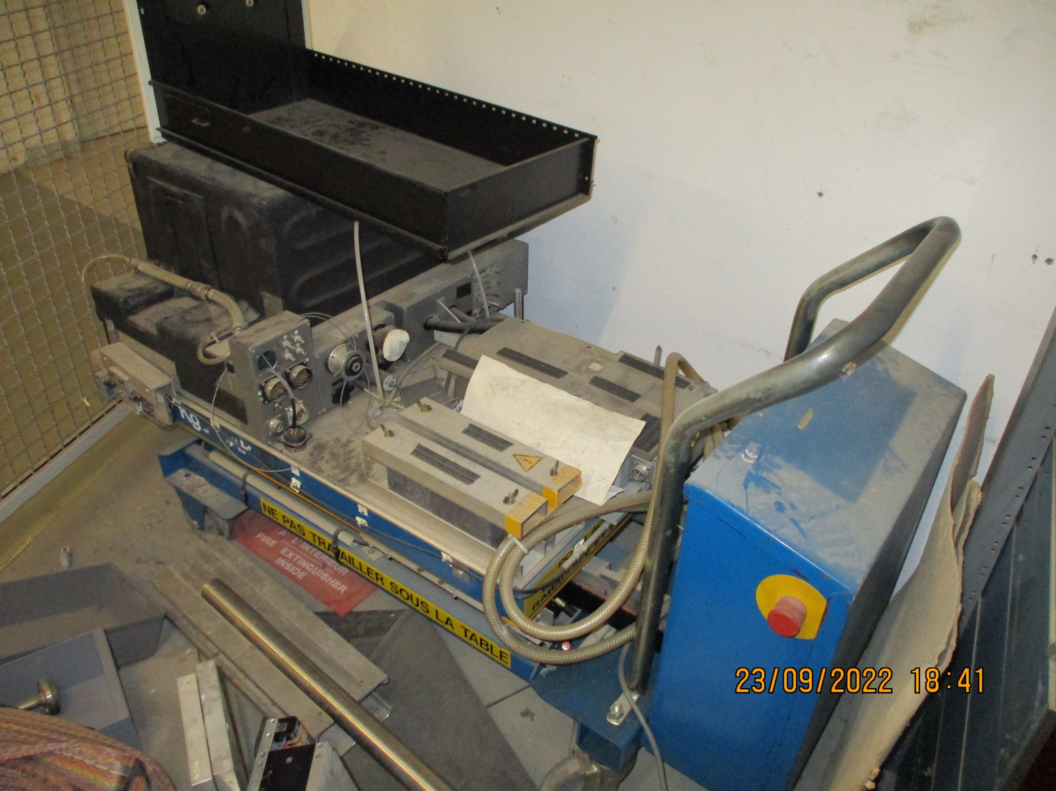
Caged area in the middle of the building.
Is any of this belonging to NA61/NA49 ?

Slide 9
Conclusion
The shelving area of the archive area/room has been cleared as directed by Piotr
Please confirm the binning of the Wiener fan units.
There are 3 piles of aluminium plates and frames in front of the shelving system. Should this be moved to more mechanical related storage on palettes ?
In the centre of the building the fenced off area has plenty of material, racks etc, some belonging to NA61. To be decided.
Additional photos are here;
http://project-cms-rpc-endcap.web.cern.ch/rpc/Physics/Experiments/NA61/Storage/892/Basement/Photos/

