Slide 1
NA61 storage
Martin & Ian

Slide 2
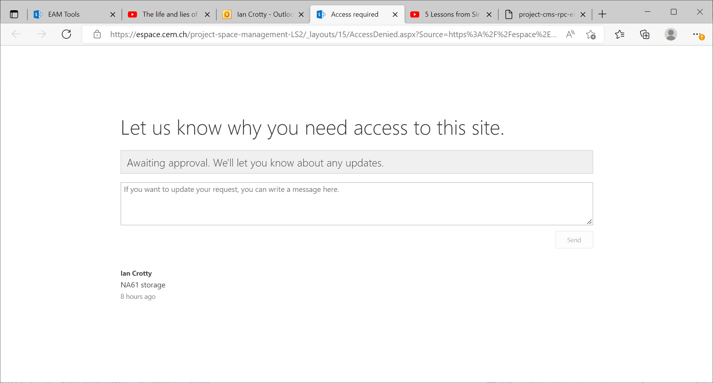
1b -Storage LS3 - List of equipment - 1-All Items (cern.ch)

Slide 3
FLEX
Bat
May 166696
Elsa Clerc 161825
Eric Halbert 166502. I think he has built the system.
Paula Barrier ?? In an email ?
What is extant with NA61
https://twicki.cern.ch/twicki/bin/viewauth/NA61/EquipementStorage (does not work ??)
https://twiki.cern.ch/twiki/bin/viewauth/NA61/WebHome
https://twiki.cern.ch/twiki/bin/view/NA61/EquipmentStorage
https://espace.cern.ch/cmms-service/Pages/EAM%20Tools.aspx

Slide 4
1b -Storage LS3 - List of equipment - 1-All Items (cern.ch)

Slide 5
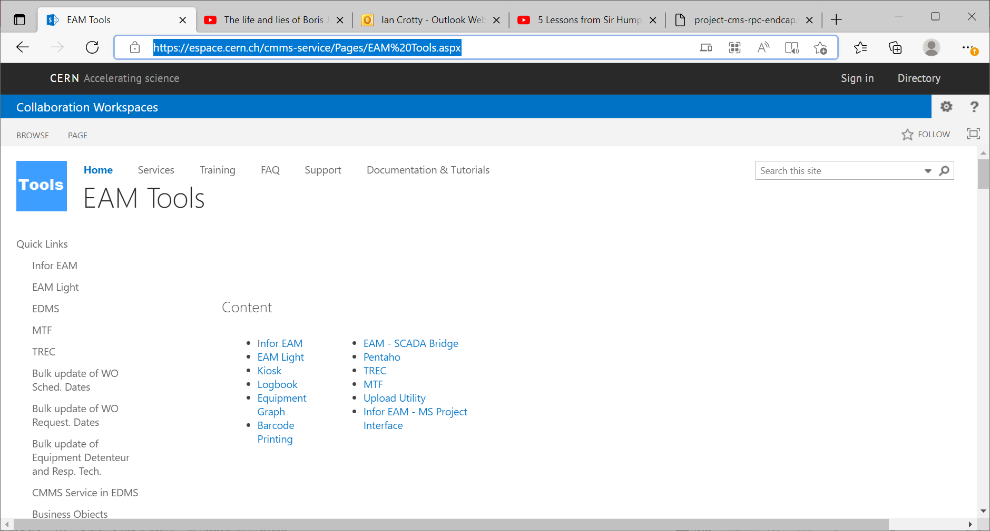

Slide 7
Automatic reply: Ian Crotty wants to access 'Space management and logistics'
Germana Riddone
Sent: 04 August 2022 10:08
To:
Ian Crotty
I am currently on holidays and I will be back to CERN on 22 August.
I will answer to your email as soon as possible.
For questions on collaborations, please contact P. Barrière.
For questions on FAIR at B180, please contact M. Charrondiere.
For questions on HFM, please contact N. Tara.
For questions on Graduate program - Origin, please contact A. Cardinaux and C. Hervet via the generic email box: ORIGIN.GP@cern.ch.
For questions on AFC-2022-2, please contact A. Cardinaux.
For questions on TTE-2022-3, please contact C. Hervet.
Best regards,
Germana

Slide 9
The case of the NA61 target

Slide 10
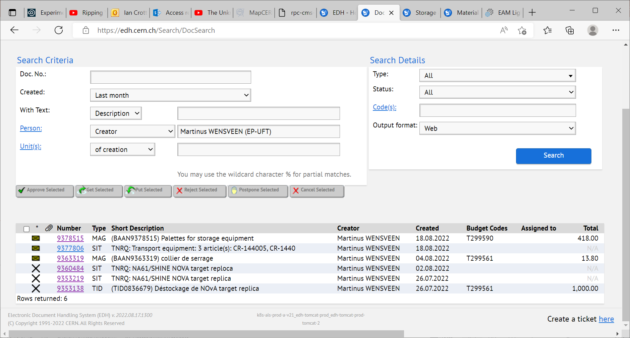

Slide 11
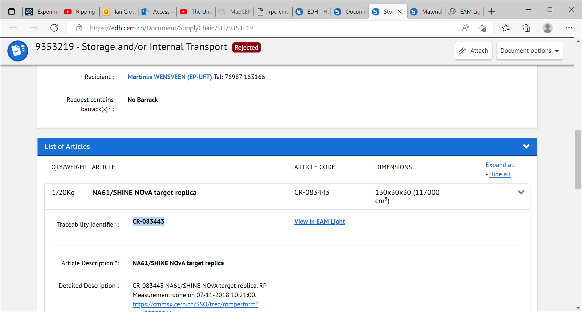
CR-083443
From :
879-R-001 NON DEFINIE PREVESSIN
To *:
887-1-202 COULOIR / DEGAGEMENT PREVESSIN
This is on the first floor

Slide 12
After 3 attepts it was done by Christian lacroix

Slide 13
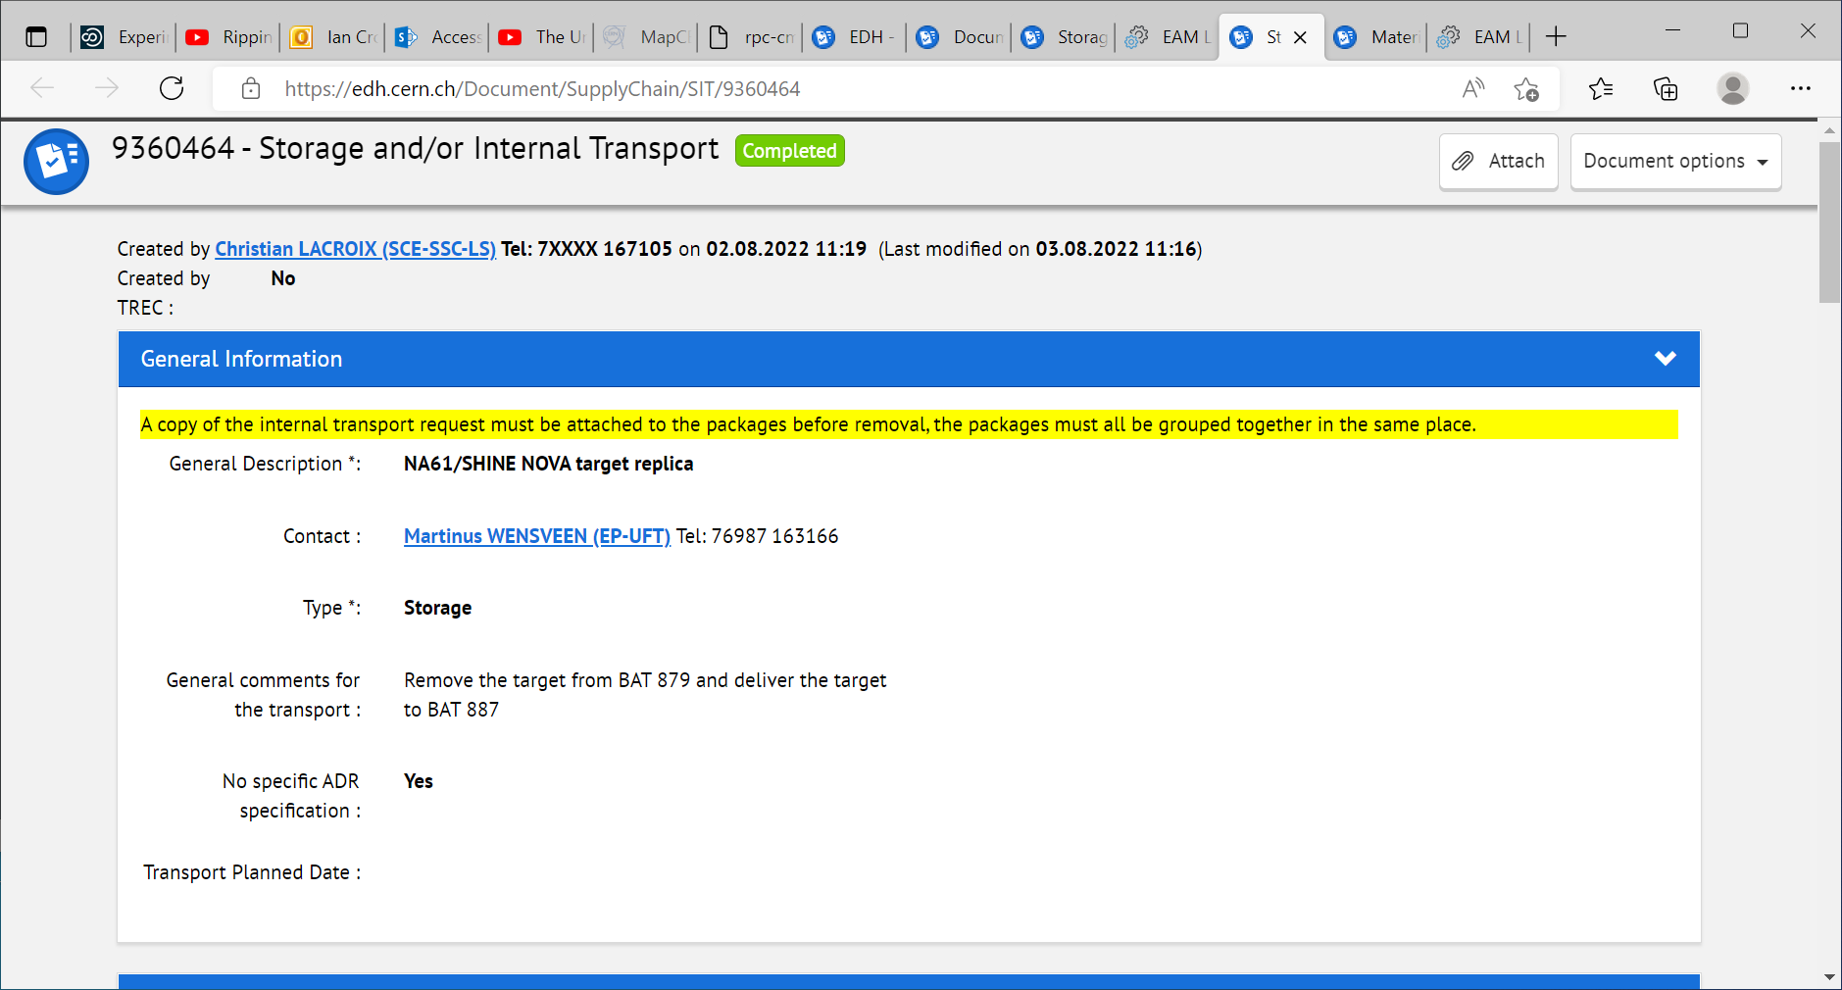

Slide 14
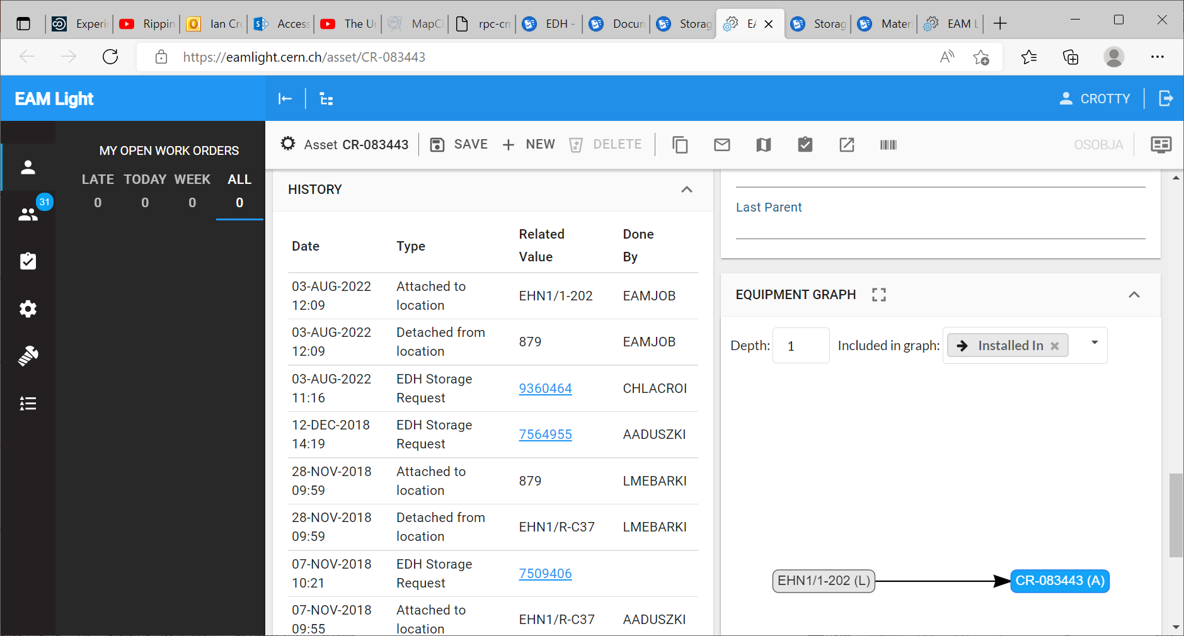
EHN1 = 887 not 879
So now where is it and if in 879 where ? Can it be located.Need Photo
Notice there is no record of it leaving 879….

Slide 15
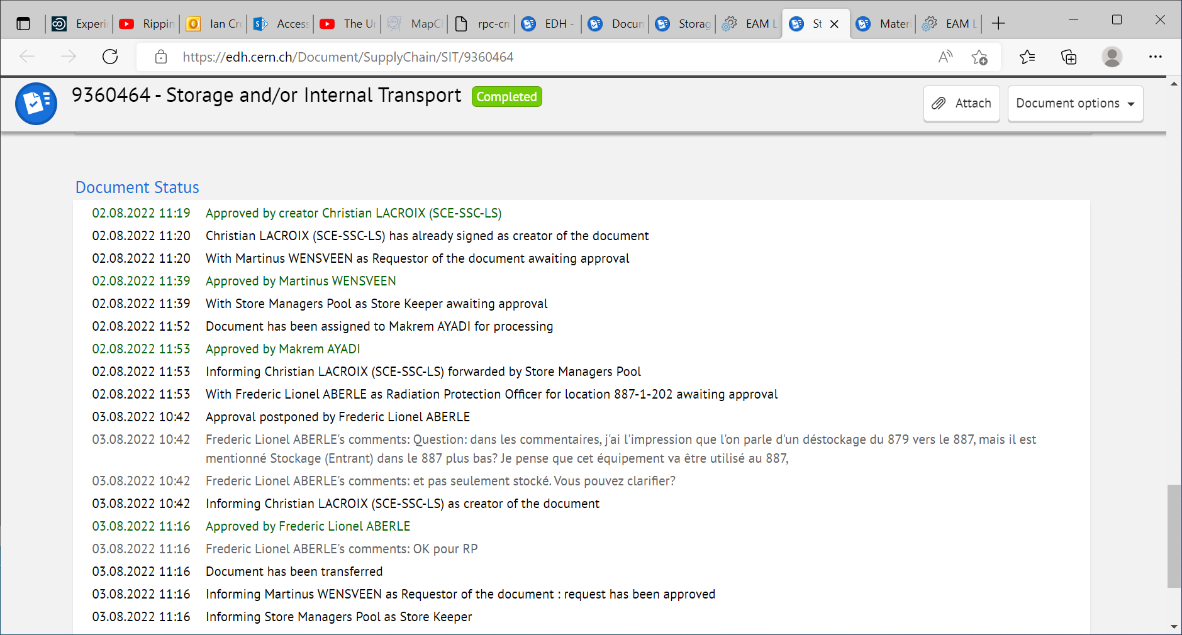

Slide 16
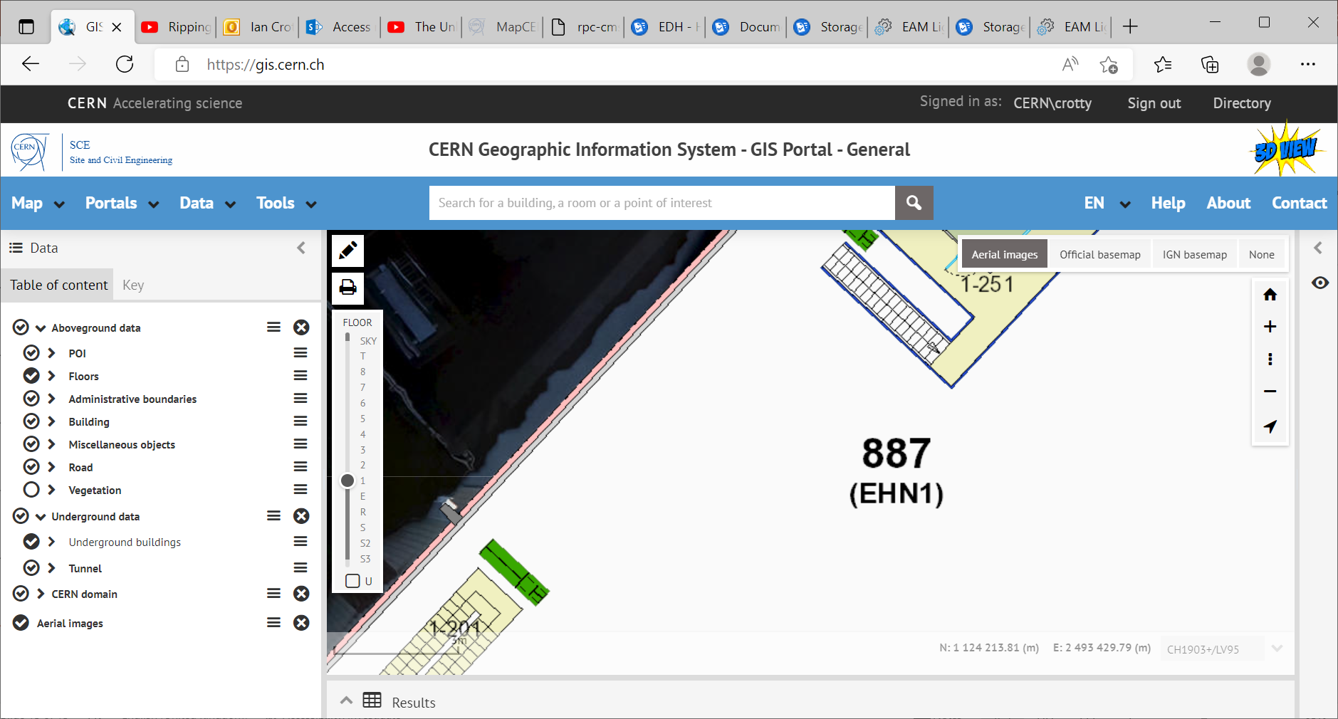
Address EHN1 1-202
Is not found .But 1-202 is next to and above the Buffer zone.

Slide 17
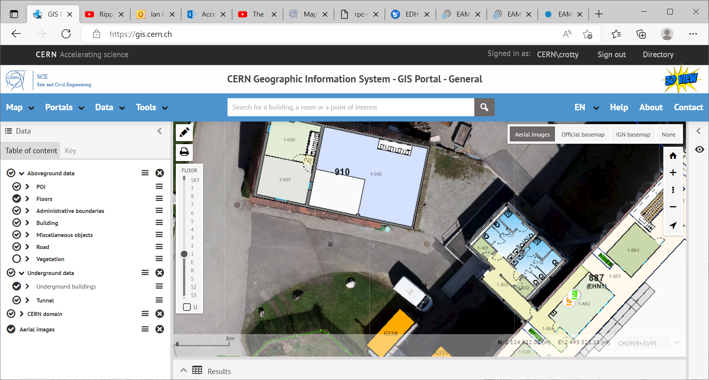
887/1-202
Is here near the coffee mchines

Slide 18
When writing an address into the CERN map the following format is required
887/R-C37
Or
887/1-202

Slide 20
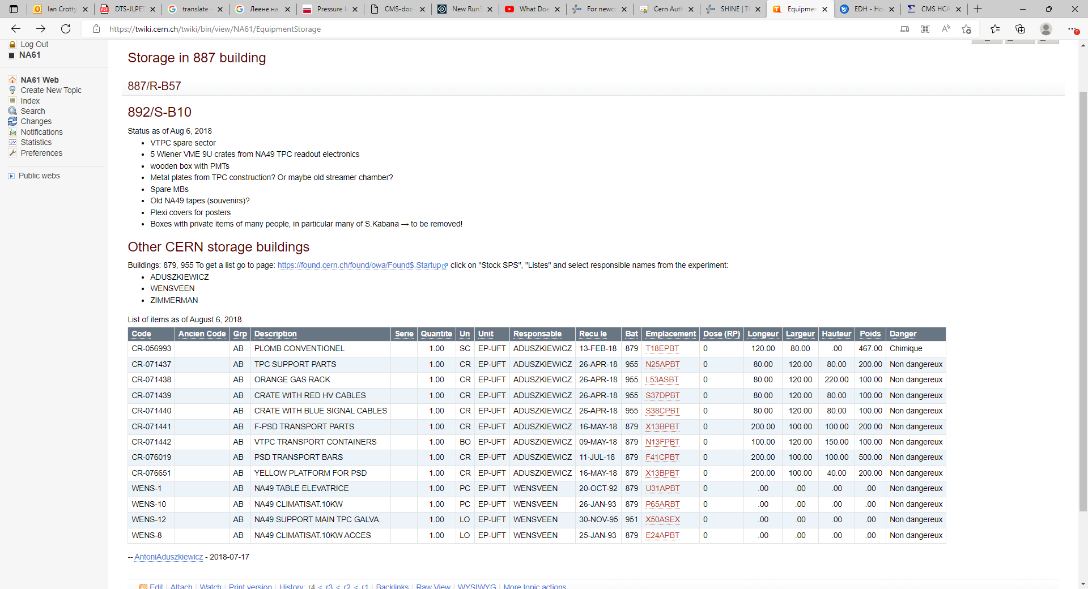
https://twiki.cern.ch/twiki/bin/view/NA61/EquipmentStorage
Buildings: 879, 955
887/R-B57
892/S-B10

Slide 21
Buildings: 879, 955 To get a list go to page: https://found.cern.ch/found/owa/Found$.Startup click on "Stock SPS", "Listes" and select responsible names from the experiment:
ADUSZKIEWICZ
WENSVEEN
ZIMMERMAN
https://found.cern.ch/found/owa/Found$.Startup

Slide 22
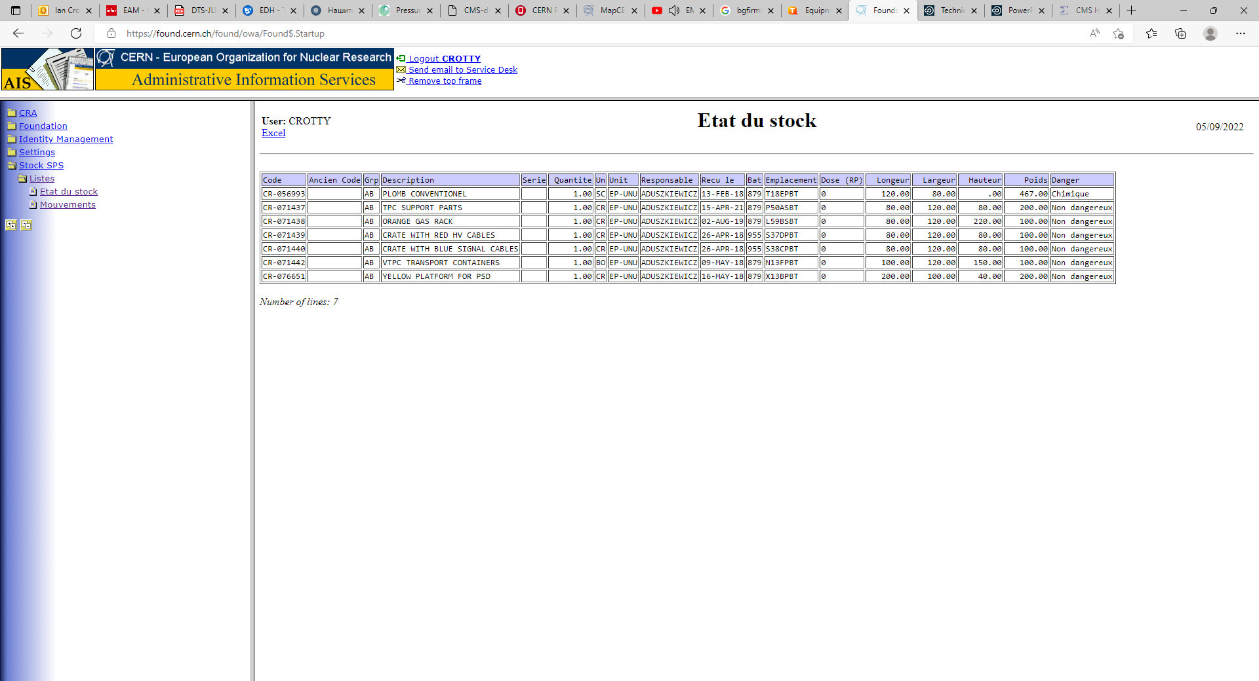
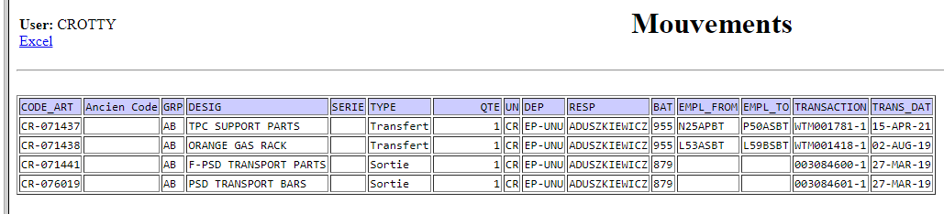
https://found.cern.ch/found/owa/Found$.Startup

Slide 23
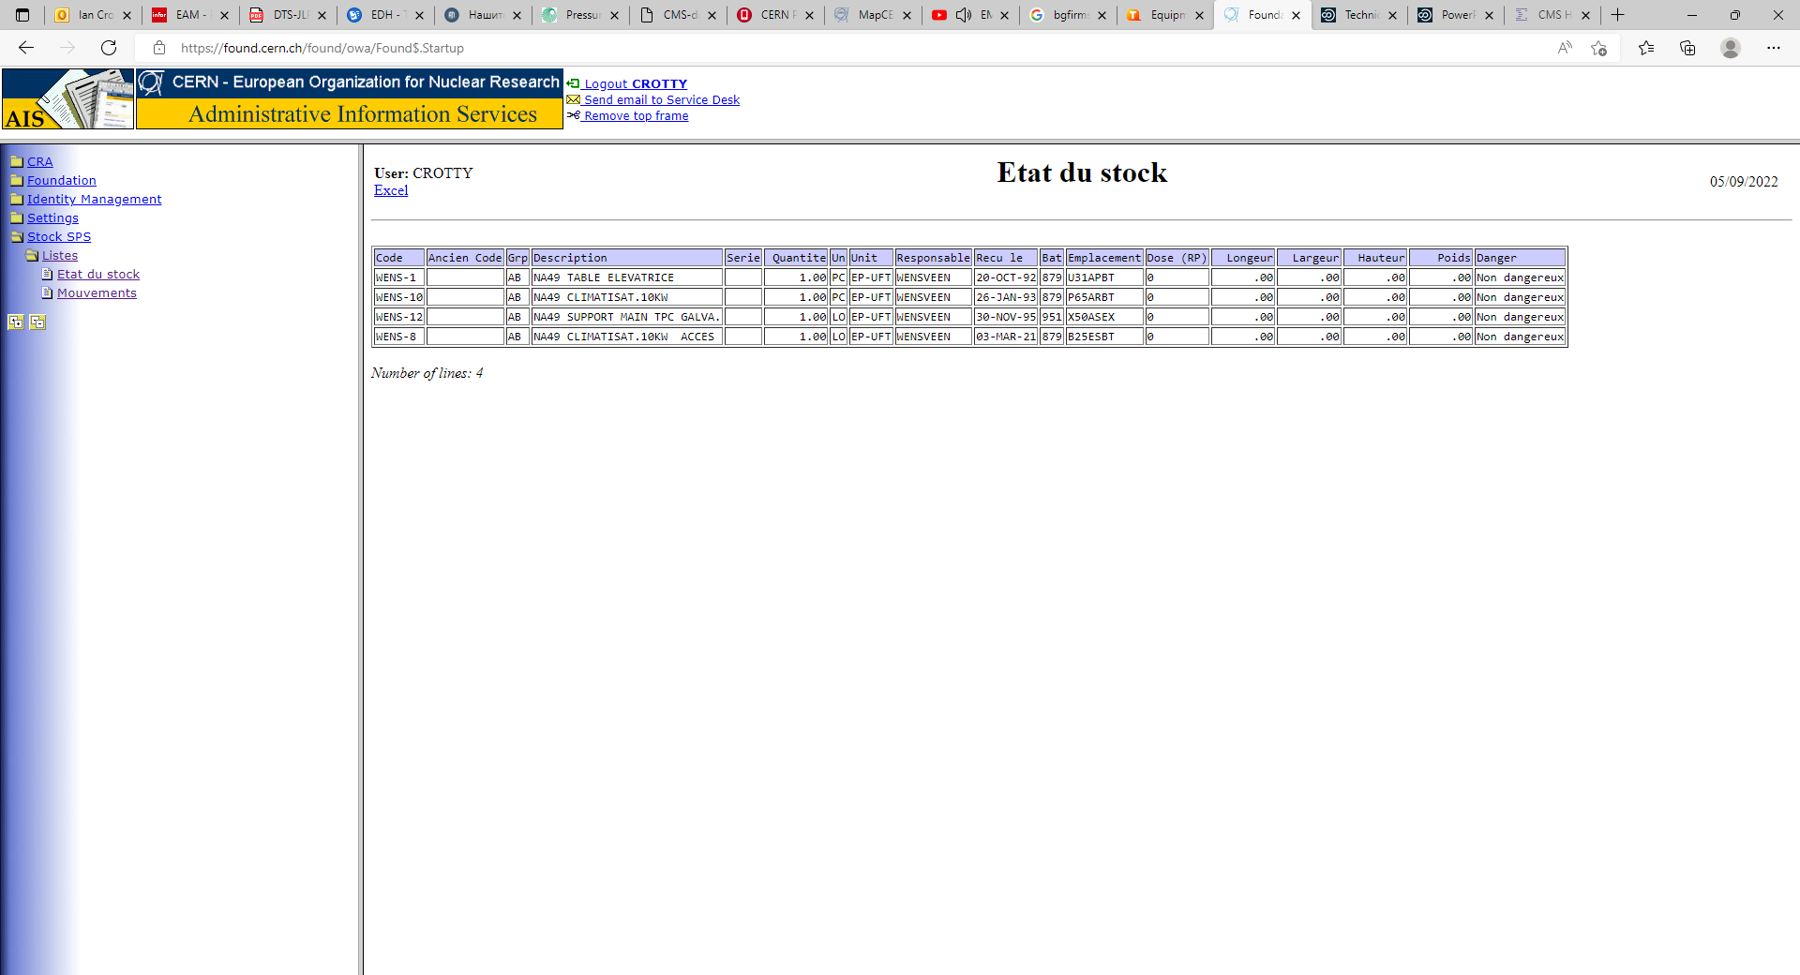
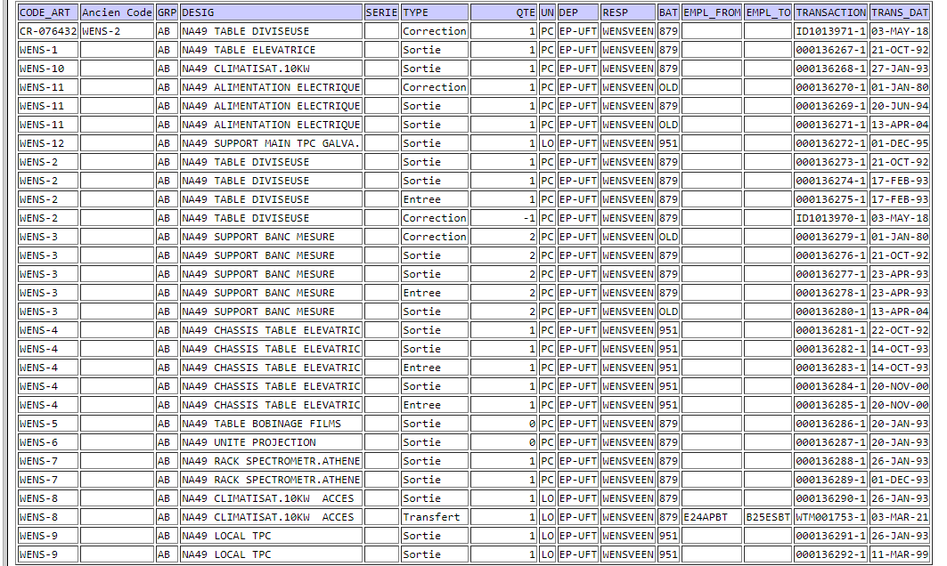
https://found.cern.ch/found/owa/Found$.Startup
Movements

Slide 24
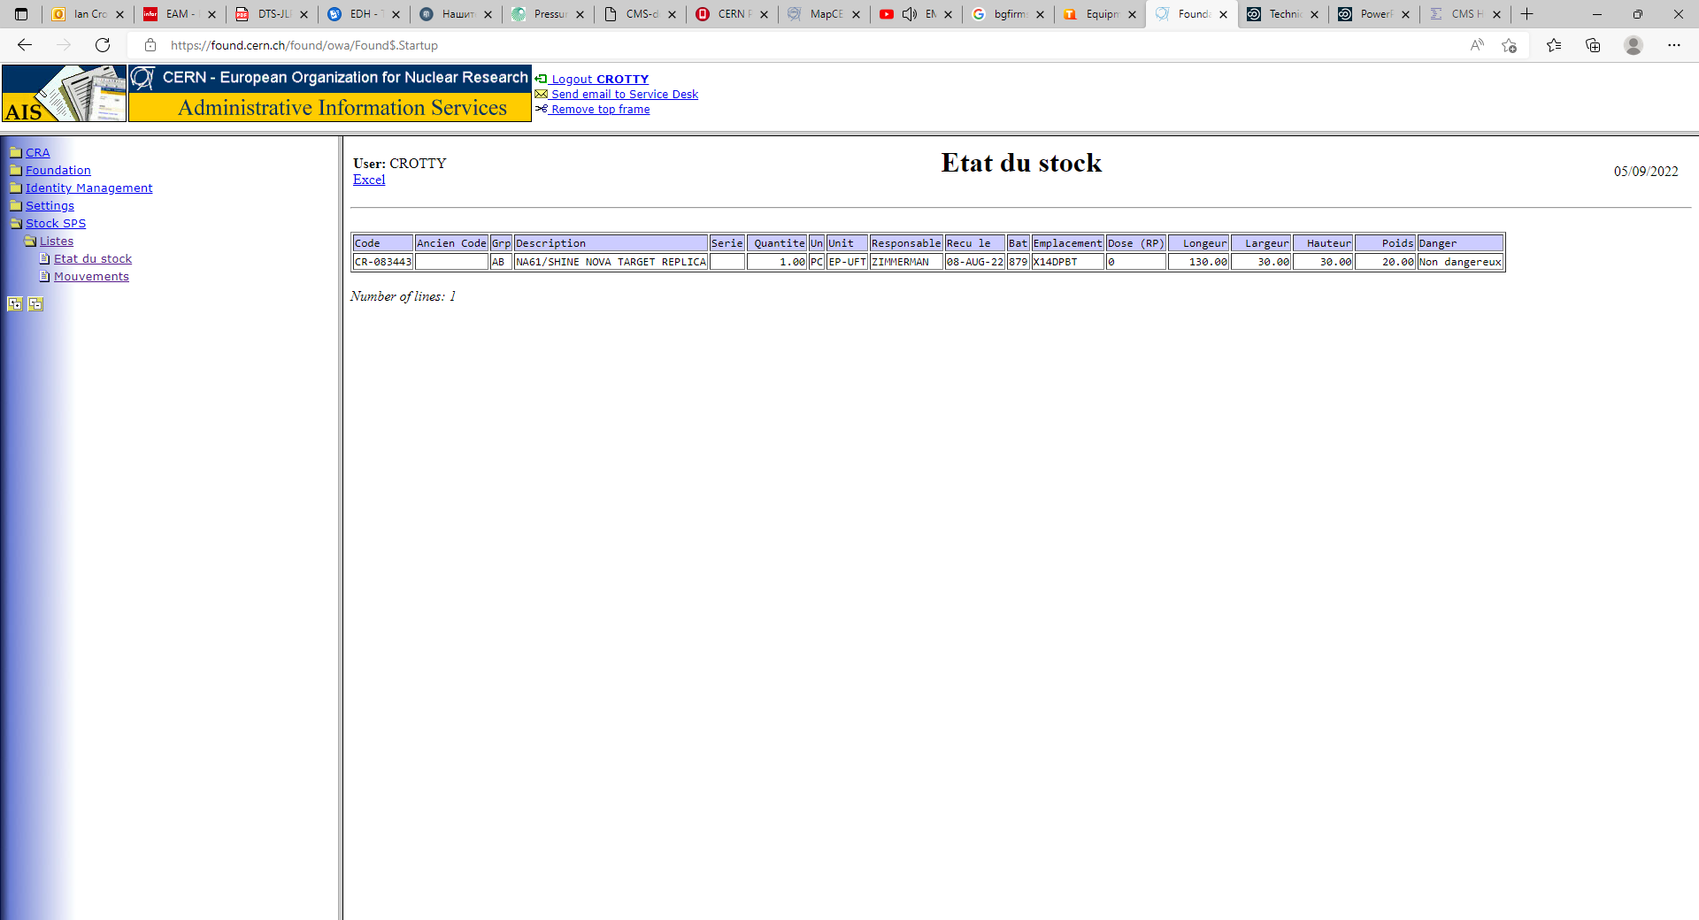


Slide 26
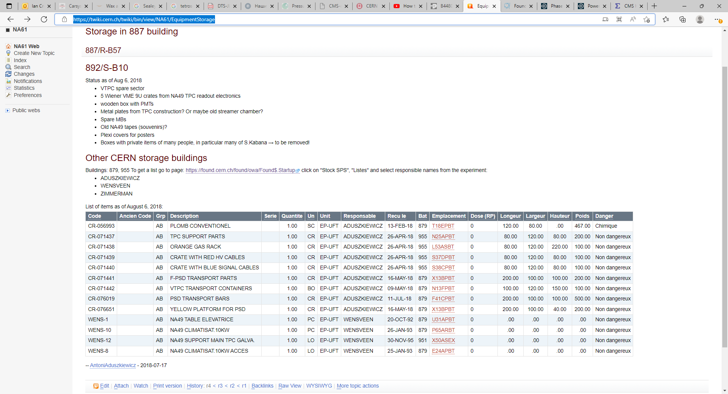
https://twiki.cern.ch/twiki/bin/view/NA61/EquipmentStorage

Slide 27
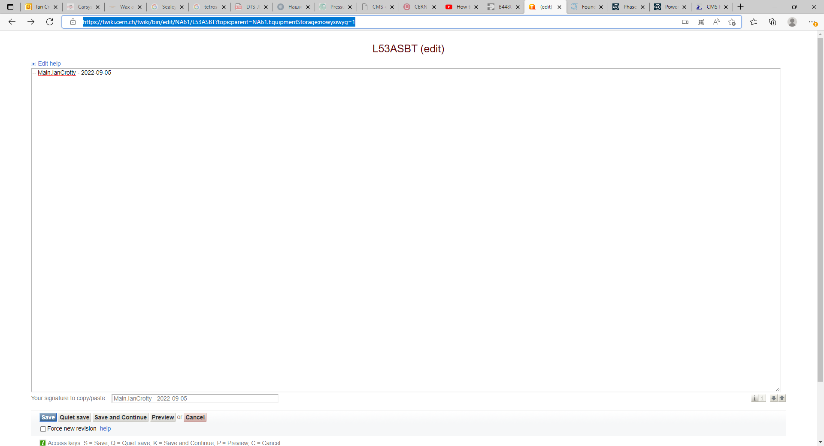
https://twiki.cern.ch/twiki/bin/edit/NA61/L53ASBT?topicparent=NA61.EquipmentStorage;nowysiwyg=1

Slide 28
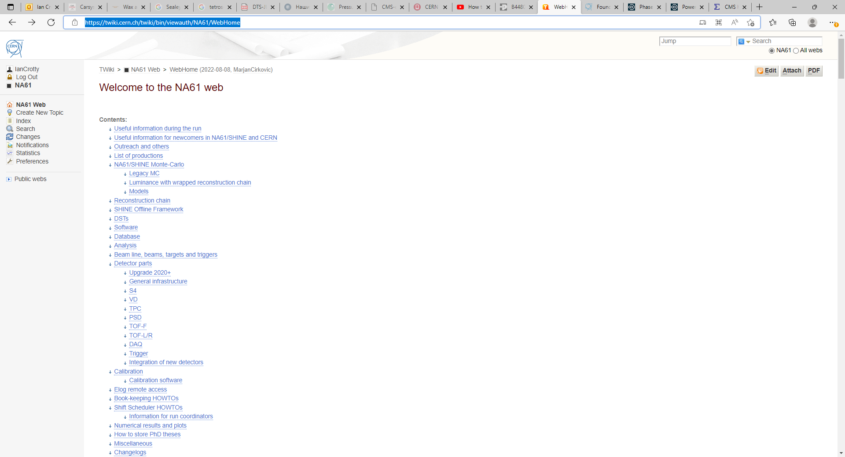
https://twiki.cern.ch/twiki/bin/viewauth/NA61/WebHome
Storage is at the bottom, seebelow

Slide 29
