Slide 1
LV cables and Ground straps
CR-140797
Ian
17 Nov 2022

Slide 2
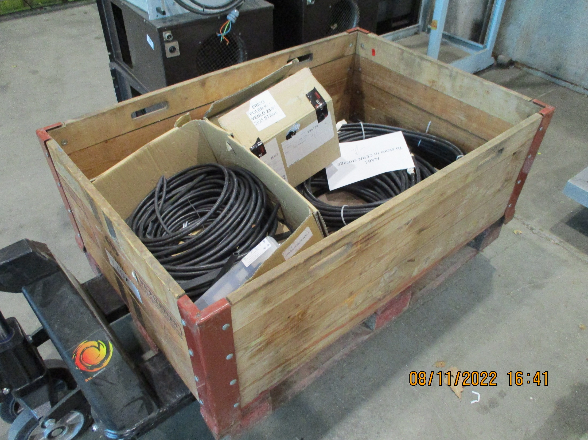
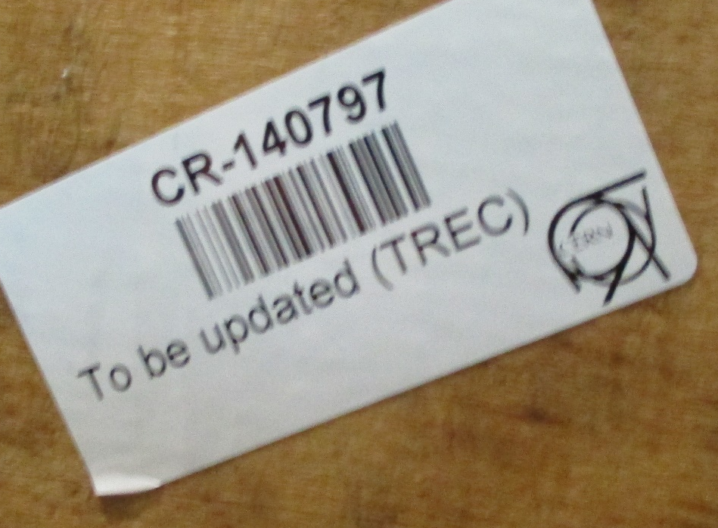
Name plates are now attached to each end of the palette

Slide 3
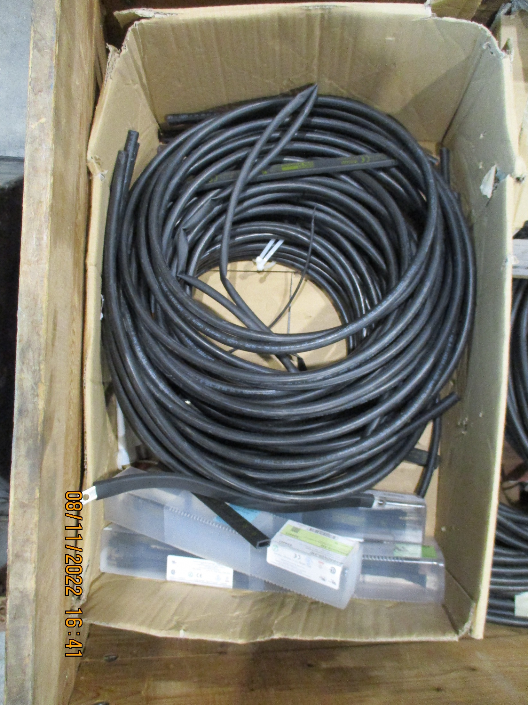
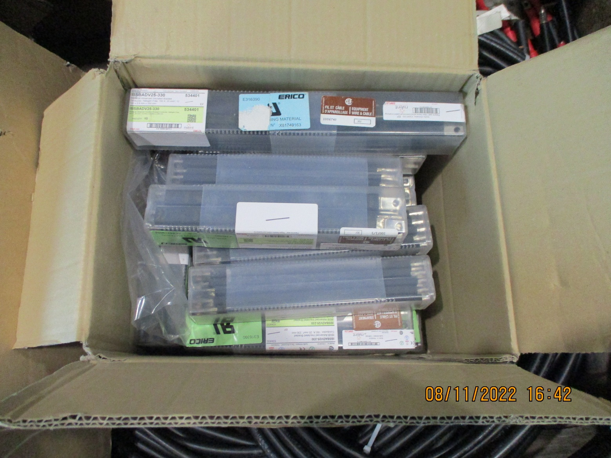
Braid ground straps
160A 25mm2
L= 230-330mm in 22 boxes
LV cable SCEM 04.08.61.935.8 with lugs & short lengths without lugs

Slide 4
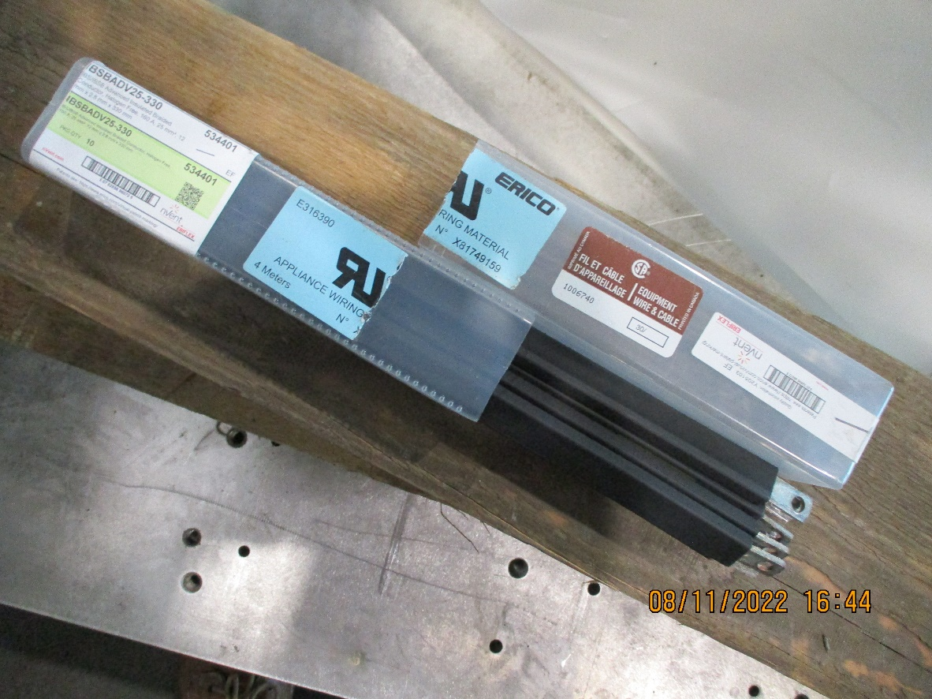
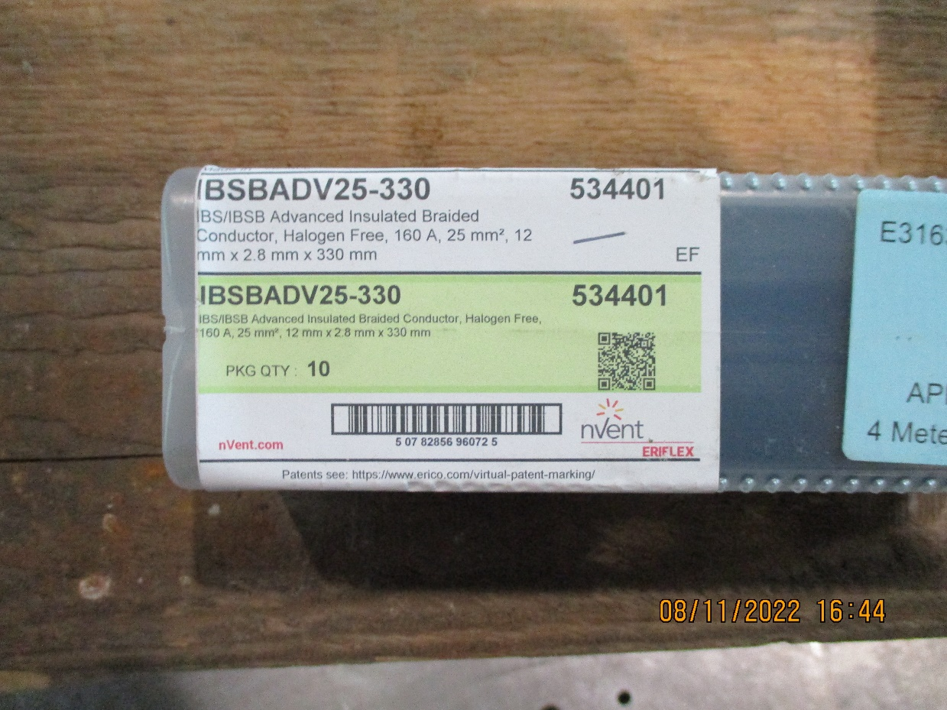

Slide 5
