Slide 1
NA61 NOvA NuMI Target Replica
TREC document for
CR-083443
Ian
3 May 2023

Slide 2
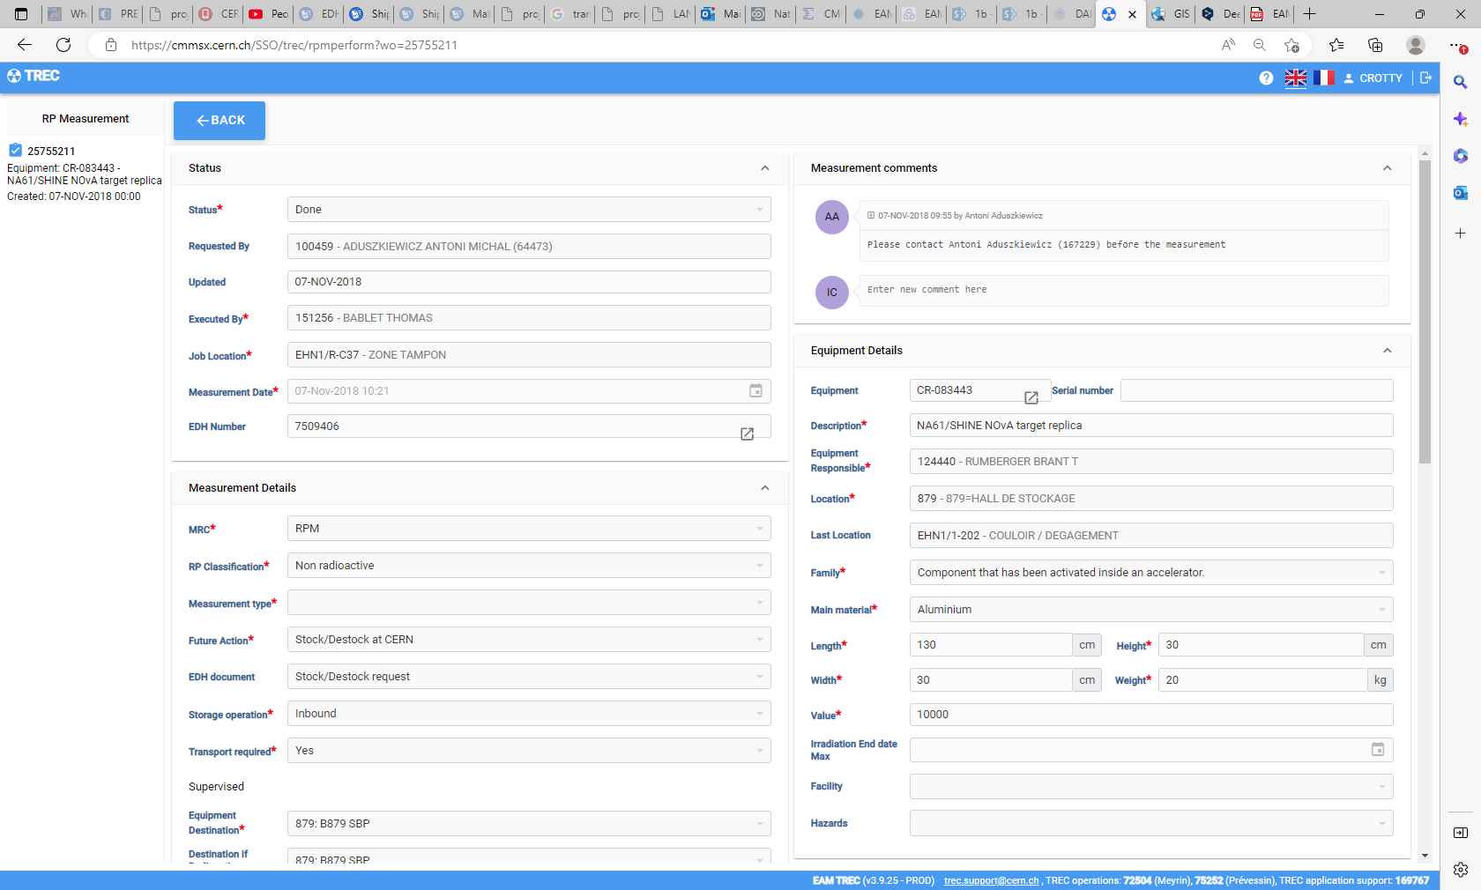
https://cmmsx.cern.ch/SSO/trec/rpmperform?wo=25755211

Slide 3
