Slide 1
Collaboration meeting NA61
Jura Krakowsko-Częstochowska
Ian
13 feb 2023

Slide 2
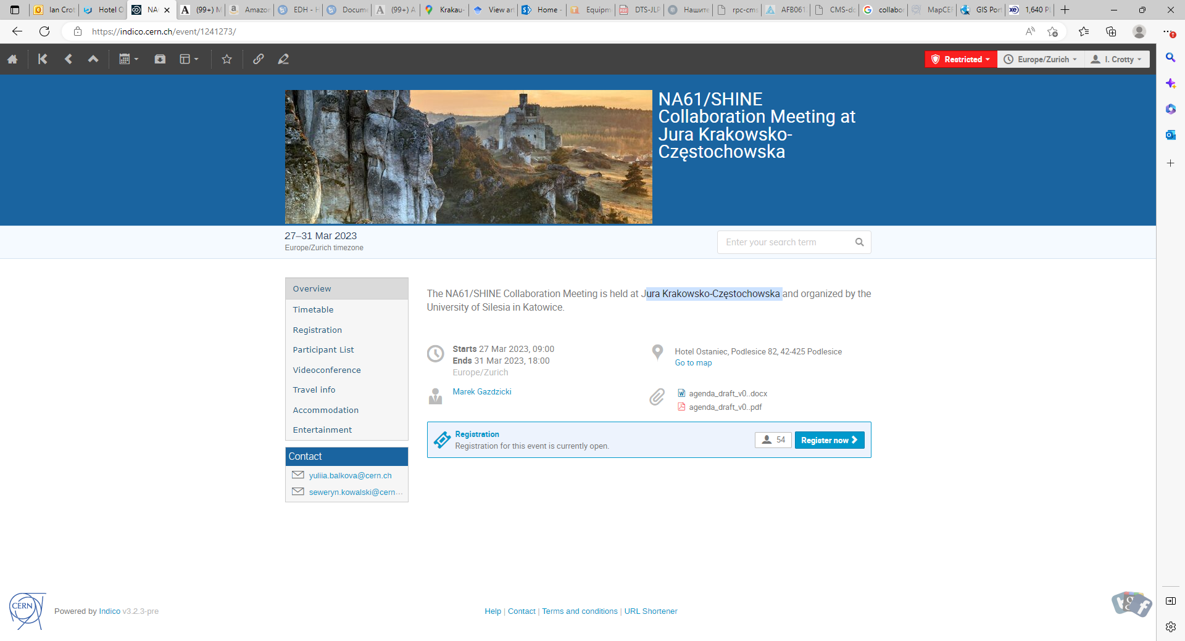
https://indico.cern.ch/event/1241273/page/28206-accommodation

Slide 3
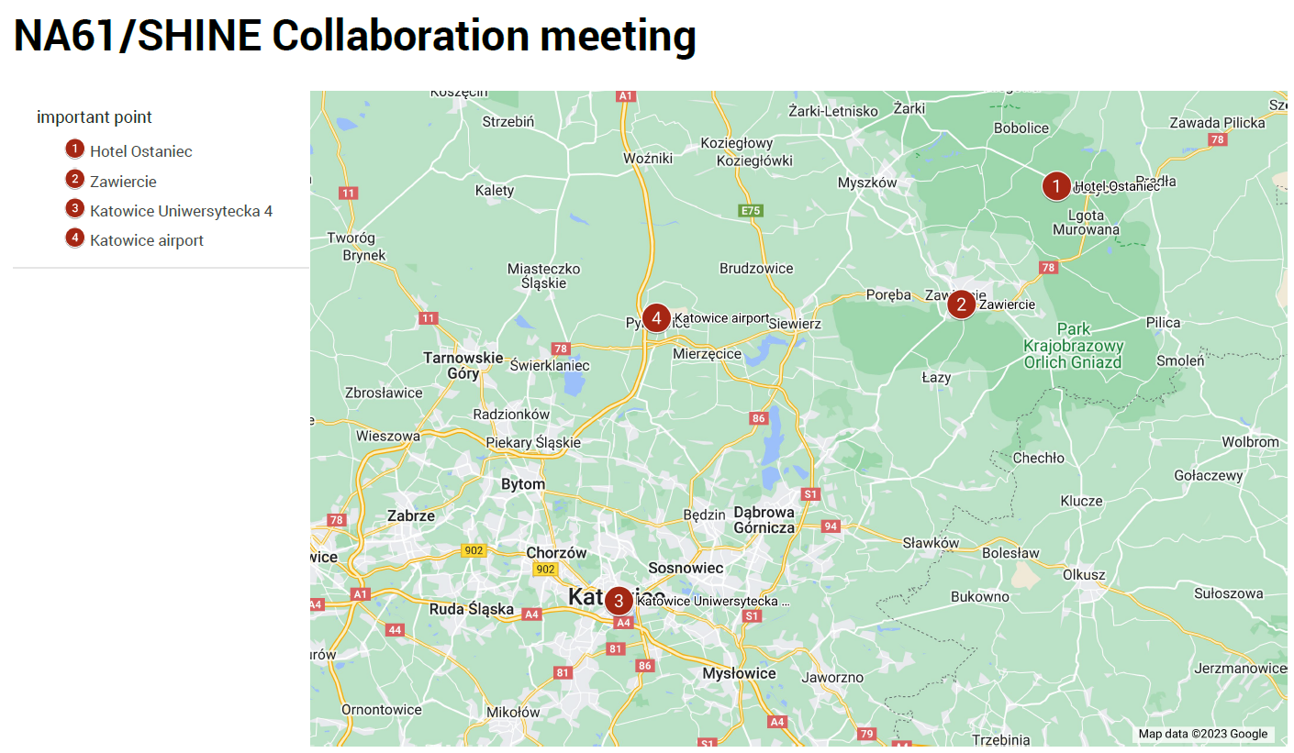
Hotel Ostaniec
Zawiercie
Katowice Uniwersytecka 4
Katowice Airport

Slide 4
Travel info
To reach Hotel Ostaniec, you can choose:
Your own car.
Train: the nearest railway station is in Zawiercie. Fast trains from Warsaw, Kielce, and Katowice stop at this station. You can find the train timetable under the link https://rozklad-pkp.pl/en. You can get from the station to the hotel by taxi price (~100 PLN).
Plane: nearest airports are in Katowice, Krakow, Wrocław or Warsaw. From the Katowice airport, you can reach the Katowice city center by bus or taxi.
We plan to organize a bus to the hotel on Sunday, March 26, 2023, in the evening, departing from Katowice Centrum (lot parking lot at Uniwersytecka, 4) and stopping at the Katowice airport and the Zawiercie railway station. The return bus is planned for Saturday, April 1, 2023, in the morning, with stops at the station in Zawiercie, the airport in Katowice, and Katowice Centrum (lot parking lot at Uniwersytecka,4)

Slide 5
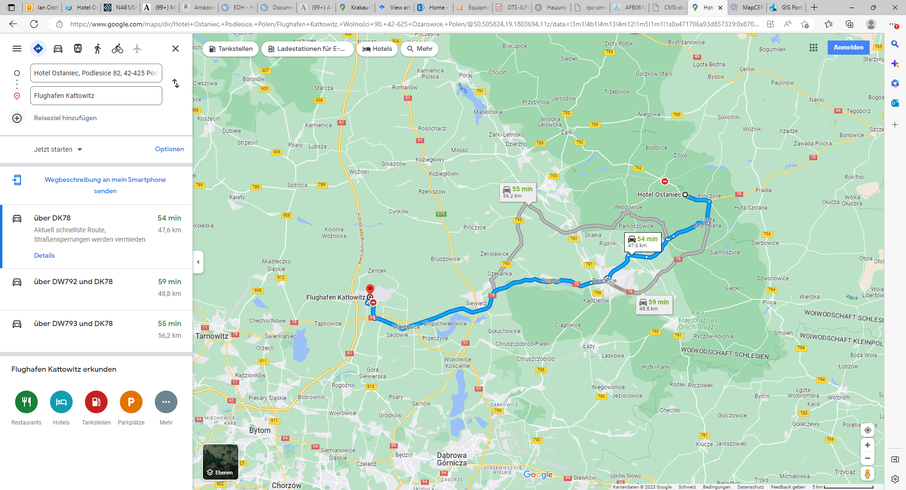

Slide 6
https://www.ccra.com/airport-codes/
KTW Katowice Airport
WAW warsaw
FRA francfort

Slide 7
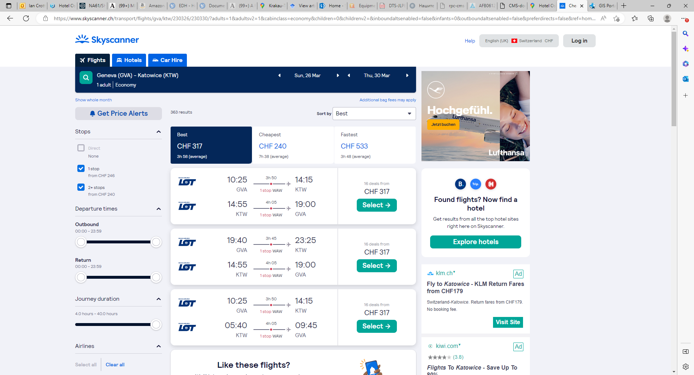

Slide 8
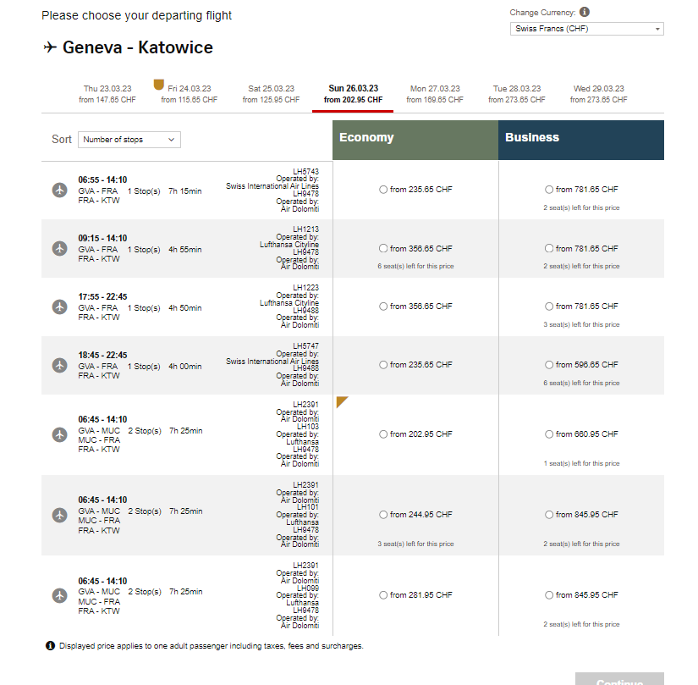
https://book.swiss.com/lh/dyn/air-lh/revenue/viewFlights

Slide 9
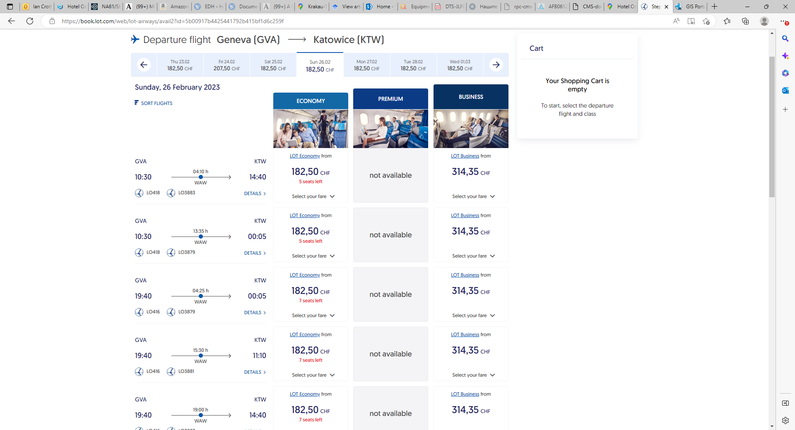
https://book.lot.com/web/lot-airways/avail2?id=5b00917b4425441792b415bf1d6c259f

Slide 11
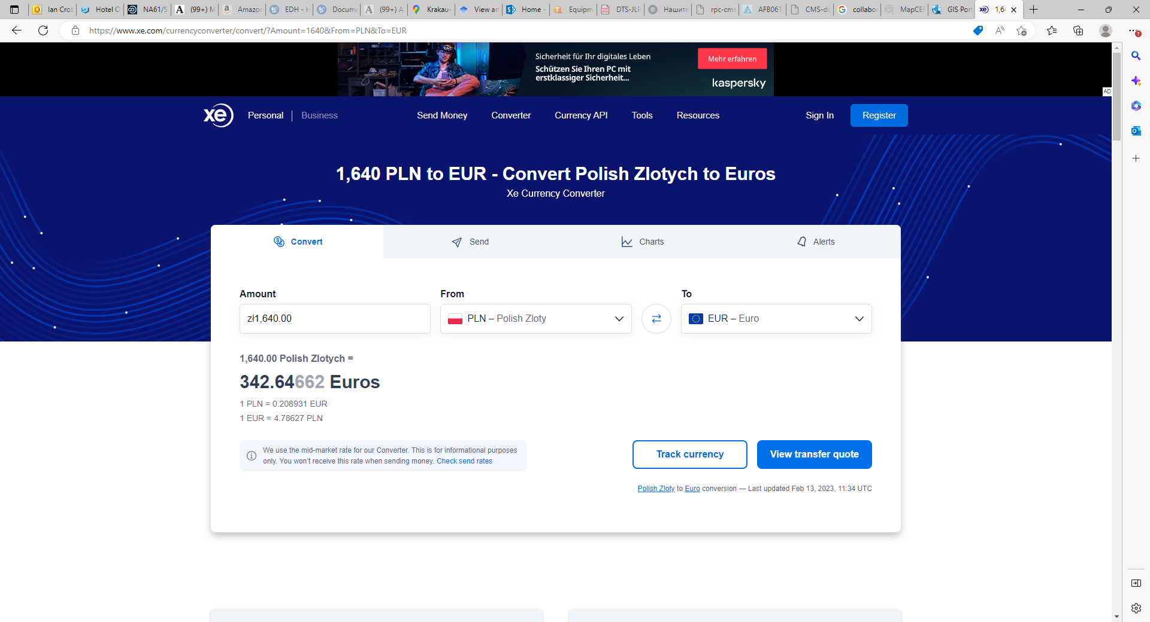
Factor 5 approx

Slide 12
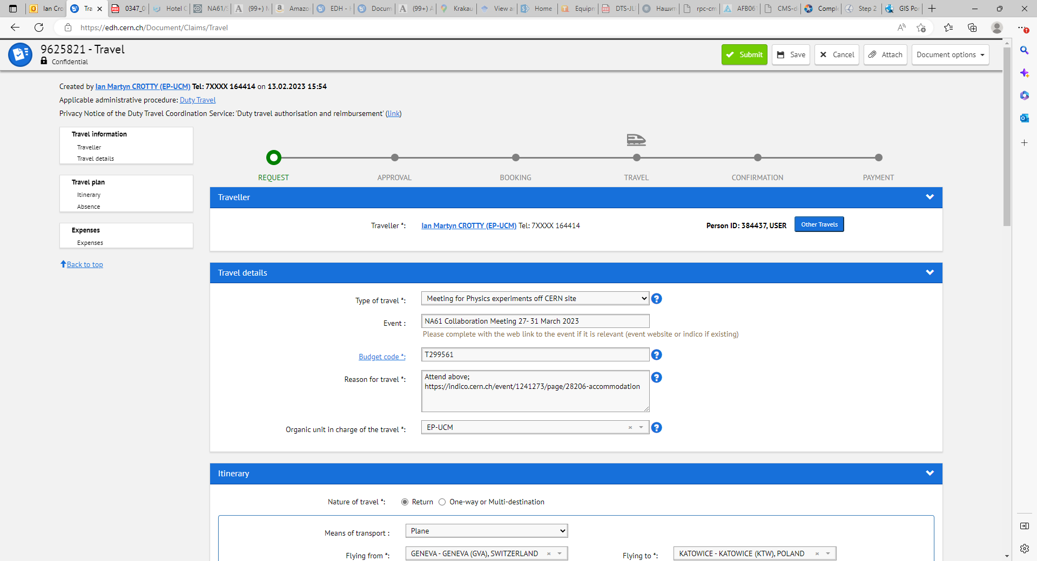

Slide 13
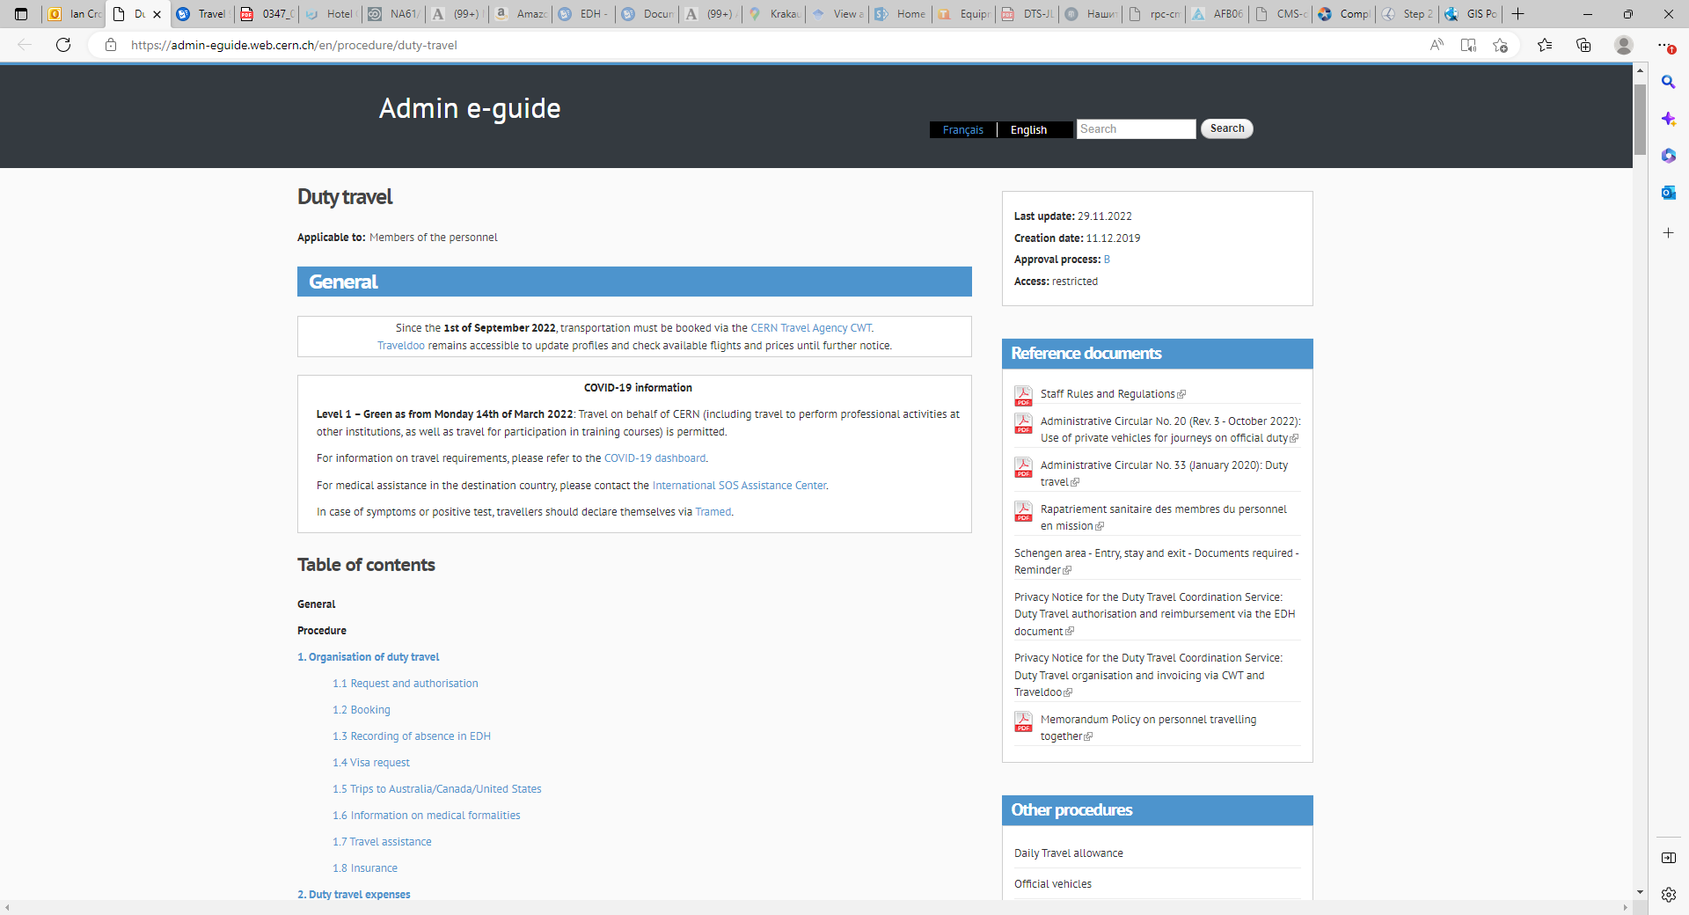
https://admin-eguide.web.cern.ch/en/procedure/duty-travel

Slide 14
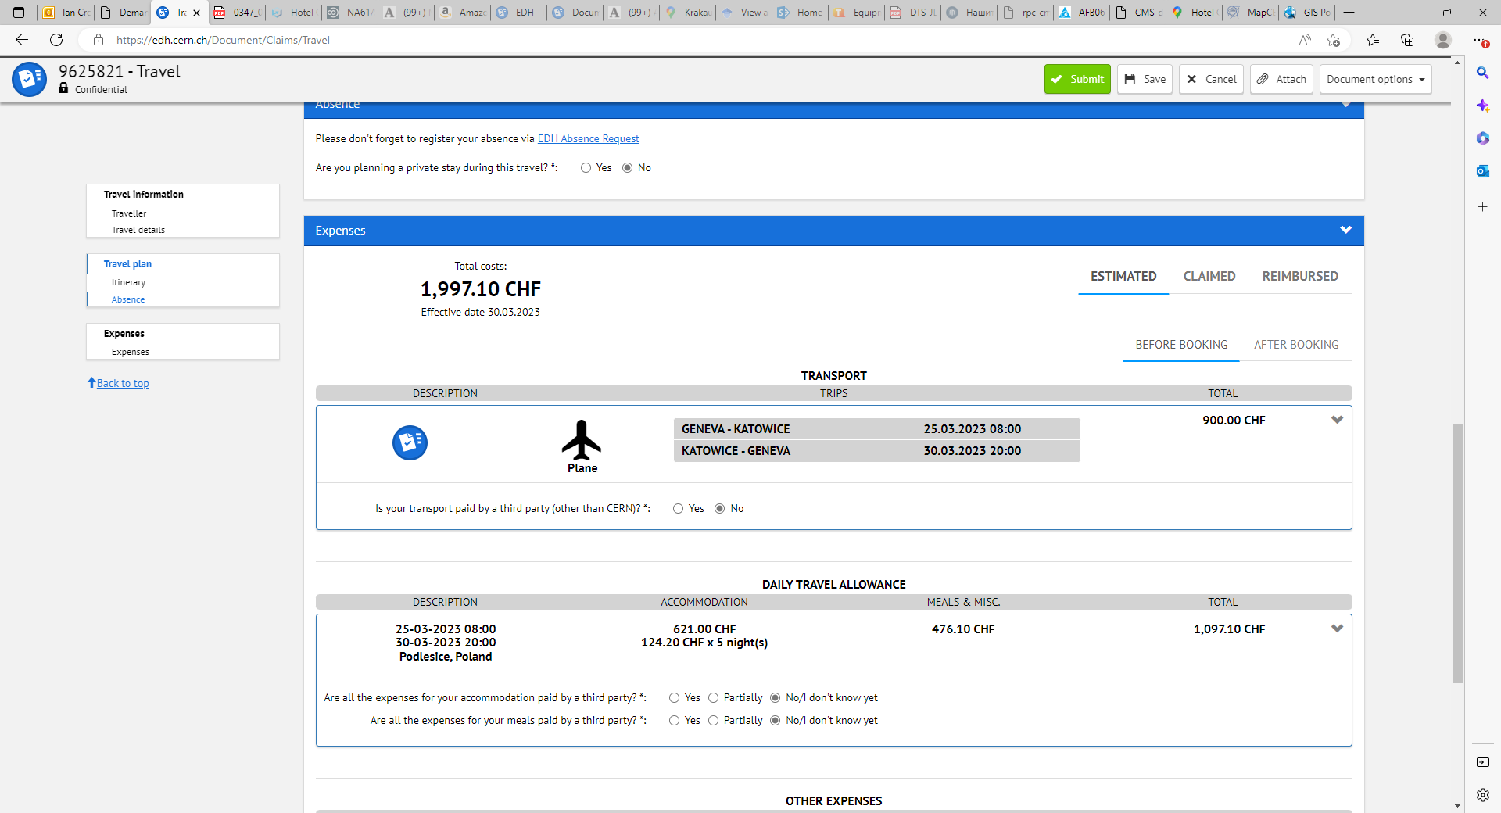

Slide 15
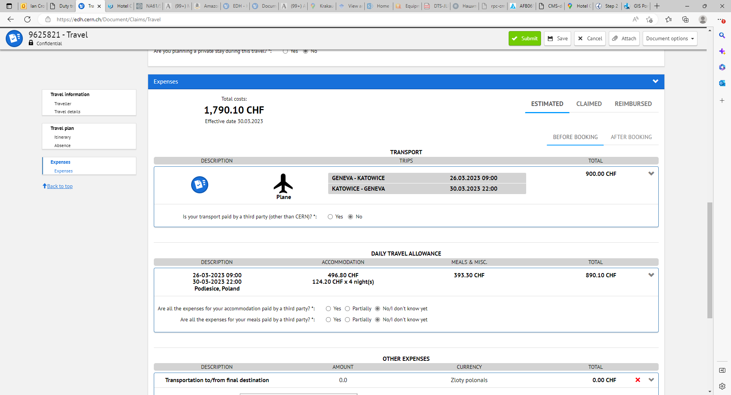

Slide 16
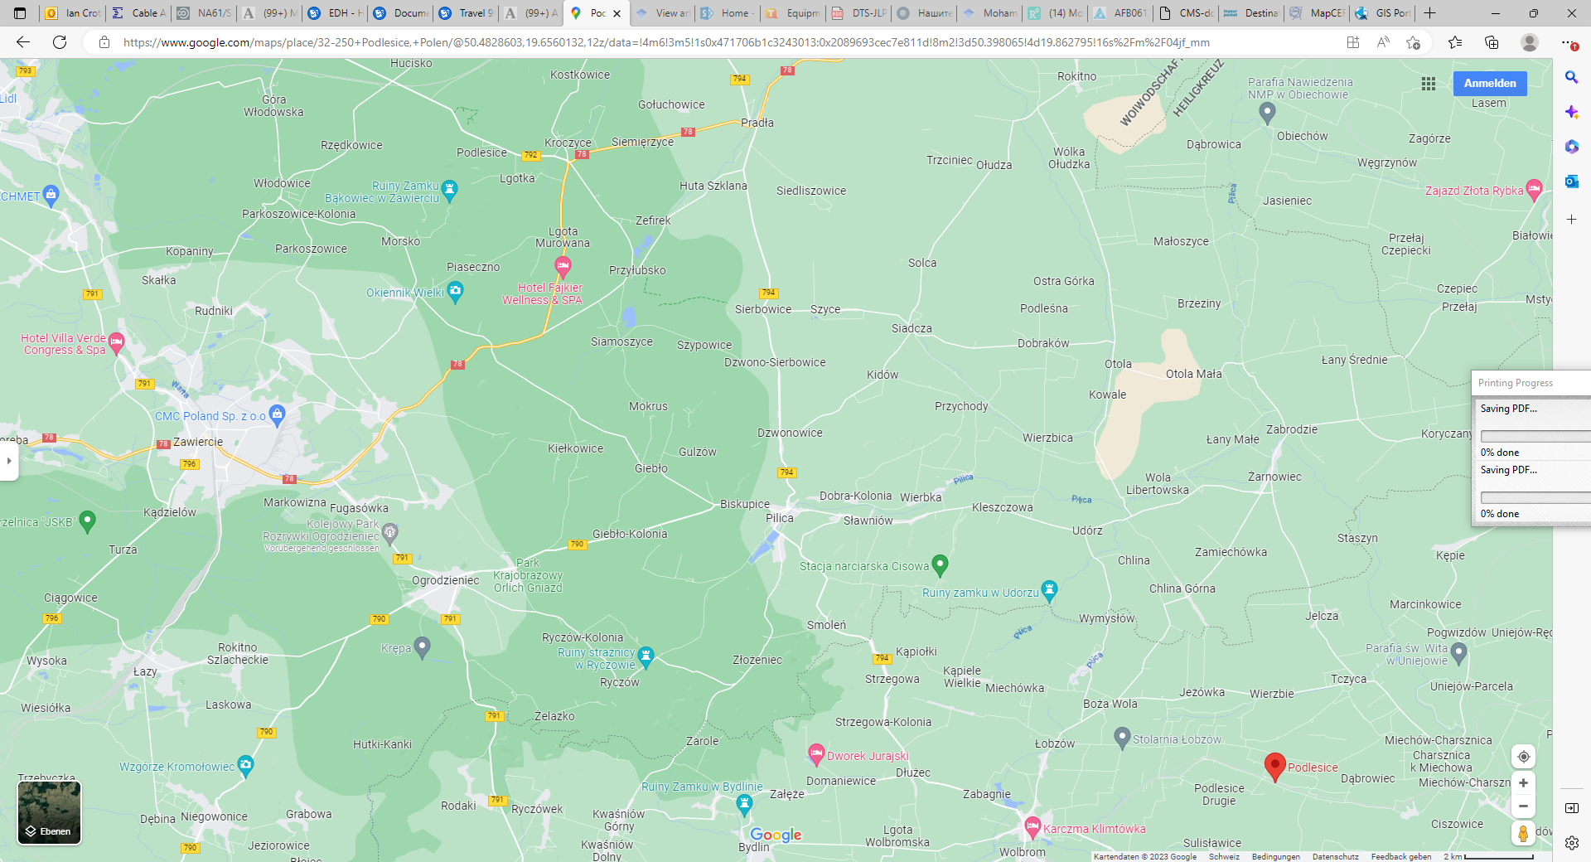
Potential confusion there are x2 Podlesice !!!

Slide 17
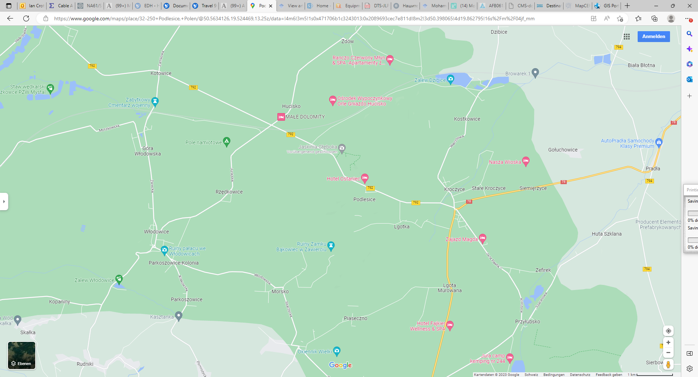

Slide 18
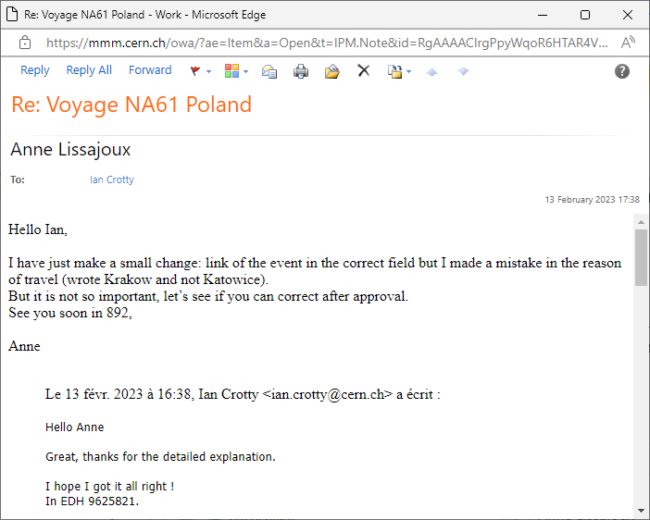

Slide 19
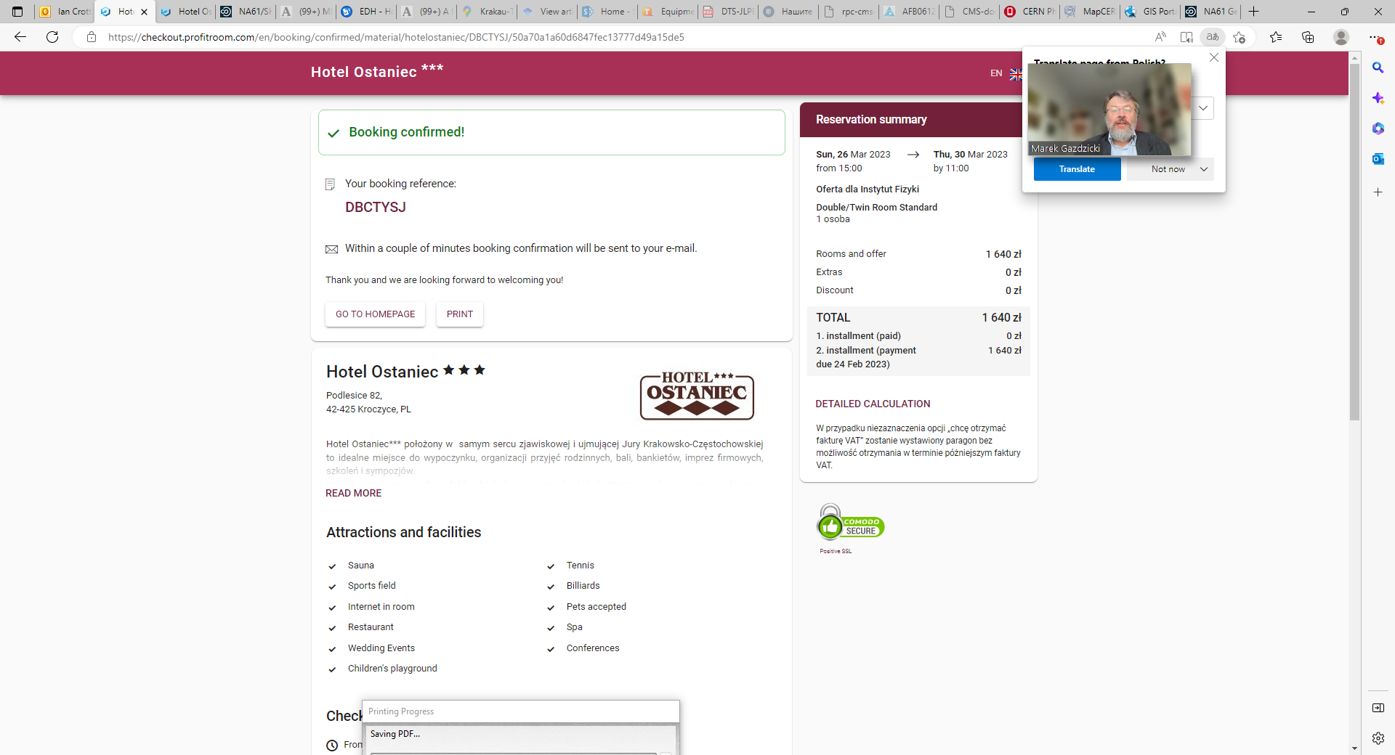
DBCTYSJ

Slide 20
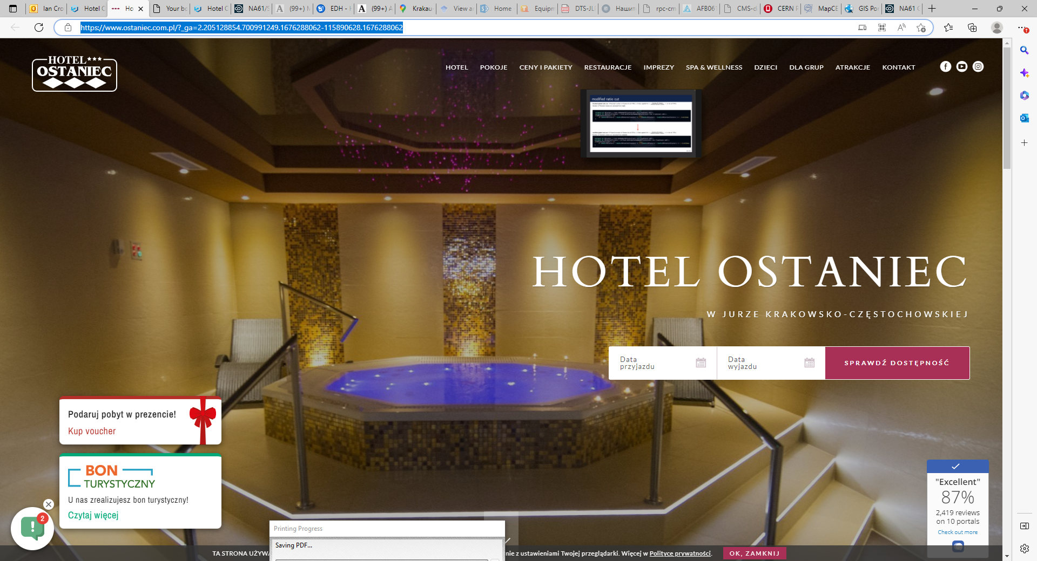
https://www.ostaniec.com.pl/?_ga=2.205128854.700991249.1676288062-115890628.1676288062

Slide 21
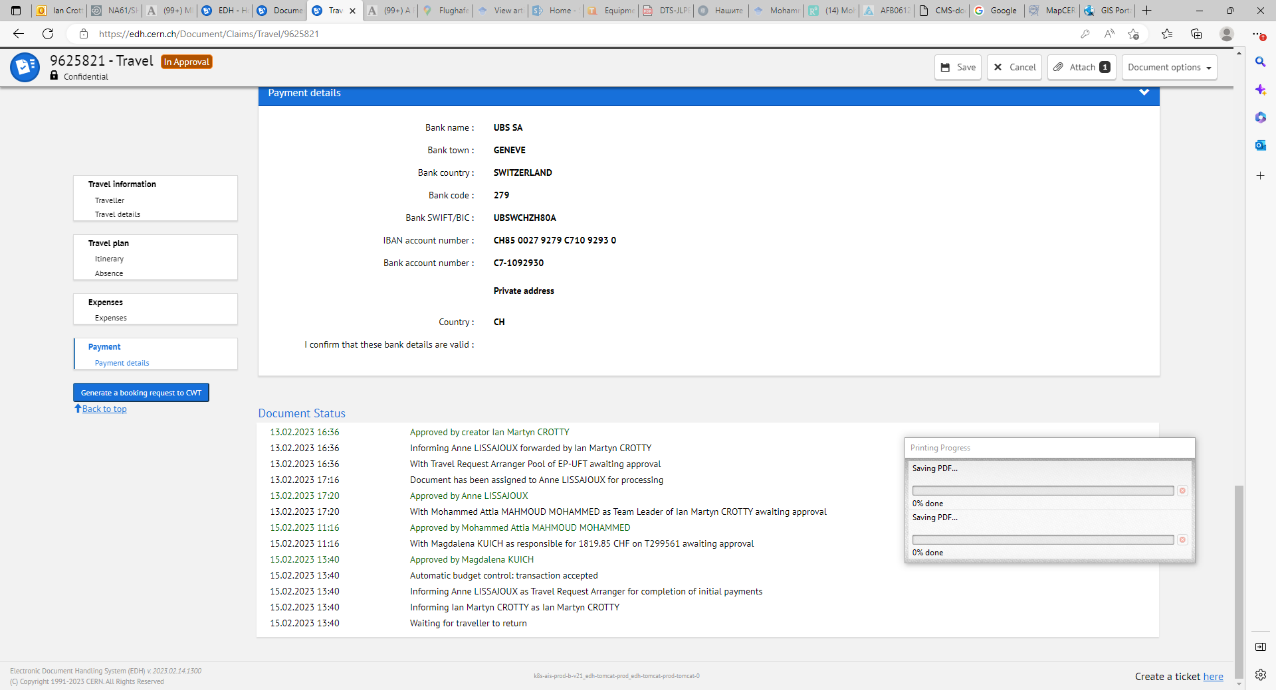

Slide 22
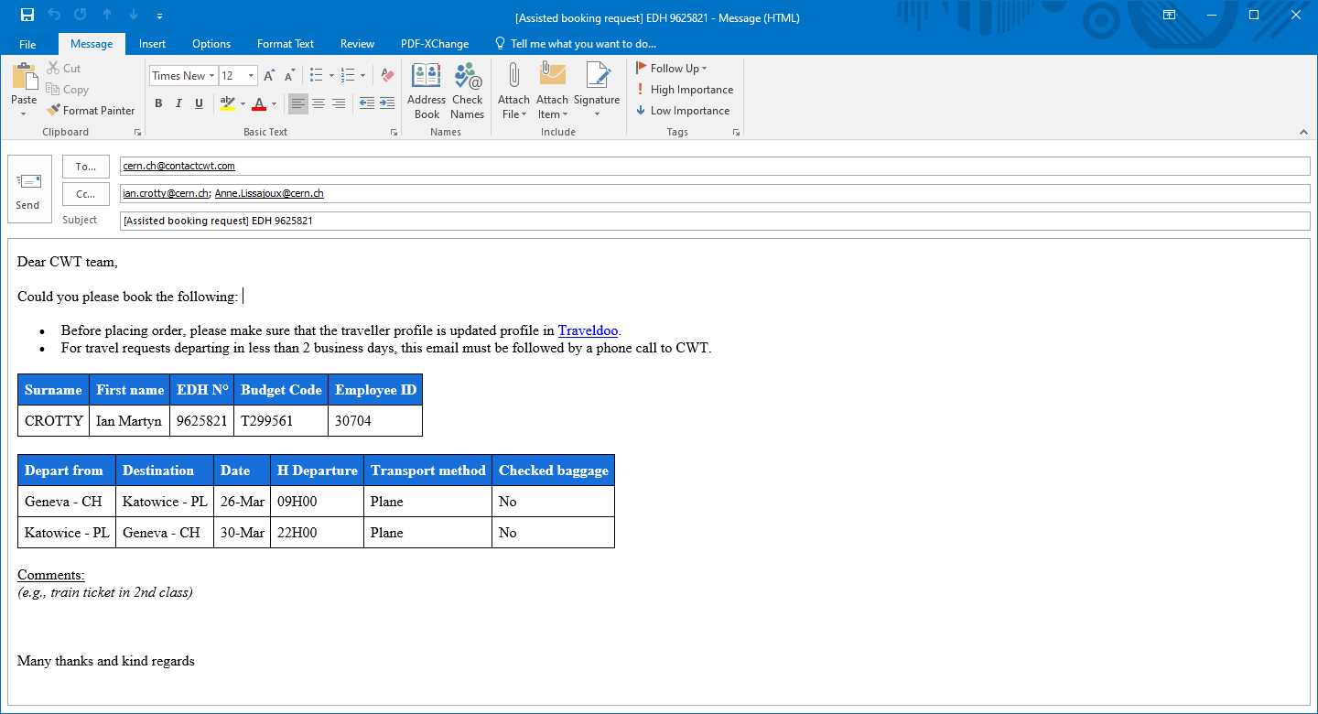
Sent on forced new outlook account (ian.crotty@cern.ch)
But it does not appear on my standard outlook account !!????
At around 1810hrs 15 Feb 2023

Slide 23
What there is around

Slide 24
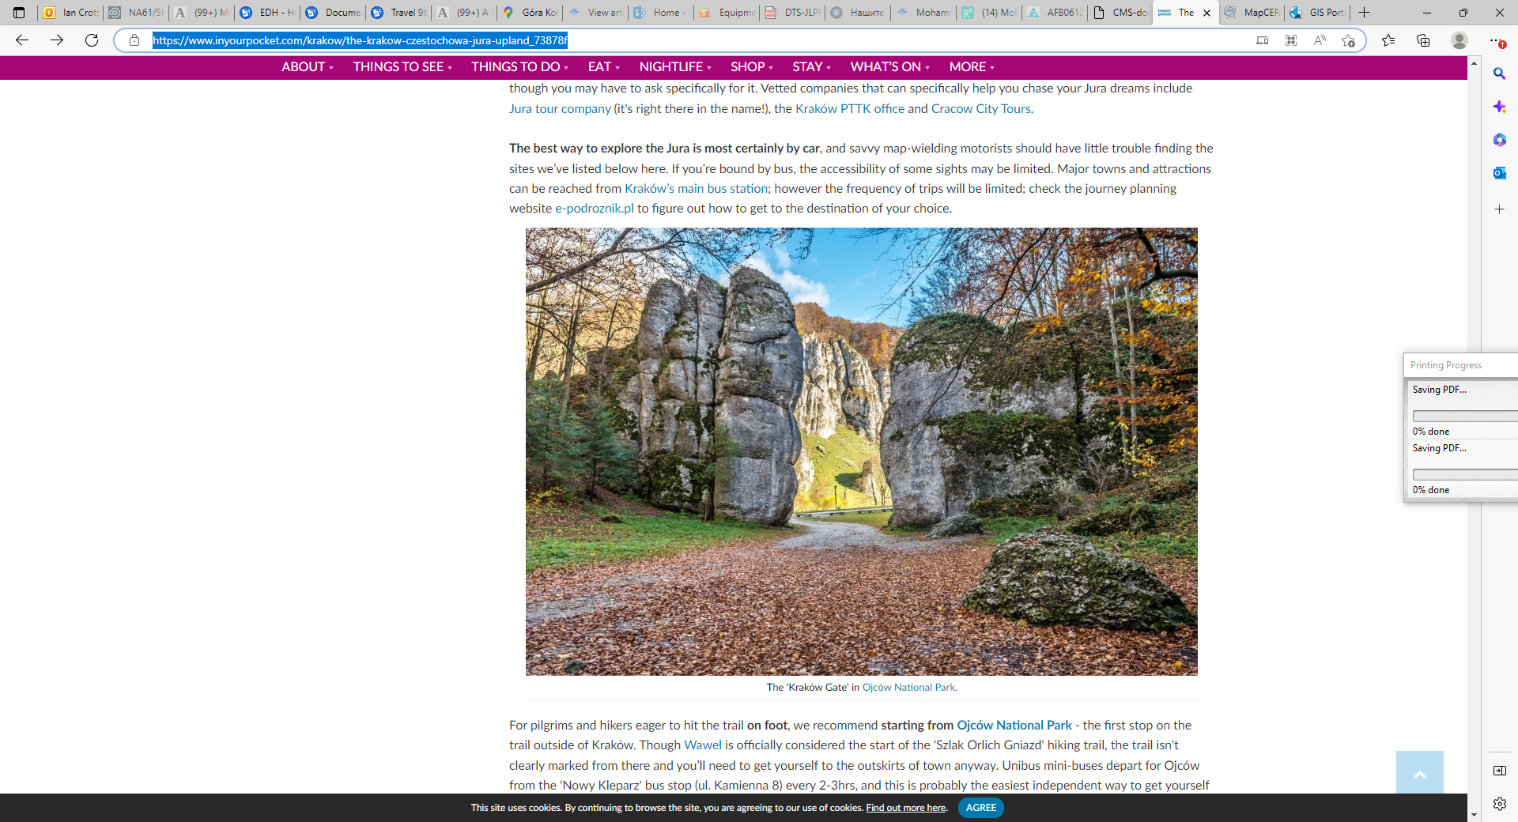
https://www.inyourpocket.com/krakow/the-krakow-czestochowa-jura-upland_73878f

Slide 25
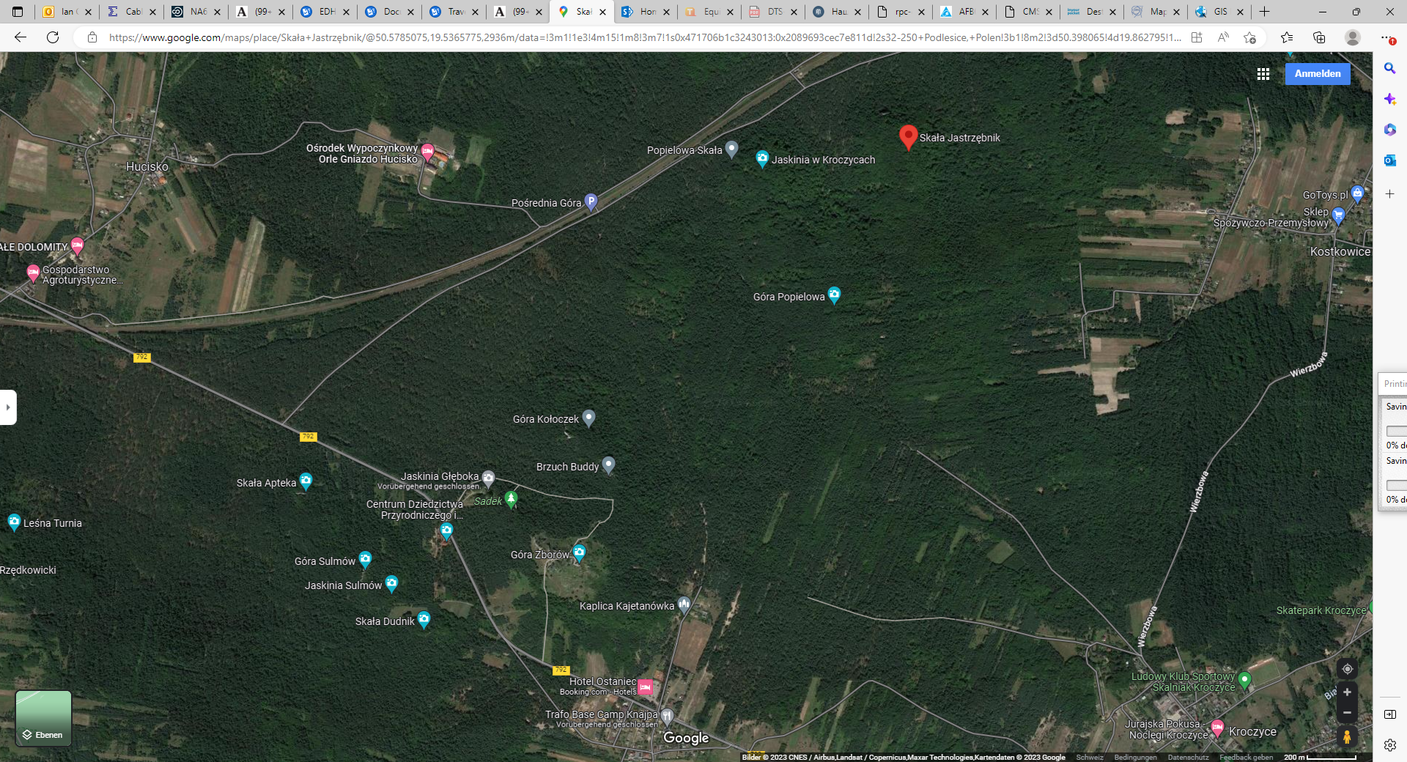

Slide 26
