Slide 1
Collaboration meeting NA61
Jura Krakowsko-Częstochowska
Ian
13 feb 2023

Slide 2
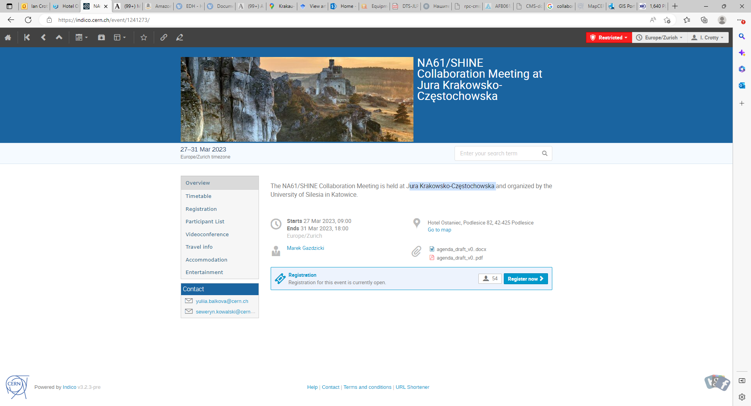
https://indico.cern.ch/event/1241273/page/28206-accommodation

Slide 3
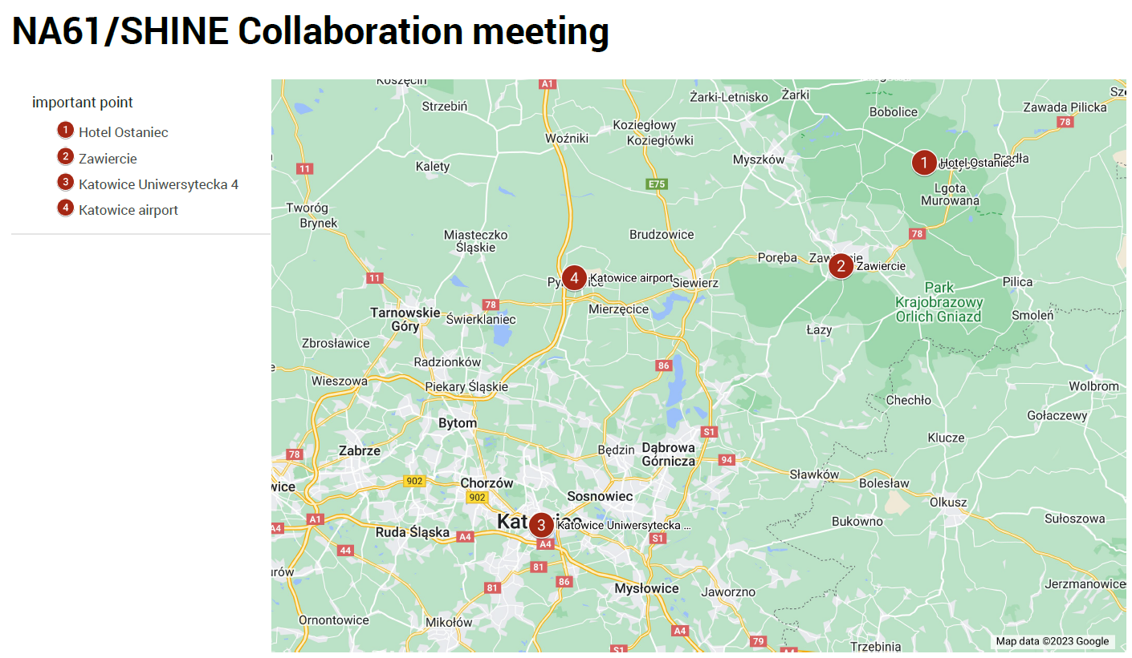
Hotel Ostaniec
Zawiercie
Katowice Uniwersytecka 4
Katowice Airport

Slide 4
Travel info
To reach Hotel Ostaniec, you can choose:
Your own car.
Train: the nearest railway station is in Zawiercie. Fast trains from Warsaw, Kielce, and Katowice stop at this station. You can find the train timetable under the link https://rozklad-pkp.pl/en. You can get from the station to the hotel by taxi price (~100 PLN).
Plane: nearest airports are in Katowice, Krakow, Wrocław or Warsaw. From the Katowice airport, you can reach the Katowice city center by bus or taxi.
We plan to organize a bus to the hotel on Sunday, March 26, 2023, in the evening, departing from Katowice Centrum (lot parking lot at Uniwersytecka, 4) and stopping at the Katowice airport and the Zawiercie railway station. The return bus is planned for Saturday, April 1, 2023, in the morning, with stops at the station in Zawiercie, the airport in Katowice, and Katowice Centrum (lot parking lot at Uniwersytecka,4)

Slide 5
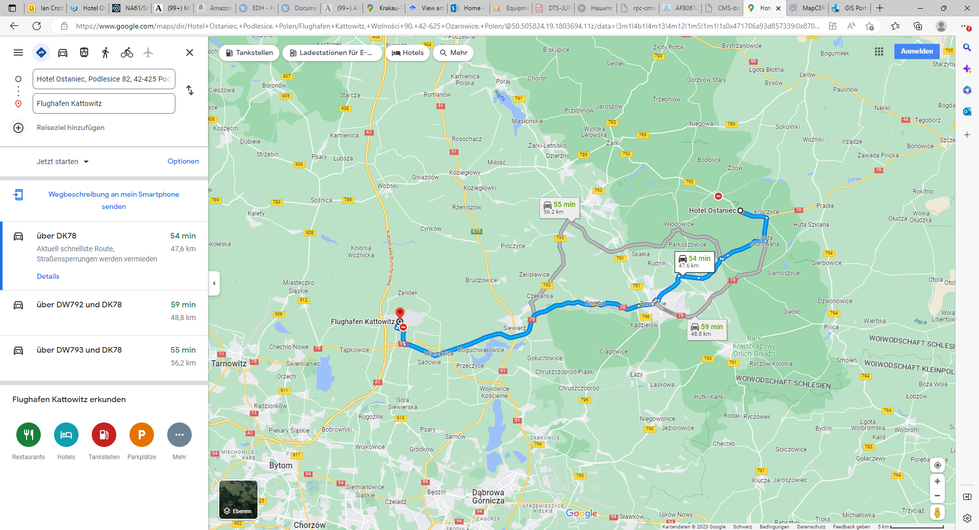

Slide 6
https://www.ccra.com/airport-codes/
KTW Katowice Airport
WAW warsaw
FRA francfort

Slide 7
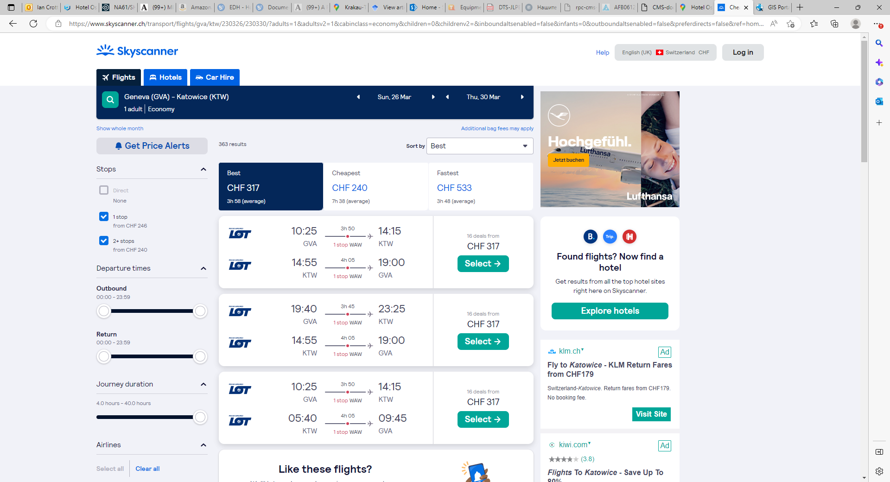

Slide 8
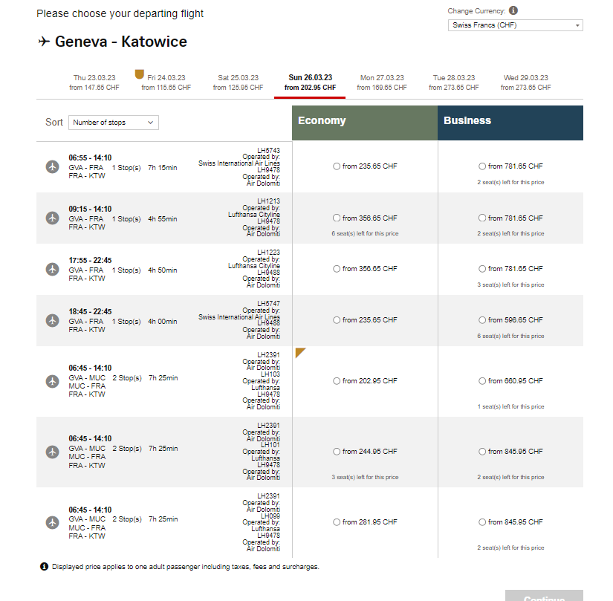
https://book.swiss.com/lh/dyn/air-lh/revenue/viewFlights

Slide 9
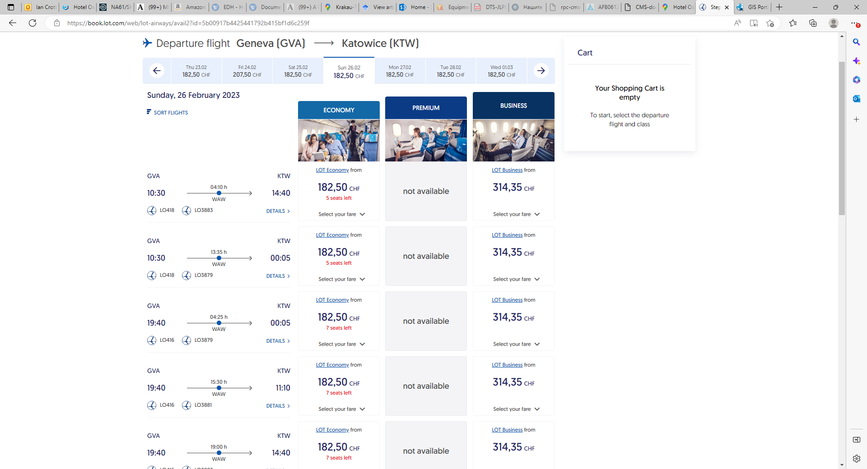
https://book.lot.com/web/lot-airways/avail2?id=5b00917b4425441792b415bf1d6c259f

Slide 11
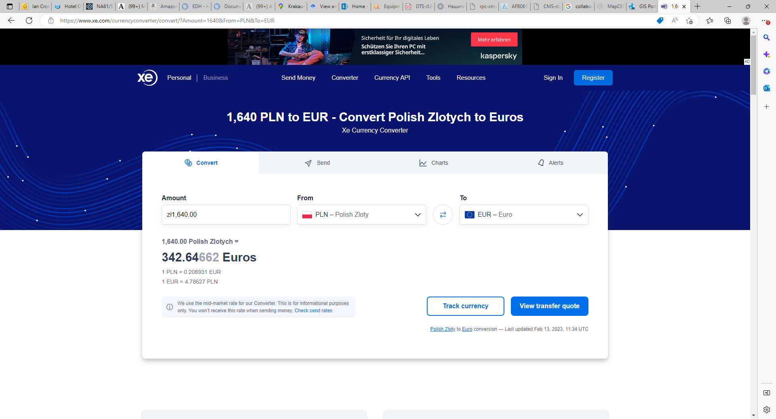
Factor 5 approx

