Slide 1
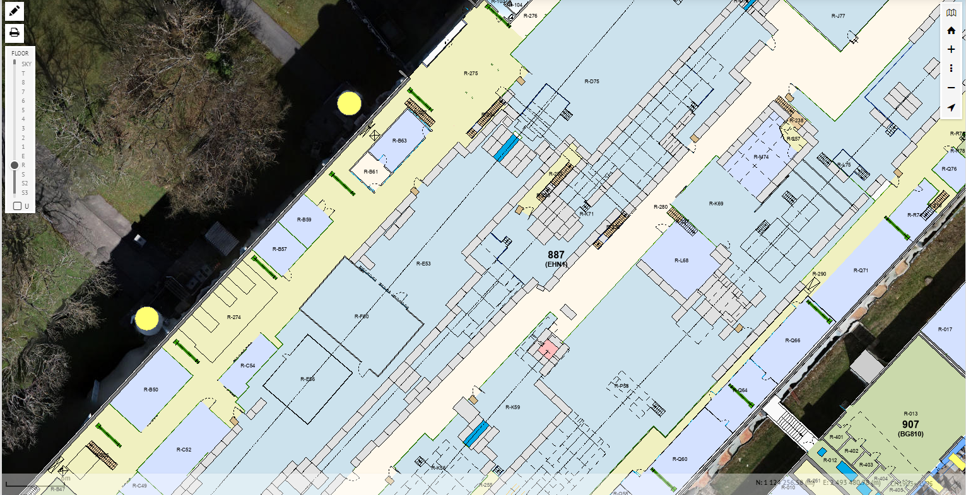
NA61 Beam area
Gis.cern.ch
Material a enlever SVP

