Slide 1

Practical EMC Issues in Large Experiments
PH-ESE Seminar
Georges Blanchot
January 2009
Georges.Blanchot@cern.ch

Slide 2
Selected Topics
Introduction to EMC
Grounding
Back end EMC requirements.
Front-end EMC requirements.
How to deal with EMI couplings.
Selected good design practices.

Slide 3
Introduction to EMC
Why do we need to care about this thing !?
“EMC = Electro Magnetic Compatibility”
Means:
Ability of a system to operate as required in presence of electro magnetic disturbances.
and also:
Ability of a system to operate without compromising the normal operation of other systems
The compatibility between systems is achieved:
  Defining methods and tools to quantify the disturbances.
  Defining limits that will ensure the good operation of all systems.

Slide 4

Interconnection of Systems
Frame
Conducted EMI
Near Field Coupling
AC
FE
FE
DC
ELMB
ESD
AC
DC
Radiated Coupling
Disturbances from AC mains
Conducted noise: via cables
Radiated noise: via E/M fields
Couplings between cables
Grounding cables

Slide 5
EMC in the Design Process
Cost
Simple Design Fixes
Improvement
On site actions
Produce new prototypes
Cabling and filtering
Prototype corrections
Patches
Design corrections
Time
Development
Production

Slide 6
Some reference documents
Non exhaustive list:
Conducted emissions and radio disturbances:
  CISPR11: ISM
  CISPR22: ITE
AC Mains:
  Harmonic current: EN-61000-3-2, EN-61000-3-4.
  Immunity levels (industrial env.): EN-61000-6-2
  Emission levels (industrial env.): EN-61000-6-4
  Fast transient/burst immunity: EN-61000-4-4
  Surge immunity : EN-61000-4-5
  Voltage dips immunity: EN-61000-4-11
LHC-EM-ES-0001 rev 2 (EDMS 113154): Main Parameters of the LHC 230/400V distribution system.

Slide 7
About the Grounding
What to expect from a ground wire?
A ground wire is an inductor of typically 1uH/m that carries about 20 mA.
  ZL = 6 Ω/m at 1 MHz.
    It develops typically 125 mV/m at 1 MHz and 20 mA.
  ZL = 125 Ω/m at 20 MHz with currents that should be below 1 mA.
    It develops again 125 mV/m at 20 MHz and 1 mA.
    20 MHz is typically the peak of susceptibility of our front-ends.
Given this:
  Long ground cables are unable to sink high frequency noise currents without developing common mode voltages.
    Grounding cables will often fail to reduce a front-end noise unless they are kept short (<< 10 cm).
  Large structures, with interconnected conductors and frames, offer much lower impedances: they are better references for systems.

Slide 8
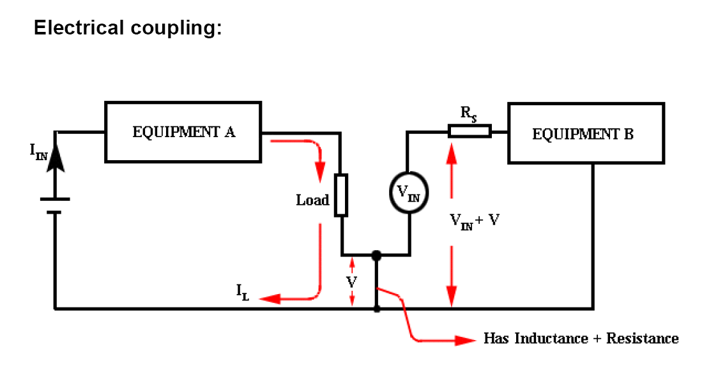
Development of CM through Grounding cable

Slide 9
But grounding is still needed
Electrical Safety:
  To carry fault or short circuit currents without developing hazardous voltages within systems
Protection against ESD:
  Carry the ESD charge away from system (without developping hazardous voltages).
To enable shielding feature of frames, boxes, etc.

Slide 10
EMC by Design
If grounding is not useful to insure the requested performance, what is the way to follow?
Good design practices!
  Design taking into account all the disturbances present in real life.
  Minimize disturbances sent to others.

Slide 11
Back-End EMC Requirements
The back end interfaces between the electrical AC network and the front-end systems.
Usually commercial off-the-shelve equipment: EU EMC regulations apply!
Power Supplies
Computing equipment
Pumps, Motors, Switches
Interfaces

Slide 12
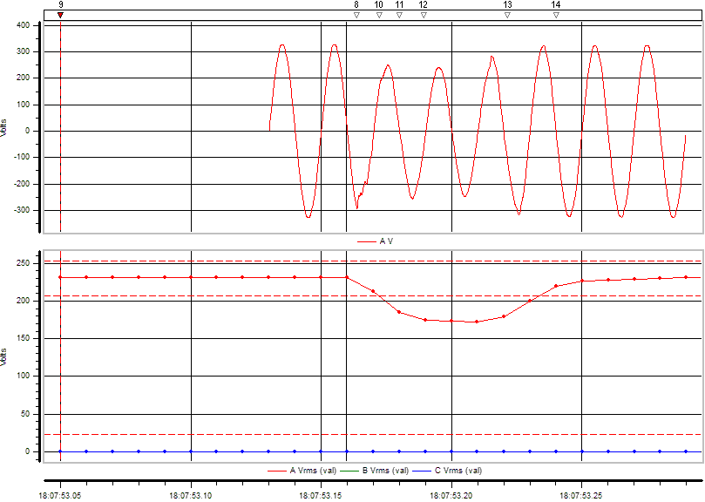
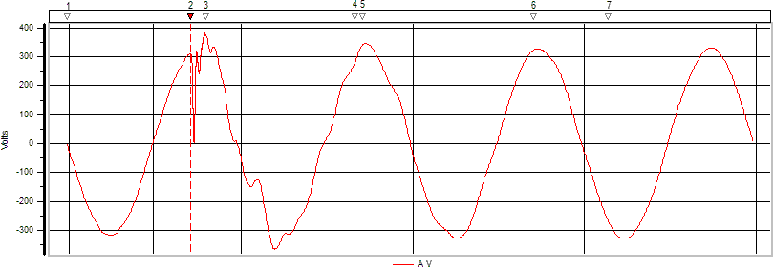
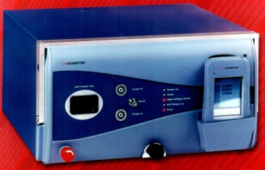
Tolerance to AC disturbances
Microcuts, voltage dips, overvoltages, non sinusoidal waveforms: they occur many times per day, every day in all control rooms of all experiments.
The behaviour of any equipment is determined by immunity tests with specialized equipment, according to an international standard.
The pool is equipped with tools to characterize system immunity according to IEC standards.
Events recorded in ATLAS Control Rooms
Schaffner Modula Test System

Slide 13
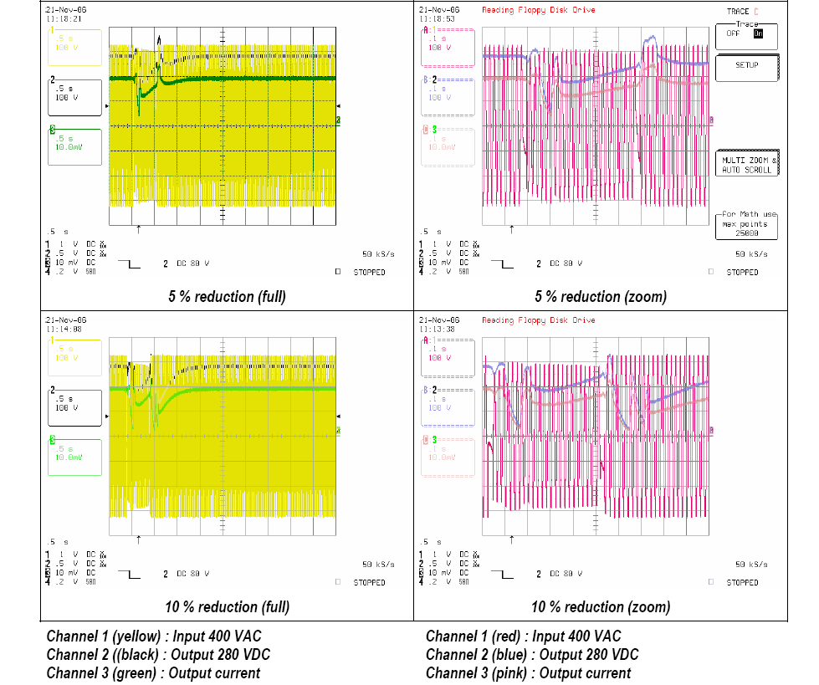
Effect of AC disturbances
A back end LVPS in a LHC experiment: immunity test in lab.
Voltage drop of 5% induces output overvoltage and transients on DC line.
Voltage drop
Output transient and overvoltage

Slide 14
Emission of Harmonic Current
The harmonics in the load current drawn from the mains is a source of disturbance for the electrical distribution network and for other users
Transformer Losses.
  Heat up the transformers and reduce their lifetime.
  To cope with harmonic current, transformers must be derated (=cost).
Increased Neutral Current.
Voltage Distortion.
  Distortion due to voltage drops caused by harmonic currents.
  AC mains received by other equipment is distorted and can cause malfunctions.
Low frequency Interferences.
  Harmonic current cause induction noise.
  Noise below few kHz is hard to filter, need to use regulators.
Degraded Power Factor
_{Extra Losses}
_{Distorded line Voltage}
_{Injected Harmonic Current}
_{Harmonic Current Source}
_{Harmonic Current Victim}

Slide 15
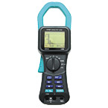
Harmonic Currents
Increased Neutral Current:
In practice, the neutral RMS current can double at most the phase RMS current.
Limit set by the facility.
Total Harmonic Distortion:
Each harmonic current is a source of extra losses
Limit set by the facility.
Limits specified in EMC standards.
Degraded Power Factor:
Remedies are either passive filters for simple cases, or active power factor correction (APFC) for complex harmonic current sources such as power converters.
User gets charged for bad power factor.
No explicit limit.
Limits on each harmonic content is defined in IEC-61000-3-2, it is achievable using PFC circuits or filters. Line diode bridge rectifiers cannot be used without PFC.

Slide 16
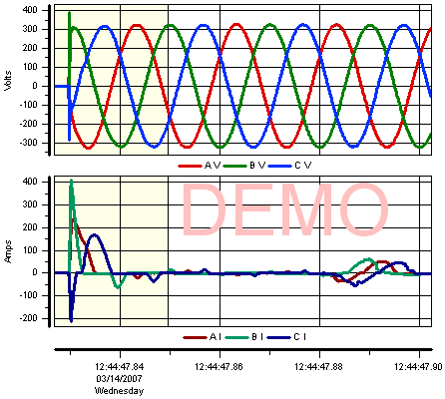
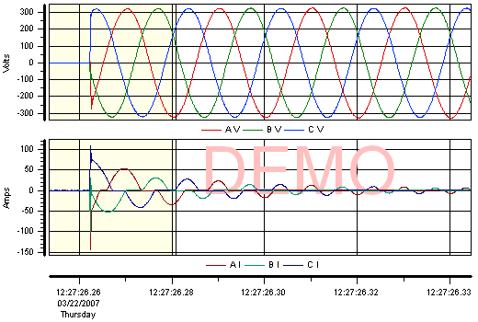
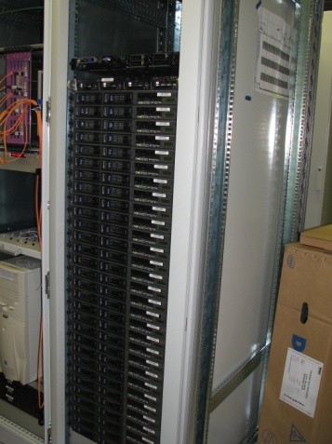
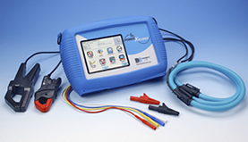
Inrush Currents
DAQ Rack in ATLAS
Inrush currents in rack equipment can pose difficulties to the electrical network (tripping computing farms): PFC and passive dampers help to smooth down the startup.
Inrush, harmonics, voltage distortions can all be measured with Power Xplorer available at the Pool.

Slide 17
Noise emission/immunity
Noise emission
  Limits on conducted noise (common mode) on all IO and power ports.
  Limits on radiated noise (EM fields): cannot be tested at CERN (only qualitative near field).
Immunity
  Incoming noise degrades the performance:
    This can be tested and quantified at CERN.
All these are common with front-end requirements and will be described on next slides.

Slide 18
Front-End EMC Requirements
Front-end = Sensing Device
Always custom made circuits, EMC performance will depend of the designer experience and of its awareness of the EMC problems
Sensitive to conducted noise from its back end
  Noise current that enters through ports and cables.
  Is translated in larger RMS in data.
  Setup dependent.
Sensitive to couplings from neighbors (systems and cables)
  Near field: electric, magnetic.
Source of conducted and radiated noise as well
  Can compromise neighboring systems.

Slide 19
Common and Differential Modes
Differential Mode:
The functional current carried by a wire and its intentional return: the electromagnetic field is mostly contained within the cable
IDM
DC / DC
Small Loop
Load
IDM
Few pF
Few pF
Ground Plane
ICM
Common Mode:
A non functional current carried by a set of wires and some surrounding conductive structures or elements: the electromagnetic field is mostly contained between the cable and the conductive structures
DC / DC
Load
ICM
Big Loop
Ground Plane

Slide 20
EMI Sources
Radiated Noise from system is small because at f=40MHz λ=7.5m that is easily shielded by the system faraday cages and enclosures.
Radiated Noise from cables comes mainly from CM noise (far field* from electrically short cables).
L
L
Need to control the sources of CM noise:
Switched power circuits and converters.
Digital circuitry.
CM coupling across cables.
S
I_{D}
S
I_{C}
I_{D}
I_{C}
d
d
E_{D}
E_{C}
Differential Mode: the far fields are opposed and cancel each other
Common Mode: the far fields add up.
The contribution of CM current to EMI is typically more than 3 orders of magnitude stronger than the contribution of the same DM current.
* Far field region starts at a distance d = λ/6, i.e. 1 m at 40 MHz.

Slide 21
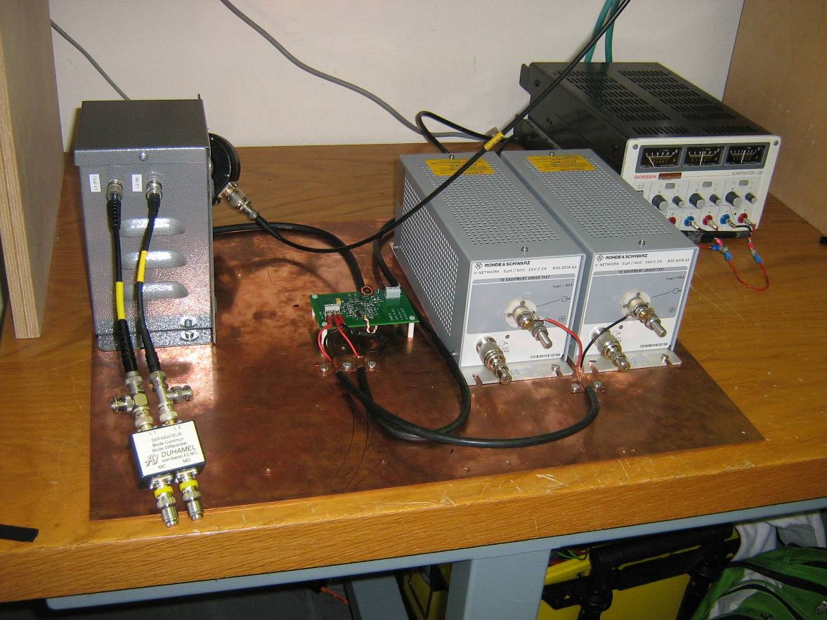
LVPS Conducted Noise
A dominant source for FE noise is the power supply. It can be characterized on a reference setup that is independent of the front-end and of the primary source.
Ground plane
Reference return path for CM currents
Cables lay on the plane.
Source, load and filters earthed to the plane.
LISN: Line Impedance Stabilization Network
Calibrated, standardized filter.
Filters noise from bulk LVPS.
Provides reference impedance seen by the converter towards its source of power, over the whole frequency range of interest.
ISL
LISN
DC/DC
ISL: Impedance Stabilized Load
Calibrated load:
  DM (load).
  CM (output to earth plane).
Splitter

Slide 22
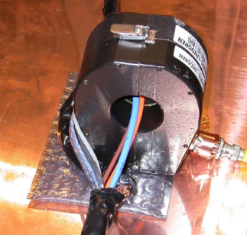
Line Impedance Stabilization Network (LISN)
V(LISN)
I_{CM+DM}
LISN
Provides a standardized voltage measurement of the symmetric and asymmetric noise between line and earth (ICM + IDM).
The impedance is calibrated from 100 kHz to 100 MHz.
Above 1 MHz: Z=50 ohms.
To measure accurately the CM current only, a calibrated current probe is used. Alternatively, a CM/DM splitter can be used (less accurate).
Current probe
CM/DM splitter

Slide 23
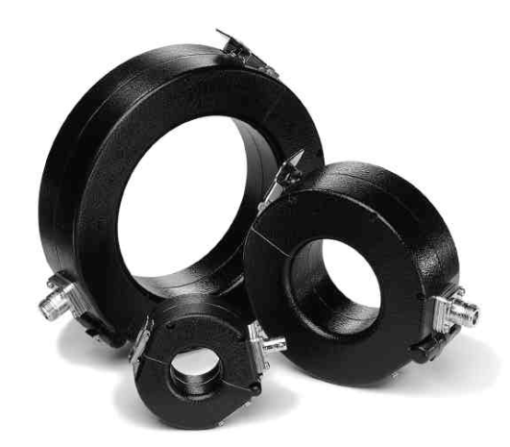
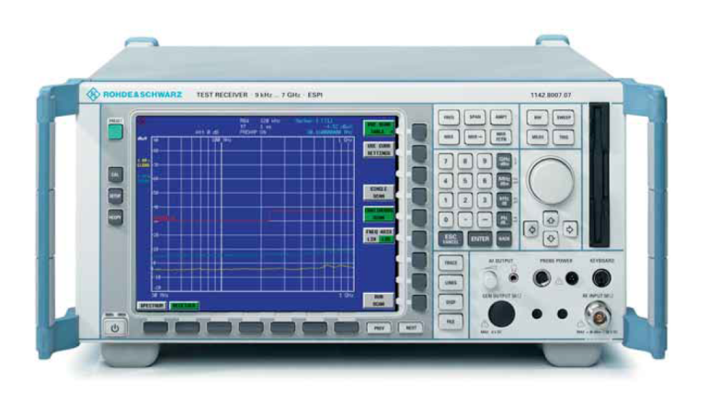
Instruments and Tools for conducted EMI measurements
Conducted EMI.
Current Probes and Injectors
DM
CM
DM
CM
DM
CM
Receiver
Receiver
Receiver
EMI Receiver (9kHz to 3GHz)
dBµA
9kHz --- 100 MHz

Slide 24
CM Noise Measurements
“Reference” level based on Class A limit from CISPR11 converted to current on a given impedance (Careful: this is NOT a real limit)
Noise (dBuA)
Frequency (Hz)
Frequency (Hz)
Example: output common mode noise for 2 custom prototypes using identical discrete components (commercial driver + switches). Only the design of the PCB and the passive components differ

Slide 25
Importance to limit the noise currents in experiments
CM currents (on all cables) must be contained under a limit that is reasonably set under 100uA in the sensitivity band of our front-ends.
CM currents above few mA will definitively collapse front-ends.
Patches are always difficult to put in place.
The sensitivity of FE is determined with susceptibility tests.

Slide 26
Typical Limits
Conducted emissions limits in LHC experiments
- Extension of CISPR11 Class A Group 1:
- to all power links in experiment zones
- to high voltage and data links
- Conversion of limits in terms of dBμA that can be easily measured on site:
- Extension of frequency:
- up to 100 MHz to cover the LHC clock and its first harmonic.
Frequency Band [MHz] | Class A Group 1
 | dBμV into 50Ω/50μH |  | dBμA
 | QPK | AVG | QPK | AVG
0,15 – 0,50 | 79 | 66 | 45 | 32
0,50 - 5 | 73 | 60 | 39 | 26
5 - 30 | 73 | 60 | 39 | 26
30 -100 | - | - | 39 | 26
= 89 uA

Slide 27

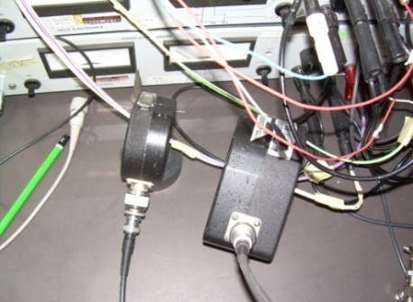
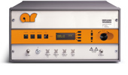

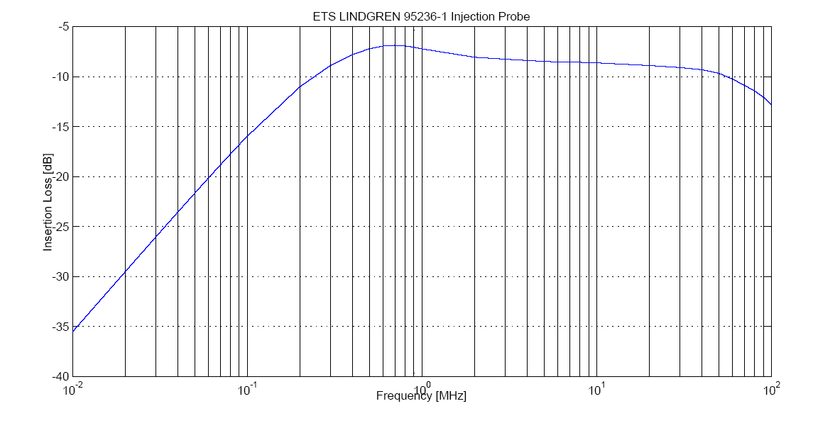
Measuring Susceptibility
CM
DM
I/O Port
Front-End Electronics
RF Generator
RF Amplifier
Spectrum Analyzer
The injected signal is provided by a RF generator that delivers a low distortion single frequency (swept).
CM or DM currents are injected inductively on the tested port using an injection current probe.
The injected current must be monitored with a calibrated probe and an accurate spectrum analyzer.
The injection of current is not very effective at low frequencies: amplifiers are often required.
The injected currents usually vary from few uA to few mA.
The frequency of interest ranges from 100 kHz up to 100 MHz: beyond this, radiated couplings take place.

Slide 28
Measuring Susceptibility
LVPS
Probe
System
Under
Test
Data Links
DAQ/DCS
Online/Offline Data Porcessing
AC
Power Link
CM Noise
Ground plane
Parameters can be:
Hit rate (Hz)
ENC (pC)
Vrms, Irms
Any combination of those, chi2, linearity coefficients, etc…
The system must define the parameter that sets the quality of its data.
RF Generator
RF Amplifier
Analyzer
EMI Couplings will degrade the noise performance of the system:
The relationship between EMI coupling and resukting noise is determined with immunity tests.
System
I (dBuA)
f (Hz)
<Xn>

Slide 29

Susceptibility example
ATLAS MDT Prototype (2004)
Low Voltage Power Supply
5VDC
11A
SHIELDED
LV Box
Detector A
Hit Rate Counter
High Voltage Power Supply
3kV @ μA
HV Split
Filter
PE
Filter
Detector B
LV Box
UNSHIELDED
Two identical detector systems:
Detector A is powered through a 15 meter shielded cable.
Detector B is powered through 15 meter unshielded cable.
The power supply is common.
The DAQ is common.
The noise evaluation parameter is set as hit rate recorded by counters.

Slide 30
Susceptibility Curve
GOOD
The shielding improves the EMI immunity of the front end electronics
BAD
The use of an unshielded power cable has a direct impact on the EMI immunity of the front end electronics
Threshold: 5mA doubles the hit rate.
One channel is particularly sensitive to CM.
Few mA are sufficient to screw up the best low noise front end electronics by more than one order of magnitude; it is also very easy to pick up few mA of noise.
Threshold: 2mA doubles the hit rate.

Slide 31
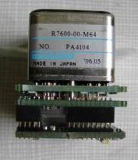
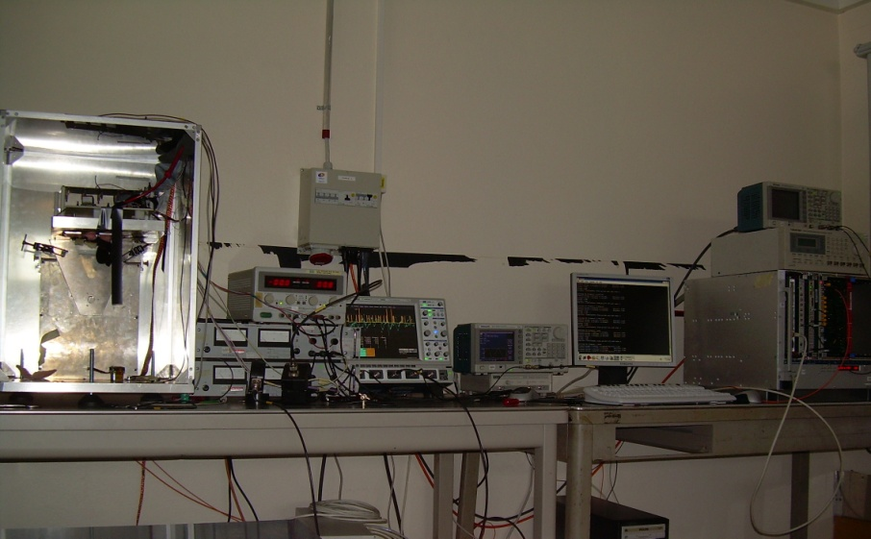
Another example: ATLAS ALFA
MAROC2 (ASIC)
ALFA-R (FPGA)
LVL1A
5V
Preamp
CLK40
Motherboard
Discri
PMT
Readout System
DATA BUS
12V
64
64
Front-End Configuration
Stream Register
SPI
To DAQ
3
Common mode currents are injected in the 12V input port first, after in the 5V port, with magnitudes up to 10 mA in the ferquency range between 150 kHz and 30 MHz.
The 12V powers exclusively the motherboard, which is fully digital. It was found to be insensitive to the injected current.
The 5V powers the front-end chips (MAROC, FPGA), with analog circuitry. It was found to be sensitive to the injected current.

Slide 32
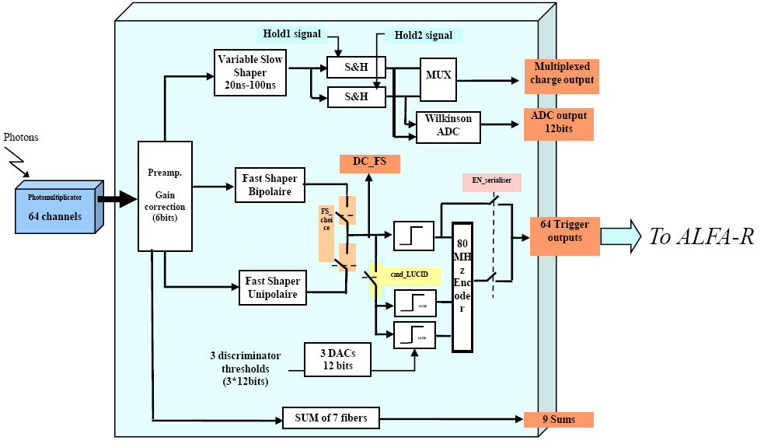
ALFA Conducted Susceptibility
The front-end chip is configured at nominal gains and the susceptibility is measured for different thresholds (DAC) in the transition region of the S curves.
The sensitive DAC range at nominal gain is found to be between 88 and 94.
Refer to: “MAROC: Multi Anode Readout Chip”, S. Blin, TWEPP 2007.
At a given threshold, the maximum noise current permitted is established for every critical frequency
The noise hit rate is a function of current, frequency and DAC
Injected current: 10 mA on 5V input.
Hit rate: up to 40% for all pixels.
Frequency peaks: 13 Mhz, 22-30 MHz
3d plot

Slide 33
Susceptibility to radiated fields
Qualitative tests to evaluate susceptibility to E field (capacitive coupling) and H field (inductive coupling) are easy to perform.
Accurate and quantitative measurements are much more difficult and require more specialized infrastructure.

Slide 34
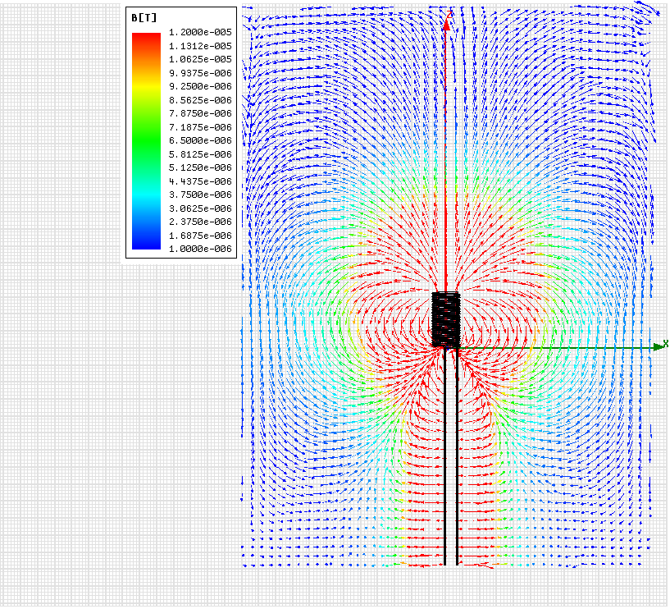
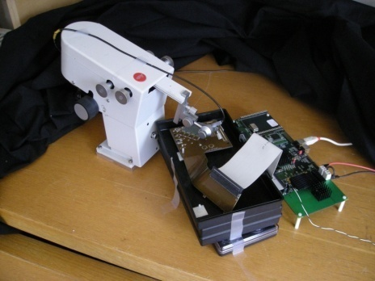
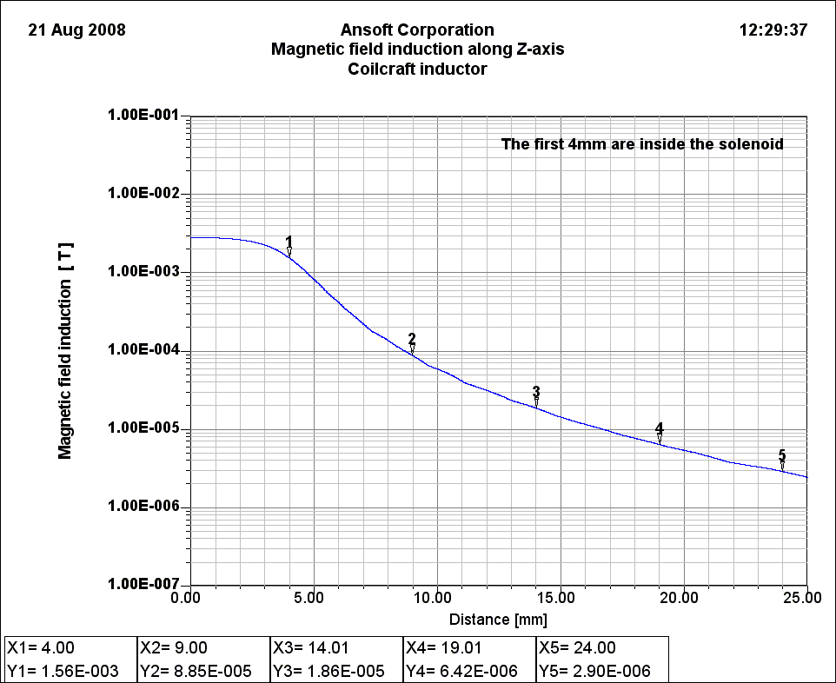
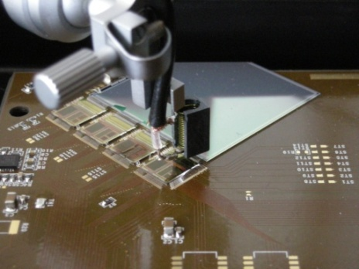
Example: TOTEM near field susceptibility
The susceptibility of systems to the magnetic field emitted by inductors of power converters is a major concern. System tests were carried out on TOTEM, with a coil driven by an amplified RF source. The coil is accurately positioned above the detector, the bondings and the ASICs and the induced noise is analyzed from the test DAQ.
538 nH air core, 1A.
Coil edge
100 uT at 5 mm from edge
Distance to center (mm) | Field (uT)
4 | 1560
9 | 88
14 | 19
19 | 6.4
24 | 2.9

Slide 35
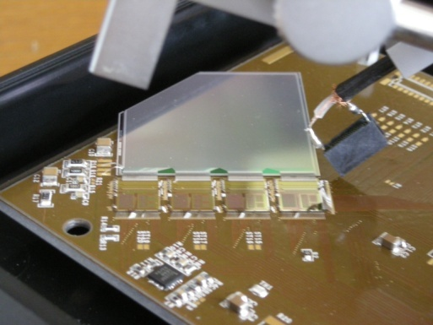
H Field Susceptibility Example
Inductor focused obliquely on the bonding
Corrupted S curve beyond this point
The TOTEM system showed noise sensitivity increasing with the frequency:
System not able anymore to extract correct S curves parameters.
The test was made at constant dB/dt: (I*f = constant).

Slide 36
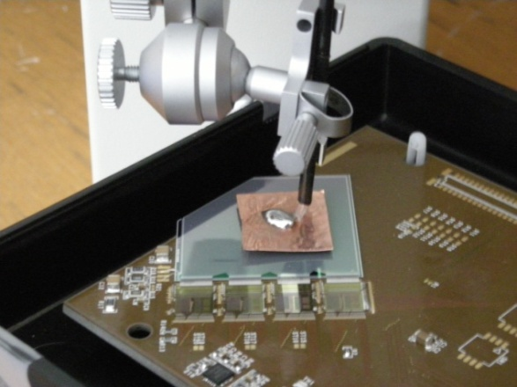
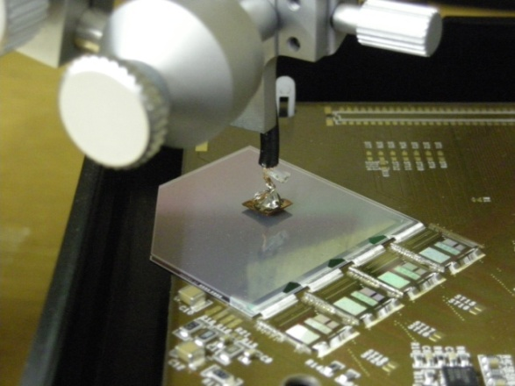
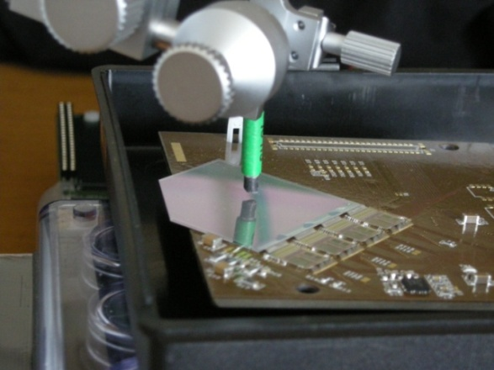
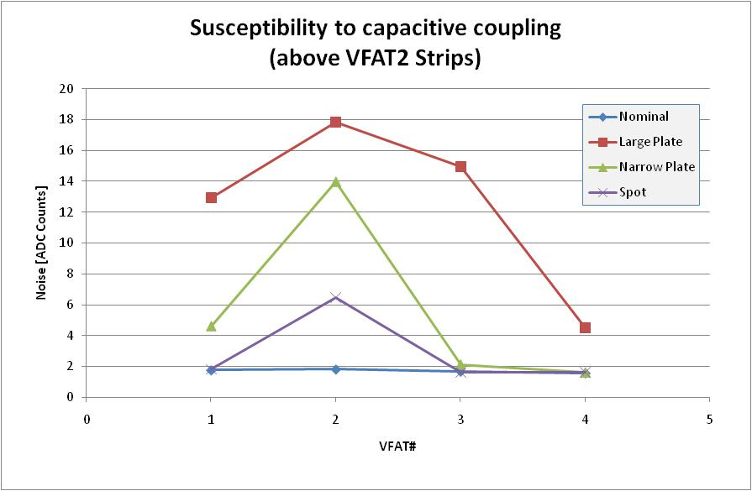
E Field Susceptibility Example
Large plate cap. coupling
Small plate cap. coupling.
Spot cap. Coupling (wire end).
The system showed also sensitivity to capacitive coupling (electric field):
3.4V/1MHz: signal equivalent to the one present on the inductor wires.
Exposed areas develop large noise.

Slide 37

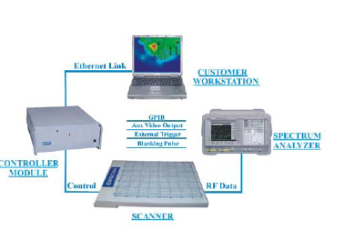
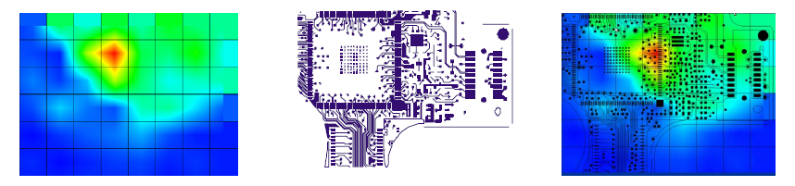

Want better tools?
ETS-Lindgren Near Field Probing Kit
Provides calibrated measurement of emitted fields, but can be used as EMI sources as well!
Nexus B field Scan
Locate EMI spots, evaluate shields
Agilent Near Field Probing Kit
Have a different sensitive geometry, to be used for calibrated measurements

Slide 38
Dealing with EMI Couplings
How to mitigate the coupling effects?
A front-end can be designed with some degree of immunity against conducted or radiated noise.
It can be connected to a compatible power supply (emits CM currents lower than the acceptable limit of the front-end system).
Still, unexpected couplings often come from unknown neighbors, in particular within the cable trays.
  The only protection is to SHIELD.

Slide 39
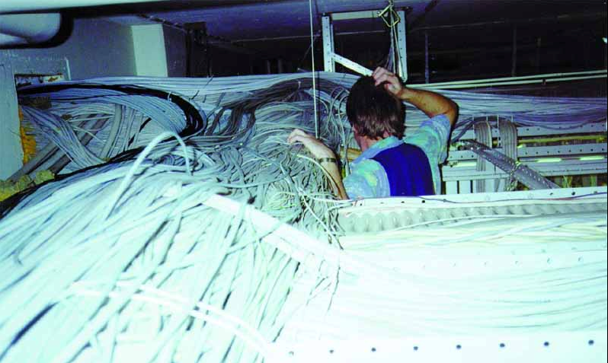
A wonderful world!

Slide 40
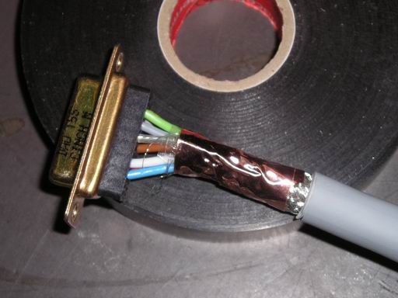
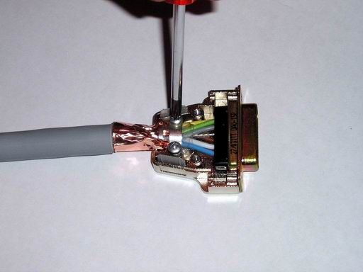
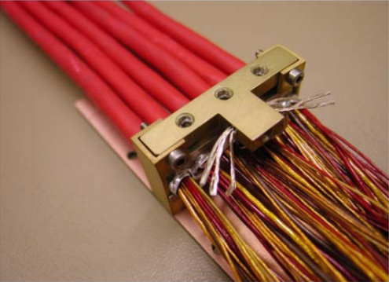
Shielding against E Field
Equivalent circuit: Shielding against external E field
v_{GS}
G
R
I_{GS}
v_{GE}
A current is coupled into the shield through stray capacitances
  Capacitance to shield
  Capacitance to ground
Performant shield is only achieved if current can flow easily
  E field shielding is achieved by grounding one side only.
  Connectors must be metallic, all around bonded to the shield, without straps, capacitors or resistors.
  Enclosure must be well bonded to the equipotential network.

Slide 41
About grounding both ends
Grounding of the shield: on both ends
Reduced common mode loop.
  The CM current is forced to return in the shield (mutual inductance)
  CM emissions are reduced radically.
Reduced electric field
  Contained within the shield
Magnetic field shielding
  The inductively coupled current is cancelled in the live conductor by mutual inductance.
Electric field shielding is improved
  - Two paths instead of one!
Shield connected on both ends
Load
AC/DC Conv.
I_{CM}
Coupling
r, l
Equipotential
Equipotential bound

Slide 42
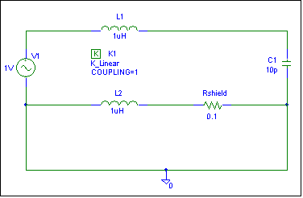
Shield is return path for CM Current
Equivalent circuit: mutual inductance forces CM current to return into the shield
I_{CM}
Ishield

Slide 43
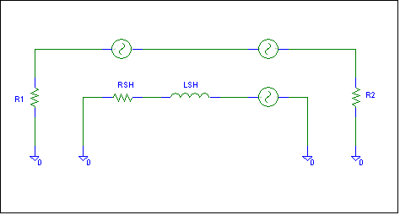
Shielding for B field
Equivalent circuit: shielding against external B field.
1
SF =

Slide 44
Shielding Effectiveness
The effectiness to shield depends of the shield construction: RSH, LSH, coverage.
It can be measured on a section of 1 meter of cable injecting a reference shield current as shown.
Optical coverages greater than 85% are always recommended.
I_{sh}
V_{l}
Figure : Transfer impedance of a shielded cable.
RF Gen.
V_{sh}
DSO
1
2
C
C
50Ω
I_{sh}
V_{l}
Figure : Current probe test setup: grounded connectors (C), injection probe (1), current probe (2).
ZT = transfer impedance <-> shielding effectiveness

Slide 45
Transfer Impedance
Example of 2 shielde dpower cables from CERN stores.
The shield effectiveness starts degrading at 100 kHz!
The corner frequency depends in particular of the shield inductnace and of its connection to the plane: pigtails add inductance and therefore degrade the shielding effectiveness.

Slide 46
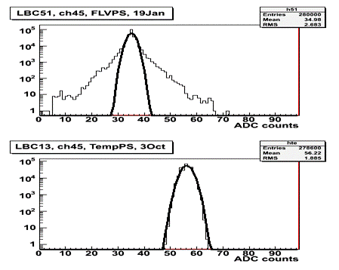
When susceptibility is discovered late
BAD
Noise shows up once using the production power supplies
Unnamed detector suffered from LVPS noise during commissioning.
GOOD
However… it looked so good in the lab!

Slide 47
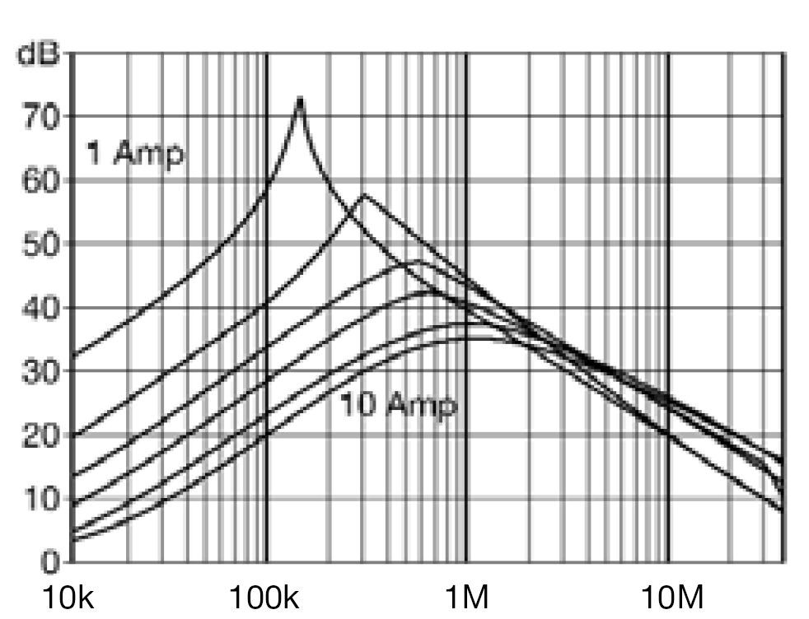
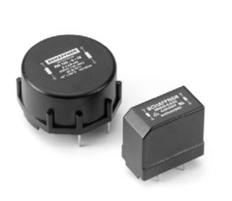
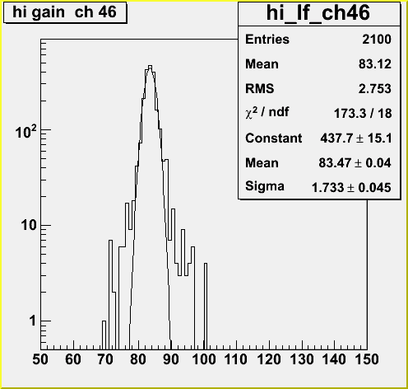
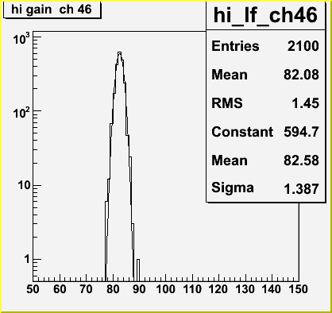
Adding Chokes
Before
After
Bulky common mode chokes provide the best attenuation of switch frequency noise.
Very hard to add on site: it is much better to insert them at the beginning of the design.
Limitation: magnetic field of experiments.
Before
After

Slide 48
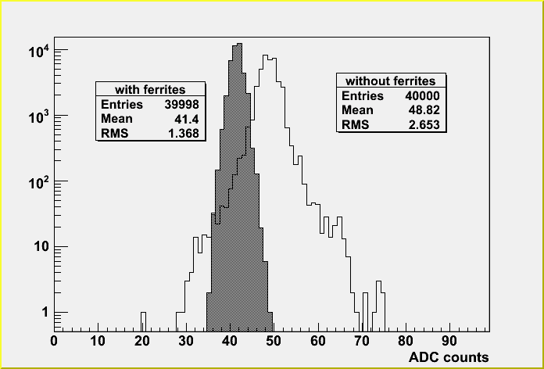
Adding ferrites
Last resource!
Compromised in presence of magnetic field.
Works better at few tens of MHz in the sensitivity range of typical front-end amplifiers.

Slide 49
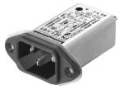
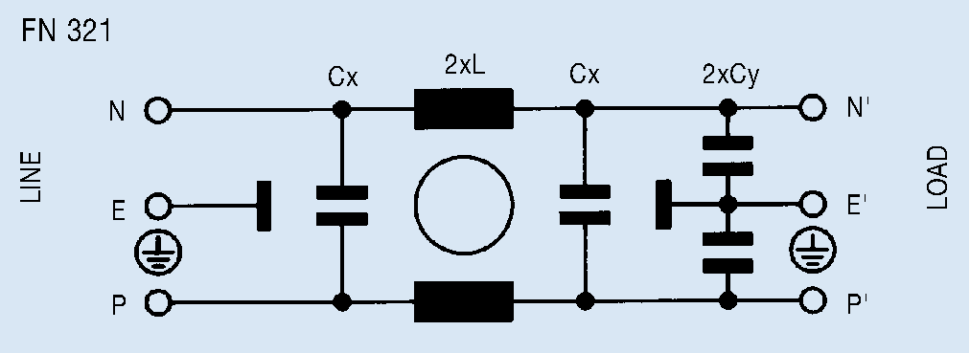
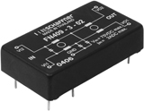
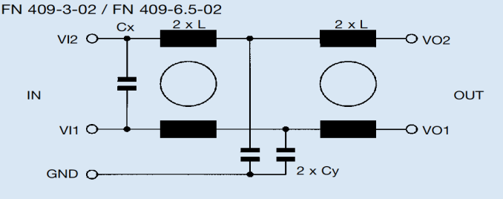
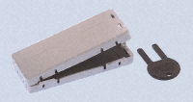

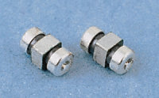
Other filters
Power plane (VO2)
Ground Plane (VO1)
Earth bonding (GND)
Whatever filter is used, make sure that the CM current never enters in your system
Earth bonding (CM)

Slide 50
Recommended Practices
How can I apply all this to my designs?
Always prefer back end systems that are compliant with EU EMC regulations: LV directive, EMC directive, CE mark.
Look for PFC in back end equipment.
Never leave floating any conductive frame, chassis, structure, box
  Interconnect them and tie them to earth with the shortest connection
  This is necessary for safety, also it radically improves the protection against EMI couplings.
  Earth loops are never a hazard: they are not part of active circuits.
Use shielded data and power cables whenever possible.
  It is almost always better to earth the shield to the frames on both ends.
  Shields are tied to earth via frames, not to active return paths.

Slide 51
Recommended Practices
Fit the power lines with common mode filters in the back end side.
Reference your front-end system to the closest ground connection.
Design with an eye on EMC aspects:
- Measure the noise emissions of prototypes.
- This leaves a chance to correct easily before production/installation.
- Measure the susceptibility of prototypes.
- It brings invaluable information that is then used to specify power supplies and cables.
Design for the real world!

Slide 52
Thanks for your attention!

