Slide 1
Geiger counter
Ian
3 June 2024

Slide 2
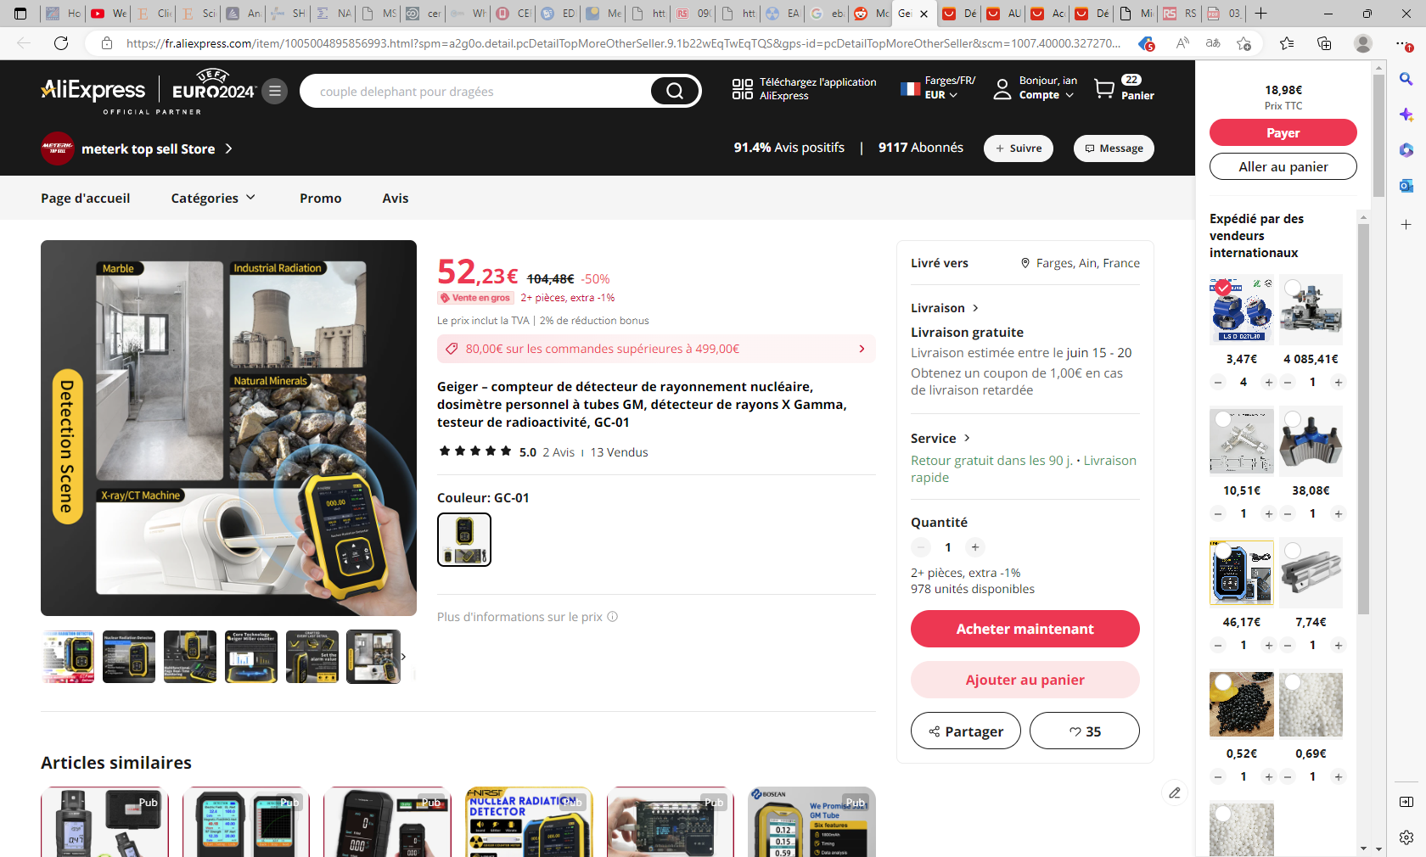

Slide 4
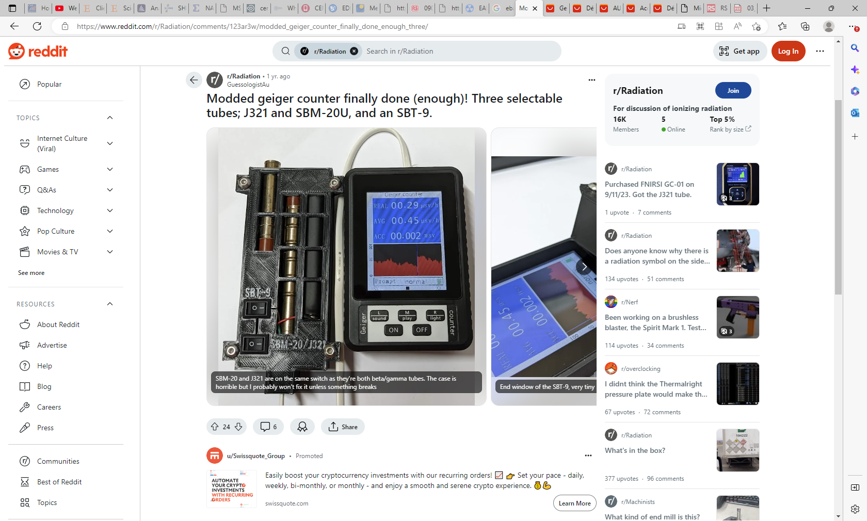
https://www.reddit.com/r/Radiation/comments/123ar3w/modded_geiger_counter_finally_done_enough_three/

Slide 5
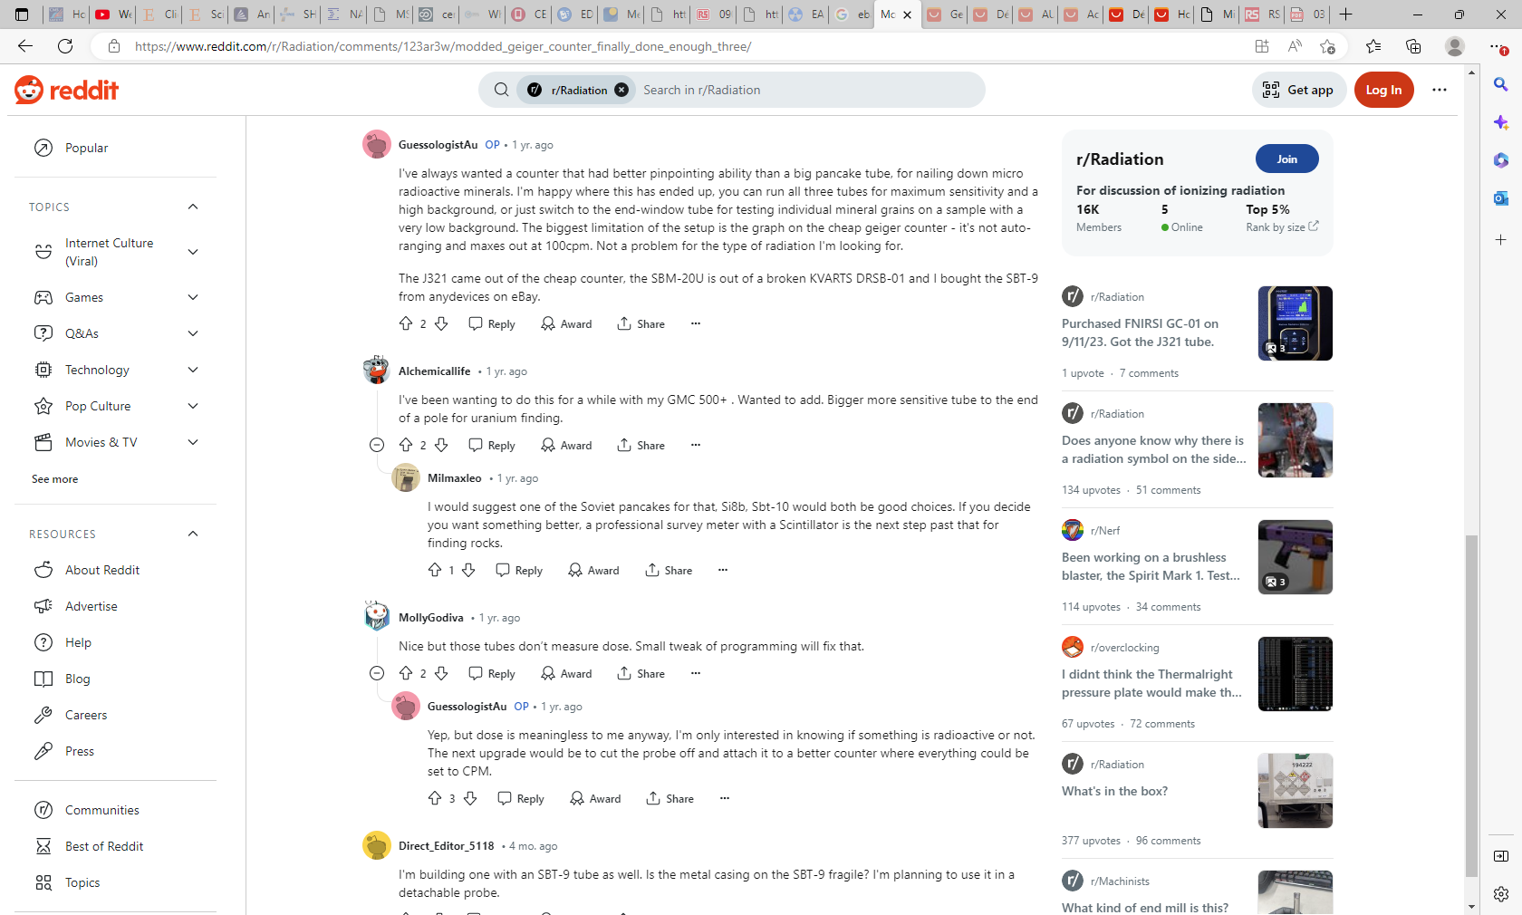

Slide 6
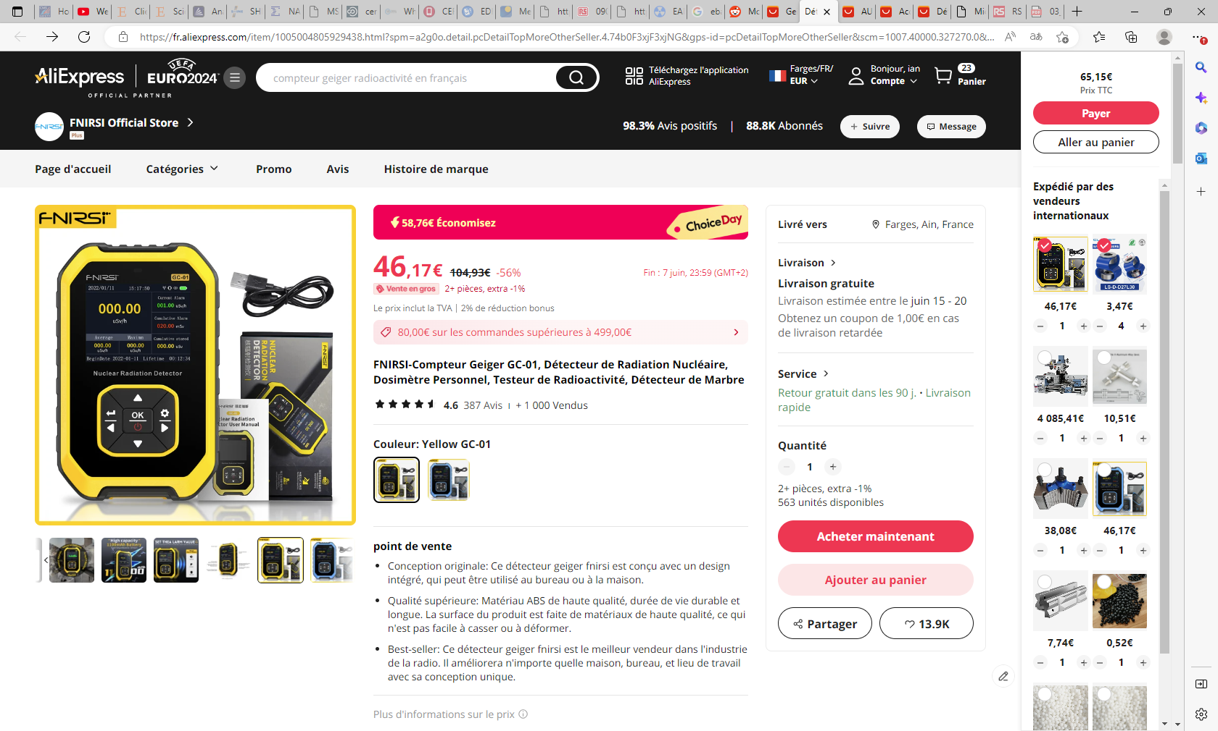

Slide 7
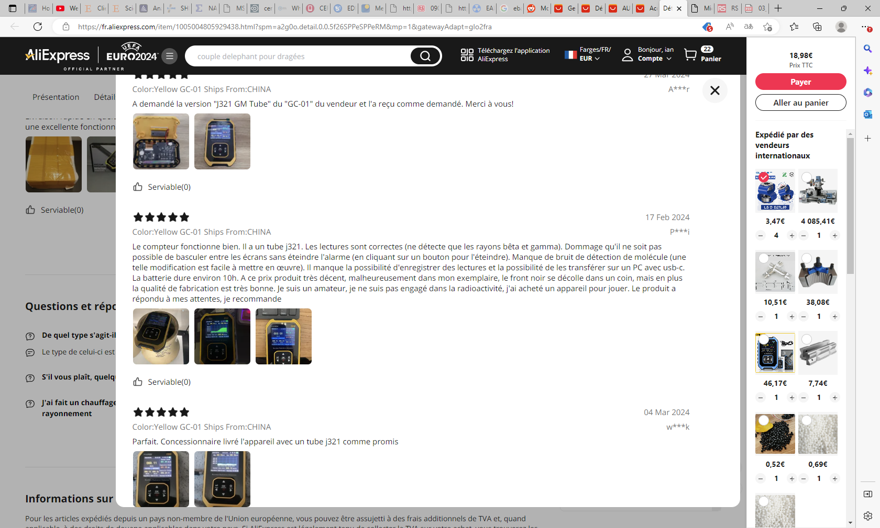

Slide 8
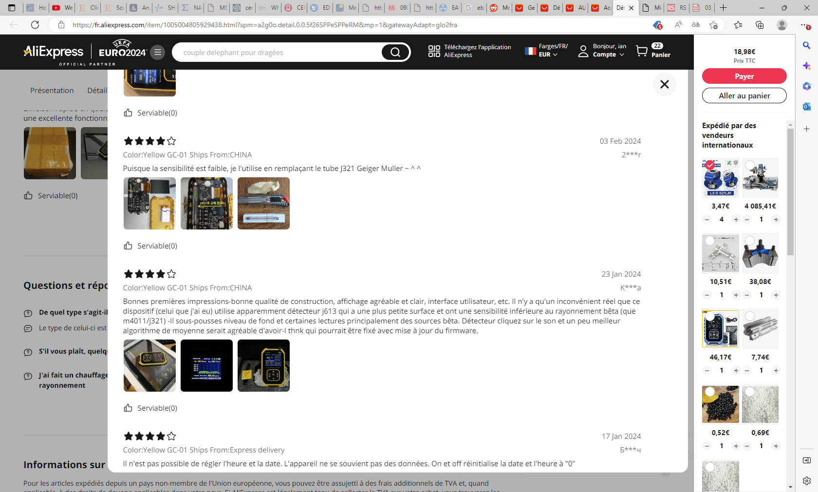

Slide 9
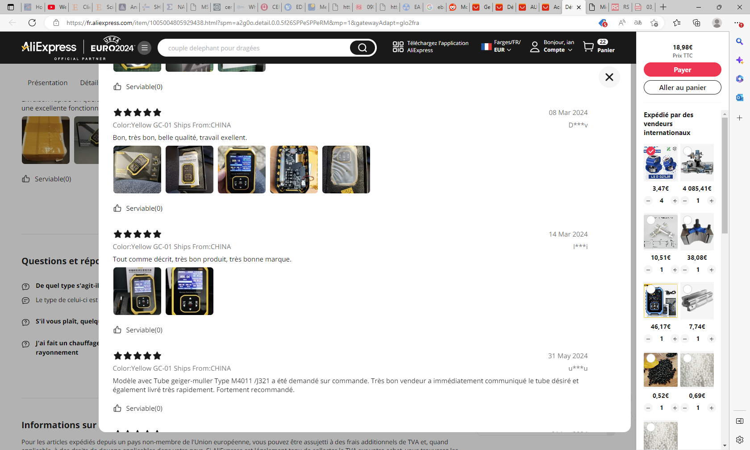

Slide 10
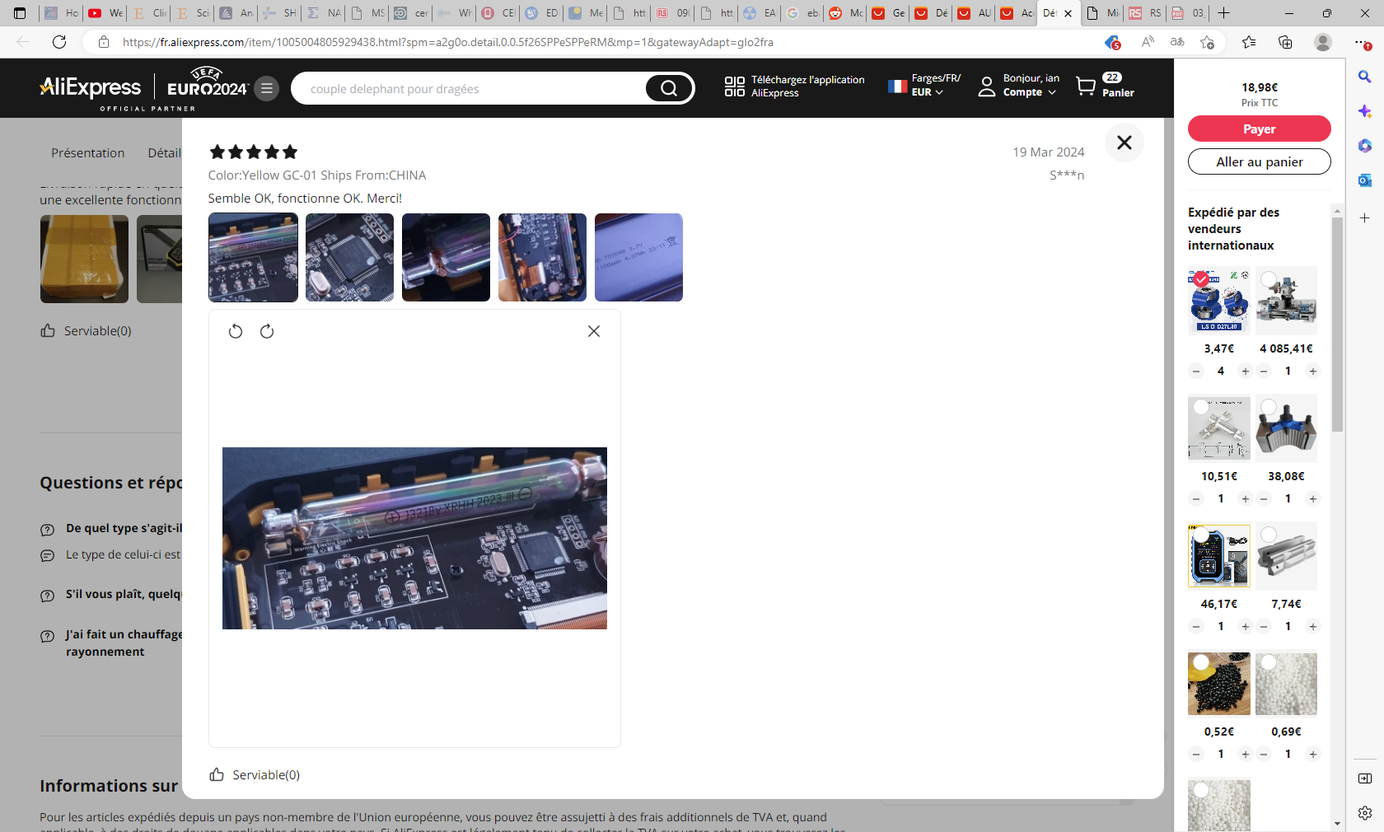

Slide 11
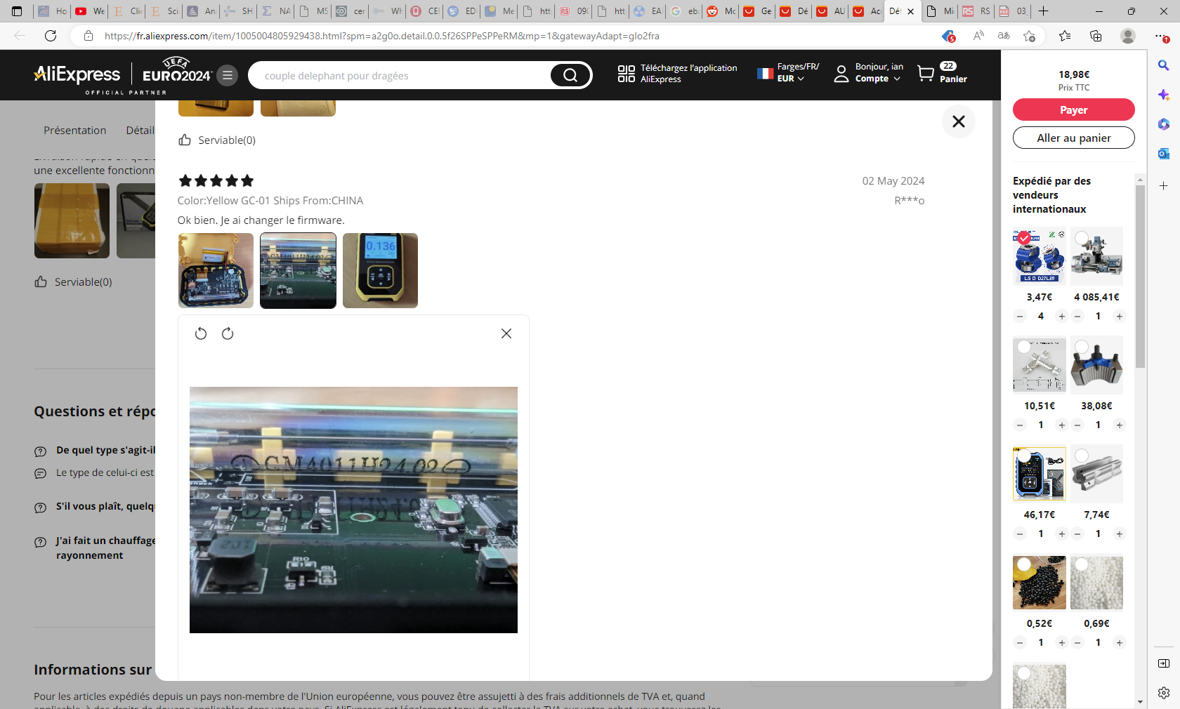

Slide 12
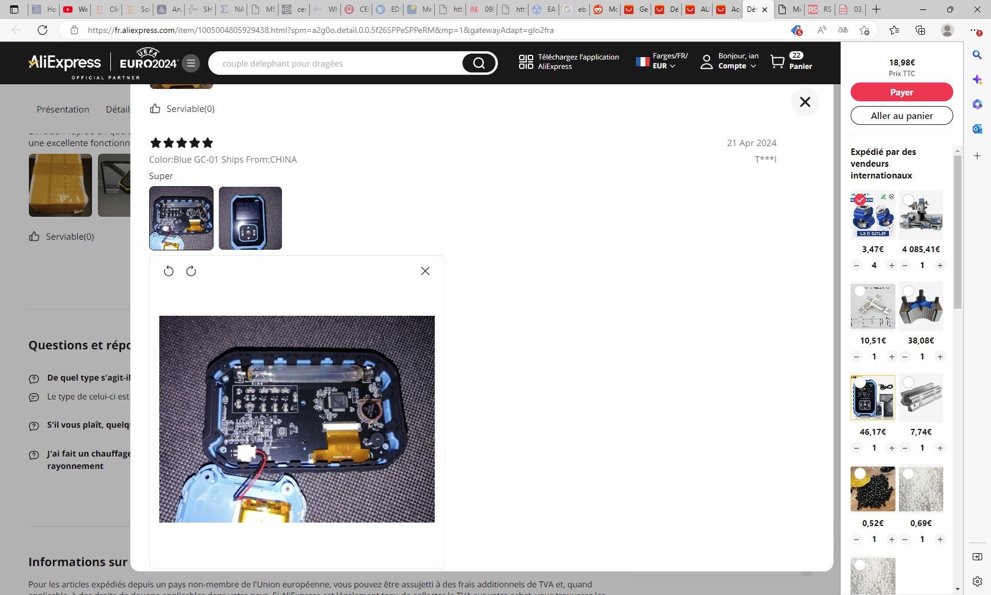

Slide 13
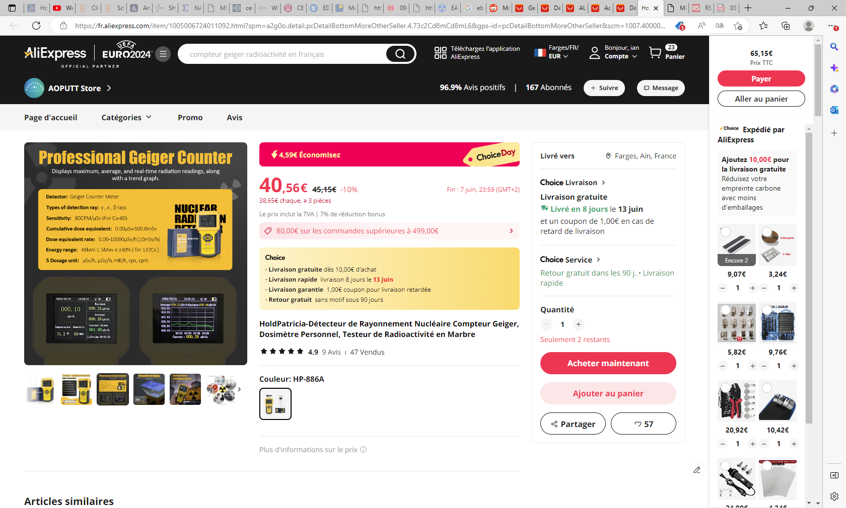

Slide 14
Sensitivity
80CPM/microSv (for Co60)
Energy range
48keV – 1.5MeV < pm30% (for 137Cs)

