Slide 1
6mm pipe clamp
Ian
21 April 2022

Slide 2
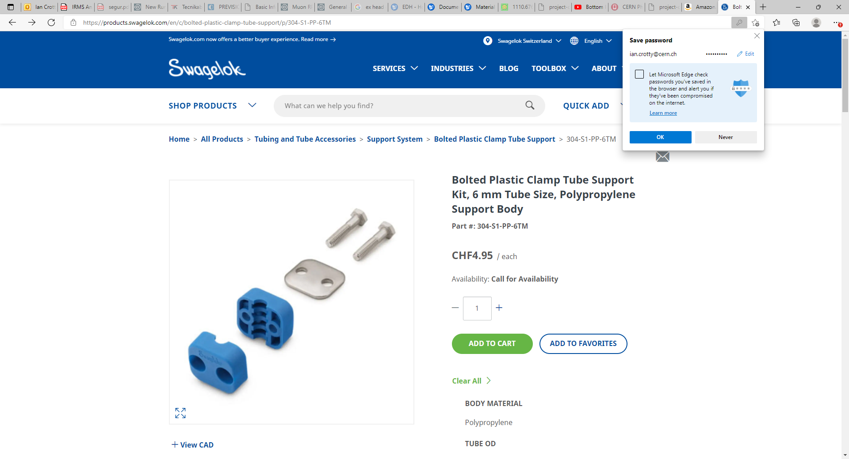

Slide 3
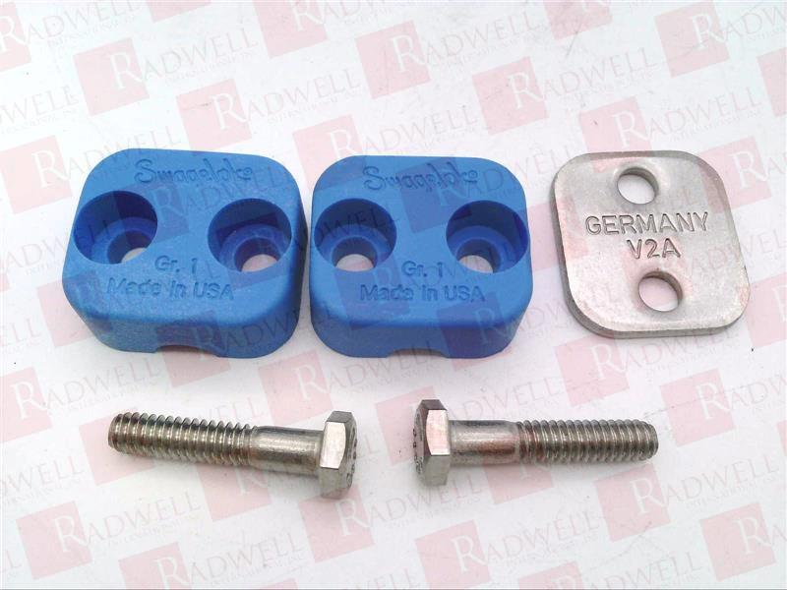
304-S1-PP-6T

Slide 4
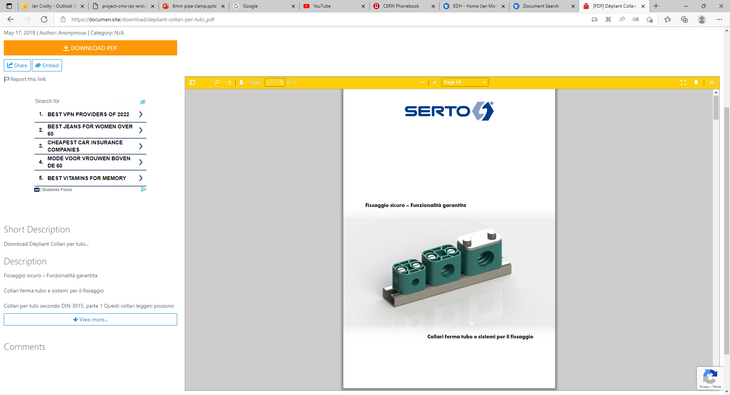
SERTO
906.1000.006
https://documen.site/download/depliant-collari-per-tubi_pdf

Slide 5
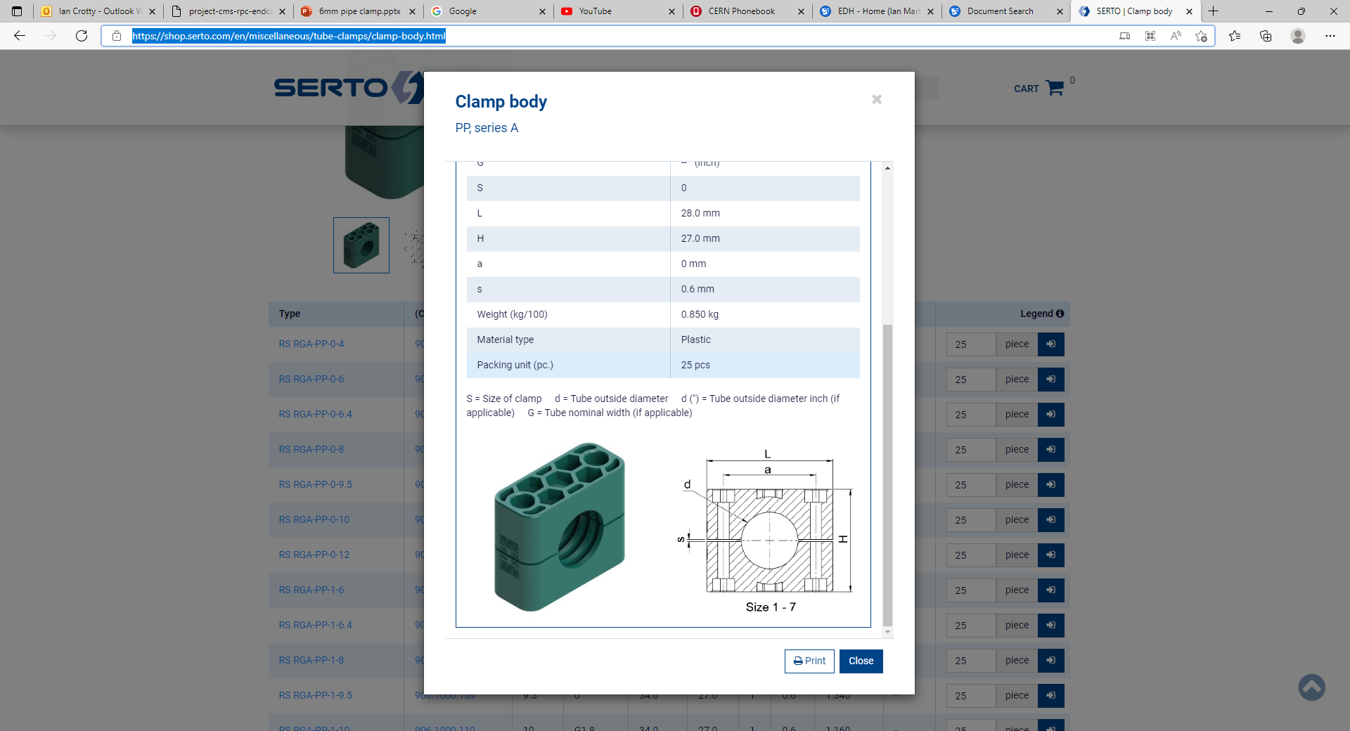
https://shop.serto.com/en/miscellaneous/tube-clamps/clamp-body.html

