Slide 1
LTD stirling Engine analysis
Ian
5 Feb 2020

Slide 2
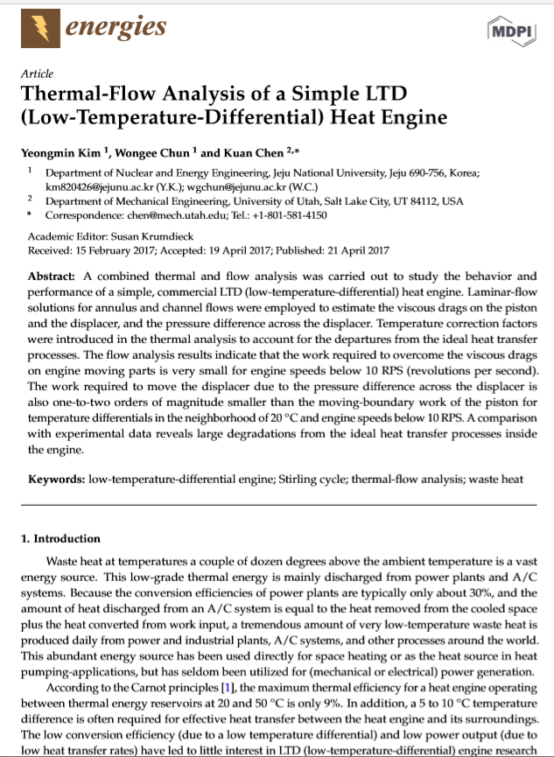
https://www.mdpi.com/1996-1073/10/4/567/pdf

Slide 3
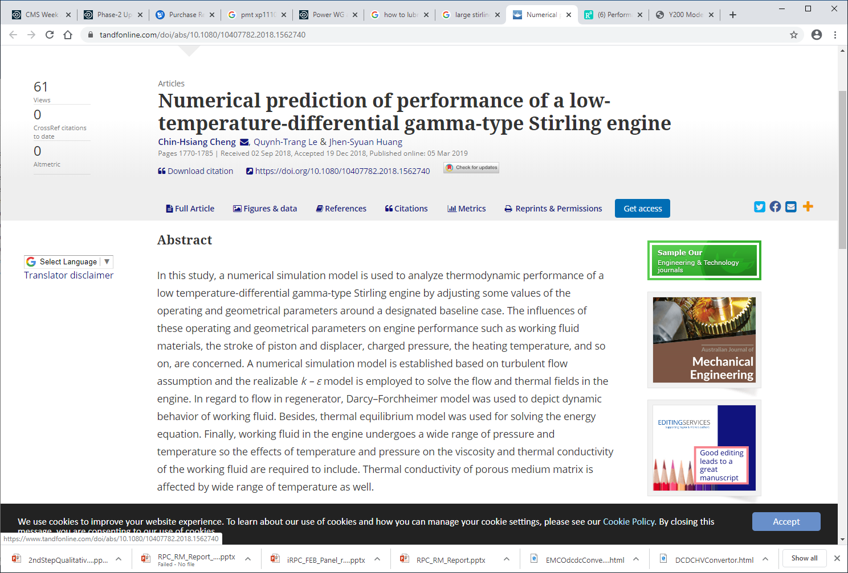
https://www.tandfonline.com/doi/abs/10.1080/10407782.2018.1562740

Slide 4
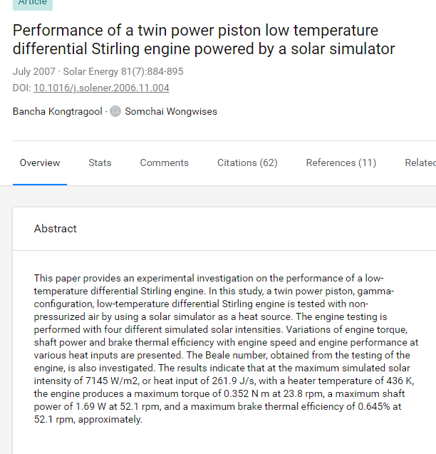
https://www.researchgate.net/publication/222538648_Performance_of_a_twin_power_piston_low_temperature_differential_Stirling_engine_powered_by_a_solar_simulator

Slide 5
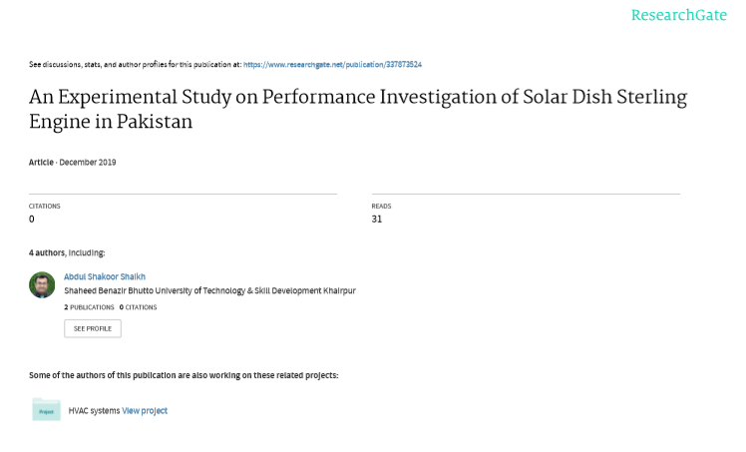
https://www.researchgate.net/publication/337873524

Slide 6
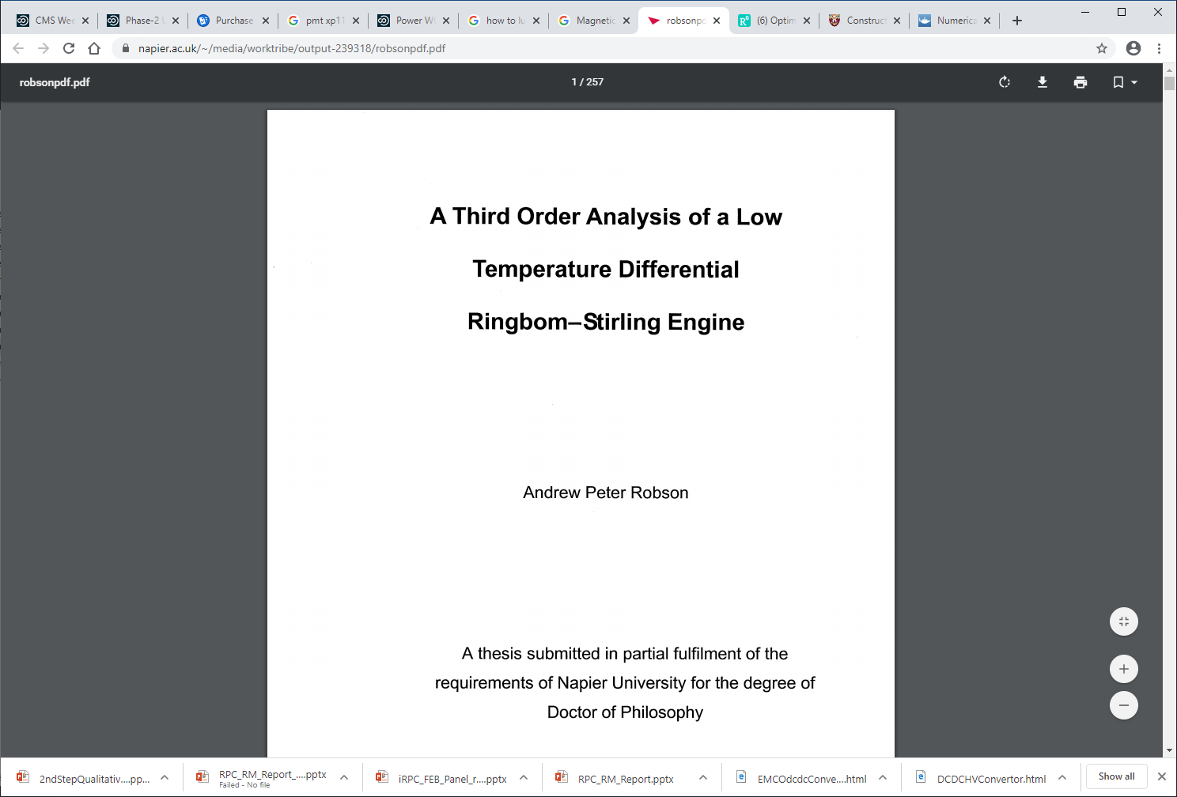
https://www.napier.ac.uk/~/media/worktribe/output-239318/robsonpdf.pdf

Slide 7
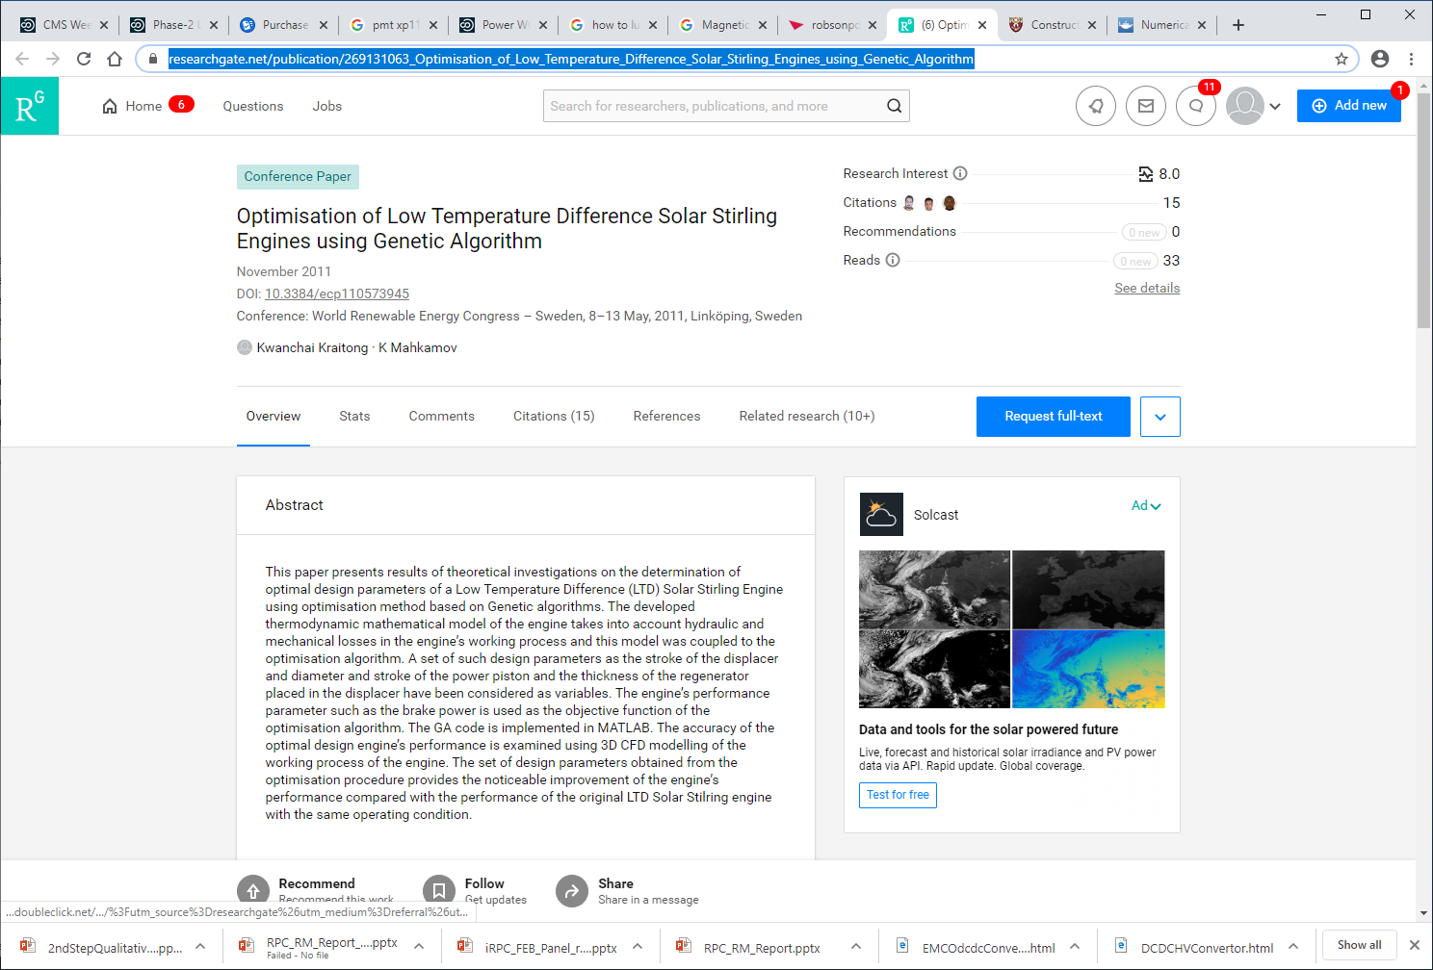
https://www.researchgate.net/publication/269131063_Optimisation_of_Low_Temperature_Difference_Solar_Stirling_Engines_using_Genetic_Algorithm

Slide 8
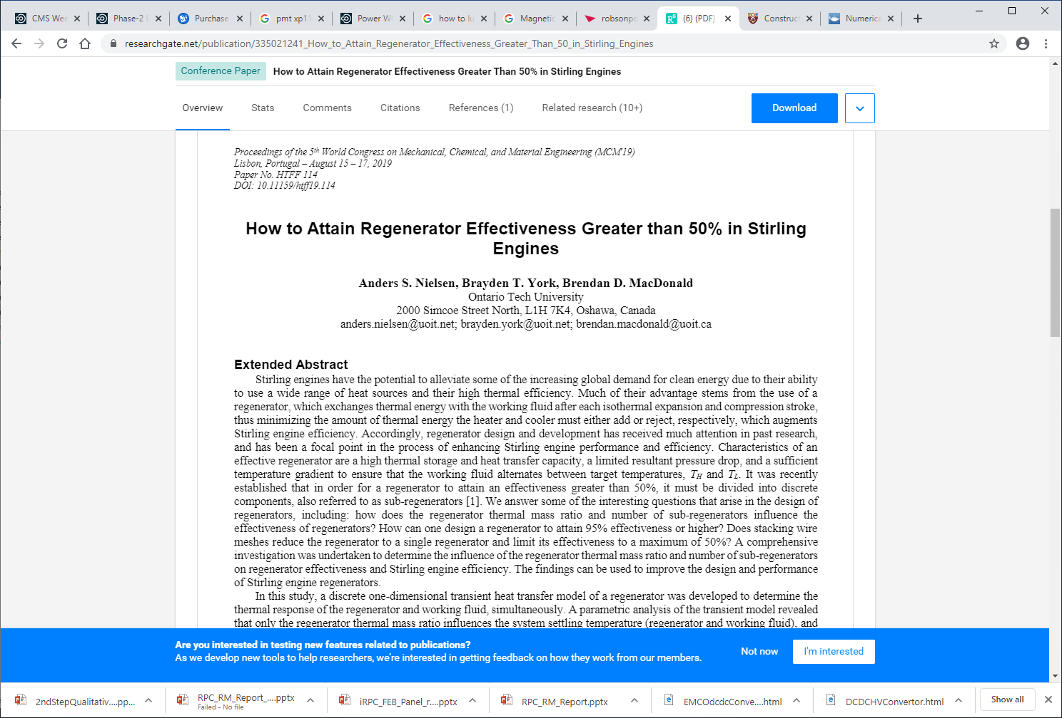
https://www.researchgate.net/publication/335021241_How_to_Attain_Regenerator_Effectiveness_Greater_Than_50_in_Stirling_Engines

Slide 9
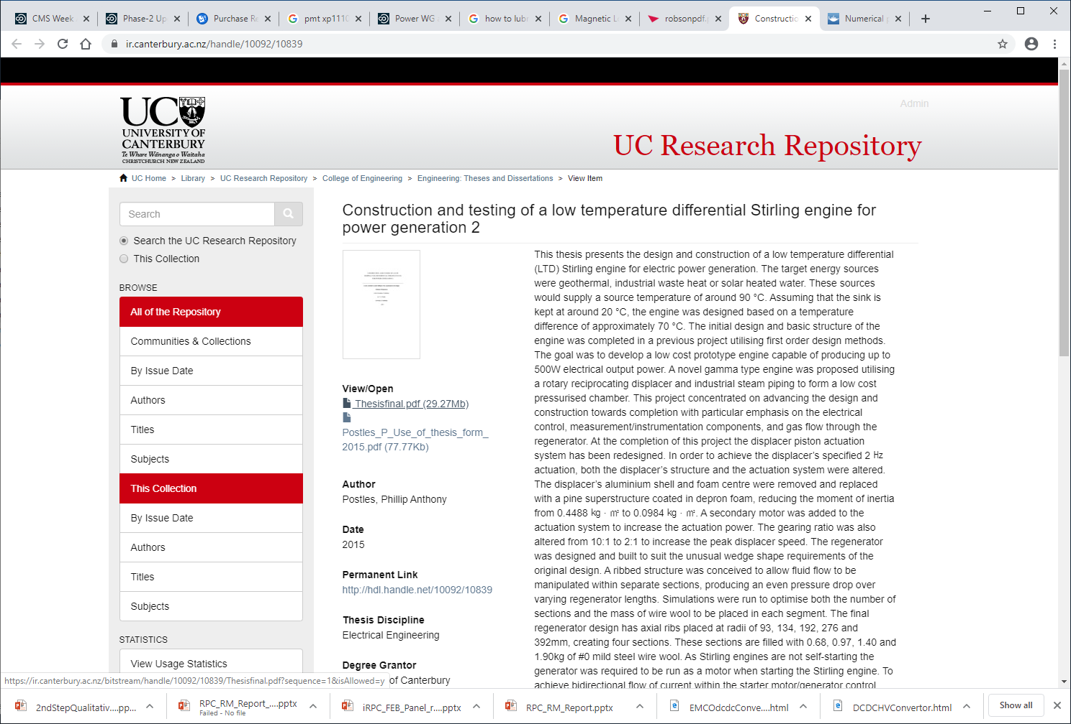
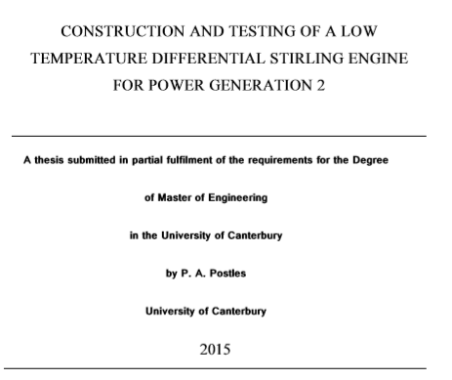
https://ir.canterbury.ac.nz/handle/10092/10839
https://ir.canterbury.ac.nz/bitstream/handle/10092/10839/Thesisfinal.pdf?sequence=1&isAllowed=y
http://hdl.handle.net/10092/10839

Slide 10
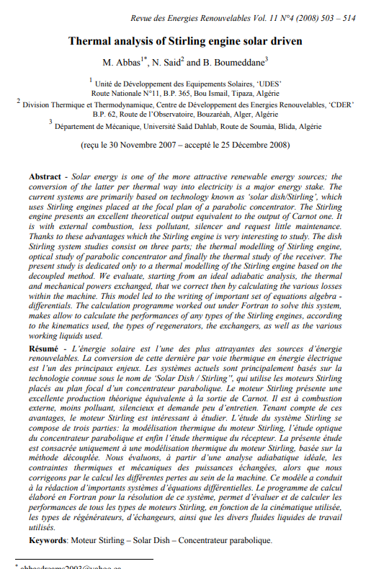
https://pdfs.semanticscholar.org/1758/bef49bdf609587170d24e2eecaec8bbb965b.pdf

Slide 11
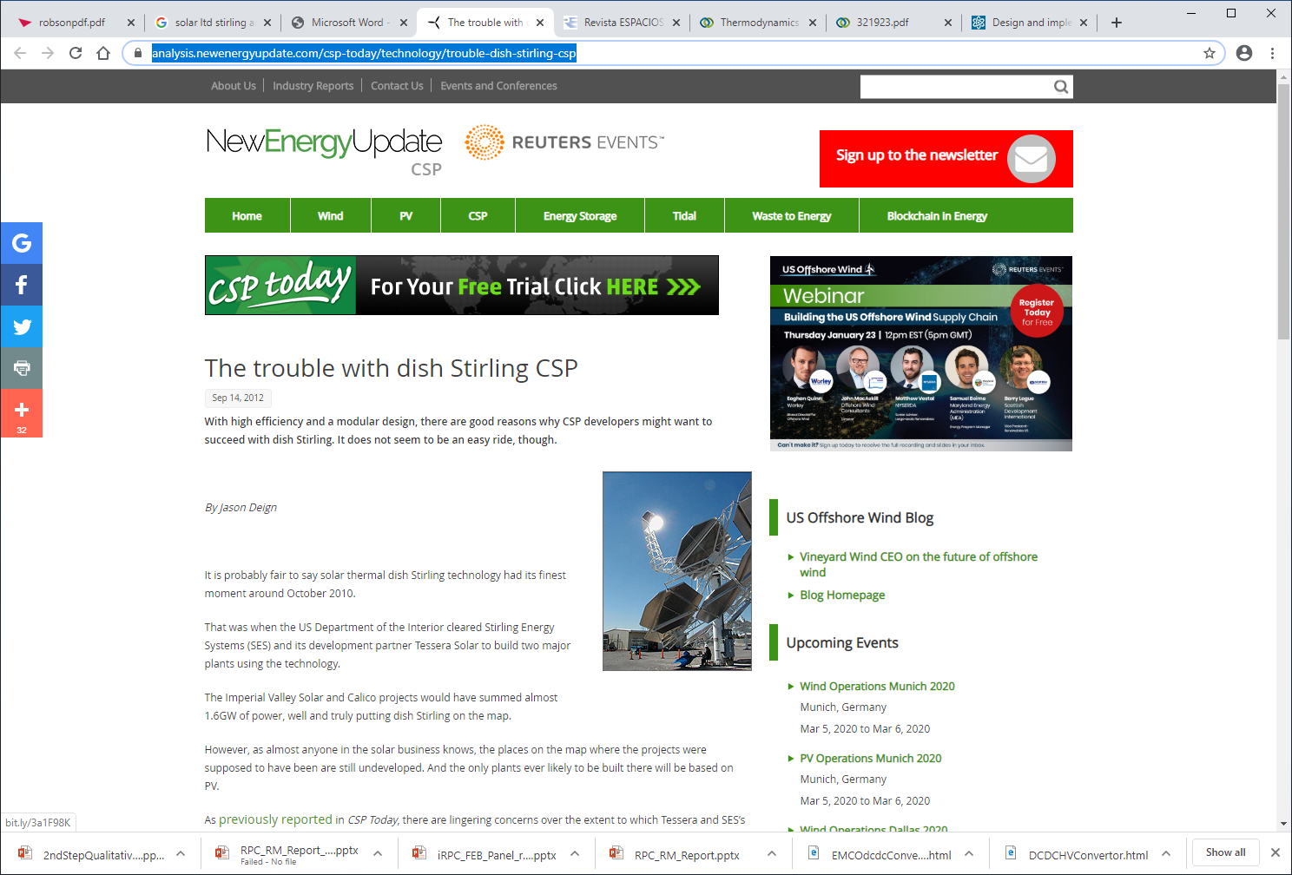
https://analysis.newenergyupdate.com/csp-today/technology/trouble-dish-stirling-csp

Slide 12
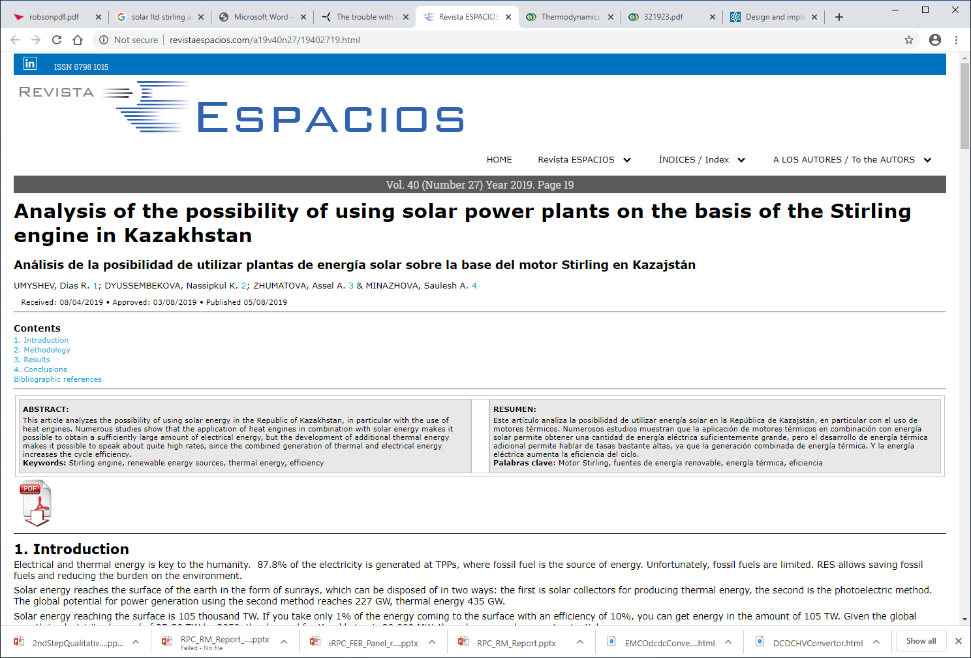
http://www.revistaespacios.com/a19v40n27/19402719.html

Slide 13
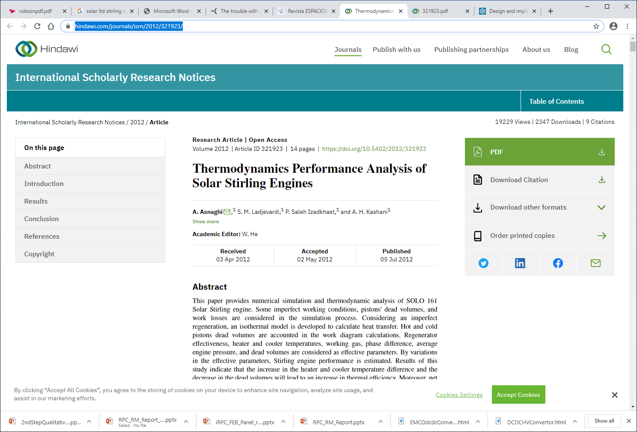
https://www.hindawi.com/journals/isrn/2012/321923/
http://downloads.hindawi.com/archive/2012/321923.pdf

Slide 14
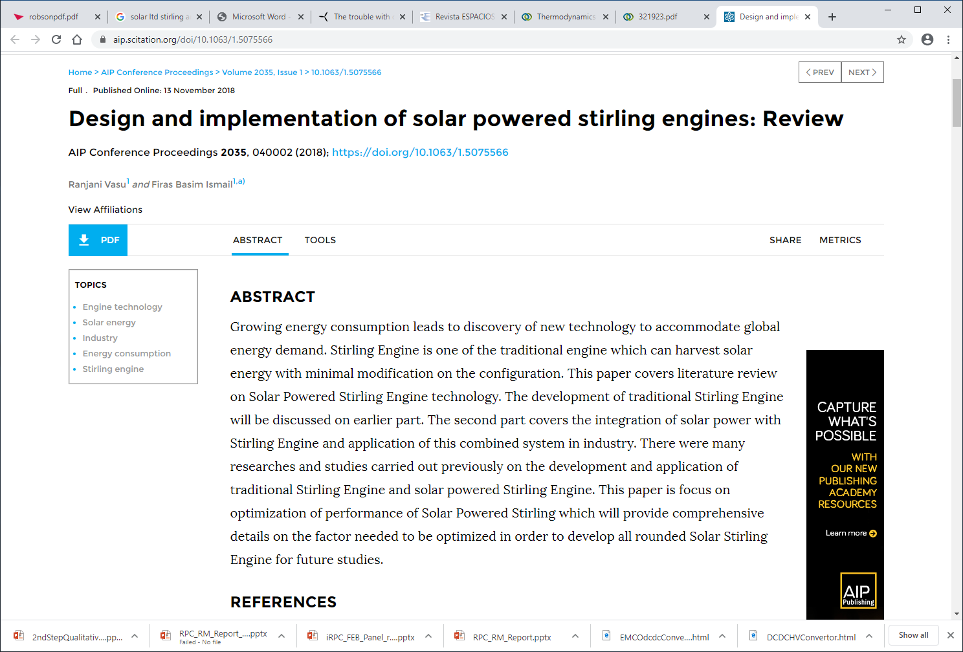
https://aip.scitation.org/doi/10.1063/1.5075566

Slide 15
https://www.napier.ac.uk/~/media/worktribe/output-239318/robsonpdf.pdf

