Slide 1
Free piston Stirling Engine
And Desalination
Ian
19 Nov 2019

Slide 2
Google search
Book by Elrod
the fluidyne engine; how to build one, how it works pdf
https://www.osti.gov/biblio/7364532-fluidyne-heat-engine-how-build-one-how-works-conference-report
https://apps.dtic.mil/docs/citations/ADA006367
https://ui.adsabs.harvard.edu/abs/1974fheh.rept.....E/similar
https://www.worldcat.org/title/fluidyne-heat-engine-how-to-build-one-how-it-works/oclc/22215980/editions?referer=di&editionsView=true
https://ui.adsabs.harvard.edu/abs/1974fheh.rept.....E/similar

Slide 3
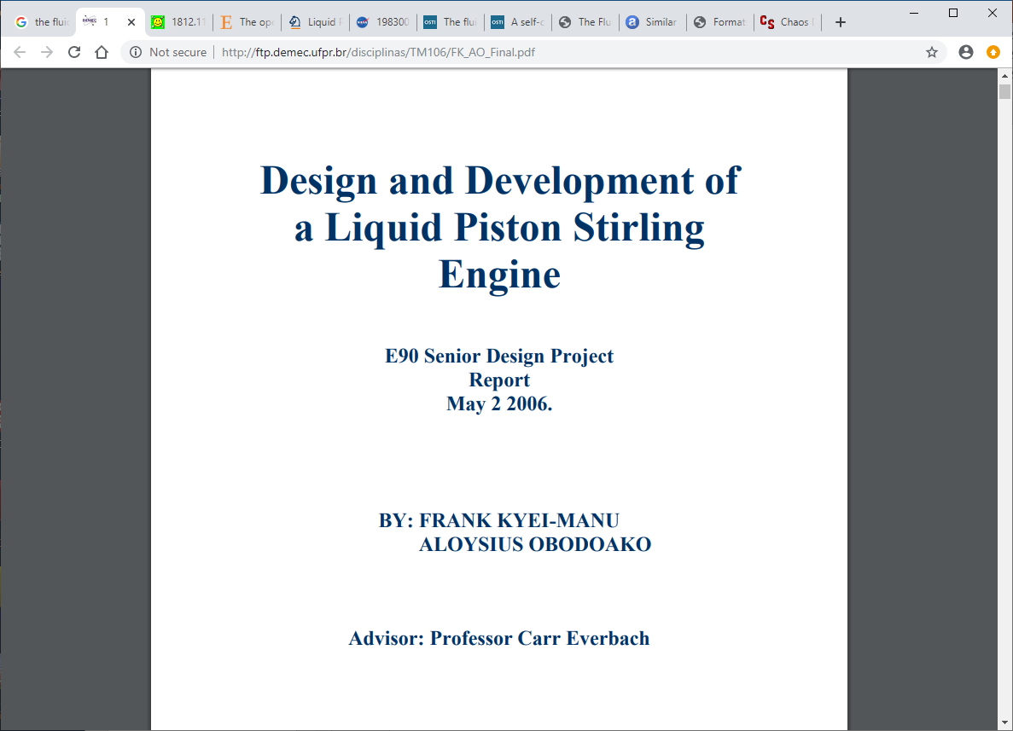
http://ftp.demec.ufpr.br/disciplinas/TM106/FK_AO_Final.pdf
62 pages

Slide 4
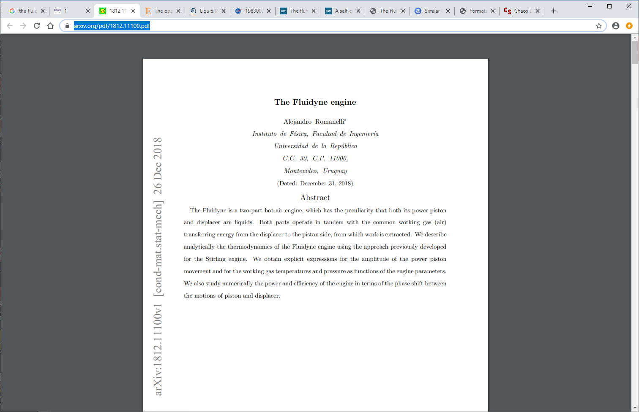
https://arxiv.org/pdf/1812.11100.pdf
13 pages

Slide 5
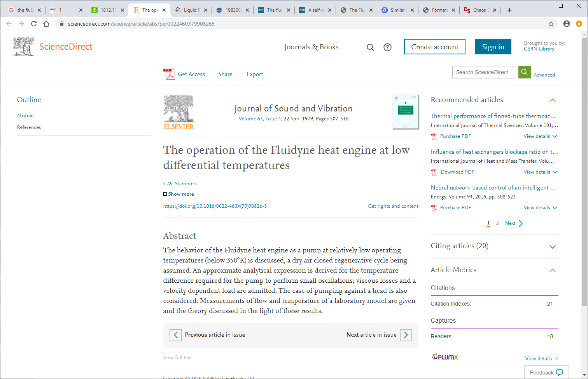
https://www.sciencedirect.com/science/article/abs/pii/0022460X79908265

Slide 6
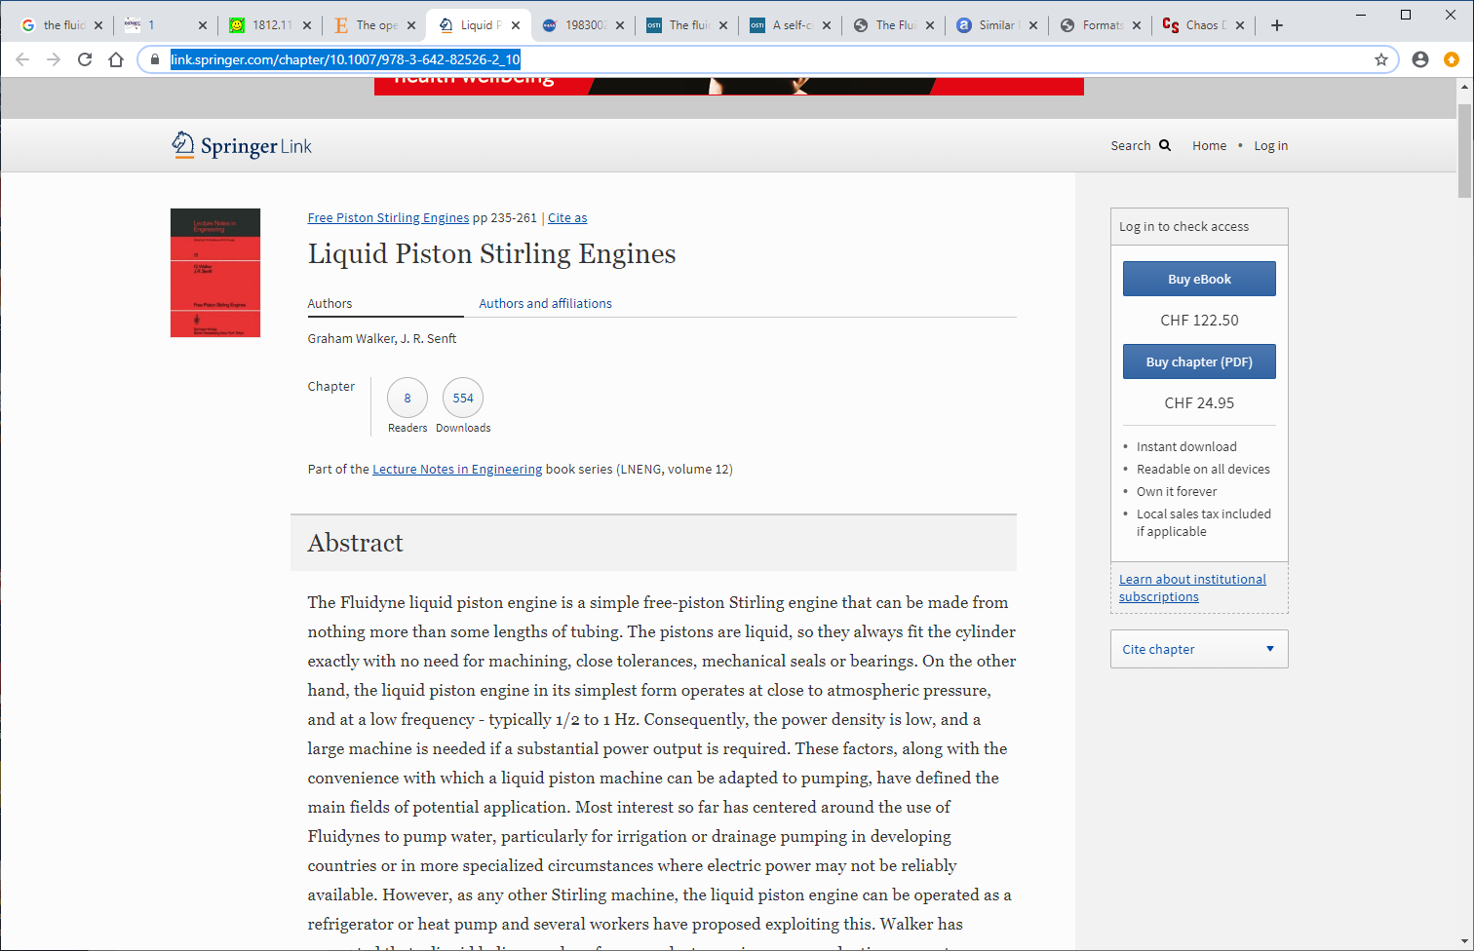
https://link.springer.com/chapter/10.1007/978-3-642-82526-2_10

Slide 7
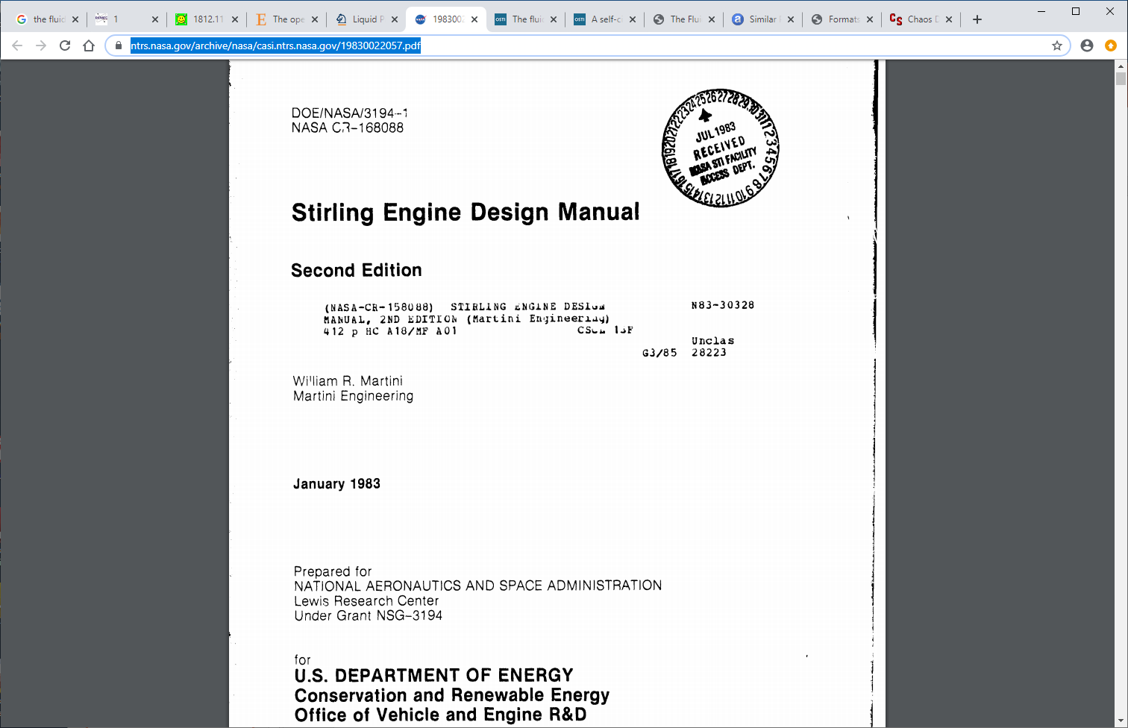
https://ntrs.nasa.gov/archive/nasa/casi.ntrs.nasa.gov/19830022057.pdf
410 pages

Slide 8
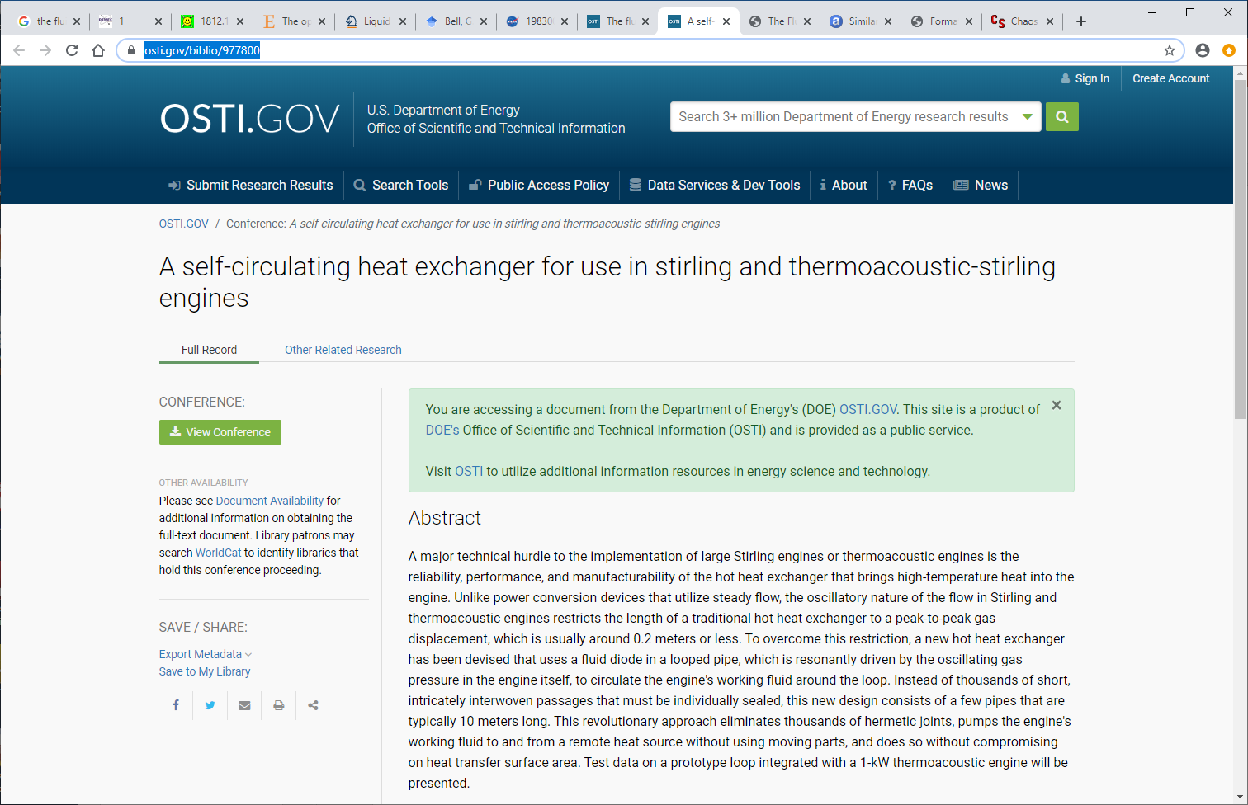
https://www.osti.gov/biblio/977800

Slide 9
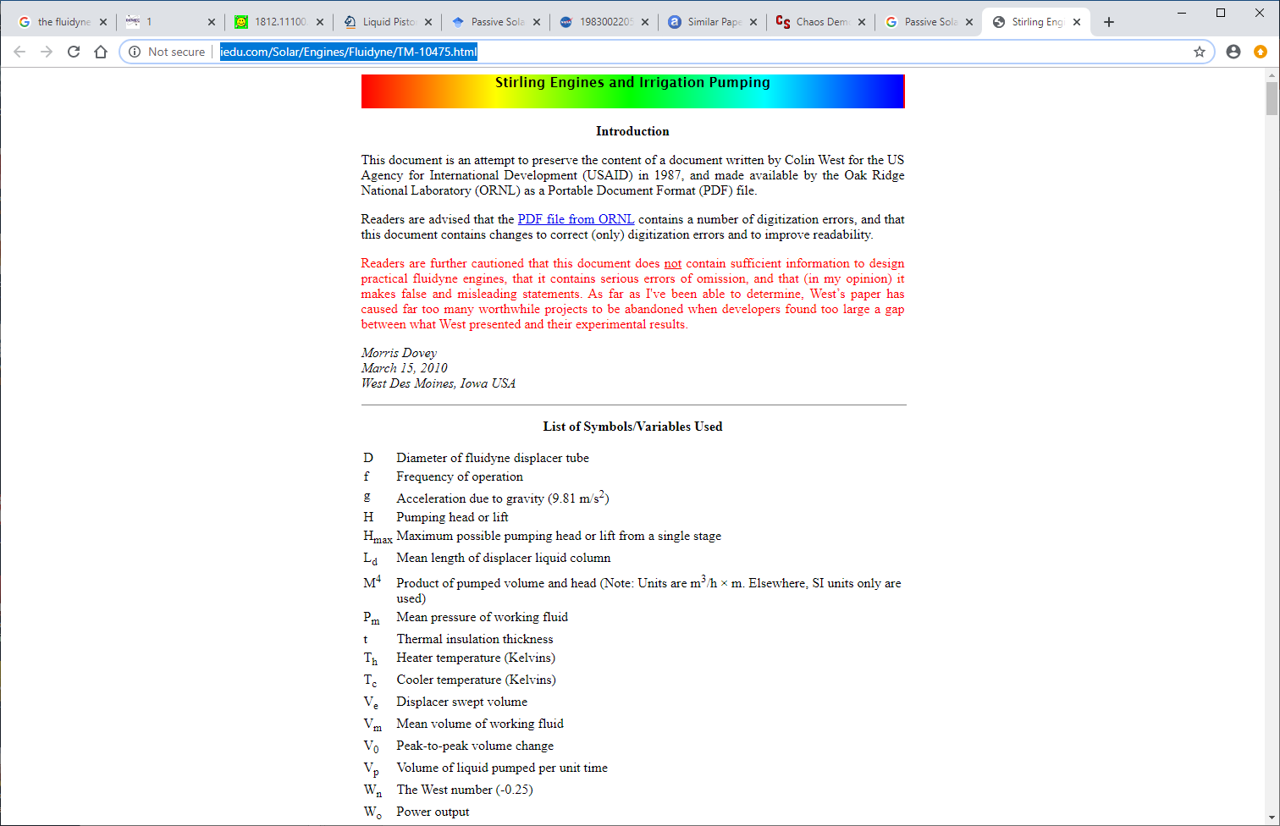
http://www.iedu.com/Solar/Engines/Fluidyne/TM-10475.html

Slide 10
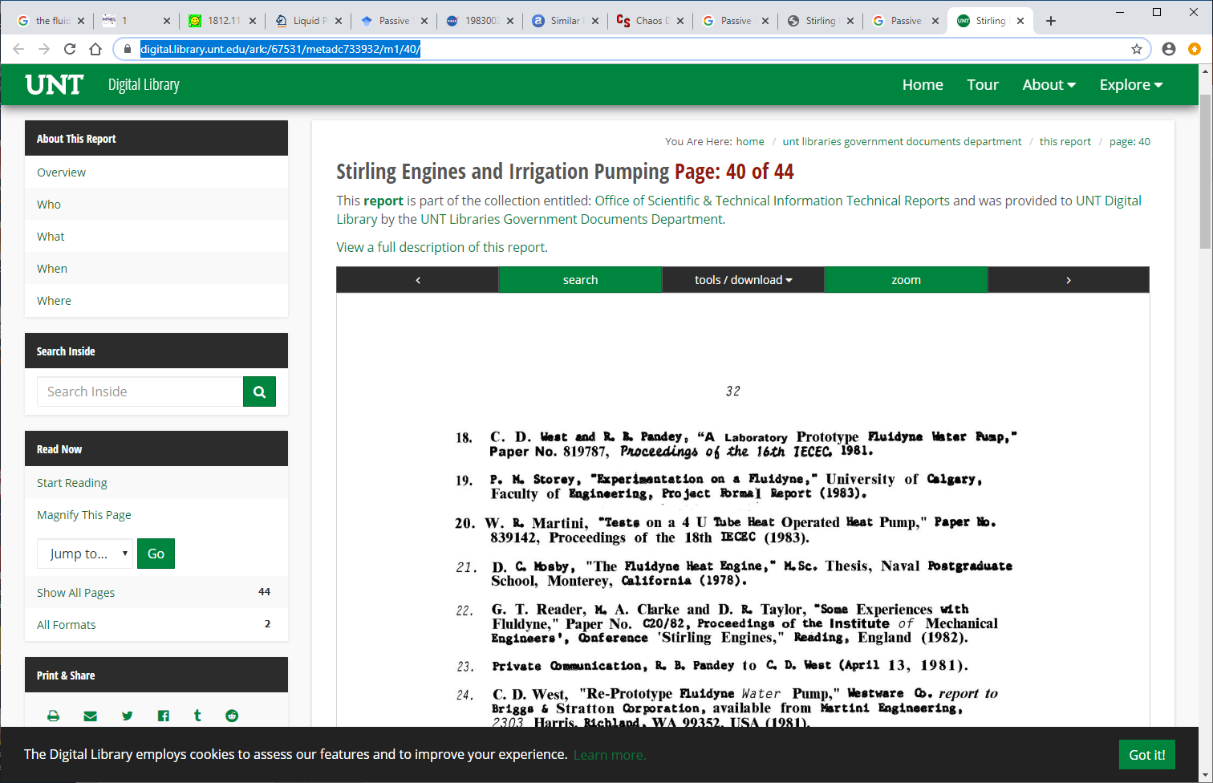
https://digital.library.unt.edu/ark:/67531/metadc733932/m1/40/

Slide 14
Desalination and cleaning of water

Slide 15
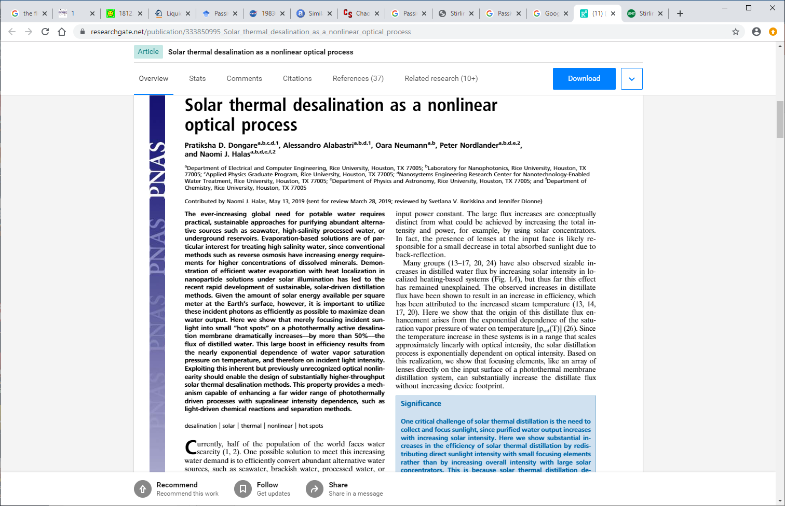
https://www.researchgate.net/publication/333850995_Solar_thermal_desalination_as_a_nonlinear_optical_process

