Slide 1
Stirling Engines and Pumps
Ian
Jan 2018

Slide 2
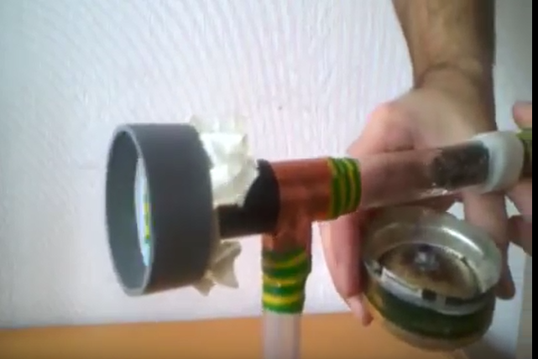
How does compelling thermoacoustic stirling engine work?
https://www.youtube.com/watch?v=dkU6QQ1ckUQ

Slide 3
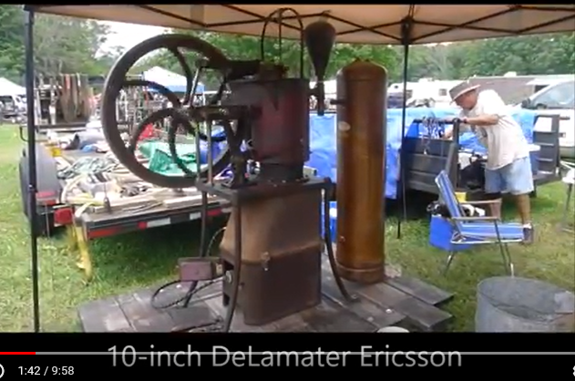
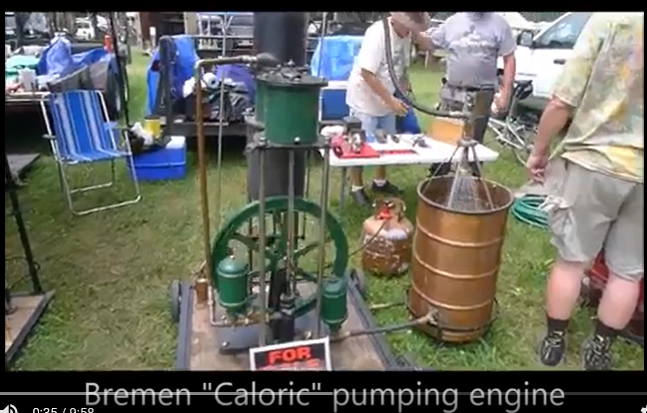
https://www.youtube.com/watch?v=cap_1dKp18Y

Slide 4
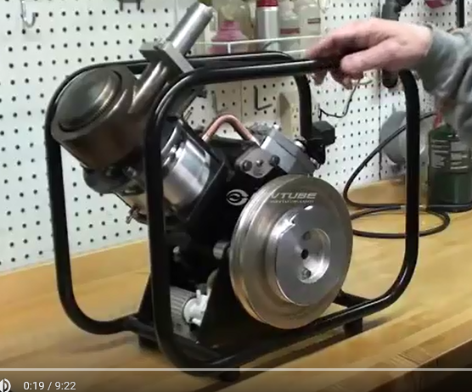
https://www.youtube.com/watch?v=z7lUzKfdHd4
Stirling Engine SV2 MKII by Kirk Engines, Inc.

Slide 5
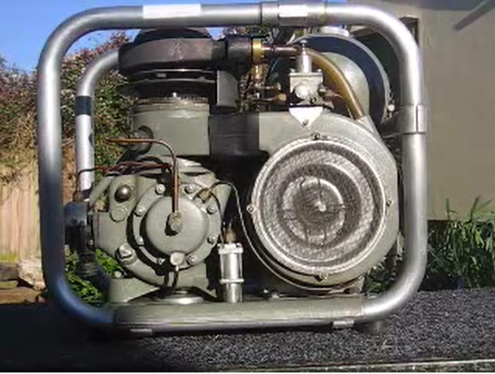
https://www.youtube.com/watch?v=M9UKu-AP02k
PHILIPS STIRLING CYCLE GENERATOR

