Slide 1
Solar club projects
Ian Crotty

Slide 2
Contents

Slide 3
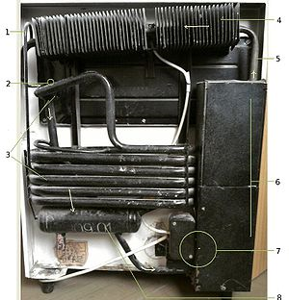
Absorbtion refridgeration cycle
http://vintageservelrefrigerators.8k.com/HowItWorks.html
https://en.wikipedia.org/wiki/Absorption_refrigerator
Labeled photo of a domestic absorption refrigerator. 1. Hydrogen enters the pipe with liquid ammonia (or lithium bromide solution)
2. Ammonia and hydrogen enter the inner compartment of the refrigerator. An increase in volume causes a decrease in the partial pressure of the liquid ammonia. The ammonia evaporates, taking heat from the liquid ammonia (ΔH_{Vap}) and thus lowering its temperature. Heat flows from the hotter interior of the refrigerator to the colder liquid, promoting further evaporation.
3. Ammonia and hydrogen return from the inner compartment, ammonia returns to absorber and dissolves in water. Hydrogen is free to rise upwards.
4. Ammonia gas condensation (passive cooling).
5. Hot ammonia (gas).
6. Heat insulation and distillation of ammonia gas from water.
7. Heat source (electric).
8. Absorber vessel (water and ammonia solution).
Water spray Solar fan
http://www.ted.com/talks/adam_grosser_and
_his_sustainable_fridge

Slide 4
Solar refrigeration
https://perso.limsi.fr/mpons/solaradsor.htm

Slide 5
Icy Ball

Slide 6
Fluidyne

Slide 7
Kid’s solar go cart Photon mini

Slide 8
Conclusion

