Slide 1
Miele W1780 Washing machine
Jan 2018 Ian

Slide 2
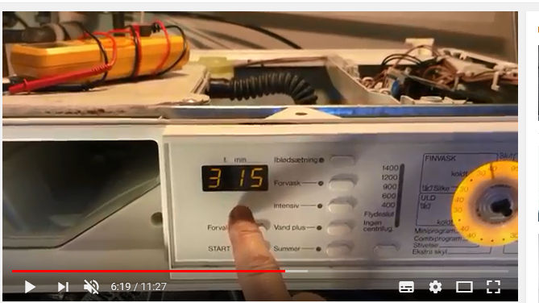
https://www.youtube.com/watch?v=v_9bZNIRRJU
Dissembly
Test Function !! Includig hours worked.

Slide 3
Front seal
https://www.youtube.com/watch?v=lSkMUxXja24
https://www.youtube.com/watch?v=2_ejohiU8h0
Full Dismantle
https://www.youtube.com/watch?v=O0nFXA8D5Hk

Slide 4
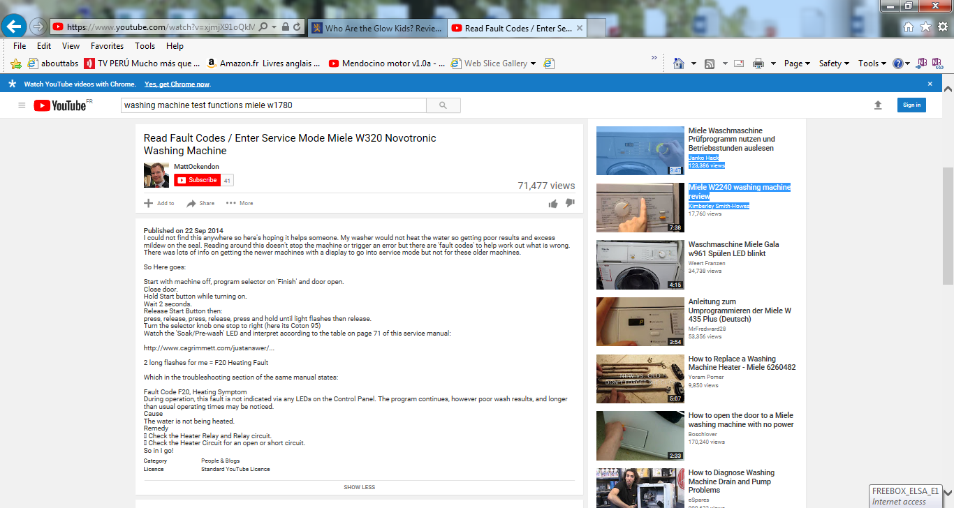
Tech manual with codes !!
https://www.youtube.com/watch?v=xjmjX91oQkM
http://www.cagrimmett.com/justanswer/W1113tech.pdf

Slide 6
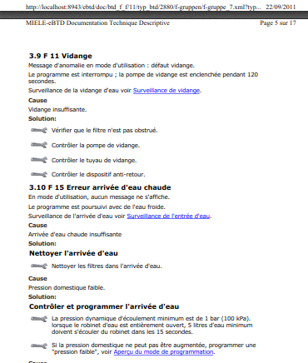
http://forum.adepem.com/depemdocs/MIELE/w2888%20MODE%20DIAGNOSTIC.pdf
See address at top of the page

Slide 7
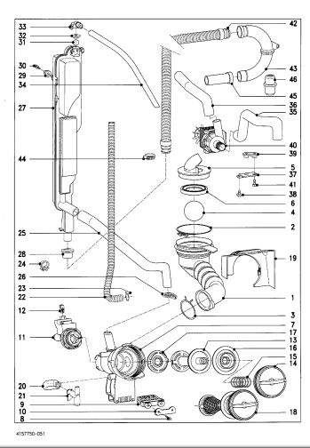
Component List with diagram, francais.
http://forum.adepem.com/depemdocs/MIELE/WT%20945%20S.pdf
It seems the refs do not agree with Mielle……!!
http://forum.adepem.com/depemdocs/MIELE/

Slide 8
Components
Drain “sound Box “ mounted on the LH rear corner after the pump
M-Nr.5745751 PP
And the non return valve
Miele T-Nr. 4663201 PP T-40
With a yellow soft ball

Slide 9
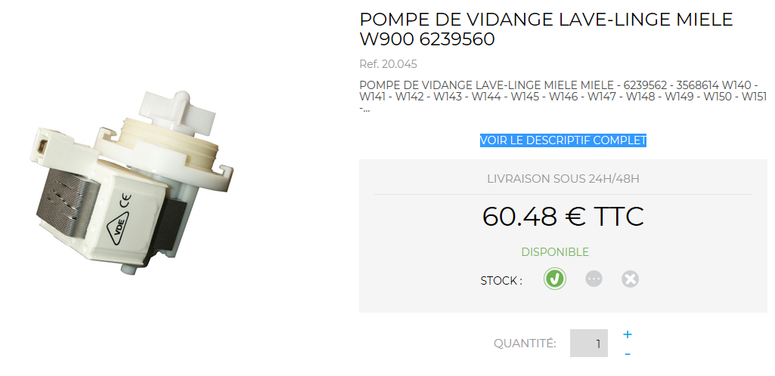
Pieces de rechange
https://www.npm.fr/recherche-s-25?s=w1780

Slide 10
Supppliers
http://www.waschmaschin.de/Miele/Miele_Ersatzteil.html
https://www.ersatzteile-24.com/index.php?searchModellNr=w1780&searchManufactor=miele&searchbar_send=Y&id=19

