Slide 1
Activities
Ian
13 – 27 Oct 2020

Slide 2
Services for RE3/1 & RE4/1 HV, LV OF and cooling all connectorised
Resistivity vs Transmission
Cryogenic Solenoid for Open days
Repair of RB chamber gas system from inside.
PRPC, higher density, flat pack chamber and rpc prediction performance, evaluate.
HGCAL, contacts
Gas Recuperation by cryogenic
MEX shipping “all” for a lab. NIM, gas etc
Oil on HPL play time
Cooling for with CSC job @ CERN
Safety tour during lock down plus shifts for LS3 commissioning
Gas system for Lyon

Slide 3
Services for RPC Upscope
RE3/1 & RE4/1
HV
LV
Cooling
Optical Fibres ( with andres)

Slide 4
Resistivity vs Transmission

Slide 5
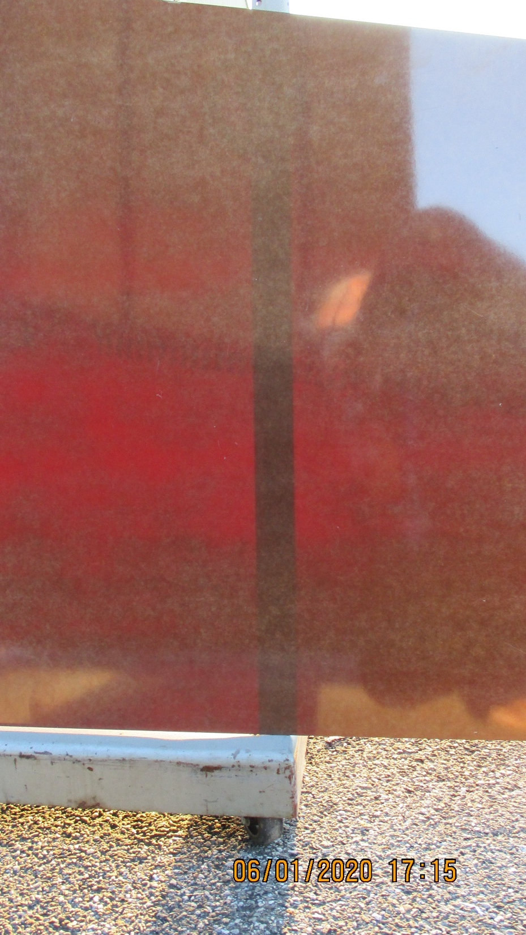
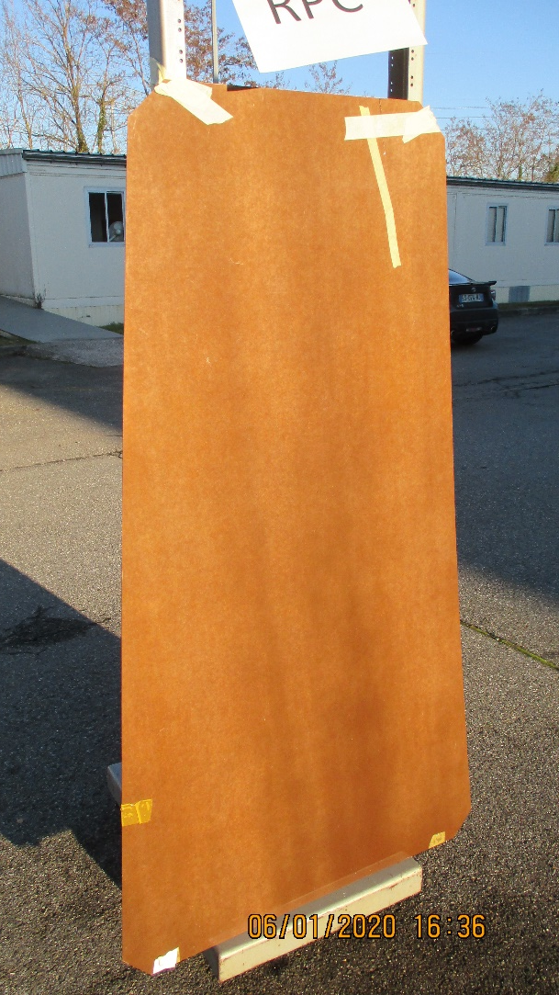

Slide 6
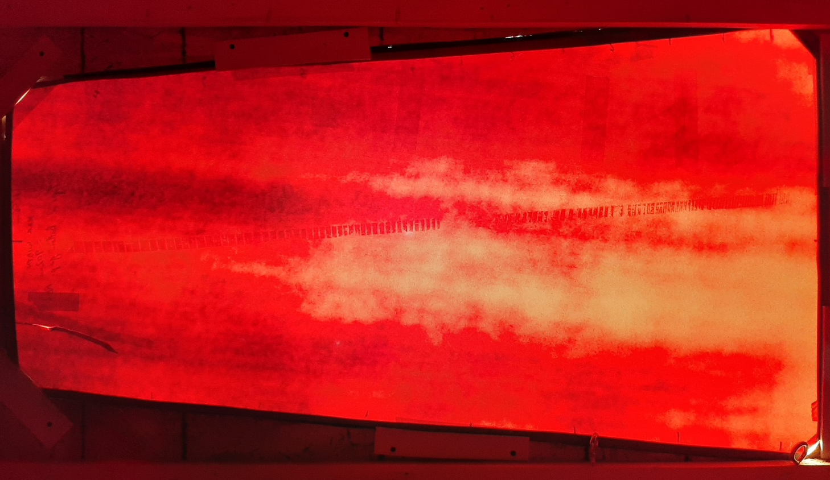
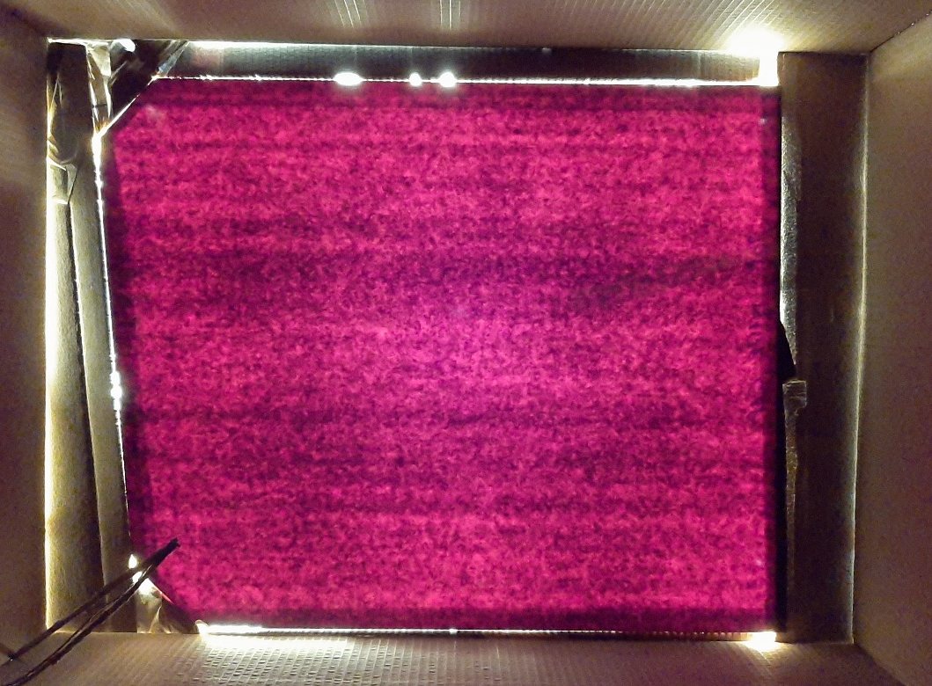
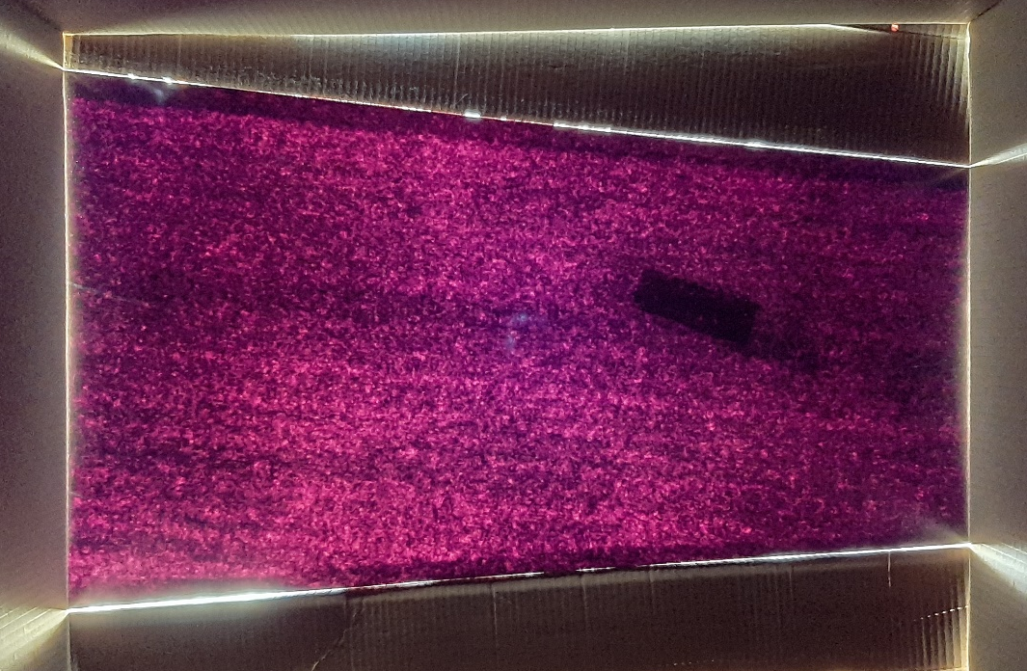
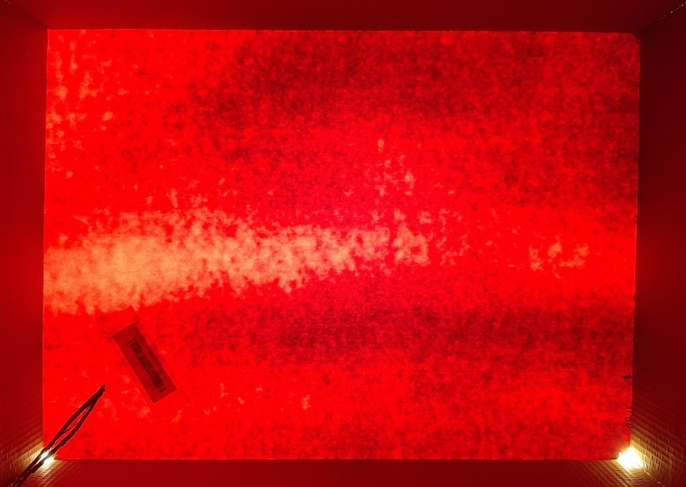
Similar lighting from the Sun and Samsung Camera. Old production on the RHS and new on the left

Slide 7
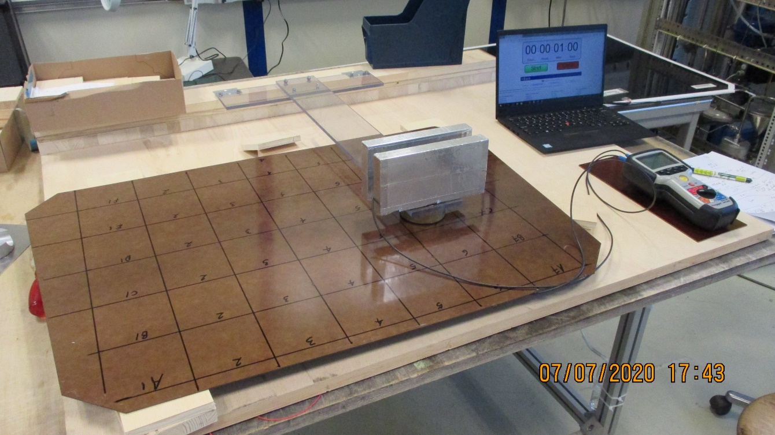
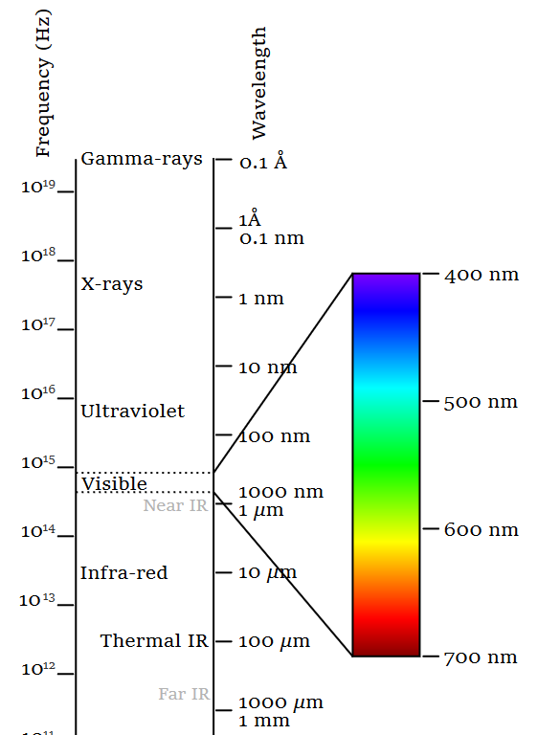
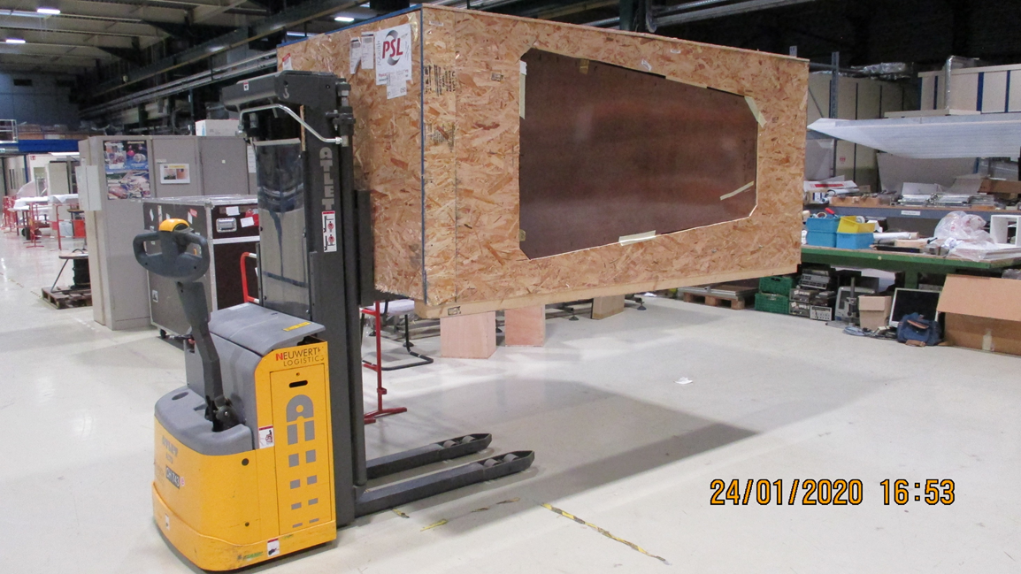
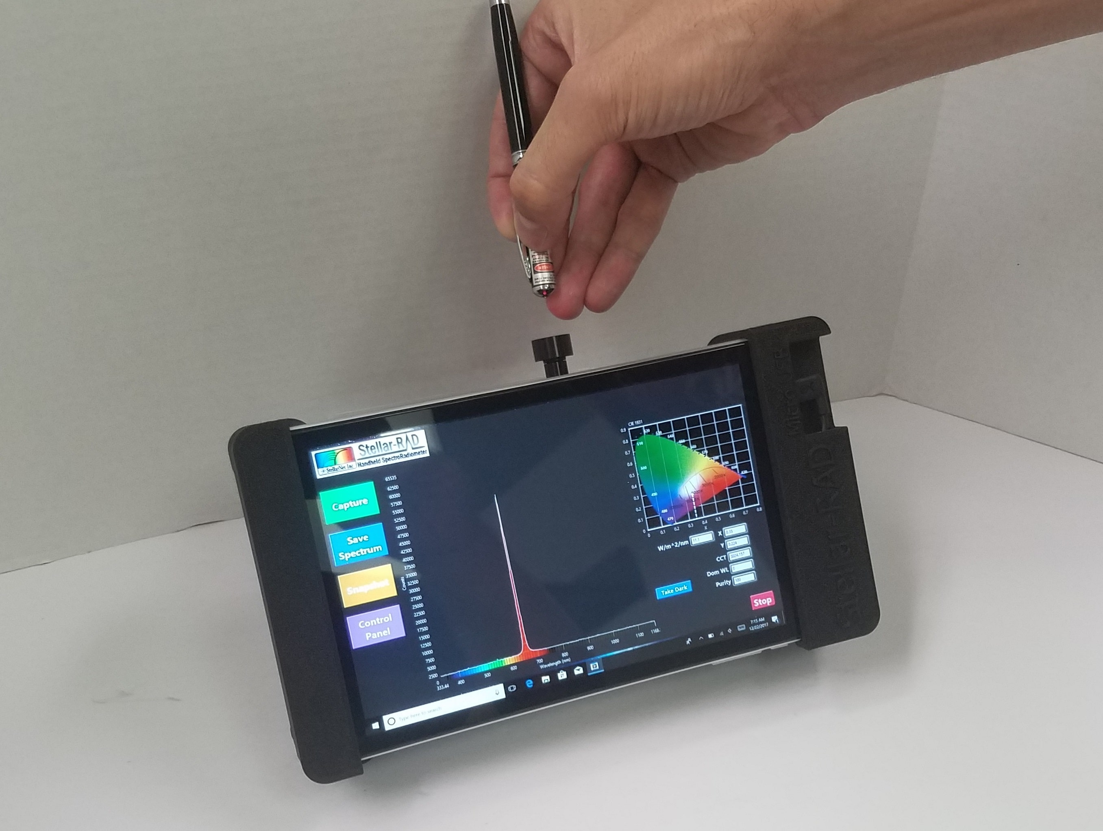
Resistivity vs Transmission
Radiometer

Slide 8
Cryogenic Solenoid for Open days

Slide 9
We can build a large (~200mm diameter x 250mm long) coil, simulating the CMS solenoid , using few windings and run a few amps through it. A large analogue meter will indicate the current.
The “B” field will be shown by compasses or similar set around the coil and to indicate B field change hanging steel piece or steel on a spring.
The coil is then immersed in liquid nitrogen , or the vapour of same, and the current will increase and the “B” field increase.
Explaining that this increase in field is “for Free” and that the field increase allows the particle ID through sagitta measurements to improve. The latter may be illustrated by long thin elastic levers (representing particle trajectory) with a small steel ball on the end that will deflect in the B field. Great care will be required in order to find the correct stiffness and ball size, perhaps the coil axis should be vertical ?
.

Slide 10
Repair of RB chamber gas pipes from inside.

Slide 11
Un roll the carpet

Slide 12
Pressurised RPC , to avoid Freons

Slide 13
PRPC high pressure chamber using “common gases” ie other than freons
Ion pair calc. as a function of density of N2, Co2, Ar and O2 etc. to equate with Freon pair production.
Paschen curve for voltage correction.
Pressure constructions that could provide flat pack configurations for large area chambers.
Experimental Methodology.
Start at atmospheric pressure with a “simple” mixture and measure the amplitude of the signals. Slowly increase the pressure, with voltage correction , and continue to measure the (increase ) in amplitude. With scintillator coincidence.

Slide 14
HGCAL, contacts

Slide 15
Karl Gil
Suggest from british guy , from Fr ex EP dept head
Hcal
David Barney
rewq

Slide 16
Gas Recuperation by cryogenic

Slide 17
Gas Recuperation by cryogenic
With gas group.
Xxx phenomena to study

Slide 18
MEX shipping “all” of a lab. NIM, gas etc

Slide 19
Photos plus list plus ship EDH

Slide 20
Oil on HPL play time

Slide 22
Cooling for with CSC job @ CERN

Slide 24
Safety tour during lock down plus shifts for LS3 commissioning

Slide 25
Gas system for Lyon

